Slide 1
Replicated database
Akshay, Girish and Rishideep

Slide 2
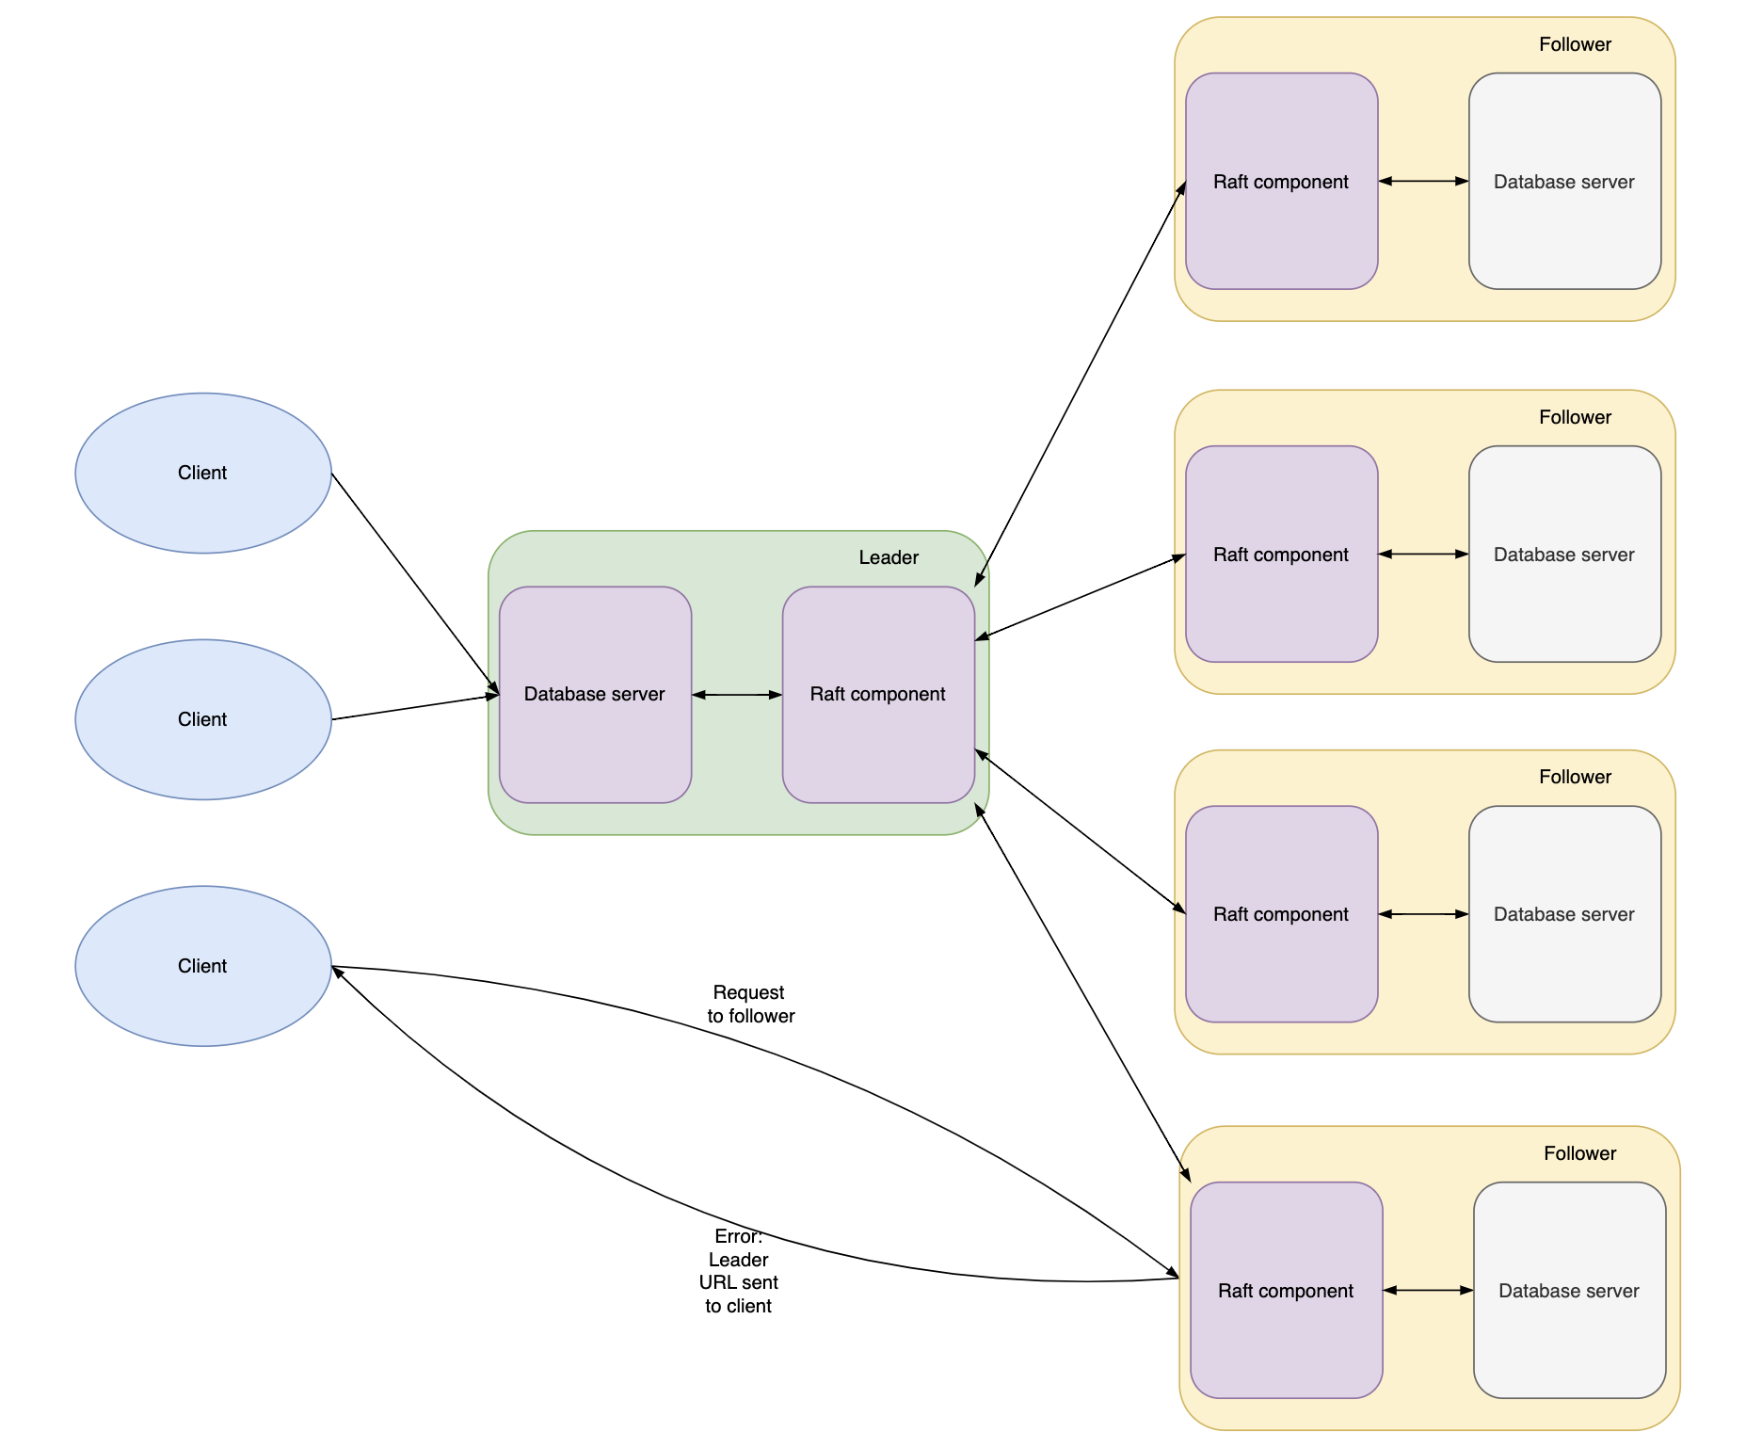
General Architecture

Slide 3
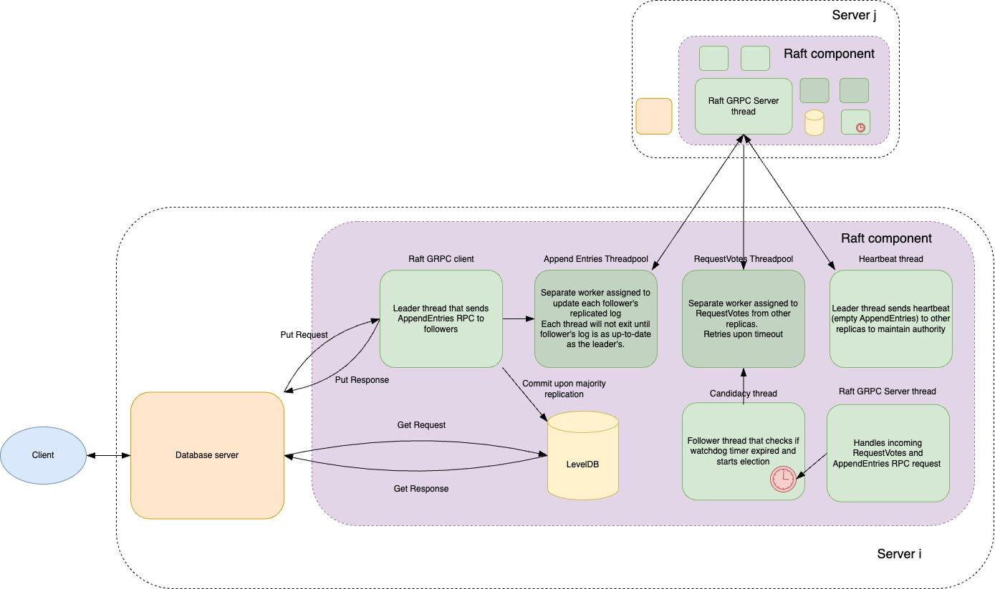
The Raft component

Slide 4
Demos

Slide 5
Raft 101

Slide 6
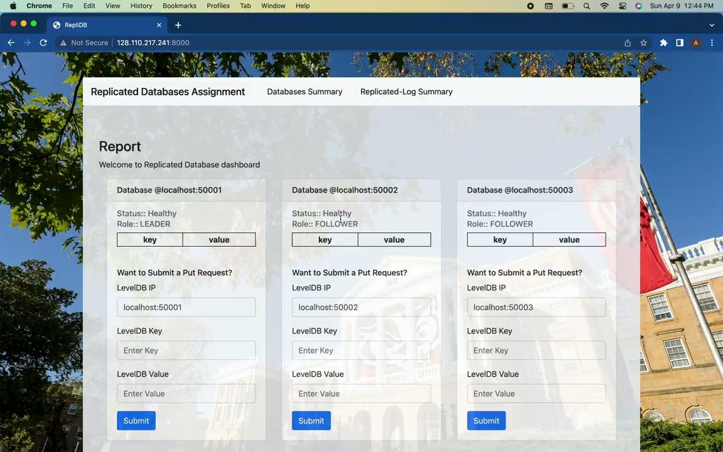

Slide 7
One less follower...

Slide 8


Slide 9
Two less followers...

Slide 10
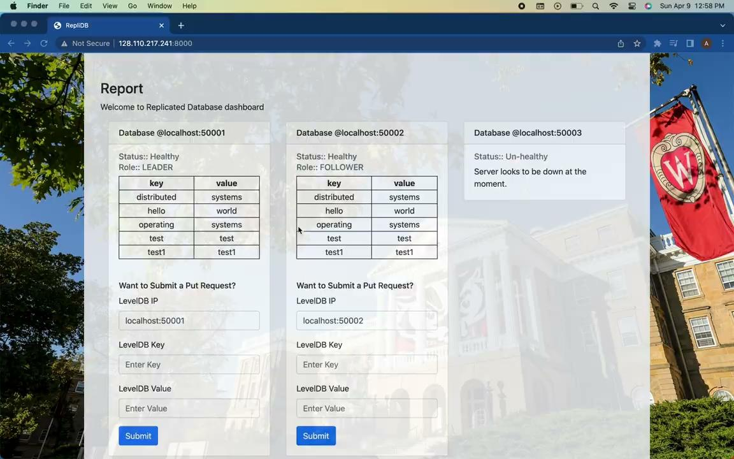

Slide 11
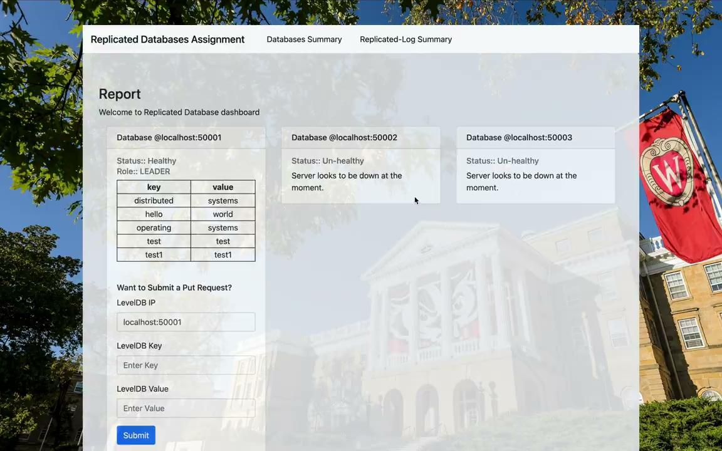

Slide 12
Followers wake up

Slide 13
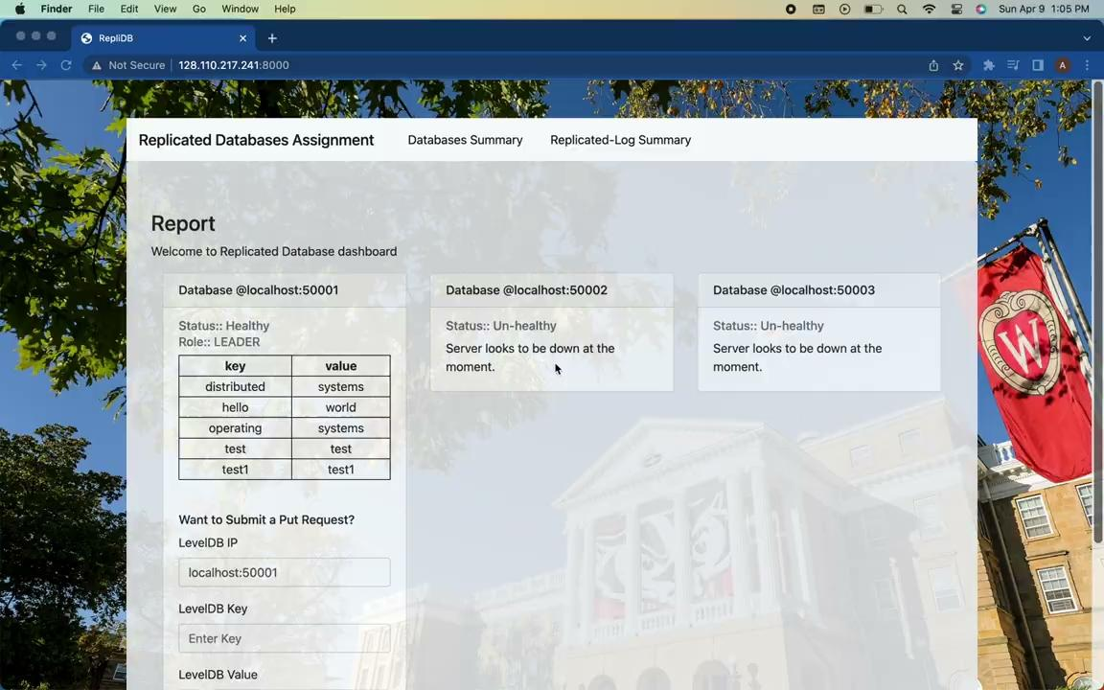

Slide 14
Leader dies...

Slide 15
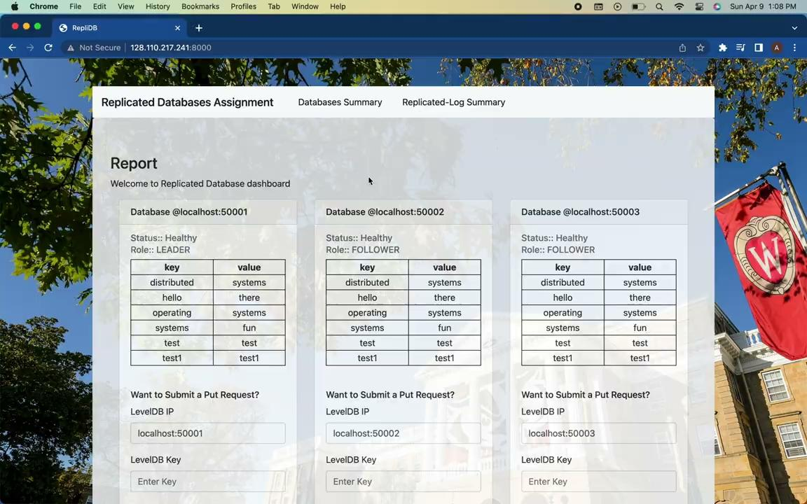

Slide 16
Old leader wakes up...

Slide 17
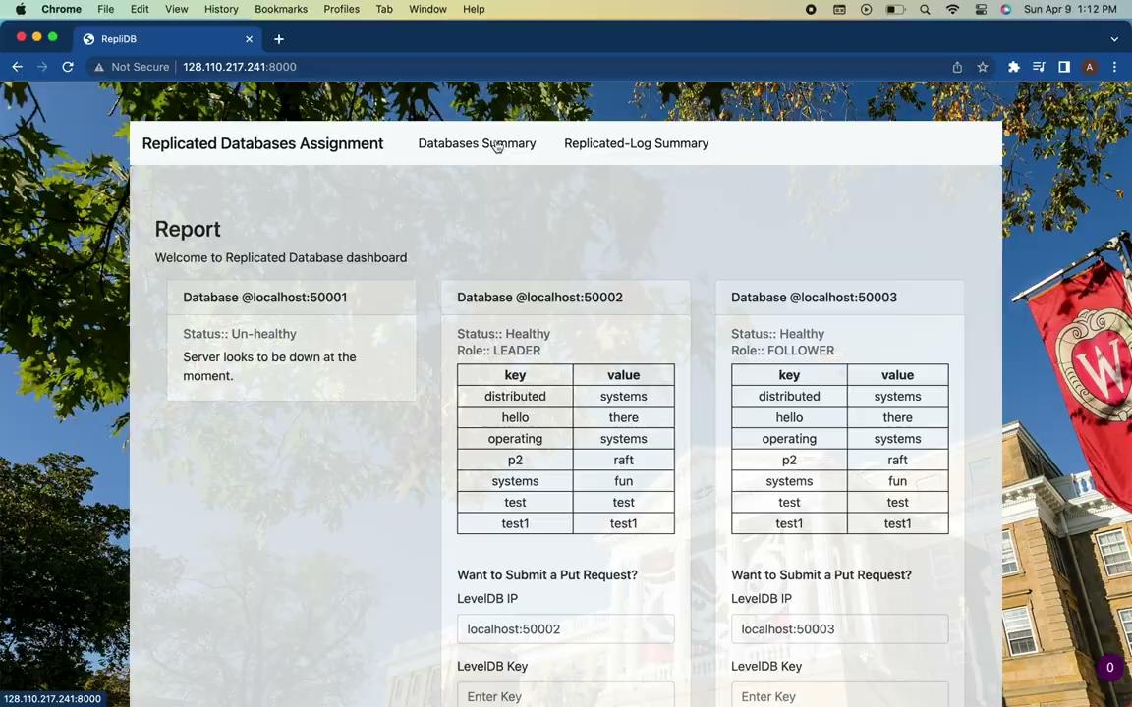

Slide 18
Test script

Slide 19


Slide 20
Graphs

Slide 21
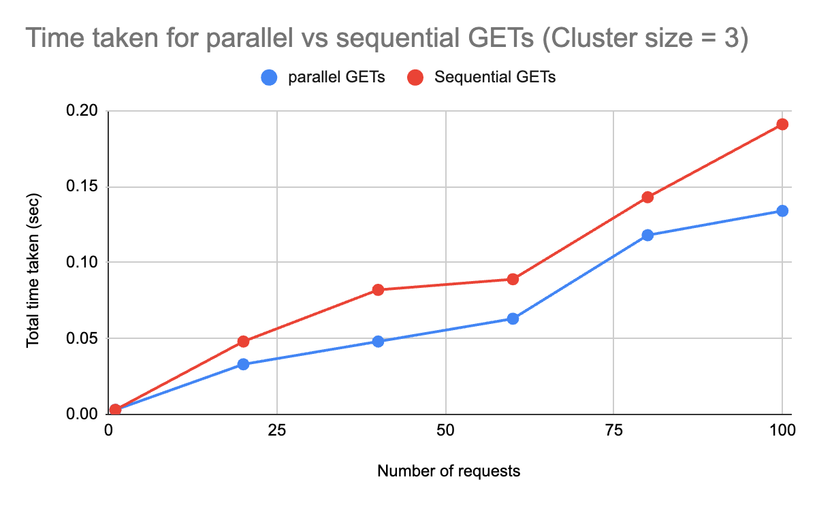

Slide 22
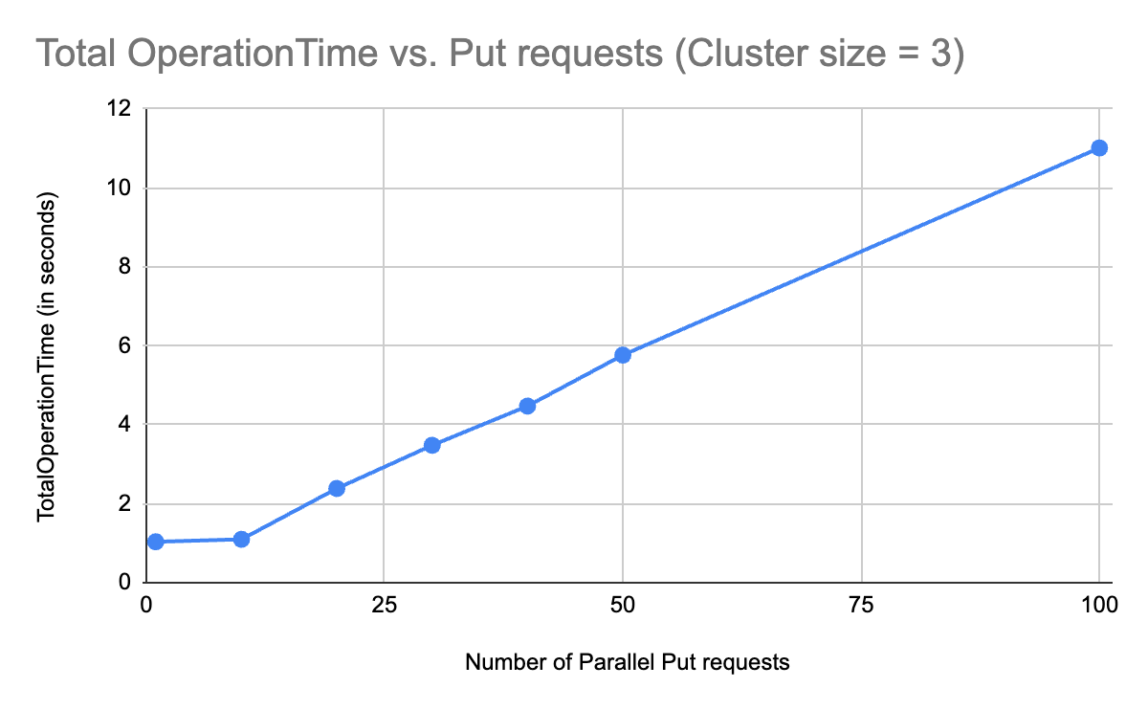

Slide 23
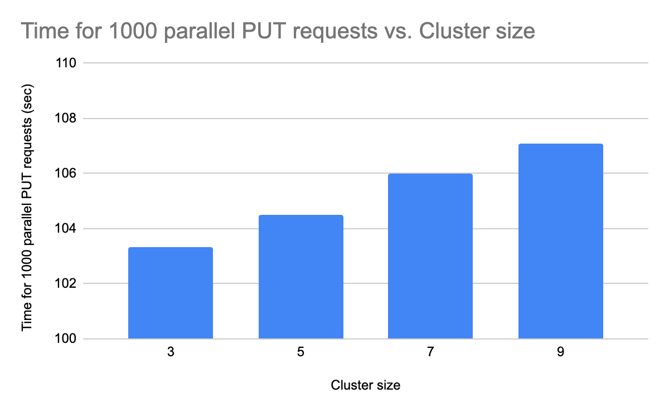

Slide 24
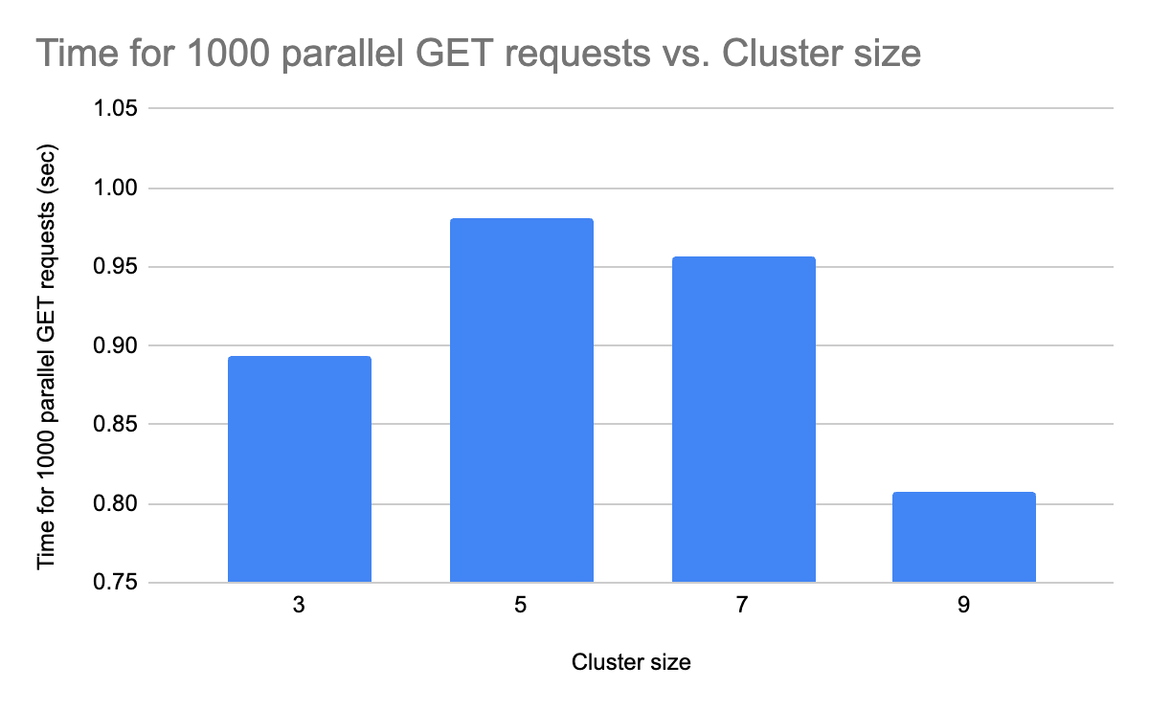

Slide 25
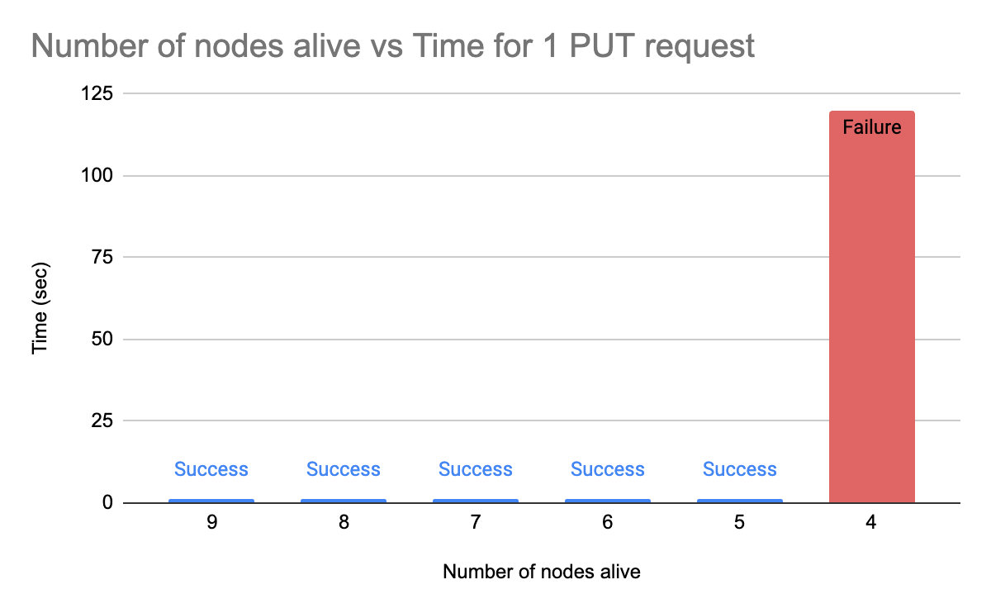

Slide 26
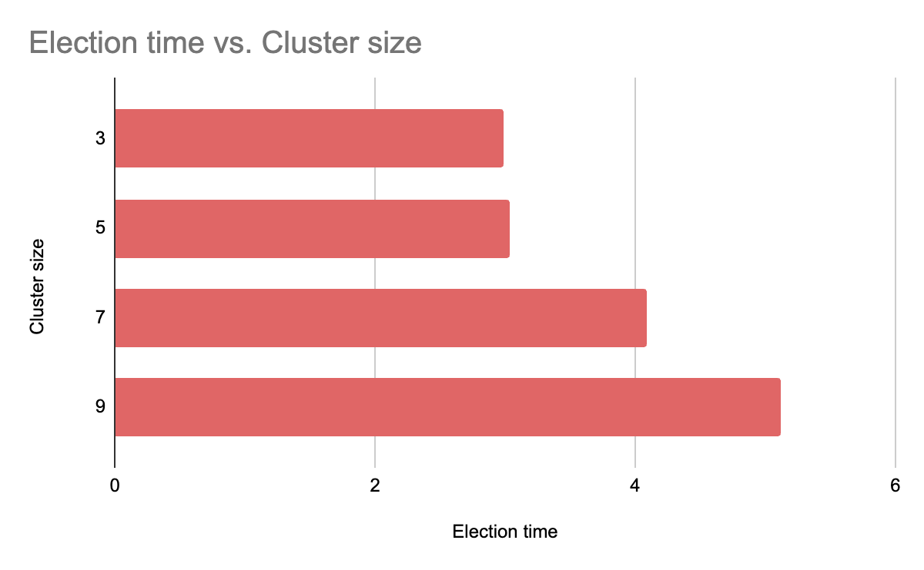

Slide 27
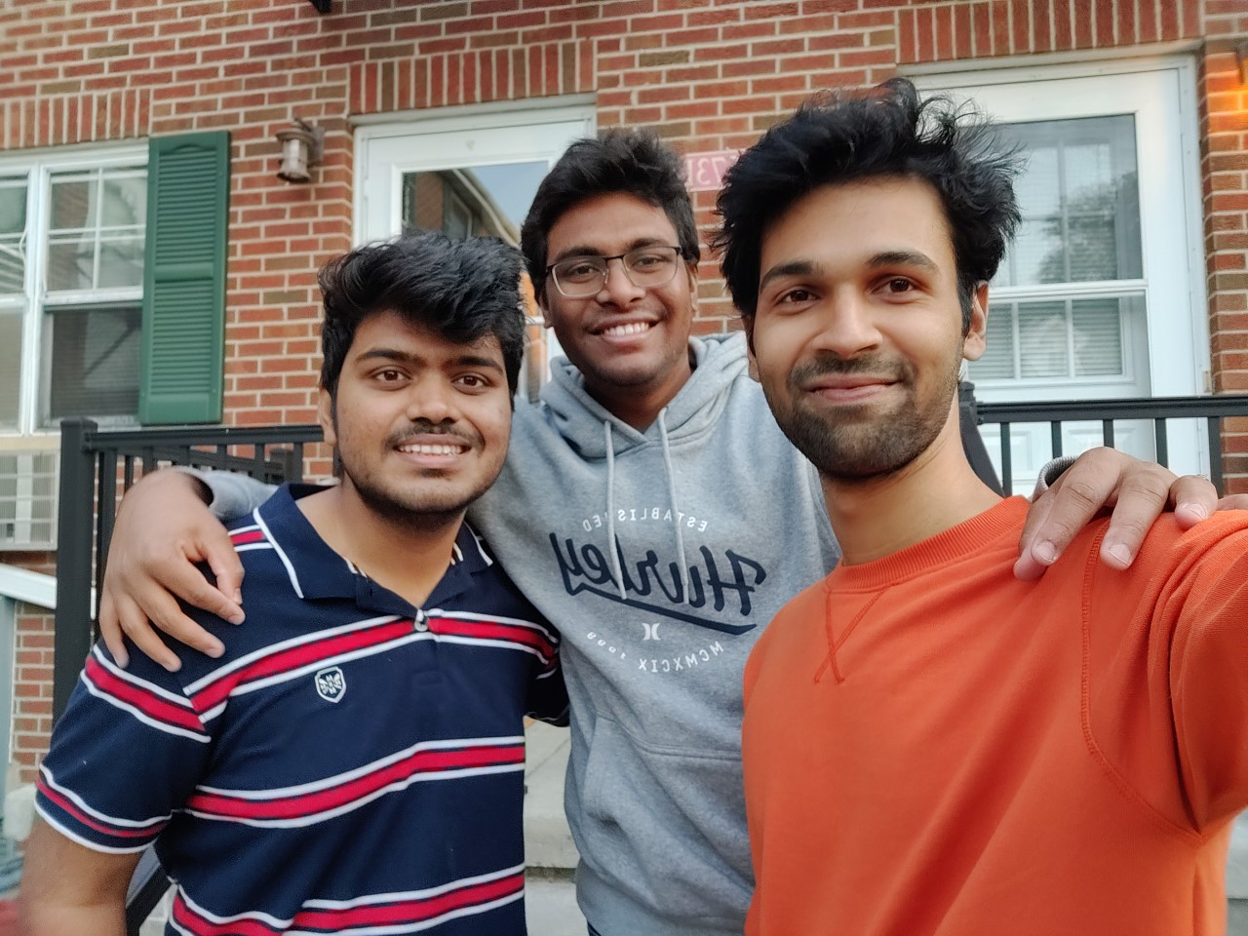
Thank you!

Slide 28
Appendix

Slide 29
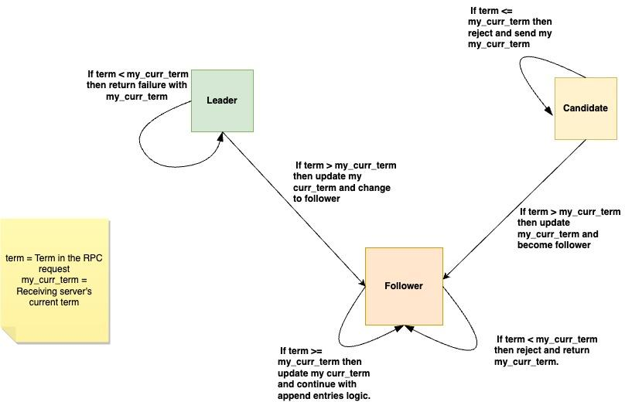
State Transition - Append Entries

Slide 30
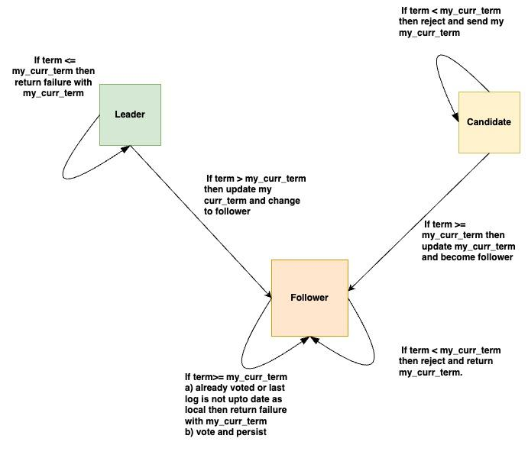
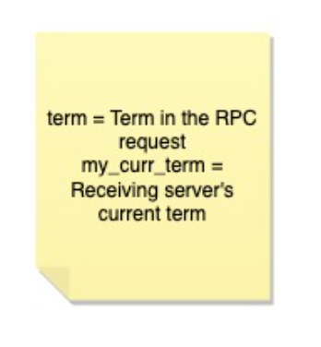
State Transition - Request Votes

Slide 31
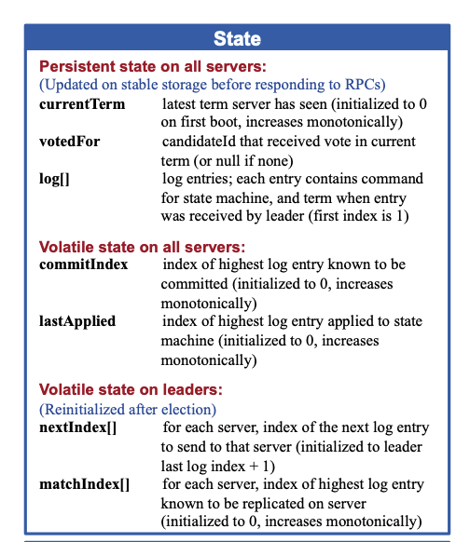
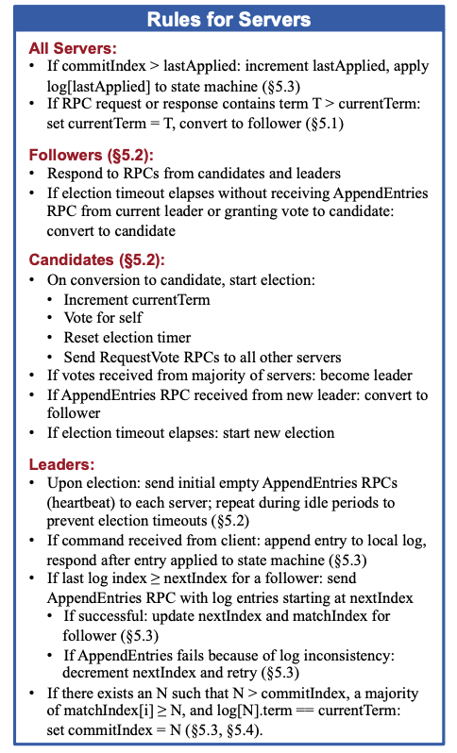

Slide 32
