Slide 1

Dr.Mahalingam College of Engineering & Technology
Department of Computer Science and Engineering 19CSPN6401 & Mini - Project
Final Review
Title: IoT Based Web application for Water Quality Monitoring System
Team Number: B020
Team Member(s): 727621BCS042 – A.Rahul Krishnan
727621BCS048 – M.Kavin
727621BCS120 – P.Sabari Vasan
Faculty Supervisor: Ms.R.Bharathi(AP/CSE)
Date: 19.05.2023
IOT Based Water Quality Monitoring System

Slide 2
Contents
Domain Introduction
Problem Description
Abstract
Objective of the Project
Literature Survey
Existing System
Block Diagram of Existing System
Disadvantage of Existing System
Proposed System
Block Diagram of Proposed System
Advantage of Proposed System
IOT Based Water Quality Monitoring System

Slide 3
Contents
Hardware / Software Requirements
Components Used
Modules
Screenshot of each module with descrption
Conclusion and Future Enhancement
Reference(s)
Online Course Details(Progress/Completion)
IOT Based Water Quality Monitoring System

Slide 4
Domain Introduction
The IOT Based Water Quality Monitoring System using a TDS sensor, NodeMCU and Blynk is a system designed for real-time monitoring of water quality.
The TDS sensor measures the Total Dissolved Solids (TDS) content of water, the NodeMCU microcontroller transmits the data to the cloud using Wi-Fi, and Blynk provides a user-friendly interface for accessing and analyzing the data.
This system helps in early detection of changes in water quality and enables timely decision-making to prevent contamination,ensuring the sustainable use of water resources.
IOT Based Water Quality Monitoring System

Slide 5
Problem description
The IOT Based Water Quality Monitoring System using a TDS sensor, NodeMCU, and Blynk addresses the challenge of accurately monitoring water quality in real-time to prevent contamination and ensure sustainable use of water resources.
The traditional methods for testing water quality are often inadequate, and there is a need for a cost-effective and easy-to-use solution that provides real-time data for early detection of changes and prompt decision-making.
IOT Based Water Quality Monitoring System

Slide 6
Abstract
A low-cost IoT-based web application for water quality monitoring has been developed to address the lack of proper water monitoring systems in many regions. The system utilizes sensors to measure parameters like temperature, total dissolved solids (TDS), and electrical conductivity (EC) to determine water quality. If the measured values fall outside the safe range, the system sends an alert to the user. The NodeMCU module serves as the core controller, processing sensor data and communicating with the Blynk platform. Blynk provides a user-friendly interface to monitor real-time sensor data remotely. This affordable and efficient solution has the potential to improve public health and environmental sustainability, particularly in areas with limited access to clean water.
IOT Based Water Quality Monitoring System

Slide 7
Objective
The objective of the IOT Based Water Quality Monitoring System:
Real-time monitoring of TDS content in water using a TDS sensor.
Storage and remote access of data through cloud server and NodeMCU microcontroller.
User-friendly data access and analysis through Blynk interface.
Early detection of water quality changes and prevention of contamination.
Affordable and easy-to-use solution for monitoring water quality.
IOT Based Water Quality Monitoring System

Slide 8
Literature Survey
S.No | Title of the paper & year | Author | Protocol / Sensors used | Merits | Demerits
1 | Water Quality Monitoring using TDS, Turbidity, Temperature & pH Sensor | Abhishek Kumar Pal, Amit Pratap Singh | Arduino IDE, TDS, Turbidity, Temperature & pH Sensor | Continuous monitoring of water quality. | Requires manual intervention to collect water samples
2 | IoT Based Low Cost System for Monitoring of Water Quality in Real-time | Anuradha, Bhakti, Chaitra, Pooja | Raspberry Pi model, ThingSpeak API. | High frequency of data collection - Mobility - Low power | Not suitable for large bodies of water
3 | Water Quality Monitoring System | Harsh Bhardwaj,Kartik Bhatia, Anjali Jain | Arduino Uno microcontroller board, thermistor, water sensor | Can help to prevent the consumption of toxic water | Not suitable for large bodies of water
IOT Based Water Quality Monitoring System

Slide 9
Literature Survey
S.No | Title of the paper & year | Author | Protocol / Sensors used | Merits | Demerits
4 | Real Time Water Quality Monitoring and Management System | Omkar Vilas Pharande, Sanket Sanjay Patil, Sourav Sunil Burse, Rutuja Arvind Patil | Uno R3 ATmega328p Arduino Development Board. | User-friendly interface - Easy to understand | Not suitable for large bodies of water
5 | Advanced Water Quality Monitoring Using Microcontroller | Avinash Kamble, Pramod Survase, Vasimakram Mulla, Sana Mujawar | ATmega328 microcontroller, TDS sensor, Turbidity Sensor Module, LCD Display. | Portable, Reduces power consumption | Not suitable for large bodies of water
IOT Based Water Quality Monitoring System

Slide 10
Existing System
The water quality monitoring system [1] assesses water quality using TDS, Turbidity, Temperature, and pH sensors.
TDS measures dissolved particle concentration, while Turbidity measures water cloudiness caused by suspended particles.
Temperature and pH are important indicators affecting microorganism growth and substance solubility.
The system is valuable in areas with limited clean drinking water by detecting potential contaminants.
Sensors connect to a microcontroller unit, which collects and sends data to a computer for real-time analysis.
It has various applications, including monitoring drinking water, groundwater, and wastewater quality.
Industries like agriculture, aquaculture, and mining can benefit from monitoring water quality for their success.
IOT Based Water Quality Monitoring System

Slide 11
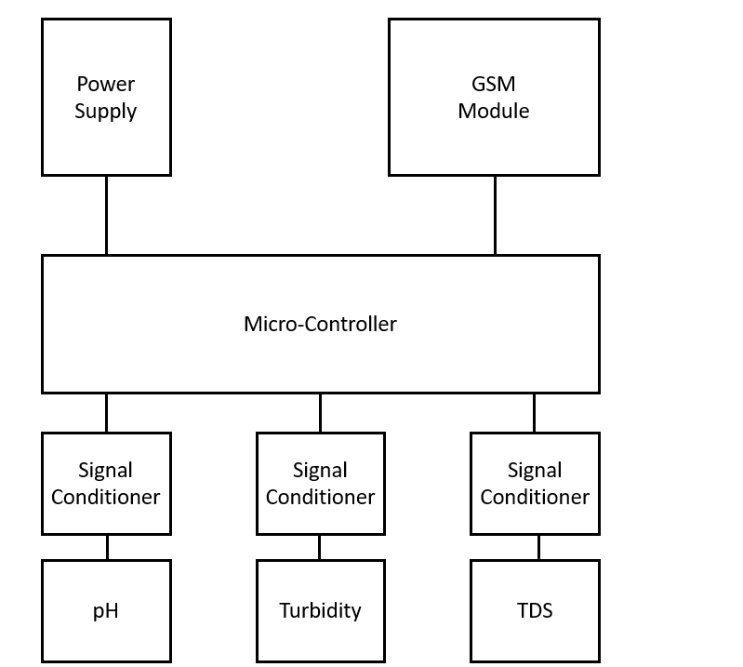
Block diagram of Existing system
IOT Based Water Quality Monitoring System

Slide 12
Disadvantage of Existing System
The water quality monitoring system using TDS, turbidity, temperature, and pH sensors has potential limitations and drawbacks.
One potential drawback is the cost of installation and maintenance, which can be a significant barrier to implementing the system in developing countries or rural areas with limited resources.
Another potential drawback is the periodic calibration required for the sensors to ensure accurate measurements, which can be time-consuming and expensive, especially if monitoring multiple water sources or large bodies of water.
Failure to calibrate the sensors can result in inaccurate readings, compromising the data's integrity collected by the system.
IOT Based Water Quality Monitoring System

Slide 13
Proposed System
The proposed system is a low-cost, real-time water quality monitoring system based on IoT technology.
It measures important physical and chemical parameters such as temperature, TDS, and electrical conductivity (EC) to determine water quality.
The system includes sensors for data collection and an ESP8266 module as the core controller.
The ESP8266 module processes sensor data and communicates with the Blynk platform.
The Blynk platform provides a user-friendly interface to monitor water quality in real-time from anywhere with an internet connection.
The system can send alerts if measured values fall outside the safe range, prompting necessary actions.
IOT Based Water Quality Monitoring System

Slide 14
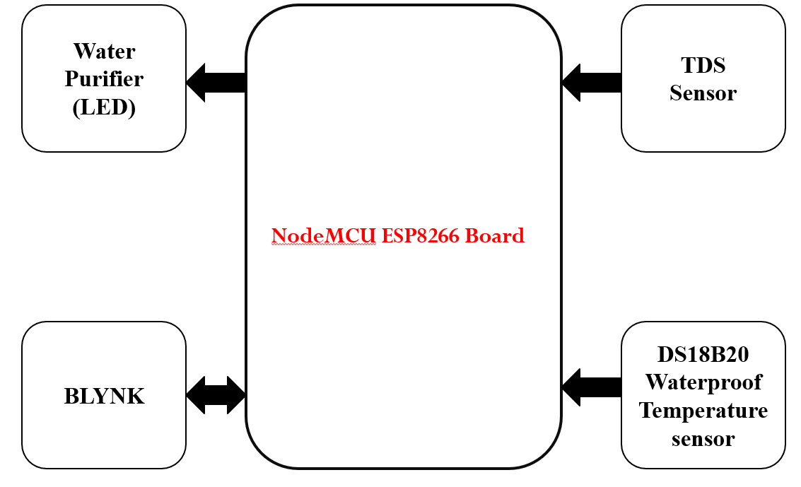
Block Diagram of Proposed System
IOT Based Water Quality Monitoring System

Slide 15
Advantage of Proposed System
The system is designed to be low-cost, making it accessible to regions with limited resources and funding for water quality monitoring systems.
The system offers real-time monitoring of water quality data, enabling users to detect and respond to potential water quality issues quickly.
The Blynk platform allows for remote monitoring of water quality from anywhere with an internet connection, enabling users to monitor water quality data in real-time from the comfort of their homes.
The system provides reliable water quality data, ensuring that users can make informed decisions about water consumption.
The system can send alerts to users when water quality values
fall outside of the range, enabling them to take necessary actions
IOT Based Water Quality Monitoring System

Slide 16


Hardware / Software Requirements
Hardware Requirements:
ESP8266 NodeMCU - 1
TDS Sensor - 1
DS18B20 Waterproof Water Temperature Sensor - 1
Breadboard
Connectors
Power supply
Software Requirements:
Development Platform : i)Arduino IDE
ii)Blynk Cloud
IOT Based Water Quality Monitoring System

Slide 17
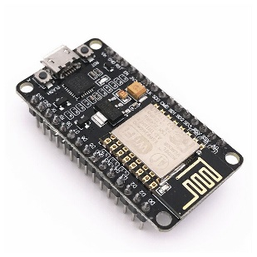
Components
NodeMCU:
The NodeMCU (Node MicroController Unit) is an open-source software and hardware development environment built around an inexpensive System-on-a-Chip (SoC) called the ESP8266.
IOT Based Water Quality Monitoring System

Slide 18
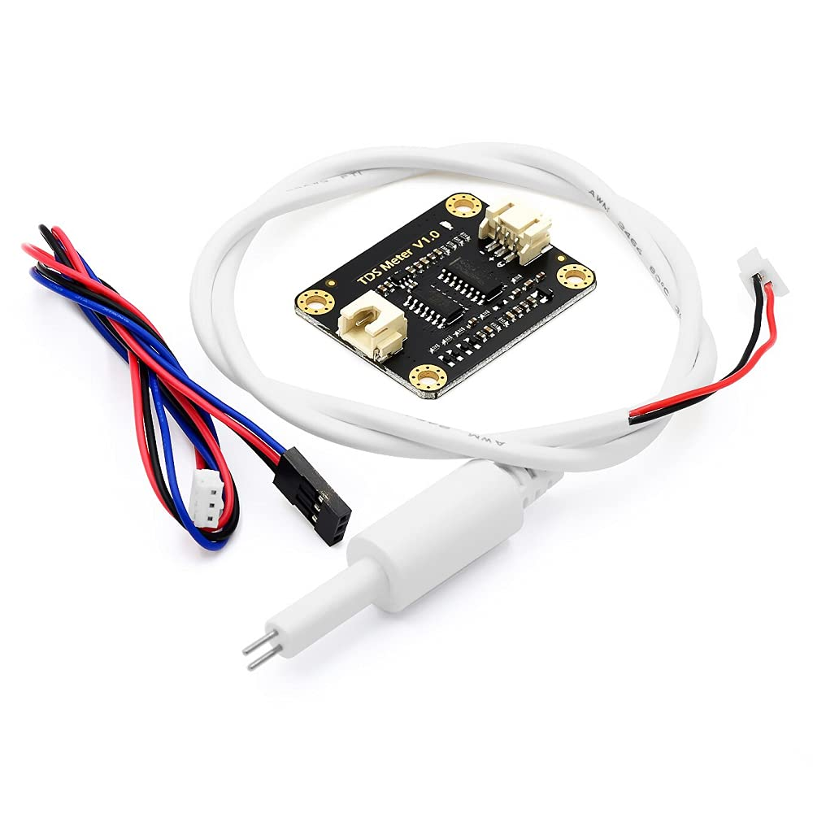
Components
TDS SENSOR:TDS stands for Total Dissolved Solids, which refers to the amount of inorganic and organic substances that are present in water.This is an important parameter for monitoring water quality because high TDS levels can indicate the presence of contaminants, such as heavy metals or salts.
IOT Based Water Quality Monitoring System

Slide 19
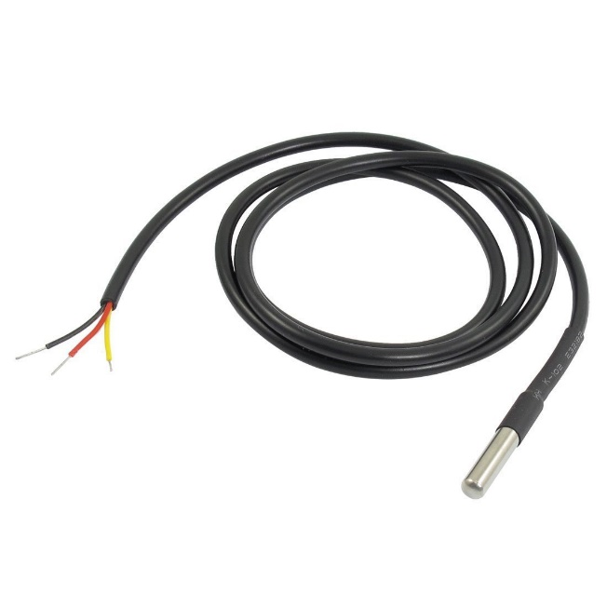
Components
DS18B20 Waterproof Water Temperature Sensor:
This digital temperature sensor is designed to be used in wet environments.It uses a one-wire interface to communicate with the microcontroller and provides accurate temperature readings with a resolution of 0.0625°C.
IOT Based Water Quality Monitoring System

Slide 20
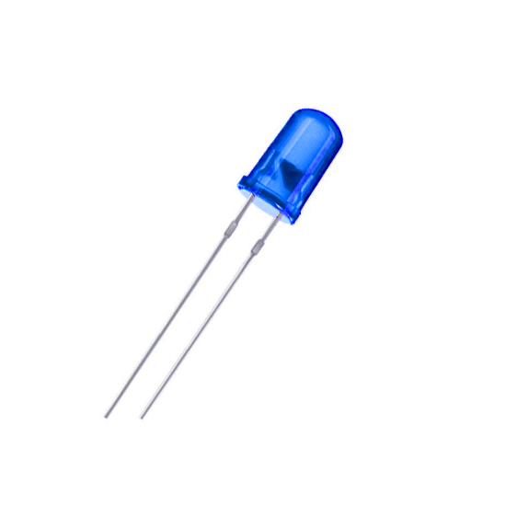
Components
LED:
A LED (Light Emitting Diode) is a simple electronic component that emits light when a voltage is applied to it. In the water quality monitoring system, the LED is used to indicate the status of the water purifier.
IOT Based Water Quality Monitoring System

Slide 21
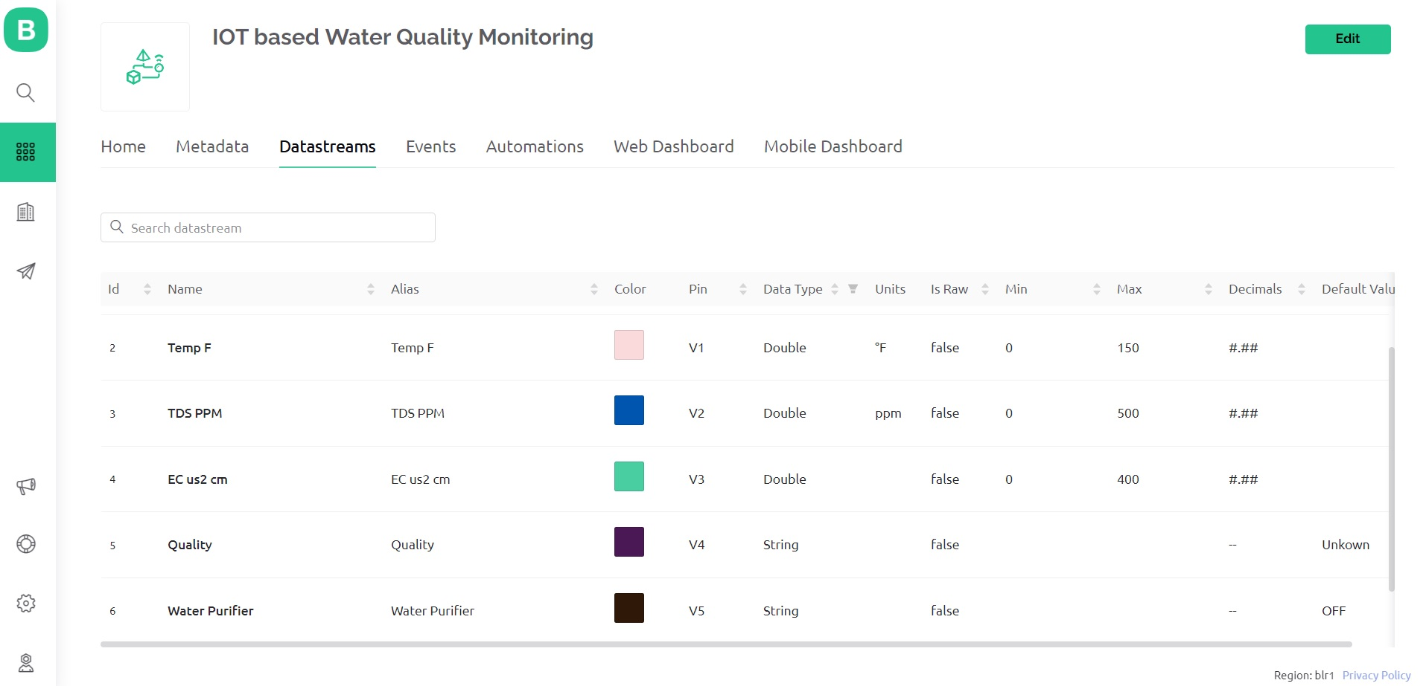
Modules
Datastreams:
IOT Based Water Quality Monitoring System

Slide 22
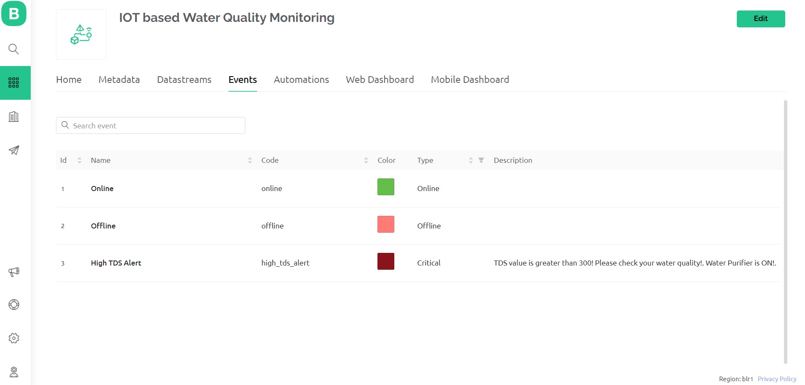
Modules
Events:
IOT Based Water Quality Monitoring System

Slide 23
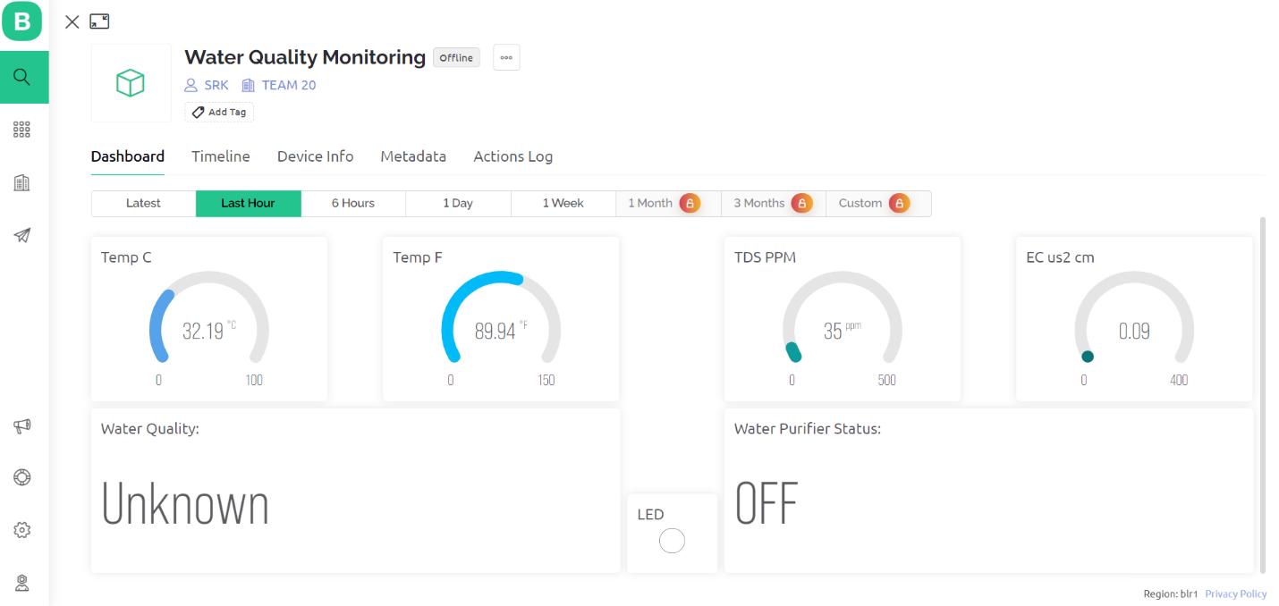
Modules
Web Dashboard:
IOT Based Water Quality Monitoring System

Slide 24
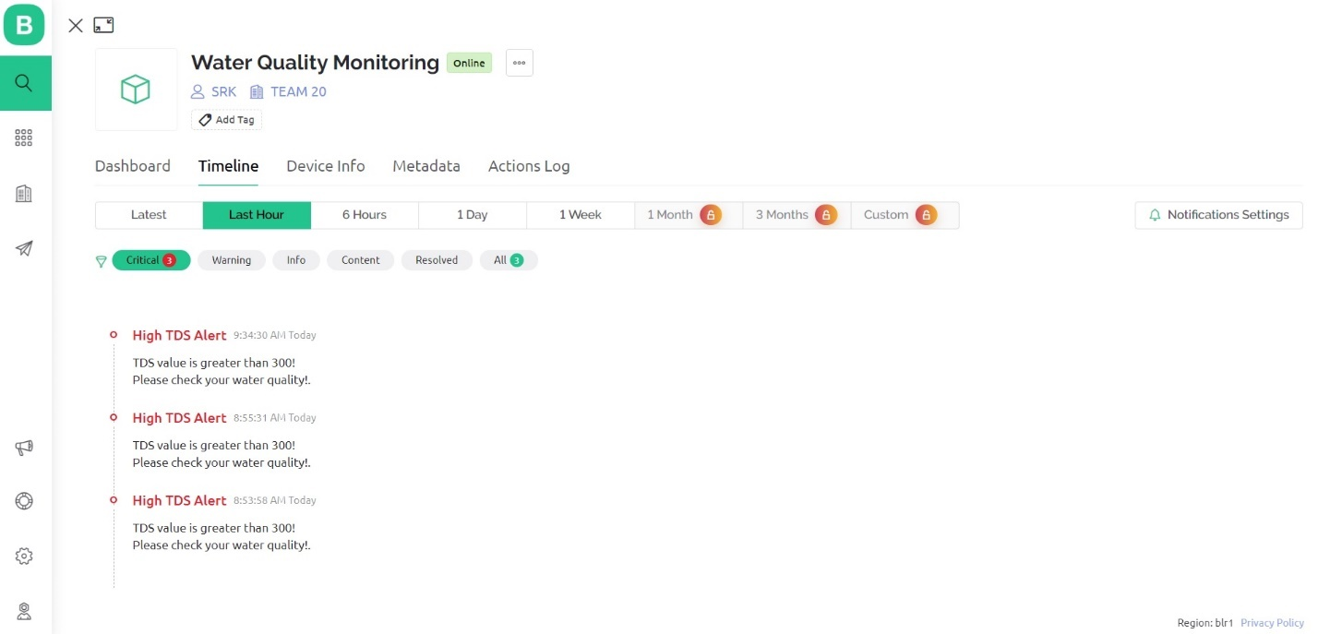
Modules
Web Dashboard Notification:
IOT Based Water Quality Monitoring System

Slide 25
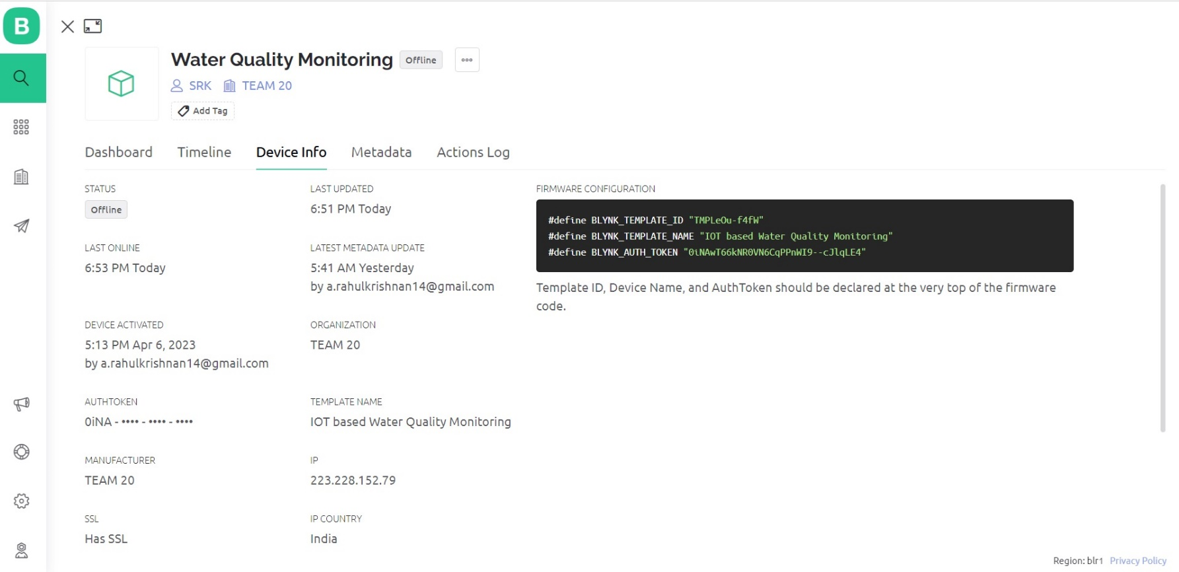
Modules
Credentials:
IOT Based Water Quality Monitoring System

Slide 26
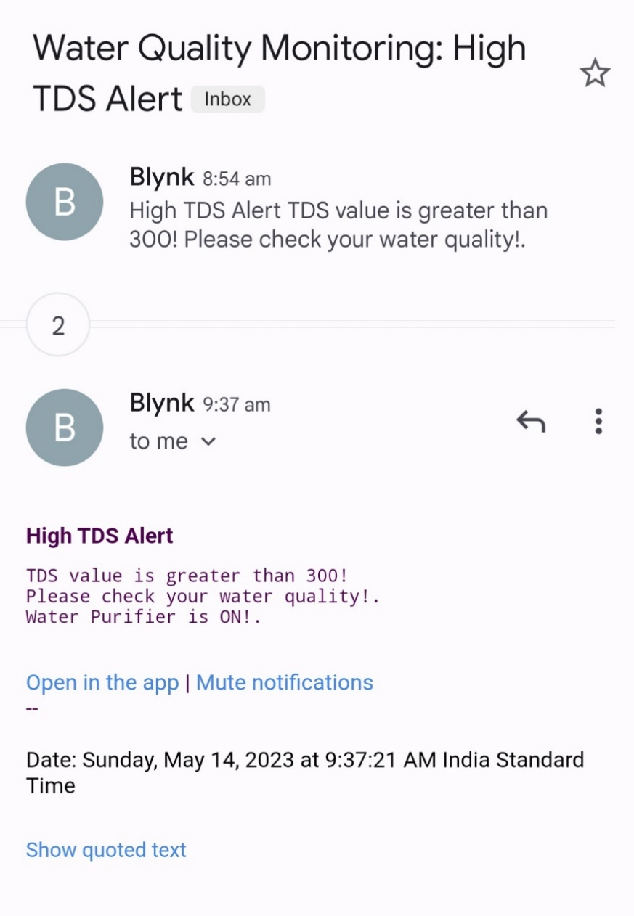
Modules
G-mail Alert:
IOT Based Water Quality Monitoring System

Slide 27
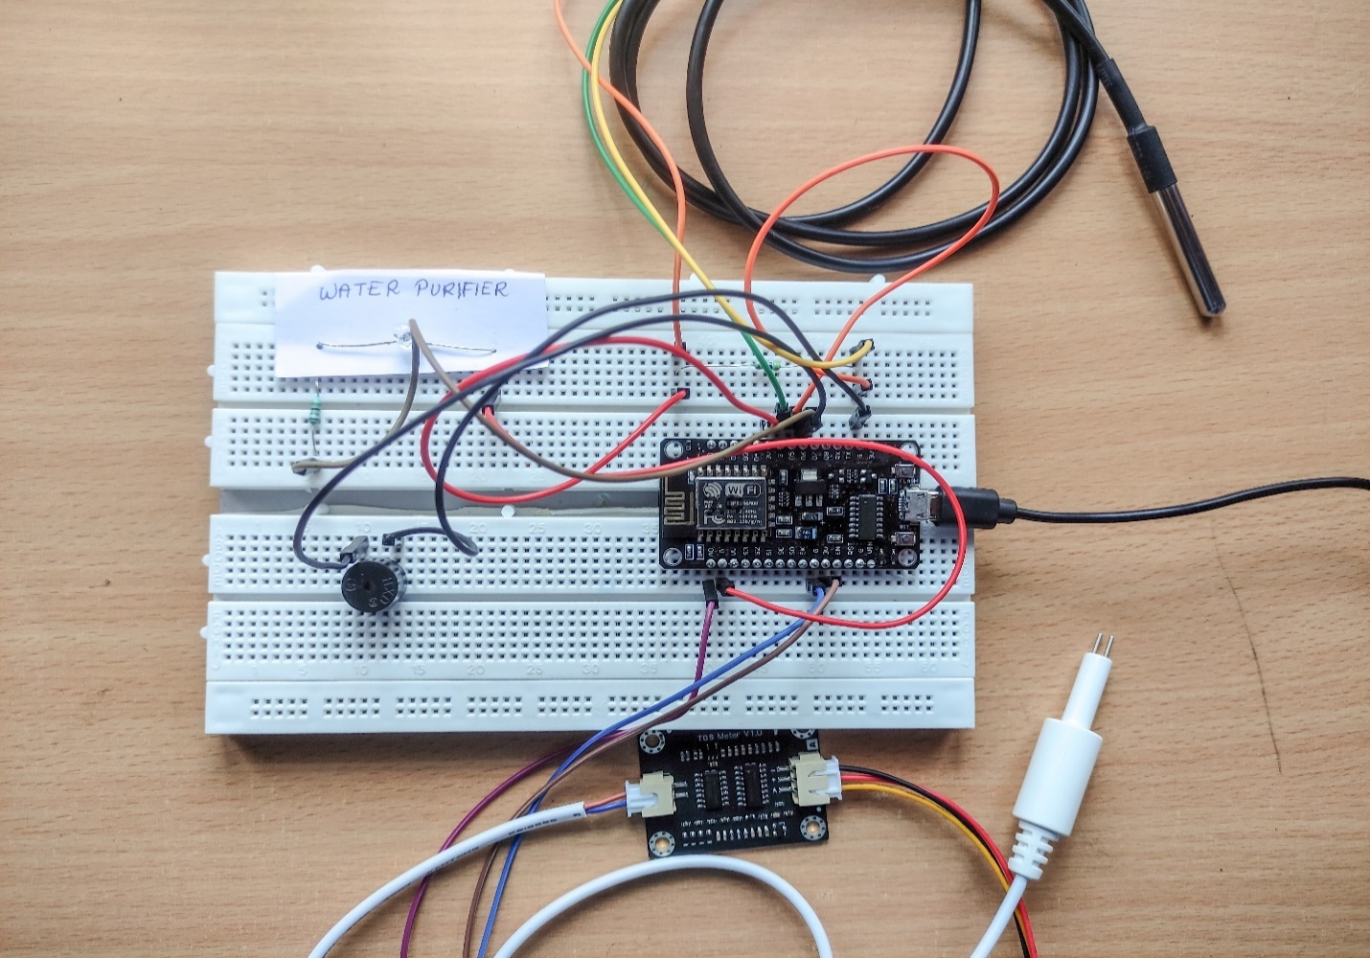
Modules
Hardware Setup:
IOT Based Water Quality Monitoring System

Slide 28
Conclusion and Future Enhancement
Conclusion:
The low-cost real-time water quality monitoring system using IoT technology is an effective solution for addressing water contamination and the spread of water-borne diseases. By accurately measuring the physical and chemical parameters of water, the system ensures the safety of water for consumption. It promptly alerts users if water quality falls below the safe limit, contributing to improved public health and environmental sustainability.
IOT Based Water Quality Monitoring System

Slide 29
Conclusion and Future Enhancement
Future Enhancement:
To enhance the Water Quality Monitoring System in the future, several areas can be explored:
Additional Sensors: Incorporating more low-cost sensors to measure additional parameters can improve system accuracy and expand its capability to detect a wider range of contaminants.
Machine Learning Integration: Integrating machine learning algorithms can enable the system to predict water quality trends and identify potential contamination sources in real-time. This would provide valuable insights and proactive measures to prevent water contamination issues.
IOT Based Water Quality Monitoring System

Slide 30
References
[1] Water Quality Monitoring using TDS, Turbidity, Temperature & pH Sensor by Abhishek Kumar Pal, Amit Pratap Singh.
[2] IoT Based Low Cost System for Monitoring of Water Quality in Real-time by Anuradha, Bhakti, Chaitra, Pooja.
[3] Water Quality Monitoring System by Harsh Bhardwaj,Kartik Bhatia, Anjali Jain. (IRJET)
[4] Real Time Water Quality Monitoring and Management System by Omkar Vilas Pharande, Sanket Sanjay Patil, Sourav Sunil Burse, Rutuja Arvind Patil.
[5] Advanced Water Quality Monitoring Using Microcontroller by Avinash Kamble, Pramod Survase, Vasimakram Mulla, Sana Mujawar.
IOT Based Water Quality Monitoring System

Slide 31
References
[6] Mithali Borbade, Shruti Danve “Real Time Water Quality monitoring system” IJIRCE journal, Vol 3, pp.5046-5068, June 2015.
[7] Vaishnavi V, Daigovane, Dr.M.A. Gaikwad “Water quality monitoring system based on IoT” Research India publication on Vol 10,pp.1107 1116,2017.
[8] Pradeepkumar M. Manisha J.Praveen Sha R.Proiserin V.Suganya Devi “The real time monitoring of water quality in IoT Environment”IJIRSET, Vol 5, pp. 4419-4427, March 2016.
[9] Aaina Venkteshwaran, Harsha Menda P. Prof. Priti Bodar “An IoT based system for water quality monitoring” pp.2510-2515,April 2017.
IOT Based Water Quality Monitoring System

Slide 32
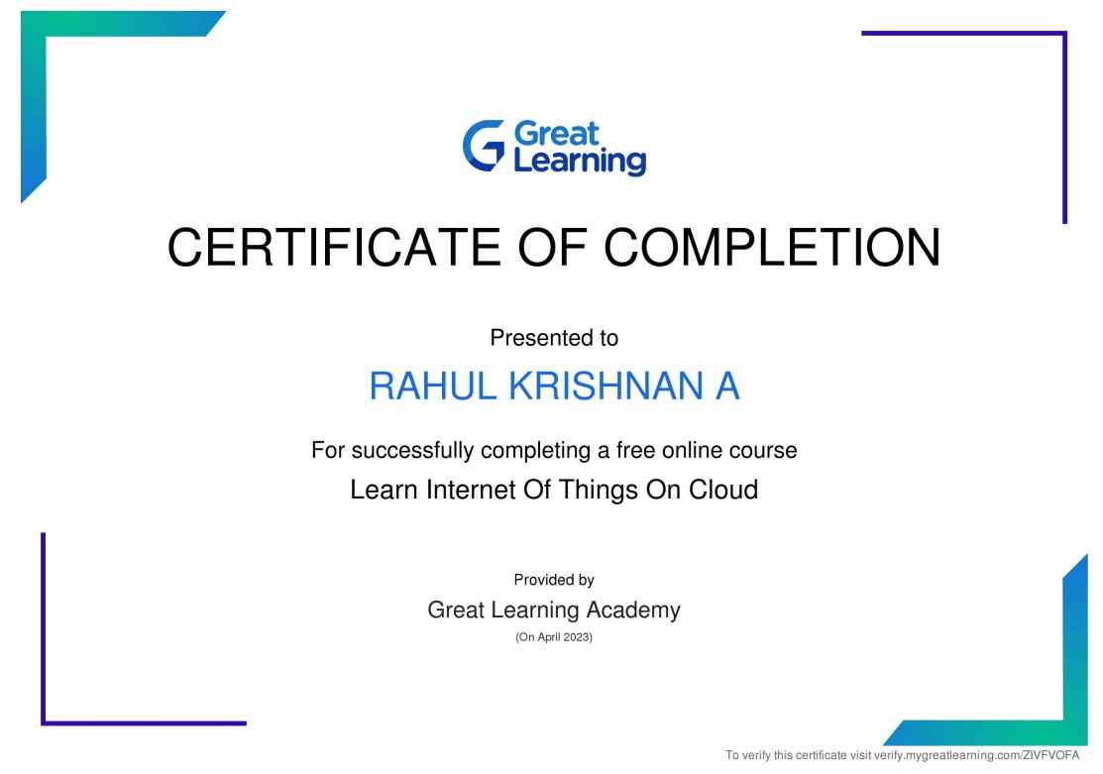
Certificates(Online Course)
IOT Based Water Quality Monitoring System

Slide 33

Certificates(Online Course)
IOT Based Water Quality Monitoring System

Slide 34
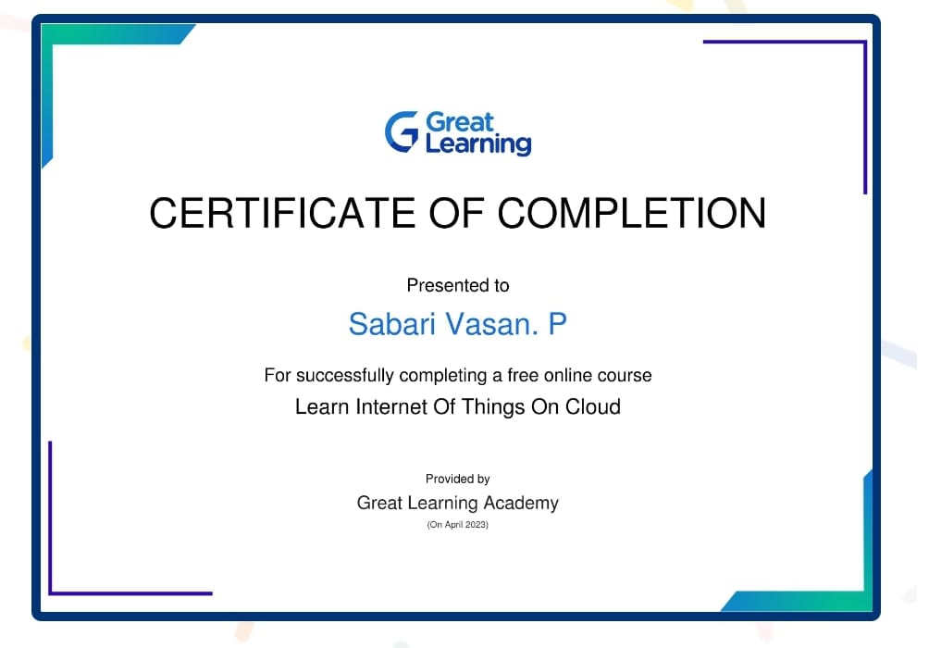
Certificates(Online Course)
IOT Based Water Quality Monitoring System

Slide 35
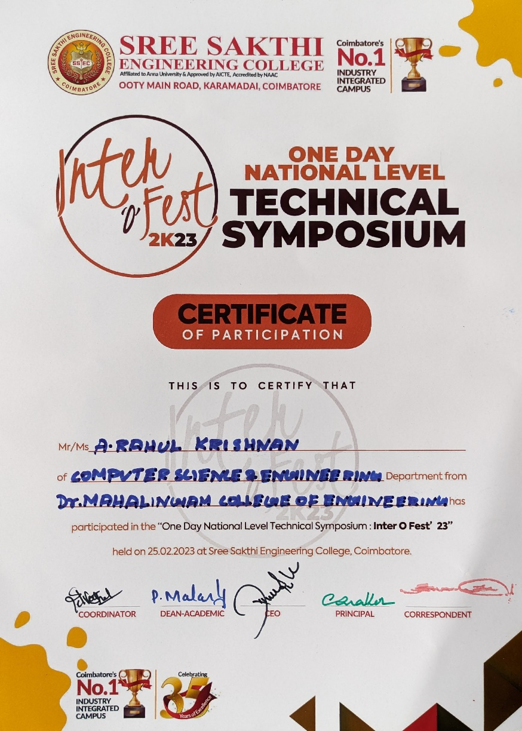
Certificate (Paper Presentation)
IOT Based Water Quality Monitoring System

Slide 36
Online Course Details
Name of the Student | Course Title with Duration | Course Platform | Status
A.Rahul Krishnan | Learn Internet of Things on Cloud 4 hrs | Great Learning | Completed
M.Kavin | Learn Internet of Things on Cloud 4 hrs | Great Learning | Completed
P.Sabari Vasan | Learn Internet of Things on Cloud 4 hrs | Great Learning | Completed
IOT Based Water Quality Monitoring System

Slide 37
Thank You

