Slide 1

Dr Mahalingam College of Engineering & Technology
Department of Computer Science and Engineering 19CSPN6601 –Innovative and Creative Project
Third Review
Title: Sentiment Analysis of Movie Reviews using RoBERTa and Data Augmentation
Team Number: B011
Team Member(s): Hariharan V (727621BCS040)
Rahul Krishnan A (727621BCS042)
Kavin M (727621BCS048)
Faculty Supervisor: Mr.P.Boopathirajan, AP (SS) / CSE
Date: 11.04.25
Advanced Sentiment Analysis of Movie Reviews

Slide 2
Contents
Domain Introduction
Problem Statement
Objective
Existing work
Proposed work
Architecture
Module Description
Screenshots
References

Slide 3
Domain Introduction
Machine Learning enables systems to learn from data and improve performance without explicit programming.
It is used in sentiment analysis to determine whether text, such as movie reviews, expresses positive or negative sentiment.
Recent advancements in ML, like deep learning, have improved the accuracy and effectiveness of analyzing complex language patterns.

Slide 4
Problem Description
Businesses need to analyze movie reviews to understand audience sentiment, but manually processing large amounts of text is inefficient.
The project aims to build a model that automatically classifies IMDb reviews as positive or negative.
This will help stakeholders make informed decisions by quickly understanding viewer sentiment.

Slide 5
Objective
Develop a machine learning model to classify IMDb movie reviews into positive or negative sentiment categories.
Automate the sentiment analysis process to save time and improve efficiency in handling large datasets.
Provide stakeholders with insights into audience sentiment to enhance decision-making and improve user experience.

Slide 6
Existing work
The existing system uses a Stacked Auto-Encoder (SAE) for extraction and Long Short-Term Memory (LSTM) for sentiment classification.
However, it can sometimes overfit the data, leading to less generalized results.
LSTM models can be computationally expensive and slow to train on large datasets.
While this model achieves 87% accuracy, its performance could be improved.

Slide 7
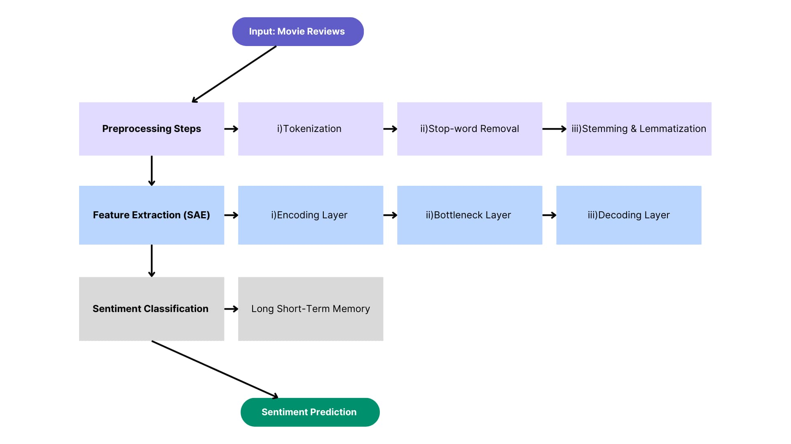
Existing System

Slide 8
Proposed work
1. Advanced Sentiment Analysis: Utilizes RoBERTa, a state-of-the-art transformer-based model, to classify IMDb movie reviews as positive or negative with improved contextual understanding.
2. Data Augmentation: Incorporates synonym replacement to diversify input data, enhancing model robustness and generalization.
3. Improved Accuracy: Achieves 93% accuracy, outperforming the existing hybrid SAE-LSTM system (87%) by leveraging RoBERTa's advanced sequence modeling capabilities.
4. Streamlined Architecture: Eliminates the need for manual feature extraction by using RoBERTa's built-in feature representation.

Slide 9
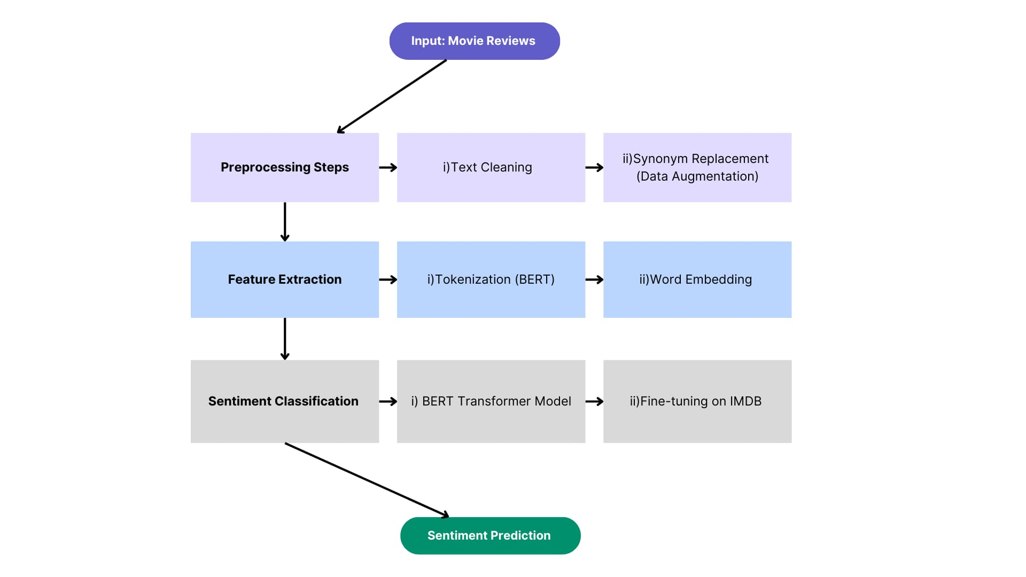
Proposed System

Slide 10
RoBERTa Architecture
Subword Tokenization: RoBERTa breaks text into subword units ( eg.“unbeliev‑able”) so it can handle uncommon or rare words more easily.
Contextual Embeddings: Each token is turned into an embedding that reflects its meaning based on the words around it.
Multi-Head Self-Attention: Inside the transformer layers, RoBERTa uses several “attention heads” to look at different parts of a sentence, helping the model understand how words relate to each other, even if they are far apart.
Deep Transformer Layers: The model goes through multiple layers of transformers, refining the embeddings at each step and adding more context.
Classification Layer: In the end, a classification head takes the final embeddings and predicts if the text is, for example, positive or negative.

Slide 11
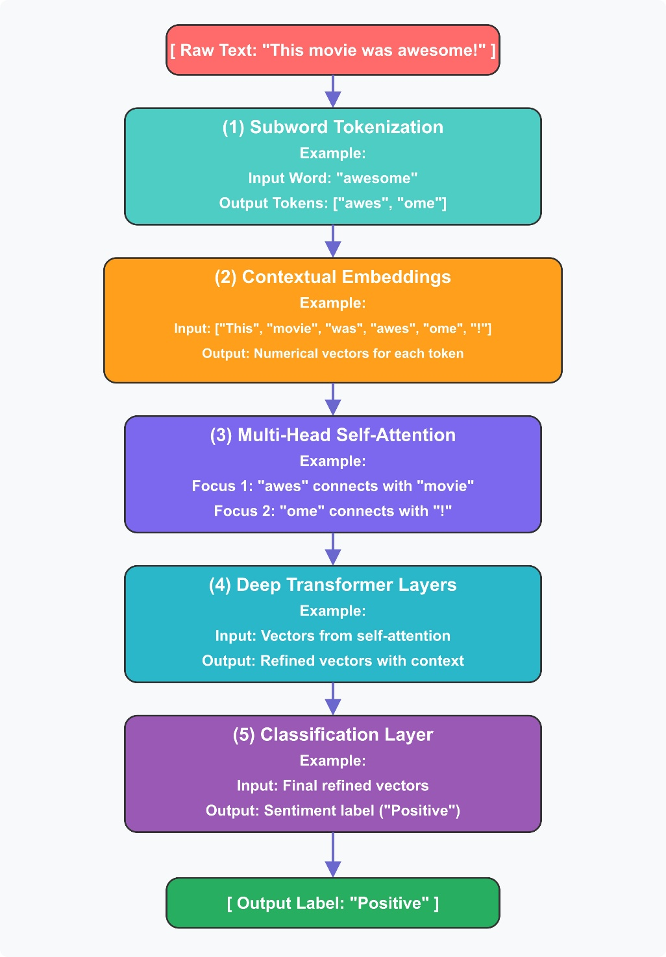
RoBERTa:

Slide 12
Module Description
1. Data Augmentation Module: Enhances training data through synonym replacement, creating varied yet semantically consistent inputs.
2. Preprocessing Module: Tokenizes text using RoBERTa’s tokenizer, ensuring optimal input representation for the classification model.
3. Sentiment Classification Module: Uses RoBERTa for sentiment prediction, followed by a sigmoid activation layer for binary classification.
4. Evaluation and Insights Module: Measures model performance with metrics like accuracy, precision, recall, and ROC-AUC, and generates actionable insights.

Slide 13
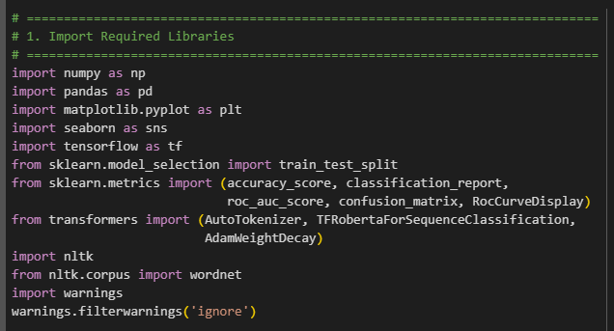
Screenshots

Slide 14
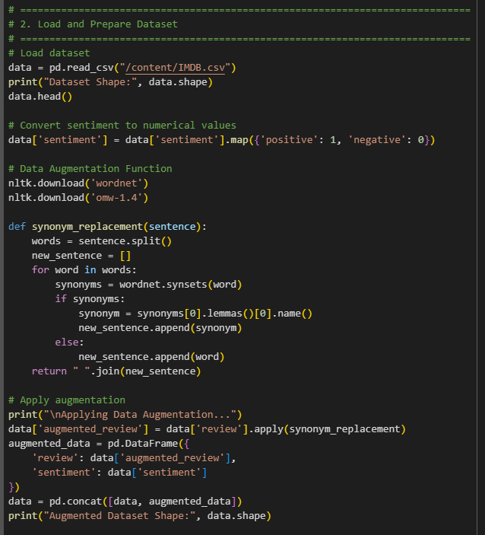
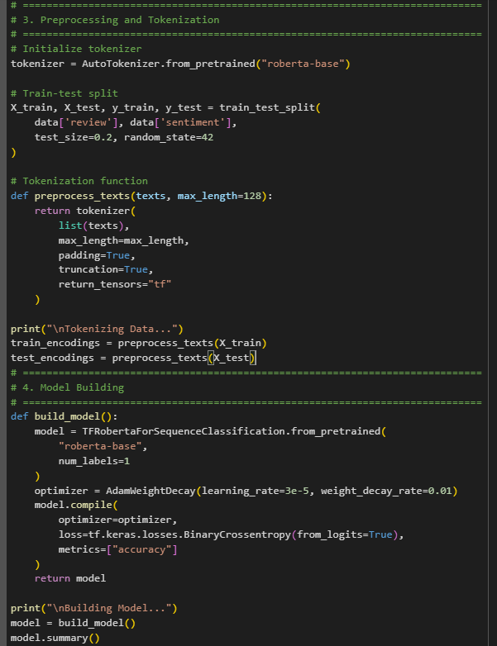
Screenshots

Slide 15
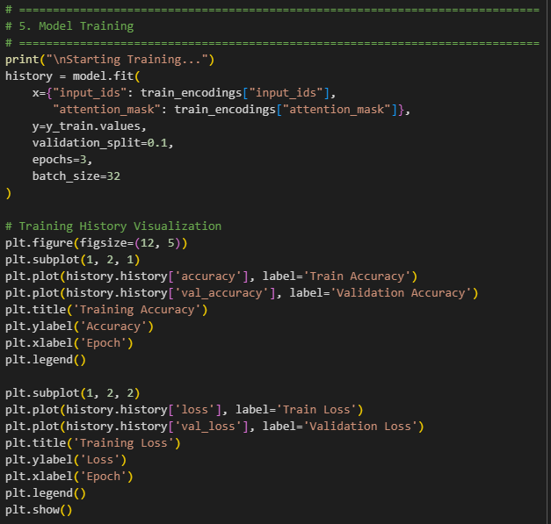
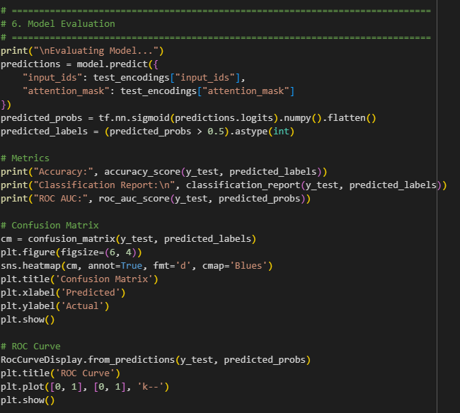
Screenshots

Slide 16
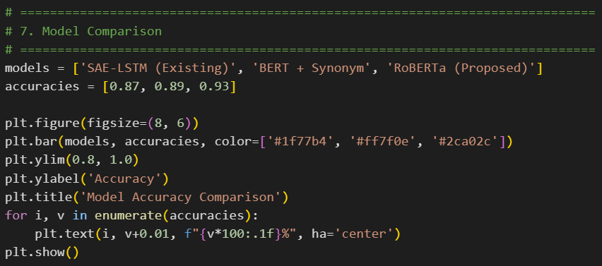
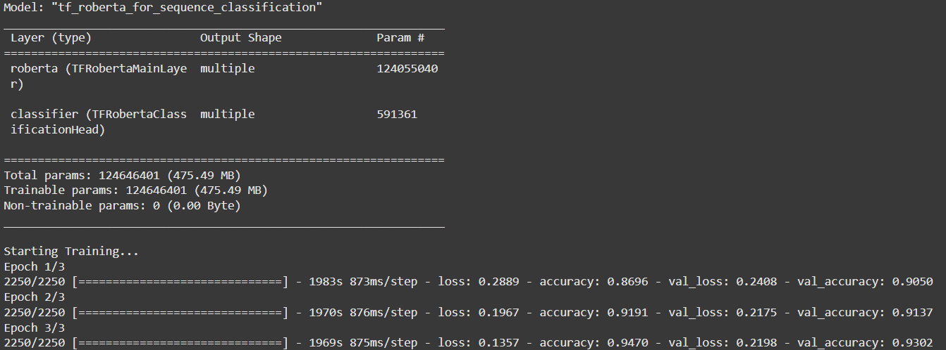
Screenshots

Slide 17
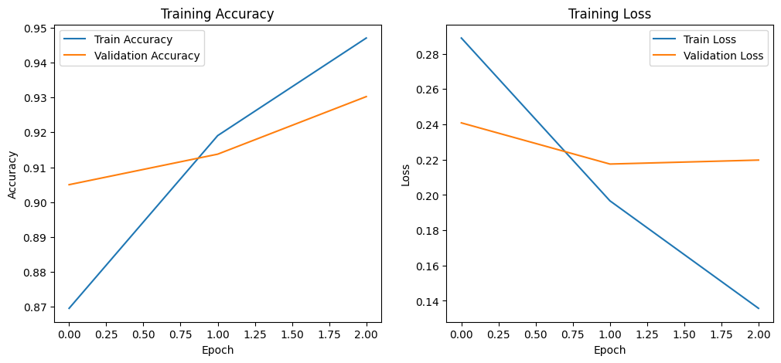
Screenshots

Slide 18
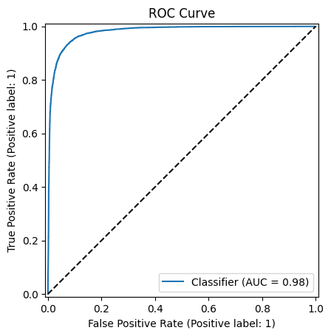
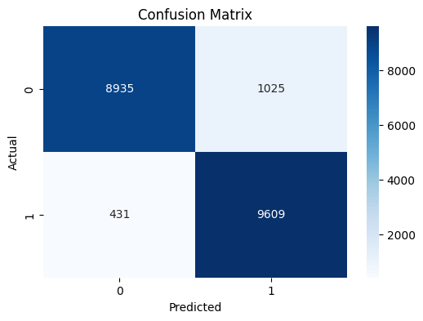
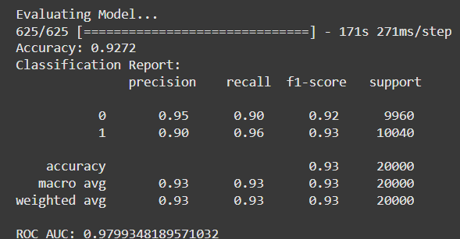
Screenshots

Slide 19
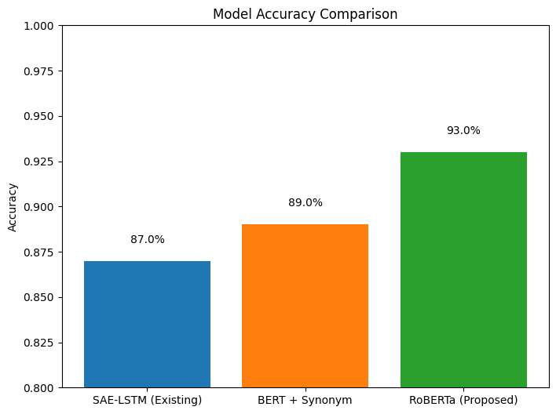
Screenshots

Slide 20
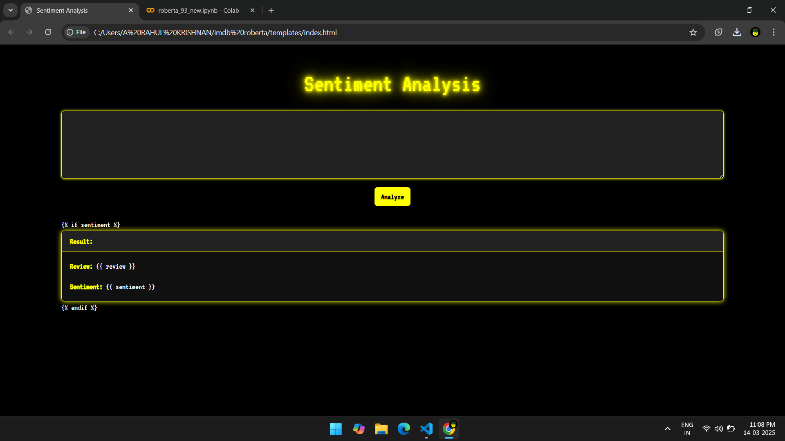
Screenshots

Slide 21
References
[1] I. Kanwal, A. Alkhayyat, F. Wahid, S. Ali, A. Ur-Rehman, and A. Al-Radaei, "Sentiment analysis using hybrid model of stacked auto-encoder-based feature extraction and long short-term memory-based classification approach," IEEE Access, vol. 11, pp. 1-12, Sep. 2023.
[2] Y. Xia, E. Cambria, A. Hussain, and H. Zhao, ‘‘Word polarity disambiguation using Bayesian model and opinion-level features,’’ Cognit. Comput., vol. 7, no. 3, pp. 369–380, Jun. 2015.
[3] I. Chaturvedi, E. Ragusa, P. Gastaldo, R. Zunino, and E. Cambria, ‘‘Bayesian network based extreme learning machine for subjectivity detection,’’ J. Franklin Inst., vol. 355, no. 4, pp. 1780–1797, Mar. 2018.
[4] O. Levy and Y. Goldberg, ‘‘Neural word embedding as implicit matrix factorization,’’ in Proc. 27th Int. Conf. Neural Inf. Process. Syst., vol. 27, 2014, pp. 2177–2185.

Slide 22
References
[5] S. Lai, K. Liu, S. He, and J. Zhao, "How to generate a good word embedding," IEEE Intelligent Systems, vol. 31, no. 6, pp. 5–14, Nov. 2016.
[6] M. Li, Q. Lu, Y. Long, and L. Gui, "Inferring affective meanings of words from word embedding," IEEE Transactions on Affective Computing, vol. 8, no. 4, pp. 443–456, Oct. 2017.
[7] M. Song, H. Park, and K.-S. Shin, "Attention-based long short-term memory network using sentiment lexicon embedding for aspect-level sentiment analysis in Korean," Information Processing & Management, vol. 56, no. 3, pp. 637–653, May 2019.

Slide 23
References
[8] J. Pennington, R. Socher, and C. Manning, "GloVe: Global vectors for word representation," in Proc. Conference on Empirical Methods in Natural Language Processing (EMNLP), 2014, pp. 1–12.
[9] A. Voulodimos, N. Doulamis, A. Doulamis, and E. Protopapadakis, "Deep learning for computer vision: A brief review," Computational Intelligence and Neuroscience, vol. 2018, Feb. 2018, Art. no. 7068349.
[10] I. Chaturvedi, R. Satapathy, S. Cavallari, and E. Cambria, "Fuzzy commonsense reasoning for multimodal sentiment analysis," Pattern Recognition Letters, vol. 125, pp. 264–270, Jul. 2019.

Slide 24
Thank You

