Slide 1

IILM UNIVERSITY
GREATER NOIDA
SUMMER INTERNSHIP
INTERNSHIP TOPIC / TITLE
UI/UX DESIGN
UI/UX Design
& Practical Project
Internship Presentation
Zivika Accessories
STUDENT NAME
Archita Srivastava
Jewellery & accessories
E-commerce interface
ENROLLMENT / ROLL NO.
CS-23411071
PROGRAM & SEMESTER
B.Tech Computer Science Engineering | 7th Semester
Designed in Figma • Interactive prototype
ORGANIZATION
Infotact Solutions
25 June 2026 – 25 September 2026
Design Associate L1 | Fully Remote

Slide 2
SUMMER INTERNSHIP
UI/UX DESIGN
PRACTICAL UI/UX PROJECT
Zivika
Accessories
Internship Presentation
Jewellery & accessories
e-commerce interface
Designed in Figma • Interactive prototype
Archita Srivastava
B.Tech CSE •CS-23411071
4th Year
IILM University, Greater Noida
Infotact Solutions | Design Associate L1

Slide 3
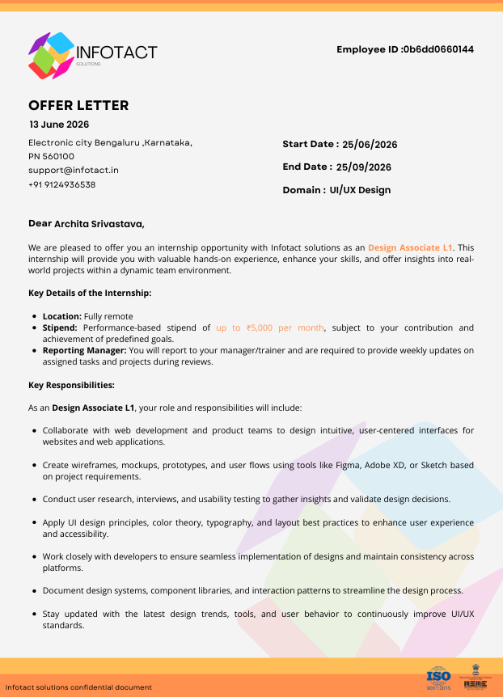
Organization & Internship Context
03
Information directly supported by the offer letter
Infotact Solutions
Internship environment
• Internship domain: UI/UX Design.
• Role offered: Design Associate L1.
• Work mode: fully remote.
• The offer describes hands-on experience and exposure to real-world projects.
• Reporting includes updates to a manager/trainer and reviews of assigned tasks and projects.
Summer Internship • UI/UX Design

Slide 4
Role & Responsibilities
04
Responsibilities stated in the offer letter
Design responsibilities
Collaboration & process
• Design intuitive, user-centered interfaces for websites and web applications.
• Create wireframes, mockups, prototypes and user flows.
• Apply UI principles, color theory, typography and layout best practices.
• Conduct user research, interviews and usability testing.
• Collaborate with web development and product teams.
• Document design systems, component libraries and interaction patterns.
• Stay updated with design trends, tools and user behaviour.
Note: These are role responsibilities listed in the offer letter; no unprovided completion/results are claimed.
Summer Internship • UI/UX Design

Slide 5
UI/UX Concepts & Skills
05
Core areas reflected in the internship role and practical design work
Visual hierarchy
Typography
Color & contrast
Organizing content so users can scan and understand the interface quickly.
Using type scale, weight and spacing to create readable content.
Using a controlled palette to support clarity and visual identity.
Layout & spacing
Information architecture
Prototyping
Maintaining alignment, rhythm and consistency across screens.
Grouping jewellery categories and navigation in a clear structure.
Connecting screens to demonstrate an interactive shopping flow.
Summer Internship • UI/UX Design

Slide 6
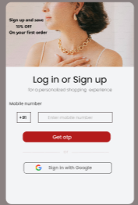
Practical UI/UX Project — Zivika Accessories
06
Jewellery & accessories e-commerce interface designed in Figma
Project purpose
To design a clean, attractive and user-friendly jewellery shopping interface with clear category navigation, consistent product presentation and a cohesive visual identity.
Key screens
• Home page
• Rings, Bracelets, Pendants & Anklets
• Login / Signup
• Interactive Figma prototype
Home page
Summer Internship • UI/UX Design

Slide 7
Problem Statement & Objectives
07
Designing a focused shopping experience for jewellery discovery
Problem statement
Objectives
Jewellery e-commerce interfaces need to balance visual appeal with easy discovery. Users should be able to understand categories, browse products and move through the shopping interface without unnecessary complexity.
• Create a premium yet minimal visual direction.
• Make product categories easy to discover.
• Present products consistently using reusable card patterns.
• Maintain visual consistency across pages.
• Demonstrate the experience through an interactive prototype.
Summer Internship • UI/UX Design

Slide 8
Project Scope & Information Architecture
08
Core structure of the Zivika shopping experience
Primary navigation
HOME
Category browsing
RINGS
BRACELETS
PENDANTS
ANKLETS
Access & interaction
LOGIN /
SIGNUP
PROTOTYPE
FLOW
Summer Internship • UI/UX Design

Slide 9
UI/UX Design Process
09
A practical flow from structure to interactive prototype
01
02
03
04
05
Define
Structure
Visual Design
Prototype
Review
Clarify the e-commerce goal and page requirements.
Organize navigation, categories and page hierarchy.
Develop typography, imagery, cards, spacing and layout.
Connect screens and interactions in Figma.
Check consistency, readability and navigation flow.
The deck does not claim formal user research or usability-test results that were not provided.
Summer Internship • UI/UX Design

Slide 10
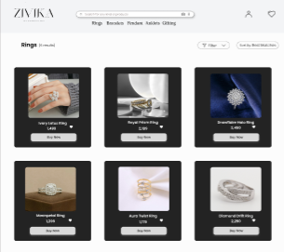
Zivika — Home & Account Experience
10
Entry point, category discovery and login/signup
Home page
Login / Signup
Summer Internship • UI/UX Design

Slide 11
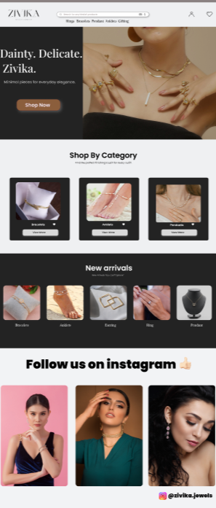
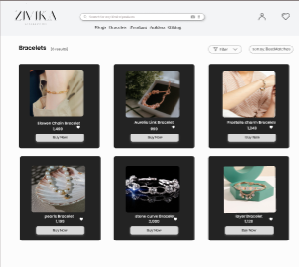
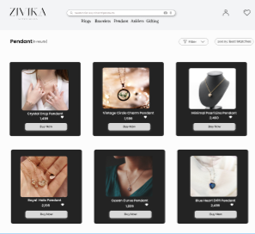
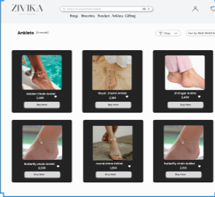
Zivika — Category Screens
11
Consistent product-card presentation across jewellery categories
Rings
Bracelets
Pendants
Anklets
Summer Internship • UI/UX Design

Slide 12
Design Decisions & UI Highlights
12
Visual choices visible in the submitted Zivika screens
Premium visual direction
Clear category navigation
Consistent product cards
Neutral backgrounds with strong black sections and warm imagery create a jewellery-focused aesthetic.
Top navigation and dedicated category pages help users move directly to major jewellery categories.
Product image, name, price and call-to-action follow a repeated presentation pattern.
Content hierarchy
Brand presence
Prototype-ready structure
Hero messaging, category blocks and product sections separate discovery stages on the home page.
The Instagram section extends the visual identity beyond product browsing.
Multiple screens are organized so the interface can be demonstrated as an interactive Figma prototype.
Summer Internship • UI/UX Design

Slide 13
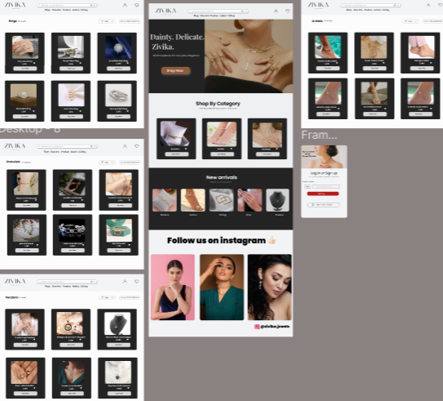
Interactive Prototype & Project Documentation
13
Figma for prototyping • GitHub for project documentation
Figma prototype
Interactive prototype:
https://www.figma.com/proto/fbBwgdjA8Cq5f0v6IBHRkV/zivika-accessories?node-id=0-1&t=9tVWaNQTShgMMxM6-1
GitHub repository
Project screenshots and documentation can be presented here.
github.com/a-rchitasrivastava/
2023-27_architaSrivastava_CS-23411071_7th_4CSE10
Open GitHub Repository
Zivika screen collection
Summer Internship • UI/UX Design

Slide 14
Learning Outcomes & Future Scope
14
What the project demonstrates and where the design can grow
Learning outcomes
Future scope
• Practiced structuring an e-commerce interface.
• Strengthened understanding of visual hierarchy, typography, spacing and consistency.
• Practiced category-based information architecture.
• Built an interactive prototype in Figma.
• Improved ability to communicate a UI/UX concept visually.
• Add detailed product pages and richer product information.
• Expand the prototype with cart, wishlist and checkout flows.
• Explore responsive/mobile layouts.
• Add accessibility-focused design checks.
• Conduct real user research and usability testing in a future iteration.
Summer Internship • UI/UX Design

