Slide 1
Dev Challenges – Solution Presentation
Adrian Rebmann

Slide 2
Agenda
Recap: Dev Challenge 1 (Function for random item allocation)
Dev Challenge 2 (Database creation and querying)
Database design and creation
SELECT statements for querying different statistics
Dev Challenge 3 (React app)
Functional Requirements
Other Requirements
Demo

Slide 3
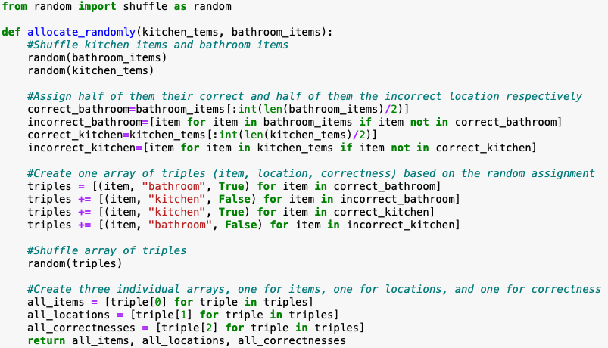
Recap Dev Challenge 1 (Function for random item allocation)
Goal: create a function that takes an even number of kitchen and bathroom items and allocates them randomly s.t. half of the items per location are correctly and half are incorrectly allocated.
Solution:
Shuffle kitchen items and bathroom items
Assign half of them their correct and half of them the incorrect location respectively
Create one array of triples (item, location, correctness) based on the random assignment from 1. and 2.
Shuffle array of triples
Create three individual arrays, one for items, one for locations, and one for correctness

Slide 4
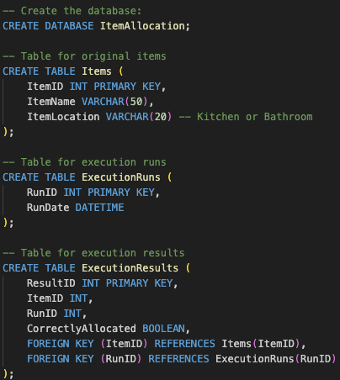
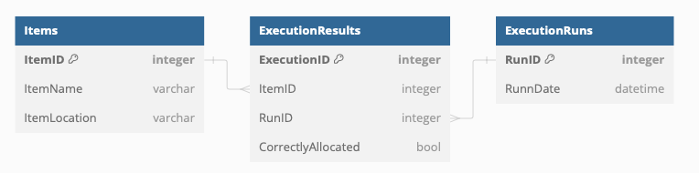
Dev Challenge 2 (Database creation and querying)
Goal: (1) Design a database schema for persisting items and execution results for random item allocation and (2) provide several queries to get statistics of the allocation results.
Solution (1)

Slide 5
Dev Challenge 2 (Database creation and querying) cont.
Solution (2)
1. Statement that returns per item, how often it was allocated correctly and incorrectly 2. Statement that returns per location, how often it was allocated correctly and incorrectly 3. Statements that return the per item and location statistics for execution runs on Mondays 4. Statements that return the per item and location statistics for the last 10 execution runs 5. Statement that returns the most correctly allocated item

Slide 6
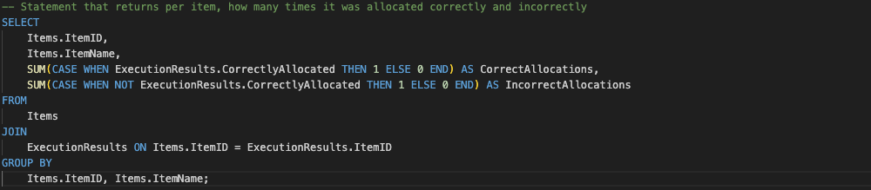
Dev Challenge 2 (Database creation and querying) cont.
Solution (2)
1. Statement that returns per item, how often it was allocated correctly and incorrectly 2. Statement that returns per location, how often it was allocated correctly and incorrectly 3. Statements that return the per item and location statistics for execution runs on Mondays 4. Statements that return the per item and location statistics for the last 10 execution runs 5. Statement that returns the most correctly allocated item

Slide 7
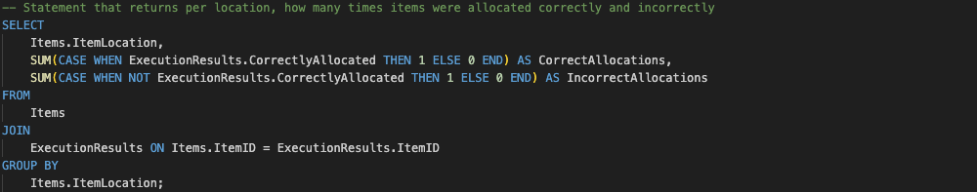
Dev Challenge 2 (Database creation and querying) cont.
Solution (2)
1. Statement that returns per item, how often it was allocated correctly and incorrectly 2. Statement that returns per location, how often it was allocated correctly and incorrectly 3. Statements that return the per item and location statistics for execution runs on Mondays 4. Statements that return the per item and location statistics for the last 10 execution runs 5. Statement that returns the most correctly allocated item

Slide 8
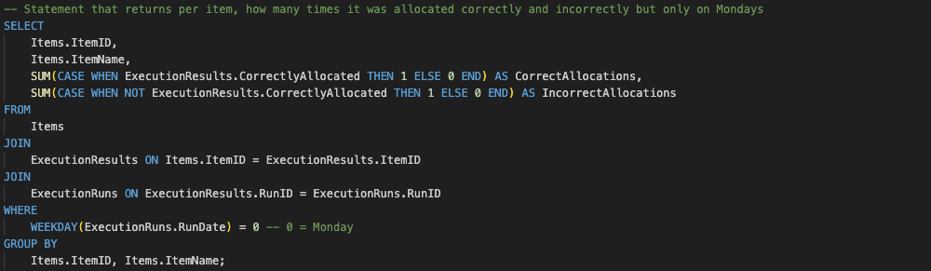
Dev Challenge 2 (Database creation and querying) cont.
Solution (2)
1. Statement that returns per item, how often it was allocated correctly and incorrectly 2. Statement that returns per location, how often it was allocated correctly and incorrectly 3. Statements that return the per item and location statistics for execution runs on Mondays 4. Statements that return the per item and location statistics for the last 10 execution runs 5. Statement that returns the most correctly allocated item

Slide 9
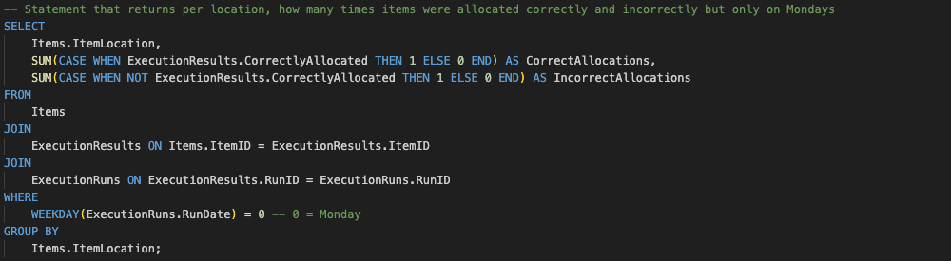
Dev Challenge 2 (Database creation and querying) cont.
Solution (2)
1. Statement that returns per item, how often it was allocated correctly and incorrectly 2. Statement that returns per location, how often it was allocated correctly and incorrectly 3. Statements that return the per item and location statistics for execution runs on Mondays 4. Statements that return the per item and location statistics for the last 10 execution runs 5. Statement that returns the most correctly allocated item

Slide 10
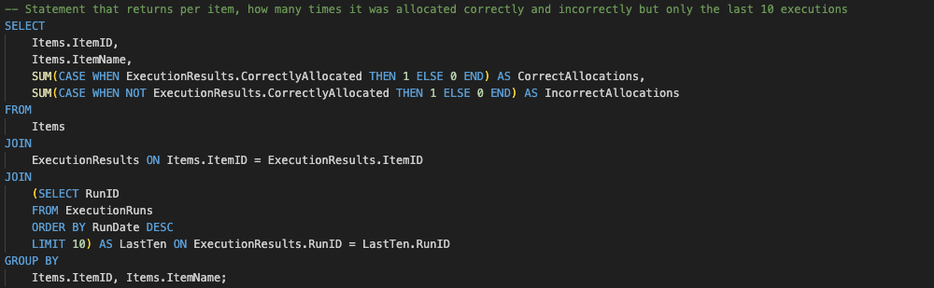
Dev Challenge 2 (Database creation and querying) cont.
Solution (2)
1. Statement that returns per item, how often it was allocated correctly and incorrectly 2. Statement that returns per location, how often it was allocated correctly and incorrectly 3. Statements that return the per item and location statistics for execution runs on Mondays 4. Statements that return the per item and location statistics for the last 10 execution runs 5. Statement that returns the most correctly allocated item

Slide 11
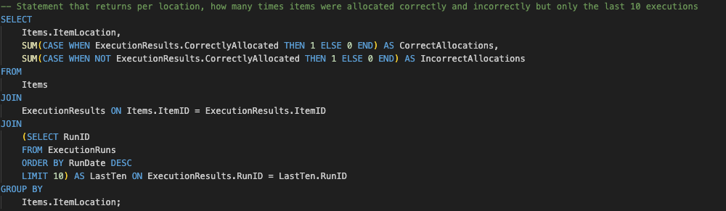
Dev Challenge 2 (Database creation and querying) cont.
Solution (2)
1. Statement that returns per item, how often it was allocated correctly and incorrectly 2. Statement that returns per location, how often it was allocated correctly and incorrectly 3. Statements that return the per item and location statistics for execution runs on Mondays 4. Statements that return the per item and location statistics for the last 10 execution runs 5. Statement that returns the most correctly allocated item

Slide 12
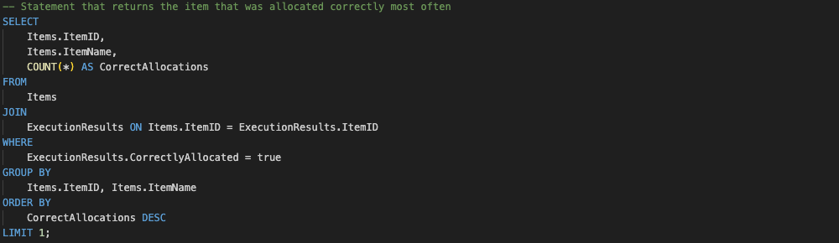
Dev Challenge 2 (Database creation and querying) cont.
Solution (2)
1. Statement that returns per item, how often it was allocated correctly and incorrectly 2. Statement that returns per location, how often it was allocated correctly and incorrectly 3. Statements that return the per item and location statistics for execution runs on Mondays 4. Statements that return the per item and location statistics for the last 10 execution runs 5. Statement that returns the most correctly allocated item

Slide 13
Dev Challenge 3 (React app)
Goal: Create a React app for random item allocation
Functional Requirements:
The user can input the kitchen and bathroom items Solution: Two input fields, one for kitchen items one for bathroom items; user can type an item and hit enter or an add button. The items are collected in a table showing id, name, and location per item The items can be deleted using dedicated buttons
Upon clicking on a button, the allocation results are shown to the user Solution: Allocation result table that shows item id, allocated location, and allocation correctness.
Input must be validated: the numbers of kitchen items and bathroom items have to be an even Solution: Button that is (1) disabled and red indicating that the number of items per location must be even, if the number if kitchen items is uneven or 0 or if number if bathroom items is uneven or 0; is (2) enabled and blue if the input is valid.
(1) Allocation statistics per item and per location must be displayed; (2) keep statistics of removed items Solution: Two tables: one for item allocation statistics and one for location allocation statistics. Stored in separate statistics maps so items are kept.

Slide 14
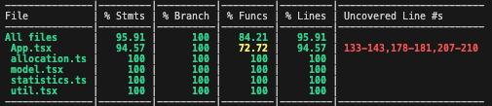
Dev Challenge 3 (React app) cont.
Other Requirements:
All content must (1) fit the screen; scrolling is only allowed in results and statistics, and (2) be responsive Solution: Using SAP UI5 web components for React: Provides AnalyticalTable component where displayed number of rows can be adjusted, is scrollable, and is responsive. Using four data tables: input items, last allocation, item statistics, location statistics. Combined with Grid component that adjusts content to screen.
Good practices of code cleanliness should be considered Solution: keep business logic (allocation function and statistics updates) and data model in dedicated files. Describe functionality of functions in comments.
Tests coverage of at least 80% is required Solution: Using testing framework (allows to test TS code and the behavior of the app/react components. Track test coverage.

Slide 15
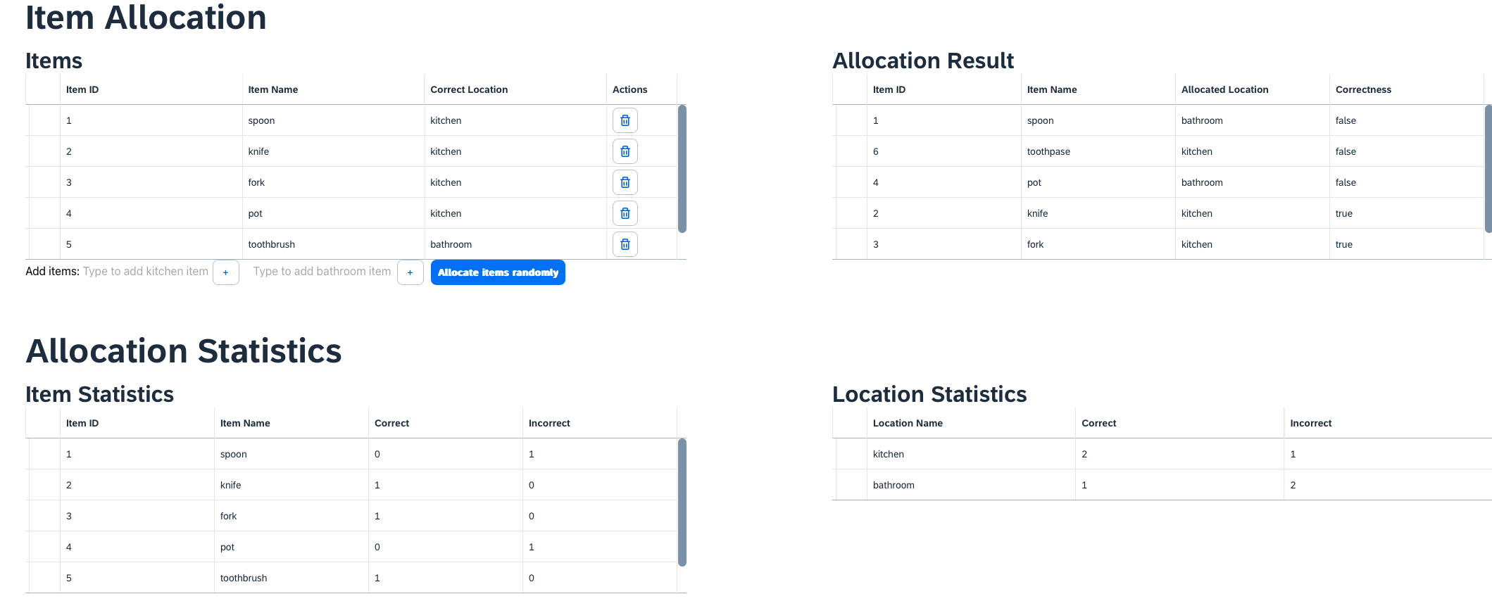
Dev Challenge 3 (React app) cont.

Slide 16
Thank you.

