Slide 1

API Health Log Analyzer Using Python
Python Mini Project
MCA (CC&D) | Semester 1
SUBMITTED BY
[Your Name] | UID: [Your UID]
MCA (CC&D) | Section: [Your Section]
SUBMITTED TO
[Faculty Name]
[Designation]
Notes:
Introduce yourself and the project: a Python tool and website that read API log files and report how healthy each API endpoint is.

Slide 2




Problem and Objectives
Objectives
Parse the log
Extract method, endpoint, status and time using regex
Manual log reading fails
Measure health
Success rate, error rate and response times
Servers write thousands of API log lines every hour. Finding failing or slow endpoints by eye is slow, tiring and easy to get wrong.
Show the results
Console report and a website dashboard with charts
Notes:
Explain why log analysis matters: real servers produce thousands of lines. The tool automates the reading and gives clear numbers, a chart, a dashboard and a website.

Slide 3
Technologies Used
re
Regex parsing
defaultdict
Group by endpoint
Requirements
Python 3.8 or higher
Code editor and terminal
Web browser
Flask, for the website (pip install flask)
Counter
Count status codes
statistics
Mean and median
csv and json
Save the reports
argparse
CLI options
SVG
Charts in the page
Flask
Website and upload
Notes:
The analysis uses only the Python standard library. Flask is needed only for the website. The dashboard is HTML and CSS generated by Python, with every chart drawn as inline SVG, so no chart library is needed.

Slide 4




System Design
Log file
Parse
Analyze
Report
api_health.log, or a file uploaded in the browser
Regex splits each line into fields
Per-endpoint rates and response times
Console, JSON and CSV files, and the dashboard page
One analysis code serves both the command line (log_analyzer.py) and the website (app.py)
Notes:
Walk through the four stages from left to right. The same functions are used by the command-line tool and by the Flask website, so nothing is written twice.

Slide 5



Data and Health Rules
CRITICAL
Errors > 15% or average > 1500 ms
One log line has 5 fields
Date and time
2026-10-03 08:00:12
DEGRADED
Errors > 5% or average > 600 ms
Method
GET
Endpoint
/api/users
Status code
200
HEALTHY
Errors <= 5% and average <= 600 ms
Response (ms)
120
Notes:
The log has five fields separated by the pipe symbol. The right side shows the three health rules, which are defined in health_status() and can be changed.

Slide 6
Source Code Highlights
parse_lines()
Parses each log line with a regex
health_status() in log_analyzer.py
def health_status(error_rate, avg_rt):
if error_rate > 15 or avg_rt > 1500:
return "CRITICAL"
if error_rate > 5 or avg_rt > 600:
return "DEGRADED"
return "HEALTHY"
analyze()
Groups by endpoint and calculates metrics
health_status()
Applies the rules to give the status
build_dashboard()
Builds the dashboard page with SVG charts
Notes:
This function is the heart of the classifier: two thresholds on error rate and response time decide the status. The right side lists the main functions; the website reuses them.

Slide 7
Website: How It Works
Same code
Reuses parse_lines(), analyze() and health_status() from log_analyzer.py
Routes in app.py (Flask)
GET / upload page
POST /analyze dashboard for the file
GET /sample dashboard for sample log
POST /api/analyze report as JSON
Safe input
5 MB limit, bad files rejected, HTML escaped
To run
pip install flask, then python app.py
Notes:
The website is a small Flask app with four routes. A visitor uploads a log file, Flask passes the text to the same analysis functions, and the dashboard page is returned.

Slide 8


Functionalities
Parse logs
Calculate metrics
Classify health
Regex reads every line and skips bad ones
Success rate, errors and response times
HEALTHY, DEGRADED or CRITICAL per endpoint
Export reports
Dashboard charts
Working website
Save results as JSON and CSV files
Donut, bar, column and line charts in SVG
Upload a log file and see the dashboard
Notes:
Six features: three core analysis steps and three ways of presenting the output. python log_analyzer.py gives the console report, and python app.py starts the website with the dashboard.

Slide 9
Output: Console Report
Total requests : 1000
Success rate : 91.7%
Error rate : 8.3%
Avg response time : 619.1 ms (median 301.0, p95 2398)
Endpoint Reqs Err% Avg ms P95 ms Status
/api/payments 176 25.0 1983.2 4644 CRITICAL
/api/orders 164 13.41 668.8 1478 DEGRADED
/api/login 157 5.1 178.7 249 DEGRADED
/api/products 145 2.76 270.8 389 HEALTHY
/api/search 183 1.64 380.6 587 HEALTHY
/api/users 175 1.14 133.4 193 HEALTHY
Notes:
This is part of what python log_analyzer.py prints for the sample log of 1,000 requests. /api/payments is CRITICAL, /api/orders and /api/login are DEGRADED.

Slide 10
Endpoint Health Report
Endpoint | Requests | Error % | Avg ms | P95 ms | Status
/api/payments | 176 | 25.0 | 1983.2 | 4644 | CRITICAL
/api/orders | 164 | 13.4 | 668.8 | 1478 | DEGRADED
/api/login | 157 | 5.1 | 178.7 | 249 | DEGRADED
/api/products | 145 | 2.8 | 270.8 | 389 | HEALTHY
/api/search | 183 | 1.6 | 380.6 | 587 | HEALTHY
/api/users | 175 | 1.1 | 133.4 | 193 | HEALTHY
Sorted by error rate, highest first. Overall: 1,000 requests, 91.7% success, 619 ms average response
Notes:
The same table the program prints in the terminal and saves in report.csv. P95 means 95 percent of requests were faster than this value.

Slide 11
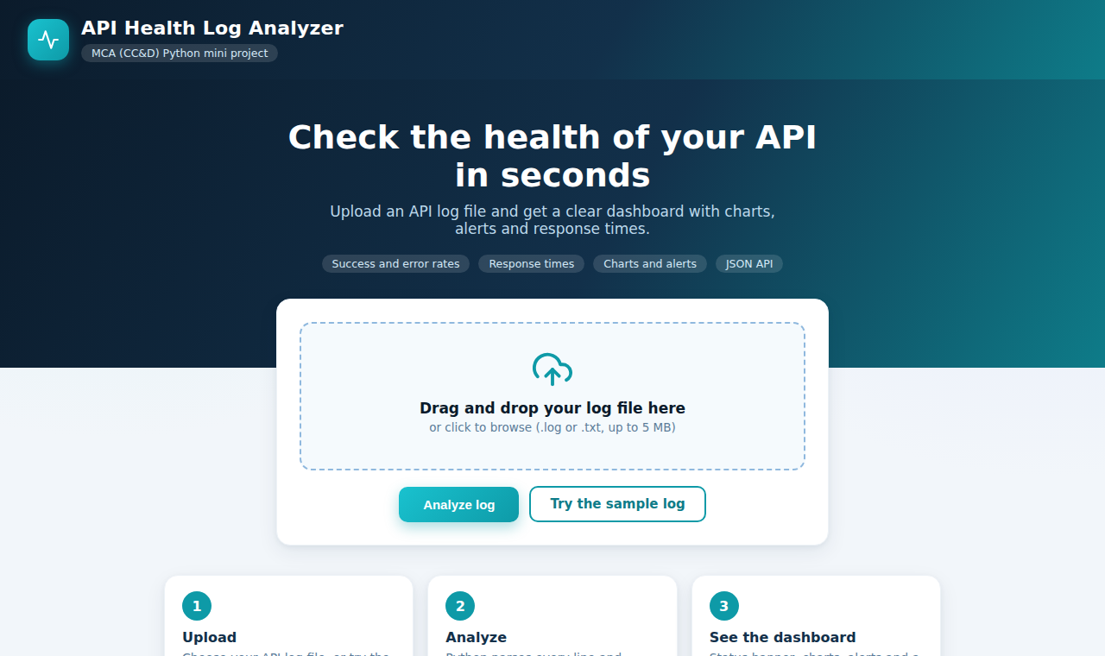
Output: Upload Page
Choose a file
Drag and drop or click to upload a .log or .txt file, up to 5 MB
Try the sample
One click analyzes the built-in sample log
Clear errors
A missing or invalid file shows a message, not a crash
Run: pip install flask, then python app.py, then open http://127.0.0.1:5000
Notes:
Demo idea: start the site, upload api_health.log or click Try the sample log. If no file is chosen, the page shows a friendly error instead of crashing.

Slide 12
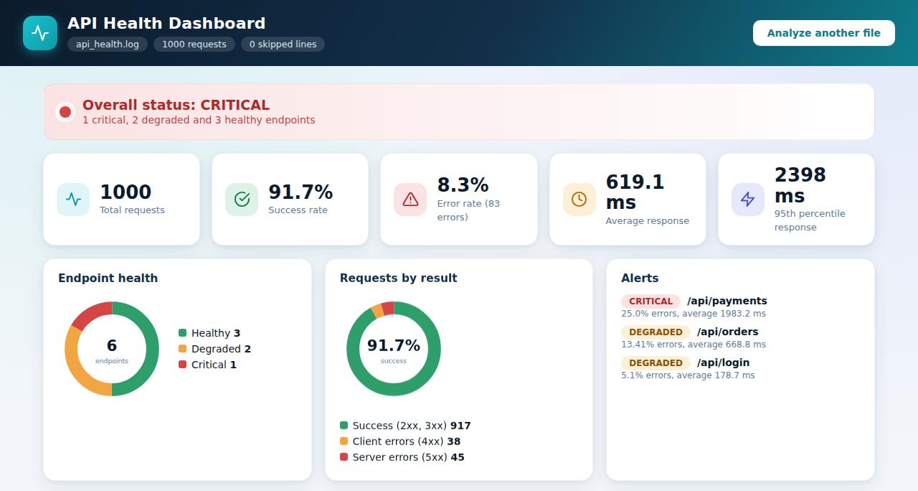
Output: Dashboard
Status banner
Worst status of all endpoints
KPI cards
Requests, success, errors and times
Donut charts
Endpoint health and request results
Alerts
Every DEGRADED or CRITICAL endpoint
The dashboard is shown by the website after a log file is uploaded
Notes:
This is the page the website returns. All charts are drawn as SVG by plain Python code in dashboard.py, so no chart library is needed.

Slide 13
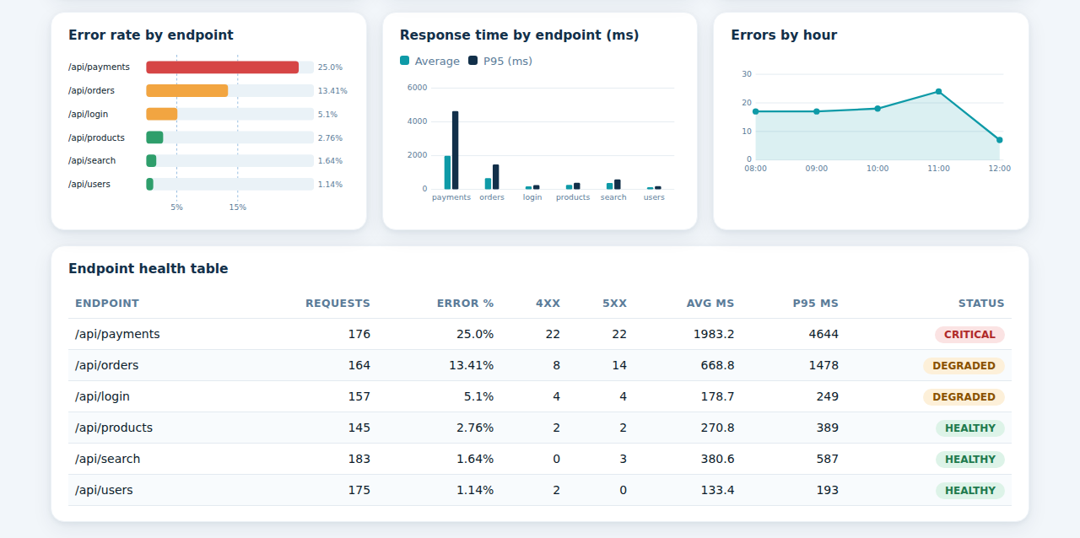
Output: Dashboard Charts
Bar chart
Error rate with 5% and 15% limits
Column chart
Average and P95 response time
Line chart
Errors in each hour
Table
Colored status badge per endpoint
Notes:
Bar chart: error rate per endpoint, with dashed lines at the 5 and 15 percent limits. Column chart: average and 95th percentile response time. Line chart: errors per hour.

Slide 14




Conclusion and Future Work
Future Work
Conclusion
Live API data using requests
The analyzer turns a large raw log into a short, readable report. It finds failing and slow endpoints automatically and shows the result as text, files and a dashboard with charts in a working website.
Email alert when an endpoint turns CRITICAL
Store logs in a database
Host the website online, with user login
Notes:
Summarise the result, then mention the next steps. The database idea connects with the PL/SQL project and hosting the website with Advanced Internet Programming.

Slide 15
Learning Outcomes
File handling and regular expressions for parsing
Dictionaries, defaultdict and Counter for grouping
Statistics: mean, median and percentiles
Exception handling, argparse, JSON and CSV export
Flask routes, file upload and safe input handling
Charts drawn as SVG and an HTML dashboard
Notes:
These are the Python skills practised in the project. They are also good points to mention in the viva.

Slide 16
Thank You
Questions?
Notes:
Invite questions.

