Slide 1
Bearer Token Authentication
token-based authentication
Abolfazl Sabagh
May 2026

Slide 2
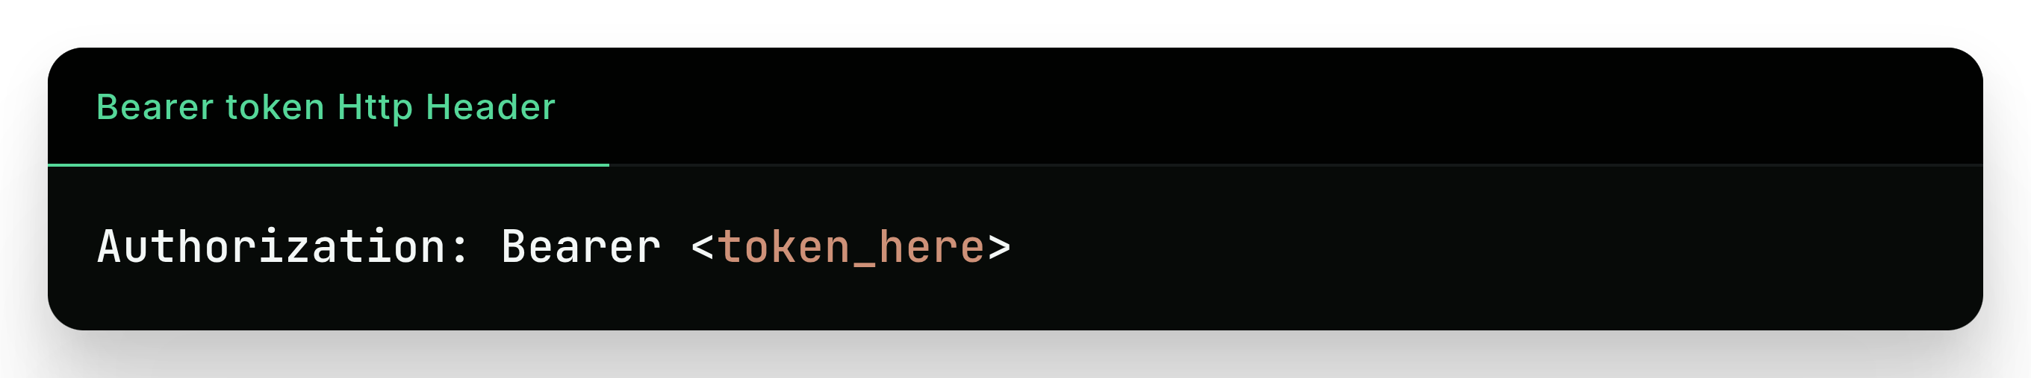
Bearer Authentication
Client obtains a token using login endpoint or another sources.
Client sends the token with each Api request to prove auth.
Server validate request using bearer token.
Bearer is someone who bear the token – in reality client.

Slide 3
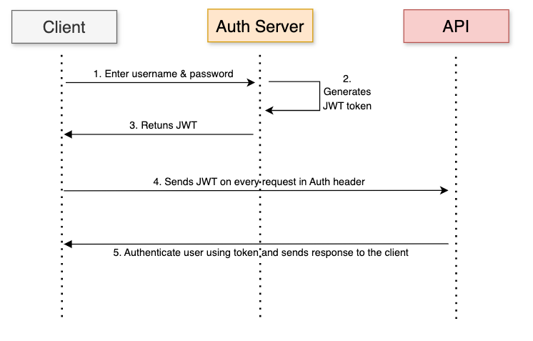

Slide 4
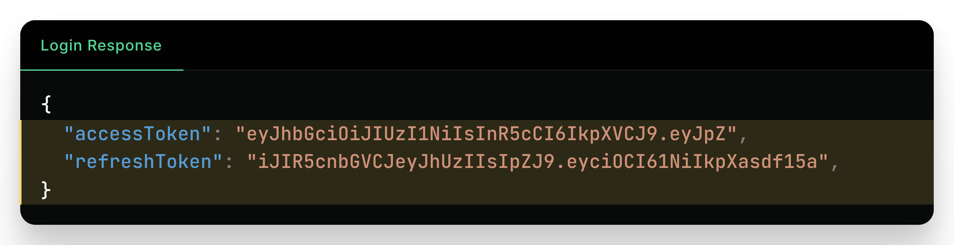
Access/Refresh token
Access Token: short-lived [5–30 min], used for Apis.
Refresh Token: long-lived [7-90 day], used for get new access tokens.

Slide 5
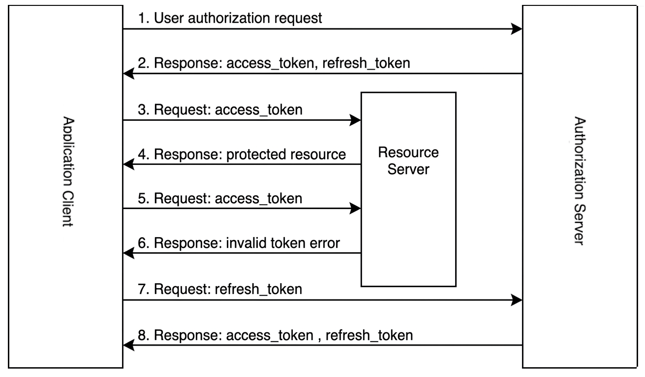

Slide 6
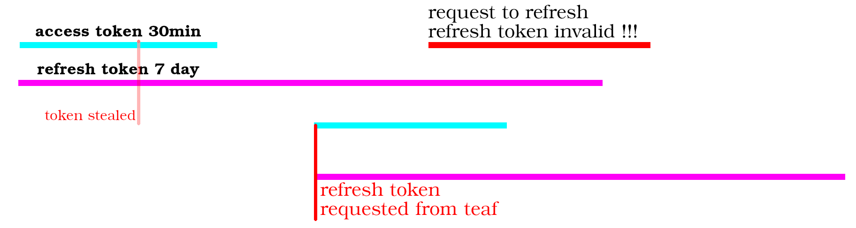
Refresh Token
Security Through Short-Lived Access Tokens.
System refresh token and user doesn’t need to login again.
The Ability to Rotate Credentials and Invalidate old refresh tokens.
Detect token theft.

