Slide 1
IP Addressing

Slide 2
INDEX
Overview
Network Concepts
Mac Address
IP Address
Public/Private IP Address
Subnet Mask
IP Classes/CIDR

Slide 3
Network Overview
Computer Network is system where multiple devices is connected together to share data, resource, services.
Communication: Email, Video Call.
Resource Sharing: Cloud Computing in internet, Shared Printer in local network.
Services: Shared Software or Services.

Slide 4
Network Concepts
Network Interface: Point to connect to device together. In hardware Ethernet port / NIC or Wi‑Fi adapter and in software – Logical Network Interface – can be wlp2s0, docker0, lo.
Network Interface can enable devices to connect.
Mac Address: Hardware identifier or Hardware Address.
IP Address: Unique device identifier or Logical Address.
Sub-net: Logical grouping of devices or Local Network Addressing.
Gateway: Entry/Exit point of network.

Slide 5
Mac Address | Hardware Address
MAC address (Media Access Control address) is a unique hardware identifier assigned to a network interface such as an Ethernet card or Wi‑Fi adapter
MAC addresses are associated directly with the network interface card (NIC)
e.i wifi (rtw88_8822ce), 60:FF:9E:35:6A:4F
24 Number in Hexadecimal
48 bit or 6 Byte length (24 * 4)

Slide 6
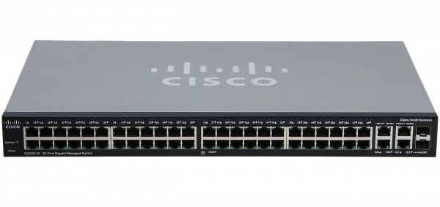
Mac Address | Hardware Address
MAC addresses are flat and not scalable
Network switches use MAC addresses to deliver data to the device on the Local Area Network (LAN).
Mac address is not routable in WAN or Internet
Mac address works at OSI Layer 2 (Data Link Layer)
Network Switches is works with Mac Addresses
ARP is resolved IP to Mac Address

Slide 7
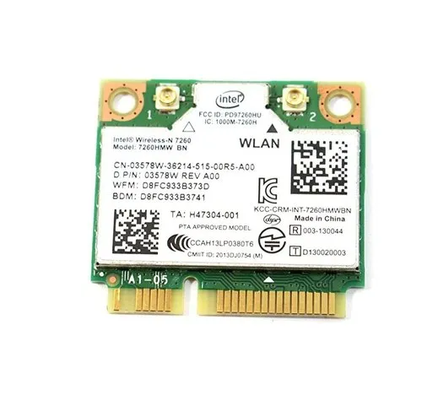
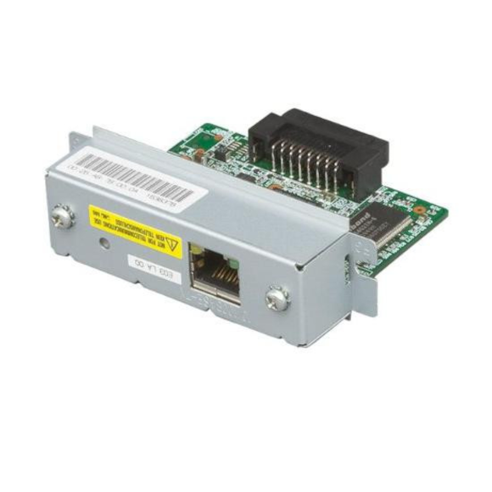
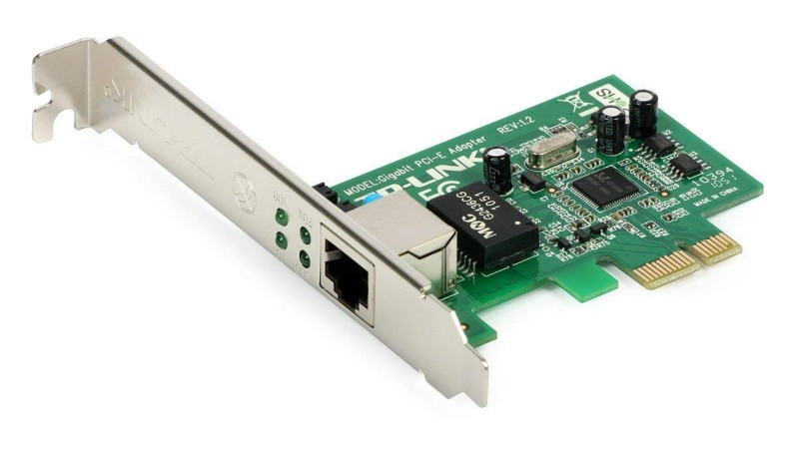
Mac Address - Devices
Computers (external or onboard)
IoT devices (Smart refrigerators)
Modems
Wifi Router | Network switches
Smart Phones
Smart TVs
Smart watches
Printers
Wifi USB dongle
Network Interface Card (NIC)

Slide 8
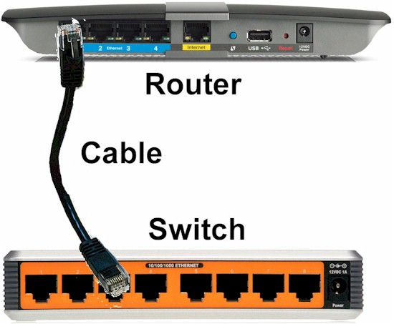
IP Address | Internet Protocol Address
IP addresses provide logical addressing
IP works at OSI Layer 3 (Network layer) and allow communication between networks
IP addresses provide logical addressing
IP addresses are hierarchical and structured (network + host) and this structure makes routing efficient for large networks.

Slide 9
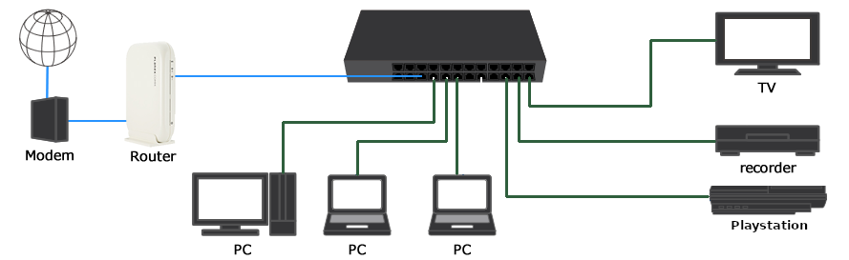
IP Address | Internet Protocol
Routers use IP addresses to route packets across multiple networks and the internet

Slide 10
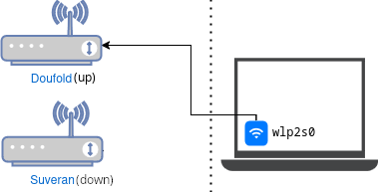
Network Interface (Device) Vs. Connection
Device: the physical/virtual NIC. Hardware like your ethernet card or wifi chip.
Connection: saved config profile (IP, DNS, gateway, etc.)
Device (ifname): wlp2s0
├── connection: Doufold (up)
└── connection: Suveran (down)

Slide 11
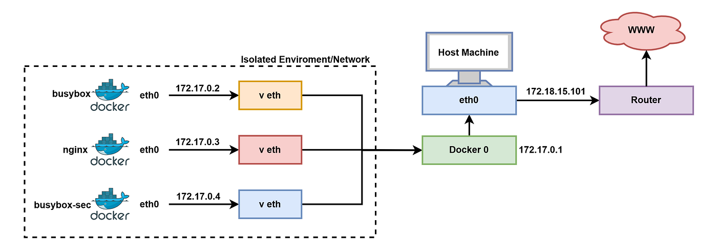
Bridge Interface | Virtual Switch
Type of network that connects multiple networks together at Layer 2 (Data Link layer).

Slide 12
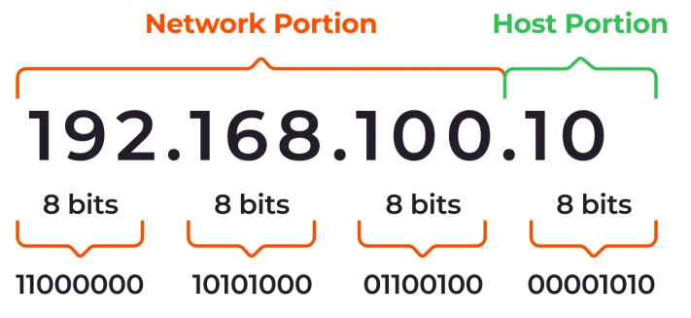
IP Address Structure
IP addresses divided to:
  Network (which network the device belongs to)
  Host (which device inside that network)
Network portion (NetID) is a fixed bit in the IP address that represents the entire network of any host It is connected to the network.
Host portion (HostID) is a fragment of an IP address that uniquely identifies a host within a network.

Slide 13
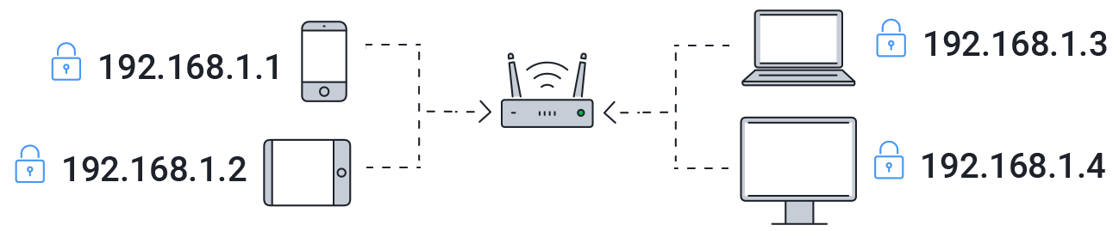
Private IP Addresses
Used inside LAN (Local Area Network)
Assigned by router/DHCP
Used for Internal Communication

Slide 14
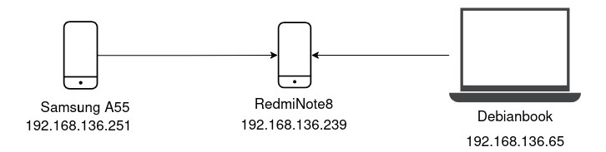
Private IP Addresses
Monitoring Traffic: tcpdump
icmp packet request: ping
Available host: arp -a
_gateway

Slide 15
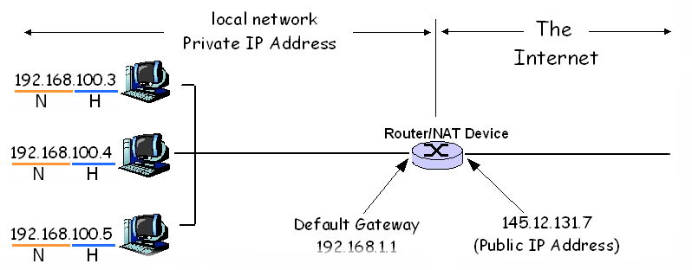
IP Address Structure | LAN and Internet
255.255.0.0

Slide 16
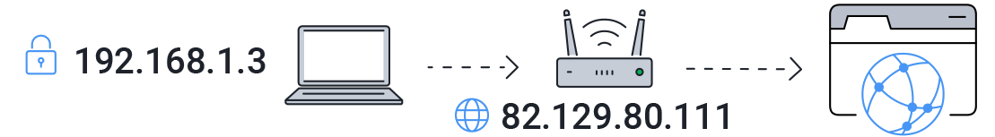
Public IP Addresses
Assigned to you by your Internet Service Provider (ISP)
Routable on the internet and globally unique Across the Internet
Used for servers, routers | $_SERVER['REMOTE_ADDR']

Slide 17
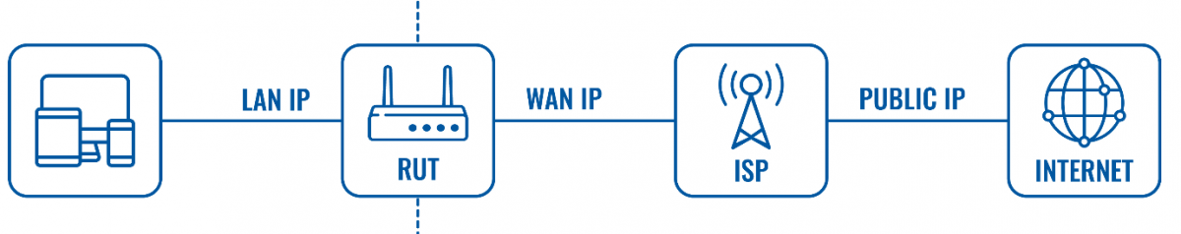
Public/Private IP Address| LAN/WAN IP Address
Device → Router → ISP → Internet
Device → ISP → VPN server → Internet
Device → Proxy → Internet

Slide 18
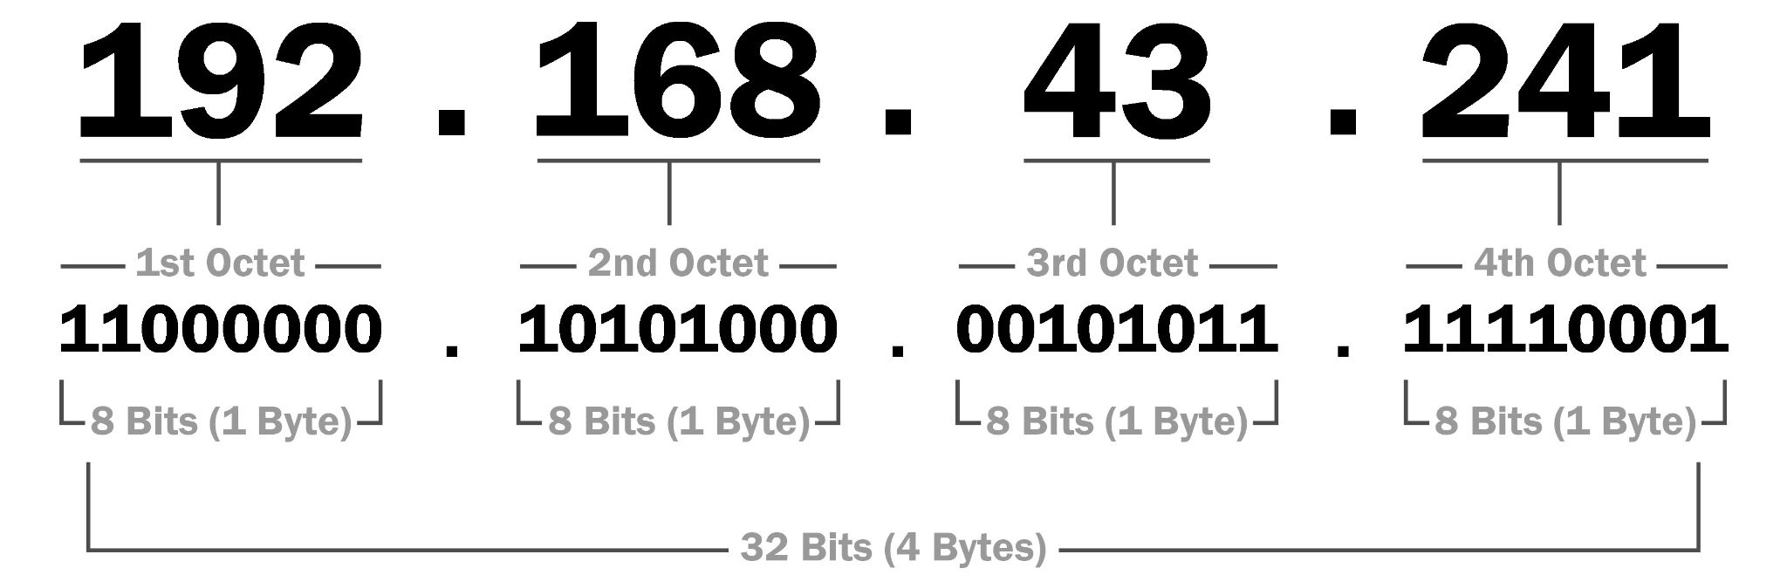
IP Addressing | IPV4
32‑bit | 2³² = 4,294,967,296
Written in 4 group Decimal octets from 0.0.0.0 to 255.255.255.255

Slide 19
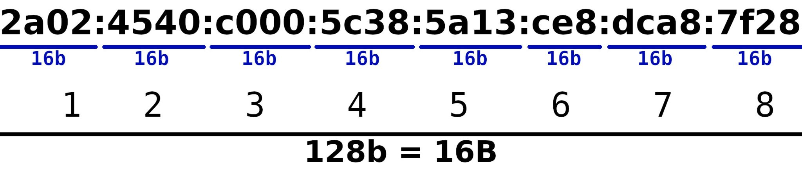
IP Addressing | IPV6
128-bit | 2¹²⁸
0000:0000:0000:0000:0000:0000:0000:0000 to ffff:ffff:ffff:ffff:ffff:ffff:ffff:ffff
Written as 8 groups expressed as Hexadecimal

Slide 20
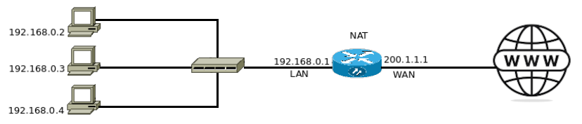
Network Address Translation | NAT
Allows multiple devices in a private network to access the internet using a single public IP address.
Translates private IPs to public IPs.
Prevents IPv4 address exhaustion.
Allows thousands of devices to share one public IP.
Port numbers separate device traffic.

Slide 21
IPV4 Subnet Mask | Local Network
Subnet Mask is 32bit number in decimal i.e. 255.255.255.0
Used to separate network portion from the host portion.
Subnet mask or Netmask is belongs to specific private network.
 | Network | Host
IP Address: 192.168.1.10 | 11000000.10101000.00000001 | 00001010
Subnet Mask: 255.255.255.0 | 11111111.11111111.11111111 | 00000000
Network IP: 192.168.1.0 | 11000000.10101000.00000001 | 00000000

Slide 22
Classful IPv4 Address System | Local Network
Class | First Octet | IP Address Range |  |  |  | Subnet Mask | CIDR
A | 1-126 | N | H | H | H | 255.0.0.0 | 8
B | 128 – 191 | N | N | H | H | 255.255.0.0 | 16
C | 192 – 223 | N | N | N | H | 255.255.255.0 | 24

Slide 23
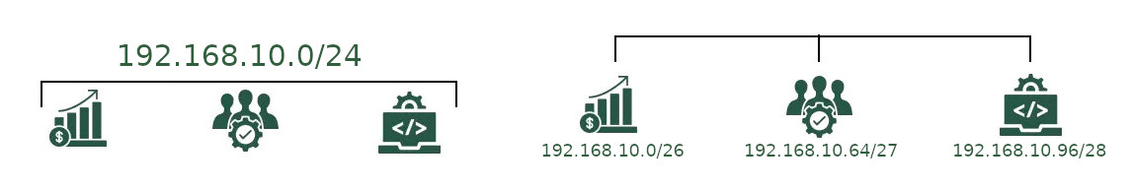
Classless Inter‑Domain Routing | CIDR
Subnetting is the process of dividing a large IP network into smaller logical networks.
The network is divided into three smaller subnets.
Improving network performance, security, and manageability.
Each department receives only the IPs it needs
IP addresses are used efficiently
62
30
14

Slide 24
Sub-netting | Local Network
Network Address (First Address) is used to identify the specific subnet. All host bit is set to zero.
Broadcast Address (Last Address) is used to send data to every device on subnet simultaneously. All host bit is set to 1.
Network | Network Address | Subnet Mask | Broadcast Address
192.168.10.0/26 | 192.168.10.0 | 255.255.255.192 | 192.168.10.63
192.168.10.64/27 | 192.168.10.64 | 255.255.255.224 | 192.168.10.95
192.168.10.96/28 | 192.168.10.96 | 255.255.255.240 | 192.168.10.111

Slide 25
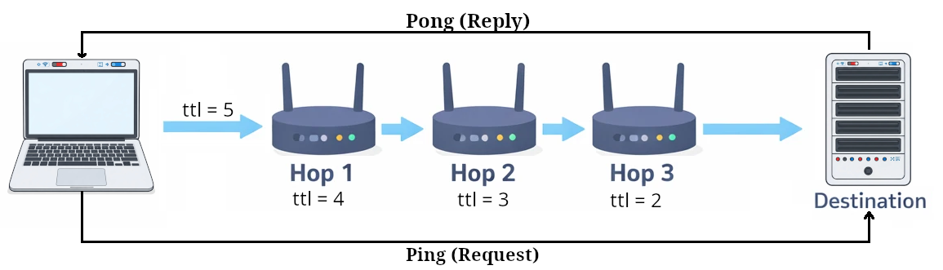
Ping | ICMP Packet
Uses the ICMP protocol's to check connection between source and destination.
Works with both IPv4 and IPv6 and hostname.
Each router decrements TTL by 1

Slide 26
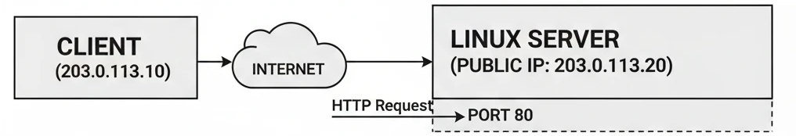
Port |Traffic Director | ss | netstat
Logical endpoint for socket: {Protocol} {IP Address} {Port} http://127.0.0.1:8080
Directing traffic to a specific application or service.
Reserved for system services (0 – 1023) (80/HTTP, 443/HTTPS, 22/SSH)
Used by specific applications and software (3306/MySQL, 5432/PostgreSQL)
Essential Linux Command: ss -tlpn (Show listening TCP ports & processes)

Slide 27
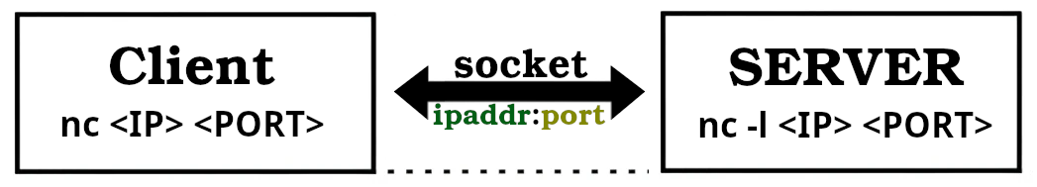
Port scanning | ncat | nc
ncat - Concatenate and redirect sockets
Arbitrary TCP and UDP connection and listener.
Listening on machine and connect from another machine under the TCP or UDP.
Listening using ncat -l on interface and port and connect using ncat or telnet.
Transferring Files throughout TCP.

Slide 28
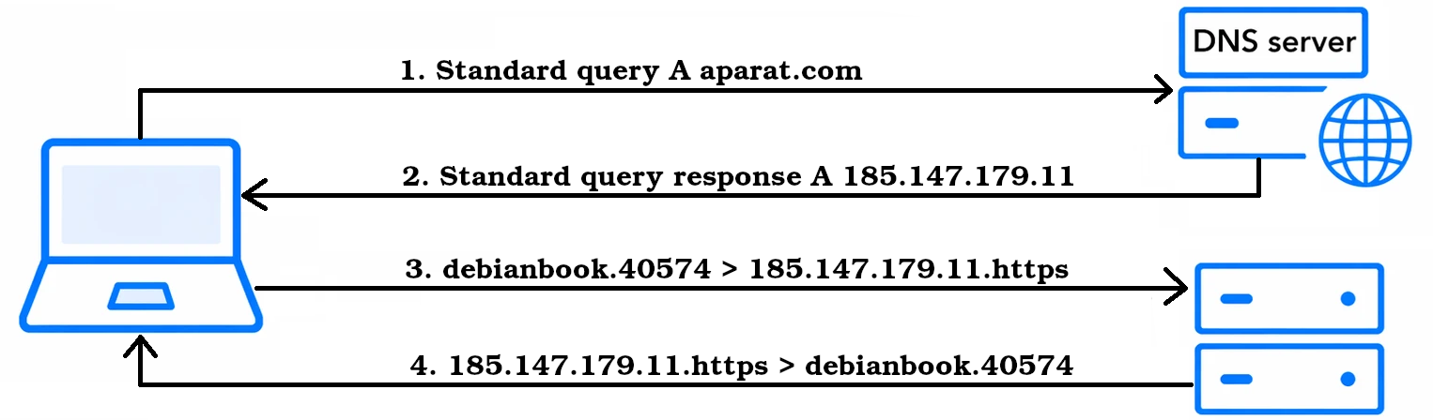
Domain Name Service | DNS
Domain Name Server (DNS) acts like the phonebook of the internet.
Translates human‑readable domain names into IP addresses (tcp/udp port 53).
DNS queries

Slide 29
DNS Record Types | DNS Servers
DNS Record Types:
  A record → Domain → IPv4 address: aparat.com → 185.147.179.11
  AAAA record → Domain → IPv6 address: google.com → 2001:4860:4802:32::78
  NS record → Domain → IPv6 address: aparat.com → dns32.cloudns.net
Popular Public DNS Servers:
  Google DNS: 8.8.8.8, 8.8.4.4, 4.2.2.4
  Cloadflare DNS: 1.1.1.1
  Shekan DNS: 178.22.122.100, 185.51.200.2
  ‌‌Begzar DNS: 185.55.224.24, 185.55.226.25, 185.55.226.26
  Electro DNS: 78.157.42.100, 78.157.42.101
IRAN

Slide 30
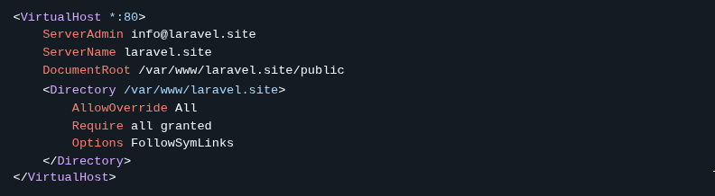
Local Hosts | Apache Virtual Host
Local and static hostname-to-IP mapping file: /etc/hosts
127.0.0.1 http://localhost
127.0.0.1 http://laravel.site

Slide 31
Conclusion
MAC address → used for communication within a local network.
IP address → used for communication between networks and across the internet.
Public/Private IP Address
Classful IPv4 Address System
Classless Inter-Domain Routing
DHCP client/server | Network Address Translator - NAT
Network IP Address in Local Area Network
Broadcast IP Address in Local Area Network

