Slide 1
Congressional Stock Analysis
Do Congress Members Beat the Market?
Machine Learning on STOCK Act Disclosures · March 2026

Slide 2
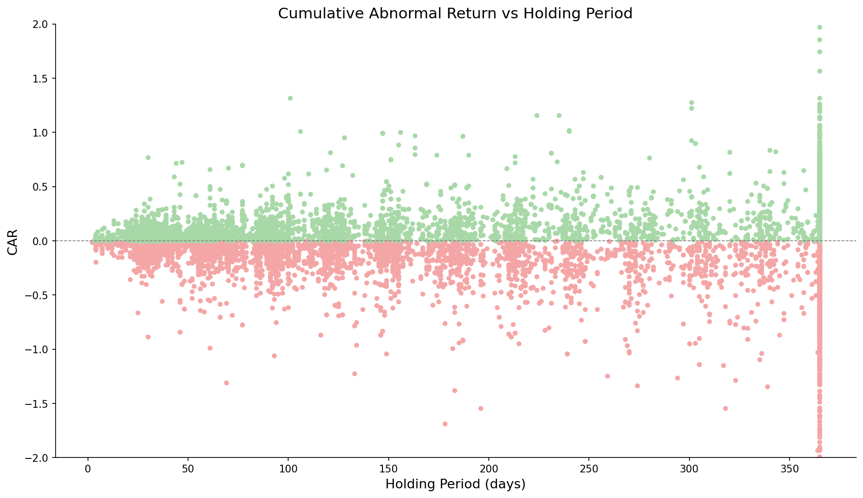
Most Congressional Purchases Underperform the Market
Blindly copying congressional trades based on public disclosure dates does not generate alpha, the average politician underperforms their own risk-adjusted benchmark, making indiscriminate trade replication an inefficient strategy
15k
Total modeled trades
-0,5%
Median CAR
48.5%
Win rate
Holding period is calculated based on disclosed buy and sell date

Slide 3
How We Measure Performance: Cumulative Abnormal Return (CAR)
Cumulative Abnormal Return (CAR)
Positive CAR (+)
Negative CAR (-)
Compensated MORE for risk than CAPM predicts
Compensated LESS, paid for risk that did not materialize
For each day, calculate the excess return relative to the stock's expected risk-adjusted return, then accumulate those daily excesses over the window.
CAPM
E[R] = R, + B x (Rm - R,)
Beta (B) estimated from 756 trading days of close prices (min 60 days).
Window
Measured buy-to-sell (if <12 months) or a fixed 12-month window.
The clock starts the day AFTER the public filing date
Excess return actual log return – CAPM-expected log return

Slide 4
Who Consistently Beats — and Loses to — the Market?
Top 10 winners
Worst 10 performers
29
-1
-3
-5
-6
4
5
5
2
2
-19
Median CAR
John F. Reed (n=63)
Bradley S. Schneider (n=22)
Suzan K. Delbene (n=21)
David P. Joyce (n=51)
John Boozman (n=45)
Victoria Spartz (n=20)
Donald Sternoff Beyer Jr (n=299)
Mo Brooks (n=24)
Dan Sullivan (n=35)
Debbie Wasserman Schultz (n=20)
Hit Rate
Median CAR
Austin Scott (n=35)
Mrs. Marjorie Taylor Greene (n=22)
Tom Malinowski (n=104)
C. Scott Franklin (n=26)
James Comer (n=27)
Michael Patrick Guest (n=43)
Carol Devine Miller (n=55)
Daniel Goldman (n=307)
Daniel Meuser (n=26)
Patrick Fallon (n=57)
Hit Rate
▸ Based on 101 politicians with ≥ 20 disclosed purchases
▸ evaluated based on CAR performance, amount of $ traded was not considered
Median Car
Hit Rate

Slide 5
Performance Over Time: Macro Events Drive Positive Rates
Performance over the years
1.208
710
651
707
658
501
545
568
496
496
475
472
317
312
355
351
116
190
168
189
89
95
108
78
92
# of trades
2015Q1
2015Q2
2015Q3
2015Q4
2016Q1
2016Q2
2016Q3
2016Q4
2017Q1
2017Q2
2017Q3
2017Q4
2018Q1
2018Q2
2018Q3
2018Q4
2019Q1
2019Q2
2019Q3
2019Q4
2020Q1
2020Q2
2020Q3
2020Q4
2021Q1
2021Q2
2021Q3
2021Q4
2022Q1
2022Q2
2022Q3
2022Q4
2023Q1
2023Q2
2023Q3
2023Q4
2024Q1
2024Q2
2024Q3
2024Q4
2025Q1
Hit Rate
▸ 2020 Q2–Q3: surge in positive rate — COVID recovery bounce lifted most purchases
▸ 2022: sharp drop aligned with rate-hike drawdown across the market
▸ Volume spikes suggest increased trading activity around election cycles
▸ Positive rate rarely exceeds 60% — even in the best macro environments
# of trades
Hit Rate

Slide 6
EDA: Median CAR Across Key Structural Variables
Party Influence
Disclosure delay (days)
Committee influence
Median CAR
Democrat
Republican
Hit Rate
Median CAR
0-10d
10-20d
20-30d
30-40d
40-45d
45-50d
50d+
Hit Rate
Median CAR
No Match
Tier 1 (Tangential)
Tier 2 (Oversight)
Tier 3 (Direct)
Hit Rate
▸ Disclosure delay capped at 45 days by STOCK Act; 50d+ entries reflect late filers
Median CAR
Hit Rate

Slide 7
Committee Membership Shows Selective Advantage
Type of committee
Additional committee activity
2,0
2,0
1,5
1,5
1,0
1,0
0,5
0,5
0,0
0,0
-0,5
-0,5
-1,0
-1,0
-1,5
-1,5
-4,0
Defense & Security
Finance & Housing
Fiscal Policy
Energy & Environment
Health & Labor
Commerce & Tech
Agriculture
Infrastructure
Oversight
-4,0
Median CAR
Hit Rate
Median CAR
Committee Chair
Majority Party
Lobbied (90d)
Hit Rate
▸ Orange = flag=1 (on committee / in role / company lobbied) · Blue = flag=0
▸ All 9 committee categories shown — previously only 5 were displayed
▸ Lobbied (90d): company had active lobbying disclosure in 90 days before filing date
Median Car
Hit Rate

Slide 8
Can an AI Model do better?
A machine learning filter recovers a subset of trades with positive risk-adjusted returns, suggesting that informed selection not blind replication is where the edge lies
Model performance
2,0
2
Years of prediction data
1,5
Optimal threshold
1,0
101
Median Car
347
215
0,5
+0,5%
Optimal threshold
-1,95%
All trades
0,0
-0,5
495
683
-1,0
887
42
Hit Rate
51,5%
Optimal threshold
44,5%
All trades
-1,5
1.3k
1.1k
-4
-4,0
50%
55%
60%
65%
70%
75%
80%
85%
90%
95%
Optimal strategy:
The model's value lies not in predicting every trade, but in knowing which ones to ignore, filtering congressional purchases down to the highest-confidence signals flips a losing strategy into a marginally profitable one
Notes:
A machine learning filter recovers a subset of trades with positive risk-adjusted returns, suggesting that informed selection — not blind replication — is where the edge lies

Slide 9
The Model: What Drives the Predictions?
Features importance
Politician characteristics
Past politician performance
Lobbying activity
Committee Jurisdiction
Intersections between traded companies and active lobbying
Committee–industry jurisdictional overlap
Stock Characteristics
Trade Signals
Information related to the stock
Specific trade information
Data sources
1: https://api.quiverquant.com/beta/bulk/congresstrading
2: Yahoo Finance
3: https://github.com/unitedstates/congress-legislators
4: https://api.quiverquant.com/beta/historical/lobbying

Slide 10
Conclusions & Caveats
Key Findings
- Copying congressional trades blindly destroys value — across the full test set, the median trade delivers -1.95% CAR with only a 44.6% win rate, meaning the average politician earns less than what their stocks' own systematic risk predicts
- Lobbying activity and committee jurisdiction are the strongest structural signals — whether a company was actively lobbying in the 90 days before filing is the single most important model feature, followed by committee oversight and direct industry-jurisdiction overlap
- Selective filtering recovers the edge — a machine learning model identifies a subset of trades with positive risk-adjusted returns, suggesting informed selection is where the alpha lies
Caveats
- Single macro regime — the test set covers Dec 2022 – Jan 2025 only; performance across different market environments (e.g. bull runs, rate cycles) is not validated out-of-sample
- Execution constraints are not modelled — no transaction costs, market impact, or liquidity limits are accounted for; real-world returns will be lower, particularly for less liquid tickers
- Disclosed trades only — STOCK Act compliance is imperfect; undisclosed or late-filed activity is not captured, meaning the dataset may systematically miss the most sensitive trades
Potential Data Enrichment (Lobbying Focus)
- Lobbying depth — currently only a binary 90-day presence flag; adding spend amount, trend direction, and which specific bills overlap with the politician's committee jurisdiction would sharpen the signal
- Proximity signal — days between the lobbying registration date and the trade's filing date; tighter proximity likely indicates more actionable information access
- Revolving door — identifying lobbyists who previously worked for the same politician or committee would flag trades with unusually direct information channels

Slide 11
Thank you

Slide 12
Methodology: How Key Signals Were Constructed
1 — Ticker ↔ Committee Matching
▸ Committee membership from timestamped YAML snapshots (unitedstates/congress-legislators on GitHub)
▸ For each trade, the snapshot closest in time to the Filed date is used
▸ Ensures membership reflects the politician's actual committees at trade time
▸ Committee codes truncated to 4 characters to normalize across snapshot formats
▸ Result: binary committee-category flags per trade (9 categories total)
2 — 3-Tier Committee–Industry Match
▸ Manual mapping in config/commette_industry_map.yaml: committee → sector → industry
▸ Tier 3 (Strong): committee has DIRECT JURISDICTION — controls budgets, contracts, or legislation
▸ Tier 2 (Medium): committee has OVERSIGHT — sets general rules, taxes, or compliance standards
▸ Tier 1 (Tangential): committee has INDIRECT impact — general legislative influence only
▸ Result: Industry match 1/2/3 binary flags per trade (1 = politician's committee matches stock's industry at that tier)
3 — Lobbying Signal
▸ Source: QuiverQuant lobbying disclosures API, downloaded per traded ticker
▸ lobbied_any_90d = 1 if the company had any active lobbying disclosure in 90 days before trade's Filed date
▸ Currently binary — lobbying spend amount and issue specificity are future enrichment candidates

Slide 13
APPENDIX
Dataset Overview
39,334
19,096
15,117
268
Total Records
Purchases
Modelled
Politicians
Metric | Value
Date range | 2012-09-13 – 2026-01-30
Transaction types | Purchase / Sale / Sale (Full) / Sale (Partial) / Exchange
Unique tickers (purchases) | 2,209
Parties | D / R / I
Chambers | Representatives / Senate
Target variable | realized_car_hybrid > 0 (binary)
CAR windows available | 1m / 3m / 6m / 9m / 12m + realized
Train / test split | 80% / 20% chronological

