Slide 1
Congressional Stock Analysis
Do Congress Members Beat the Market?
Machine Learning on STOCK Act Disclosures · March 2026
15,117
172
3,025
Modelled Purchases
Politicians
Test Set Trades

Slide 2
How We Measure Performance: CAR
CAR Formula
CAR(t₁, t₂) = Σ [ R_stock(t) − R_benchmark(t) ]
summed daily from t₁ (day after disclosure) to t₂ (sell date or +12 months)
▸ CAR = stock return minus the market benchmark over the same period
▸ Positive CAR → stock outperformed the market
▸ Negative CAR → stock underperformed the market
▸ We use realized_car_hybrid as the primary metric:
▸ → actual buy-to-sell return if position closed within 12 months
▸ → 12-month fixed-window CAR otherwise (no sell recorded)
▸ Congress members must disclose trades within 45 days (STOCK Act)
▸ CAR window starts the day after the disclosure filing date
A positive CAR means the politician's trade beatthe market — not just made money.

Slide 3
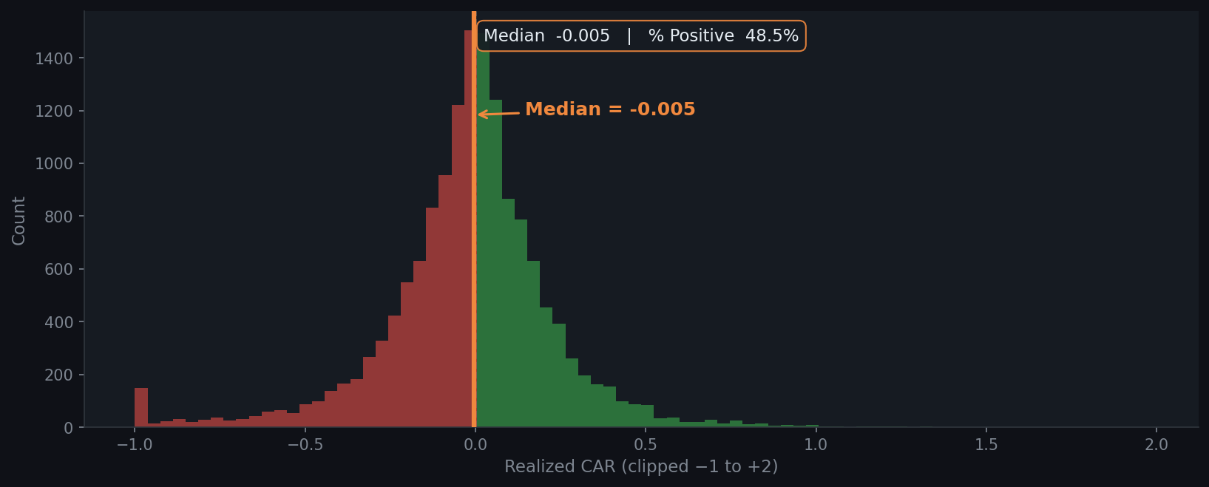
Most Congressional Purchases Underperform the Market
Median CAR is -0.005 (-0.5%) · only 48.5% of purchases beat the market Green = positive return · Red = negative · Orange line = median

Slide 4
Who Consistently Beats — and Loses to — the Market?
▸ Based on 101 politicians with ≥ 20 disclosed purchases
▸ Bar color: green = positive median CAR, red = negative
▸ Dashed line = overall average win rate
▸ Pie counts politicians by whether their personal win rate is above or below 50%

Slide 5
Performance Over Time: Macro Events Drive Positive Rates
▸ 2020 Q2–Q3: surge in positive rate — COVID recovery bounce lifted most purchases
▸ 2022: sharp drop aligned with rate-hike drawdown across the market
▸ Volume spikes suggest increased trading activity around election cycles
▸ Positive rate rarely exceeds 60% — even in the best macro environments

Slide 6
Past Skill is the Strongest Predictor of Future Outperformance
▸ Quintile 5 (highest past hit rate / CAR) consistently shows higher future positive rate
▸ The monotonic pattern from Q1→Q5 confirms these are genuine skill signals, not noise
▸ This is computed with a 12-month look-ahead gap — no data leakage

Slide 7
Committee Membership Shows Selective Advantage
▸ Orange bars (flag = 1) above blue bars = being on that committee lifts positive rate
▸ Committee Chair and Majority Party flags show the clearest structural edges
▸ Lobbied (90d): companies with active lobbying disclosure tend to be large-caps with higher visibility — not direct insider signal

Slide 8
Mean CAR Turns Positive Only at High Confidence (≥ 85%)
Confusion matrix @ 0.60
 | Pred: No beat | Pred: Beat mkt
Actual: No beat | TN = 1,097 | FP = 581
Actual: Beat mkt | FN = 845 | TP = 502
▸ 0.60: 46.4% precision
▸ 0.85: 53.0% precision
▸ Bars = N trades (green if CAR > 0)
▸ Line = mean CAR %
Threshold 0.85 → 53% win rate · median CAR +0.67% · 249 trades · 53.0% precision

Slide 9
The Model: What Drives the Predictions?
Model Setup
▸ Algorithm: XGBoost binary classifier
▸ Split: 80/20 chronological (no random shuffle)
▸ Train cutoff: Dec 2022
▸ Train: 12,092 | Test: 3,025 trades
▸ 31 features: skill, stock, committee, lobbying
▸ Grid search over depth, LR, estimators
▸ Test precision @ 0.60: 46.4%
Politician skill signals dominate over stock-level or committee signals

Slide 10
$100 per Trade: Model vs Naive vs SPY
▸ Model: $108,300 invested in 1,083 flagged trades (36% of test set)
▸ Naive: $302,500 invested across all 3,025 test purchases
▸ SPY: $100 invested on each trade date, 12-month forward return
▸ No transaction costs, slippage, or position limits assumed

Slide 11
Conclusions & Caveats
Key Findings
▸ Most trades underperform: only 48.5% of purchases beat the market on average
▸ Past politician skill (hit rate, mean CAR) is the strongest predictor — consistent with persistent trading skill rather than luck
▸ Committee membership has selective lift, most pronounced for Chair and Majority Party roles
▸ XGBoost reaches 46.4% precision at threshold 0.60, vs ~50% random baseline
▸ Dollar simulation shows meaningful cumulative lift for model-selected trades over the test period
Caveats
▸ No transaction costs or market impact modelled
▸ Test set is a single holdout period — results may not generalise across regimes
▸ Skill signals are backward-looking: politicians who traded well in the past are not guaranteed to continue
▸ STOCK Act disclosure lag (up to 45 days) means the market may have already moved
▸ Dataset covers disclosed trades only — undisclosed activity is not captured
Next steps: forward testing on live disclosures · add alternative data (insider filings, options flow)

Slide 12
APPENDIX
Dataset Overview
39,334
19,096
15,117
268
Total Records
Purchases
Modelled
Politicians
Metric | Value
Date range | 2012-09-13 – 2026-01-30
Transaction types | Purchase / Sale / Sale (Full) / Sale (Partial) / Exchange
Unique tickers (purchases) | 2,209
Parties | D / R / I
Chambers | Representatives / Senate
Target variable | realized_car_hybrid > 0 (binary)
CAR windows available | 1m / 3m / 6m / 9m / 12m + realized
Train / test split | 80% / 20% chronological

