Slide 1
More SQL…
Sheila Fallon

Slide 2
Contents
Views
Stored Programs
Stored Procedure
Stored Function
Trigger
Event

Slide 3
Views

Slide 4
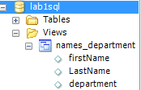
Introduction to views
A view consists of a SELECT statement that’s stored as an object in the database
Use the CREATE VIEW statement
CREATE VIEW names_department AS
SELECT firstName, LastName, department
FROM details;
select * from names_department;

Slide 5
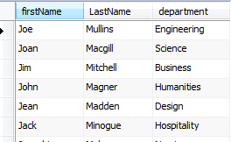
Virtual Table/ viewed table
Although a view behaves like a virtual table, it doesn’t store any data. Instead, a view always refers back to its base tables.
When you create a view, you can refer to the view anywhere you would normally use a table in a SELECT, INSERT, UPDATE or DELETE statement

Slide 6

Update example
This will update Joe Mullins to a researcher in the details table.
To drop a view :
DROP VIEW view_name;

Slide 7
Benefits of using a view
Design Independence
Data Security
Simplified queries
Updatability

Slide 8
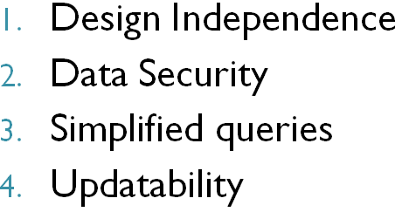
Design Independence
Views can limit the exposure of tables to external users and applications. As a result, if the design of the table changes, you can modify the view as necessary so users who query the view don’t need to be aware of the change, and applications that use the view don’t need to be modified.

Slide 9
Data Security
Views can restrict access to data in a table by using the SELECT clause to include only selected columns of a table or by using the WHERE clause to include only selected rows in a table.

Slide 10
Simplified Queries
Views can be used to hide the complexity of retrieval operations. Then the data can be retrieved using simple SELECT statements that specify a view in the FROM clause.

Slide 11
Updatability
With certain restrictions, views can be used to update, insert, and delete data from a base table

Slide 12

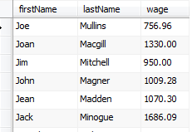
Working with views
You can create a view by joining two tables
If a view contains calculated columns, you will want to name that column

Slide 13
Creating an Updatable view
Once you create a view, you can refer to it in a SELECT statement.
You can also refer to it in INSERT, UPDATE and DELETE statements, but to do this the view must be updatable.
If a view isn’t updatable, it’s called a read-only view
The requirements for coding updatable views are more restrictive than for coding read-only views. That’s because MySQL must be able to unambiguously determine which base tables and columns are affected

Slide 14
Requirements for creating an updateable view
The select list can’t include a DISTINCT clause
The select list can’t include aggregate functions
The SELECT statement can’t include a GROUP BY or HAVING clause
The view can’t include the UNION operator

Slide 15
Insert/delete rows through a view
Its more common to insert/delete rows by working with the base tables
E.g. for the INSERT statement to insert rows into a base table through a view, both the view and the INSERT statement must include all columns from the base table that require a value
If the view names more than one base table, an INSERT statement can insert data into only one of those tables
To DELETE rows from a base table through a view, the view must be based on a single table.

Slide 16
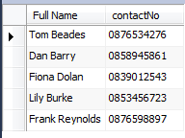
Class Exercise
In theDocs database create the following view (hint: look up the concat function)

Slide 17
Stored Programs
Stored Programs can include procedural code to control the flow of execution
4 types of Stored Program:
Stored Procedure
Stored Function
Trigger
Event

Slide 18
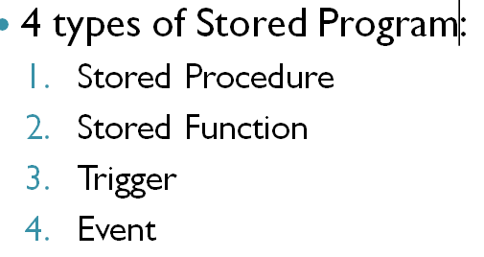
Stored Procedure
A Stored Procedure is a database object that contains a block of procedural SQL code. You can use SPs to execute an INSERT, UPDATE , or DELETE statement

Slide 19
Stored Procedure
The Syntax of the CREATE PROCEDURE Statement
CREATE PROCEDURE procedure_name
(
[parameter_name_1 data_type]
[, parameter_name_2 data_type]...
)
sql_block

Slide 20
A Script that creates a SP that updates a table
Changes default delimiter of the semicolon (;) to //
This is necessary as the ;semicolan is used within the CREATE PROCEDURE statement and it allows you to use the // to identify the end of the CREATE PROCEDURE statement
DELIMITER //
CREATE PROCEDURE update_invoices_credit_total
(
invoice_id_param INT,
credit_total_param DECIMAL(9,2)
)
BEGIN
DECLARE sql_error TINYINT DEFAULT FALSE;
DECLARE CONTINUE HANDLER FOR SQLEXCEPTION
SET sql_error = TRUE;
START TRANSACTION;
UPDATE invoices
SET credit_total = credit_total_param
WHERE invoice_id = invoice_id_param;
Parameters used to pass
values to the SP from a
calling program
Condition Handler

Slide 21
A Script that creates a SP that updates a table ctd
IF sql_error = FALSE THEN
COMMIT;
ELSE
ROLLBACK;
END IF;
END//
A statement that calls the stored procedure
CALL update_invoices_credit_total(56, 300);
Passing values to the SP, one for each parameter

Slide 22
Condition Handler

Slide 23
Condition Handler ctd.
You can use the DECLARE … HANDLER statement to declare a handler for errors that may occur. In MySQL, this is referred to as a condition handler.
To continue execution when an error occurs, use the CONTUINUE keyword.

Slide 24
Exercise –……
Write a SP named “update_details_rate” that will increase the rate for an employee by a given amount
call update_details_rate (6, 100.10);
Id and rate increase are passed in as parameters

Slide 25
Input & Output parameters
Input parameters accept values that are passed from the calling program. These values cannot be changed by the body of the SP. By default, parameters are identified as input parameters. As a result, the IN keyword is optional for identifying input parameters.
Output parameters store values that are passed back to the calling program. These values must be set by the body of the SP. To identify an output parameter, you must code the OUT keyword.

Slide 26
SP - input & output parameters
DELIMITER //
CREATE PROCEDURE update_invoices_credit_total
(
IN invoice_id_param INT,
IN credit_total_param DECIMAL(9,2),
OUT update_count INT
)
BEGIN
DECLARE sql_error TINYINT DEFAULT FALSE;
DECLARE CONTINUE HANDLER FOR SQLEXCEPTION
SET sql_error = TRUE;
START TRANSACTION;
UPDATE invoices
SET credit_total = credit_total_param
WHERE invoice_id = invoice_id_param;
IF sql_error = FALSE THEN
SET update_count = 1;
COMMIT;
ELSE
SET update_count = 0;
ROLLBACK;
END IF;
END//
A statement that calls this stored procedure:
CALL update_invoices_credit_total(56, 200, @update_count);
A statement to see the value of the output parameter:
SELECT CONCAT('row_count: ', cast(@update_count as char)) AS update_count;
Or
Select @update_count;

Slide 27
Stored Function
The code for creating a Stored Function works similarly to the code for creating a Stored Procedure. However, there are 2 primary differences
A MySQL function always returns a single value
A function can’t make changes to the database such as executing an INSERT, UPDATE or DELETE statement.

Slide 28
Stored Functions ctd.
To identify the data type that’s returned by a function, you use the RETURNS keyword in the declaration for the function. Then, in the body of the function, you use the RETURN keyword to specify the value that’s returned
A function can accept input parameters that work like the input parameters for a SP
To call a SF, you can use it in any expression just like a built-in function.

Slide 29
A function that calculates salary
Drop Function if exists calculate_salary;
DELIMITER //
CREATE Function calculate_salary
(
id_param INT
)
RETURNS DECIMAL(9,2)
BEGIN
DECLARE salary_var DECIMAL(9,2);
select sum(rate*hours)
into salary_var
from details
where id = id_param;
RETURN salary_var;
END//
select calculate_salary(3); Calling the Function
Run this example

Slide 30
DROP Function
DROP FUNCTION IF EXISTS calculate_salary;

Slide 31
Triggers
A trigger is a named block of code that executes, or fires, in response to an insert update or delete statement
You can fire a trigger before or after an insert, update or delete statement is executed on a table.
You must specify a FOR EACH ROW clause. This creates a row-level trigger that fires once for each row that’s modified.
MySQL only supports row-level triggers

Slide 32
BEFORE TRIGGER
DELIMITER //
CREATE TRIGGER details_before_update
BEFORE UPDATE ON details
FOR EACH ROW
BEGIN
SET NEW.department = UPPER(NEW.department);
END//
An UPDATE statement that fires the trigger
update details
set department = "any dept"
where id = 5;
Run this example

Slide 33
AFTER TRIGGER
You can use an AFTER trigger to insert rows into an audit table
Example
Create a table that stores information about actions that occurred on the orders table

Slide 34
Create an Audit table
CREATE TABLE
use om;
DROP TABLE IF EXISTS orders_audit;
CREATE TABLE orders_audit
(
order_id INT NOT NULL,
customer_id INT NOT NULL,
action_type VARCHAR(50),
action_date DATETIME NOT NULL
)

Slide 35
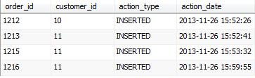
Triggers that insert rows into the audit table – AFTER INSERT
DELIMITER //
DROP TRIGGER IF EXISTS orders_after_insert;
CREATE TRIGGER orders_after_insert
AFTER INSERT on orders
FOR EACH ROW
BEGIN
INSERT INTO orders_audit VALUES
(NEW.order_id, NEW.customer_id, "INSERTED", NOW());
END//
INSERT INTO orders VALUES (1215, 11, '2009-11-23', '2009-11-28');
SELECT * from om.orders_audit;
Use OM database to run this example

Slide 36
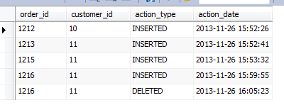
Triggers that insert rows into the audit table – AFTER DELETE
DELIMITER //
DROP TRIGGER IF EXISTS orders_after_delete;
CREATE TRIGGER orders_after_delete
AFTER DELETE on orders
FOR EACH ROW
BEGIN
INSERT INTO orders_audit VALUES
(OLD.order_id, OLD.customer_id, "DELETED", NOW());
END//
DELETE FROM orders WHERE order_id = 1216;
Use OM database to run this example
SELECT * from om.orders_audit;

Slide 37
Show Triggers/ DROP TRIGGERS
SHOW TRIGGERS;
or
SHOW TRIGERS IN om;
MySQL does not provide a way to alter TRIGGERS, you have use the DROP TRIGGER statement and CREATE a new TRIGGER

Slide 38
Triggers – some considerations
Triggers can obscure what the server is really doing, because a simple statement can make the server perform a lot of “invisible” work. E.g. if a trigger updates a related table, it can double the number of rows a statement affects.
Using triggers can slow down processing if there are a lot of data inserts, e.g. an over night job that populates a warehouse
Using Triggers can make maintenance of code more difficult as they are not directly visible

Slide 39
Triggers – some considerations
Triggers can be hard to debug – its often difficult to analyse performance bottlenecks when triggers are involved.
Triggers can cause non obvious deadlocks

Slide 40
Events
An event, or scheduled event, is a named block of code that executes, or fires according to the event scheduler.
By default the event scheduler is OFF
SHOW VARIABLES;
SET GLOBAL event_scheduler = ON;

Slide 41
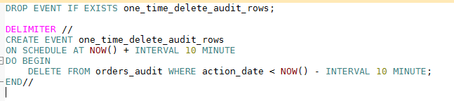
One-time Event
An event can be a one-time event that occurs once or a recurring event that occurs regularly at a specified interval.
Use OM database to run this example
Note: I used MINUTE here for testing purposes, MONTH would be more realistic

Slide 42
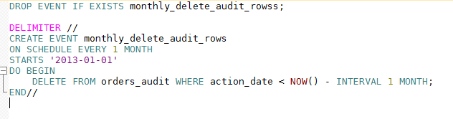
Recurring Event
You can use MINUTE, HOUR, DAY, WEEK, MONTH or YEAR

Slide 43
View, Alter or Drop Events
SHOW EVENTS
SHOW EVENTS IN om;
To enable or disable an event:
ALTER EVENT monthly_delete_audit_rows DISABLE/ENABLE
DROP EVENT IF EXISTS monthly_delete_audit_rows

