Slide 1
NoSQL
Not Only SQL

Slide 2
Contents
Big Data
Denormalization
NoSQL introduction
Cap Theorem
Types of NoSQL databases
Characteristics of NoSQL
Advantages of NoSQL

Slide 3
Big Data - What is it?
Massive volumes of rapidly growing data:
Smartphones broadcasting location (few secs)
Chips in cars diagnostic tests (1000s per sec)
Cameras recording public/private spaces
RFID tags read at as travel through supply-chain

Slide 4
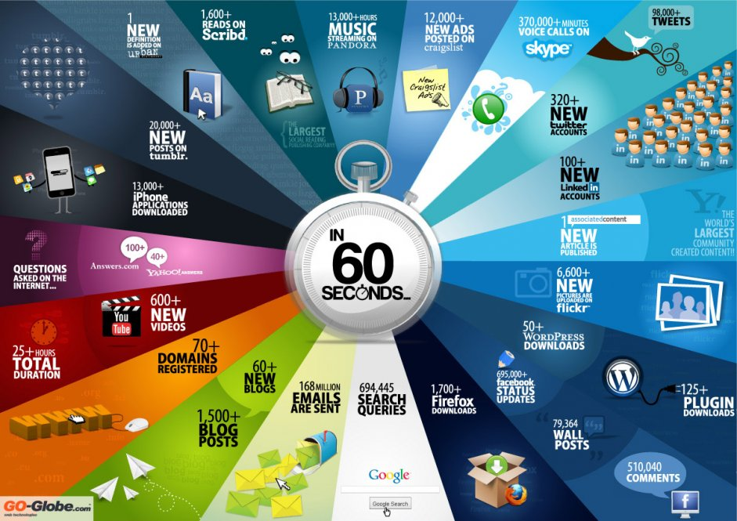

Slide 5
Characteristics of Big Data
Grows at a fast pace
Diverse
Not formally modeled
Unstructured
Heterogeneous
Data is valuable
Standard DBs and DWs cannot capture diversity and heterogeneity
Cannot achieve satisfactory performance

Slide 6
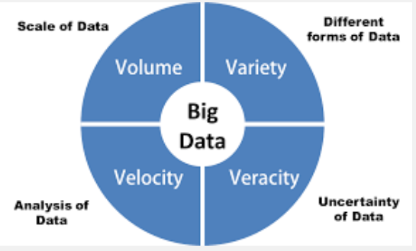
Big Data – 4 Vs
Volume
Variety
Veracity
Velocity

Slide 7
Volume
Scale of the Data
Enormous volumes of data
It used to be employees created data
Now that data is generated by machines, networks and human interaction on systems like social media.

Slide 8
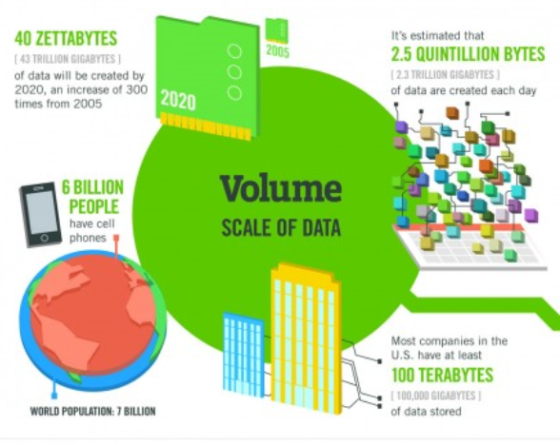
Volume
Notes:
http://highscalability.com/blog/2012/9/11/how-big-is-a-petabyte-exabyte-zettabyte-or-a-yottabyte.html

Slide 9
Variety - Different forms of data
Variety refers to the many sources and types of data both structured and unstructured.
We used to store data from sources like spreadsheets and databases.
Now data comes in the form of emails, photos, videos, monitoring devices, PDFs, audio, etc.
This variety of unstructured data creates problems for storage, mining and analysing data.

Slide 10
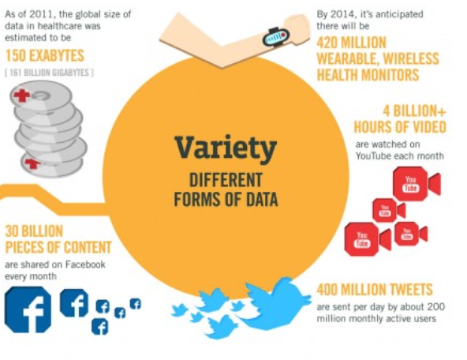
Variety

Slide 11
Veracity - Uncertainty of data
Big Data Veracity refers to the biases, noise and abnormality in data.
Is the data that is being stored, and mined meaningful to the problem being analysed?
Some feel veracity in data analysis is the biggest challenge when compares to things like volume and velocity.
In scoping out your big data strategy you need to have your team and partners work to help keep your data clean and processes to keep ‘dirty data’ from accumulating in your systems

Slide 12
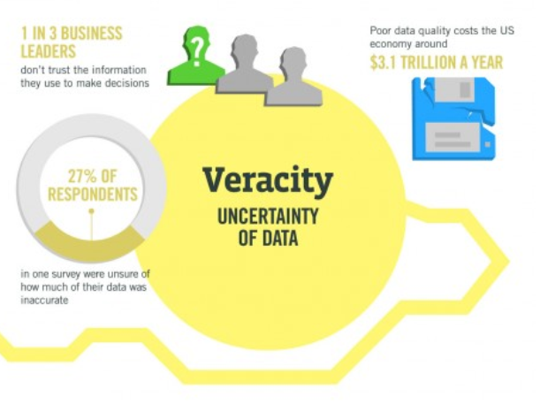
Veracity

Slide 13
Velocity - Analysis of data
Big Data Velocity deals with the pace at which data flows in from sources like business processes, machines, networks and human interaction with things like social media sites, mobile devices, etc.
The flow of data is massive and continuous.
This real-time data can help researchers and businesses make valuable decisions that provide strategic competitive advantages

Slide 14
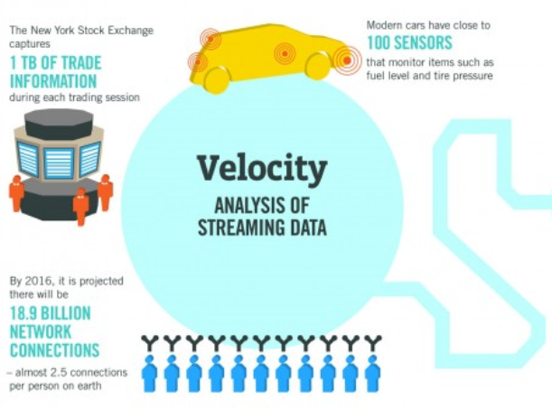
Velocity

Slide 15


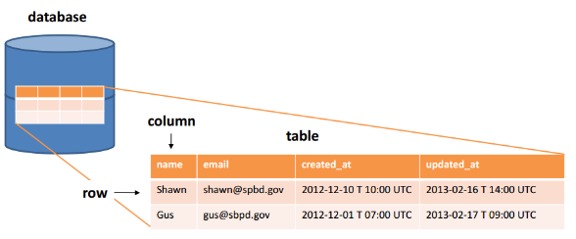

Relational Databases
Tables
SQL (Structured Query Language)
MySQL, Sybase, Oracle

Slide 16


Newer databases for large data sets
NoSQL databases are increasingly used in big data and real-time web applications.
Data is modelled in means other than the tabular relations used in relational databases
Horizontal rather than vertical scaling (see next slide)

Slide 17
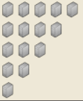
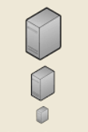
Horizontal scaling means that you scale by adding more machines into your pool of resources where Vertical scaling means that you scale by adding more power (CPU, RAM) to your existing machine.
Horizontal Scaling
Vertical Scaling

Slide 18
Explaining Big Data
https://www.youtube.com/watch?v=7D1CQ_LOizA
Notes:
7 mins

Slide 19
What is NoSQL?
Stands for Not Only SQL
Class of non-relational data storage systems
Usually do not require a fixed table schema nor do they use the concept of joins
All NoSQL offerings relax one or more of the ACID properties (will talk about the CAP theorem)

Slide 20
Denormalization

Slide 21
Denormalization
Denormalization is the process of attempting to optimize the read performance of a database by adding redundant data or by grouping data.

Slide 22
Denormalisation
Normalizing tables is generally the recommended approach.
The premise of the normalization rules is that SQL statements can retrieve the information by joining the two tables.
The problem is that, in some cases, performance problems can occur as a result of normalization.
For example, some user queries might view data that is in two or more related tables; the result is too many joins.

Slide 23
Joins - The Disadvantage of Normalization
The main drawback to having a highly normalization database structure is that you may need a large number of joins to pull back the records the application needs to function.
This will become apparent in environments in which many concurrent users access the database.
To help alleviate this issue, application designers denormalize the database design after the normalization process in order to meet the application performance requirements, usually by adding summary and/or redundant data back into the normalized tables.

Slide 24
Denormalization Example
A data architect might keep a running total of employees’ accumulated earnings for the year in the employee table rather than recalculating the data through a series of joins.
It might also be reasonable to duplicate attributive table information into the primary tables (e.g., copy an employee’s job description into the employee table).

Slide 25
Denormalization – Consider the DB Purpose
What is the database’s intended use?
Specifically, you should consider whether the database will be used primarily for warehousing or transaction activity.
In transactional processing databases, normalization is vital for ensuring data integrity
Conversely, in warehouse implementations, read performance is most important, and therefore database designers implement a much higher degree of denormalization.

Slide 26
Summary – when to denormalize
When a column from a joined table is used repeatedly in search criteria, you should consider moving that column to the primary key table if it will eliminate the need for a join
If a table is updated infrequently, you should consider denormalizing it to improve efficiency. Because the data remains relatively constant, you don’t have to worry about data redundancy errors once the initial data is entered and verified
Include columns with derived values when those values are used frequently in search conditions. If you do so, you need to be sure that the column value is always synchronized with the value of the columns its derived from.

Slide 27
CAP Theorem
Eric Brewer, states that it is impossible for a distributed computer system to simultaneously provide all three of the following guarantees:
Consistency
Availability
Partition Tolerance

Slide 28
CAP Theorem ctd.
Consistency: write a value and then you read the value you get the same value back. In a partitioned system there are windows where that's not true
Availability: may not always be able to write or read. The system will say you can't write because it wants to keep the system consistent.
Partition Tolerance: The system continues to operate despite arbitrary partitioning due to network failures.

Slide 29
CAP Theorem ctd.
You can have at most two of these three properties for any shared-data system
To scale out, you have to partition. That leaves either consistency or availability to choose from
In almost all cases, you would choose availability over consistency

Slide 30
CAP Theorem ctd.
Choose a specific approach based on the needs of the service.
For the checkout process you always want to honor requests to add items to a shopping cart because it's revenue producing.
In this case you choose high availability. Errors are hidden from the customer and sorted out later.
When a customer submits an order you favor consistency because several services-credit card processing, shipping and handling, reporting are simultaneously accessing the data.

Slide 31
Consistency Model
A consistency model determines rules for visibility and apparent order of updates.
For example:
Row X is replicated on nodes M and N
Client A writes row X to node N
Some period of time t elapses.
Client B reads row X from node M
Does client B see the write from client A?
Consistency is a continuum with tradeoffs
For NoSQL, the answer would be: maybe
CAP Theorem states: Strict Consistency can't be achieved at the
same time as availability and partition-tolerance.

Slide 32
Eventual Consistency
When no updates occur for a long period of time, eventually all updates will propagate through the system and all the nodes will be consistent
For a given accepted update and a given node, eventually either the update reaches the node or the node is removed from service
Known as BASE (Basically Available, Soft state, Eventual consistency), as opposed to ACID

Slide 33
BASE (Basically Available, Soft state, Eventual consistency), as opposed to ACID
The types of large systems based on CAP aren't ACID they are BASE
* Basically Available - system seems to work all the time * Soft State - it doesn't have to be consistent all the time * Eventually Consistent - becomes consistent at some later time
Everyone who builds big applications builds them on CAP and BASE: Google, Yahoo, Facebook, Amazon, eBay, etc

Slide 34
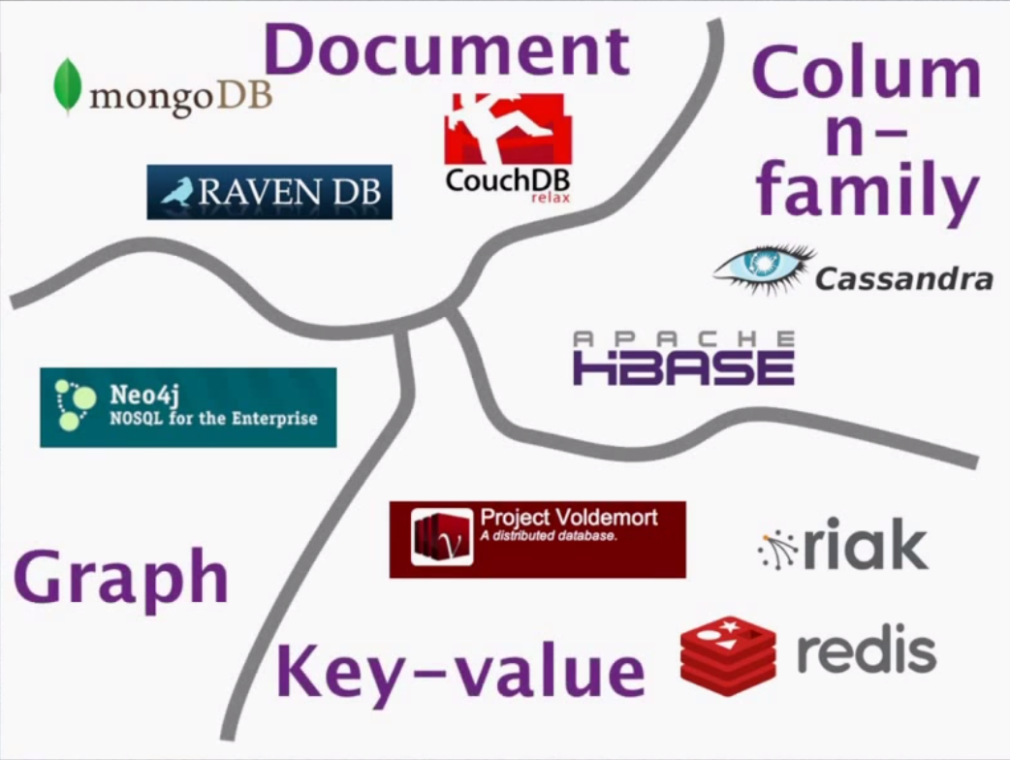
Types of NoSQL Databases

Slide 35

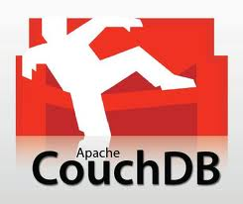
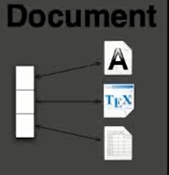

Types of NoSQL Databases
Key-value databases
Based on Amazon’s Dynamo
a table with two columns, such as ID and NAME
ID column being the key
NAME column storing the value = a blob that the data store just stores
basic operations: get the value for the key, put a value for a key, delete a key from the data store
Document databases
document databases store documents in the value part of the key-value store
key-value stores where the value is examinable
can consist of maps, collections
We will look at MongoDB

Slide 36

Key-Value Stores
id | hair_color | age | height
1923 | Red | 18 | 6’0”
3371 | Blue | 34 | NA
… | … | … | …
Table in relational db
Store/Domain in Key-Value db

Slide 37
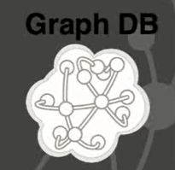
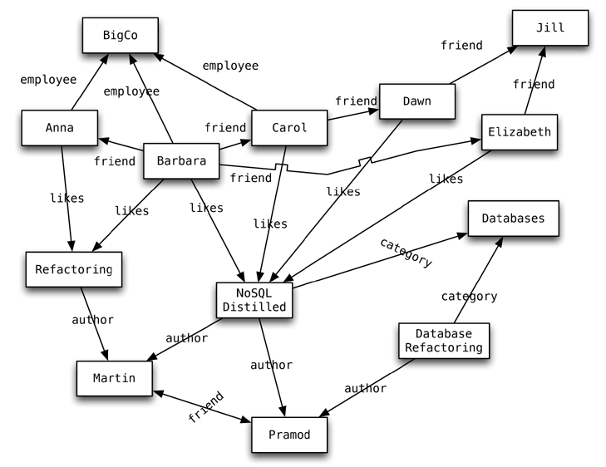


Types of NoSQL Databases
Graph databases
Inspired by Euler & graph theory
Key value pairs – nodes (equivalent to rows in rdbms)
Types of relationships between nodes
Properties of the relationships (e.g. how do two people know each other , work, college, social etc.)
allow to find interesting patterns

Slide 38



Types of NoSQL Databases
BigTable clones / ColumnFamily –
Based on Google’s BigTable
Distributed system for managing structured data that is designed to scale to a very large size.
Data is indexed by row key, column key, and a timestamp.
Each cell in a Bigtable can contain multiple versions of the same data; These versions are indexed by a time stamp.

Slide 39
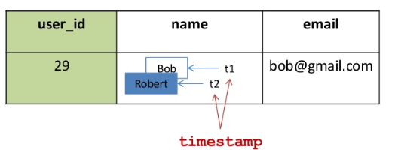
BigTable ctd.
Each cell in a Bigtable can contain multiple versions of the same data, These versions are indexed by a time stamp.
Each individual row can have it’s own schema – e.g. one row has 2 email columns, another 3

Slide 40
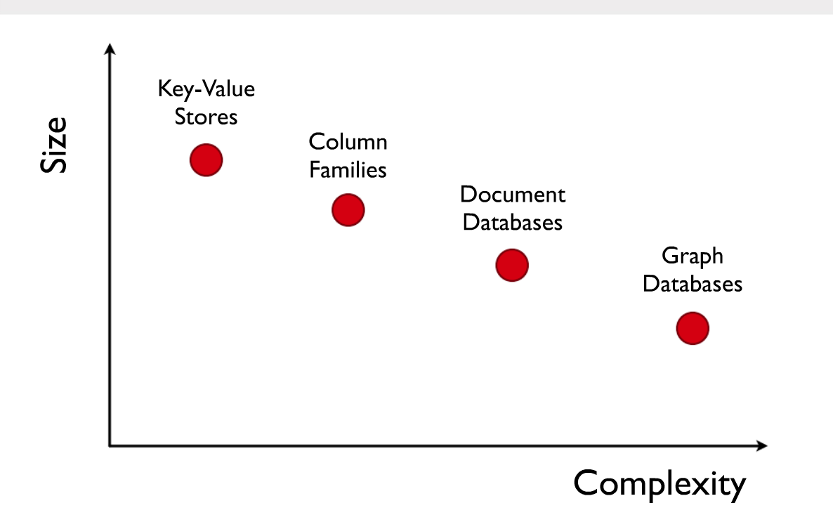
Focus of Different Data Models

Slide 41
NoSQL Databases – the End of Relational Databases?
Relational databases are not going away
Compelling arguments for most projects
familiarity, stability, feature set, and available support
We should see relational databases as one option for data storage
polyglot persistence - using different data stores in different circumstances
The problem they solve:
huge amounts of data are now handled in real-time
both data and use cases are getting more and more dynamic
social networks (relying on graph data) have gained impressive momentum

Slide 42
NoSQL - Characteristics
NoSQL databases have a number of distinctive characteristics
NoSQL does not use SQL as its query language.
NoSQL database systems arose alongside major Internet companies, e.g. Google, Amazon, and Facebook, which had challenges in dealing with huge quantities of data which conventional RDBMS solutions could not cope with.
NoSQL database systems are developed to manage large volumes of data that do not necessarily follow a fixed schema.
Data is partitioned among different machines (for performance reasons and size limitations) so that traditional JOIN operations cannot be used.

Slide 43
NoSQL - Characteristics
NoSQL cannot necessarily give full ACID guarantees.
Usually only eventual consistency is guaranteed or transactions limited to single data items.
This means that given a sufficiently long length of time over which no changes are sent, all updates can be expected to propagate eventually through the system.
NoSQL has a distributed, fault-tolerant architecture.
Several NoSQL systems employ a distributed architecture, with the data held in a redundant manner on several servers.
In this way, the system can easily scale out by adding more servers, and failure of a server can be tolerated.

Slide 44
NoSQL - Characteristics
This type of database typically scales horizontally and is used for managing large amounts of data, when the performance and real-time nature is more important than consistency (as in indexing a large number of documents, serving pages on high-traffic web sites, and delivering streaming media)

Slide 45
NoSQL Advantages
Elastic scaling
Big data
Reduced Personnel Costs
Reduced Equipment Costs
Flexible Data Models

Slide 46
NoSQL - Elastic Scaling
For years, database administrators have relied on scale up — buying bigger servers as database load increases — rather than scale out — distributing the database across multiple hosts as load increases.
However, as transaction rates and availability requirements increase, and as databases move into the cloud or onto virtualized environments, the economic advantages of scaling out on commodity hardware become irresistible.
RDBMS might not scale out easily on commodity clusters, but the new breed of NoSQL databases are designed to expand transparently to take advantage of new nodes, and they’re usually designed with low-cost commodity hardware in mind.

Slide 47
NoSQL - Big Data
Just as transaction rates have grown out of recognition over the last decade, the volumes of data that are being stored also have increased massively.
O’Reilly has cleverly called this the “industrial revolution of data.”
RDBMS capacity has been growing to match these increases, but as with transaction rates, the constraints of data volumes that can be practically managed by a single RDBMS are becoming intolerable for some enterprises.
Today, the volumes of “big data” that can be handled by NoSQL systems, such as Hadoop, outstrip what can be handled by the biggest RDBMS.

Slide 48
NoSQL – Reduced Personnel Costs
Despite the many manageability improvements claimed by RDBMS vendors over the years, high-end RDBMS systems can be maintained only with the assistance of expensive, highly trained DBAs.
DBAs are involved in the design, installation, and on-going tuning of high-end RDBMS systems.
NoSQL databases are generally designed from the ground up to require less management: automatic repair, data distribution, and simpler data models lead to lower administration and tuning requirements — in theory.

Slide 49
NoSQL – Reduced Equipment Costs
NoSQL databases typically use clusters of cheap commodity servers to manage the exploding data and transaction volumes, while RDBMS tends to rely on expensive proprietary servers and storage systems.
The result is that the cost per gigabyte or transaction/second for NoSQL can be many times less than the cost for RDBMS, allowing you to store and process more data at a much lower price point.

Slide 50
NoSQL – Flexible Data Models
Change management is a big headache for large production RDBMS. Even minor changes to the data model of an RDBMS have to be carefully managed and may necessitate downtime or reduced service levels.
NoSQL databases have far more relaxed — or even nonexistent — data model restrictions. NoSQL Key Value stores and document databases allow the application to store virtually any structure it wants in a data element. Even the more rigidly defined BigTable-based NoSQL databases (Cassandra, HBase) typically allow new columns to be created without too much fuss.

