Slide 1
Transaction
Management

Slide 2
Chapter Contents
Transaction Concept
ACID principles
Transaction State Diagram
Stored Procedures
Concurrency Problems
Lost Updates
Dirty Reads
Nonrepeatable Reads
Phantom
Transaction Isolation Level
Deadlock

Slide 3
CONCURRENCY CONTROL
“CONCURRENCY CONTROL deals with ensuring that the integrity of the database is preserved when it is being simultaneously accessed by more than one user”
If you’ve been working with MySQL on your own computer, you’ve been the only user of your database. In the real world , though, a database may be used by thousands of users at the same time. Then what happens when two users e.g. try to update the same data at the same time ..?

Slide 4
Database Consistency
A database is in a CONSISTENT state if there are no contradictions between items stored in the database.
However, during the course of routine processing, it is sometimes necessary for the database to momentarily enter an inconsistent state.

Slide 5
Database Consistency
The DBMS must take measures to ensure that this momentary inconsistency does not become permanent
If another user were to access the data at this point, that user would see inconsistent data; and if user were performing an operation that updated the database, the inconsistent data might be incorporated into that update.

Slide 6
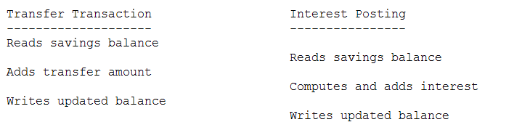
Database Consistency
In the case of concurrent processing, overlapping of two operations on the same data could also result in inconsistency - e.g. if the funds transfer were being executed with another computation to post interest, the following could occur
The updated balance is overwritten by the posting of interest.

Slide 7
The Transaction Concept
At the heart of strategies for preventing problems like these is to make the DBMS work by processing of a series of TRANSACTIONS.
Each transaction begins with the database in a consistent state, and ends with the database in a consistent state - but may momentarily place the database into an inconsistent state due to the necessity of performing updates one after another.

Slide 8
Definition of a Transaction
A transaction is a group of SQL statements that you combine into a single logical unit of work. By combining SQL statements like this, you can prevent certain kinds of database errors.

Slide 9
ACID Principles
To preserve system consistency, we must guarantee that each transaction satisfies four requirements.
These are called the ACID properties, after the first letters of their names; Atomicity, Consistency, Isolation, Durability

Slide 10
ATOMICITY
ATOMICITY: We must guarantee that each transaction is processed ATOMICALLY - i.e. either none of it is done, or all of it is done.
It must NOT be possible for only part of a transaction to be carried out.
This means that if a transaction is aborted for any reason (due to a logical error in the data or a request by the user), then all effects of the transaction must be removed from the database and the database must be restored to the state it was in before the transaction was begun.

Slide 11
CONSISTENCY
If a transaction is executed in isolation (with no other transactions executing concurrently), and the database is in a consistent state when the transaction starts, then it will still be in a consistent state when it is finished.

Slide 12
ISOLATION
Even if transactions are executing concurrently, the overall result is the same as if they executed serially - i.e. as if each transaction executed in isolation, with one transaction completing before the next begins.

Slide 13
DURABILITY
Once a transaction is completed, its effects on the database must persist, even if there is a subsequent system crash.
This may mean restoring some data that was destroyed by a crash upon restart.

Slide 14
Transaction States
Active: from the time it starts, until it either fails or reaches its last statement.
Partially committed: its last statement has executed, but its changes to the database have not yet been made permanent.

Slide 15
Transaction States
3. Committed: its changes to the database have been made permanent. As soon as a transaction has partially committed, the DBMS attempts to move it to the committed state - though there is no guarantee it will be able to successfully do so.

Slide 16
Transaction States
4. Failed: a logical error or user abort has precluded completion, so any changes it has made to the database must be undone. Note: The SQL ROLLBACK statement places the transaction into the failed state. A SQL COMMIT that fails due to a constraint violation also places the transaction into a failed state. Once a transaction has failed, the DBMS must move the transaction to the aborted state.
5. Aborted: all effects of the transaction have been removed from the database.

Slide 17
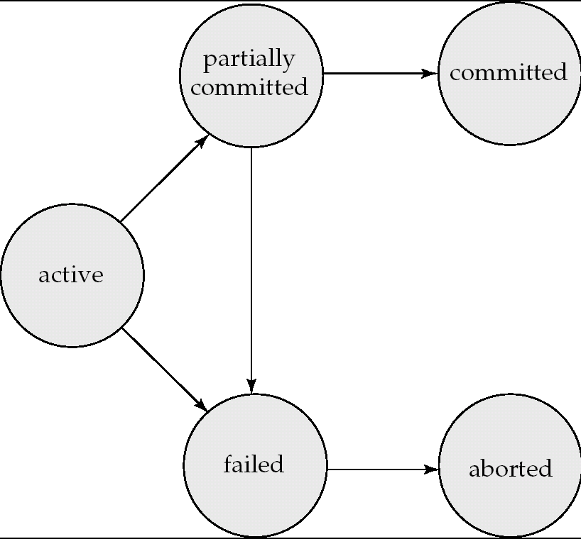
Transaction State Diagram

Slide 18
AutoCommit Mode
By default, a MySQL session uses the autocommit mode which automatically commits INSERT, UPDATE and DELETE statements immediately after you execute them,
You can use transactions to change this.

Slide 19
Stored Procedures
Transactions are often coded as Stored Procedures in MySQL.
We will look at a SP named test that does not accept any parameters.
The DELIMITER statement changes the delimiter from the default delimiter of the semicolan (;) to two slashes (//). This is necessary because the semicolan is used within the CREATE PROCEDURE statement and it allows you to use two front slashes to identify the end of the CREATE PROCEDURE statement.

Slide 20
Test SP - Error Handling
The SP named test has 3 INSERT statements that are coded as a transaction.
The SP declares a variable named sql_error and sets it to FALSE indicating that no SQL error has occurred.
Then the second DECLARE statement creates a condition handler that sets the sql-error variable to TRUE if a SQL error occurs.

Slide 21
Test SP
The START TRANSACTION statement identifies the start of the transaction which temporarily turns off autocommit mode.
Then the 1st INSERT adds a new invoice to the invoice table.
Next 2 more INSERTs add the line items to the invoice-line_items table.

Slide 22
Test SP
After the INSERT statements, an IF statement uses the SQL error variable to check whether an error occurred when executing any of the INSERT statements.
If an SQL error did not occur, this code uses the COMMIT statement to commit the changes to the database, which makes the changes permanent.
Otherwise the ROLLBACK statement rolls back the changes, which cancels them

Slide 23
Maintaining Data Integrity
To understand why this is necessary, suppose that each of these INSERT statements is committed to the database immediately after it’s executed. Then what will happen if the 3rd INSERT statement fails?
In that case the invoices and invoice_Line_Items tables won’t match. Specifically the sum of the line_item_amount columns in the invoice_Line_Itemstable won’t equal to the invoice_total column in the Invoices table.
In other words, the integrity of the data won’t be maintained

Slide 26
Class Exercise
Write a transaction to update the details table as follows
Increase employee id = 9 hours by 10
Decrease employee id =10 hours by 10

Slide 27
Concurrency
“CONCURRENCY CONTROL deals with ensuring that the integrity of the database is preserved when it is being simultaneously accessed by more than one user”

Slide 28
Four types of Concurrency problems
Lost Updates
Dirty Reads
Nonrepeatable reads
Phantom Reads

Slide 29
1 - Lost Updates
This occurs when two transactions select the same row and then update the row based on the values originally selected. Since each transaction is unaware of the other, the later update overwrites the earlier update
Example with the funds transfer and computation of interest

Slide 30
2 - Dirty Reads
This occurs when a transaction selects data that hasn’t been committed by another transaction. For example, transaction A changes a row. Transaction B then selects the changed row before transaction A commits the change. If transaction A then rolls back the change, transaction B has selected data that doesn’t exist in the database.

Slide 31
3 - Nonrepeatable reads
Nonrepeatable Reads Occur when two SELECT statements that try to get the same data get different values because another transaction has updated the data in the time between the two statements.
For example, transaction A selects a row. Transaction B then updates the row. When transaction A selects the same row again, the data is different.

Slide 32
4 - Phantom Reads
Phantom Reads occur when you perform an update or delete on a set of rows at the same time that another transaction is performing an insert or delete that affects one or more rows in that same set of rows.
For example, transaction A updates the payment total for each invoice that has a balance due, but transaction B inserts a new, unpaid, invoice while transaction A is still running. After transaction A finishes, there is still an invoice with a balance due.

Slide 33
The transaction isolation level
The simplest way to prevent concurrency problems is change the default locking behaviour. To do that, you use the SET TRANSACTION ISOLATION LEVEL statement.
The transaction isolation level controls the degree to which transactions are isolated from one another.

Slide 34
Concurrency Problems prevented by each transaction isolation level
Isolation Level | Dirty Reads | Lost Updates | Nonrepeatable reads | Phantom reads
READ UNCOMMITTED | Allows | Allows | Allows | Allows
READ COMMITTED | Prevents | Allows | Allows | Allows
REPEATABLE READ | Prevents | Prevents | Prevents | Allows
SERIALIZABLE | Prevents | Prevents | Prevents | Prevents
This figure lists the 4 transaction isolation levels that MySQL provides
and shows which concurrency problems they prevent or allow

Slide 35
Serializable
We see from the previous table that if you use the SERIALIZABLE option, all 4 concurrency problems will be prevented. Each transaction is completely isolated from every other transaction and concurrency is severely restricted. The server does this by locking each resource, preventing other transactions accessing it. Since each transaction must wait for the previous transaction to commit, the transactions are executed serially, one after another.

Slide 36
Serializable – ctd
Since the SERIALIZABLE level eliminates all concurrency problems, you may think that this is always the best option. However, this option requires more overhead to manage all of the locks, so the access time for each transaction is increased. For some systems, this may cause significant performance problems- typically you want to use SERIALIZABLE isolation level only for situations in which phantom reads aren’t acceptable.

Slide 37
READ UNCOMMITTED
The lowest isolation level is READ UNCOMMITTED, which allows all four of the concurrency problems to occur. It does this by performing SELECT queries without setting any locks and without honouring any existing locks. Since this means that your SELECT statement will always execute immediately, this setting provides the best performance. Since other transactions can retrieve and modify the same data, however, this setting can’t prevent concurrency problems.

Slide 38
READ COMMITTED
The READ COMMITTED isolation level prevents transactions from seeing data that has been changed by other transactions but not committed. This prevents dirty reads, but allows for other types of concurrency problems.

Slide 39
REPEATABLE READ
The default isolation level for MySQL is REPEATABLE READ. With this level, rows read by a transaction will be read consistently within the same transaction. To accomplish that, the server places locks on all the data used by the transaction that prevents others from updating the data.

Slide 40
Deadlock
A deadlock occurs when neither of two transactions can be committed because each has a lock on a resource needed by another transaction.
- See explanation on next slide
Transaction A
START TRANSACTION;
UPDATE savings SET balance = balance - transfer_amount;
UPDATE checking SET balance = balance + transfer_amount;
COMMIT;
Transaction B (possible deadlock)
START TRANSACTION;
UPDATE checking SET balance = balance - transfer_amount;
UPDATE savings SET balance = balance + transfer_amount;
COMMIT;

Slide 41
Deadlock Victim
Here, transaction A updates the savings account first, then the checking account, while transaction B updates the checking account first and then the savings account.
Now, suppose that the first statement in transaction A locks the savings account, and the first statement in transaction B locks the checking account. At that point, a deadlock occurs because transaction A needs the savings account and transaction B has to be rolled back so the other can proceed, and the loser is known as a deadlock victim.

Slide 42
Four ways to prevent Deadlock
Don’t allow transactions to remain open very long
Don’t use a transaction isolation level higher than necessary
Make large changes when you be assured of nearly exclusive access
Take locking behaviour into consideration when coding your transactions

Slide 43
1)Don’t allow transactions to remain open very long
Keep transactions short – the longer you leave a transaction open and uncommitted, the more likely it is that another transaction will need to work with that same resource
When coding your transaction make sure to include the appropriate COMMIT and ROLLBACK statements. Don’t code statements that take a long time to execute between the START TRANSACTION statement that starts the transaction and the COMMIT or ROLLBACK statement that finishes the transaction.
Keep SELECT statements outside of the transaction except when absolutely necessary
Never code requests for user input during a transaction

Slide 44
2) Don’t use a transaction isolation level higher than necessary
The transaction isolation level controls the
degree to which transactions are isolated
from one another.
The higher you set the isolation level,
the more likely it is that two transactions will be
unable to work with the same resource at
the same time.
The default level of REPEATABLE READ
is usually acceptable, but you should
consider changing to READ COMMITTED
if deadlock becomes a problem.

Slide 45
Recap - transaction isolation
Isolation Level | Dirty Reads | Lost Updates | Nonrepeatable reads | Phantom reads
READ UNCOMMITTED | Allows | Allows | Allows | Allows
READ COMMITTED | Prevents | Allows | Allows | Allows
REPEATABLE READ | Prevents | Prevents | Prevents | Allows
SERIALIZABLE | Prevents | Prevents | Prevents | Prevents
This figure lists the 4 transaction isolation levels that MySQL provides and shows which concurrency problems they prevent or allow

Slide 46
3) Make large changes when you can be assured of nearly exclusive access
You should schedule transactions that modify a large number of rows to run when no other transactions, or only a small number of other transactions, will be running. That way, it’s less likely that the transactions will try to change the same rows at the same time.
If you need to change millions of rows in an active table, don’t do so during hours of peak usage. If possible, give yourself exclusive access to the database before making large changes.

Slide 47
4)Take locking behaviour into consideration when coding you transaction
If you need to code two or more transactions that update the same resources, code the updates in the same order in each transaction. – see transactions on next slide

Slide 48
Update Statements that illustrate Deadlocking
UPDATE statements that illustrate deadlocking
Transaction A
START TRANSACTION;
UPDATE savings SET balance = balance - transfer_amount;
UPDATE checking SET balance = balance + transfer_amount;
COMMIT;
Transaction B (possible deadlock)
START TRANSACTION;
UPDATE checking SET balance = balance - transfer_amount;
UPDATE savings SET balance = balance + transfer_amount;
COMMIT;
Transaction B (prevents deadlocks - note order )
START TRANSACTION;
UPDATE savings SET balance = balance + transfer_amount;
UPDATE checking SET balance = balance - transfer_amount;

Slide 49
Advantages of concurrent transaction Execution
Increased processor and disk utilization, leading to better transaction throughput
E.g. one transaction can be using the CPU while another is reading from or writing to the disk
Reduced average response time for transactions: short transactions need not wait behind long ones.
Concurrent execution of transactions is important when data must be fetched from disk or when transactions are long, and is less important when data is in memory and transactions are very short

