Slide 1
MongoDB

Slide 2
Contents
Overview of MongoDB
MongoDB Server
MongoDB Client - Interactive shell
Validation

Slide 3
Introduction
humongous - extremely large : huge
http://www.mongodb.org/
An open source, high-performance, schema-free, document-oriented NoSQL database system.
A record in MongoDB is a document, which is a data structure composed of field and value pairs.

Slide 4
Relational v. Mongo
Relational Mongo
database database
table collection
row document
column field

Slide 5
Mongo is a Schema-less Database
Fields are associated with documents rather than collections.
In other words different documents in a collection can have different fields.
MongoDB is a schema-less database.

Slide 6
Large Data Sets – Scalability Issues
Large data sets and high throughput applications challenge the capacity of a single server:
High query rates can exhaust CPU
Large data sets can exceed storage capacity of a single machine/ can also stress RAM

Slide 7
Large Data Sets – Scalability Issues
Database systems have 2 approaches to address these scalability issues
Vertical Scaling – “scale up” – increase CPU, increase storage capacity. Practical maximum for vertical scaling, cost of these high performance systems versus smaller systems
Sharding or Horizontal scaling distributes data over multiple servers, or shards. Each shard is an independent database, and collectively, the shards make up a single logical database.

Slide 8
Sharding
MongoDB's path to scaling out to huge volumes.
MongoDB provides horizontal scalability as part of its core functionality
Automatic shading distributes data across a cluster of machines

Slide 9
Sharding
Sharding is a method for storing data across multiple machines.
MongoDB uses sharding to support deployments with very large data sets and high throughput operations.

Slide 10
Advantages of Sharding
Each shard processes fewer operations as the cluster grows. As a result, shared clusters can increase capacity and throughput horizontally. For example, to insert data, the application only needs to access the shard responsible for that records
Sharding reduces the amount of data that each server needs to store

Slide 11
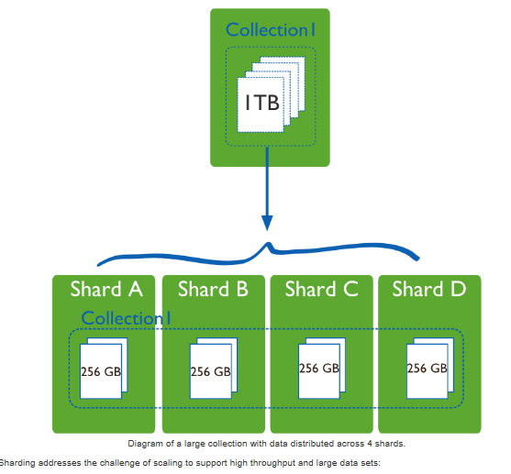
http://docs.mongodb.org/

Slide 12
Replication
Replication is the process of synchronizing data across multiple servers
This protects the database from the loss of a single server.
It also allows recovery from hardware failure and service interruption
A Replica Set is a group of MongoDB servers that maintain the same data set, providing redundancy and increasing data availability

Slide 13
MongoDB – Interactive Shell
Download the zip file from Moodle

Slide 14
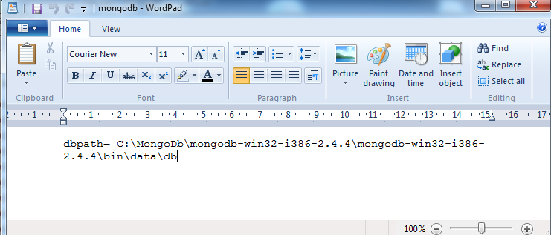
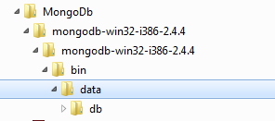
mongodb.config
Create data/db folder - this determines where databases are created.
Create a file called mongodb.config in the bin folder.

Slide 15
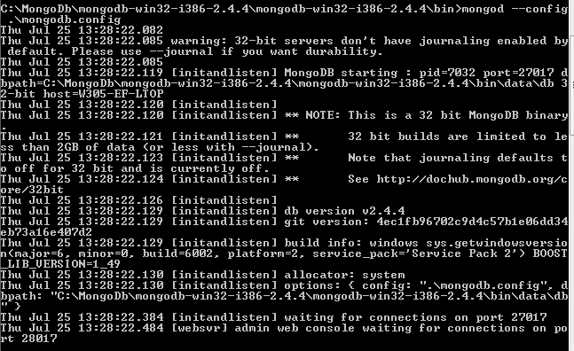
Run the Server
mongod --config .\mongodb.config
[You might need to delete a lock file (mongod.lock) in your example folder if mongod was not shut down correctly].

Slide 16
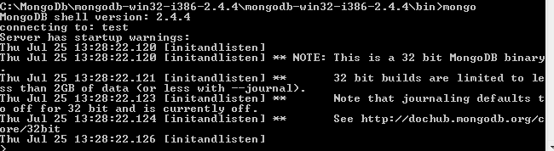
Run the Client
mongo

Slide 17
MongoDB Interactive Shell
Allows you to issue commands to MongoDB
Is a Javascript Shell.
Allows you to insert, query, update, delete

Slide 18
JSON
JSON provides an easy way to create and store data structures for use with JavaScript
Data encoded with JSON can be read into a variable which creates an object.
www.json.org/js.htm

Slide 19
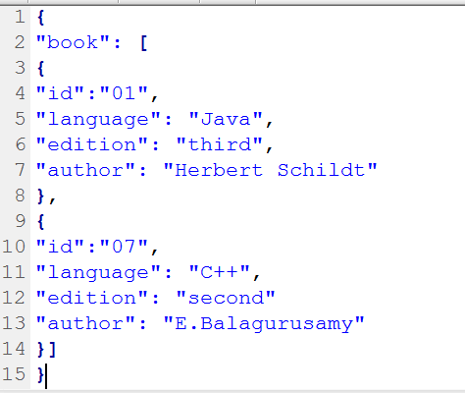
JSON - Example

Slide 20
JSON - Syntax
Data is represented in name/value pairs
Curly braces hold objects and each name is followed by ':‘ (colon), the name/value pairs are separated by , (comma).

Slide 21
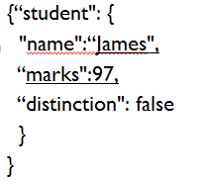
JSON - Datatypes
Number
String
Boolean

Slide 22

Querying data in Mongodb
db – to display the database you are using
show dbs – to list the databases
use Lib – to switch database
db.getCollectionNames() or show collections
insert
db.book.insert({name:'Harry Potter', price:19.99})
(db refers to the current database)

Slide 23
Insert (using interactive shell)
db.book.insert({name:'Introduction to MongoDB', price:'39.99'})
db.book.find() (lists all the documents in a collection)

Slide 24
Insert – Schema-less
db.book.insert({name:'Introduction to Java', price:49.99})
db.book.insert({name:‘C#’})
db.book.insert({name:‘C++’})
Schema-less database.
db.book.find()

Slide 25
Query Selectors
{field: value} is used to find any documents where field is equal to value.
db.book.find({name:‘C++'})

Slide 26
More Data
db.book.insert({name:'MySQL', price:20.99})
db.book.insert({name:‘Android', price:20.99})

Slide 27
Range Queries & Operators
db.book.find({price:{$lt:25}})
db.book.find({price: {$lt: 25, $gt: 20}} )
$lt, $lte, $gt, $gte and $ne are used for less than, less than or equal, greater than, greater than or equal and not equal operations

Slide 28

Updating / Set
Set is used to change fields.
db.book.update({name:‘Databases'}, {$set: {price: 24}})
db.book.find({name:‘Databases'})

Slide 29
Adding a new field to all documents in a collection
In case you want to add a new_field to all your collection, you have to use empty selector, and set multi flag to true (last param) to update all the documents
db.your_collection.update({},{$set : {"new_field":1}},false,true)
In the above example last 2 fields false, true specifies the upsert and multi flags.
Upsert: If set to true, creates a new document when no document matches the query criteria.
Multi: If set to true, updates multiple documents that meet the query criteria. If set to false, updates one document.

Slide 30

Counting
db.book.find({price: {$gt: 25}}).count()

Slide 31
Remove Documents
In MongoDB, the db.collection.remove() method removes all documents from a collection

Slide 32
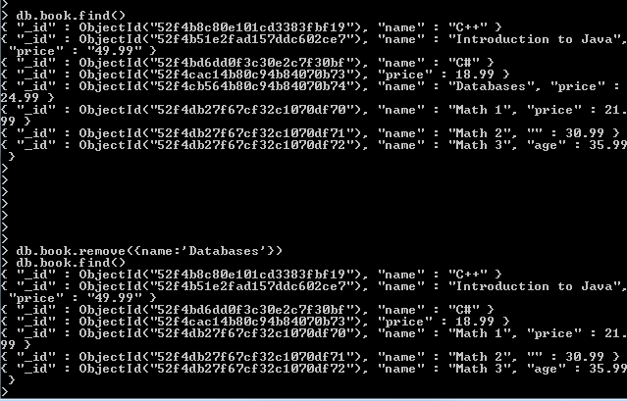
Remove Documents that matches a condition
db.book.remove( { name : “Databases" } )

Slide 33
To do:
Run mongoDB server - follow steps given earlier (create config file, db folder )
Run the command line client
Try the following commands: use, insert, update etc.

Slide 34
Validation

Slide 35
Benefit of flexible schemas
Relational
Up-front schema definition phase
Adding a new column takes time to develop and “lots” of time to roll out in production
Existing rows must be reformatted
MongoDB
Start hacking your app right away
Want to store new type on information?
Just start adding it
If it doesn’t apply to all instances – just leave it out

Slide 36
Why validate documents?
Many people writing to the database
Many developers
Many teams
Many companies
Many development languages
Multiple application want to exploit the same data, need to agree on what’s there
Usually a core set of keys and attributes you want there.

Slide 37
Why validate documents? ctd
For any key you may care about
Existence
Type
Format
Value
Existence in combination with other keys (e.g. need a phone number or an email address)
Some core checks
E.g. price should always be there and it should be a number and e.g. > 0

Slide 38
MongoDB 3.2 validation
Using MongoDB query language
Automatically tests each insert/update and delivers a warning or error if a rule is broke.
You choose which attributes to validate and which you don’t care about

Slide 39
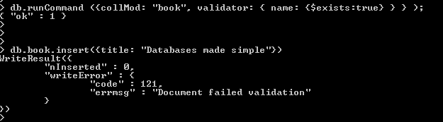
Book collection fails if you don’t include a name attribute

Slide 40
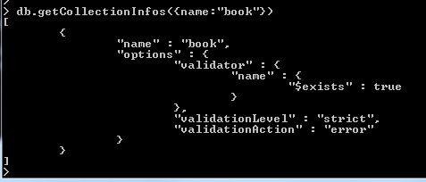
To see what rules have been added to a collection

Slide 41
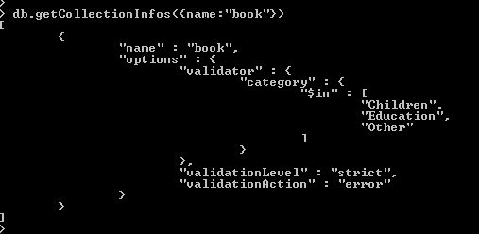
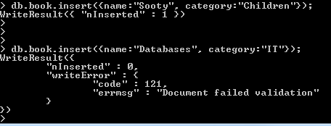
Restricting the values for a field
The category field in the book
Collection has a validation rule added limiting it’s value to Children, Education or other

Slide 42
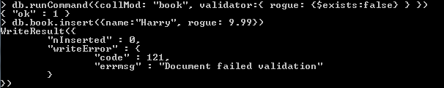
book collection fails if you include rouge attribute

Slide 43
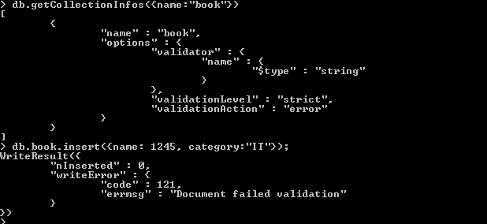
Validation - String
Notes:
db.runCommand({collMod: "book", validator: {price: {$type: 1}}});

Slide 44
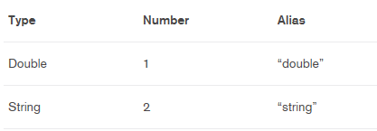
Validation : Number

Slide 45
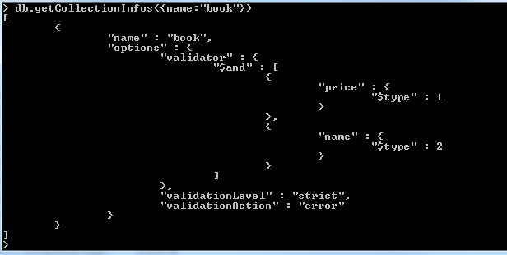
Validation – combining a number of rules
Notes:
> db.runCommand({collMod: "book", validator:{$and: [ {price: {$type: 1}}, {name:
{$type:2}} ]}});

