Slide 1
Company
Strategy Briefing 2020
Rockbuster Stealth LLC

Slide 2
Table of contents
01
02
03
Introduction
Objective
Findings
04
Key Takeaways & Suggested Actions

Slide 3
01
Introduction
Rockbuster Stealth LLC

Slide 4
Introduction
Rockbuster Stealth LLC, a renowned global movie rental company, is taking measures to stay ahead of the competition posed by streaming giants such as Netflix and Amazon Prime. In an effort to adapt to the changing landscape of the movie rental industry, the company has decided to launch an online video rental service using its extensive movie licenses. This move demonstrates the company's commitment to offering a diverse range of services to its customers and maintaining its position as a leading player in the movie rental market. With this new initiative, Rockbuster Stealth LLC aims to provide its loyal customers with greater convenience and accessibility to their favorite movies, while also attracting new customers to its platform.

Slide 5
02
Objective
Rockbuster Stealth LLC

Slide 6
Provide support to the Business Intelligence (BI) department in developing an effective launch strategy for the upcoming online video service.

Slide 7
03
Findings
Rockbuster Stealth LLC

Slide 8
Data Snapshot
Total
Films
Best-selling
Genre
Most Prevalent Rating
1000
Sports
PG-13
Average
Rental Cost
Average
Rental Duration
Most Frequent
Language
$2.94
5 days
English
Total Customers
Global
Market Reach
Overall
Revenue
599
109 countries
$61,312

Slide 9
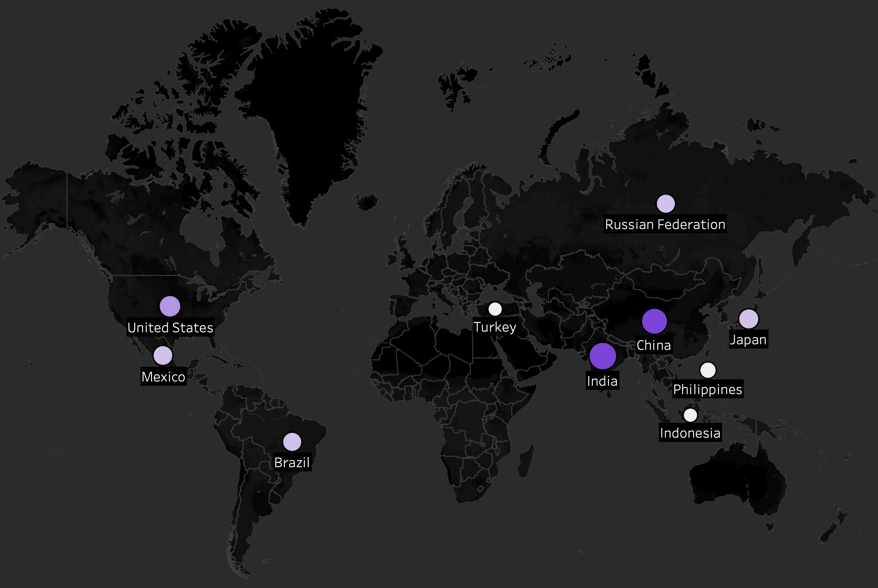
Company Global Footprint
Geographical Distribution of Top 10 Countries by # Customers and Total Payments
India generated the highest revenue of $6033 and China followed closely behind with $5274. These figures place them as the top two revenue-generating countries, while having a favorable customer count of 60 and 53, respectively.
Indonesia, Philippines, and Turkey have comparatively lower customer counts, which indicates a relatively weaker performance in these markets.

Slide 10
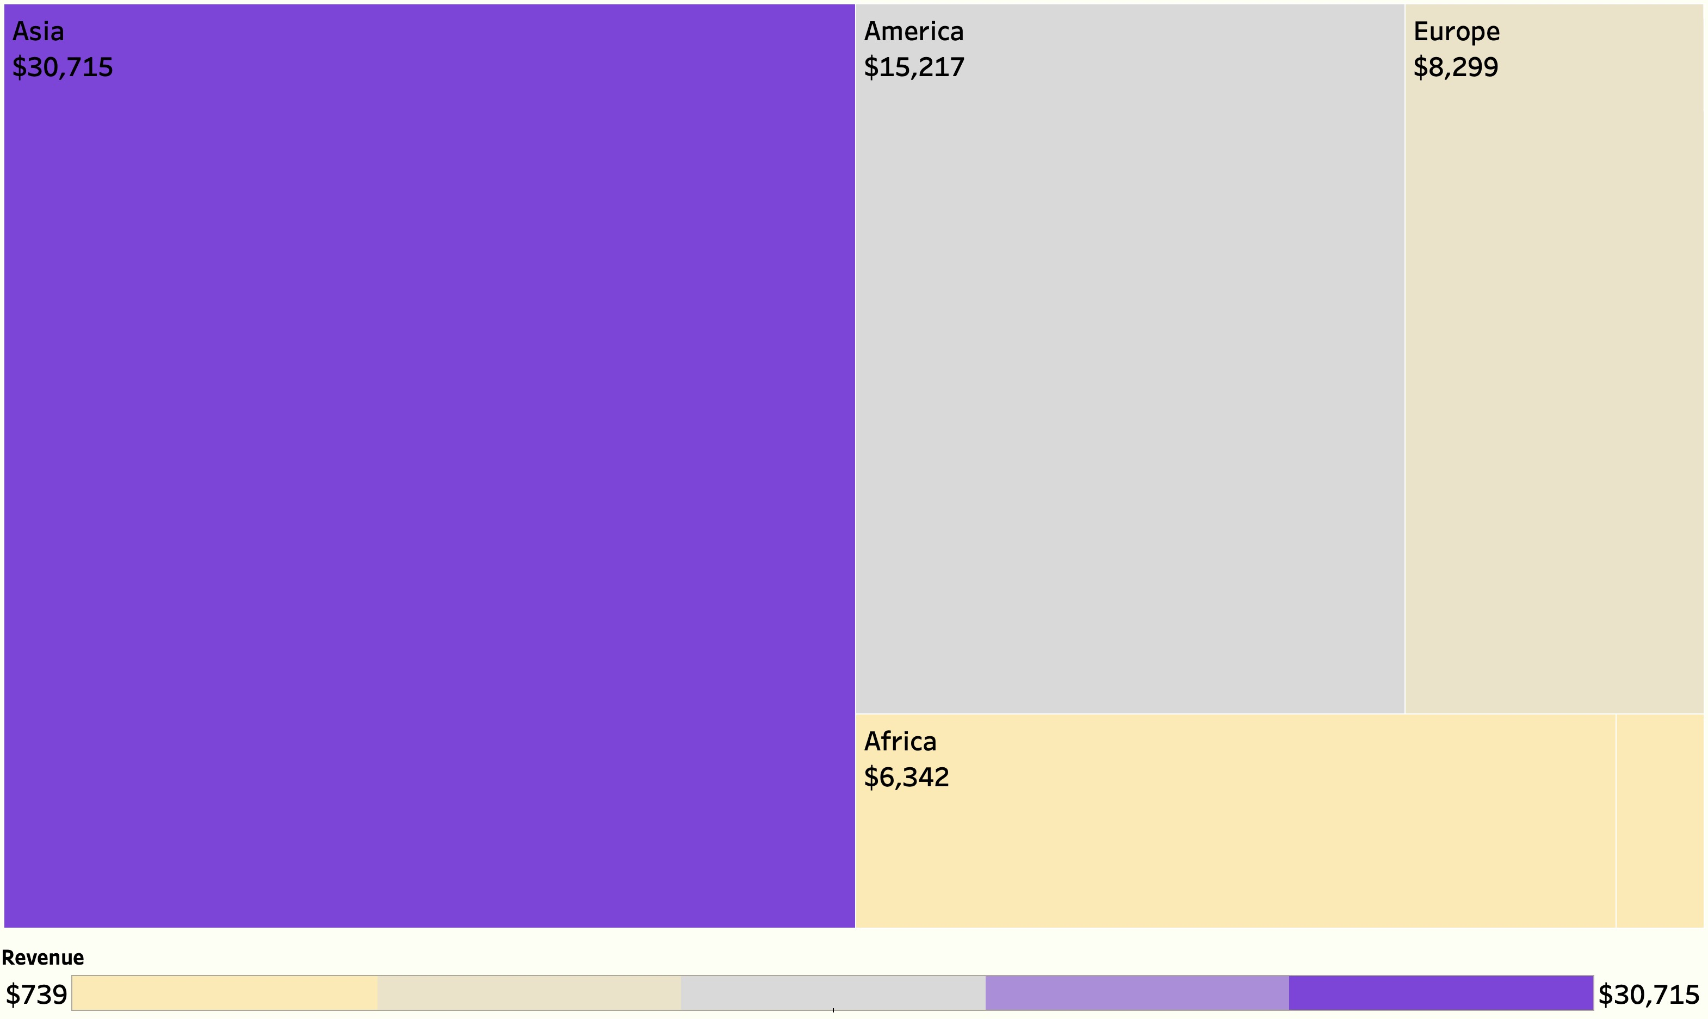
Where In The World Is Our Revenue?
Revenue by Geographical Region
Asia stands out as the region generating the highest revenue, with a total amount of $30,715. This significant figure accounts for approximately 50% of the total revenue generated across al geographical regions.
Oceania generated $739, being the lowest compared to other regions. This suggests that the company may have a smaller customer base located in this area.
Oceania
$739

Slide 11
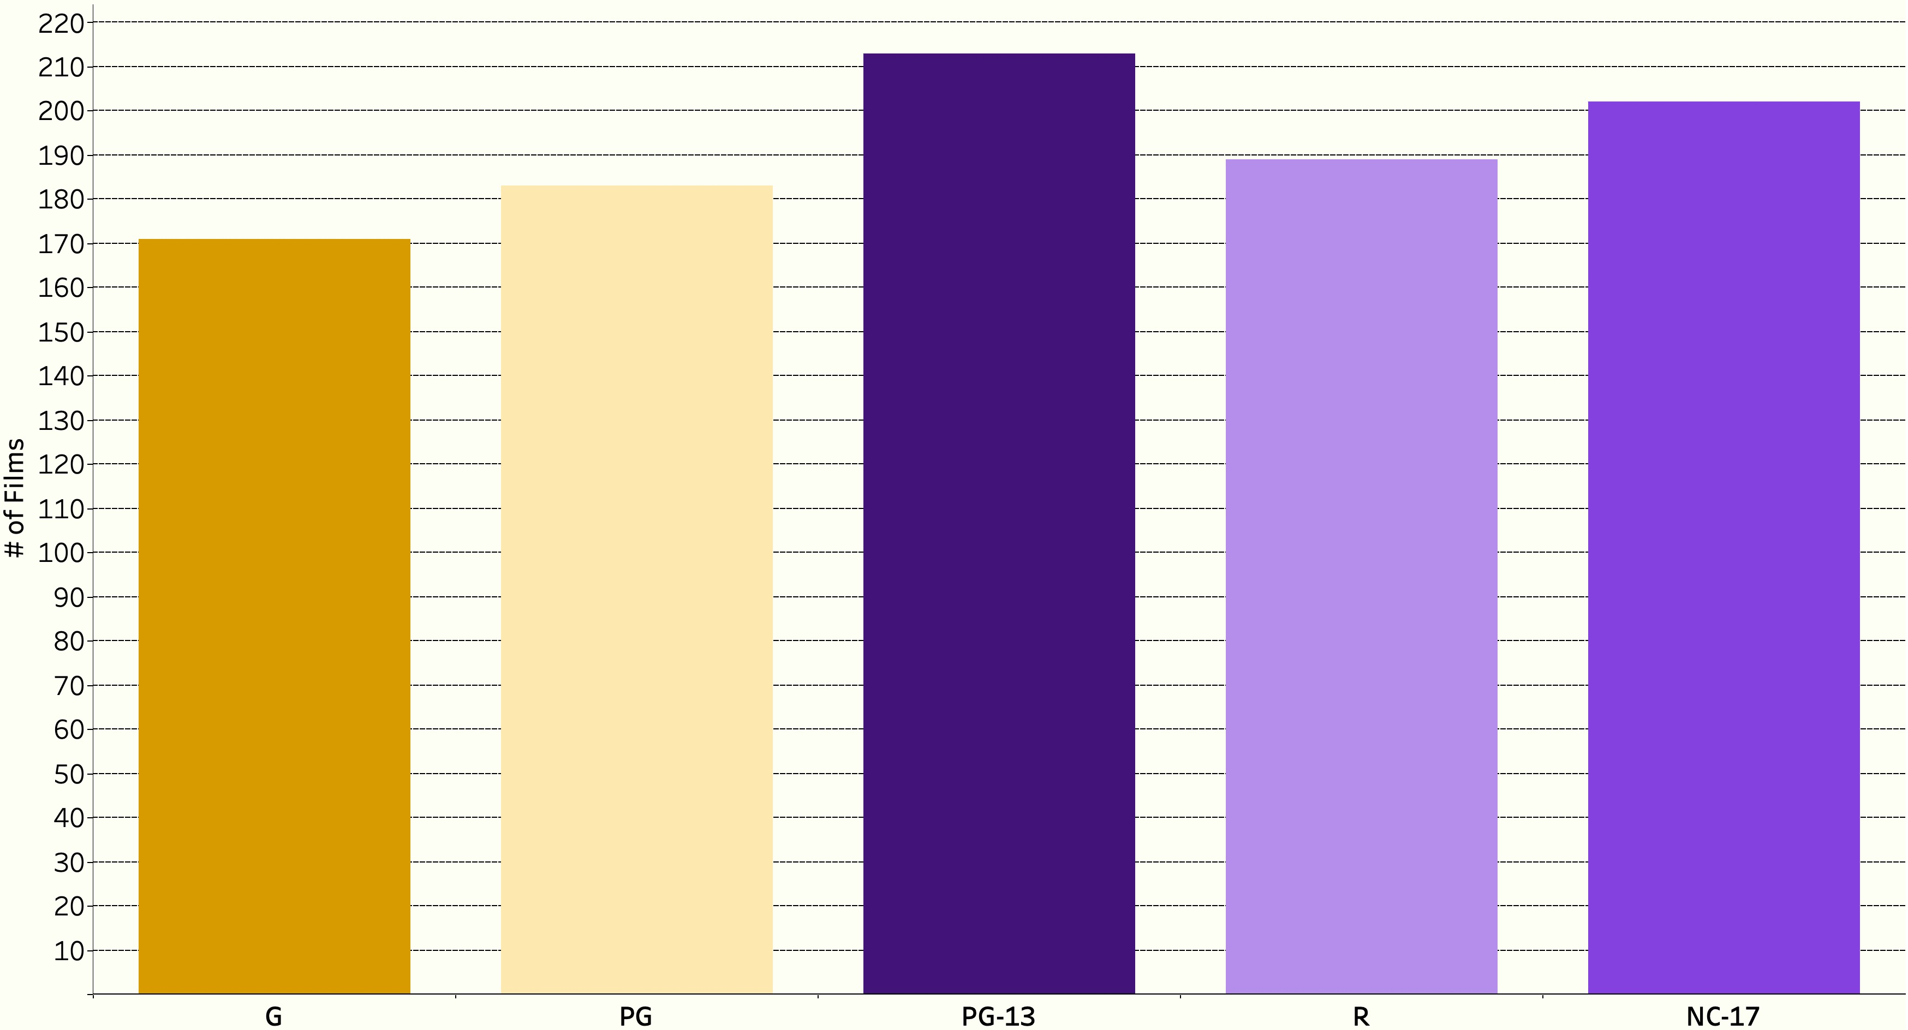
Lights, Camera… Ratings!
Film Rating Distribution
There is no significant difference in the film counts across ratings. This indicates that the movie rental company has a well-rounded collection, offering a diverse selection of films across different ratings, without a significant bias towards any specific rating category.

Slide 12
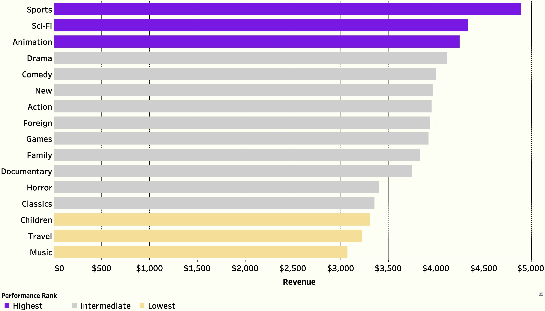
Genre-ing Profits
Revenue by Genre
The highest performing genres are Sports, Sci-fi, and Animation. It is possible that these genres attract a wide audience, including adults and children.
The lowest performing genres are Music, Travel, and Children. This suggest that these genres are not as popular or that they may appeal to a niche audience.

Slide 13
Films That Inspire Hope
Top Performing Films
1 | Telegraph Voyage | $215.75
2 | Zorro Ark | $199.72
3 | Wife Turn | $198.73
4 | Innocent Usual | $191.74
5 | Hustler Party | $190.78
6 | Saturday Lambs | $190.74
7 | Titans Jerk | $186.73
8 | Harry Idaho | $177.73
9 | Torque Bound | $169.76
10 | Dogma Family | $168.72
Although "Telegraph Voyage" occupies the highest position in terms of revenue, the fluctuations among the remaining movies are minimal. This suggests that the popularity and success of these movies are on par with each other, without any clear dominance.
The titles do not appear to follow a specific pattern or genre, indicating a diverse selection of movies that have resonated with the customers.

Slide 14
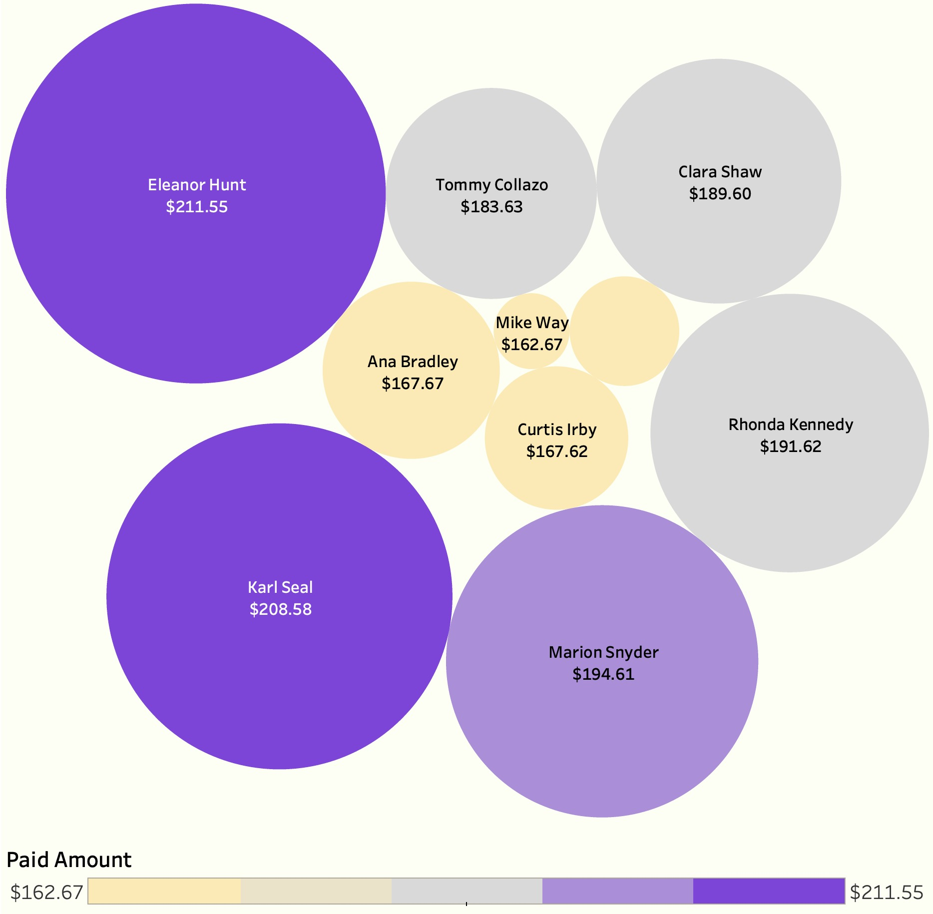
Our Best Living Assets
High Value Customers
The top two highest value customers, Eleanor Hunt and Karl Seal, generated significantly more revenue than the rest of the customers on the list.
Marcia Dean
$166.61
There are no demographic or other details provided about these customers. Further analysis that considers factors such as age, gender, location, and rental habits could provide more insights into what makes these customers high value and how the company can attract and retain more customers like them.

Slide 15
04
Key Takeaways & Suggested Actions
Rockbuster Stealth LLC

Slide 16
Key Takeaways
Potential growth opportunities for the movie rental company include expanding further in Asia, leveraging the strong customer base in America, and optimizing strategies in Europe, all of which could lead to increased revenue.
Understanding the popularity and demand for different genres can help the rental company make informed decisions regarding inventory management and marketing strategies.
Customers have diverse preferences, and multiple movies can attract significant viewership and generate substantial revenue. Identifying and prioritizing high-value customers emerges as crucial in recognizing their significant contribution to the company's revenue.

Slide 17
Suggested Actions
Strengthen market presence in India and China by allocating additional resources and market efforts.
Capitalize on the high average spend in the United States.
Explore growth opportunities in emerging markets such as Japan, Mexico, Brazil and the Russian Federation.
Increase focus on lucrative genres such as Sports, Sci-fi, and Animation.
Evaluate inventory and customer preferences to match popularity.
Acquire titles that are high in demand or in emerging trends.
Provide personalized experiences to retain and engage customers.
Implement loyalty programs that offer exclusive benefits and rewards to incentivize customers to spend more and remain loyal to the company.
Group customers into different segments to tailor marketing strategies to target each segment effectively.

Slide 18
Thanks!
Do you have any questions?
a_sampeter@outlook.com

