Slide 1

Review of Netflix movies and tv shows
Corbin Getz, Bilkis Khan, Robert stockwell

Slide 2

Summary
Since the world has been shut down for the past 2 years, and people still demand to be entertained.
We decided to investigate entertainment options from one of the most popular streaming platforms, Netflix.
The team also investigated a recommendation system based on the dataset that we processed.

Slide 3
The data
What does the initial data look like?

Slide 4
Why this data?
The data set reviewed is
“Netflix Movies and TV Shows”
Found on Kaggle.
This was decided on in comparison with available dataset because:
Provided a large number attributes and records to review.
Has active discussions happening on the Kaggle
Provides quarterly updates
Usability
Limited number of null values
What we would like to find from the dataset
Break down of movies and Tv shows
Most popular countries, directors, actors and growth
Recommendations based on title names

Slide 5
preparation
# | Column | Non-Null Count | Dtype
0 | show_id | 8807 | Object
1 | type | 8807 | Object
2 | Title | 8807 | Object
3 | director | 6173 | Object
4 | Cast | 7982 | Object
5 | country | 7976 | Object
6 | date_added | 8797 | Object
7 | release_year | 8807 | Int64
8 | rating | 8803 | Object
9 | duration | 8804 | Object
10 | listed_in | 8807 | Object
11 | description | 8807 | Object
The dataset contains a total of
12 columns
8807 records
Info() function returned the information on the raw
Converted 2 column data types for later use
Date_added to datetime
Year_added to int

Slide 6
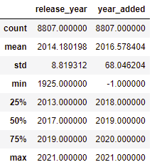
Exploration
Pandas describing the data for returns the provided table.

Slide 7
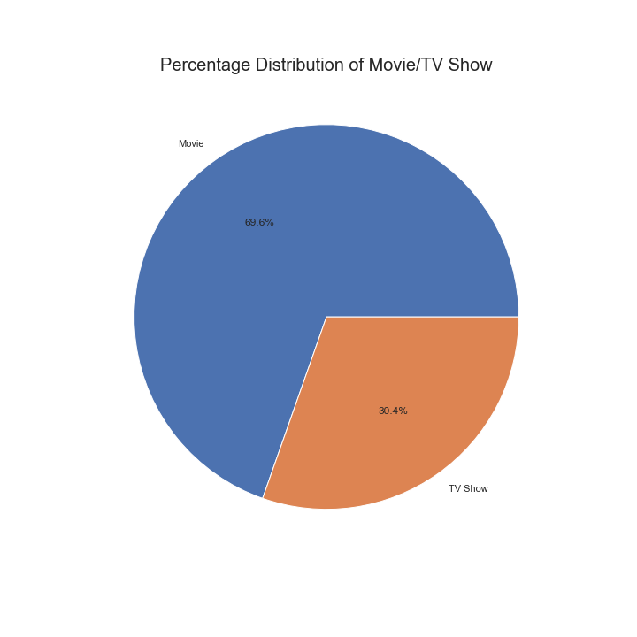
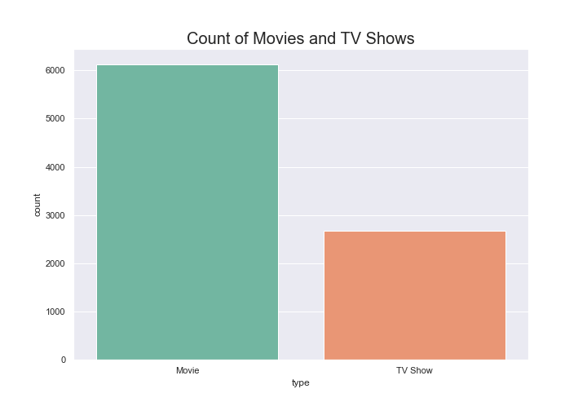
Quick breakdown of data

Slide 8
Break down by country
Finding out how engaged each country is

Slide 9
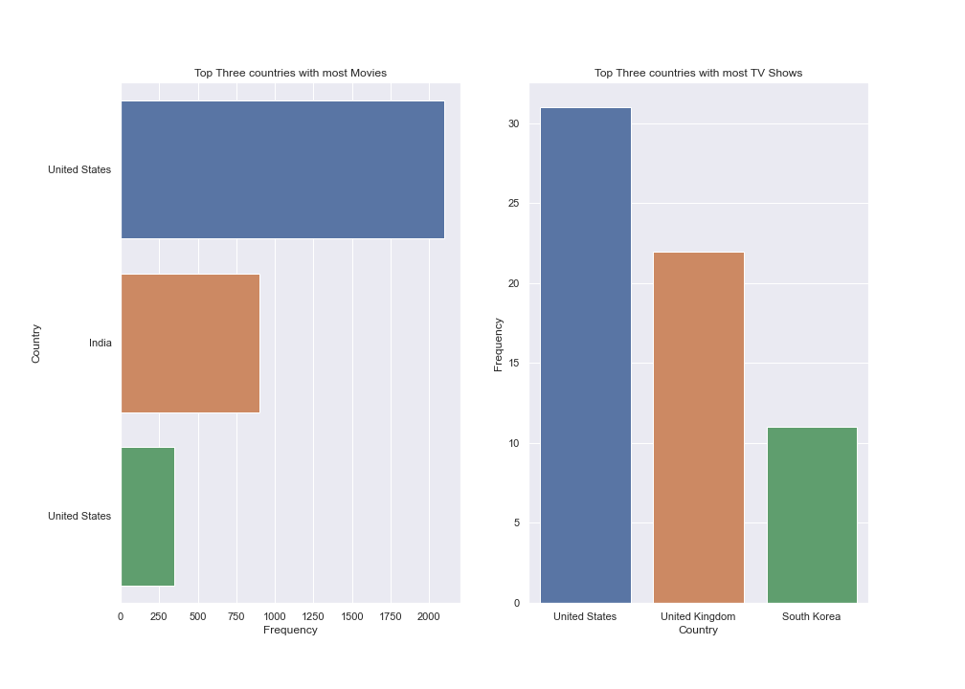
Countries with most movies and tv shows

Slide 10
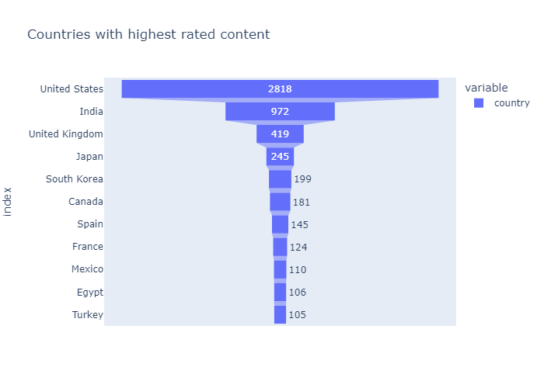
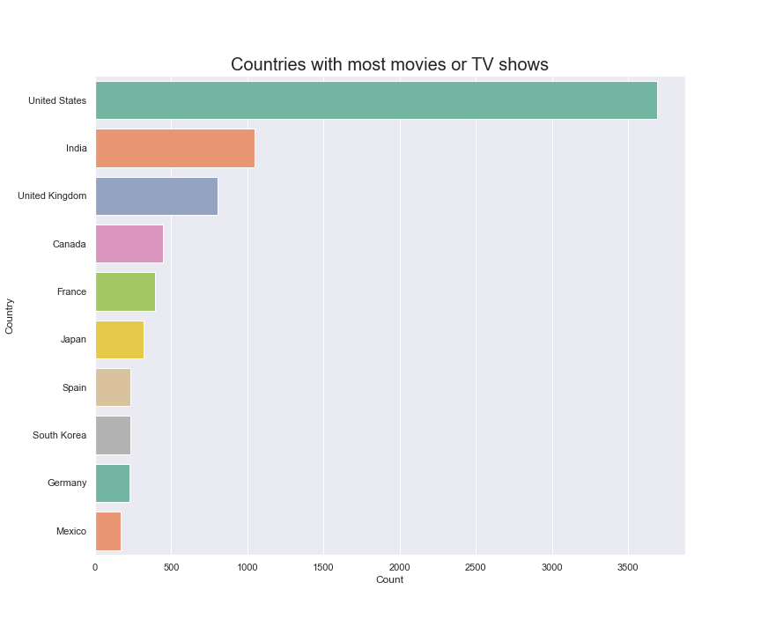
United states and India
Here we discover that both the United State and India have the highest ranking and the most programs added to the Netflix system.
The United States dominates by a wide margin.

Slide 11
Yearly Information
What changed over the years

Slide 12
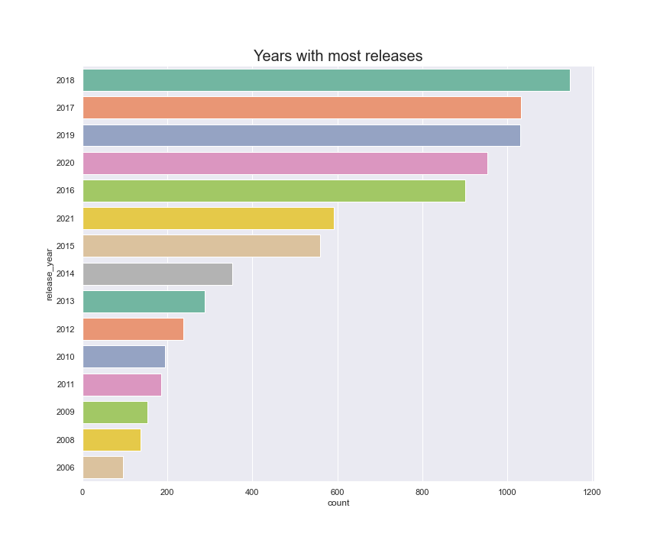
Years with the most releases

Slide 13
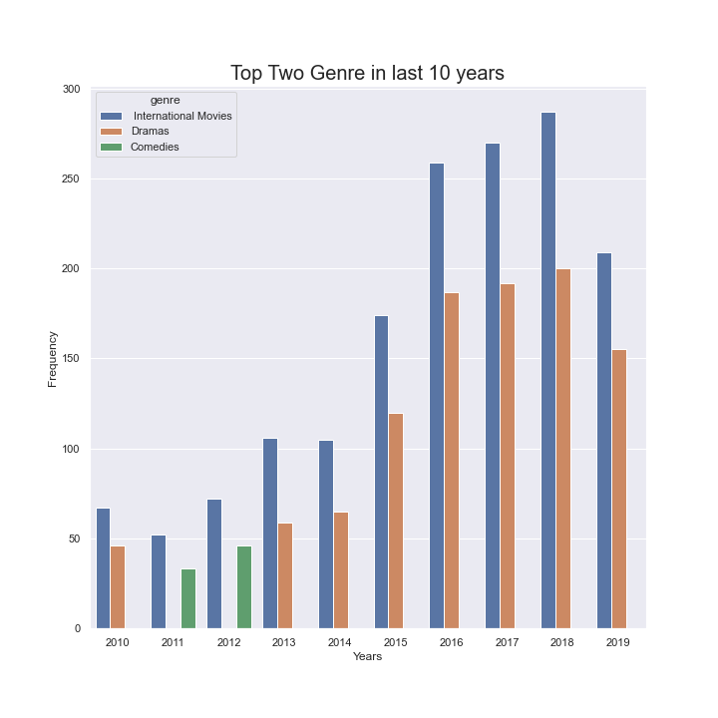
Most popular genre (2010 – 2019)

Slide 14
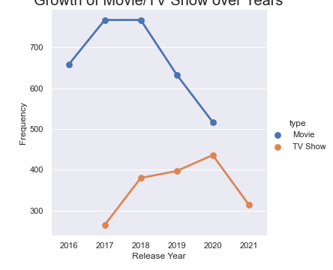
Yearly growth of movies and tv shows

Slide 15
directors and actors
Who was the busiest directors and actors of the years

Slide 16
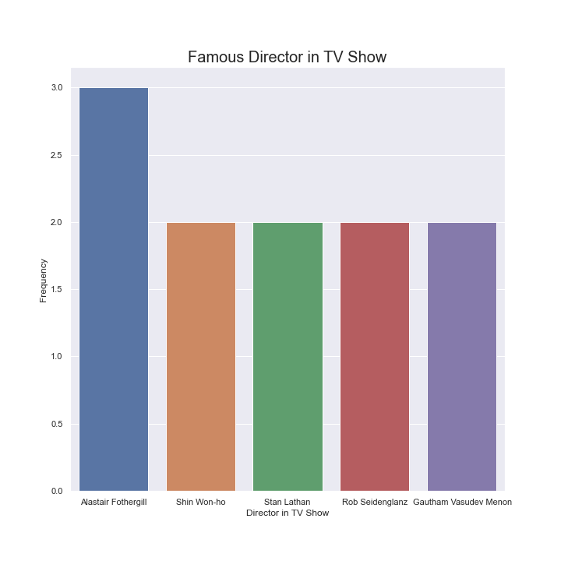
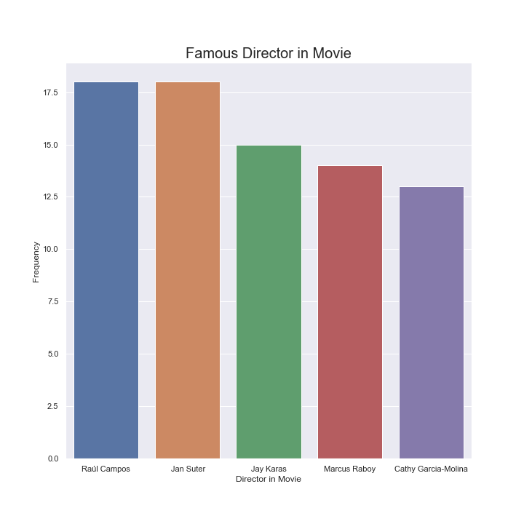
directors
What director has the most movies or tv shows added to Netflix?

Slide 17

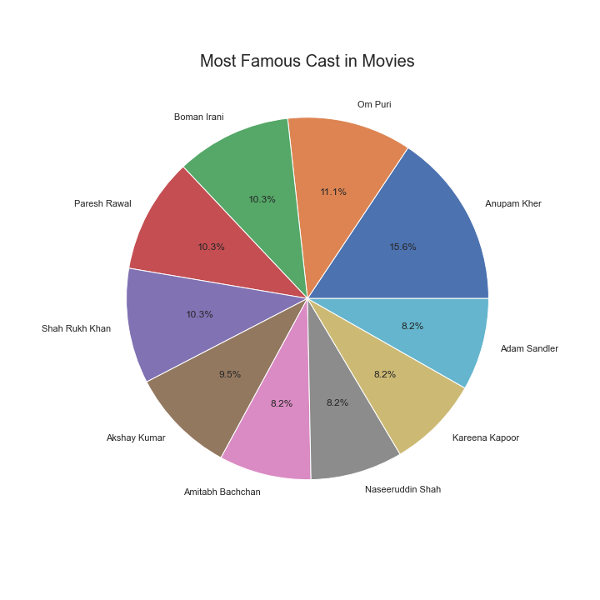
Actors and actresses
Which actor or actress has the most movies or tv shows added to Netflix?

Slide 18
recommendations
What do you want to watch? Let us help

