Slide 1

Review of Netflix movies and tv shows
Data Maniacs: Corbin Getz, Bilkis Khan, Robert stockwell

Slide 2

Summary
Since the world has been shut down for the past 2 years, and people still demand to be entertained.
We decided to investigate entertainment options from one of the most popular streaming platforms, Netflix.
The team also investigated a recommendation system based on the dataset that we processed.

Slide 3
The data and Why
The data set reviewed is
“Netflix Movies and TV Shows”
Found on Kaggle.
This was decided on in comparison with available dataset because:
Provided a large number attributes and records to review.
Has active discussions happening on Kaggle
Provides quarterly updates
Usability
Limited number of null values
What we would like to find from the dataset
Break down of movies and Tv shows
Most popular countries, directors, actors and growth
Recommendations based on title names

Slide 4
What does the initial data look like? And preparation
# | Column | Non-Null Count | Dtype
0 | show_id | 8807 | Object
1 | type | 8807 | Object
2 | Title | 8807 | Object
3 | director | 6173 | Object
4 | Cast | 7982 | Object
5 | country | 7976 | Object
6 | date_added | 8797 | Object
7 | release_year | 8807 | Int64
8 | rating | 8803 | Object
9 | duration | 8804 | Object
10 | listed_in | 8807 | Object
11 | description | 8807 | Object
The dataset contains a total of
12 columns
8807 records
Info() function returned the information on the raw
Converted 2 column data types for later use
Date_added to datetime
Year_added to int

Slide 5
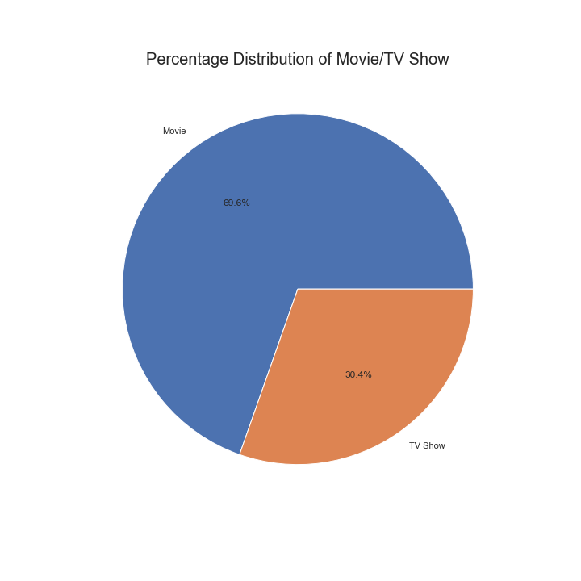
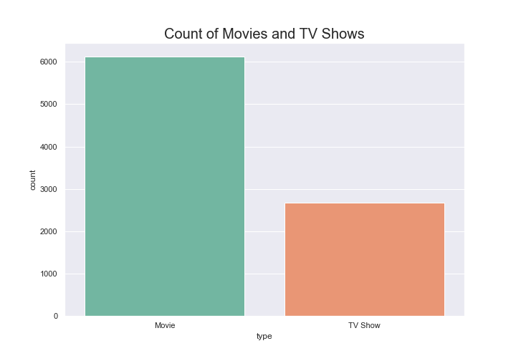
Quick breakdown of data

Slide 6
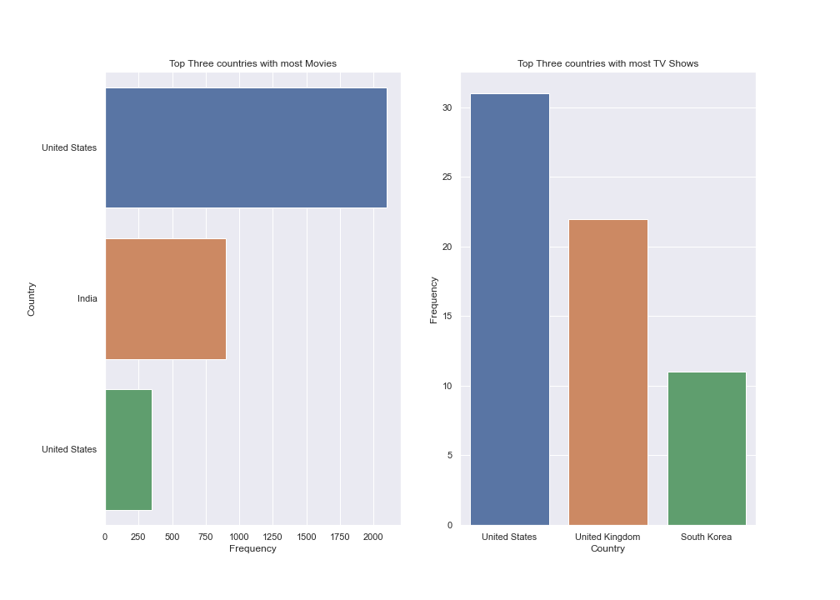
Countries with most movies and tv shows

Slide 7
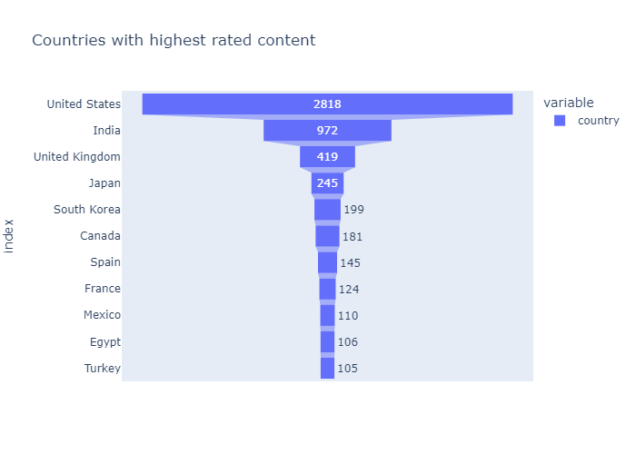
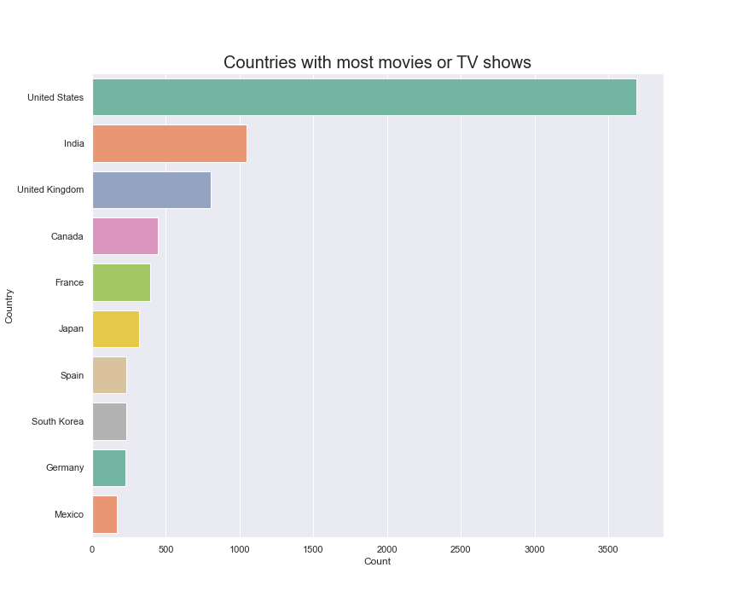
United states and India
Here we discover that both the United State and India have the highest ranking and the most programs added to the Netflix system.
The United States dominates by a wide margin.

Slide 8
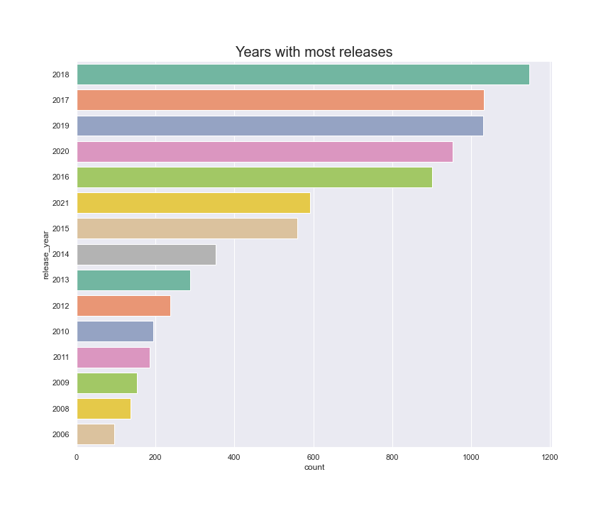
Years with the most releases

Slide 9
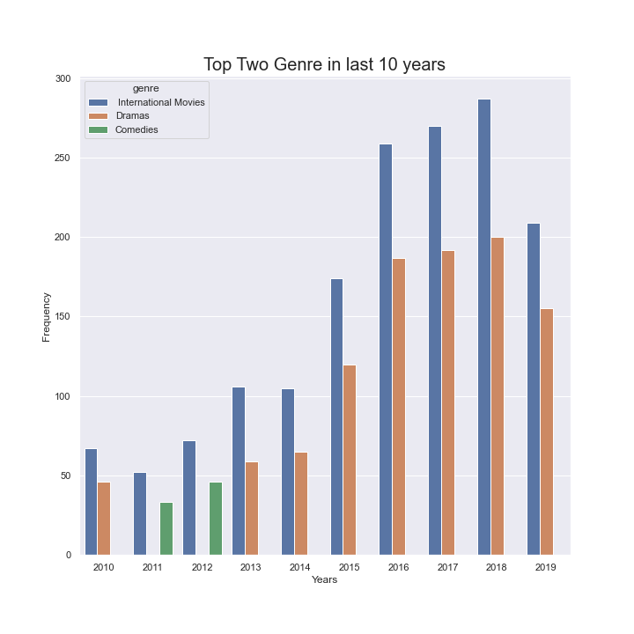
Most popular genre (2010 – 2019)

Slide 10
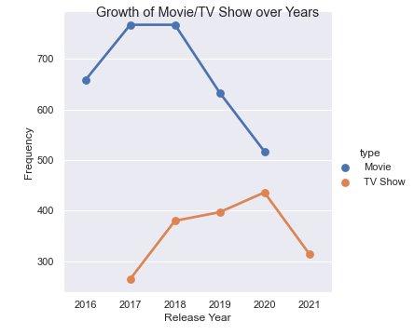
Yearly growth of movies and tv shows

Slide 11
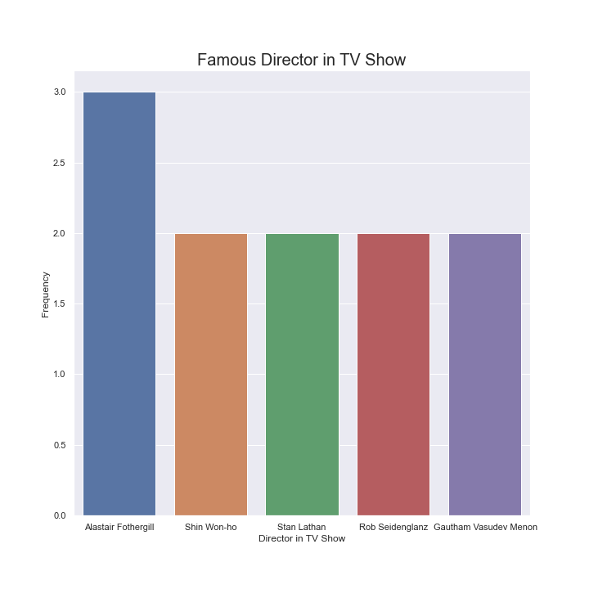

directors
Which director has the most movies or tv shows added to Netflix?

Slide 12

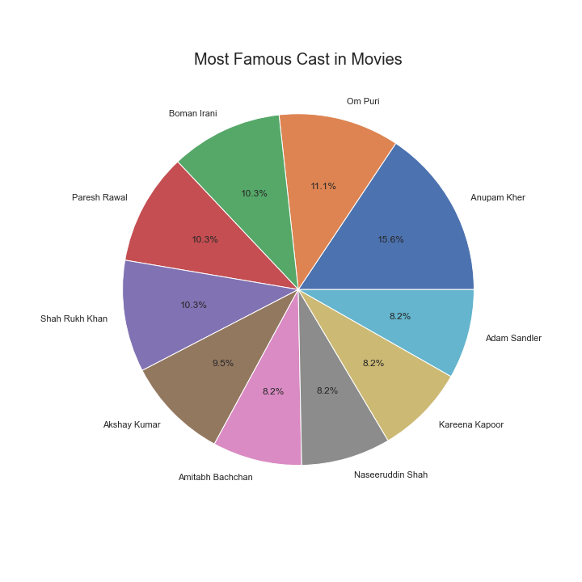
Actors and actresses
Which actor or actress has the most movies or tv shows added to Netflix?

Slide 13
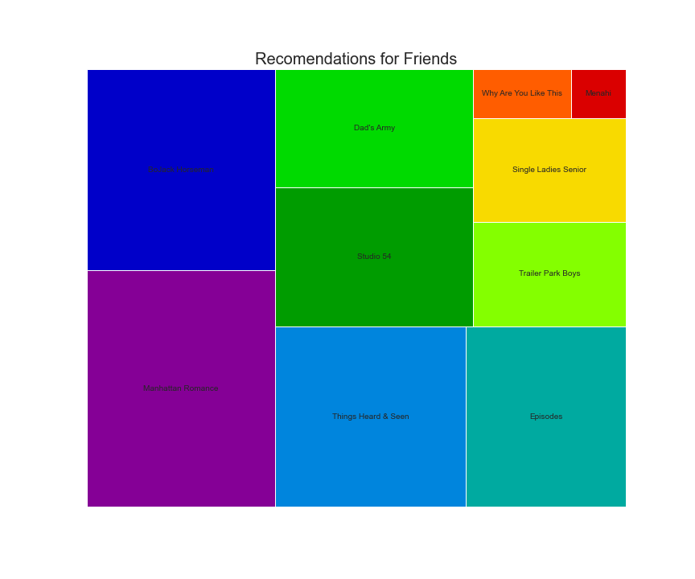
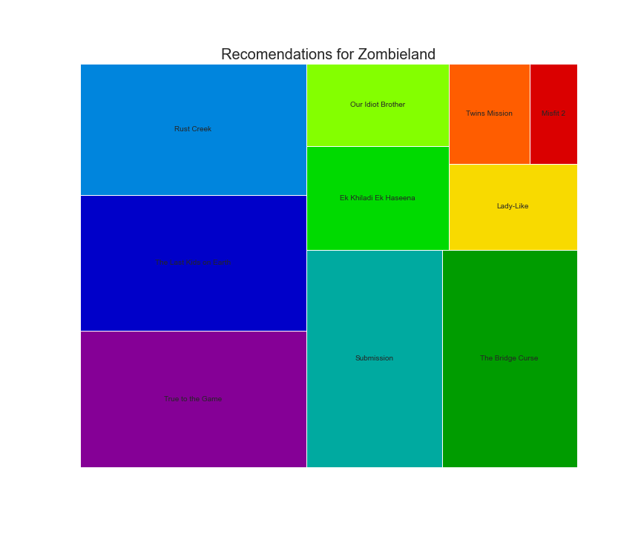
Recommendations
Select a movie or tv show on Netflix, we’ll let you know what else you might like.

Slide 14
conclusion
Break down of movies and Tv shows
Movies dominate at 70%
TV Shows make up 30% of the available flix
Most popular countries and growth
The two most popular countries are the United States and India.
United State by a wide margin
Year 2018 had the most titles release
Movie growth has trended lower since 2018
Tv Show growth has also trended lower since 2021
Recommendations based on title names
Created a recommendation system
Visualize the results with a tree node graphic to help select the next flix to watch.
The team was able to find some interesting things with this dataset. We answered some of the following questions.

