Slide 1
Lab 3
Anton Svanborg, Erik Cruz

Slide 2
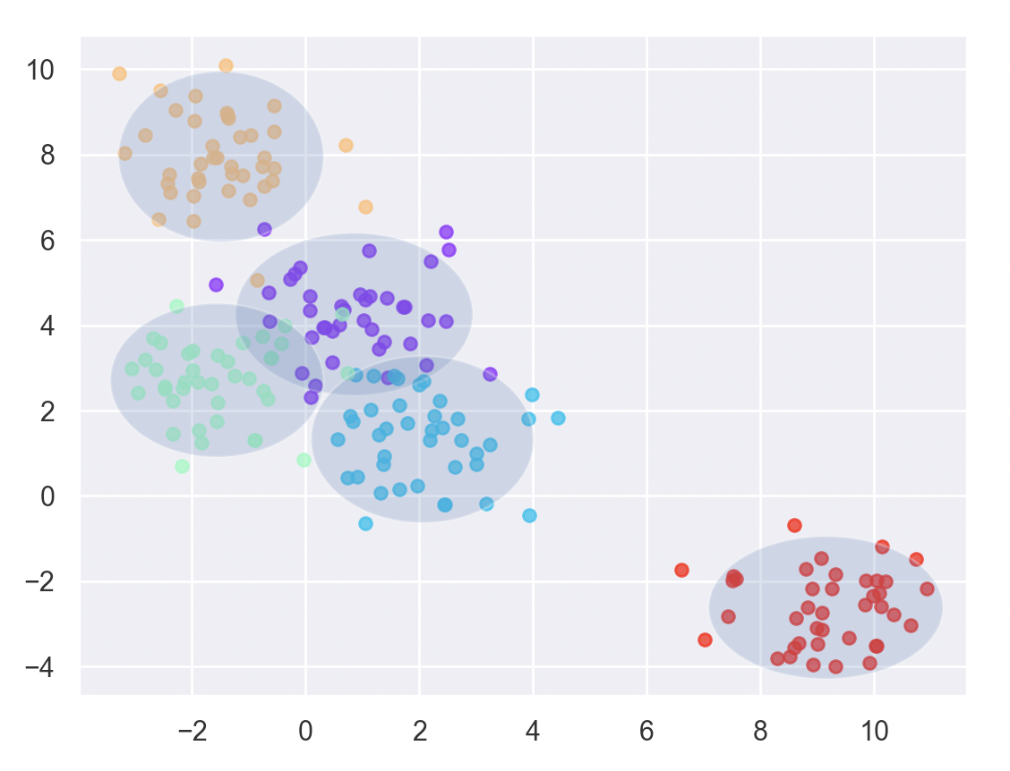
Assignment 1: 95%-confidence interval

Slide 3
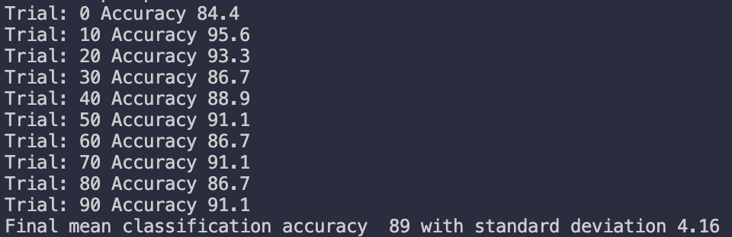
Assignment 3: Iris

Slide 4
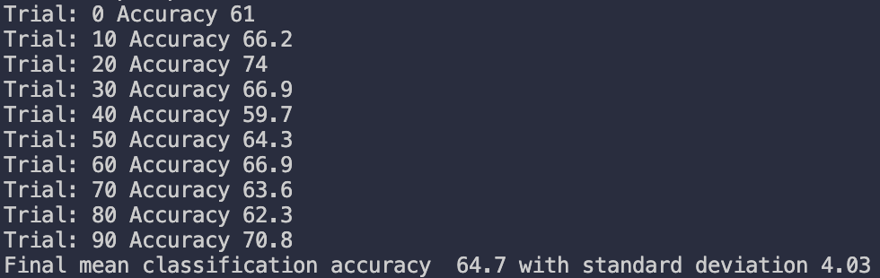
Assignment 3: Vowel

Slide 5
Assignment 3:
” When can a feature independence assumption be reasonable and when not?”
When they are not obvioulsly correlated. If we see some correlation we should use some other classification method.

Slide 6
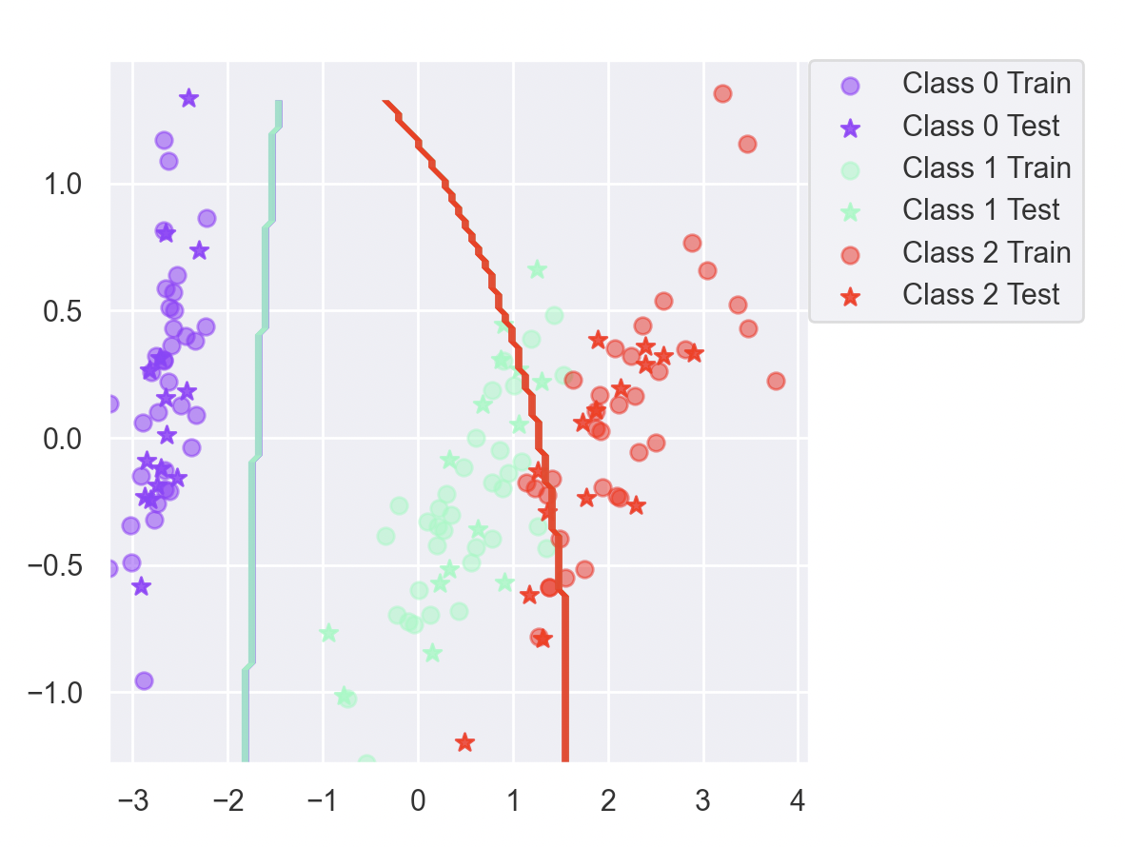
Assignment 3:
”How does the decision boundary look for the Iris dataset? How could one improve the classification results for this scenario by changing classifier or, alternatively, manipulating the data? ”
We could seperate the data (class 1 and 2 could give 100% accuracy), use some sort of linear separation between class 1 and 2 (not perfect but better) or by using boosting.

Slide 7
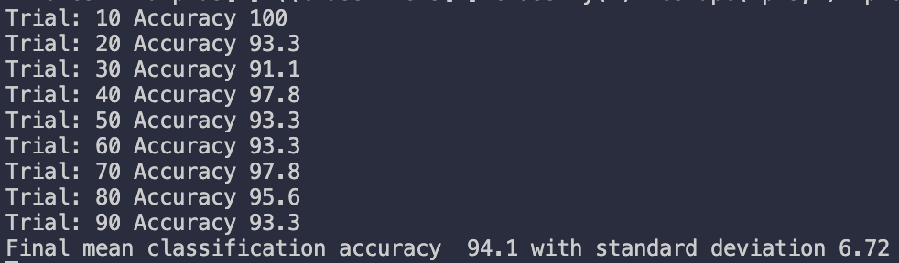
Assignment 5: Boosted Bayes on Iris

Slide 8
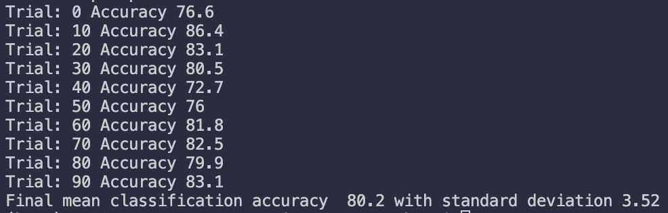
Assignment 5: Boosted Bayes on Vowels
64.7 → 80.2

Slide 9
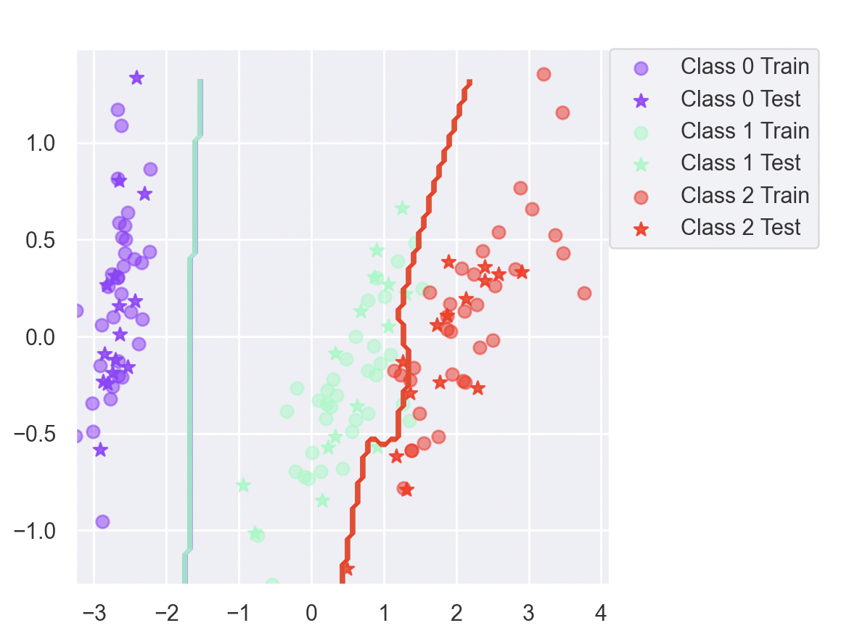
Assignment 5: Boosted Iris Boundries
Is there any improvement in classification accuracy? Why/why not?
Yes! 89 → 94.1
Plot the decision boundary of the boosted classifier on iris and compare it with that of the basic. What differences do you notice? Is the boundary of the boosted version more complex?
More complex and better suited for data
Can we make up for not using a more advanced model in the basic classifier by using boosting?
Yes! We can use Adaboosting for weak classifiers with error less than 50%

Slide 10
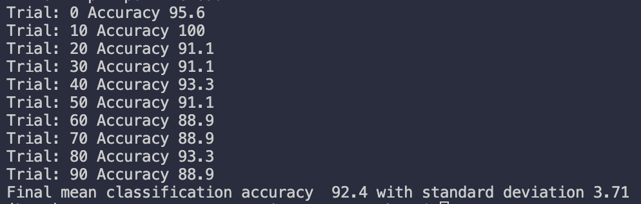
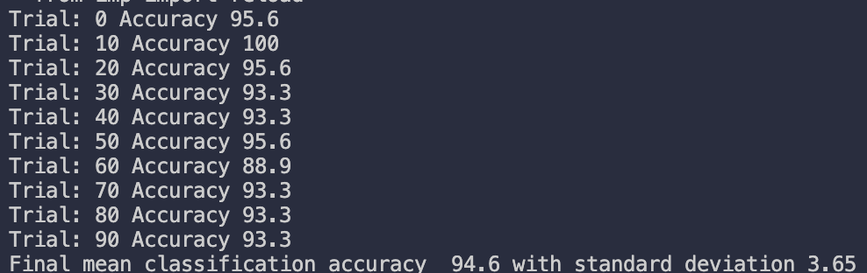
Assignment 6: Decision Tree Iris
Improvement in accuracy?
Not boosted:
Boosted:

Slide 11
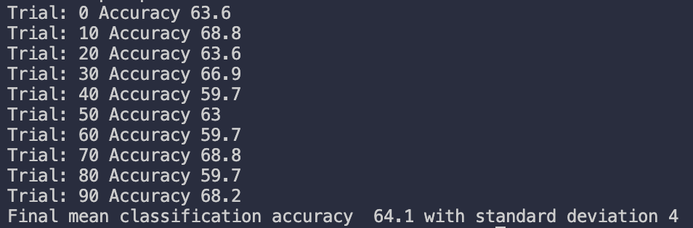
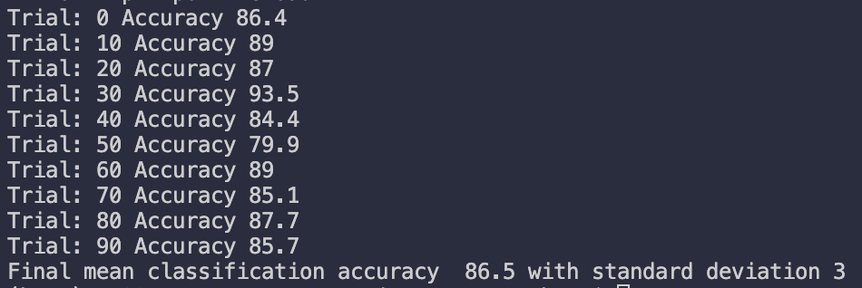
Assignment 6: Decision tree Vowels
Improvement in accuracy?
Not boosted:
Boosted:

Slide 12
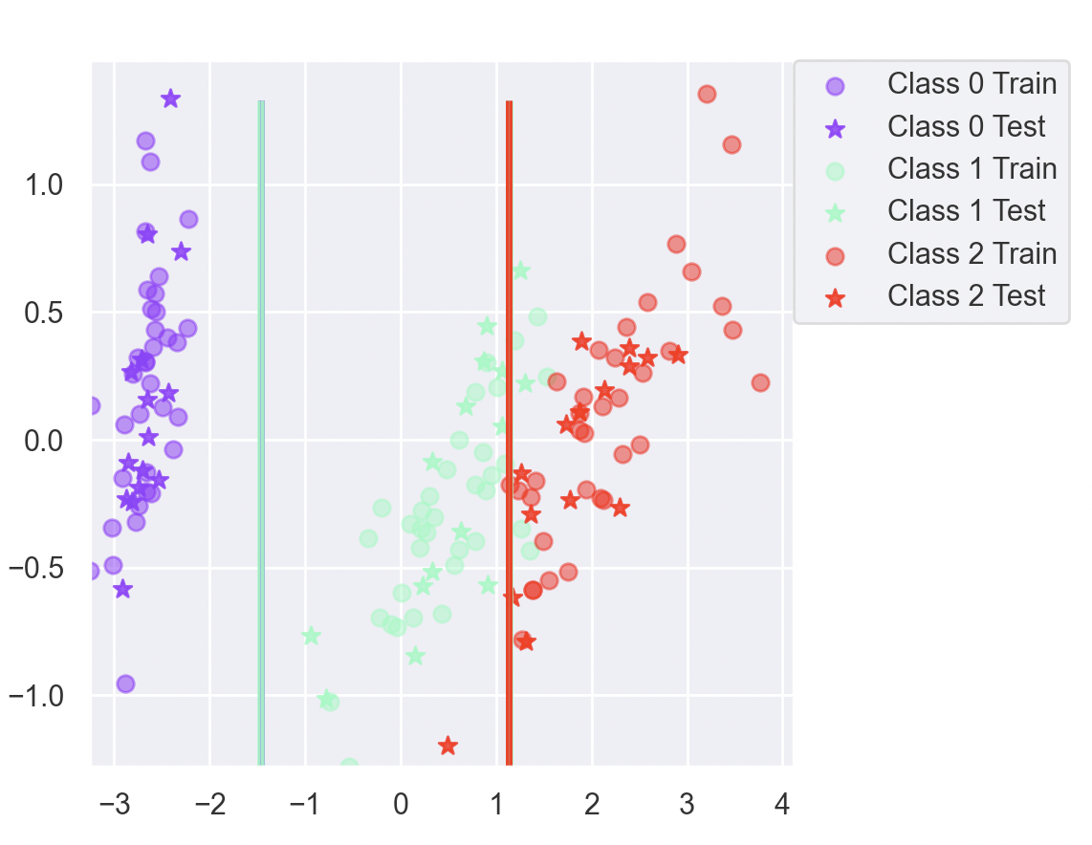
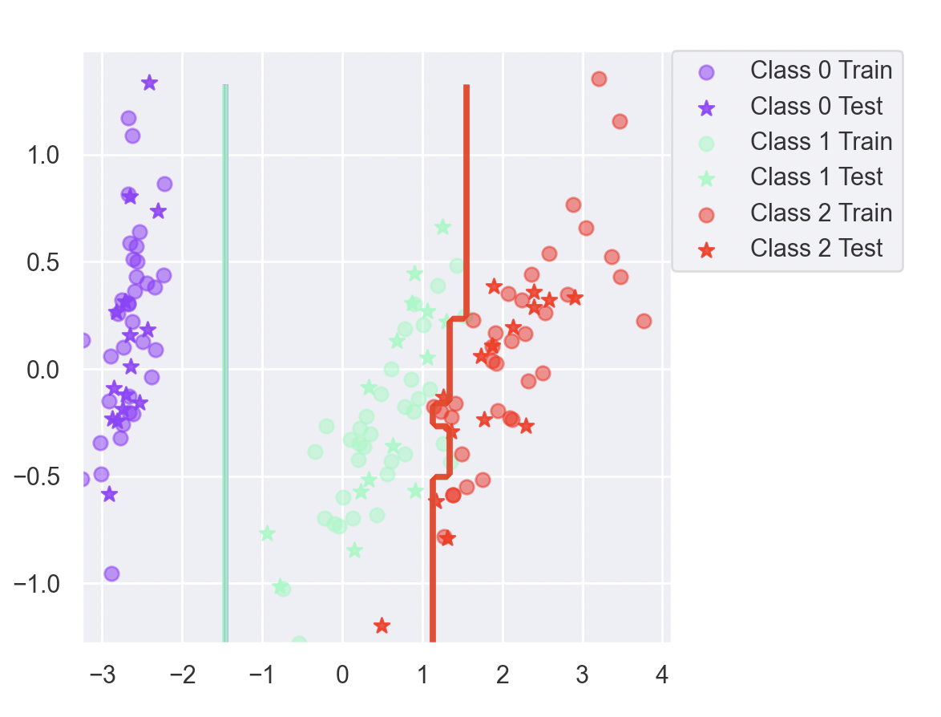
Assignment 6: Decision tree boosted iris boundries
What differences do you notice? Is the boundary of the boosted version more complex?

Slide 13
Assignment 6: Questions
Can we make up for not using a more advanced model in the basic classifier by using boosting?
Yes! We can use Adaboosting for weak classifiers with error less than 50%

Slide 14
Assignment 7:
Outliers: Boosted algorithm are sensitive to outliers since they will often be missclassified and thus gain a higher weight than other data points. Other basic algorithms will not be as sensitive.
Irrelevant inputs: Decision tree and Naive Bayes are not sensitive to irrelevant input. Decision trees wont look at these since they will have low entropy. Boosting should not affect these characteristics.
Predictive power: Naïve Bayes with little training data. Decision trees will often prune out unlikely events, meaning that they need a lot of data to have high predictive power.
Mixed types of data: Decision trees handles mixed types of data well, since they branch on discriminative features. Adaboost and random forest do well too.
Choose Multinomial Naive Bayes for binary or categorical data and Gaussian Naive Bayes for continuous data. Some transformations from continuous data to categorical data could be necessary.
Scalability: Naïve Bayes algorithm only requires one pass on the entire dataset to calculate the posterior probabilities for each value of the feature in the dataset. So, when we are dealing with large datasets or low-budget hardware, Naive Bayes algorithm is a feasible choice.

