Slide 1
Lab 2
Cruz, Svanborg

Slide 2
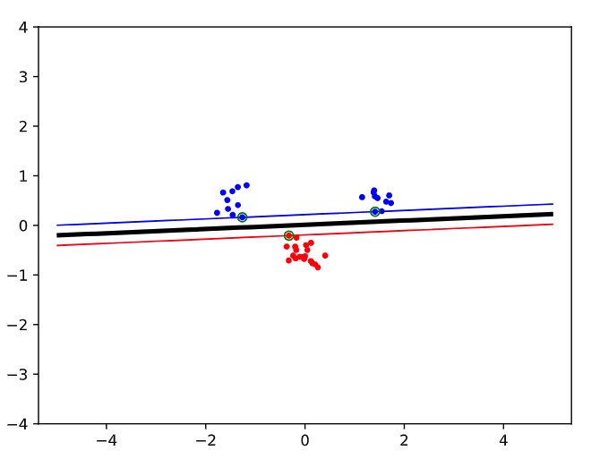
Base Case

Slide 3
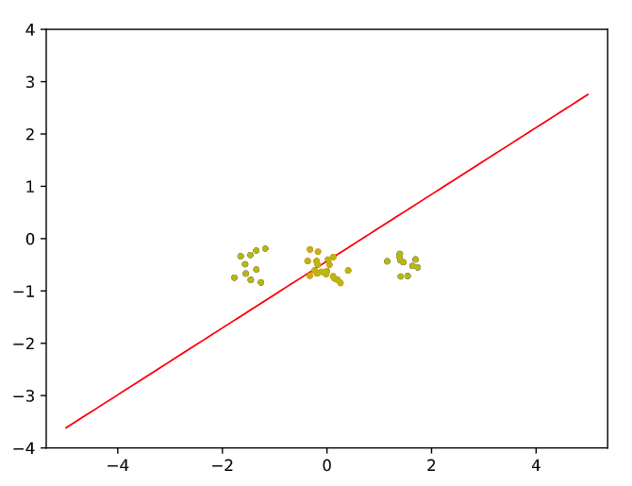
Q1: Move around

Slide 4
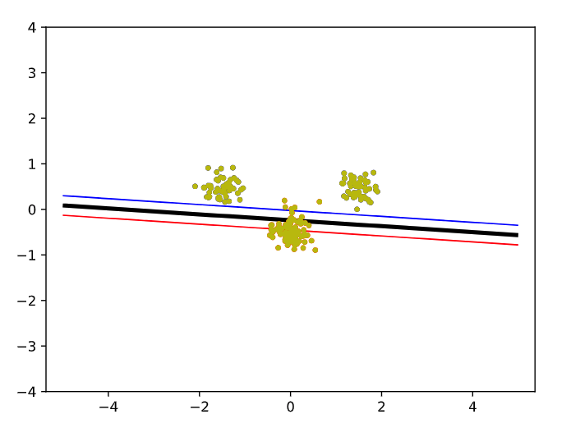
Q1: Move around

Slide 5
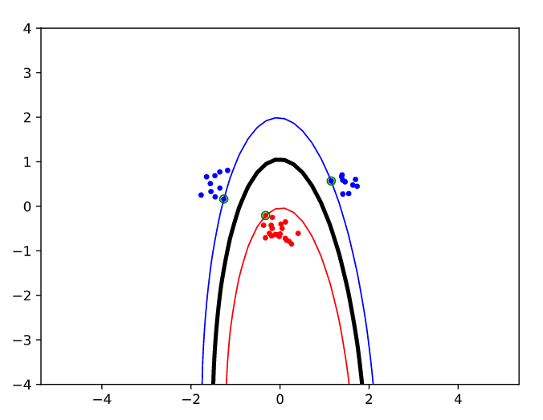
Q2+Q3: Polynomial parameters: p=2

Slide 6
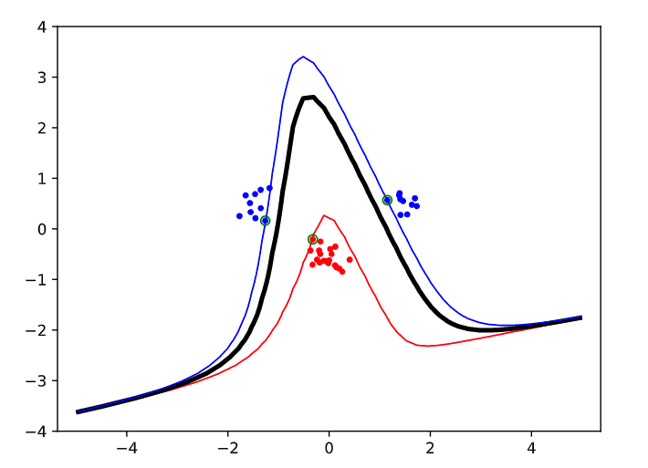
Q2+Q3: Polynomial parameters: p=5

Slide 7
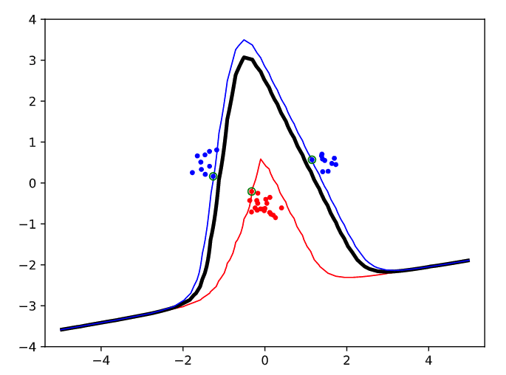
Q2+Q3: Polynomial parameters: p=9

Slide 8
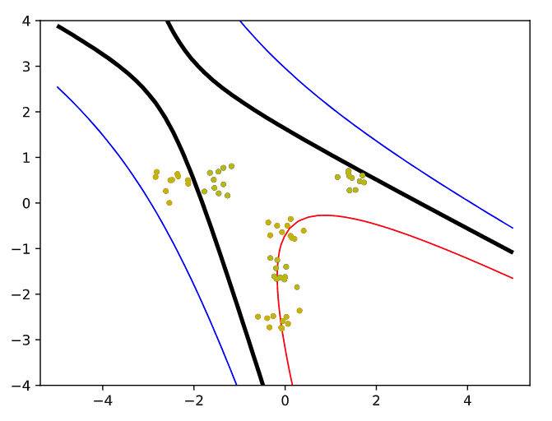
Q2+Q3: Polynomial parameters: p=2

Slide 9
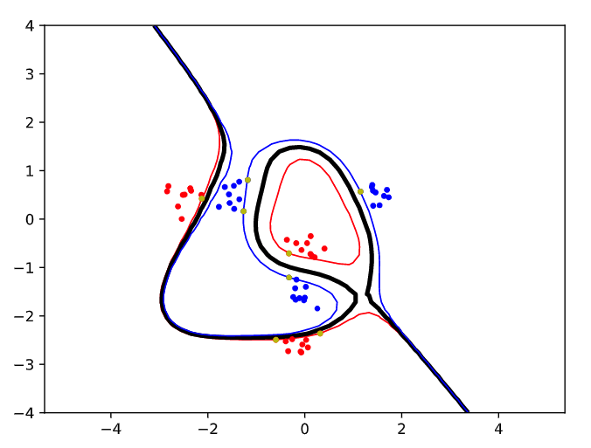
Q2+Q3: Polynomial parameters: p=5

Slide 10
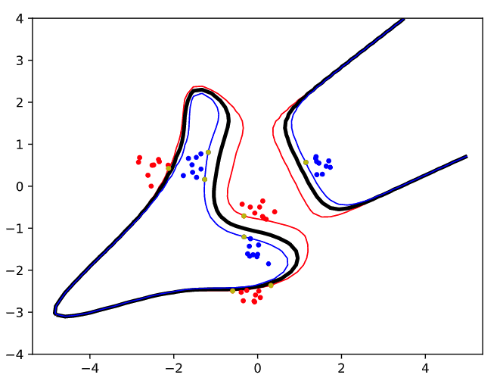
Q2+Q3: Polynomial parameters: p=6

Slide 11
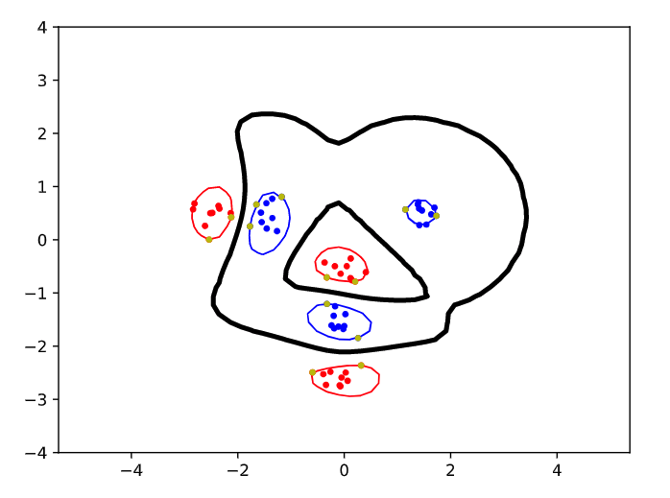
Q2+Q3: RBF parameters: sigma=0.1

Slide 12
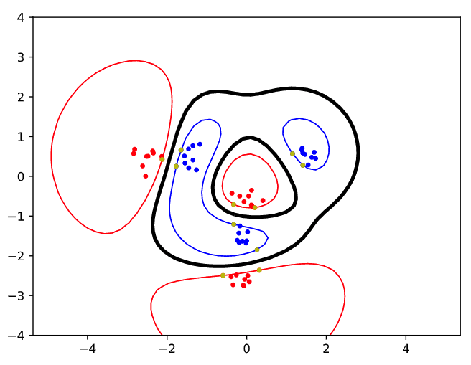
Q2+Q3: RBF parameters: sigma=1

Slide 13
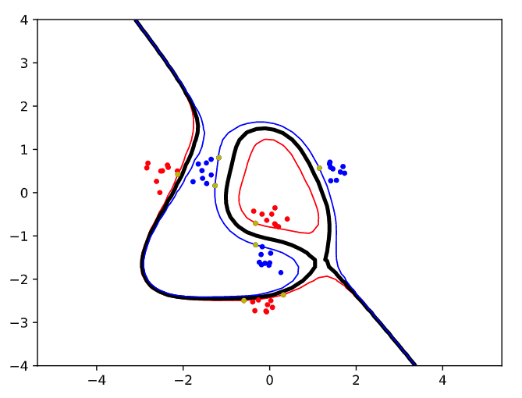
Q2+Q3: RBF parameters: sigma = 5

Slide 14
Q3: Bias-Variance Tradeoff
In the polynomial case: Higher p fits the data better because we can reach more points. But this introduces a risk of overfitting which we now leads to high variance.
In RBF case: Large sigma leads to flexible and smooth boundry, thus avoiding overfitting and high variance but leading to high bias.

Slide 15
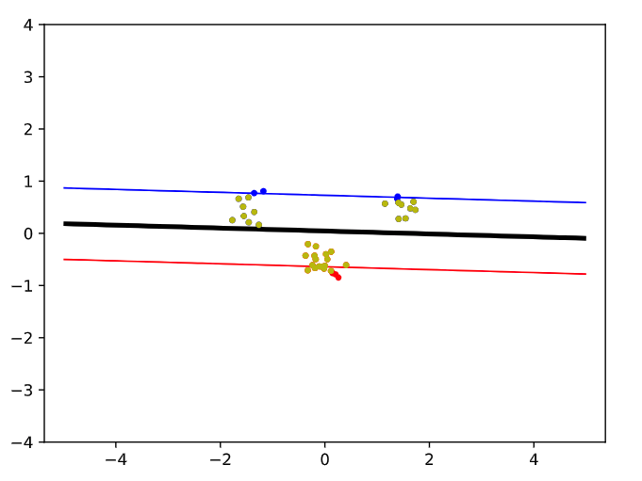
Q4: C-variable = 0.1

Slide 16
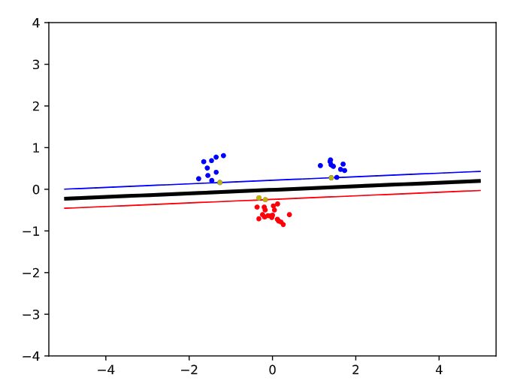
Q4: C-variable = 10

Slide 17
Q4: C-variable
C is like a penalty term. Large C penalize hard for errors => small margin. Thus very large C will move us closer to the original case where we have no upper bound for alpha.
Small C => larger margin and more missclassification. Good to use for noisy data.
C sets the relative importance of avoiding slack versus getting a wider margin.

Slide 18
Q5: More Slack versus More Complex
When the data consists of overlapping classes (for example because of noise or outliers) then we want to opt for more slack, so that the model can generalize better.
When the data consists of separate clusters of data points that are hard to separate linearly, we can opt for a more complex kernel function.

