Slide 1




Google Hangouts Translate Project
Google Project Manager: Keith Stevens
Developers: Huan-Sony Nguyen, Luna Li, Amy Lin, Zhuo Li, Xinyou Yu

Slide 2
Team Organization
Keith Stevens
Project Manager
Zhuo Li
Developer
Xinyou Yu
Developer
Huan-Sony Nguyen
Developer, Project Point
Luna Li
Developer
Amy Lin
Developer
Notes:
Amy

Slide 3
Motivation
Difficult to have a smooth conversation online between people who speak different languages.
Although there are existing applications like LINE that provide chat-box translation features, they are often inaccurate.
There are many people who have friends/family in other countries and may want to communicate in the language they are most comfortable with.
There are international businesses that would benefit greatly from an application that automatically translates speech/text during meetings with people from different countries.
Notes:
Luna

Slide 4
Problem
There is not a hassle-free way to chat with foreign language speakers
Notes:
Luna

Slide 5
Solution
We will utilize the existing Google Translate and Google Hangouts APIs to create a new automatic translate feature on top of the Hangouts video/chat-box. It will automatically translate speech and text for the user in real time.
This creates an easy way for users to simply log in to their Google account, install the add-on and chat with foreign language speakers.
Notes:
Luna

Slide 6
Requirements
Dual mode: supports both text translation and speech translation seamlessly
Interface: translation in text shown as overlaid subtitle – unobstructed video display
Live translation: translations have to be live – within 500 milliseconds
Capacity: translations should be supported for multiple users – up to 5
Language variety: multiple options for users – up to 80 choices ( * )
Mobile platform: supports mobile platform and cross-platform
Notes:
Sony

Slide 7

Use Case 1
Name: Chat Translation
Description: translates text input in one user’s chat box from one language into another user’s chat box. Each user chooses their preferred language. Initial Step-by-step:
Turn on the Translate App/plugin in Google Hangouts.
Click on the Setting icon.
Choose languages to translate from and to (in a dropdown menu)
Start typing messages in the chat box
Click Send/Enter
Notes:
Sony

Slide 8
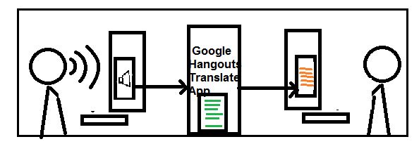
Use Case 2
Name: Voice Translation
Description: translates speeches from one user in one language to text in another user’s language. The text will be printed on the receiver’s screen (in the window displaying the speaker). Initial Step-by-step:
Turn on the Translate App/plugin in Google Hangouts.
Have the video session (in Hangouts) opened, with microphone and speakers plugged in.
Click on the Setting icon on the left hand bar.
Configure the settings by choosing languages to translate from and to
Click Accept, then start speaking into the microphone.
Notes:
Sony

Slide 9
Risk Analysis
Google Web Speech API has sixty seconds limit per translation, so if the person speaks too fast, the translation will get cut off, and may result in information loss.
Multiple people talk simultaneously in the same room confuses Google Web Speech API.
For the current mechanism, we save all chat history in local memory, so device with small memory may run out of memory.
Google Translate API has limit on the characters translated per day, so in a conversation-intensive large group meeting, Google Translate API may not be able to properly translate.
Notes:
Sony

Slide 10
Milestones
Hangouts
Translate
Chat Box Text Translation
Speech-to-Text
Finalize & Test
2 – 5 Participants
Two UI Mockups
Chat via Text & Audio / Video
2+ Languages
Live Translation
Default Conversion
Convert Speech to Text
Enforce User Consent
Limit Recording Sessions
Test Subsystems
Test Overall System
Chrome Support
Audio / Graphics UI
Present Final Version to Client
Notes:
Amy

Slide 11
Milestones
Hangouts
Translate
Chat Box Text Translation
Speech-to-Text
Finalize & Test
2 – 5 Participants
Two UI Mockups
Chat via Text & Audio / Video
2+ Languages
Live Translation
Default Conversion
Convert Speech to Text
Enforce User Consent
Limit Recording Sessions
Test Subsystems
Test Overall System
Chrome Support
Audio / Graphics UI
Present Final Version to Client
Notes:
Amy

Slide 12
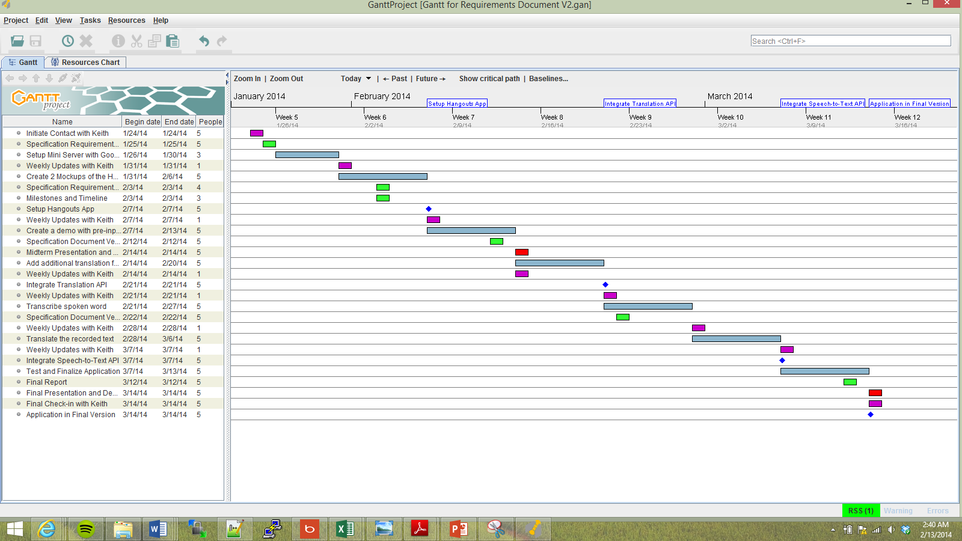
Notes:
Amy

Slide 13
Notes:
Amy

Slide 14
Overall System Diagram
Sender’s browser/client
Google Hangout Server
Receiver’s browser/client
Video
Hangouts Default Video Chat
Video
Audio
Audio
Language Setting
Speech To Text
Hangouts Shared States
Translate
Text
Text
Message
Message
Language Setting
Notes:
A-tion + Xinyou

Slide 15
Current System Design
Work as a stand alone application instead of an extension
Build a new chat system, instead of building on the built-in chat application
Type-in text and speech-converted text share the same message system
All message logs are stored in both server and clients
Translation is done based on the real time language settings
Notes:
A-tion + Xinyou

Slide 16
Demo
Notes:
A-tion + Xinyou

Slide 17
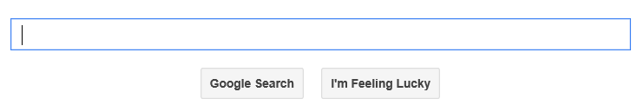
Q&A

