Slide 1
Network Flow: Ford Fulkerson’s And Edmonds Karp’s Algorithm
CSEN703/707: Analysis and Design of Algorithms project
Supervisors: Dr. Wael Abo El-Saadat, Eng. Karim Amir
Prepared by:
Ahmed Tarek 31-4177 T12, Mostafa Ibrahim 31-, Nada 31-

Slide 2
Overview and Motivation
Example problem:
Let’s say we have a connected, (integer) weighted, and directed graph as a pipe network where the edges represent pipes and vertices represent splitting points. Each edge has a weight that is the capacity that of the pipe (water flowing though it). There are also two special vertices: source s and sink t.
What is the maximum flow (rate or throughput) from the source s to sink t in this newtwork (It is as if water is flowing in the pipe network, and we want to calculate the maximum volume of water over time that can pass through the network of pipes)?
This problem is called the Maximum Flow problem (often abbreviated as just Max Flow), it belongs to the family of problems involving flow in networks and is used a lot for example (max throughput between router I and router J).

Slide 3
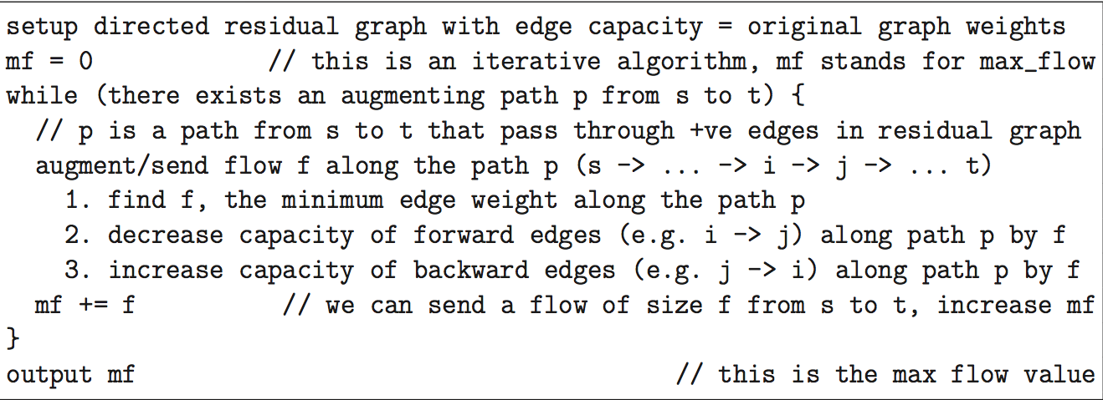
Ford Fulkerson’s Method
One solution for Max Flow is the Ford Fulkerson’s method—invented by the same Lester Randolph Ford, Jr who invented the Bellman Ford’s algorithm and Delbert Ray Fulkerson.
An approach to solve Max Flow was invented by Randolph Ford, Jr and Delbert Ray Fulkerson is Ford Fulkerson’s Method. Pseudo Code:

Slide 4
Ford Fulkerson’s Method
Description:
Ford Fulkerson’s method is an iterative algorithm that repeatedly finds augmenting path p: A path from source s to sink t that passes through +ve weighted edges in the residual graph.
After finding an augmenting path p that has f as the minimum edge weight along the path p (the throughput/bottleneck edge in this path), Ford Fulkerson’s method does the following: Decreasing the capacity of forward (i → j) and increasing the capacity of backward (j → i) edges along path p by f.
Ford Fulkerson’s method will keep doing this process until there is no more possible augmenting path from source s to sink t anymore which implies that the total flow so far is the maximum flow.

Slide 5
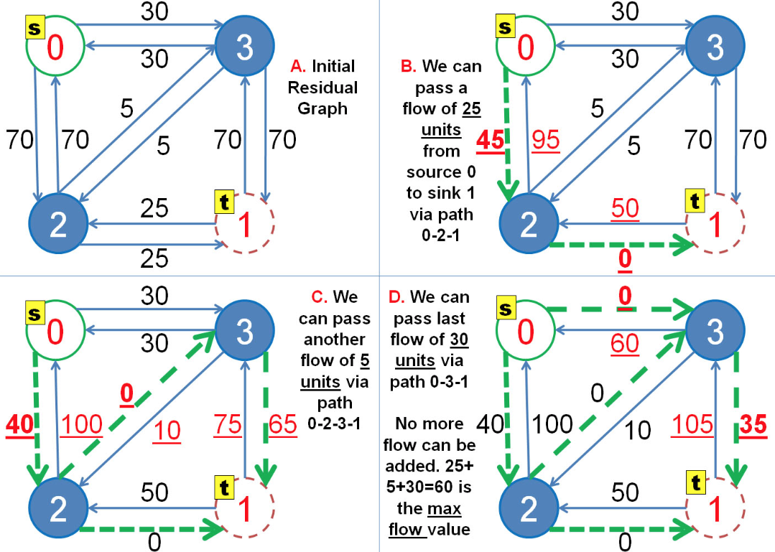
Ford Fulkerson’s Method
Visualization:

Slide 6
Ford Fulkerson’s Method
Explanation:
The reason for decreasing the capacity of forward edge is because by sending a flow through augmenting path p, we will decrease the remaining (residual) capacities of the (forward) edges used in p since it was used up.
The reason for increasing the capacity of backward edges may not be that obvious, but this step is important for the correctness of Ford Fulkerson’s method. By increasing the capacity of a backward edge (j → i), Ford Fulkerson’s method allows future iteration (flow) to cancel (part of) the capacity used by a forward edge (i → j) that was incorrectly used by some earlier flow(s).

Slide 7
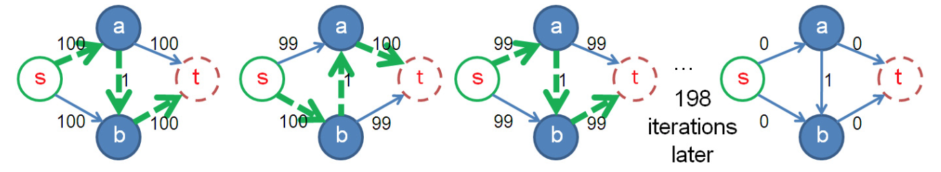
Ford Fulkerson’s Method
Implementation methods and Asymptotic time (worst case scenario):
There are multiple ways to find an augmenting s-t path in the pseudo code above each with different behavior. In this presentation, we discuss two of these ways: via DFS or via BFS.
DFS:
DFS may run in O(|f∗|E) where |f∗| is the Max Flow mf value. This is because if the input network was as the figure below.
Encountering a situation where two augmenting paths: s→a→b→t and s→b→a→t only decrease the (forward) edge capacities along the path by 1. In the worst case, this is repeated |f∗| times (200 times in the figure below).
Because DFS runs in O(E) in a flow. graph, the overall time complexity is O(|f∗|E). We do not want this unpredictability since the problem may have a (very) large |f∗| value. This is why BFS is usually used.

Slide 8
Edmonds Karp’s Algorithm
A variation and a better implementation of the Ford Fulkerson’s method is to find the shortest path in terms of number of layers/hops between s and t using BFS instead of DFS.
This algorithm was discovered by Jack Edmonds and Richard Manning Karp, thus named as Edmonds Karp’s algorithm.
The algorithm runs in O(VE2) as it can be proven that after O(VE) BFS iterations, all augmenting paths will already be exhausted.
s BFS runs in O(E) in a flow graph, the overall time complexity is O(V E2). Edmonds Karp’s only needs two s-t paths in the previous network : s→a→t (2 hops, send 100 unit flow) and s→b→t (2 hops, send another 100). That is, it does not get trapped to send flow via the longer paths (3 hops): s→a→b→t (or s→b→a→t).
The simplest Edmonds Karp’s code uses only Adjacency Matrix named as res with size O(V 2) to store the residual capacity of each edge.
This version—which runs in O(V E) BFS iterations × O(V 2) per BFS due to Adjacency Matrix = O(V 3E)—is fast enough to solve some (small-size) Max Flow problems only. (when to use and when not to use)
Visualization: https://visualgo.net/maxflow

Slide 9
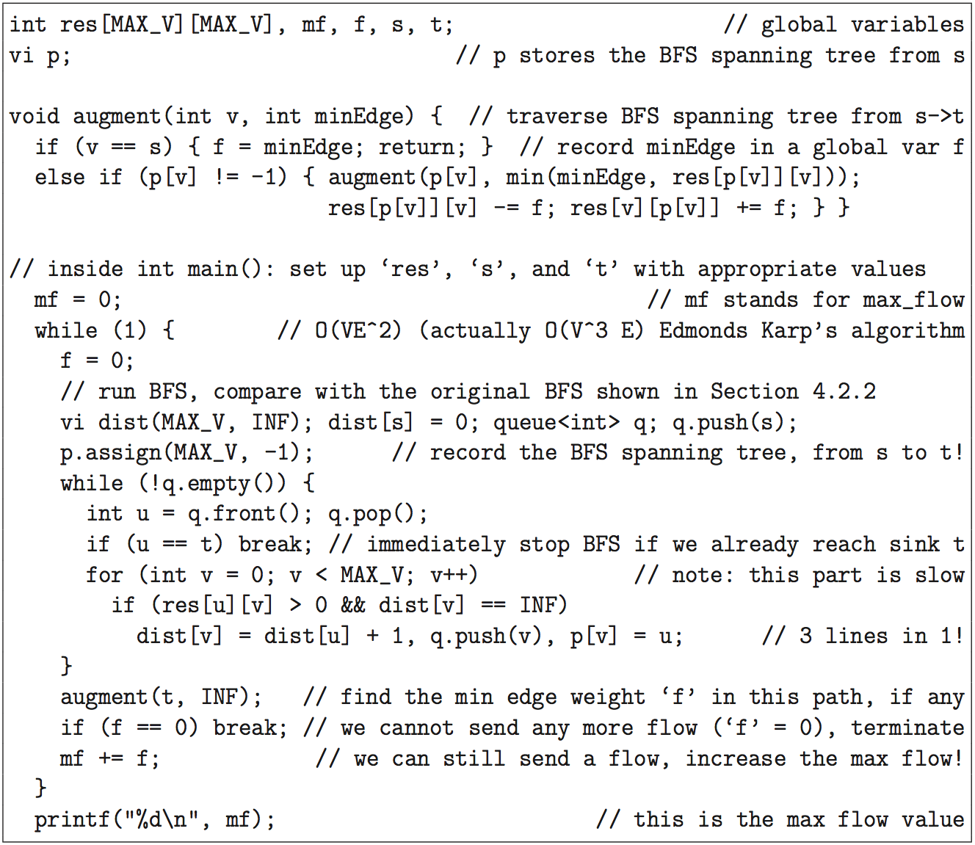
Edmonds Karp’s Algorithm

Slide 10
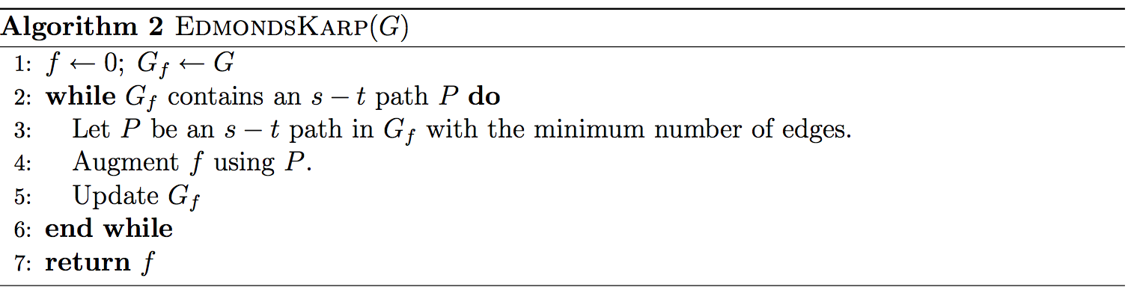
Edmonds Karp’s Algorithm
Pseudo Code:

Slide 11
Edmonds Karp’s Algorithm
When to use:
This version—which runs in O(V E) BFS iterations × O(V 2) per BFS due to Adjacency Matrix = O(V 3E) is fast enough to solve most (small-size) Max Flow problems Quickly otherwise faster (newer) alternatives are quicker.
Faster network flow algorithms have been discovered.
There is an algorithm due to Dinic that is very similar in spirit to Edmonds-Karp but achieves a running time of O(mn2).
The fastest known algorithm, due to Goldberg and Rao, has a running time of O(mmin{n2/3,m1/2}log(n2/m)log(U)), provided that the edge capacities are integers between 1 and U.
When Not to use (Extreme Floating Points):
This version runs very slowly with extremely large inputs.
The behavior of the algorithm with irrational inputs explains its worst-case behavior in practice given floating-point capacities, terrible!!
Even with very reasonable capacities, a careless implementation of Ford-Fulkerson could enter an infinite loop simply because of round-off error.

Slide 12
Edmonds Karp’s Algorithm
Variations:
There is an algorithm due to Dinic that is very similar in spirit to Edmonds-Karp but achieves a running time of O(mn2).
A modification of Dinic’s algorithm using fancy data structures achieves running time O(m nlogn).
The preflow-push algorithm, of Kleinberg-Tardos, has a running time of O(n3).
The fastest known algorithm, due to Goldberg and Rao, has a running time of O(m*min{n2/3,m1/2}*log(n2/m)*log(U)), provided that the edge capacities are integers between 1 and U.
These variations all have the pro of being quicker but with the tradeoff (con) of being harder to implement since they are more complex.
Dinic’s algorithm has the cons of utilizing fancy data-structures costing space.
Goldberg and Rao’s run extremely fast provided that the edge capacities are integers between 1 and U.

Slide 13
References
Competitive programming, Steve halim & Felix
http://research.ijcaonline.org/volume37/number1/pxc3876624.pdf
http://www.cse.unt.edu/~tarau/teaching/AnAlgo/Edmonds%E2%80%93Karp%20algorithm.pdf
http://www.cs.cornell.edu/courses/cs4820/2011sp/handouts/edmondskarp.pdf

