Slide 1
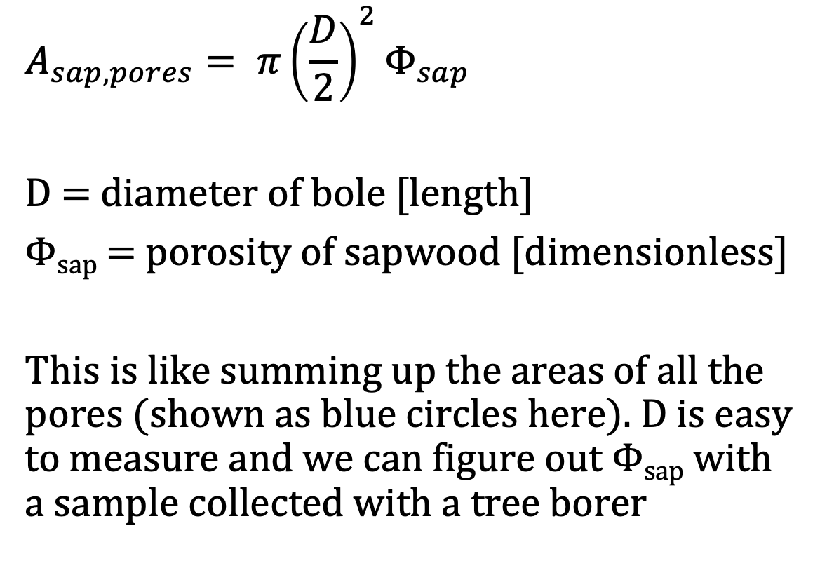
What is the cross-sectional pore area through which sap flows in the sapwood?
$$A_{sap,pores}= π{\left(\frac{D}{2}\right)}^{2}Φ_{sap}$$
D = diameter of bole [length]
Φ_{sap} = porosity of sapwood [dimensionless]
This is like summing up the areas of all the pores (shown as blue circles here). D is easy to measure and we can figure out Φ_{sap} with a sample collected with a tree borer

Slide 2
Sap flow sensors give us instantaneous sap velocities (v)
And v changes with time over each day.
The sensor only captures this for part of the bole, but we can generally assume that the value (or at least its relative change over time) is reasonably representative across the bole
v is length/time

Slide 3
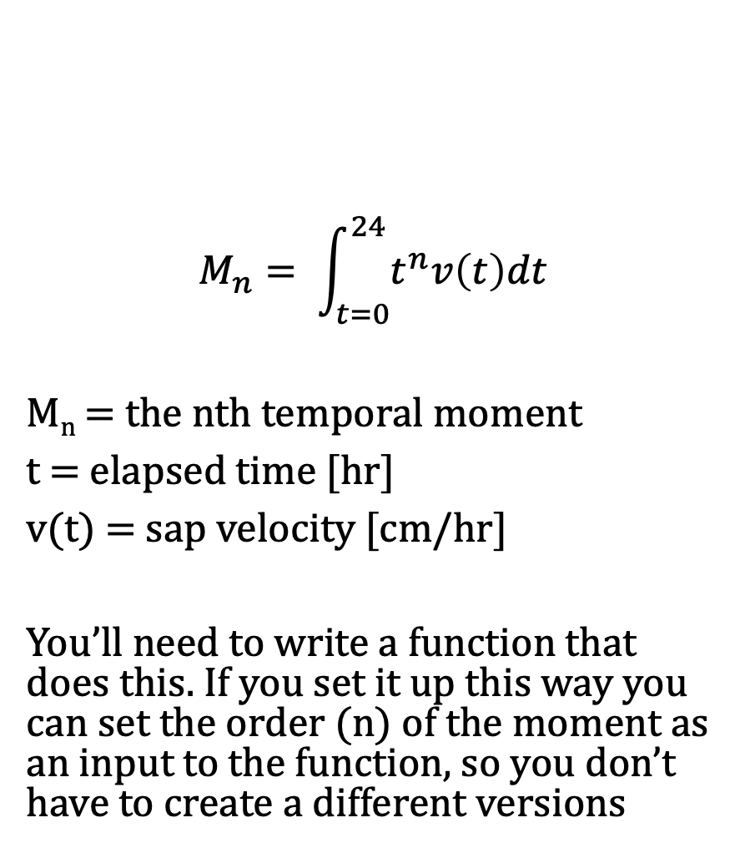
Diel temporal moments
$$M_{n}= \int_{t=0}^{24}{t^{n}v\left(t\right)dt}$$
M_{n} = the nth temporal moment
t = elapsed time [hr]
v(t) = sap velocity [cm/hr]
You’ll need to write a function that does this. If you set it up this way you can set the order (n) of the moment as an input to the function, so you don’t have to create a different versions

Slide 4
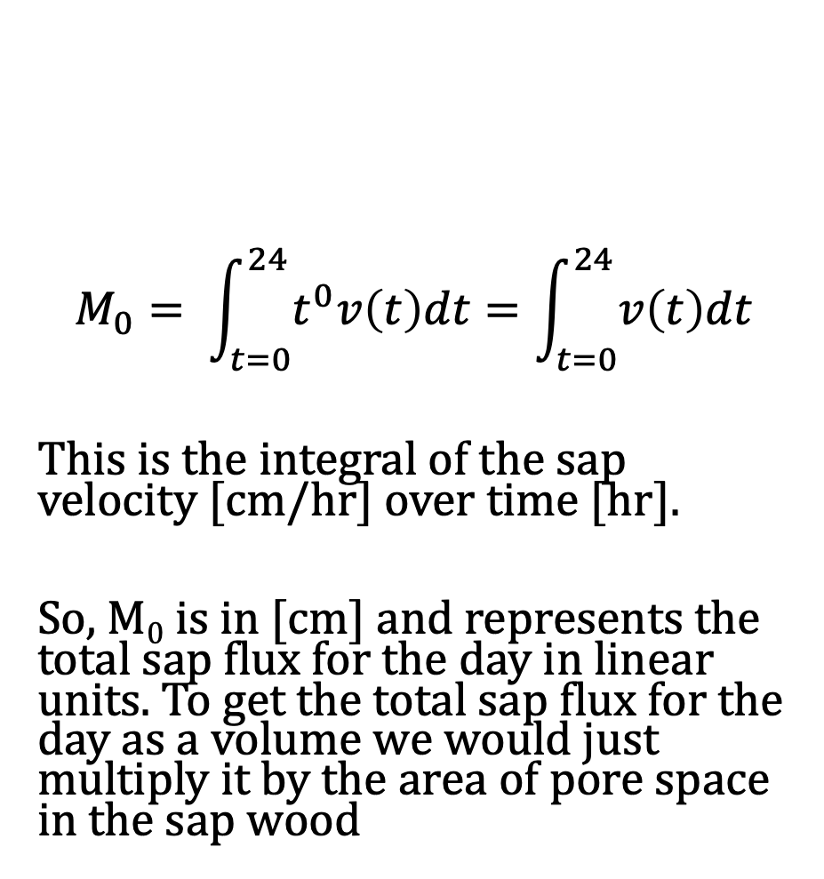
Zeroth temporal moment = diel sap flux
$$M_{0}= \int_{t=0}^{24}{t^{0}v\left(t\right)dt}=\int_{t=0}^{24}{v\left(t\right)dt}$$
This is the integral of the sap velocity [cm/hr] over time [hr].
So, M₀ is in [cm] and represents the total sap flux for the day in linear units. To get the total sap flux for the day as a volume we would just multiply it by the area of pore space in the sap wood

Slide 5
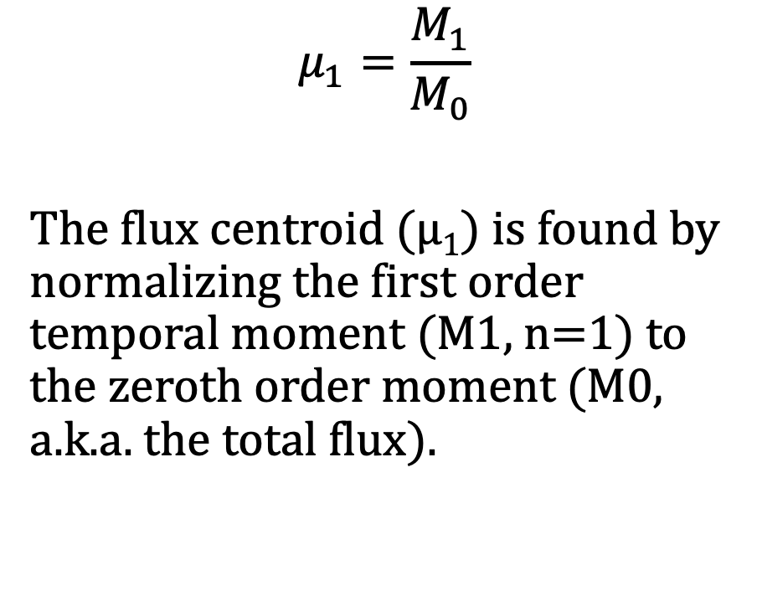
Flux centroid
$$μ_{1}=\frac{M_{1}}{M_{0}}$$
The flux centroid (μ₁) is found by normalizing the first order temporal moment (M1, n=1) to the zeroth order moment (M0, a.k.a. the total flux).

Slide 6
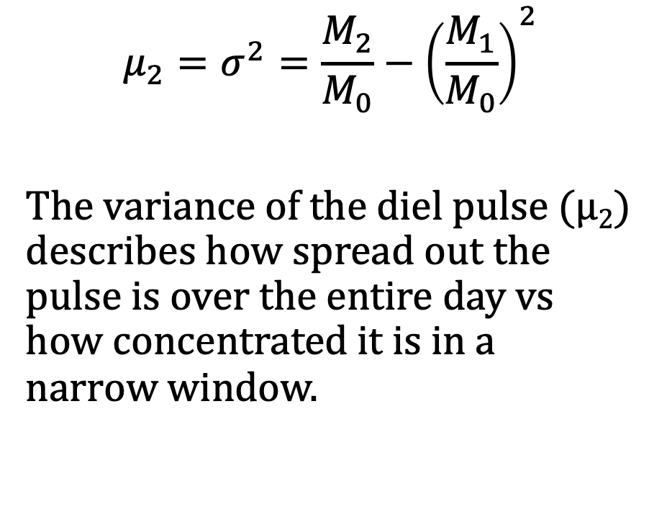
Variance of the pulse
$$μ_{2}=σ^{2}=\frac{M_{2}}{M_{0}}−{\left(\frac{M_{1}}{M_{0}}\right)}^{2}$$
The variance of the diel pulse (μ₂) describes how spread out the pulse is over the entire day vs how concentrated it is in a narrow window.

Slide 7
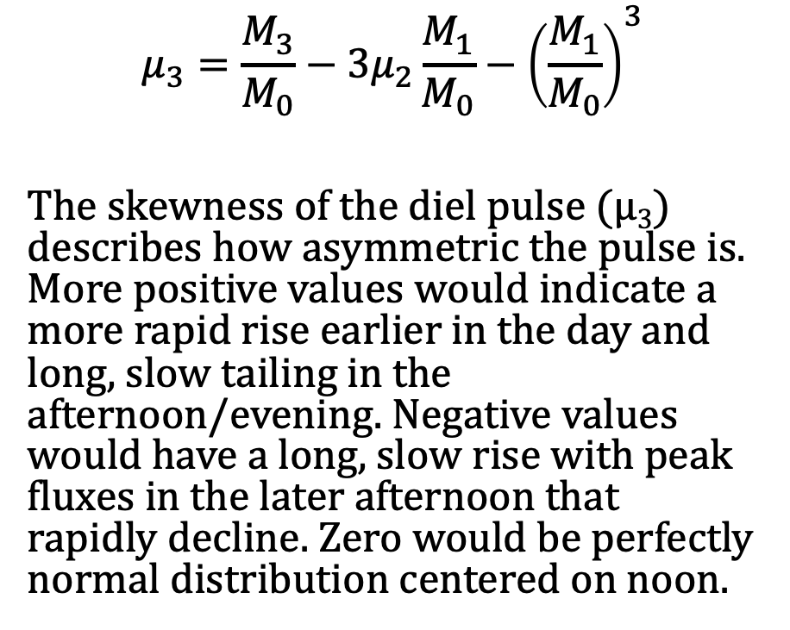
Skewness of the pulse
$$μ_{3}=\frac{M_{3}}{M_{0}}−3μ_{2}\frac{M_{1}}{M_{0}}−{\left(\frac{M_{1}}{M_{0}}\right)}^{3}$$
The skewness of the diel pulse (μ₃) describes how asymmetric the pulse is. More positive values would indicate a more rapid rise earlier in the day and long, slow tailing in the afternoon/evening. Negative values would have a long, slow rise with peak fluxes in the later afternoon that rapidly decline. Zero would be perfectly normal distribution centered on noon.

Slide 8
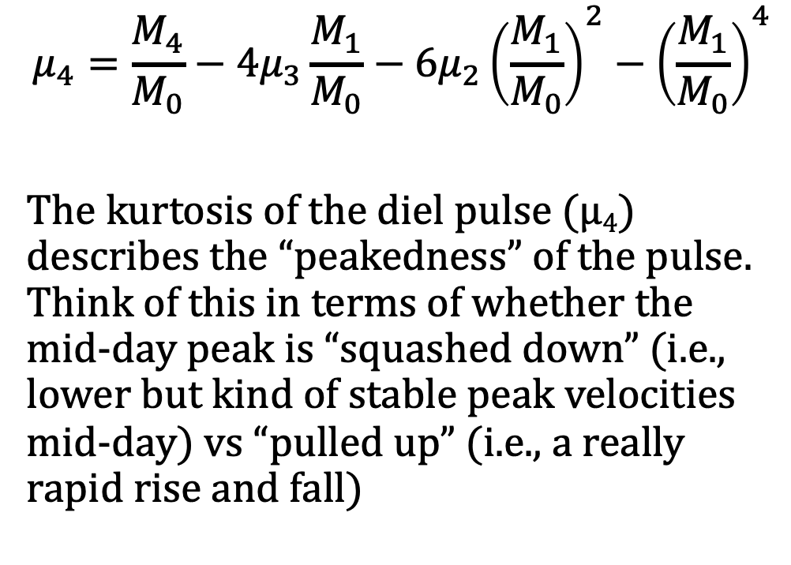
Kurtosis of the pulse
$$μ_{4}=\frac{M_{4}}{M_{0}}−4μ_{3}\frac{M_{1}}{M_{0}}−6μ_{2}{\left(\frac{M_{1}}{M_{0}}\right)}^{2}−{\left(\frac{M_{1}}{M_{0}}\right)}^{4}$$
The kurtosis of the diel pulse (μ₄) describes the “peakedness” of the pulse. Think of this in terms of whether the mid-day peak is “squashed down” (i.e., lower but kind of stable peak velocities mid-day) vs “pulled up” (i.e., a really rapid rise and fall)

