Slide 1
LUT Based HW Implementations of
Hopfield Neural Nets

Slide 2
Hopfield Neural Networks
Fully connected recurrent network — N bipolar neurons, sᵢ ∈ {-1, +1}
Symmetric weight matrix W with zero diagonal — no self-connections
Training writes W once; stores M patterns as energy minima
Energy: E(s) = −½ sᵀWs — stored patterns sit at local minima
Inference: start from corrupted input, converge to nearest stored memory
Unlike deep nets — no layers, no backprop, no gradient descent at inference

Slide 3
Hebbian Learning
Wᵢⱼ = (1/N) Σ_μ ξᵢ^μ ξⱼ^μ , Wᵢᵢ = 0
Neurons that agree in a pattern → positive weight; disagree → negative
All M patterns accumulated in one shot — no iterations, order-independent
Local: Wᵢⱼ depends only on neurons i and j across patterns
Incremental: new pattern = rank-1 update ΔW = ξξᵀ / N
Storage capacity ≈ 0.138N — spurious states dominate above this
Note: inverted patterns (−ξ) are also attractors

Slide 4
Storkey Learning
ΔW = (1/N)(ξ^μ(ξ^μ)ᵀ − h(ξ^μ)ᵀ − ξ^μ hᵀ), hᵢ = Σⱼ≠ᵢ Wᵢⱼ ξⱼ^μ
hᵢ = local field — what current weights already predict for pattern μ
Correction terms subtract existing crosstalk before writing the new pattern
Updated once per pattern, in presentation order — earlier patterns may be overwritten
Local and incremental: bounded work per pattern, no global recomputation
Storage capacity ≈ 0.14–0.22N — significantly better than Hebbian
~2× compute per pattern vs Hebbian, but far fewer spurious states above capacity

Slide 5
Pseudo-inverse Learning
W = Ξ (ΞᵀΞ)⁻¹ Ξᵀ where Ξ = [ξ¹|…|ξᴹ] (N×M pattern matrix)
Theoretically optimal — stores up to N linearly independent patterns
Weights W form the orthogonal projection onto the pattern subspace
NOT incremental: one new pattern → full pseudo-inverse recomputed over all M patterns
NOT local: each Wᵢⱼ depends on all M patterns simultaneously via matrix inversion
Hardware cost: O(N²M + M³) matrix inversion — no online update circuit is feasible
For our project (offline training → static LUT): technically usable, but Storkey preferred

Slide 6
Local & Incremental — Why It Matters
Local:
Wᵢⱼ is determined only by neurons i and j — no global communication during training
Maps directly to hardware: each weight update is an independent multiply-accumulate
Incremental:
Add patterns one at a time — bounded, fixed work per pattern (rank-1 update)
Hardware relearning: Storkey → small fixed update circuit
Hardware relearning: pseudo-inverse → full matrix inverter on chip — impractical
Pseudo-inverse: global (all patterns coupled) + batch (all patterns needed at once)

Slide 7
Inference Process
sᵢ ← sign( hᵢ ), hᵢ = Σⱼ Wᵢⱼ sⱼ (local field — weighted vote)
Each neuron checks its neighbours: positive field → +1, negative field → −1
Tie (hᵢ = 0): hold current state — no change
Sweep through all neurons repeatedly until no neuron changes state
Fixed point = stored memory (perfect recall) or spurious state (above capacity)
LUT insight: sign(hᵢ) is a Boolean function of N binary inputs → truth table
Only the sign matters, not the magnitude — hardware needs no multiplier

Slide 8
Update Order Semantics
Async-cyclic (chosen for hardware):
One neuron per clock cycle, fixed order 0→1→…→N−1, repeat. Fully deterministic
Async-random:
Random order each sweep — unbiased, same convergence guarantee as cyclic
Sync:
All N neurons update simultaneously — fast throughput but unsafe (2-cycles possible)
Convergence proof (async only): each flip ΔE = −hᵢΔsᵢ ≤ 0 — energy never increases
Goles & Olivos (1980): sync with symmetric W → fixed point OR infinite 2-cycle oscillation

Slide 9
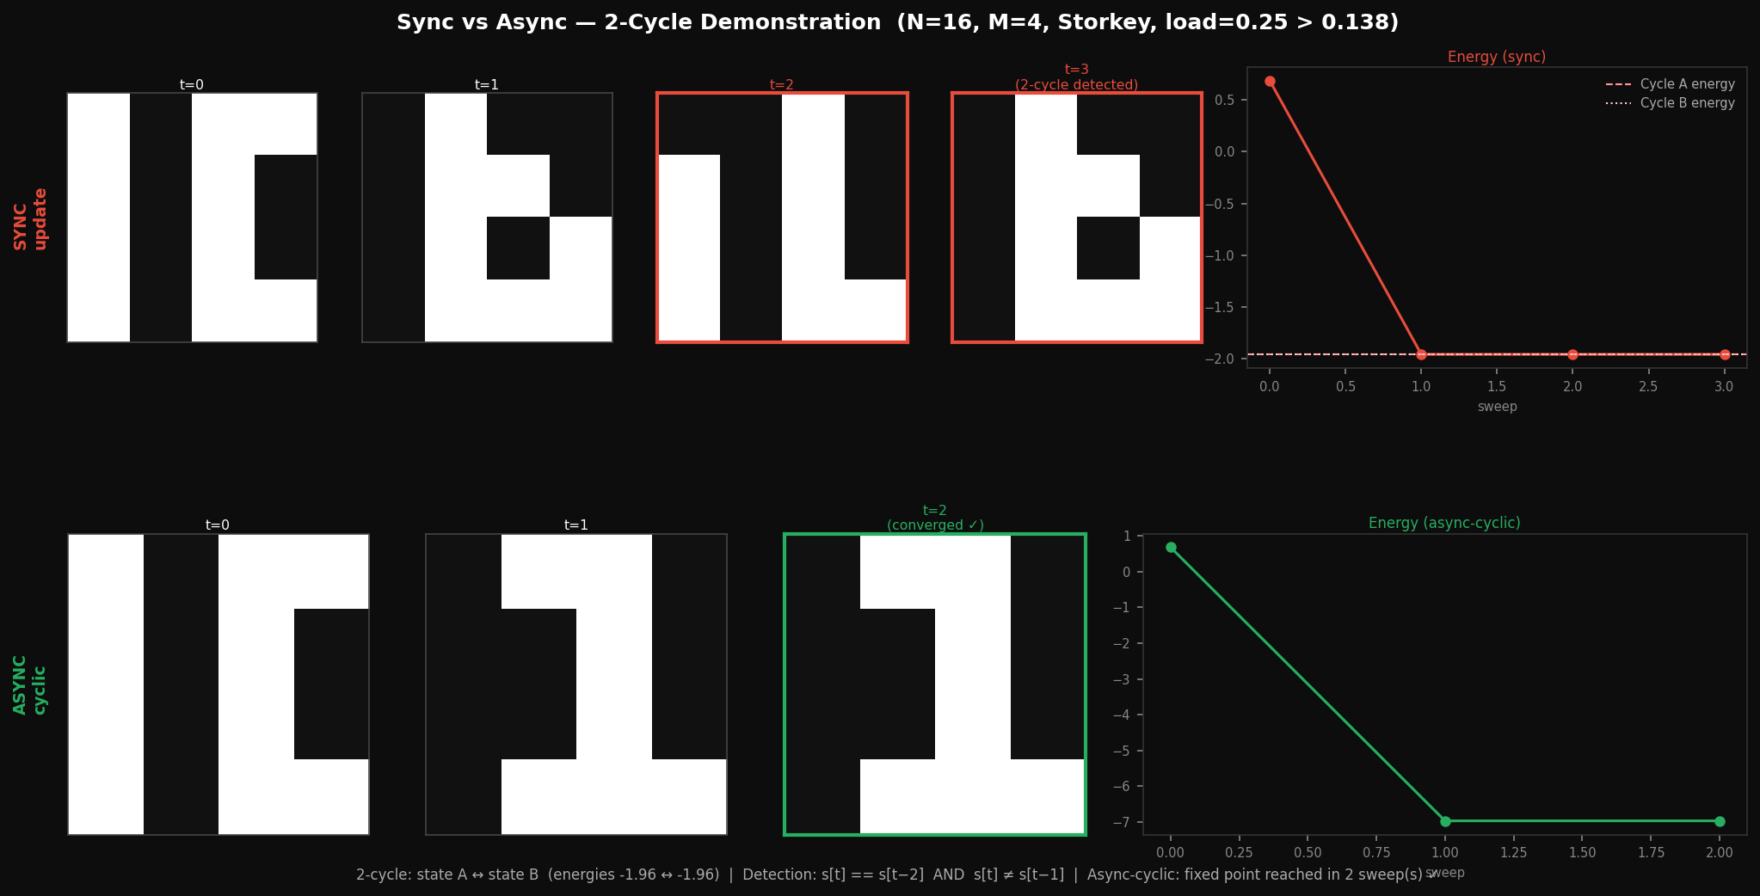
The 2-Cycle Problem (Sync Update)
2-cycle: states A and B where sync(A) = B and sync(B) = A — infinite oscillation
Same weights, same start — only update mode differs (top row sync, bottom async-cyclic)
Detection rule: s[t] == s[t−2] AND s[t] ≠ s[t−1]
Not an edge case — demonstrated with M=4 patterns in N=16 above capacity (load = 0.25)
Hardware sync implementation must include a 2-cycle detector to guarantee termination

Slide 10
Training Code Capabilities
Learning rules — one-line switch:
RULE = STORKEY / HEBBIAN (sim/python/hopfield_net.py, line 20)
Update modes — one-line switch:
UPDATE_MODE = ASYNC_CYCLIC / ASYNC_RANDOM / SYNC
Benchmark sweep (sim/python/benchmark.py):
N ∈ {6,8,10,12,14,16}, load M/N up to 0.30, 9 noise levels, 50 trials per point
Metrics: recall accuracy, basin width, spurious rate, mean convergence sweeps
Output: timestamped CSV → sim/results/, plots → sim/plots/

Slide 11
Datasets & Benchmarks
Random binary (built-in):
Synthetic N-bit patterns, M configurable — fully reproducible, no external data
sklearn 8×8 digits (built-in, no internet):
1,797 hand-written digit images (0–9), binarised at threshold 8 → {−1, +1}
Key results from benchmark sweep:
Both rules: zero spurious rate below 0.138N — matches theoretical capacity exactly
Above capacity (N=8, load=0.38): Hebbian → 79% spurious; Storkey → ~0%
Basin width scales with N: N=16, M=1 → 6 bits; N=6, M=1 → 2 bits

Slide 12
LUT Synthesis Pipeline
W (N×N weights, Python)
↓ truth_table_gen.py → 2ᴺ rows per neuron (.pla format)
↓ Espresso minimiser → minimal Sum-of-Products Boolean expression
↓ sv_emitter.py → SystemVerilog always_comb blocks
↓ Quartus synthesis → LUT-mapped netlist on Cyclone V FPGA
Hazard-free mode: Espresso -Dhazard adds consensus terms — safe for single-variable transitions
Feasibility: N≤10 comfortable (~1K rows/neuron), N=16 borderline (~64K rows)
N>16 → sparse: keep F strongest weights per neuron → 2ᶠ rows (LogicNets approach)

Slide 13
Research Roadmap
Phase 1 (next step): Clocked Baseline
Python training → truth tables → Espresso → clocked SystemVerilog → ModelSim + Quartus
One flip-flop per neuron, one LUT evaluation per clock cycle, counter FSM
Goal: formal termination proof by energy argument, ModelSim RTL vs Python agreement
Phase 2: Async Combinational Feedback
Strip flip-flops — wire LUT outputs directly back to inputs
Demonstrate convergence without clock; analyse hazard-free correctness
Phase 3: Ising Machine
Encode NP-hard problem instance as weight matrix W — run hardware to find ground state
Approximate combinatorial optimisation using the same LUT synthesis pipeline

Slide 14
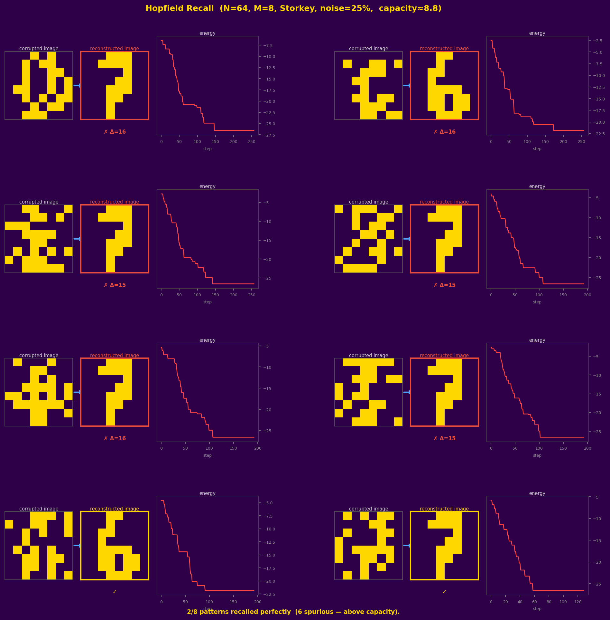
Demo: Hopfield Recall
N=64, M=8 patterns (load = 0.125, below 0.138N capacity)
sklearn 8×8 digits 0–7, binarised — 25% pixel noise, Storkey, async-cyclic
All 8 patterns recalled perfectly in ≤ 2 sweeps = ≤ 128 clock cycles
Energy curve per neuron-update step — strictly decreasing to fixed point

