Slide 1
Binary Hopfield Networks
Training & Inference
May 19 Meeting - ECE SRIP - Code Review, Deep Dive & MNIST Demo
s - {-1, +1}

Slide 2
Today's Agenda
01
Code & Repo Overview
Python pipeline, C sim, RTL - what each file does
02
Datasets & Specs
What data we're using, format, size, evaluation protocol
03
Training Deep Dive
Hebbian rule, Storkey rule, comparison table
04
Inference & Convergence
Async/sync update, energy function, fixed-point detection
05
MNIST Visualization
Live demo: store digits - corrupt - retrieve - energy

Slide 3
01
Code & Repo Overview

Slide 4
01 - Code & Repo Overview - Pipeline at a Glance
Patterns
(-1 vectors)
hopfield_train.py
Hebbian / Storkey
- W matrix
truth_table_gen.py
Enumerate 2- inputs
- per-neuron TT
logic_minimize.py
Quine-McCluskey
- SOP cover
sv_export.py
Emit SV assign
- .sv file
RTL / FPGA
(Artix-7)
c_sim/
Independent reference
(cross-verify)
- Python | C Sim | RTL Output
python/hopfield_train.py - python/truth_table_gen.py - python/logic_minimize.py
python/sv_export.py - python/pipeline.py | c_sim/hopfield_train.c - hopfield_sim.c - hopfield.h
rtl/hopfield_top.sv - neuron_bank.sv - weight_rom.sv - update_ctrl.sv

Slide 5
01 - Code Chunks - Specifications
File | Purpose | Key Functions | In - Out
hopfield_train.py | Hebbian & Storkey weight learning | train_hebbian() train_storkey() update_async() energy() | Pattern list - W.npy
truth_table_gen.py | Enumerate neuron update functions | enumerate_truth_tables() save_csv() save_json() | W.npy - TT CSV + JSON
logic_minimize.py | Q-M Boolean minimization + hazard-free cover | minimize_all() hazard_free_cover() | Truth tables - SOP cover
sv_export.py | SystemVerilog code generation | generate_sv() | Cover + TT - .sv file
pipeline.py | End-to-end driver script | stage_train/tt/minimize/sv() | CLI args - all artifacts
hopfield_train.c | C weight computation | hopfield_train_hebbian() hopfield_train_storkey() | Pattern arrays - W.txt
hopfield_sim.c | C simulation + demo main() | hopfield_run_async/sync() hopfield_energy() | W + state - converged state

Slide 6
02 - Datasets & Evaluation Protocol
Random Bipolar (Small)
Random Bipolar (Medium)
N = 8 neurons - P = 3 patterns
Dtype: int8 -1 | Seed: 42
N = 16 neurons - P = 4 patterns
Dtype: int8 -1 | Seed: 42
Default pipeline demo, SV synthesis
Scalability testing, C sim
Capacity: ~1 pattern (alpha=0.138)
Capacity: ~2 patterns
sklearn Digits (8-8)
Custom Pattern File
N = 64 neurons - P = 5 patterns
Binarised MNIST-like -1
.txt - one row per pattern
Space-separated -1 integers
MNIST demo, visual verification
Application-specific data
Capacity: ~9 patterns
Variable by N and P
Evaluation: store P patterns - corrupt each with k bit-flips - run updates - check overlap m = (1/N) xi.s -> 1.0 = perfect recall

Slide 7
03
Training Deep Dive

Slide 8
03 - Hebbian Learning (Outer-Product Rule)
W = (1/N) * Sum_mu xi_mu * (xi_mu)^T with W_ii = 0
Each term xi_i * xi_j reinforces connections between neurons that agree in pattern mu. Diagonal zeroed - no self-excitation.
One-Shot
Capacity
Full W computed in one pass over all patterns. O(N-P) time.
alpha_max ~= 0.138 -> ~0.138N patterns reliably stored
Spurious States
Hardware-Friendly
Inverted patterns (-) and mixtures are also attractors
Simple outer-product sum; weights are integers if N is small
W = np.zeros((N, N))
for xi in patterns: W += np.outer(xi, xi)
W /= N; np.fill_diagonal(W, 0)

Slide 9
03 - Storkey Learning Rule (Higher Capacity)
W <- W + (1/N) [ xi*xi^T - h*xi^T - xi*h^T ]
where h_i = Sum_{k!=i} W_ik * xi_k (local field from current weights, excluding diagonal)
Correction terms h- + -h- subtract interference from previously stored patterns. Applied once per pattern, in order.
Hebbian
Storkey
One-shot (batch)
Sequential (online)
- - 0.138N
- - 0.14-0.22N
More spurious states
Fewer spurious states
Order-independent
Order-dependent
Simpler to implement
2- compute per pattern

Slide 10
03 - Training Methods Comparison
Property | Hebbian | Storkey | Pseudo-Inverse
Capacity (alpha = P/N) | ~0.138 | ~0.14-0.22 | 1.0 (exact up to N)
Computation | O(N-P) | O(N-P) | O(N-P + inverse)
One-shot learning? | YES | NO - Sequential | YES (batch)
Error correction | None | Partial | Perfect
Spurious attractors | Many | Fewer | Fewest
Hardware-friendly? | YES - Very | YES | CAUTION - Expensive
In this codebase? | YES | YES | NO

Slide 11
04
Inference & Convergence

Slide 12
04 - Inference (Retrieval) - How It Works
s_i = sign( Sum_j W_ij * s_j ) = sign( h_i )
Apply to one neuron at a time (async) or all at once (sync) - repeat until fixed point
Asynchronous Update
Synchronous Update
One random neuron updated per step
ALL neurons updated simultaneously
Energy E = -(1/2) s^T W s monotonically decreases
Maps to single clock-cycle RTL update
Convergence to fixed point GUARANTEED
Can oscillate (2-cycles) - not always a fixed pt
Used in Python + C simulation
Used in hardware FSM (COMPUTE state)
steps - 10-20 - N for reliable recall
Fixed-point check after each full round
RTL FSM (update_ctrl.sv): IDLE - COMPUTE - CHECK_FP - DONE
CHECK_FP: compare state_before vs state_after - equality signals convergence

Slide 13
04 - Lyapunov Energy Function - Why Convergence Is Guaranteed
E(s) = -(1/2) s^T W s = -(1/2) Sum_{i,j} W_ij * s_i * s_j
Bounded Below
Non-Increasing
W is finite & symmetric - E has a global minimum
Each async update satisfies: Delta_E = -(s_i_new - s_i)*h_i <= 0
Fixed Points = Minima
Finite State Space
A state with no lower-energy neighbor is a fixed point
{-1,+1}^N has 2^N states - must reach minimum in finite steps
- Spurious Attractors
Stored patterns are designed to be energy minima, but other minima exist too:
- Inverted patterns (-) are always fixed points
- Mixture states (average of k stored patterns) emerge near capacity
The network can 'recall' these instead of a stored pattern - happens more near - - 0.138

Slide 14
05
MNIST Visualization - Store, Corrupt & Retrieve

Slide 15
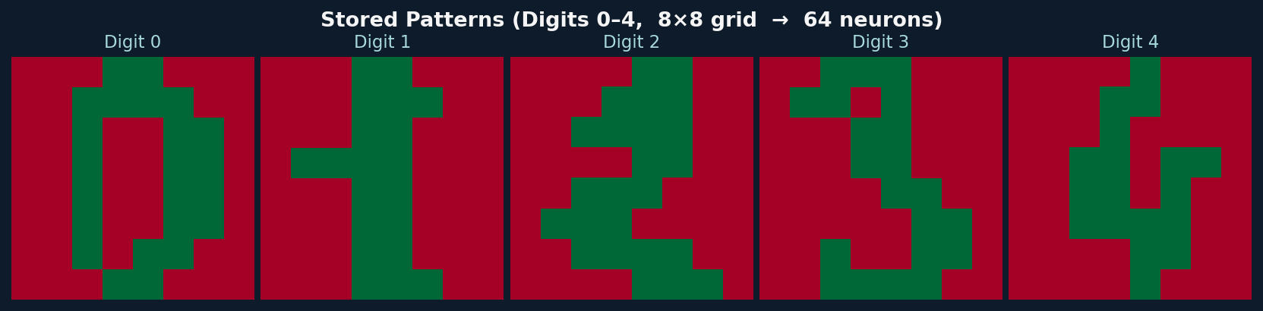
05 - Stored Digit Patterns (sklearn 8-8 Digits, binarised to -1)
5 digit templates (digits 0-4) stored as bipolar vectors of length 64. Green = +1 (active neuron), Red = -1 (inactive neuron).
N = 64 neurons
P = 5 patterns
Hebbian training
Capacity
8-8 pixel grid per digit
Digits 0, 1, 2, 3, 4
W = (1/64) * Sum_mu xi_mu (xi_mu)^T
~9 patterns before recall degrades
Training: Hebbian rule applied once to all 5 patterns simultaneously - W is 64-64 symmetric matrix with W_ii = 0

Slide 16
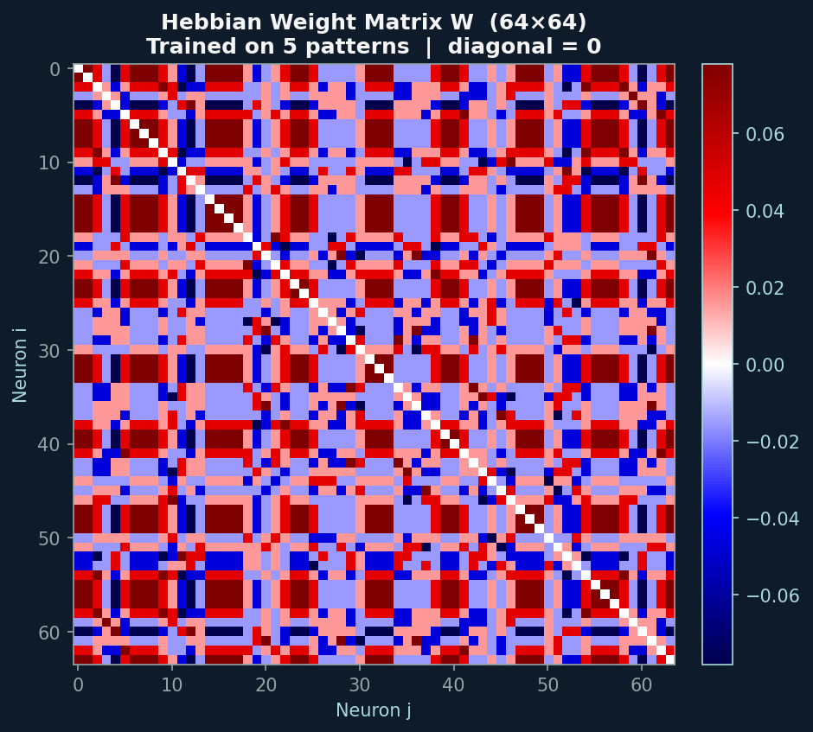
05 - Learned Weight Matrix W (64-64 Hebbian)
Red = strong negative weight (neurons tend to disagree). Blue = strong positive weight (neurons tend to agree). Diagonal is forced to zero - no self-connections.
W_ij = (1/N) * sum_mu xi_i^mu * xi_j^mu | W_ij = W_ji | W_ii = 0

Slide 17
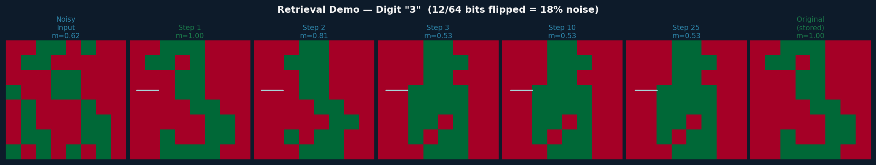
05 - Retrieval Demo - Digit "3" with 12/64 bits corrupted (~19% noise, 25 sync steps)
Starting from a noisy probe (19% of bits flipped), synchronous updates converge to the stored "3" pattern within a few steps. Overlap m = (1/N) xi.s -> 1.0.
Noisy Input
Steps 1-3
Step 10-25
Original
19% bits flipped
from stored digit
Most neurons snap
to correct state fast
Residual errors
corrected, m - 1.0
Ground truth
stored pattern

Slide 18
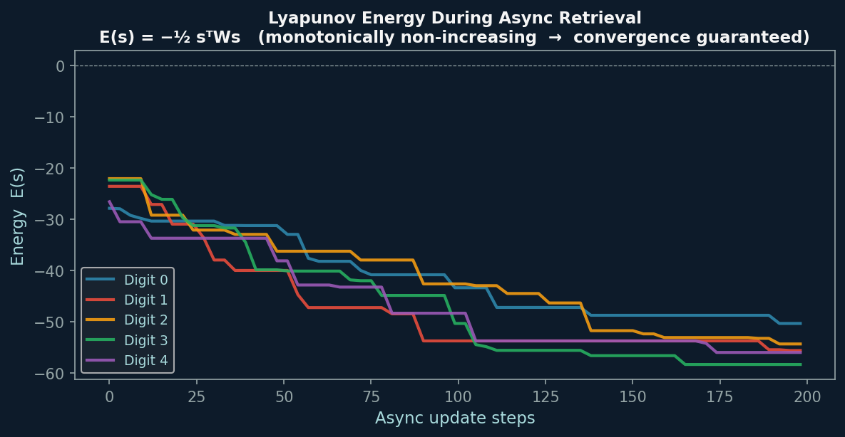
05 - Lyapunov Energy During Async Retrieval (5 digits, 8 bits corrupted each)
Energy decreases monotonically with each asynchronous update step - provably. All five digit patterns converge to stable energy minima within ~100 steps for N=64.
E(s) = -(1/2) s^T W s | Delta_E = -(s_i_new - s_i)*h_i <= 0 | Finite state space -> guaranteed convergence

Slide 19
Summary & Next Steps
Code
5 Python modules + 3 C files covering full train-RTL pipeline. Well-parameterized by N.
Training
Hebbian (simple, one-shot) and Storkey (higher cap, sequential) both implemented. Hebbian preferred for HW.
Inference
Async update: convergence guaranteed via Lyapunov energy. Sync update: used in RTL, may 2-cycle.
Capacity
Hard limit ~0.138N patterns. At N=64 - ~9 patterns. Truth-table synthesis only feasible for N-20.
MNIST Demo
5 digits stored in 64-neuron net. 19% corrupted input reliably retrieved within 25 sync steps.

