Slide 1
Object-oriented programming
Lecture №2
based on the C language++
2th semester

Slide 2
pointer this
friend functions
operators overloading

Slide 3
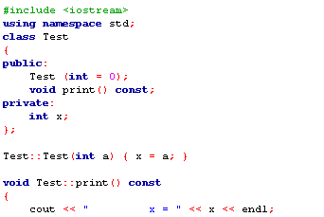


Pointer * This.
Each object is accompanied by a pointer to itself - called a pointer this - this is an implicit argument in all references to elements within the object.
Example 6. Using a pointer * this.

Slide 4
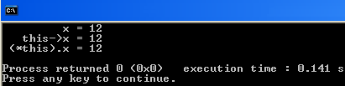


Another example of the use of the index this:

Slide 5
friendlys functions

Slide 6
Friendly functions and classes
friendly features - a feature that is not a member of the class, but has access to class members declared in the fields private or protected.
friendly function declared within a class, the elements of which it needs access to the keyword friend.
Friendly feature can be an ordinary function or by another previously defined class.
One function can be friendly to multiple classes.

Slide 7
Friendly features - an example
class monstr;
class hero {
public:
void kill (monstr &);
};
class monstr{
friend int steal_ammo(monstr &);
friend void hero :: kill (monstr &);
};
int steal_ammo(monstr & M) {return -M.ammo;}
void hero :: kill (monstr & M) {
M.health = 0; M.ammo = 0;
}

Slide 8
Friendly classes - an example
class hero{
...
friend class mistress;
}
class mistress {
...
void f1 ();
void f2 ();
}

Slide 9
operations Overloading

Slide 10
2. Overloading operations.
Operations are overloaded by compiling a description of the function (with the header and the body), the function name consists of the keyword operatorand functions of the mark. For instance:
To use the operation on class objects, this operation must be overloaded, but there are two exceptions:
Assignment (=) operationIt can be used with each class without explicit congestion. The default assignment operator is reduced to bit copy of class fields, but this bit copy is unacceptable for classes with dynamically created fields; for such classes to explicitly overload the assignment operator.
1)

Slide 11
2)
operation of receipt address (K)It can be used with any class objects without overloading; it simply returns the address of an object in memory. But addressing operation can also overload.
Operations that can be overwhelmed:
+ - * /% ^ & |
~! = <> + = - = * =
/ =% = ^ = ^ = << >>
==! = <=> = && || ++ -
-> [] () new delete

Slide 12
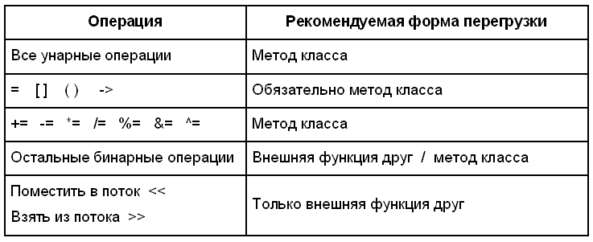
Operations that can not be overloaded:
. . * :::? Sizeof
The recommended form of operator overloading.

Slide 13
under overload operations stored number of arguments, the priorities of operations and rules of association (from right to left or left to right), used in standard data types;
for standard data types can not override the operation;
function operations may not have default arguments;
inherited functions-operations (excluding =);
function operations may not be defined as static.

Slide 14
Function operations
Format:
type operator operation (parameter list) {
body functions
}
Function, operation can be determined:
as a class method
as a friendly class function
as an ordinary function
Notes:
если левый операнд встроенного типа, перегружать можно только как внешнюю функцию, иначе следует перегружать как метод.

Slide 15
Overloading unary operations
1. Within the class:
class monstr{
...
monstr & Operator ++ ()
{++ health; return * this;}
};
monstr Vasia;
cout << (++Vasia).get_health();

Slide 16
Overloading unary operations
2. How friendly features:
class monstr{
...
friend monstr & Operator ++ ( monstr & M);
};
monstr& Operator ++ (monstr & M) {++M.health; return M;}
3. Outside of Class:
void change_health (int he) {health = he;}
...
monstr & operator ++ (monstr & M) {
int h = M.get_health (); h ++;
M.change_health (h);
return M;}

Slide 17
Overloading the postfix increment
The presence of the argument (int) Indicates that it is post-increment
class monstr{
...
monstr operator ++ (int) {
monstrM (* this); health ++;
return M;
}
};
monstr Vasia;
cout << (Vasia++).get_health();

Slide 18
Overloading binary operators
1. Within the class:
class monstr {
...
bool operator> (const monstr & M) {
if (health> M.get_health ())
return true;
return false; }
};
2. Outside of class:
bool operator> (const monstr & M1, const monstr & M2) {
if (M1.get_health ()> M2.get_health ())
return true;
return false;
}

Slide 19
assignment Overloading
Operation function must return a reference to the object for which it is due, and take as a parameter a single argument - a reference to the object is assigned
const monstr& Operator = (const monstr & M) {
// Check to see samoprisvaivanie:
if (& M == this) return * this;
if (name) delete [] name;
if (M.name) {name = new char [strlen(M.name) + 1];
strcpy(Name, M.name);}
else name = 0;
health = M.health; ammo =M.ammo; skin =M.skin;
return *this;}
monstr A (10), B, C;
C = B = A;

Slide 20
operations Overloading new and delete
they do not need to pass a parameter class type;
the first parameter of the function new and new [] be transmitted type of object size size_t (this is the type returned by the sizeof operator, defined in <stddef.h> header file); the call is passed to the function implicitly;
they should be determined by the type of the return value void *, even return returns a pointer to other types of (usually a class);
operation delete must have a return type void and the first argument of type void *;
Operation allocation and deallocation are static class members.

Slide 21
class Obj {...};
class pObj{
...
private:
Obj * P;
};
pObj * P = new pObj;
static void * operator new (size_t size);
void operator delete (void * ObjToDie. size_t size);
#include <new.h>
SomeClass a = new (buffer) SomeClass(his_size);

Slide 22
Overload type driving operation
imya_novogo_tipa operator ();
monstr :: operator int () {
return health;
}
...
monstr Vasia; cout << int (Vasia);

Slide 23
Overload operation function call
class if_greater {
public:
int operator () (Int a, int b) const {
return a> b;
}
};
if_greater x;
cout << x (1, 5) << endl; //x.operator () (1, 5))
cout << if_greater () (5, 1) << endl;

Slide 24
indexing operation Overloading
class Vect{
public:
explicit Vect(int n = 10);
//initialization array:
Vect(const int a [], int n);
~Vect() {Delete [] p; }
int& Operator [] (int i);
void Print ();
private:
int* P;
int size;
};

Slide 25
indexing operation Overloading
Vect::Vect(int n): size (n) {p = new int[Size];}
Vect::Vect(const int a [], int n): size (n) {
p = new int[Size];
for (int i = 0; i <Size; i++) p [i] = A [i]; }
int& Vect::operator [] (int i) {
if (i <0 || i > = Size) {
cout << "Incorrect index (i = "<< i << ")" << endl;
cout << "completion programs"<< endl;
exit (0); }
return p [i];
}

Slide 26
indexing operation Overloading
void Vect:: Print () {
for (int i = 0; i <Size; i++) cout << p [i] << "";
cout << endl; }
int main () {
int arr[10] = {1, 2, 3, 4, 5, 6, 7, 8, 9, 10};
Vect a (arr, 10);
a.Print();
cout << a [5] << endl;
cout << a [12] << endl;
return 0;
}

