Slide 1
Data visualization
All samples available on:
http://github.com/a-vodka/dv

Slide 2
Realisation of the course
This course has been developed within the framework of the project “Mechanics digital" by the German Academic Exchange Service (DAAD) under funding program “Ukraine digital: Ensuring academic success in times of crisis (2022)" The course has been developed in collaboration with our colleagues from the Otto-von-Guericke-University Magdeburg in Germany We would like to thank the DAAD for their financial and logistical support

Slide 3
Data visualization
Lecturer:
Oleksii Vodka
Candidate of Technical Sciences, Associate Professor of the
Oleksii.vodka@khpi.edu.ua
Department
Mathematical modeling and Intelligent Computation in Engineering (MME)

Slide 4
Course outline
Visualization of numerical data
Visualization of nonnumeric data
Binary tree visualization
Graph visualization
Dimensionality reduction algorithms in data visualization tasks
Visualization of text data (tex/latex)

Slide 5
Recommended online course
https://courses.prometheus.org.ua/courses/IRF/DV101/2016_T3/about
https://www.coursera.org/learn/datavisualization

Slide 6
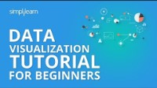
23 Best Data Visualization Tools for 2024
https://www.simplilearn.com/data-visualization-tools-article
https://www.youtube.com/watch?v=MiiANxRHSv4

Slide 7
Visualization
Visualization is...
a representation of a physical phenomenon or process in a form suitable for visual perception;
the method of directed image evocation;
creating a mental model of something.

Slide 8
Levels of stoicism
Scientific/Statistical data visualization
Business intelligence
Data Visualization for Non-Expert Users (NEUVis: Visualization for Non-Expert Users)
Infographics in Mass Media (Infographics, Data journalism)
Chartjunk (graphic garbage)

Slide 9
NUMERIC DATA VISUALIZATION

Slide 10
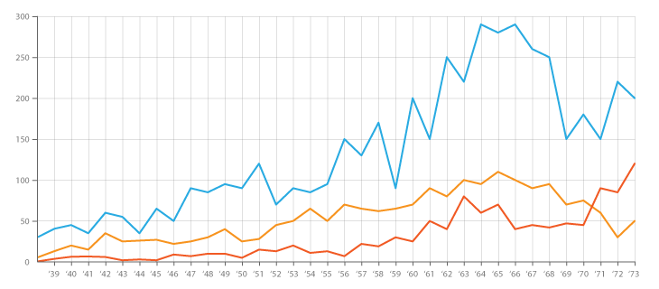
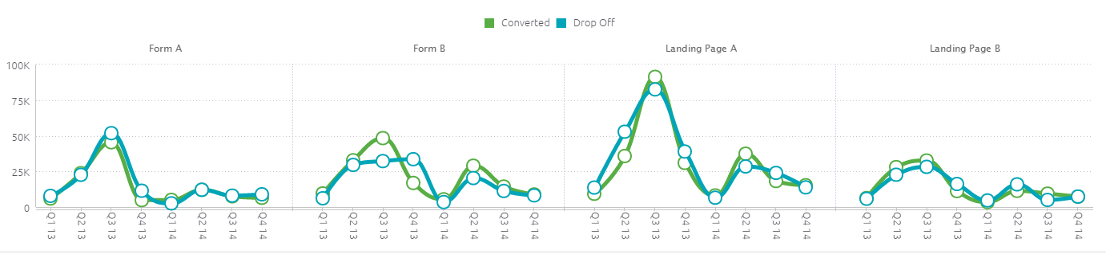
Line Chart
The line chart is good in many cases

Slide 11
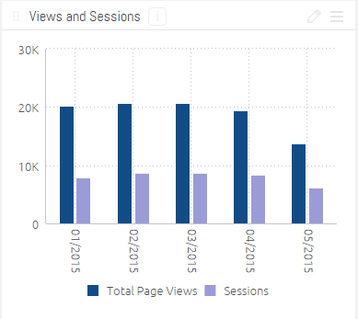
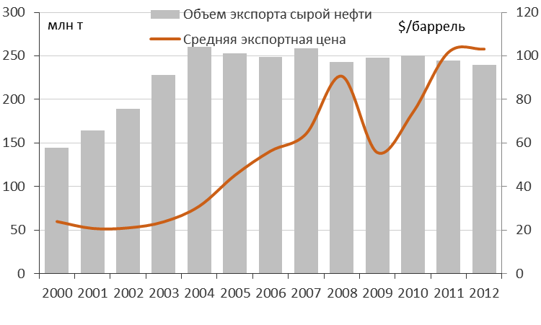
Column Chart (Column Chart)
In order to highlight peaks and trends, you can "cross" the columns with a line chart:

Slide 12
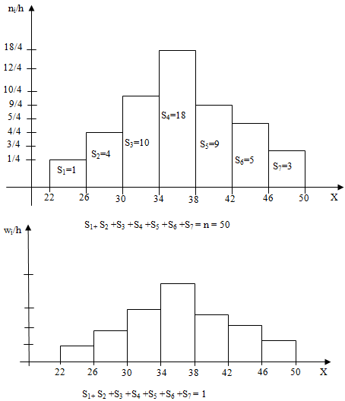
Bar Histograms (Bar Histograms)
Histograms are used to represent numeric data of one category. Not to be confused with a bar chart

Slide 13
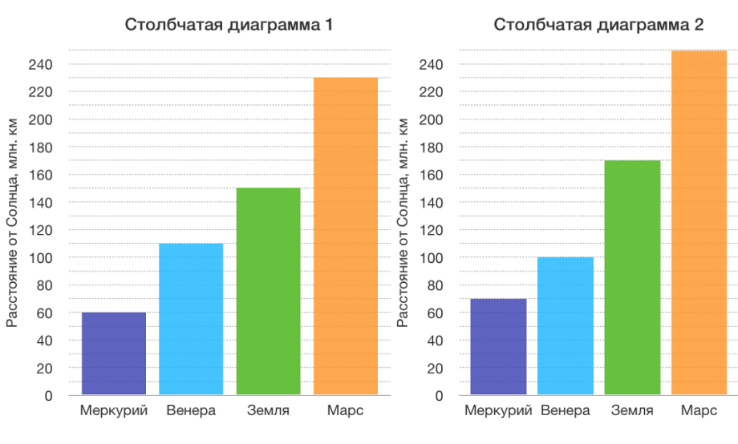
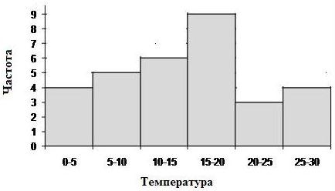
Bar chart vs. Bar chart
Bar chart | Histogram
There is a distance between columns | No distance between columns
Used to compare categorical data | They are used to identify the dependence of qualitative data
If you rearrange the columns, the logic is the same. Venus and Earth are two categories that are independent of each other. | If you rearrange the columns in the histogram of observed temperatures, it breaks the logic, because we consider one value (temperature) and not different categories

Slide 14
Pie Charts
Displays the percentage occupied by each value within the dataset as a broken circle. For example, the market shares of cellular operators. Can display multiple datasets at once - in this case, the charts are overlapping, with each one being smaller than the previous one. For example, the market shares of mobile operators for the last 3 years.

Slide 15
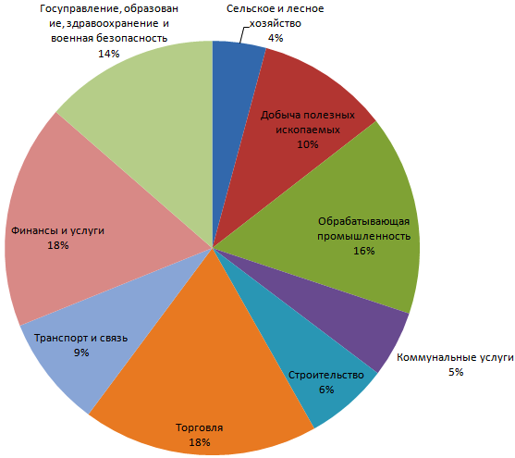
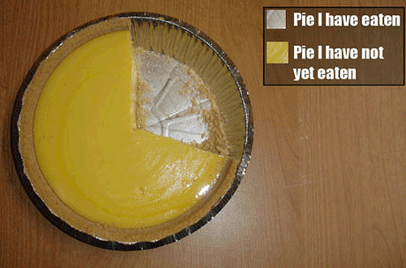
Pie Charts

Slide 16
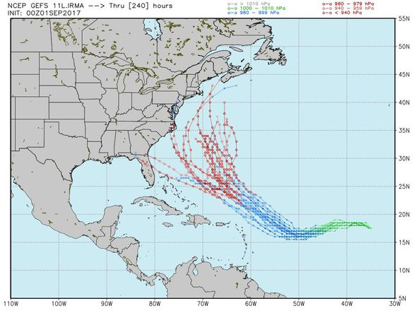
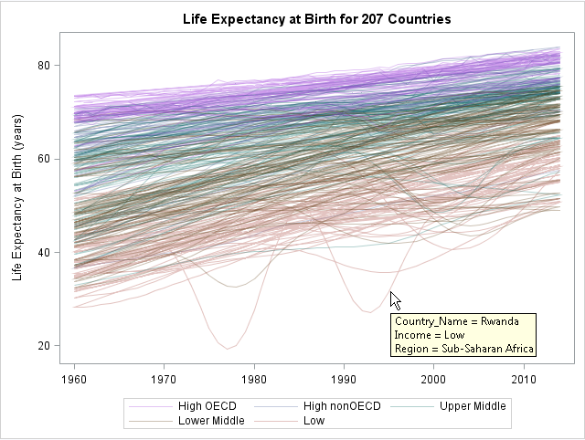
Spaghetti Charts
The spaghetti chart is a very unusual type of chart that is only gaining popularity.

Slide 17
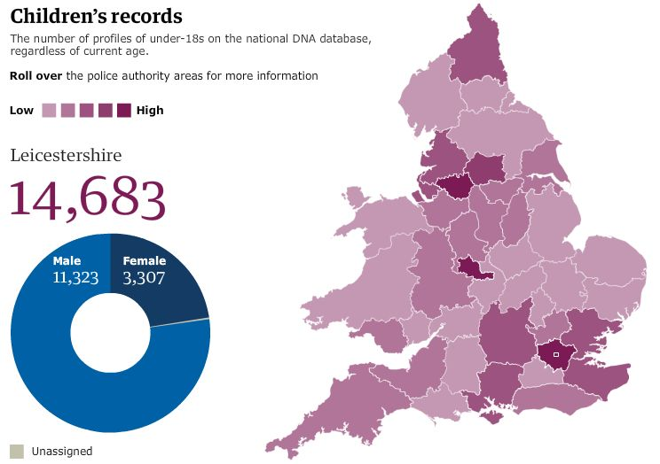
Geographic Chart (Map Charts)
Geographic charts are specifically designed for analyzing geographic information, representing spatial relationships and regional data.

Slide 18
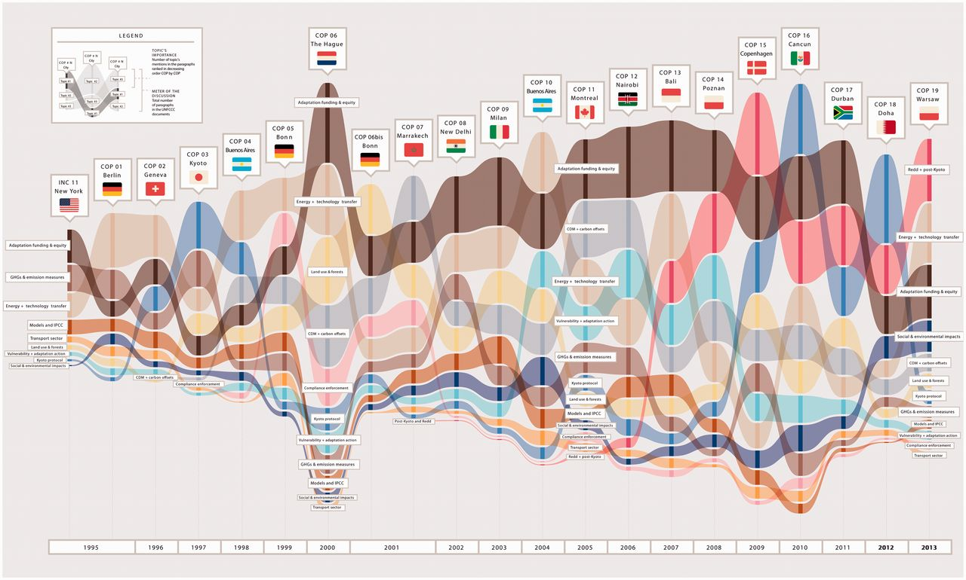
Stream Graph (Stream Graph)

Slide 19
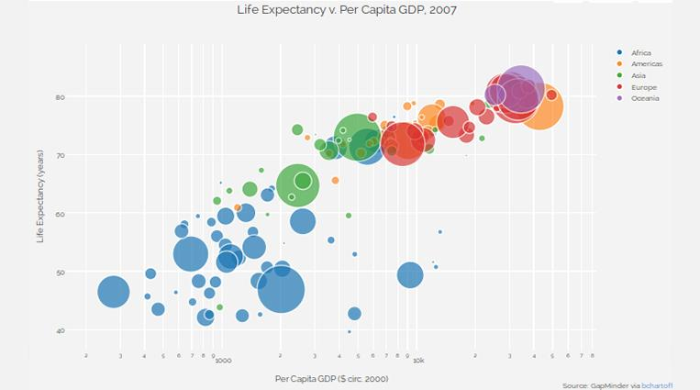
Bubble Charts (Bubble Charts)

Slide 20
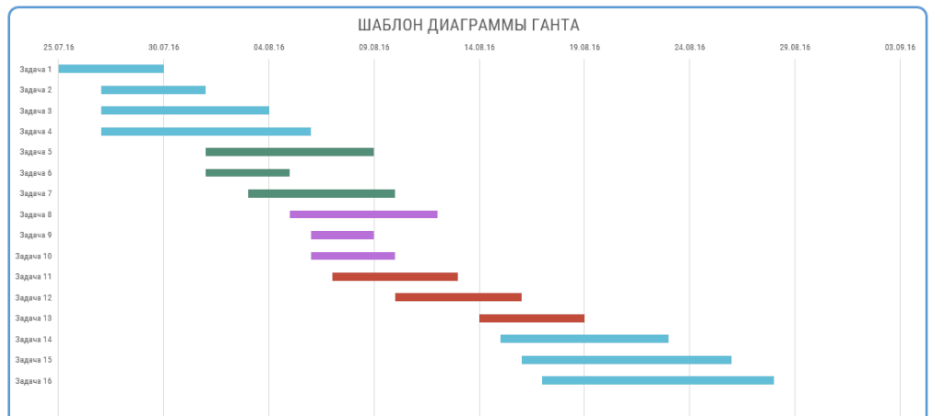
Gantt chart

Slide 21
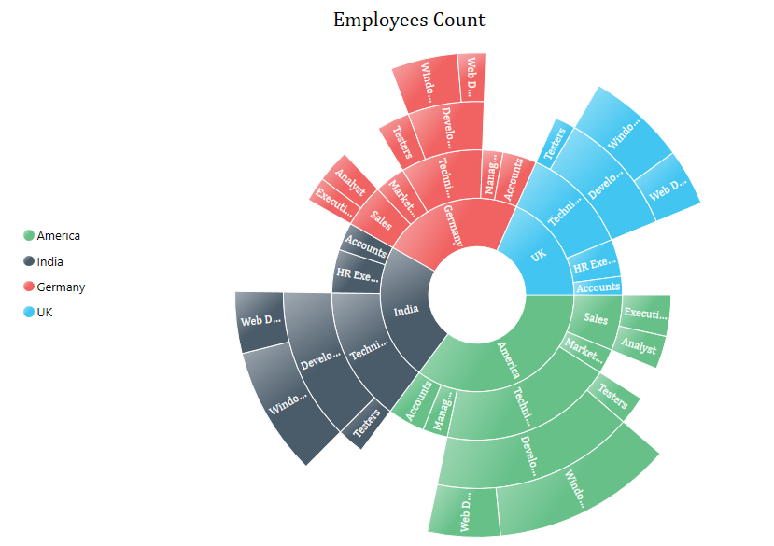
Radiation diagram (Sunburts)
Diagram for representing hierarchical data.

Slide 22
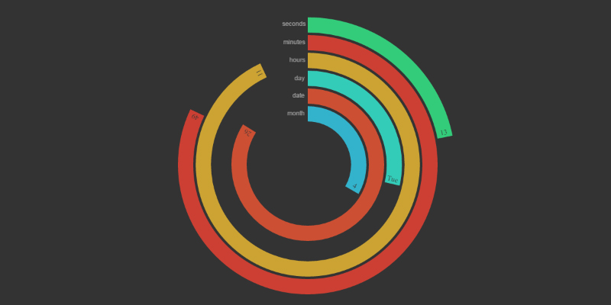
Polar Clock
The graph works like a clock and shows the amount of work done every second. It looks like the "copying files" window, where the green indicator showed how much of the data had already been copied.

Slide 23
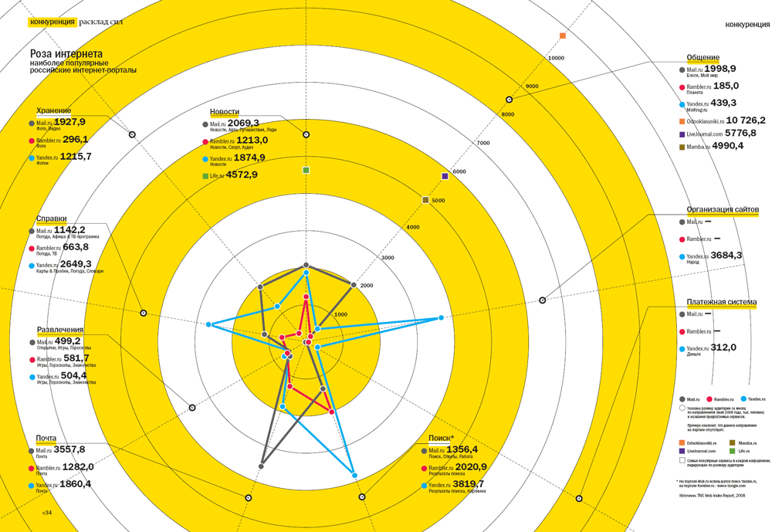
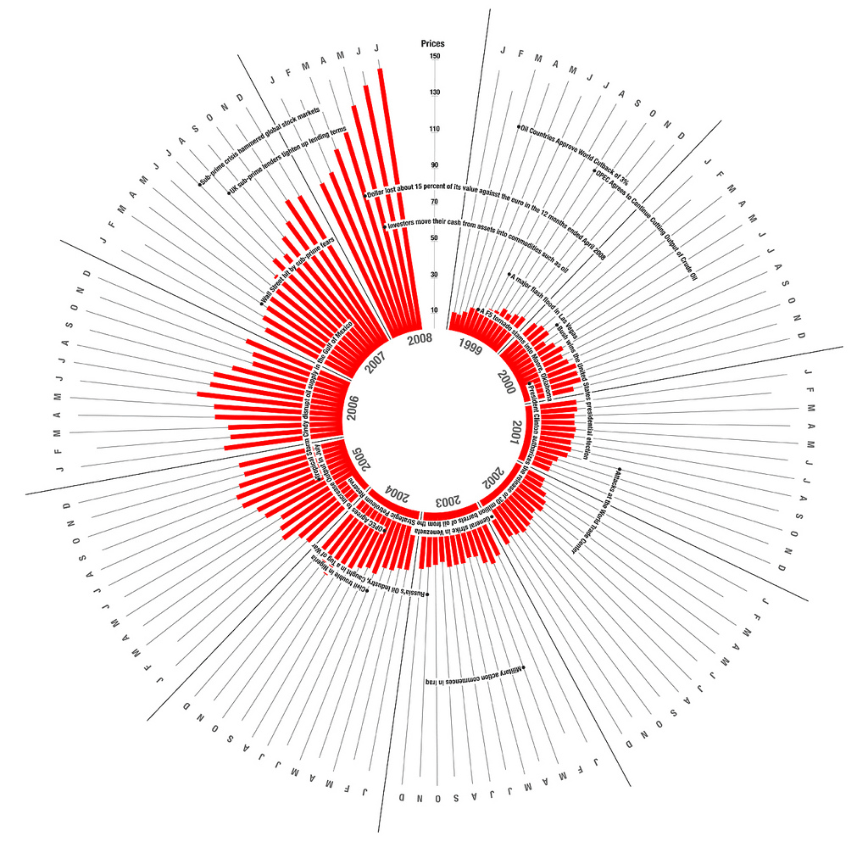
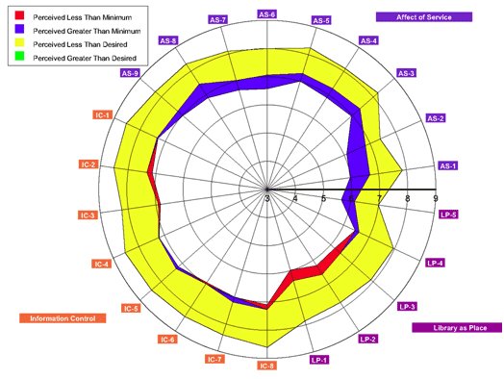
Radar chart

Slide 24
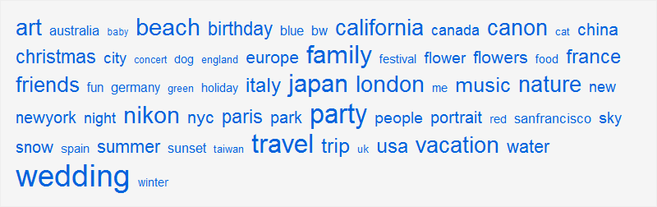
The tag cloud
Compares keywords or phrases (values) contained within a text fragment (dataset), giving each a different font size. The font size depends on the value of the parameter. For example, the 25 most frequently mentioned words in the newspapers for December 2008.

Slide 25
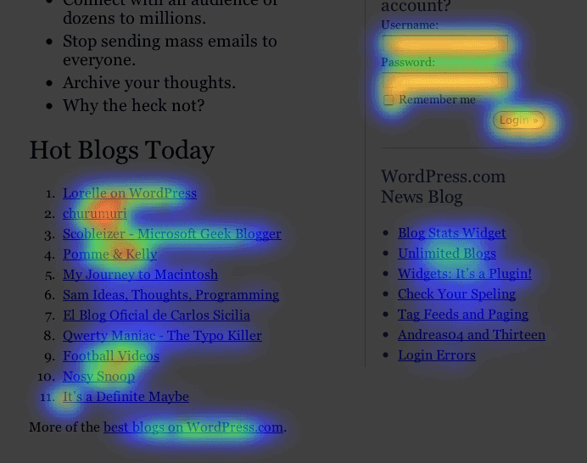
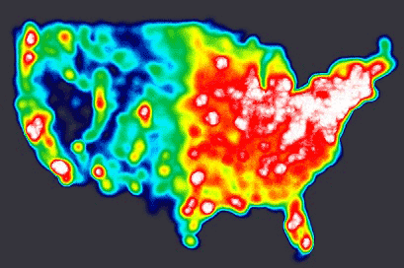
Heat map (heat map)
Compares values within a dataset by shading them with one of the colors in a pre-selected spectrum. The basis is an image or other diagram on which the values are arranged. The color depends on the value of the parameter and is most often superimposed in the form of spots. For example, the elements of the home page of the site, which users click on most often.

Slide 26
TREES AND STRUCTURE DIAGRAMS
Shows the structure of the dataset and the relationships between its elements.

Slide 27
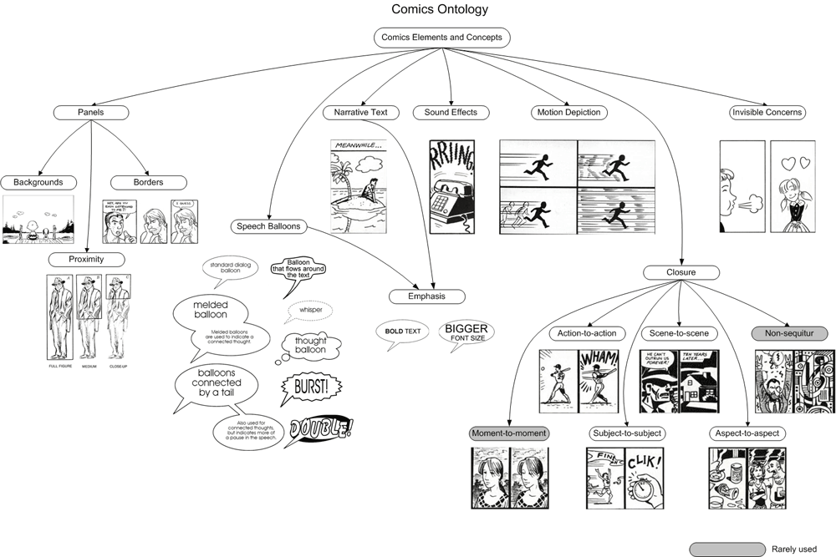
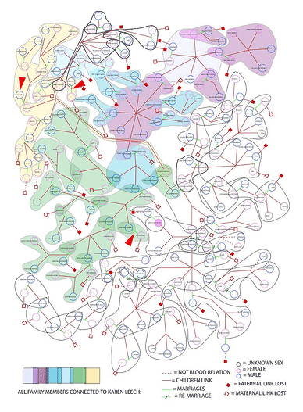
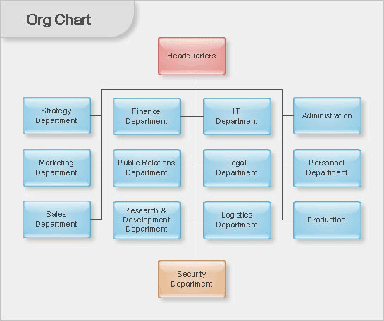
tree

Slide 28
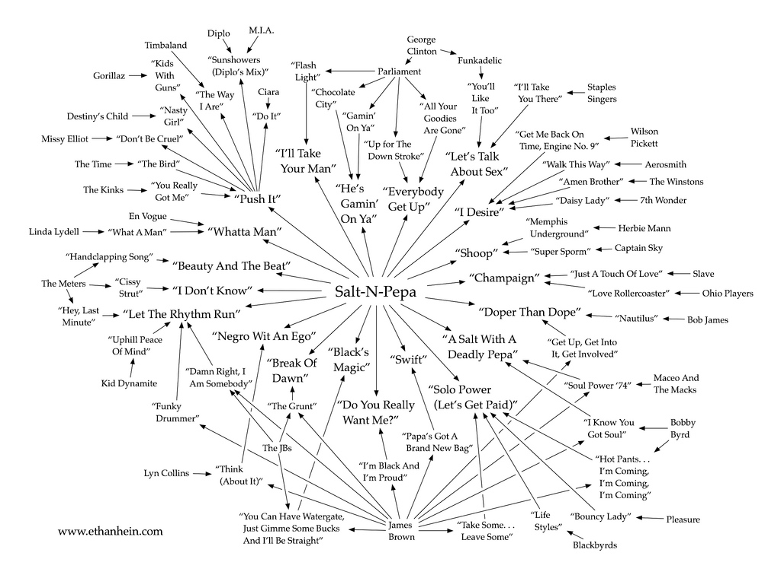
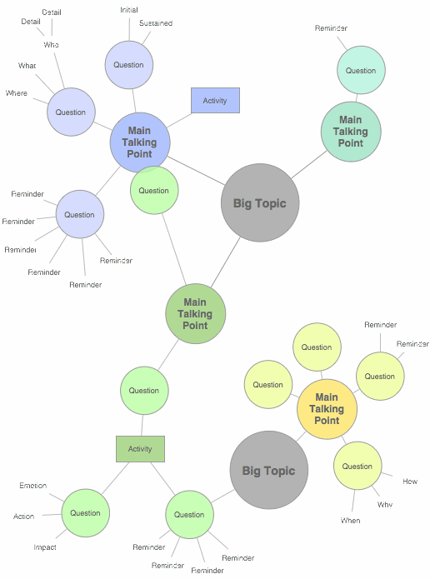
MIND MAP mind map
Shows the composition and structure of a phenomenon or concept in the form of a tree, in which each node has one or more child elements. It is a special case of a tree, with the difference that the branches diverge from the node located in the center of the image. For example, an outline of a book on project management that reflects its content and basic concepts.

Slide 29
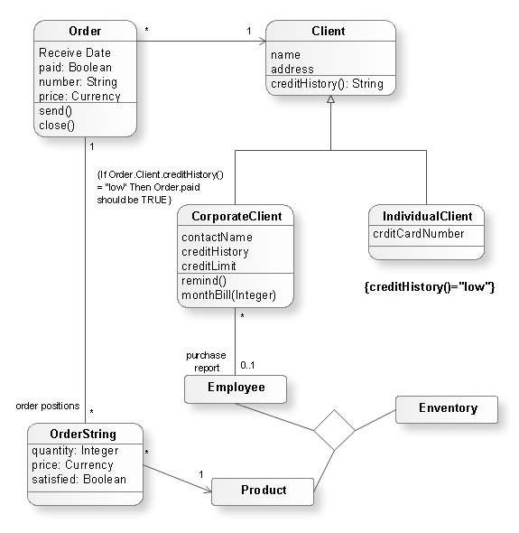
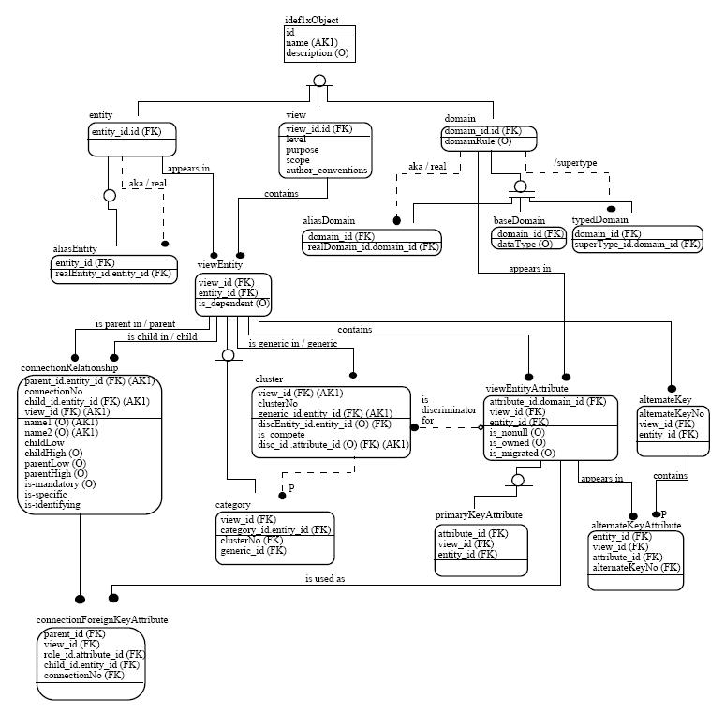
FORMALIZED STRUCTURAL DIAGRAMS
Shows the composition and structure of a system or part of a system in the form of cards that are described in varying degrees of detail and related to each other as parent and child. Displayed in a standardized way - for example, using UML (Unified Modeling Language) or IDEFIX (Integration Definition for Information Modeling). For example, all of the entities necessary for one of the modules of a software system to work.

Slide 30
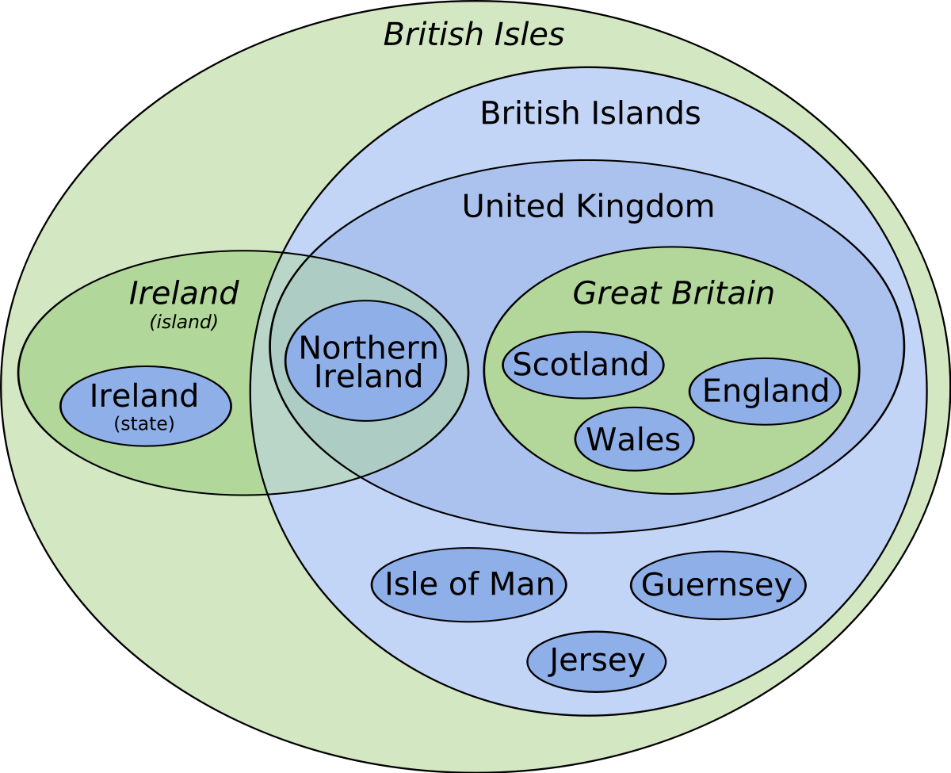
VENN/EULER DIAGRAM
Shows the relationships between the values of the dataset as overlapping circles (most often three). The area in which all the circles intersect shows the commonalities between them.

Slide 31
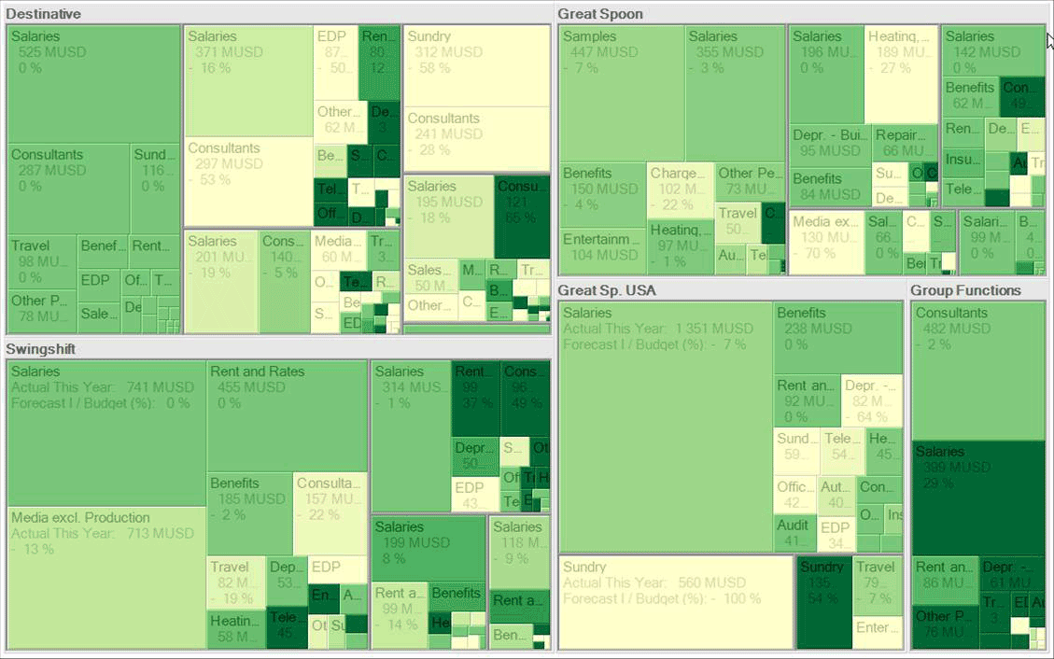
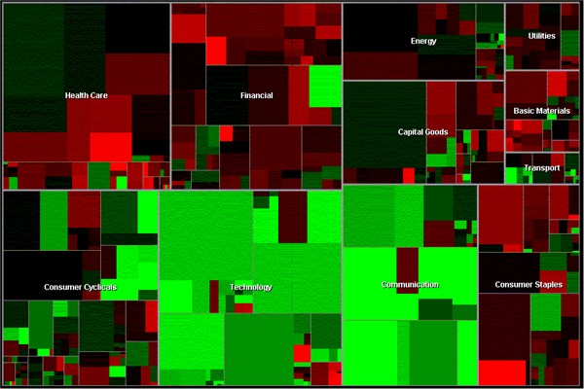
flat tree (tree map)
Shows the hierarchy of the dataset, in which elements are parent or child in relation to each other. It is displayed as a set of nested rectangles, each of which is a branch of the tree, and those within it are children and branches. Rectangles vary in size depending on the parameter and have a color, which is set by another parameter.

Slide 32
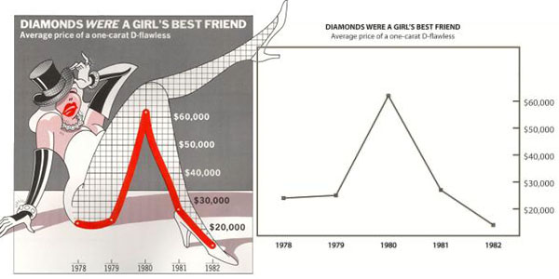
ChartJunk

Slide 33
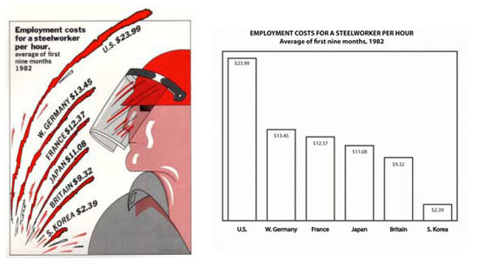
chartJunk

Slide 34
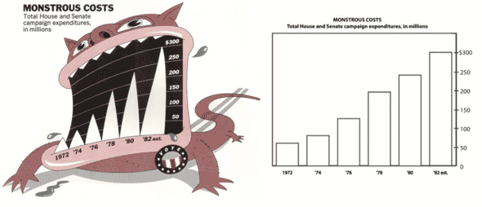
chartJunk

Slide 35
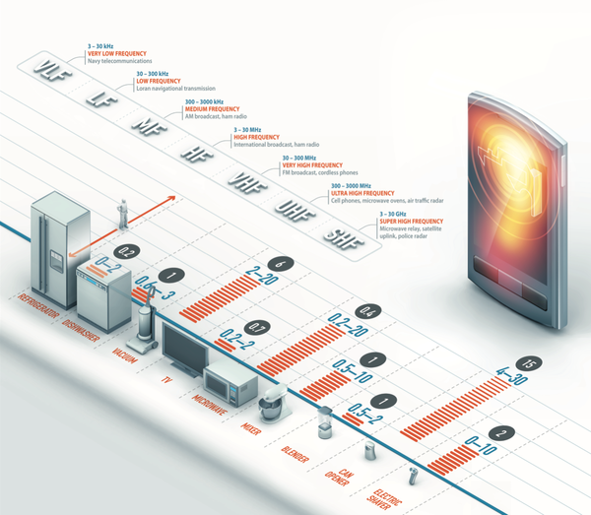
ChartJunk vs Data Visualization

Slide 36
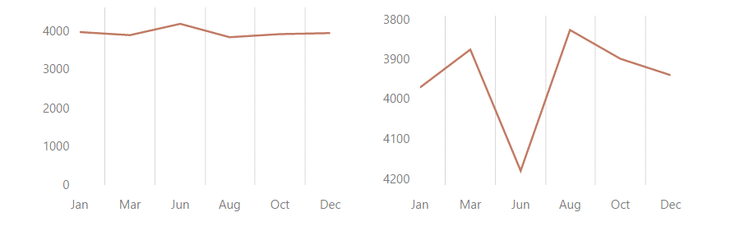

Scale

Slide 37
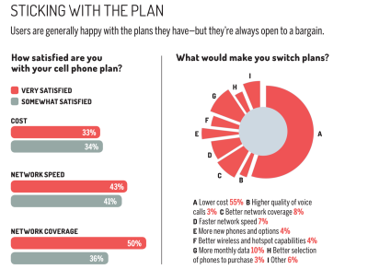
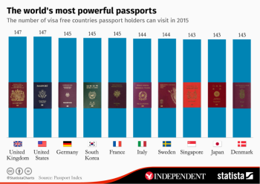
Unsuccessful charts

Slide 38
12 Python Data Visualization Libraries
https://mode.com/blog/python-data-visualization-libraries

Slide 39
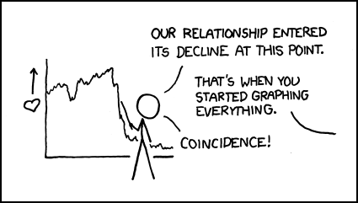
Thank you for your attention

