Slide 1
Data visualization
All samples available on:
http://github.com/a-vodka/dv

Slide 2
Realisation of the course
This course has been developed within the framework of the project “Mechanics digital" by the German Academic Exchange Service (DAAD) under funding program “Ukraine digital: Ensuring academic success in times of crisis (2022)" The course has been developed in collaboration with our colleagues from the Otto-von-Guericke-University Magdeburg in Germany We would like to thank the DAAD for their financial and logistical support

Slide 3
Graph Analyzing with NetworkX on python [reference] http://networkx.github.com/documentation/latest/tutorial/index.html

Slide 4
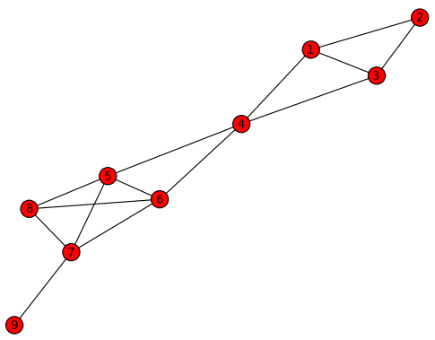
Simple Graph Analysis
Let us create a simple graph in figure 1.1
import networkx as net
import matplotlib.pyplot as plt
g=net.Graph()
g.add_edge(1,2)
g.add_edge(1,3)
g.add_edge(1,4)
g.add_edge(2,3)
g.add_edge(3,4)
g.add_edge(4,5)
g.add_edge(4,6)
g.add_edge(5,6)
g.add_edge(5,7)
g.add_edge(5,8)
g.add_edge(6,7)
g.add_edge(6,8)
g.add_edge(7,8)
g.add_edge(7,9)
# g.add_edges_from([(1,2), (1,3), (1,4), (2,3), (3,4), (4,5), (4,6), (5,6), (5,7), (5,8), (6,7), (6,8), (7,8), (7,9)])
net.draw(g)
plt.show()
plt.savefig("figure1.1.png")
figure1.1.py

Slide 5
Simple Graph Analysis
Get the information of a graph
>>> g.number_of_edges() (=g.size())
14
>>> g.number_of_nodes() (=len(g))
9
>>> g.is_directed()
False
>>> g.is_multigraph()
False
>>> g.has_node(1)
True
>>> g.has_node(10)
False
>>> g.has_edge(4,5)
True
>>> g.has_edge(4,8)
False
>>> g.nodes()
[1, 2, 3, 4, 5, 6, 7, 8, 9]
>>> g.edges()
[(1, 2),
(1, 3),
(1, 4),
(2, 3),
(3, 4),
(4, 5),
(4, 6),
(5, 8),
(5, 6),
(5, 7),
(6, 8),
(6, 7),
(7, 8),
(7, 9)]

Slide 6
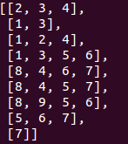
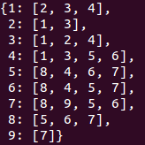
Simple Graph Analysis
Get the information of a graph (cont.)
>>> g.adjacency_list()
>>> g.neighbors(5)
[8, 4, 6, 7]
>>> dict((x, g.neighbors(x)) for x in g.nodes())
Get the degree of a node
>>> g.degree(1)
3
>>> g.degree([1,2,3])
{1: 3, 2: 2, 3: 3}
>>> g.degree()
{1: 3, 2: 2, 3: 3, 4: 4, 5: 4, 6: 4, 7: 4, 8: 3, 9: 1}
>>> sorted(g.degree())
[1, 2, 3, 4, 5, 6, 7, 8, 9]
>>> sorted(g.degree().values())
[1, 2, 3, 3, 3, 4, 4, 4, 4]

Slide 7
Simple Graph Analysis
Attribute
Graph Attributes
>>> g.graph
{}
>>> g.graph['caption']='Figure1.1. Simple Graph'
>>> g.graph
{'caption': 'Figure1.1. Simple Graph'}
Node Attributes
>>> g.add_node(1, time='5pm')
>>> g.add_nodes_from([3,4], time='2pm')
>>> g.node[1]
{'time': '5pm'}
>>> g.node[1]['room'] = 714
>>> g.nodes(data=True)
[(1, {'room': 714, 'time': '5pm'}), (2, {}), (3, {'time': '2pm'}), (4, {'time': '2pm'}), (5, {}), (6, {}), (7, {}), (8, {}), (9, {})]

Slide 8
Simple Graph Analysis
Attribute
Edge Attributes
>>> g.add_edge(1, 2, weight=4.7)
>>> g.add_edges_from([(3, 4),(4, 5)], color='red')
>>> g.add_edges_from([(1, 2, {'color':'blue'}), (2, 3, {'weight':8})])
>>> g[1][2]['weight'] = 5.7
>>> g.edge[1][2]['weight'] = 6.7
>>> g.edges(data=True)
[(1, 2, {'color': 'blue', 'weight': 6.7}), (1, 3, {}), (1, 4, {}), (2, 3, {'weight': 8}), (3, 4, {'color': 'red'}), (4, 5, {'color': 'red'}), (4, 6, {}), (5, 8, {}), (5, 6, {}), (5, 7, {}), (6, 8, {}), (6, 7, {}), (7, 8, {}), (7, 9, {})]

Slide 9
Graph operation
Graph generators and graph operations
Applying classic graph operations
subgraph(g, nbunch) - induce subgraph of G on nodes in nbunch
>>> g3 = net.Graph()
>>> g3.add_path([0,1,2,3])
>>> h = g3.subgraph([0,1,2])
>>> h.edges()
[(0, 1), (1, 2)]
union(g1, g2) - graph union
disjoint_union(g1, g2) - graph union assuming all nodes are different
cartesian_product(g1, g2) - return Cartesian product graph
compose(g1, g2) - combine graphs identifying nodes common to both
complement(g) - graph complement
create_empty_copy(g) - return an empty copy of the same graph class
convert_to_undirected(g) - return an undirected representation of G
convert_to_directed(g) - return a directed representation of G

Slide 10
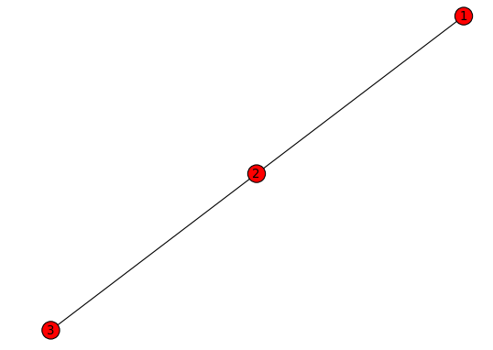
Simple Graph Analysis
Graph Union
Compose operation for two graphs, G and H
Composition is the simple union of the node sets and edge sets.
The node sets of G and H need not be disjoint.
Attributes from H take precedent over attributes from G
>>> import networkx as net
>>> g1 = net.Graph()
>>> g2 = net.Graph()
>>> g1.add_edge(1,2)
>>> g2.add_edge(2,3)
>>> g3 = net.compose(g1, g2)
>>> net.draw(g3)
>>> plt.show()
See also
net.union(G1,G2)
net.uniondisjoint_union(G1,G2)
net.cartesian_product(G1,G2)
net.compose(G1,G2)

Slide 11
Simple Graph Analysis
Simple Analysis of Graph
Connected Components
>>> g.add_node("spam")
>>> net.connected_components(G)
[[1, 2, 3, 4, 5, 6, 7, 8, 9], ['spam']]
>>> g.remove_node("spam")
>>> net.connected_components(G)
[[1, 2, 3, 4, 5, 6, 7, 8, 9]]
Clustering Coefficiency
>>> net.clustering(g)
{1: 0.6666666666666666, 2: 1.0, 3: 0.6666666666666666, 4: 0.3333333333333333, 5: 0.6666666666666666, 6: 0.6666666666666666, 7: 0.5, 8: 1.0, 9: 0.0}

Slide 12
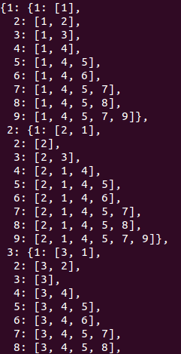
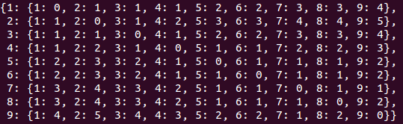
Shortest Path vs. Dijkstra Path
Get the shortest path between two nodes
>>> import networkx.algorithms as algo
>>> algo.shortest_path(g,1,9)
[1, 4, 5, 7, 9]
>>> print ([p for p in algo.all_shortest_paths(g,1,9)])
[[1, 4, 5, 7, 9], [1, 4, 6, 7, 9]]
>>> algo.average_shortest_path_length(g)
2.111111111111111
>>> algo.all_pairs_shortest_path(g)
>>> algo.all_pairs_shortest_path_length(g)
>>> algo.all_pairs_shortest_path_length(g)[2]
{1: 1, 2: 0, 3: 1, 4: 2, 5: 3, 6: 3, 7: 4, 8: 4, 9: 5}

Slide 13
Shortest Path vs. Dijkstra Path
Dijkstra’s Algorithm
It can determine the lowest “cost” path between two given nodes
“cost” is determined by summing edge weights.
In unweighted graphs, an edge weight is assumed to be one.
>>> algo.dijkstra_path(g, 1, 9)
[1, 4, 5, 7, 9]
>>> algo.dijkstra_predecessor_and_distance(g, 1)
({1: [], 2: [1], 3: [1], 4: [1], 5: [4], 6: [4], 7: [5, 6], 8: [5, 6], 9: [7]},
{1: 0, 2: 1, 3: 1, 4: 1, 5: 2, 6: 2, 7: 3, 8: 3, 9: 4})

Slide 14
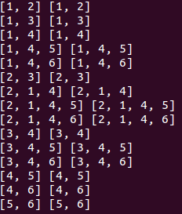
Shortest Path vs. Dijkstra Path
Shortest Path vs. Dijkstra Path
Get node pairs
>>> import itertools
>>> list(itertools.combinations(g.nodes(), 2))
[(1, 2), (1, 3), (1, 4), (1, 5), (1, 6), (1, 7), (1, 8), (1, 9), (2, 3), (2, 4), (2, 5), (2, 6), (2, 7), (2, 8), (2, 9), (3, 4), (3, 5), (3, 6), (3, 7), (3, 8), (3, 9), (4, 5), (4, 6), (4, 7), (4, 8), (4, 9), (5, 6), (5, 7), (5, 8), (5, 9), (6, 7), (6, 8), (6, 9), (7, 8), (7, 9), (8, 9)]
>>> nn = g.nodes()
>>> nn[:5]
[1, 2, 3, 4, 5]
Compare the two paths
>>> for pair in itertools.combinations(nn[:6], 2):
print algo.shortest_path(g, *pair), algo.dijkstra_path(g, *pair)

Slide 15
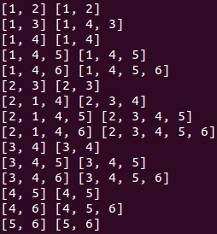
Shortest Path vs. Dijkstra Path
Shortest Path vs. Dijkstra Path
Get weighted graph
>>> from random import choice
>>> ee = g.edges()
>>> new_edges = [x + (choice(range(100)),) for x in ee]
>>> new_edges
[(1, 2, 37), (1, 3, 85), (1, 4, 62), (2, 3, 63), (3, 4, 16), (4, 5, 26), (4, 6, 84), (5, 8, 86), (5, 6, 26), (5, 7, 48), (6, 8, 99), (6, 7, 44), (7, 8, 91), (7, 9, 0)]
>>> g.clear()
>>> g.add_weighted_edges_from(new_edges)
Compare the two paths
>>> for pair in itertools.combinations(nn[:6], 2):
print algo.shortest_path(g, *pair), algo.dijkstra_path(g, *pair)

Slide 16
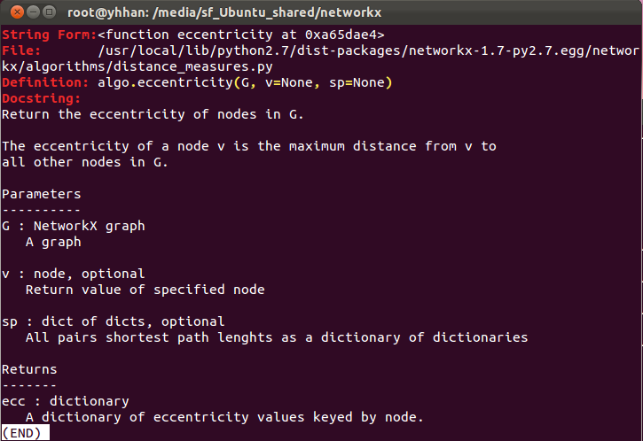
Graph Features
Get the information of a graph
>>> algo.eccentricity(g, 5)
3
>>> algo.radius(g)
3
>>> algo.diameter(g)
5
>>> algo.center(g)
[4, 5, 6]
>>> algo.periphery(g)
[2, 9]
>>> algo.eccentricity?

Slide 17
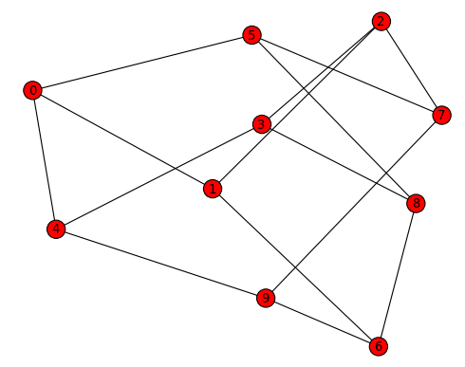
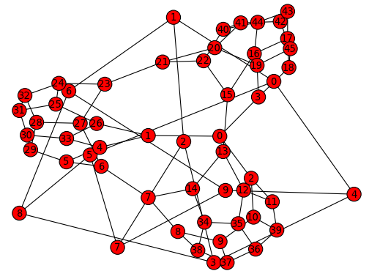
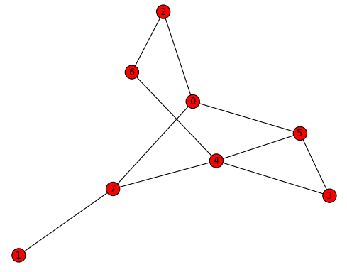
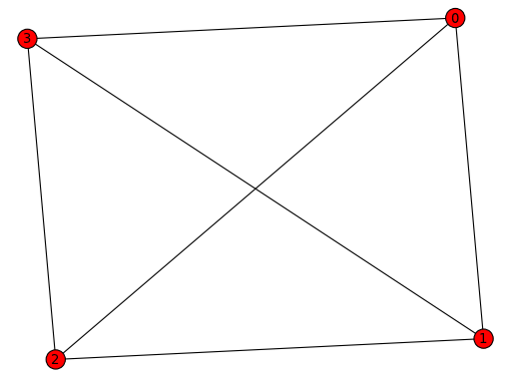
Simple Graph Analysis
Graph generators and graph operations
Using a call to one of the classic small graphs
>>> petersen=net.petersen_graph()
>>> tutte=net.tutte_graph()
>>> maze=net.sedgewick_maze_graph()
>>> tet=net.tetrahedral_graph()

Slide 18
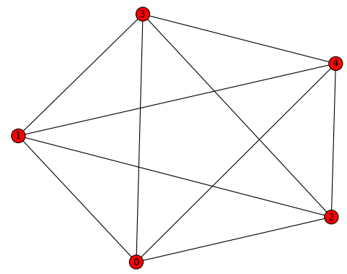
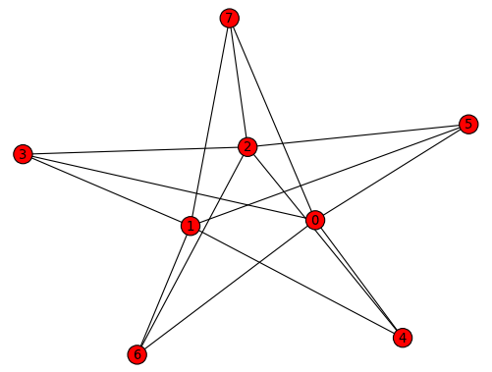
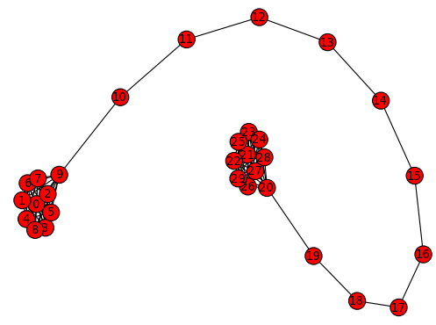
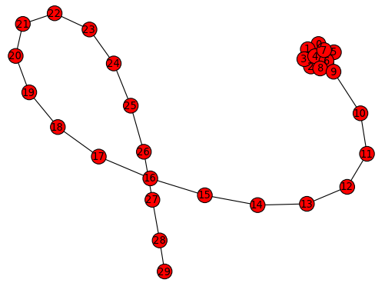
Simple Graph Analysis
Graph generators and graph operations
Using a (constructive) generator for a classic graph
>>> k_5=net.complete_graph(5)
>>> k_3_5=net.complete_bipartite_graph(3,5)
>>> barbell=net.barbell_graph(10,10)
>>> lollipop=net.lollipop_graph(10,20)

Slide 19
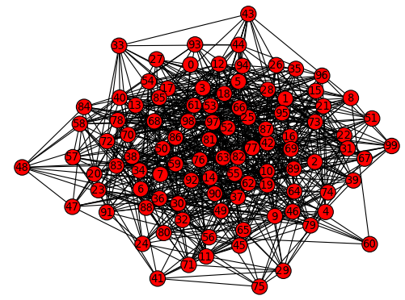
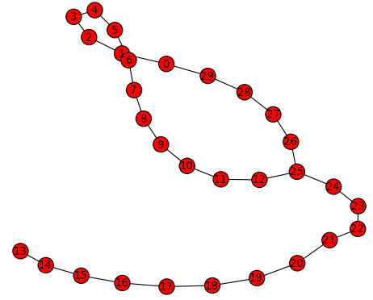
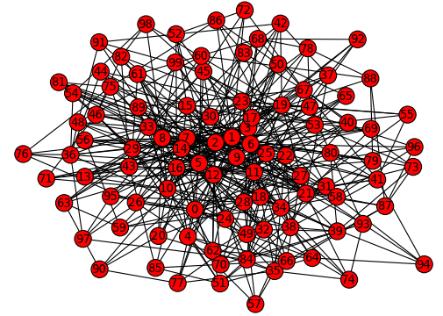
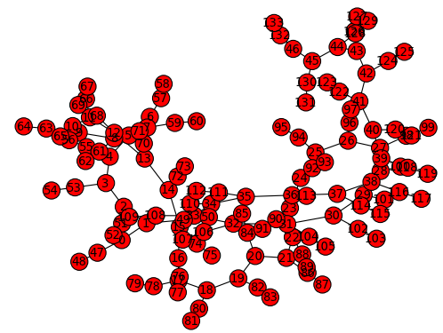
Simple Graph Analysis
Graph generators and graph operations
Using a stochastic graph generator
>>> er=net.erdos_renyi_graph(100,0.15)
>>> ws=net.watts_strogatz_graph(30,3,0.1)
>>> ba=net.barabasi_albert_graph(100,5)
>>> red=net.random_lobster(100,0.9,0.9)
See also http://networkx.lanl.gov/reference/generators.html

Slide 20
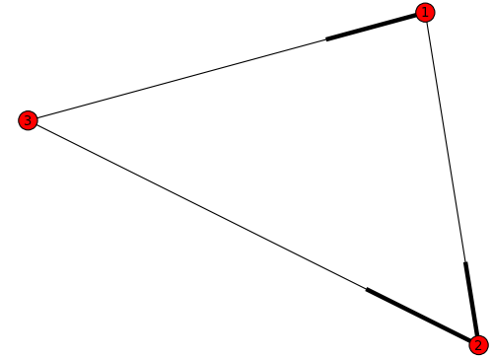
Simple Graph Analysis
Directed Graphs
“DiGraph” class provides additional methods specific to directed edges
>>> dg=net.DiGraph()
>>> dg.add_weighted_edges_from([(1,2,0.5), (3,1,0.75), (3,2,0.1)])
>>> dg.in_degree(2)
2
>>> dg.out_degree(3)
2
>>> dg.out_degree(1, weight='weight')
0.5
>>> dg.degree(1, weight='weight')
1.25

Slide 21
Simple Graph Analysis
Directed Graphs
“DiGraph” class provides additional methods specific to directed edges
>>> dg.predecessors(2)
[1, 3]
>>> dg.predecessors(3)
[]
>>> dg.successors(1)
[2]
>>> dg.neighbors(1) (equivalent to dg.successors())
[2]
If you want to treat a directed graph as undirected for some measurement you should probably convert it
>>> h = net.Graph(dg)

Slide 22
Simple Graph Analysis
Multigraphs
“MultiGraph” and “MultiDiGraph” classes allow you to add the same edge twice between any pair of nodes, possibly with different edge data.
These can be powerful for some applications, but many algorithms (e.g., shortest path) are not well defined on such graphs.
>>> mg=net.MultiGraph()
>>> mg.add_weighted_edges_from([(1,2,.5), (1,2,.75), (2,3,.5), (3,1,0.1)])
>>> mg.degree(weight='weight')
{1: 1.35, 2: 1.75, 3: 0.6}

Slide 23
Case Study1. Twitter

Slide 24
Tweepy
Tweepy
A Python wrapper around the Twitter API
This library provides a pure Python interface for the Twitter API
https://github.com/tweepy/tweepy
Install
Install tweepy:
>>> easy_install tweepy

Slide 25


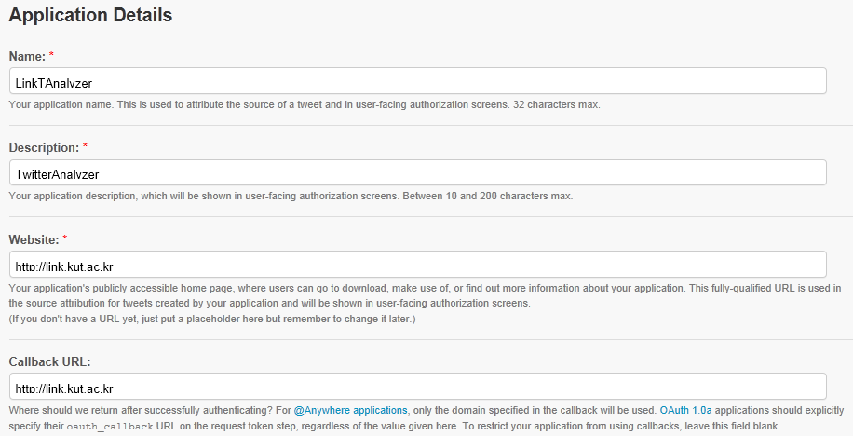
Twitter Authentication
Twitter Authentication
Oauth Application Registration:
http://twitter.com/oauth_clients
My applications
Create a new application

Slide 26
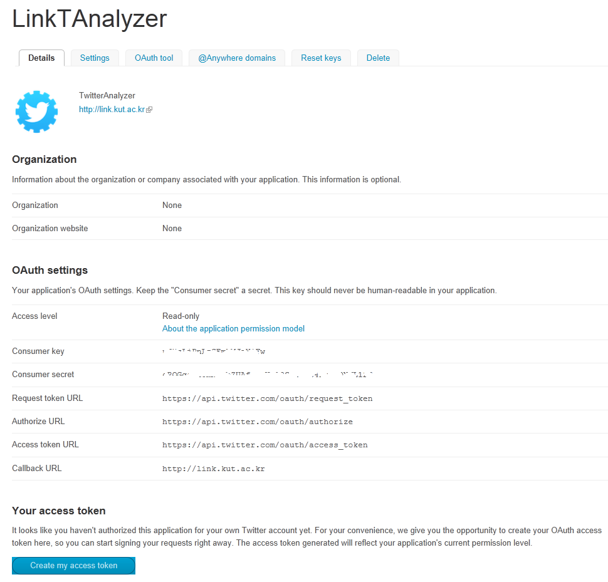
Twitter Authentication
Twitter Authentication
New Application Description

Slide 27
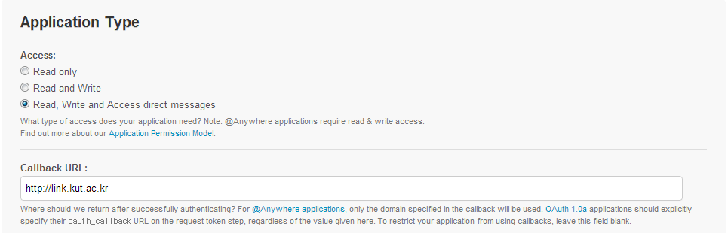
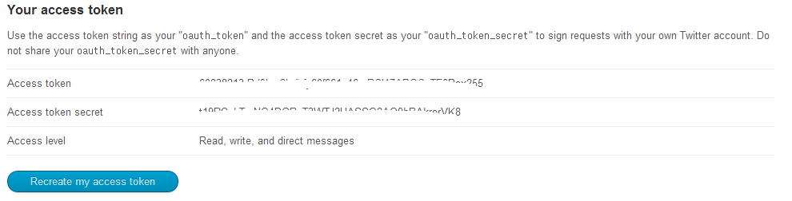
Twitter Authentication
Twitter Authentication
Settings ➔ Application Type
Details ➔ Create Access Token

Slide 28
Twitter Rate Limiting
Twitter REST API Rate Limiting in v1.1
Refer to https://dev.twitter.com/docs/rate-limiting/1.1
Per User
per access token in your control
15 Minute Windows
all 1.1 endpoints require authentication
per-method request limits
two initial buckets available for GET requests:
15 calls every 15 minutes
180 calls every 15 minutes
Details: https://dev.twitter.com/docs/rate-limiting/1.1/limits
Three Values related to Rate Limit
Limit
the rate limit ceiling for that given request
Remaining
the number of requests left for the 15 minute window
Reset
the remaining window before the rate limit resets in UTC epoch seconds

Slide 29
Read Nodes and Edges from Twitter
My Friends & My Followers
Fetches my neighbors (ego network)
mytweepy.py
# yhhan's twitter ID = 60838213
import tweepy
import networkx as net
import matplotlib.pyplot as plt
auth = tweepy.OAuthHandler(consumer_key=‘xxxxxxxxxxxxx', consumer_secret=‘xxxxxxxxxxxxx')
auth.set_access_token(key=‘xxxxx', secret=‘xxxxxxxxx')
api = tweepy.API(auth)
me = api.me()
print "My id is %d" %me.id
print "My name is %s" %me.name
print "My screen name is %s" %me.screen_name
print "My time zone is %s" %me.time_zone
print "My language is %s" %me.lang

