Slide 1
Data visualization
All samples available on:
http://github.com/a-vodka/dv

Slide 2
Realisation of the course
This course has been developed within the framework of the project “Mechanics digital" by the German Academic Exchange Service (DAAD) under funding program “Ukraine digital: Ensuring academic success in times of crisis (2022)" The course has been developed in collaboration with our colleagues from the Otto-von-Guericke-University Magdeburg in Germany We would like to thank the DAAD for their financial and logistical support

Slide 3
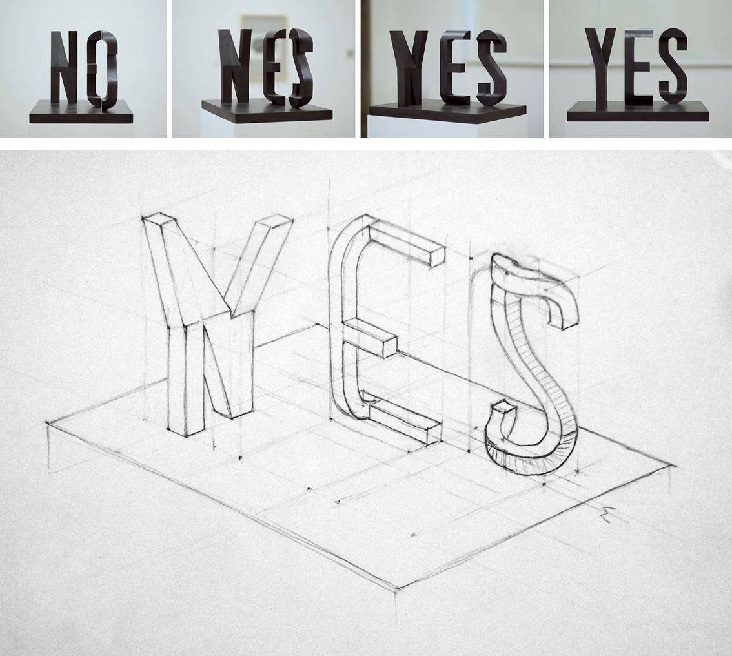
Projection is important

Slide 4
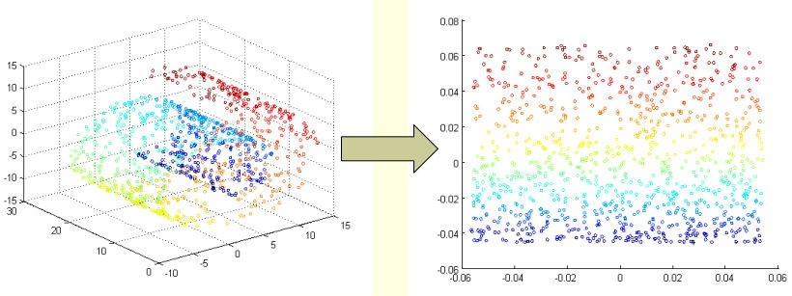
Dimensionality Reduction

Slide 5
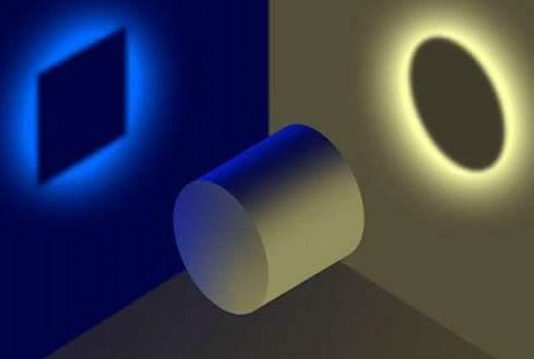

Dimensionality Reduction
Simple example
3-D data
Y
Z
X
Y
Y
X
Z

Slide 6
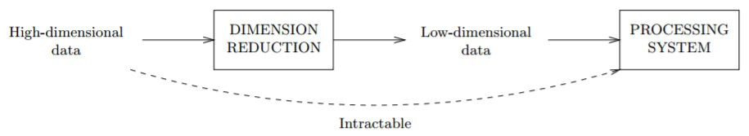
Motivation
Widely used in
language processing
Image processing
Denoising
Compressing

Slide 7
Dimension Reduction Overview
Parametric
(LDA)
Linear
(PCA)
Dimension reduction
Non-
parametric
Global
(ISOMAP)
Nonlinear
Local
(LLE, SNE)

Slide 8
Dimensionality Reduction
Linear method
PCA (Principle Component Analysis)
Preserves the variance
Non-linear method
ISOMAP
LLE
tSNE
Laplacian
Diffusion map
KNN Diffusion
A global geometric framework for nonlinear dimensionality reduction, J.B.Tenenbaum, V.De Silva, J.C.Langford (science 2000)
Nonlinear Dimensionality Reduction by Locally Linear Embedding, Sam T. Roweis and Lawrence K. Saul (science 2000)
Visualizing Data using t-SNE,
Laurens van der Maaten, Geoffrey Hinton (Journal of machine learning research 2008)

Slide 9
PCA
x₁
x₁
λ₁e₁
λ₂e₂
x₀
x₀
λ_{k} is the marginal variance along the principle direction e_{k}

Slide 10
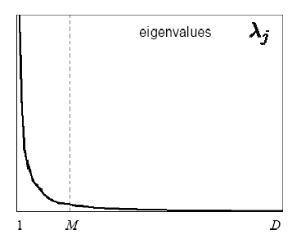
PCA
Projecting onto e₁ captures the majority of the variance and hence it minimizes the error.
x₁
x₁
λ₁e₁
Reduction
λ₁e₁
λ₂e₂
λ₂e₂
x₀
x₀
Choosing subspace dimension M:
Large M means lower expected error in the subspace data approximation

Slide 11
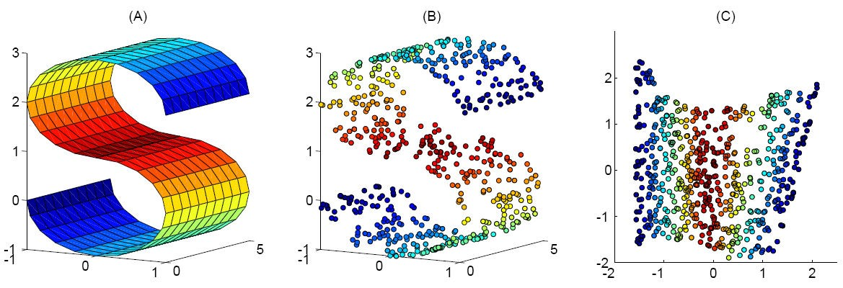
Nonlinear Dimensionality Reduction
Many data sets contain essential nonlinear structures that invisible to PCA.

Slide 12
Matrix eigenvalues
Consider a square matrix of order n with constant real elements a_{ij}
Definition. A number is called an eigenvalue, and a non-zero vector is called the corresponding eigenvector of the matrix if the equality holds:

Slide 13
Matrix eigenvalues
Definition. The set of all eigenvalues of a matrix is called spectrum of the matrix.
Comment. Let's imagine equality (1) in the following. form:
or
E - unit matrix. Equality (2) is a system of linear algebraic equations for the vector h .

Slide 14
Matrix eigenvalues
A system of type (2) is always consistent, since it always has a zero solution.
System (2) has a trivial (zero) solution if the determinant of the matrix
System (2) has non-zero solutions if

Slide 15
Matrix eigenvalues
Equation (3) is called characteristic
matrix equation.
Solutions of equation (3) are called eigenvalues of the matrix.
Equation (3) can be represented in the following. form

Slide 16
Matrix eigenvalue
Having calculated the determinant, expanded it into elements of the first row, and grouped similar terms, we obtain an algebraic equation of n degree
relative to \lambda , and where are constant real numbers
A polynomial of degree relatively is called
characteristic polynomial of the matrix

Slide 17
EIGENVALUES OF THE MATRIX
According to the fundamental theorem of algebra, a characteristic equation always has exactly n roots (taking into account their multiplicity), which in the general case are complex numbers.
Theorem. Any constant square matrix
of order n has, taking into account multiplicity, exactly n eigenvalues coinciding with the roots x of the characteristic equation.

Slide 18
EIGENVALUES OF THE MATRIX
Comment. The task of finding one's own
values of matrix A reduces to solving
characteristic equation (*) .
Example. Find eigenvalues and vectors
matrices
Solution. We compose the characteristic equation

Slide 19
EIGENVALUES OF THE MATRIX
Let's find the eigenvector
corresponding to own
meaning

Slide 20
EIGENVALUES OF THE MATRIX
Putting
we get

Slide 21
EIGENVALUES OF THE MATRIX
is an eigenvector
matrices with their own
meaning
Likewise for the eigenvalue
we get the following

Slide 22
Properties of matrix eigenvalues
Product of matrix eigenvalues
equal to its determinant
Number of non-zero eigenvalues
matrix is equal to its rank.
All eigenvalues of the matrix are non-zero
only and only if the matrix
non-degenerate.

Slide 23
Properties of matrix eigenvalues
If the eigenvalue is non-degenerate
matrix, then the eigenvalue of A⁻¹
matrices

Slide 24
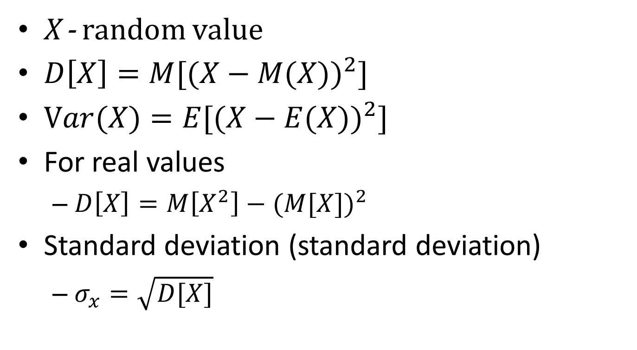
Dispersion​
$X$- random value
$D\left[X\right]=M[{(X−M(X))}^{2}]$
$Var(X)=E[{(X−E(X))}^{2}]$
For real values
$D\left[X\right]=M\left[X^{2}\right]−{(M[X])}^{2}$
Standard deviation (standard deviation)
$σ_{x}=\sqrt{D[X]}$

Slide 25
Covariance​
$X, Y$– random variables
$$cov\left(X,Y\right)=M\left[\left(X−M\left[X\right]\right)\left(Y−M\left[Y\right]\right)\right]$$
$$cov\left(X,Y\right)=E\left[\left(X−E\left[X\right]\right)\left(Y−E\left[Y\right]\right)\right]$$
For samples$X_{(n)}, Y_{(n)}$
$$cov\left(X_{\left(n\right)}, Y_{\left(n\right)}\right)=\frac{1}{n}\sum_{i=1}^{n}{(x_{i}−\overline{x})(y_{i}−\overline{y})}$$
where $\overline{x}$and $\overline{y}$are the average values of the samples

Slide 26
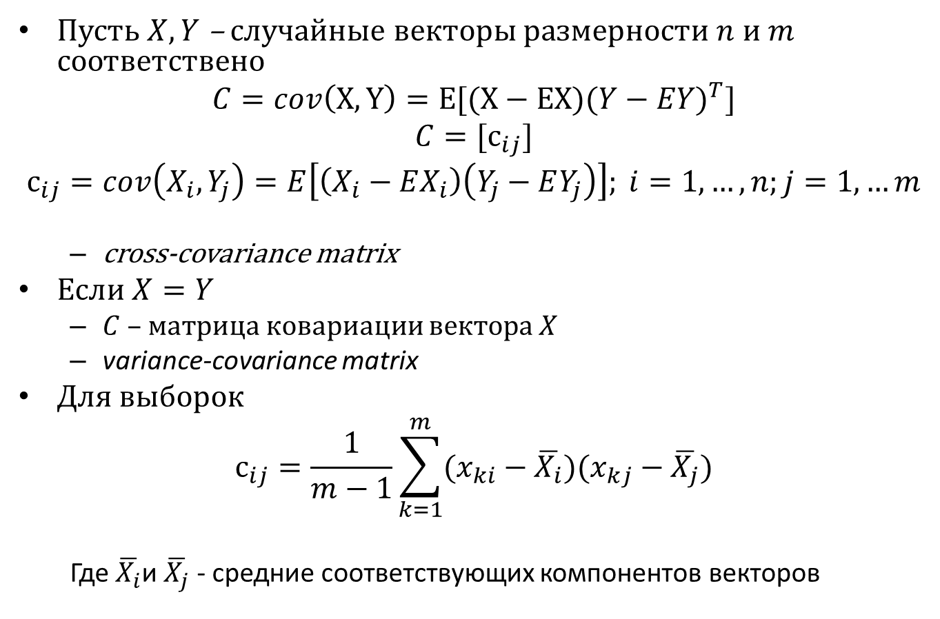
Covariance matrix
Let $X, Y$be random vectors of dimension$n$ and $m$accordingly
$$C=cov\left(X, Y\right)=E[(X−EX){(Y−EY)}^{T}]$$
$$C=[с_{ij}]$$
$с_{ij}=cov\left(X_{i},Y_{j}\right)=E\left[\left(X_{i}−EX_{i}\right)\left(Y_{j}−EY_{j}\right)\right]; i=1,…,n;j=1,…m$
cross-covariance matrix
If$X=Y$
$C$– vector covariance matrix$X$
variance-covariance matrix
For samples
$$с_{ij}=\frac{1}{m−1}\sum_{k=1}^{m}{(x_{ki}−\overline{X_{i}})(x_{kj}−\overline{X_{j}})}$$
Where $\overline{X_{i}}$and $\overline{X_{j}}$are the averages of the corresponding components of the vectors

Slide 27
Correlation​
For samples$X_{(n)}, Y_{(n)}$
Pearson correlation coefficient
$$r_{XY}=\frac{cov(X,Y)}{σ_{X}σ_{Y}}=\frac{\sum_{i=1}^{n}{(x_{i}−\overline{x})(y_{i}−\overline{y})}}{\sqrt{\sum_{1}^{n}{{(x_{i}−\overline{x})}^{2}}\sum_{1}^{n}{{(y_{i}−\overline{y})}^{2}}}}$$
$$r_{XY}∈[−1,+1]$$
Measure of linear dependence
$\left|r_{XY}\right|=1⇒x, y$– linearly dependent
$r_{XY}=$0 $⇒x, y$– linearly independent

Slide 28
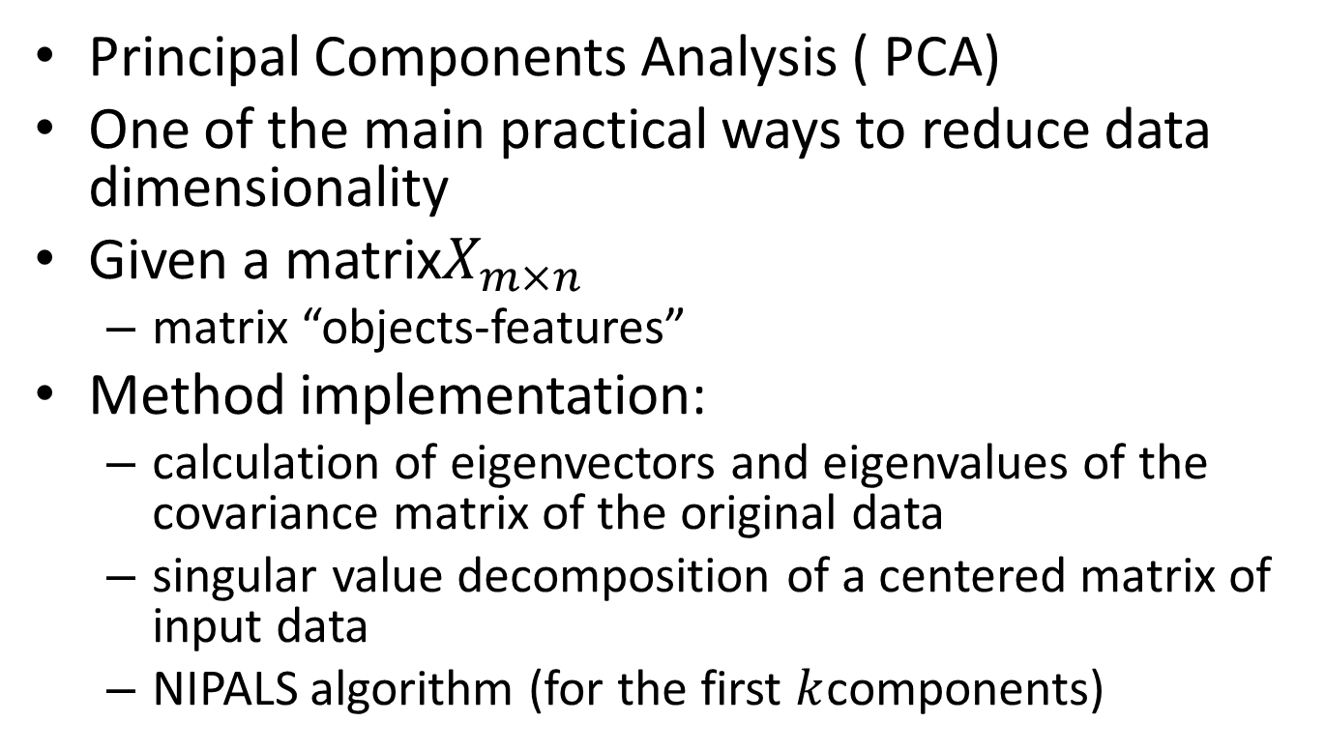
Principal component method
Principal Components Analysis ( PCA)
One of the main practical ways to reduce data dimensionality
Given a matrix$X_{m×n}$
matrix “objects-features”
Method implementation:
calculation of eigenvectors and eigenvalues of the covariance matrix of the original data
singular value decomposition of a centered matrix of input data
NIPALS algorithm (for the first $k$components)

Slide 29
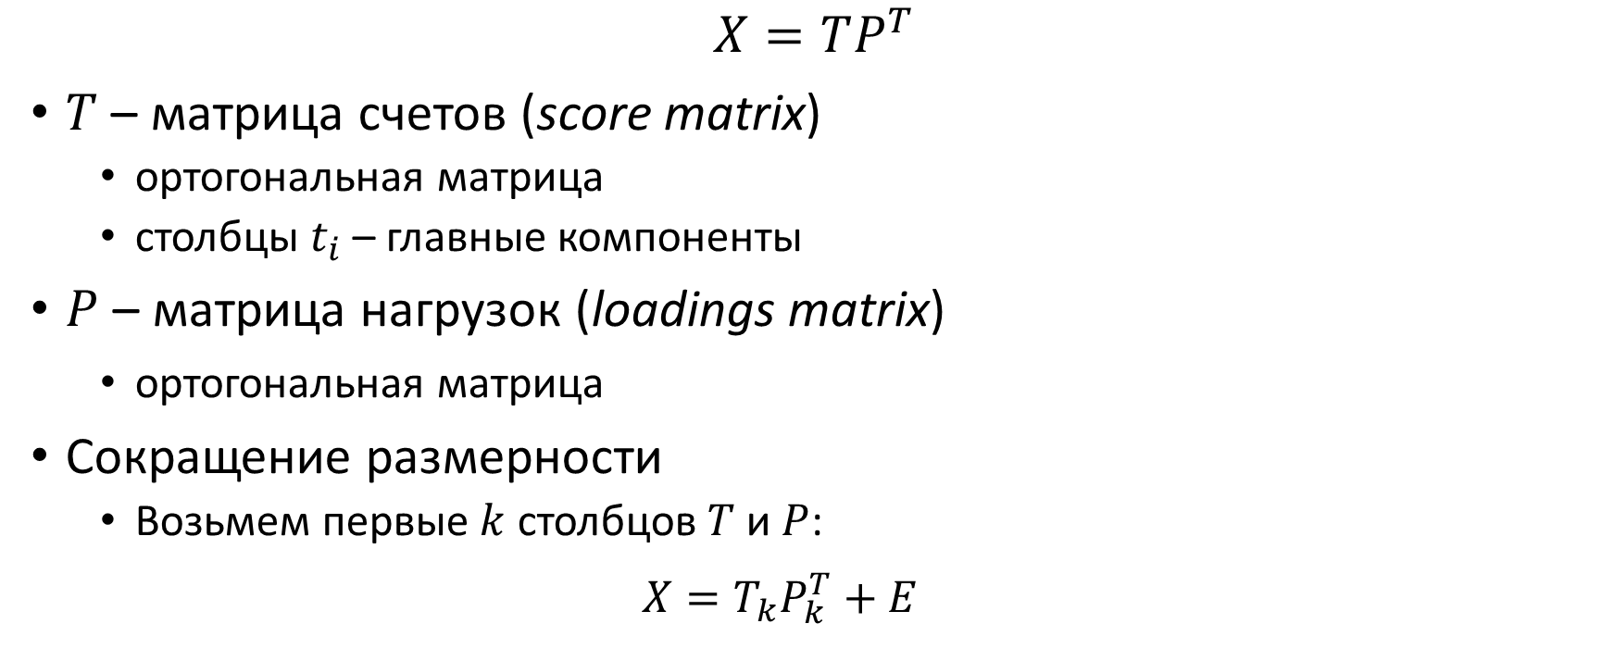
Formalization
$$X=TP^{T}$$
$T$– score matrix​
orthogonal matrix
columns $t_{i}$- main components
$P$– loadings matrix​​
orthogonal matrix
Dimensionality reduction
Let's take the first $k$columns $T$and $P$:
$$X=T_{k}P_{k}^{T}+E$$

Slide 30
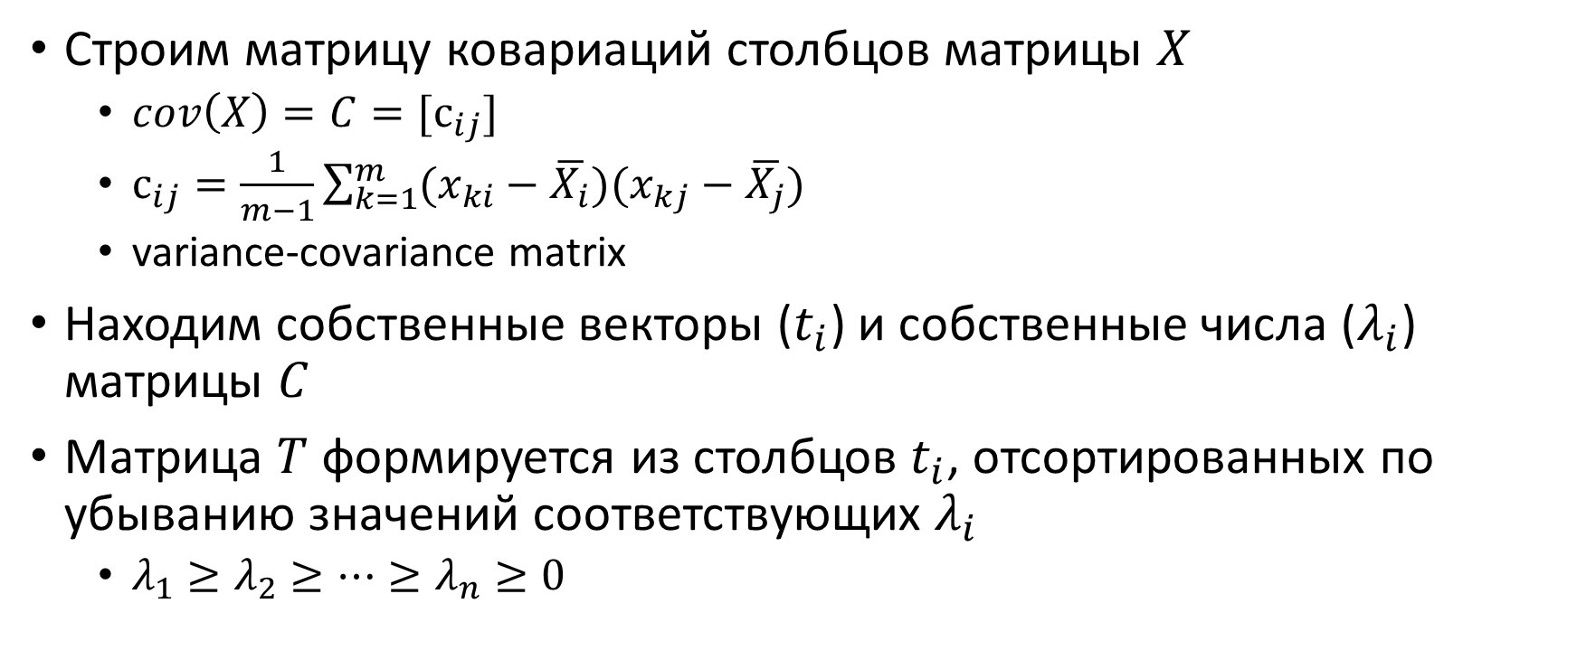
Classic implementation
Constructing a covariance matrix of matrix columns$X$
$cov\left(X\right)=C=[с_{ij}]$
$с_{ij}=\frac{1}{m−1}\sum_{k=1}^{m}{(x_{ki}−\overline{X_{i}})(x_{kj}−\overline{X_{j}})}$
variance-covariance matrix
Finding the eigenvectors ( $t_{i}$) and eigenvalues ( $λ_{i}$) of the matrix$C$
The matrix $T$is formed from columns $t_{i}$sorted in descending order of the corresponding values$λ_{i}$
$λ_{1}≥λ_{2}≥…≥λ_{n}≥0$

Slide 31
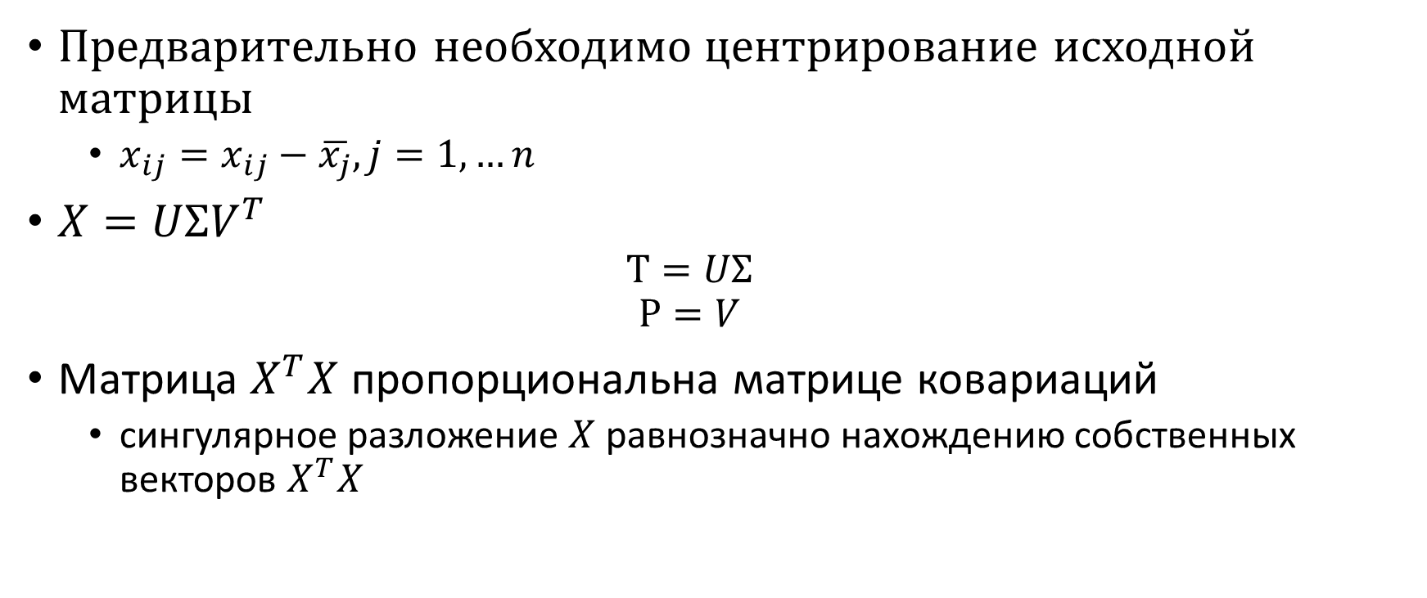
SVD
It is necessary to first center the original matrix
$x_{ij}=x_{ij}−\overline{x_{j}}, j=1,…n$
$X=UΣV^{T}$
$$T=UΣ$$
$$P=V$$
Matrix$X^{T}X$ is proportional to the covariance matrix
singular value decomposition $X$is equivalent to finding the eigenvectors$X^{T}X$

Slide 32

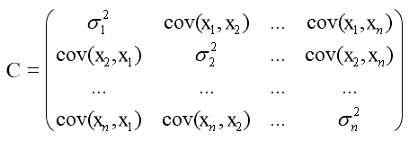
Step 3: Calculate the covariance matrix
Find the covariance matrix C of size n × n as:
C = ¹ ⁄ _{(n − 1)} X ^{T} X
The use of N − 1 instead of N is due to the Bessel correction

Slide 33
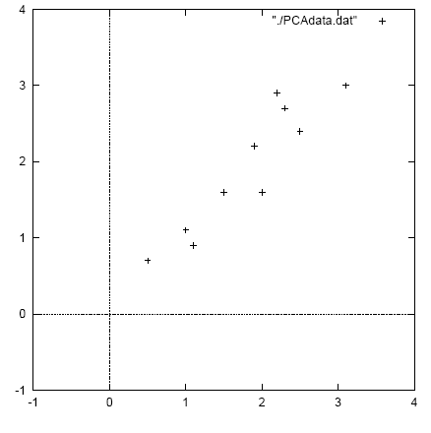
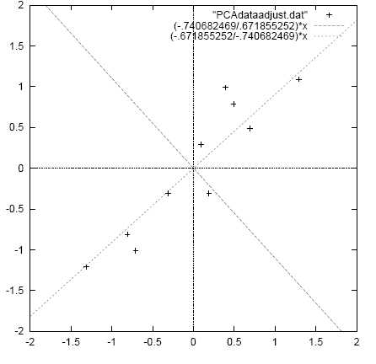
PCA example (1)
original data
mean centered data with
PCs overlayed

Slide 34
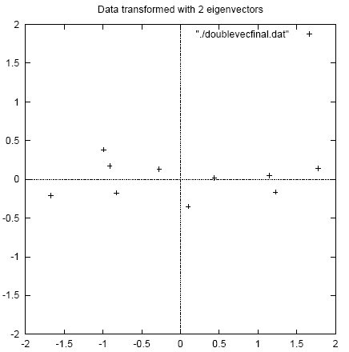
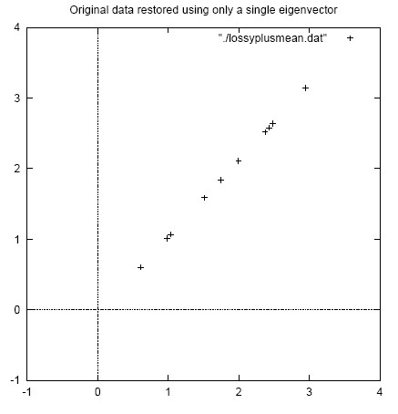
PCA example (1)
original data projected
Into full PC space
original data reconstructed using
only a single PC

Slide 35
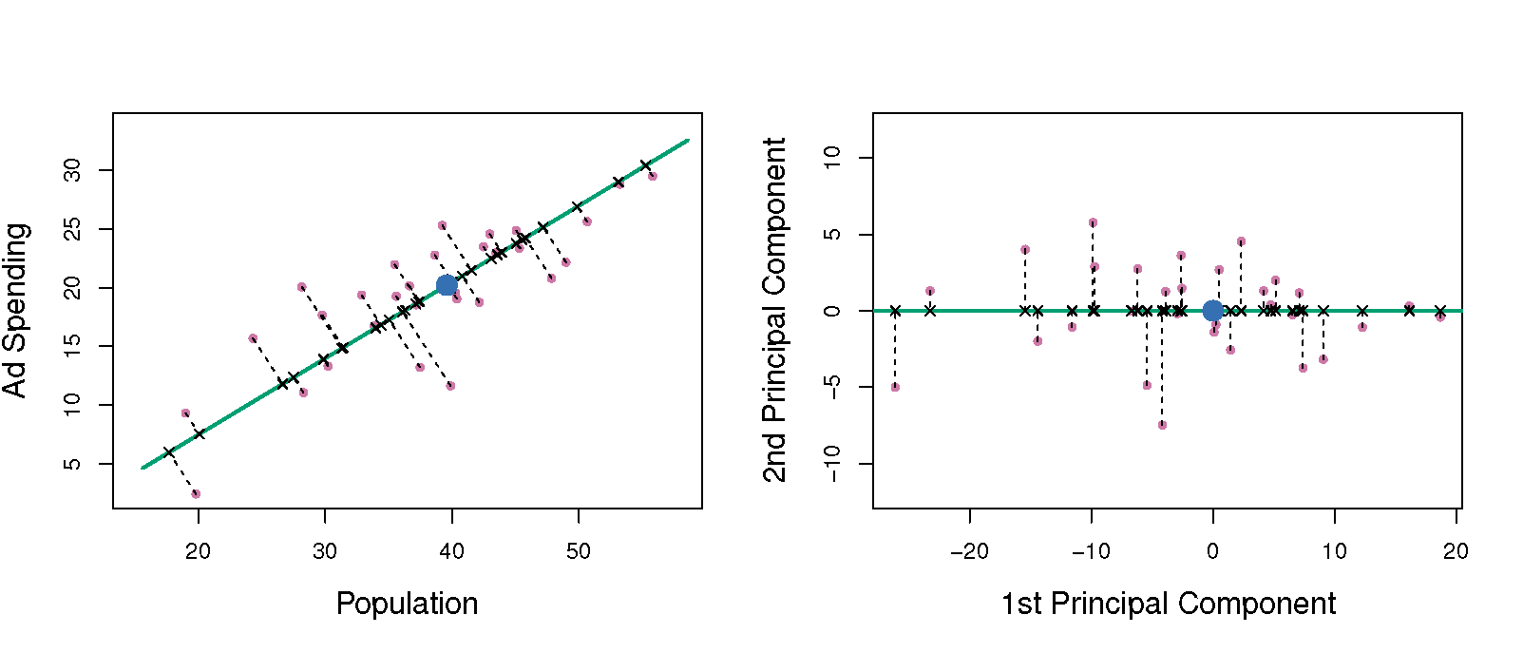
PCA example (2)

Slide 36
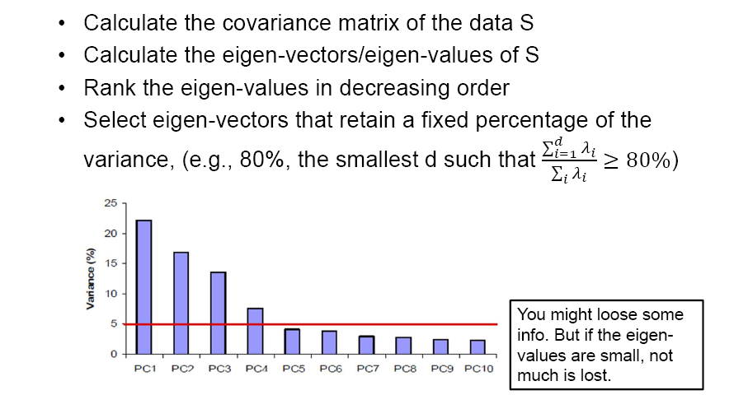
PCA: choosing the dimension k

Slide 37
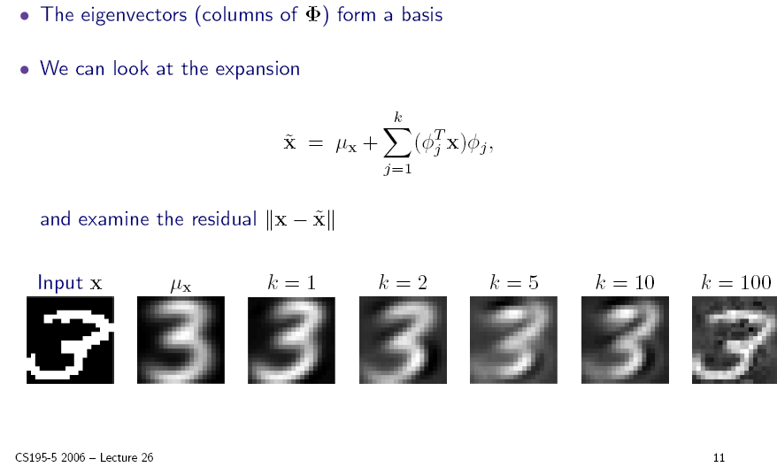
PCA: choosing the dimension k

Slide 38
PCA example: face recognition
A typical image of size 256 x 128 pixels is described by 256 x 128 = 32768 dimensions.
Each face image lies somewhere in this high-dimensional space.
Images of faces are generally similar in overall configuration, thus
They cannot be randomly distributed in this space.
We should be able to describe them in a much lower-dimensional space.

Slide 39
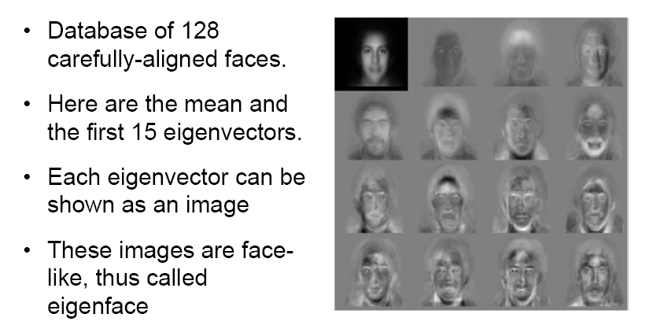
PCA for face images: eigenfaces

Slide 40
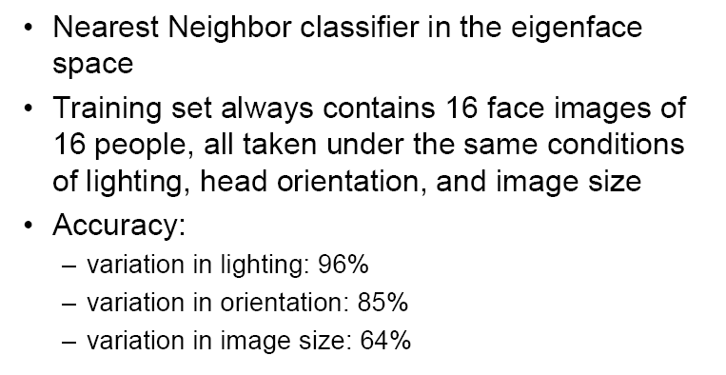
Face recognition in eigenface space
(Turk and Pentland 1991)

Slide 41
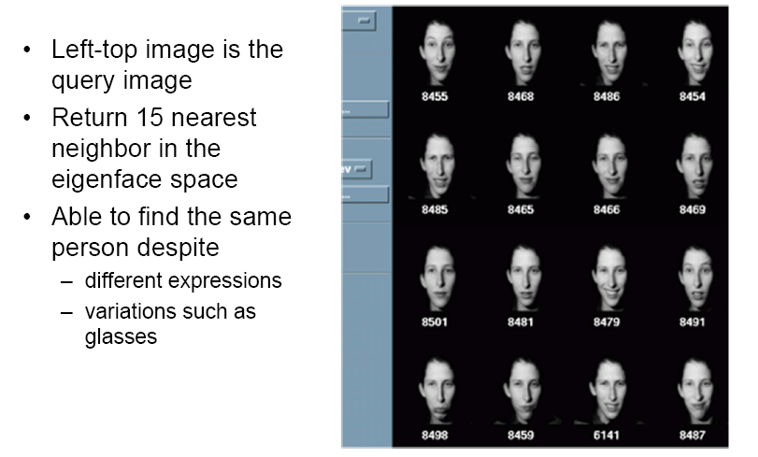
Face image retrieval

Slide 42
PCA: a useful preprocessing step
Helps reduce computational complexity.
Can help supervised learning.
Reduced dimension ⇒ simpler hypothesis space.
Smaller VC dimension ⇒ less risk of overfitting.
PCA can also be seen as noise reduction.
Caveats:
Fails when data consists of multiple separate clusters.
Directions of greatest variance may not be most informative (i.e. greatest classification power).

Slide 43
Scaling up PCA
Practical issue: covariance matrix is n x n.
E.g. for image data Σ = 32768 x 32768.
Finding eigenvectors of such a matrix is slow.
Singular value decomposition (SVD) to the rescue!
Can be used to compute principal components.
Efficient implementations available, e.g. MATLAB svd.

Slide 44
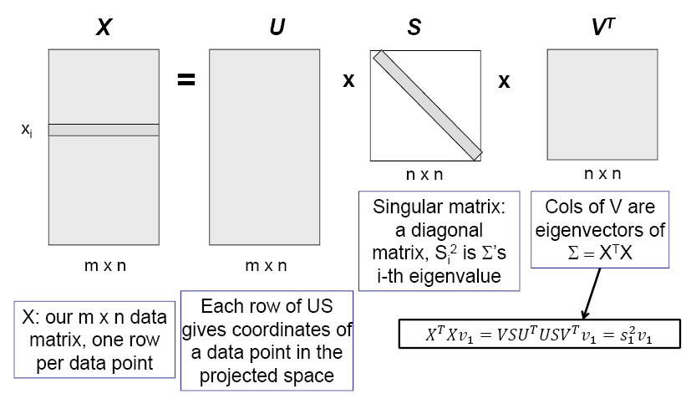
Singular value decomposition (SVD)
X = U⋅S⋅V^{T}

Slide 45
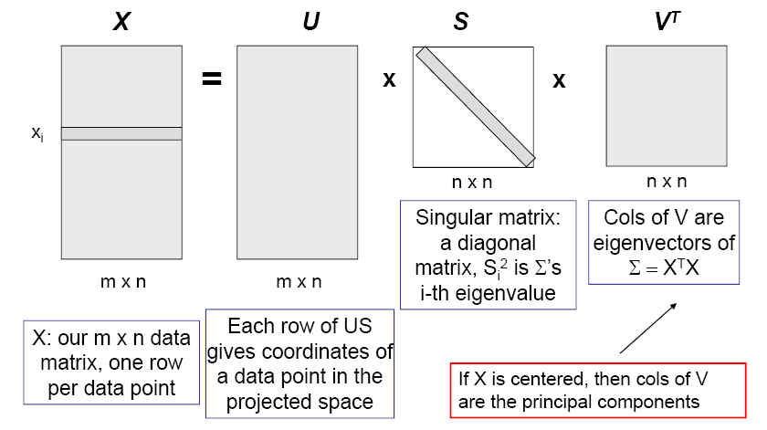
Singular value decomposition (SVD)
X = U⋅S⋅V^{T}

Slide 46
SVD for PCA
Create mean-centered data matrix X.
Solve SVD: X = U⋅S⋅V^{T}.
Columns of V are the eigenvectors of Σ sorted from largest to smallest eigenvalues.
Select the first k columns as our k principal components.

Slide 47
Singular Value Decomposition
For an m× n matrix A of rank r there exists a factorization
(Singular Value Decomposition = SVD) as follows:
m×m
m×n
V is n×n
The columns of U are orthogonal eigenvectors of AA^{T}.
The columns of V are orthogonal eigenvectors of A^{T}A.
Eigenvalues λ₁ … λ_{r} of AA^{T} are the eigenvalues of A^{T}A.
Singular values.

Slide 48
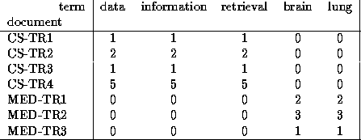
Singular Value Decomposition
Problem:
#1: Find concepts in text
#2: Reduce dimensionality

Slide 49
SVD - Definition
A_{[n x m]} = U_{[n x r]} Λ _{[ r x r]} (V_{[m x r]})^{T}
A: n x m matrix (e.g., n documents, m terms)
U: n x r matrix (n documents, r concepts)
Λ: r x r diagonal matrix (strength of each ‘concept’) (r: rank of the matrix)
V: m x r matrix (m terms, r concepts)

Slide 50
SVD - Properties
THEOREM [Press+92]: always possible to decompose matrix A into A = U Λ V^{T} , where
U, Λ, V: unique (*)
U, V: column orthonormal (ie., columns are unit vectors, orthogonal to each other)
U^{T}U = I; V^{T}V = I (I: identity matrix)
Λ: singular value are positive, and sorted in decreasing order

Slide 51
SVD - Properties
‘spectral decomposition’ of the matrix:
λ₁
=
x
x
u₁
u₂
λ₂
v₁
v₂

Slide 52
SVD - Interpretation
‘documents’, ‘terms’ and ‘concepts’:
U: document-to-concept similarity matrix
V: term-to-concept similarity matrix
Λ: its diagonal elements: ‘strength’ of each concept
Projection:
best axis to project on: (‘best’ = min sum of squares of projection errors)

Slide 53
SVD - Example
A = U Λ V^{T} - example:
retrieval
inf.
lung
data
brain
CS
=
x
x
MD

Slide 54
SVD - Example
doc-to-concept
similarity matrix
A = U Λ V^{T} - example:
retrieval
CS-concept
inf.
lung
MD-concept
data
brain
CS
=
x
x
MD

Slide 55
SVD - Example
A = U Λ V^{T} - example:
retrieval
inf.
‘strength’ of CS-concept
lung
data
brain
CS
=
x
x
MD

Slide 56
SVD - Example
A = U Λ V^{T} - example:
term-to-concept
similarity matrix
retrieval
inf.
lung
data
brain
CS-concept
CS
=
x
x
MD

Slide 57
SVD – Dimensionality reduction
Q: how exactly is dim. reduction done?
A: set the smallest singular values to zero:
=
x
x

Slide 58
SVD - Dimensionality reduction
~
x
x

Slide 59
SVD - Dimensionality reduction
~

Slide 60
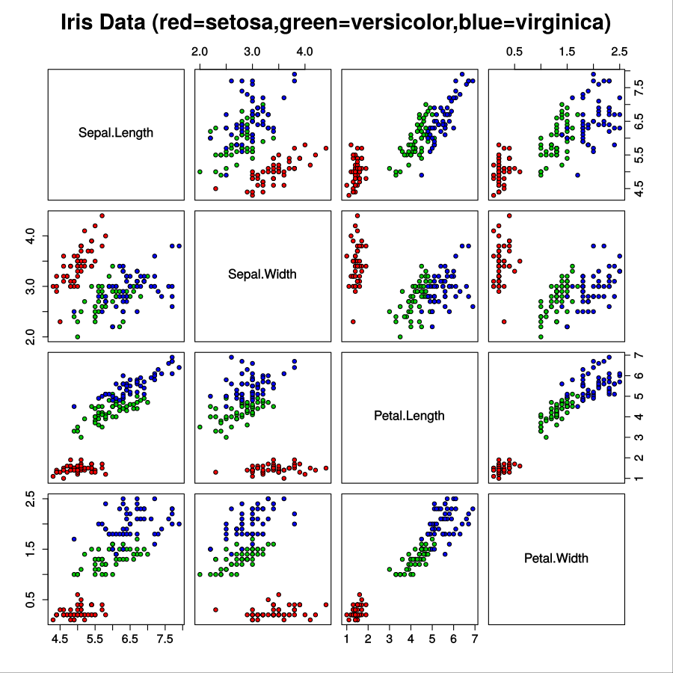
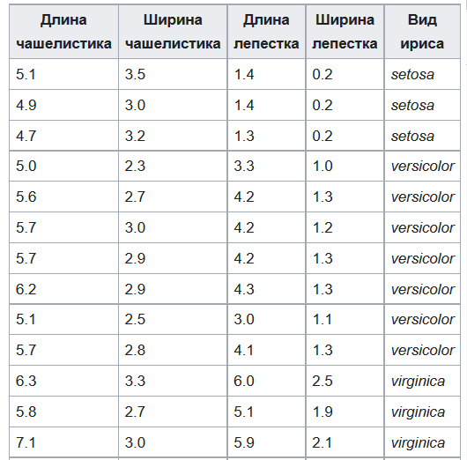
Ирисы Фишера

Slide 61
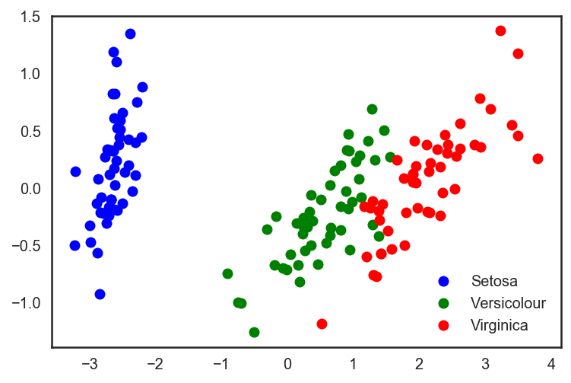
Проекция ирисов на главные компоненты

Slide 62
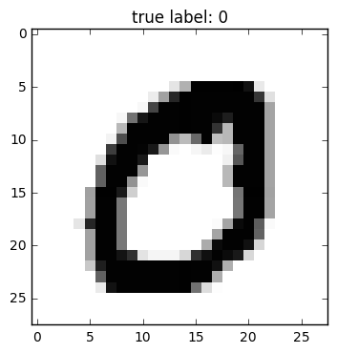
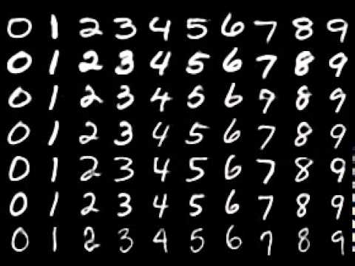
MNIST (сокр. от Mixed National Institute of Standards and Technology)

Slide 63
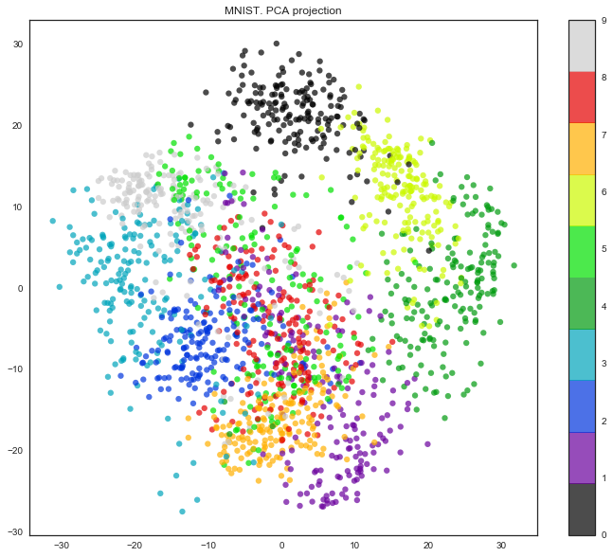

Slide 64
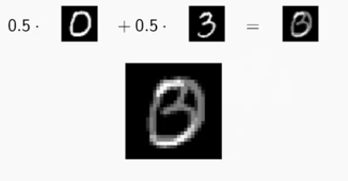
Почему такой плохой результат?
Линейная комбинация объектов датасета не является рукописной цифрой.
Значит объекты расположены в подпространстве, не являющемся линейным.

Slide 65
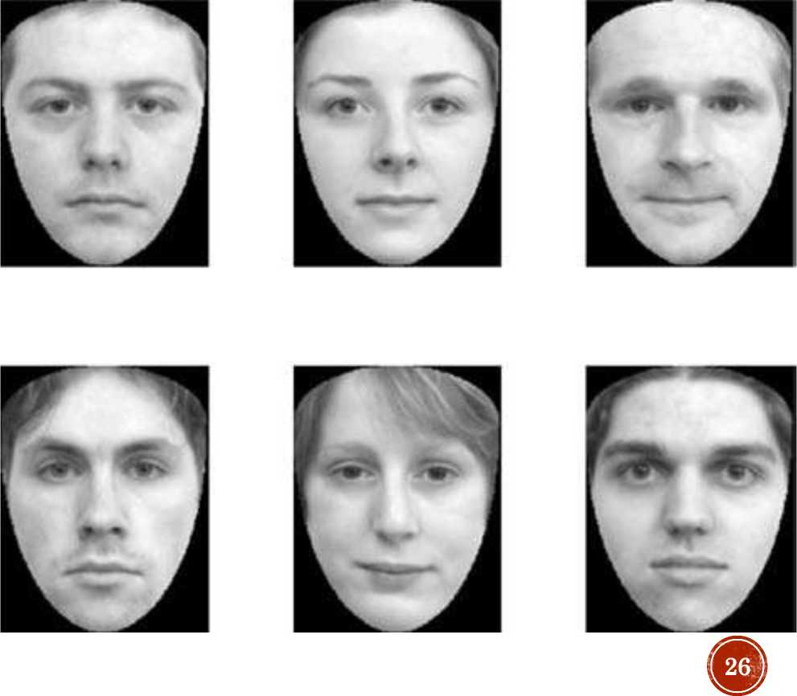
Key Example: Eigenfaces And The
Human Face
• It is self-evident that the basic placement, size and shape of human facial features are similar. Therefore, we can expect that an ensemble of suitably scaled and registered images of the human face will exhibit fairly strong correlation. Each image consisted of 21 054 grey-scale pixel values.
Figure 9.13 A sample of human faces scaled and registered such that each can be described by the same number of pixels (21 054).

Slide 66
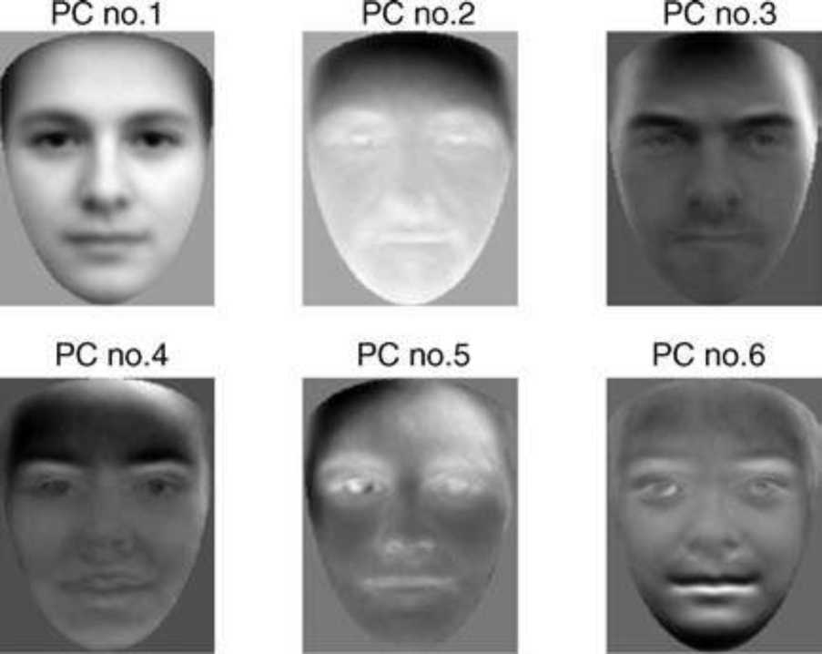

Figure 9.15 The first six facial principal components from a sample of 290 faces. The first principal is the average face. Note the strong male appearance coded by principal component no. 3
PCA- by Farah Al-Tufaili

