Slide 1
Визуализация данных
Лекции доступны онлайн по адресу
http://github.com/a-vodka/dv

Slide 2
Outline
F
I
n
t
r
o
d
u
c
t
i
o
n
F
C
a
n
o
n
i
c
a
l
O
r
d
e
r
i
n
g
G
K
a
n
t
A
l
g
o
r
i
t
h
m
i
c
a
(
1
9
9
6
)
1
6
:
4
¡
3
2
.
,
F
R
e
a
l
i
z
e
r
W
S
c
h
n
y
d
e
r
S
O
D
A
1
9
9
0
p
p
1
3
8
¡
1
4
8
.
,
;
;
F
O
r
d
e
r
l
y
S
p
a
n
n
i
n
g
T
r
e
e
C
h
i
a
n
g
L
i
n
L
u
S
O
D
A
2
0
0
1
p
p
5
0
6
¡
5
1
5
,
,
,
;
;
F
A
p
p
l
i
c
a
t
i
o
n
:
C
o
m
p
a
c
t
°
o
o
r
-
p
l
a
n
n
i
n
g
L
i
a
o
L
u
Y
e
n
J
A
l
g
o
r
i
t
h
m
s
4
8
(
2
0
0
3
)
4
4
1
-
4
5
1
,
,
,
:

Slide 3
Outline
F
I
n
t
r
o
d
u
c
t
i
o
n
F
C
a
n
o
n
i
c
a
l
O
r
d
e
r
i
n
g
G
K
a
n
t
A
l
g
o
r
i
t
h
m
i
c
a
(
1
9
9
6
)
1
6
:
4
¡
3
2
.
,
F
R
e
a
l
i
z
e
r
W
S
c
h
n
y
d
e
r
S
O
D
A
1
9
9
0
p
p
1
3
8
¡
1
4
8
.
,
;
;
F
O
r
d
e
r
l
y
S
p
a
n
n
i
n
g
T
r
e
e
C
h
i
a
n
g
L
i
n
L
u
S
O
D
A
2
0
0
1
p
p
5
0
6
¡
5
1
5
,
,
,
;
;
F
A
p
p
l
i
c
a
t
i
o
n
:
C
o
m
p
a
c
t
°
o
o
r
-
p
l
a
n
n
i
n
g
L
i
a
o
L
u
Y
e
n
J
A
l
g
o
r
i
t
h
m
s
4
8
(
2
0
0
3
)
4
4
1
-
4
5
1
,
,
,
:

Slide 4
Introduction
Graph drawing algorithm aims to construct geometric representations of graphs in 2D and 3D.
The output is a drawing of the graph; the drawing should be easy to understand, easy to remember, beautiful.
The input is a graph with no geometry
A - B, C, D
B - A, C, D
C - A, B, D, E
D - A, B, C, E
E - C, D
C
A
B
E
D

Slide 5
Aesthetics & Evaluation
“The graphic properties of a good drawing”
Why are we interested? To enhance “readability”
Examples
Crossings
Area
Uniform Edge Length
Angular Resolution
Aspect Ratio
B
A
B
B
B
B
B
B
A
A
A
A
B
A
A
A
“does the diagram convey the information?

Slide 6
What GD conventions already exist?
Lots but they are often classified in terms of the drawing style they follow
Straight Line Drawing
Orthogonal Drawing
Grid Drawing
Circular Drawing
Polyline Drawing
Upward drawing.

Slide 7
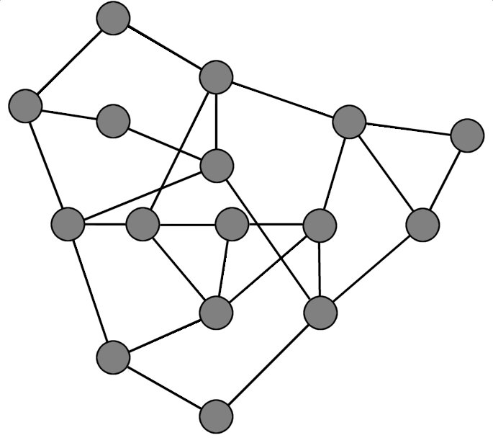
Straight Line Drawing

Slide 8
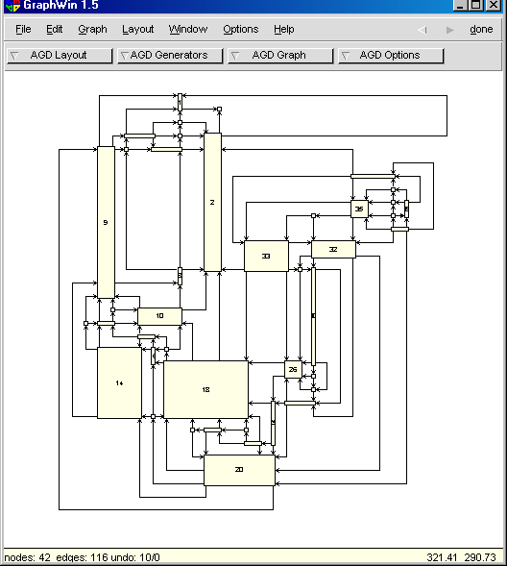
Orthogonal drawing

Slide 9
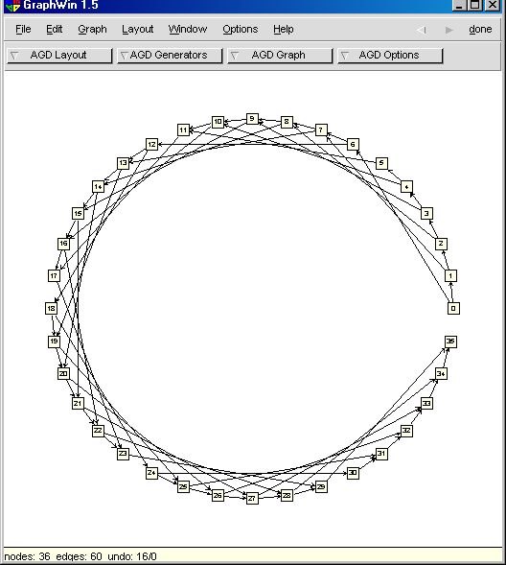
Circular Layout

Slide 10
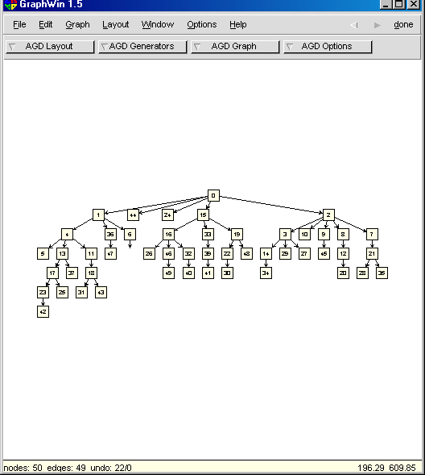
Tree Layout

Slide 11
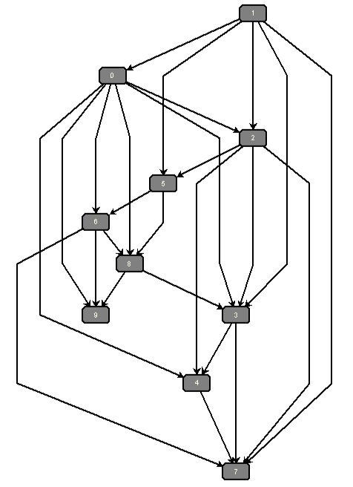
Layered Layout

Slide 12
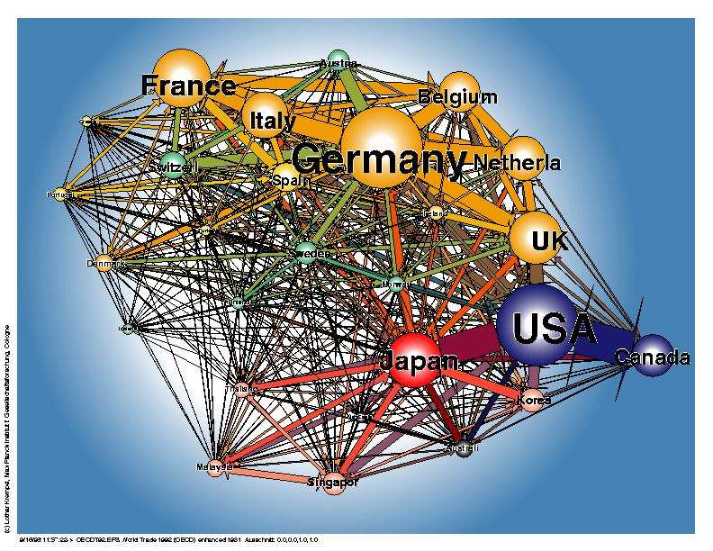
1992
http://www.mpi-fg-koeln.mpg.de/~lk/netvis/trade/WorldTrade.html

Slide 13
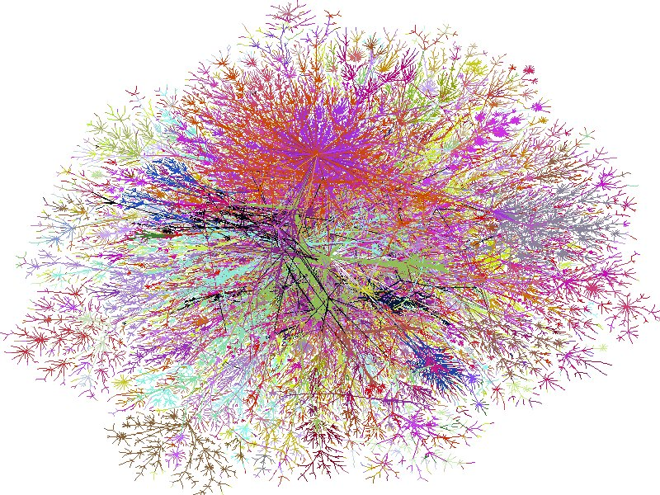
Artistic Visualization of Internet Connectivity
Background
© Lucent

Slide 14
Trade-Offs
I
n
g
e
n
e
r
a
l
o
n
e
c
a
n
n
o
t
s
i
m
u
l
t
a
n
e
o
u
s
l
y
o
p
t
i
m
i
z
e
t
w
o
,
a
e
s
t
h
e
t
i
c
c
r
i
t
e
r
i
a
M
i
n
i
m
a
l
c
r
o
s
s
i
n
g
s
M
a
x
i
m
a
l
s
y
m
m
e
t
r
i
e
s

Slide 15
Complexity Issues
F
T
e
s
t
i
n
g
p
l
a
n
a
r
i
t
y
t
a
k
e
s
l
i
n
e
a
r
t
i
m
e
F
T
e
s
t
i
n
g
u
p
w
a
r
d
p
l
a
n
a
r
i
t
y
i
s
N
P
-
h
a
r
d
F
M
i
n
i
m
i
z
i
n
g
c
r
o
s
s
i
n
g
s
i
s
N
P
-
h
a
r
d
F
M
i
n
i
m
i
z
i
n
g
b
e
n
d
s
i
n
p
l
a
n
a
r
o
r
t
h
o
g
o
n
a
l
d
r
a
w
-
i
n
g
I
N
P
-
h
a
r
d
i
n
g
e
n
e
r
a
l
I
p
o
l
y
n
o
m
i
a
l
t
i
m
e
f
o
r
a
¯
x
e
d
e
m
b
e
e
d
i
n
g

Slide 16
Two Famous Graph Drawing Techniques
An algorithmic method: The Sugiyama Method
A declarative method: The Force Directed Method, a.k.a. Spring Algorithms, Spring Embedding.

Slide 17
The Sugiyama method
A layered network is a graph whose nodes are partitioned into layers L₁, L₂, ..., L_{k}.
Normally, the graph is directed and acyclic.
L₆
L₅
L₄
L₃
L₂
L₁
Slide 17

Slide 18
The Sugiyama method
Layered networks are often used to represent dependency relations.
Sugiyama et al. developed a simple method for drawing layered networks in 1979.
quadrilateral
Sugiyama’s aims included:
few edge crossings
edges as straight as possible
nodes spread evenly over the page
trapezium
parallelogram
rectangle
diamond
square
Slide 18

Slide 19
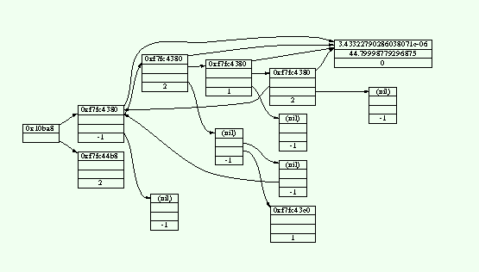
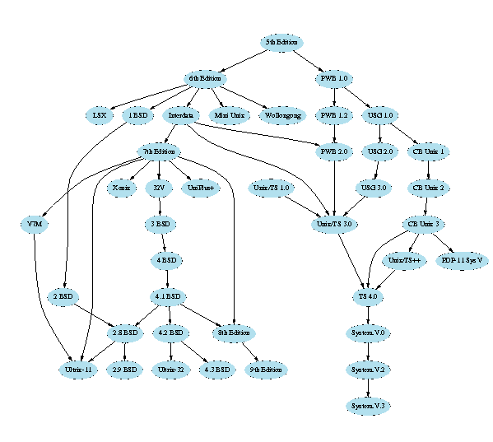
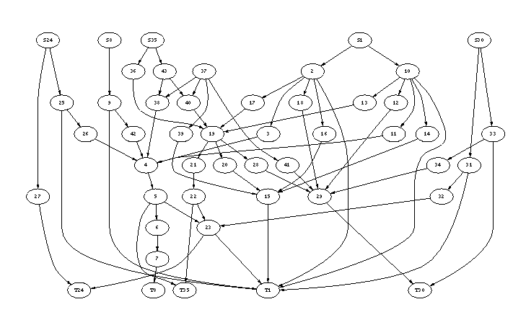
The Sugiyama method
Sugiyama drawings are easily recognised.
© AT&T

Slide 20
The Sugiyama method: 4 steps
1. Eliminate directed cycles.
2. Place each node into a layer.
3. Order the nodes within each layer to avoid edge crossings.
4. Straighten the long edges.
Slide 20

Slide 21
Sugiyama Step 3: order the nodes within each layer
1
2
2
1
3
4
5
4
5
3
6
7
6
7
step 3
8
9
9
8
10
11
12
11
10
12
13
14
13
14
21 edge crossings
5 edge crossings
Slide 21

Slide 22
Sugiyama Step 3: order the nodes within each layer
1
2
L₆
Step 3 uses a “layer-by-layer sweep”, from bottom to top.
At each stage of the sweep, we:
hold one layer fixed, and
re-arrange the nodes in the layer above to avoid edge crossings.
3
4
5
L₅
free
6
7
L₄
fixed
free
8
9
L₃
fixed
free
10
11
12
L₂
fixed
13
14
L₁
Slide 22
Notes:
8

Slide 23
Sugiyama Step 3: re-arranging each layer
free
8
9
L₃
1
2
3
4
5
fixed
10
11
12
L₂
6
7
Re-arrange
free layer
free
8
9
L₃
9
8
L₃
fixed
10
11
12
L₂
10
11
12
L₂
13
14
The difficult part is to re-arrange the free layer
Slide 23

Slide 24
Force directed graph drawing

Slide 25
The problem
Given a set of vertices and edges,
compute positions for the vertices.
If the edges don’t have to be straight (e.g. curved), compute something about them too.
Probably control points for a parametric curve

Slide 26
Drawing general undirected graphs
Some problems are hard because there are a lot of constraints
This one is hard because there are very little constraints

Slide 27
Overview
The concept of force directed drawing
Aspects of force directed drawing

Slide 28
Metaphor
Vertices are metal rings
Exert a repulsive force
This way, vertices don’t come too close together.

Slide 29
Metaphor
Edges are springs that connect the rings
An attractive force between connected vertices.
This way, vertices with edges between them don’t go too far apart

Slide 30
Metaphor
Will probably give a good looking drawing
Define an ‘energy’ function on drawings
Minimize this energy

Slide 31
Forces

Slide 32
Forces

Slide 33
Forces

Slide 34
Forces

Slide 35
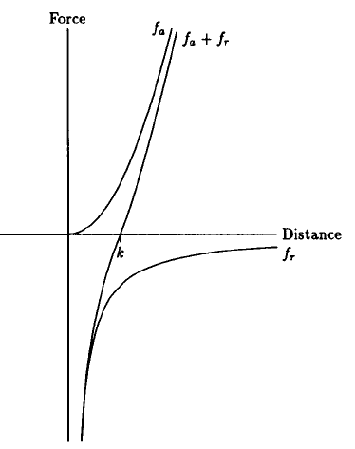
Example magnitude of forces
Fruchterman & Reingold (‘91)
Attraction quadratic
Repulsion hyperbolic
Parameterized for the distance we try to achieve
f_{a} = d² / k
f_{r} = -k² / d

Slide 36
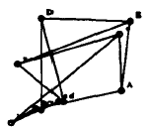
Fruchterman & Reingold

Slide 37
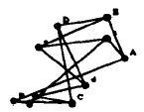

Slide 38
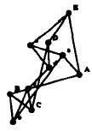

Slide 39
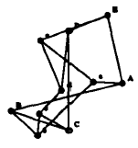

Slide 40
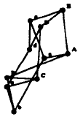

Slide 41


Slide 42
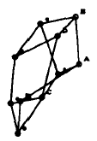

Slide 43
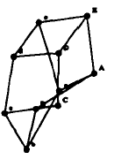

Slide 44
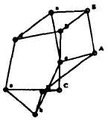

Slide 45
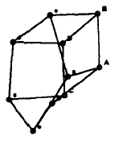

Slide 46
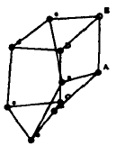

Slide 47
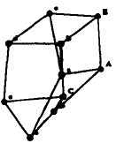

Slide 48
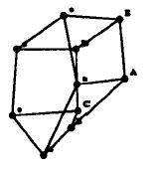

Slide 49
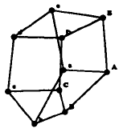

Slide 50
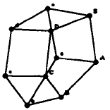

Slide 51
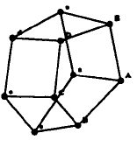

Slide 52
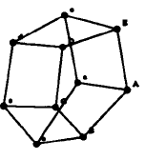
“Final”

Slide 53
“Final”

Slide 54
“Final”

Slide 55
Termination
Well …
50 iterations?
Energy threshold?
Local minimum reached?
User input?

Slide 56
Oft-cited papers
(E) Eades (’84) A heuristic for graph drawing
(K&K) Kamada & Kawai (’89) An algorithm for drawing general undirected graphs.
(F&R) Fruchterman & Reingold (’91): Graph Drawing by Force-directed Placement
(D&H) Davidson & Harel (’96) Drawing Graphs Nicely Using Simulated Annealing

Slide 57
Aspects of force directed algos
Very flexible concept
Many aspects
Can be mixed and matched

Slide 58
What are good drawings?
K&K: “The graph structure encompasses so many kinds of structures, from trees to complete graphs, that it is difficult to find out the common criteria of nice drawings.”

Slide 59
What are good drawings?
K&K, D&H, F&R
Distribute the vertices and edges uniformly
Symmetry whenever possible
D&H, F&R
Conform to the shape of the frame
Reduce the number of edge crossings
D&H
Keep vertices from coming too close to edges
F&R
Uniform edge length

Slide 60
What are good drawings?
D&H: be able to weigh which aesthetic criteria are important
Then it will also be possible to tweak it

Slide 61
What are good drawings?
versus

Slide 62
What are good drawings?
K&K: edge crossing per se is not a good criterion.
“Balance” is more important
versus

Slide 63
Initial configuration
D&H, F&R: random.
K&K: on a circle.
Both ‘just work’
In all the implementations, can also specify start positions

Slide 64
Edge length
K&K: Try to make uniform
F&R: Pairs of vertices should have distance in the plane equal to their distance in the graph
D&H: As short as possible

Slide 65
Moving vertices
Typically one at a time (K&K, D&H)
Susceptible to local minima
All at once for better results (F&R)
Limit the distance moved in one step
Big steps at first, small ones later

Slide 66
Moving vertices
Gansner and North (’98) Improved Force-Directed Layouts
Construct Voronoi diagram
Move vertices to their Voronoi cell centroid

Slide 69
Moving vertices
Gansner, Koren & North (’04) again Graph Drawing by Stress Majorization
Different optimization technique, known as majorization.
Existing technique from a different field
Reportedly works great here
Both improved running time and stability

Slide 70
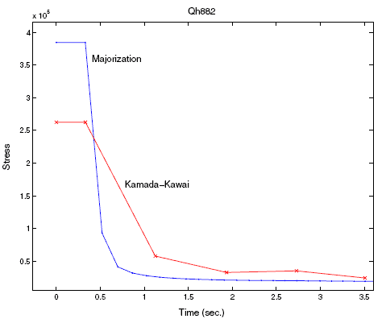
Majorization runtime

Slide 71
What to do about edge-crossings
Again, K&K: edge crossings aren’t bad at all.
D&H: trying to make edges short tends to give little crossings.
Algorithms for drawing plane graphs exist, but don’t always give nice pictures.
Better to have a few crossings in an otherwise good looking drawing.

Slide 72
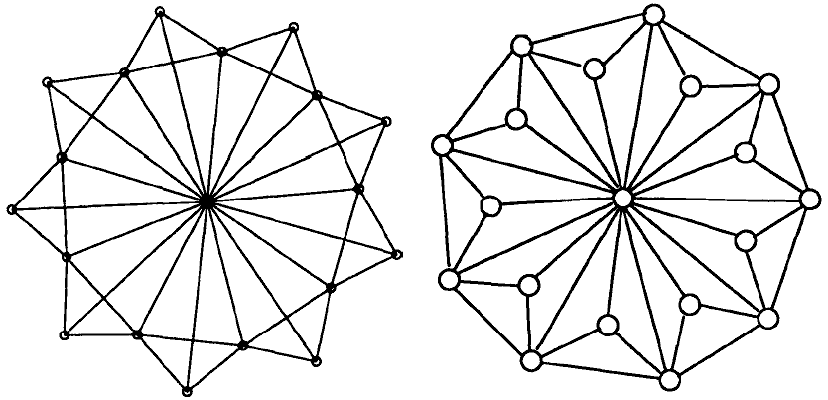
What to do about edge-crossings
F&R
D&H

Slide 73
What to do about edge-crossings
François Bertault (’00) A force-directed algorithm that preserves edge-crossing properties
(Find a drawing of the graph with minimal edge crossings using some algorithm)
Beautify it using force directed methods
Don’t introduce edge crossings!

Slide 74
Conclusion
Force directed methods give good results
Other methods give unsatisfactory results
E.g. GraphViz uses it.
Lots of opportunities to tweak

Slide 75
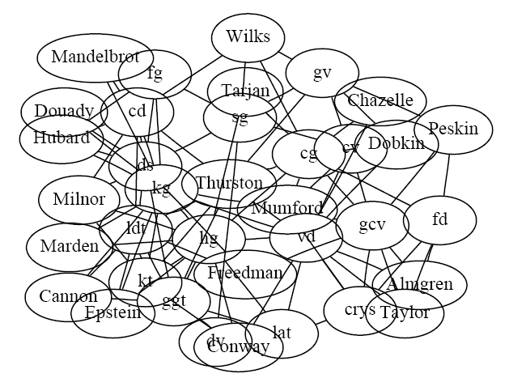
Non-point vertices
Again, Gansner and North (’98) Improved Force-Directed Layouts

Slide 76
