Slide 1
Data visualization
All samples available on:
http://github.com/a-vodka/dv

Slide 2
Realisation of the course
This course has been developed within the framework of the project “Mechanics digital" by the German Academic Exchange Service (DAAD) under funding program “Ukraine digital: Ensuring academic success in times of crisis (2022)" The course has been developed in collaboration with our colleagues from the Otto-von-Guericke-University Magdeburg in Germany We would like to thank the DAAD for their financial and logistical support

Slide 3

Plotting - matplotlib
User friendly, but powerful, plotting capabilites for python
http://matplotlib.sourceforge.net/
Once installed (default at Observatory)
>>> import pylab
Settings can be customised by editing ~/.matplotlib/matplotlibrc
default font, colours, layout, etc.
Helpful website
many examples

Slide 4
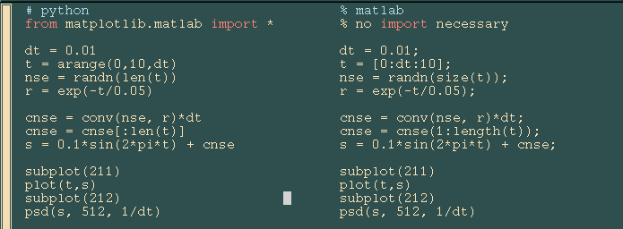
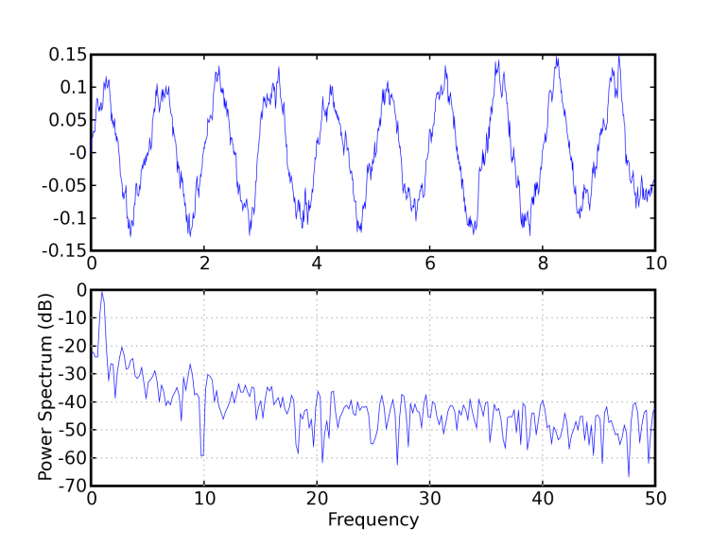
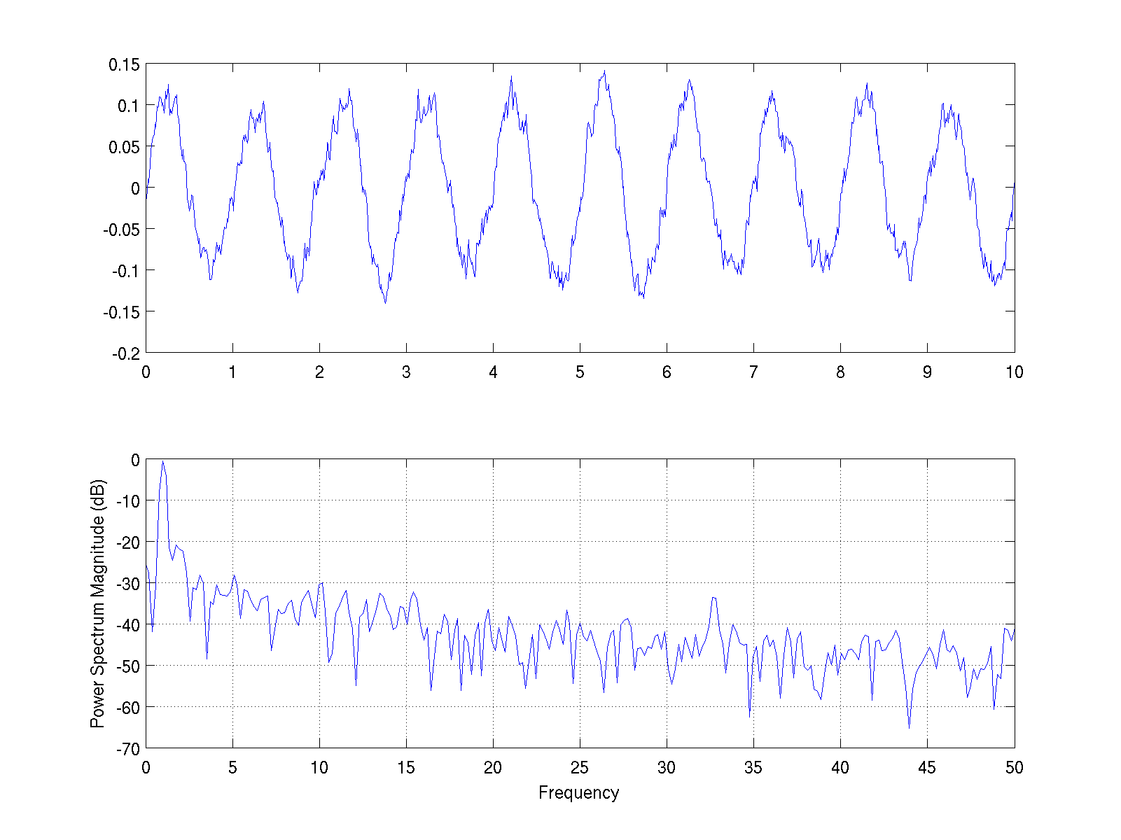
Copy the great architectures E Tufte

Slide 5
matplotlib 3 ways
embedding in a webserver or GUI (Tk, GTK, WX, Cocoa, Qt, FLTK)‏
production scripting
interactive shell (pylab / pyplot)‏

Slide 6
interactive demo
the interactive shell, rich data structures, numpy arrays, pylab mode
rich text support, what you see is what you get, mathtext
event handling, GUI embedding
website - sphinx

Slide 7
Pyplot and pylab
pylab is a module in matplotlib that gets installed alongside matplotlib; and matplotlib.pyplot is a module in matplotlib.
Pyplot provides the state-machine interface to the underlying plotting library in matplotlib. This means that figures and axes are implicitly and automatically created to achieve the desired plot. Setting a title will then automatically set that title to the current axes object.
Pylab combines the pyplot functionality (for plotting) with the numpy functionality (for mathematics and for working with arrays) in a single namespace, For example, one can call the sin and cos functions just like you could in MATLAB, as well as having all the features of pyplot.
The pyplot interface is generally preferred for non-interactive plotting (i.e., scripting). The pylab interface is convenient for interactive calculations and plotting, as it minimizes typing. Note that this is what you get if you use the ipython shell with the --pylab option, which imports everything from pylab and makes plotting fully interactive.

Slide 8
Pylab and Pyplot
$ python
Python 2.7.3 (default, Aug 9 2012, 17:23:57)
[GCC 4.7.1 20120720 (Red Hat 4.7.1-5)] on linux2
Type "help", "copyright", "credits" or "license" for more information.
>>> import matplotlib.pyplot as plt
>>> plt.plot([1,2,3,4])
[<matplotlib.lines.Line2D object at 0x1fe53d0>]
>>> plt.ylabel('some numbers')
<matplotlib.text.Texy object at 0x1d6ad90>
>>> plt.show()
$ ipython –-pylab
Python 2.7.3 (default, Aug 9 2012, 17:23:57)
Type "copyright", "credits" or "license" for more information.
IPython 0.13.2 -- An enhanced Interactive Python.
? -> Introduction and overview of IPython's features.
%quickref -> Quick reference.
help -> Python's own help system.
object? -> Details about 'object', use 'object??' for extra details.
Welcome to pylab, a matplotlib-based Python environment [backen: GTKAgg].
For more information, type ‘help(pylab)’
In [1]: plot([1,2,3,4])

Slide 9
Matplotlib.pyplot example
Function | Description
acorr | plot the autocorrelation function
annotate | annotate something in the figure
arrow | add an arrow to the axes
axes | create a new axes
axhline | draw a horizontal line across axes
axvline | draw a vertical line across axes
axhspan | draw a horizontal bar across axes
axvspan | draw a vertical bar across axes
axis | set or return the current axis limits
barbs | a (wind) barb plot
bar | make a bar chart
barh | a horizontal bar chart
broken_barh | a set of horizontal bars with gaps
box | set the axes frame on/off state
boxplot | make a box and whisker plot
cla | clear current axes
clabel | label a contour plot
clf | clear a figure window
clim | adjust the color limits of the current image
close | close a figure window
colorbar | add a colorbar to the current figure
cohere | make a plot of coherence
contour | make a contour plot
contourf | make a filled contour plot
csd | make a plot of cross spectral density
delaxes | delete an axes from the current figure
draw | Force a redraw of the current figure
errorbar | make an errorbar graph
figlegend | make legend on the figure rather than the axes
figimage | make a figure image
figtext | add text in figure coords
figure | create or change active figure
fill | make filled polygons
fill_between | make filled polygons between two curves
Function | Description
gca | return the current axes
gcf | return the current figure
gci | get the current image, or None
getp | get a graphics property
grid | set whether gridding is on
hexbin | make a 2D hexagonal binning plot
hist | make a histogram
hold | set the axes hold state
ioff | turn interaction mode off
ion | turn interaction mode on
isinteractive | return True if interaction mode is on
imread | load image file into array
imsave | save array as an image file
imshow | plot image data
ishold | return the hold state of the current axes
legend | make an axes legend
locator_params | adjust parameters used in locating axis ticks
loglog | a log log plot
matshow | display a matrix in a new figure preserving aspect
margins | set margins used in autoscaling
pcolor | make a pseudocolor plot
pcolormesh | make a pseudocolor plot using a quadrilateral mesh
pie | make a pie chart
plot | make a line plot
plot_date | plot dates
plotfile | plot column data from an ASCII tab/space/comma delimited file
pie | pie charts
polar | make a polar plot on a PolarAxes
psd | make a plot of power spectral density
quiver | make a direction field (arrows) plot
rc | control the default params
Function | Description
gca | return the current axes
gcf | return the current figure
gci | get the current image, or None
getp | get a graphics property
grid | set whether gridding is on
hexbin | make a 2D hexagonal binning plot
hist | make a histogram
hold | set the axes hold state
ioff | turn interaction mode off
ion | turn interaction mode on
isinteractive | return True if interaction mode is on
imread | load image file into array
imsave | save array as an image file
imshow | plot image data
ishold | return the hold state of the current axes
legend | make an axes legend
locator_params | adjust parameters used in locating axis ticks
loglog | a log log plot
matshow | display a matrix in a new figure preserving aspect
margins | set margins used in autoscaling
pcolor | make a pseudocolor plot
pcolormesh | make a pseudocolor plot using a quadrilateral mesh
pie | make a pie chart
plot | make a line plot
plot_date | plot dates
plotfile | plot column data from an ASCII tab/space/comma delimited file
pie | pie charts
polar | make a polar plot on a PolarAxes
psd | make a plot of power spectral density
quiver | make a direction field (arrows) plot
rc | control the default params

Slide 10
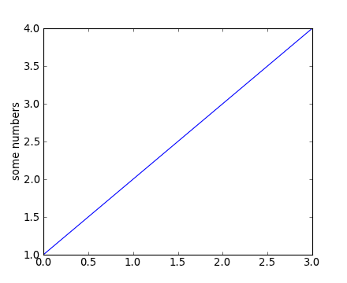
Matplotlib.pyplot basic example
matplotlib.pyplot is a collection of command style functions that make matplotlib work like MATLAB. Each pyplot unction makes some change to a figure: eg, create a figure, create a plotting area in a figure, plot some lines in a plotting area, decorate the plot with labels, etc....
import matplotlib.pyplot as plt plt.plot([1,2,3,4])
plt.ylabel('some numbers')
plt.show()

Slide 11
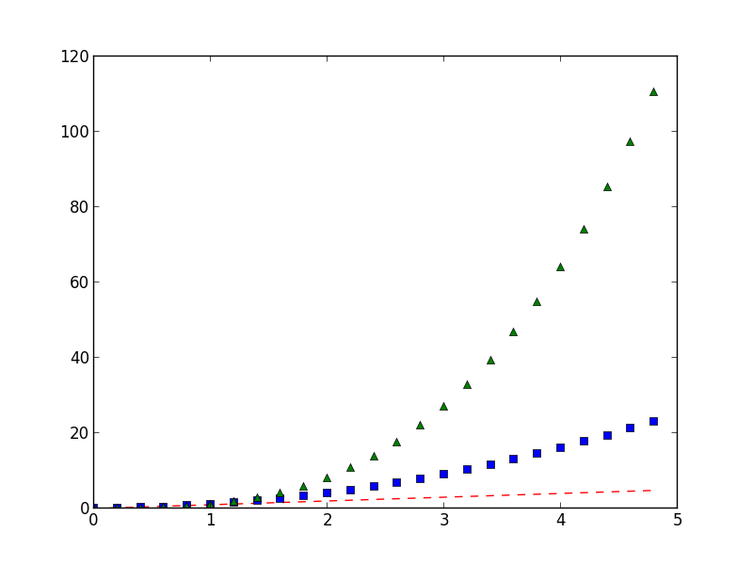
Matplotlib.pyplot basic example
Generally, you will use numpy arrays. In fact, all sequences are converted to numpy arrays internally. The example below illustrates a plotting several lines with different format styles in one command using arrays.
import numpy as np
import matplotlib.pyplot as plt
# evenly sampled time at 200ms intervals
t = np.arange(0., 5., 0.2)
# red dashes, blue squares and green triangles plt.plot(t, t, 'r--', t, t**2, 'bs', t, t**3, 'g^')
Notes:
11

Slide 12
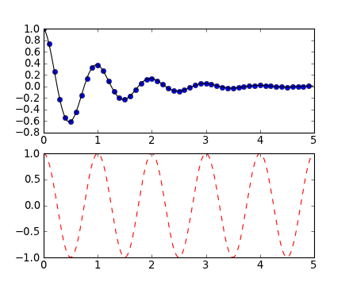
Matplotlib.pyplot example
Working with multiple figures and axes. The subplot() command specifies numrows, numcols, fignum, where fignum ranges from 1 to numrows*numcols.
import numpy as np
import matplotlib.pyplot as plt
def f(t):
return np.exp(-t) * np.cos(2*np.pi*t)
t1 = np.arange(0.0, 5.0, 0.1)
t2 = np.arange(0.0, 5.0, 0.02)
plt.figure(1)
plt.subplot(211)
plt.plot(t1, f(t1), 'bo', t2, f(t2), 'k')
plt.subplot(212)
plt.plot(t2, np.cos(2*np.pi*t2), 'r--')
Notes:
12

Slide 13
Matplotlib.pylab example
Working with multiple figures and axes. The subplot() command specifies numrows, numcols, fignum, where fignum ranges from 1 to numrows*numcols.
In [1]: def f(t):
... Return exp(-t) * cos(2*np.pi*t)
In [2]: t1 = arange(0.0, 5.0, 0.1)
In [3]: t2 = arange(0.0, 5.0, 0.02)
In [4]: figure(1)
Out[4]: <matplotlib.figure.Figure at 0x3419a50>
In [5]: subplot(211)
Out[5]: <matplotlib.axes.AxesSubplot ar 0x33f9090>
In [6]: plot(t1, f(t1), 'bo', t2, f(t2), 'k')
Out[6]:
[<matplotlib.lines.Line2D at 0x3667950>
<matplotlib.lines.Line2D at 0x3667ad0>]
Notes:
13

Slide 14
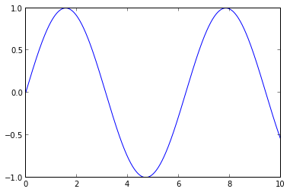
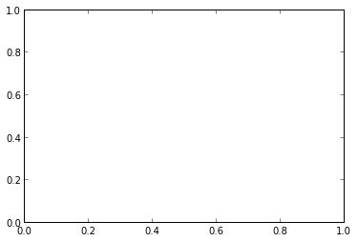
Matplotlib (OO): Behind the scenes
When we called pylab.plot previously, there were a few things happening in the background:
matplotlib created a Figure instance, which is an object describing the plot window and its properties, and containing lists of all its elements
matplotlib created an Axes element within the figure. An axes can be thought of as a plotting window, where data can be arranged by x and y coordinates.
Now we will create our figure and axes:
This creates a blank axes. Now we can call plot as we did before, except now we use the plot method of ax:
import matplotlib.pyplot as plt
fig = figure() # a new figure window
ax = fig.add_subplot(1, 1, 1) # specify (nrows, ncols, axnum)
import numpy as np
x = np.linspace(0,10,1000)
y=np.sin(x)
ax.plot(x,y)
Notes:
14

Slide 15
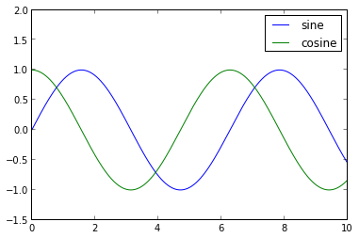
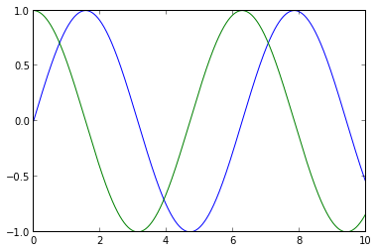
Matplotlib (OO): Behind the scenes
The figure remains open between IPython commands! There are ways to make this happen using the pylab interface we saw previously, but they're much less clean. Let's see this explicitly by now over-plotting a cosine:
We can set the axes limits using ax.set_xlim rather than pylab.xlim and add a legend:
y2 = np.cos(x)
ax.plot(x, y2)
>>> ion()
>>> y2 = np.cos(x)
>>> ax.plot(x, y2)
ax.set_ylim(-1.5, 2.0)
ax.legend(['sine', 'cosine'])
Notes:
15

Slide 16
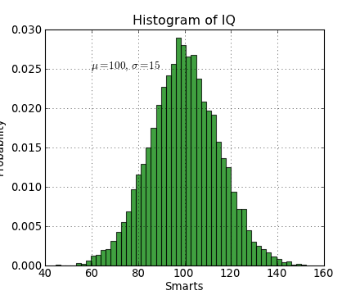
Matplotlib.pyplot example
import numpy as np
import matplotlib.pyplot as plt
mu, sigma = 100, 15
x = mu + sigma * np.random.randn(10000)
# the histogram of the data
n, bins, patches = plt.hist(x, 50, normed=1, facecolor='g', alpha=0.75)
plt.xlabel('Smarts')
plt.ylabel('Probability')
plt.title('Histogram of IQ')
plt.text(60, .025, r'$\mu=100,\ \sigma=15$')
plt.axis([40, 160, 0, 0.03])
plt.grid(True)
Working with text.
The text() command can be used to add text in an arbitrary location, and the xlabel(), ylabel() and title() are used to add text in the indicated locations.
Notes:
16

Slide 17
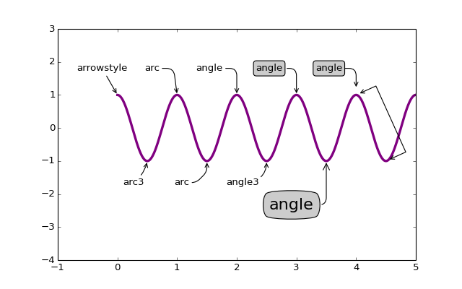
Overwhelming annotation
from matplotlib.pyplot import figure, show
from matplotlib.patches import Ellipse
import numpy as np
if 1:
fig = figure(1,figsize=(8,5))
ax = fig.add_subplot(111, autoscale_on=False, xlim=(-1,5), ylim=(-4,3))
t = np.arange(0.0, 5.0, 0.01)
s = np.cos(2*np.pi*t)
line, = ax.plot(t, s, lw=3, color='purple')
ax.annotate('arrowstyle', xy=(0, 1), xycoords='data',
xytext=(-50, 30), textcoords='offset points',
arrowprops=dict(arrowstyle="->")
)
ax.annotate('arc3', xy=(0.5, -1), xycoords='data',
xytext=(-30, -30), textcoords='offset points',
arrowprops=dict(arrowstyle="->",
connectionstyle="arc3,rad=.2")
)
ax.annotate('arc', xy=(1., 1), xycoords='data',
xytext=(-40, 30), textcoords='offset points',
arrowprops=dict(arrowstyle="->",
connectionstyle="arc,angleA=0,armA=30,rad=10"),
)
ax.annotate('arc', xy=(1.5, -1), xycoords='data',
xytext=(-40, -30), textcoords='offset points',
arrowprops=dict(arrowstyle="->",
connectionstyle="arc,angleA=0,armA=20,angleB=-90,armB=15,rad=7"),
)
ax.annotate('angle', xy=(2., 1), xycoords='data',
xytext=(-50, 30), textcoords='offset points',
arrowprops=dict(arrowstyle="->",
connectionstyle="angle,angleA=0,angleB=90,rad=10"),
)
ax.annotate('angle3', xy=(2.5, -1), xycoords='data',
xytext=(-50, -30), textcoords='offset points',
arrowprops=dict(arrowstyle="->",
connectionstyle="angle3,angleA=0,angleB=-90"),
)
ax.annotate('angle', xy=(3., 1), xycoords='data',
xytext=(-50, 30), textcoords='offset points',
bbox=dict(boxstyle="round", fc="0.8"),
arrowprops=dict(arrowstyle="->",
connectionstyle="angle,angleA=0,angleB=90,rad=10"),
)
ax.annotate('angle', xy=(3.5, -1), xycoords='data',
xytext=(-70, -60), textcoords='offset points',
size=20,
bbox=dict(boxstyle="round4,pad=.5", fc="0.8"),
arrowprops=dict(arrowstyle="->",
connectionstyle="angle,angleA=0,angleB=-90,rad=10"),
)
ax.annotate('angle', xy=(4., 1), xycoords='data',
xytext=(-50, 30), textcoords='offset points',
bbox=dict(boxstyle="round", fc="0.8"),
arrowprops=dict(arrowstyle="->",
shrinkA=0, shrinkB=10,
connectionstyle="angle,angleA=0,angleB=90,rad=10"),
)
ann = ax.annotate('', xy=(4., 1.), xycoords='data',
xytext=(4.5, -1), textcoords='data',
arrowprops=dict(arrowstyle="<->",
connectionstyle="bar",
ec="k",
shrinkA=5, shrinkB=5,
)
)
if 1:
fig = figure(2)
fig.clf()
ax = fig.add_subplot(111, autoscale_on=False, xlim=(-1,5), ylim=(-5,3))
el = Ellipse((2, -1), 0.5, 0.5)
ax.add_patch(el)
ax.annotate('$->$', xy=(2., -1), xycoords='data',
xytext=(-150, -140), textcoords='offset points',
bbox=dict(boxstyle="round", fc="0.8"),
arrowprops=dict(arrowstyle="->",
patchB=el,
connectionstyle="angle,angleA=90,angleB=0,rad=10"),
)
ax.annotate('fancy', xy=(2., -1), xycoords='data',
xytext=(-100, 60), textcoords='offset points',
size=20,
#bbox=dict(boxstyle="round", fc="0.8"),
arrowprops=dict(arrowstyle="fancy",
fc="0.6", ec="none",
patchB=el,
connectionstyle="angle3,angleA=0,angleB=-90"),
)
ax.annotate('simple', xy=(2., -1), xycoords='data',
xytext=(100, 60), textcoords='offset points',
size=20,
#bbox=dict(boxstyle="round", fc="0.8"),
arrowprops=dict(arrowstyle="simple",
fc="0.6", ec="none",
patchB=el,
connectionstyle="arc3,rad=0.3"),
)
ax.annotate('wedge', xy=(2., -1), xycoords='data',
xytext=(-100, -100), textcoords='offset points',
size=20,
#bbox=dict(boxstyle="round", fc="0.8"),
arrowprops=dict(arrowstyle="wedge,tail_width=0.7",
fc="0.6", ec="none",
patchB=el,
connectionstyle="arc3,rad=-0.3"),
)
ann = ax.annotate('wedge', xy=(2., -1), xycoords='data',
xytext=(0, -45), textcoords='offset points',
size=20,
bbox=dict(boxstyle="round", fc=(1.0, 0.7, 0.7), ec=(1., .5, .5)),
arrowprops=dict(arrowstyle="wedge,tail_width=1.",
fc=(1.0, 0.7, 0.7), ec=(1., .5, .5),
patchA=None,
patchB=el,
relpos=(0.2, 0.8),
connectionstyle="arc3,rad=-0.1"),
)
ann = ax.annotate('wedge', xy=(2., -1), xycoords='data',
xytext=(35, 0), textcoords='offset points',
size=20, va="center",
bbox=dict(boxstyle="round", fc=(1.0, 0.7, 0.7), ec="none"),
arrowprops=dict(arrowstyle="wedge,tail_width=1.",
fc=(1.0, 0.7, 0.7), ec="none",
patchA=None,
patchB=el,
relpos=(0.2, 0.5),
)
)
show()
Notes:
17

Slide 18
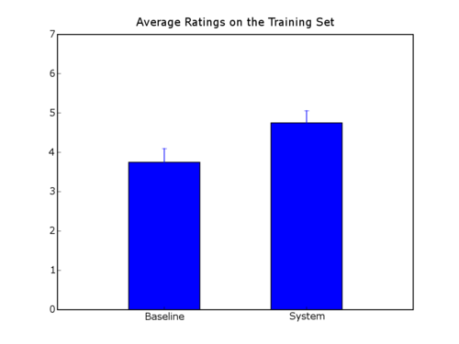
Matplotlib.pyplot example
Bar chart.
import numpy.numarray as na
from pylab import *
labels = ["Baseline", "System"]
data = [3.75 , 4.75]
error = [0.3497 , 0.3108]
xlocations = na.array(range(len(data)))+0.5
width = 0.5
bar(xlocations, data, yerr=error, width=width)
yticks(range(0, 8))
xticks(xlocations+ width/2, labels)
xlim(0, xlocations[-1]+width*2)
title("Average Ratings on the Training Set")
show()
Notes:
18

Slide 19
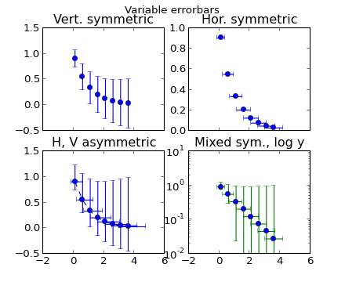
Matplotlib.pyplot example
Error bars.
import numpy as np
import matplotlib.pyplot as plt
fig, axs = plt.subplots(nrows=2, ncols=2, sharex=True)
ax = axs[0,0]
ax.errorbar(x, y, yerr=yerr, fmt='o')
ax.set_title('Vert. symmetric')
# With 4 subplots, reduce the number
# of axis ticks to avoid crowding.
ax.locator_params(nbins=4)
ax = axs[0,1]
ax.errorbar(x, y, xerr=xerr, fmt='o')
ax.set_title('Hor. symmetric')
ax = axs[1,0]
ax.errorbar(x, y, yerr=[yerr, 2*yerr], xerr=[xerr, 2*xerr], fmt='--o')
ax.set_title('H, V asymmetric')
ax = axs[1,1]
ax.set_yscale('log')
# Here we have to be careful to keep all y values positive:
ylower = np.maximum(1e-2, y - yerr)
yerr_lower = y - ylower
ax.errorbar(x, y, yerr=[yerr_lower, 2*yerr], xerr=xerr,
fmt='o', ecolor='g')
ax.set_title('Mixed sym., log y')
fig.suptitle('Variable errorbars')
plt.show()
Notes:
19

Slide 20
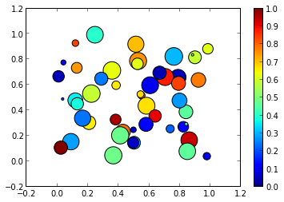
Matplotlib.pyplot examples
Scatter plots
import numpy as np
import pylab as plt
x = np.random.random(50)
y = np.random.random(50)
c = np.random.random(50) # color of points
s = 500 * np.random.random(50) # size of points
fig, ax = plt.subplots()
im = ax.scatter(x, y, c=c, s=s, cmap=plt.cm.jet)
# Add a colorbar
fig.colorbar(im, ax=ax)
# set the color limits - not necessary here, but good to know how.
im.set_clim(0.0, 1.0)

Slide 21
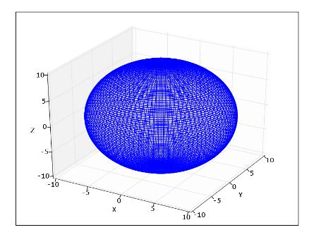
Matplotlib.pyplot example
3D plots.
from numpy import *
import pylab as p
import mpl_toolkits.mplot3d.axes3d as p3
# u and v are parametric variables.
# u is an array from 0 to 2*pi, with 100 elements
u=r_[0:2*pi:100j]
# v is an array from 0 to 2*pi, with 100 elements
v=r_[0:pi:100j]
# x, y, and z are the coordinates of the points for plotting
# each is arranged in a 100x100 array
x=10*outer(cos(u),sin(v))
y=10*outer(sin(u),sin(v))
z=10*outer(ones(size(u)),cos(v)
fig=p.figure()
ax = p3.Axes3D(fig)
ax.plot_wireframe(x,y,z)
ax.set_xlabel('X')
ax.set_ylabel('Y')
ax.set_zlabel('Z')
p.show()
Notes:
21

Slide 22
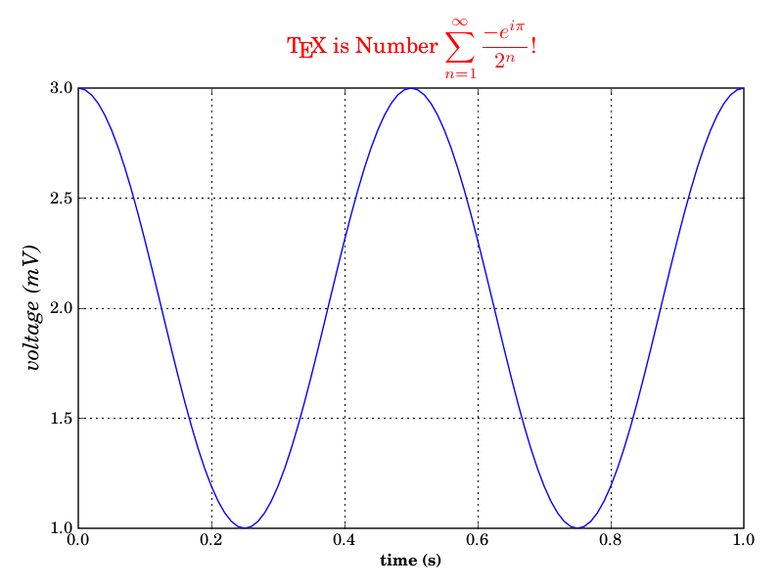
Matplotlib.pyplot example
Using TeX.
from matplotlib import rc
from matplotlib.numerix import arange, cos, pi
from pylab import figure, axes, plot, xlabel,
ylabel, title, grid, savefig, show
rc('text', usetex=True)
figure(1)
ax = axes([0.1, 0.1, 0.8, 0.7])
t = arange(0.0, 1.0+0.01, 0.01)
s = cos(2*2*pi*t)+2
plot(t, s)
xlabel(r'\textbf{time (s)}')
ylabel(r'\textit{voltage (mV)}',fontsize=16)
title(r"\TeX\ is Number $\displaystyle\sum_{n=1}^\infty\frac{-e^{i\pi}}{2^n}$!", fontsize=16, color='r')
grid(True)
savefig('tex_demo')
show()
Notes:
22

Slide 23
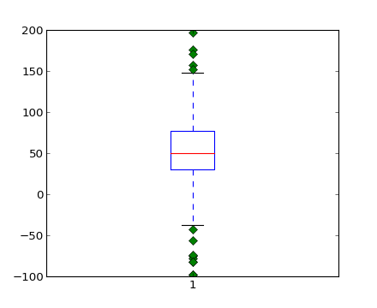
Matplotlib.pyplot example
Statistics plots (box and whiskers plot).
from pylab import *
# fake up some data
spread= rand(50) * 100
center = ones(25) * 50
flier_high = rand(10) * 100 + 100
flier_low = rand(10) * -100
data =concatenate((spread, center, flier_high, flier_low), 0)
figure()
boxplot(data,1)
Notes:
23

Slide 24
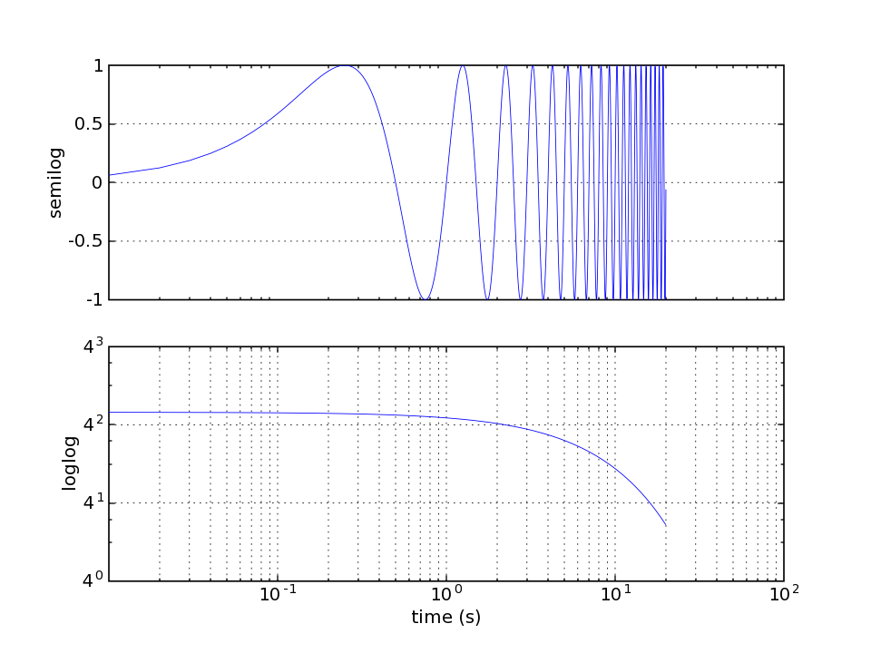
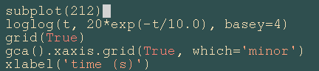
log demo
Notes:
Log demo

Slide 25
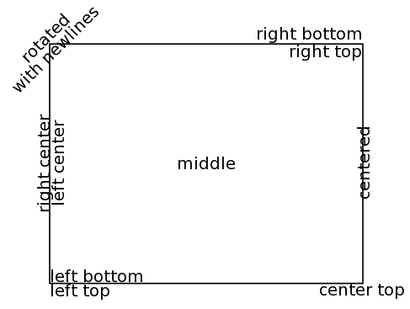
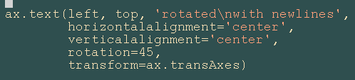
text alignment

Slide 26
3D tutorial
https://matplotlib.org/stable/gallery/index.html

Slide 27
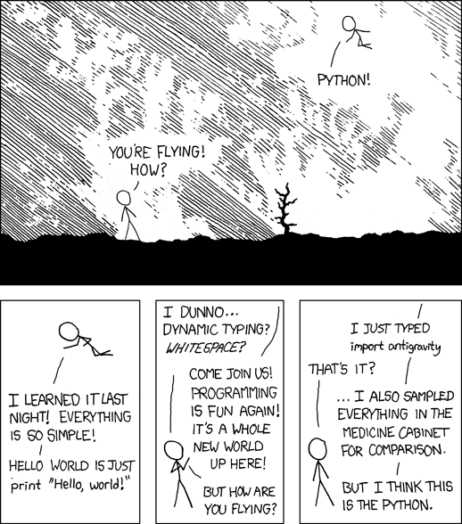
Fits your brain (part II): But I think this is the python

