Slide 1
Data visualization
All samples available on:
http://github.com/a-vodka/dv

Slide 2
Realisation of the course
This course has been developed within the framework of the project “Mechanics digital" by the German Academic Exchange Service (DAAD) under funding program “Ukraine digital: Ensuring academic success in times of crisis (2022)" The course has been developed in collaboration with our colleagues from the Otto-von-Guericke-University Magdeburg in Germany We would like to thank the DAAD for their financial and logistical support

Slide 3
Multidimensional Scaling (MDS)

Slide 4
Multidimensional Scaling (MDS)
The algorithm detects meaningful underlying dimensions that explain
observed similarities or dissimilarities (distances) between the
investigated objects.
Given:
n x n matrix of dissimilarities between n objects
(∆^{T} = ∆; δ_{ij} ≥ 0; δ_{ii} = 0)
OR n x n matrix of similarities between n objects
(Θ^{T} = Θ; θ_{ij} ≤ θ_{ii})
convert to dissimilarities → δ_{ij}² = θ_{ii} + θ_{jj} - 2θ_{ij}
Goal: Find a configuration in a low-dimensional Euclidean space R^{k}
whose interpoint distances d(x_{i},x_{j}) closely match dissimilarities.

Slide 5
Measure of goodness-of-fit: Stress
Let the new configuration be obtained by projecting x₁,…,x_{n} onto a k-D subspace.
Minimizing “lack of fit” between the two configurations (dissimilarities and distances)
Stress of the configuration: Φ(∆ , D) = Σ (δ_{ij}² – d_{ij}²)
Then, the subspace is spanned by the k largest principal components.

Slide 6
Classical Solution: Metric method
Given: nxn ∆ dissimilarities matrix of n points in m-D space
Questions:
- Is ∆ an interpoint distance matrix in Euclidean space?
- If yes, what is the dimension?
→ What are the coordinates?
First, check whether ∆ is Euclidean:
define
A_{nxn} with elements a_{ij} = -(1/2)δ_{ij}²
B = HAH = UΛU^{T} “centered inner product matrix”
H_{nxn} = I – n⁻¹1 1^{T} “centering matrix”
→ ∆ is Euclidean if and only if B is positive semidefinite
i.e. λ(B) ≥ 0, with rank ≤ m

Slide 7
Classical Solution: Metric method
If ∆ is Euclidean:
- Construct the matrix A
- Obtain the matrix B with elements b_{ij} = a_{ij} - a_{i·} - a_{·j} + a··
- Find the k largest eigenvalues λ₁ > … > λ_{k} of B, with corresponding
eigenvectors X = (x₁,…, x_{k}) which are normalized by x_{i}^{T} x_{i} = λ_{i} , i =
1,…,k (k< m, is whatever we pick)
- Then, the required coordinates of the reconstruction points P_{i} are
x_{i} = (x_{i1},…, x_{in})^{T}

Slide 8
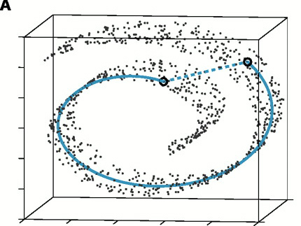
The “Swiss roll” data set
Unlike the geodesic distance, the Euclidean distance cannot
reflect the geometric structure of the data points

Slide 9
ISOMAP

Slide 10
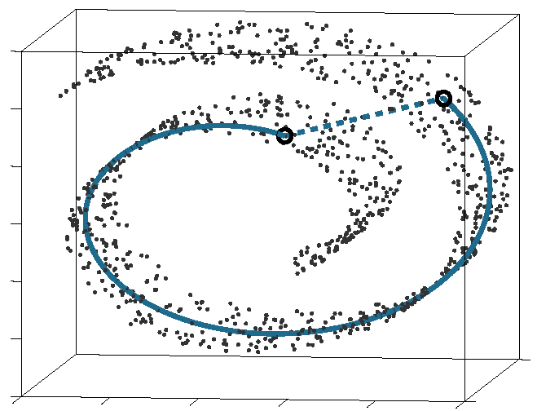
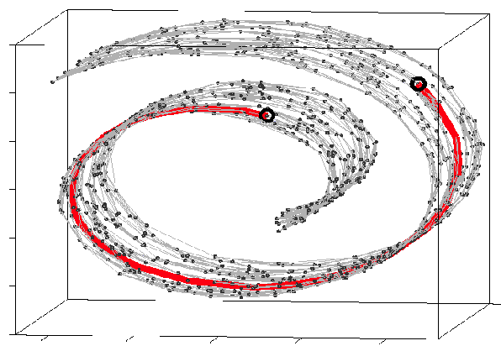
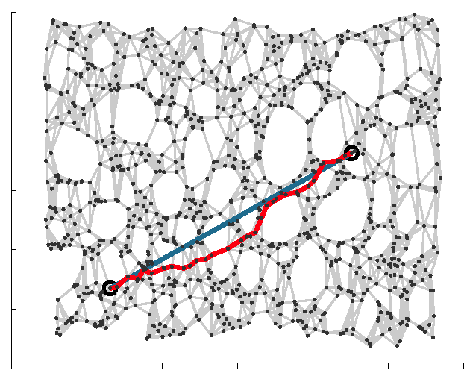
ISOMAP
ISOMAP (Isometric feature Mapping)
Preserves the intrinsic geometry of the data.
Uses the geodesic manifold distances between all pairs.

Slide 11
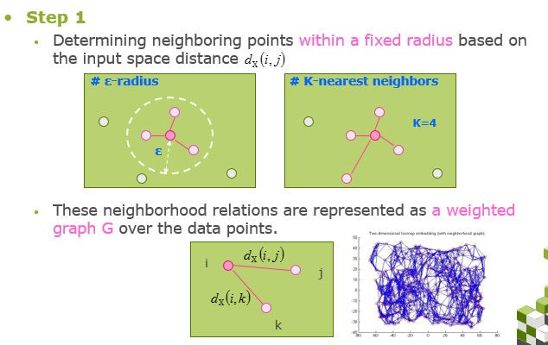
ISOMAP

Slide 12
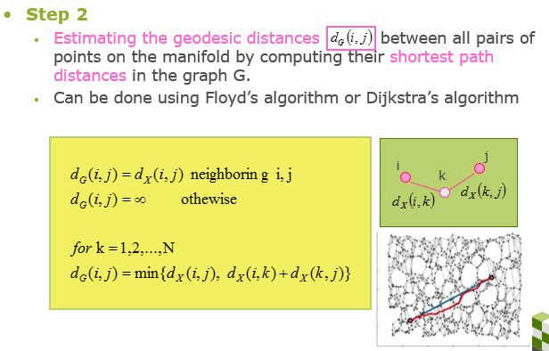
ISOMAP

Slide 13
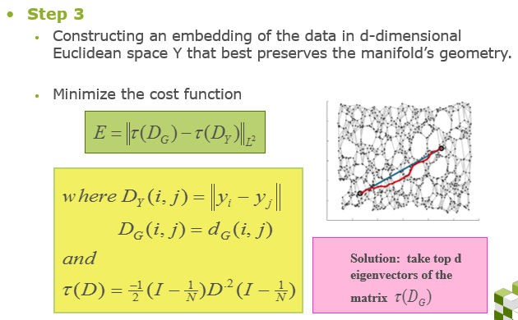

ISOMAP

Slide 14
Isomap Algorithm
Step | Name | Description
1 O(DN²) | Construct neighborhood graph, G | Compute matrix D_{G}={d_{X}(i,j)} d_{x}(i,j) = Euclidean distance between neighbors
2 O(DN²) | Compute shortest paths between all pairs | Compute matrix D_{G}={d_{G}(i,j)} d_{G}(i,j) = sequence of hops = approx geodesic dist.
3 O(dN²) | Construct k-dimensional coordinate vectors | Apply MDS to D_{G} instead of D_{X}

Slide 15
Summary on Isomap Algorithm
Advantages:
Nonlinear
Non-iterative
Globally optimal
Parameters: k or ε (chosen fixed radius)
Disadvantages:
Graph discreteness overestimates the geodesic distance
k must be high to avoid “linear shortcuts” near regions of high surface curvature

Slide 16
Manifold Recovery Guarantee of ISOMAP
Isomap is guaranteed asymptotically to recover the true dimensionality
and geometric structure of nonlinear manifolds.
As the sample data points increases, the graph distances provide increasingly better approximations to the intrinsic geodesic distances.

Slide 17
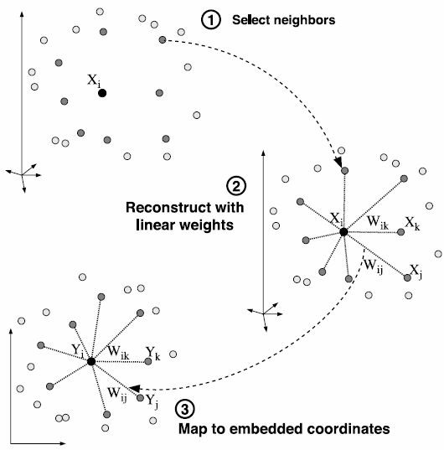


LLE: Local Linear Embedding

Slide 18







LLE: Solution
https://www.cs.nyu.edu/~roweis/lle/papers/lleintro.pdf Reconstruct linear weights w:
Local covariance matrix:
Map to embedded coordinates Y:
Bottom d+1 eigen vectors of
,discard bottom 1, which is unit vector

Slide 19
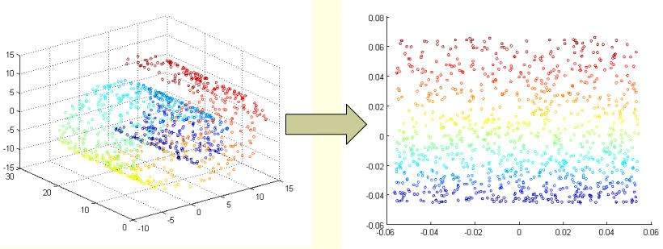
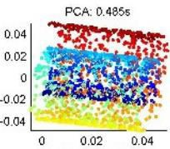
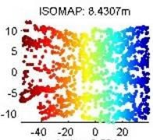
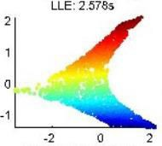
PCA vs. ISOMAP vs. LLE

Slide 20
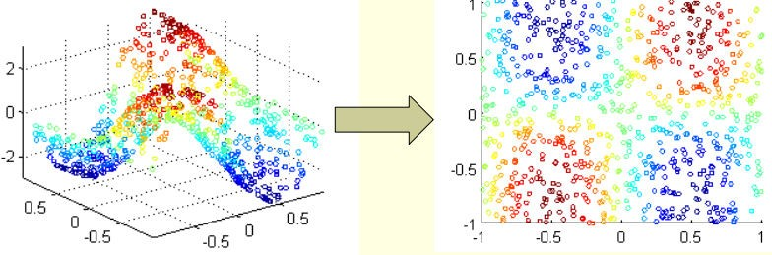
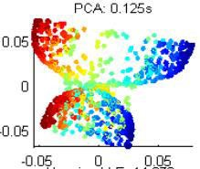
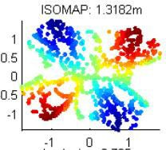
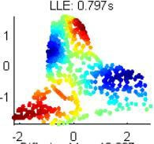
PCA vs. ISOMAP vs. LLE

Slide 21
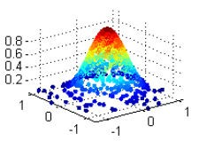
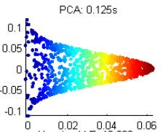
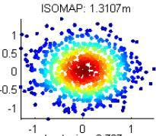
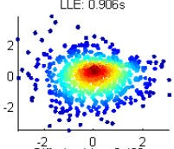
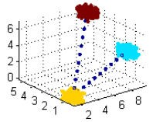
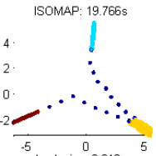
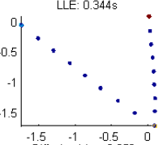
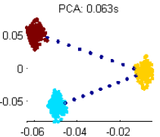
PCA vs. ISOMAP vs. LLE

Slide 22
Designing your own dimension reduction!
High dimensional representation of data
Geodesic distance
Local linear weighted representation
Low dimensional representation of data
Euclidean distance
Local linear weighted representation
Cost function between High and Low dimensional
representation

Slide 23
Laplacian eigenmaps

Slide 24
Laplace Beltrami Operator (1)
The Laplace operator is a second order differential operator in the n-dimensional Euclidean space:
Laplace Beltrami operator:
The Laplacian can be extended to functions defined on surfaces, or more generally, on Riemannian and pseudo-Riemannian manifolds.
Notes:
Riemannian manifold: real differential manifold
Pseudo-Riemannian manifold: generalized Riemannian manifold with positive definite metric tensor<-量測空間的距離及角度

Slide 25
Laplace Beltrami Operator (2)
We can justify that the eigenfunctions of the Laplace Beltrami operator have properties desirable for embedding…

Slide 26
Lapalcian of a Graph (1)
Let G(V,E) be a undirected graph without graph loops. The Laplacian of the graph is
d_{ij} if i=j (degree of node i)
L_{ij} = -1 if i≠j and (i,j) belongs to E
0 otherwise

Slide 27
Lapalcian of a Graph (2)
1
2
4
3
D
W(weight matrix)

Slide 28
Laplacian Eigenmap (1)
Consider that , and M is a manifold embedded in R^{l}. Find y₁,.., y_{n} in R^{m} such that y_{i} represents x_{i}(m<<l )

Slide 29
Laplacian Eigenmap (2)
Construct the adjacency graph to approximate the manifold
1
3
2
4
3
-1
-1
3
-1
-1
L =
=D-W
-1
0
0
-1
︰
0
︰

Slide 30
Laplacian Eigenmap (3)
There are two variations for W (weight matrix)
- simple-minded (1 if connected, 0 o.w.)
- heat kernel (t is real)

Slide 31
Laplacian Eigenmap (4)
Consider the problem of mapping the graph G to a line so that connected points stay as close together as possible
To choose a good “map”, we have to minimize the objective function
W_{ij} , (y_{i}-y_{j})
y^{T}Ly where y = [y₁ … y_{n}]^{T}

Slide 32
Laplacian Eigenmap (5)
Therefore, this problem reduces to find argmin y^{T}Ly subjects to y^{T}Dy = 1
(removes an arbitrary scaling factor in the embedding)
The solution y is the eigenvector corresponding to the minimum eigenvalue of the generalized eigenvalue problem
Ly = λDy

Slide 33
Laplacian Eigenmap (6)
Now we consider the more general problem of embedding the graph into m-dimensional Euclidean space
Let Y be such a n*m map
Notes:
Y等於幾個m個最小eigenvalue的eigenvector所組成的matrix

Slide 34
Laplacian Eigenmap (7)
To sum up:
Step1: Construct adjacency graph
Step2: Choosing the weights
Step3: Eigenmaps Ly = λDy
Ly₀ = λ₀Dy₀, Ly₁ = λ₁Dy₁ …
0= λ₀≦ λ₁≦… ≦ λ_{n-1}
x_{i} → (y₀(i), y₁(i),…, y_{m}(i))
Recall that we have n data points, so L and D is n×n and y is a n×1 vector

Slide 35
ISOMAP, LLE and Laplacian Eigenmap
The graph-based algorithms have 3 basic steps.
1. Find K nearest neighbors.
2. Estimate local properties of manifold by looking at neighborhoods found in Step 1.
3. Find a global embedding that preserves the properties found in Step 2.

Slide 36
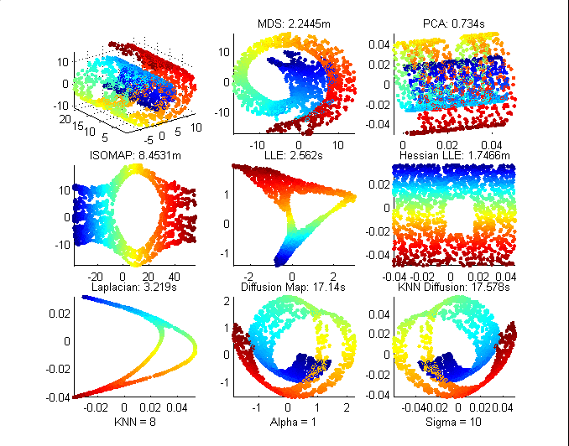
Non-Convexity (2)
Only Hessian LLE can handle non-convexity.
ISOMAP, LLE, and Laplacian find the hole but the set is distorted.

Slide 37
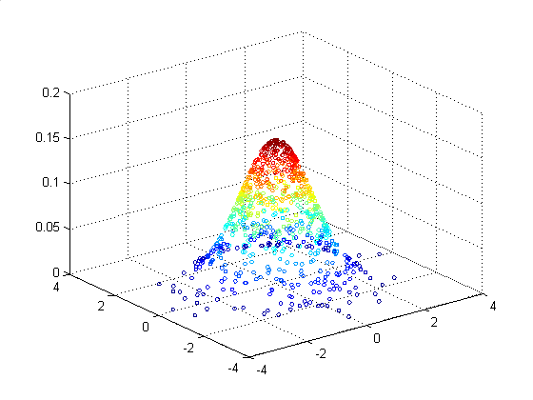
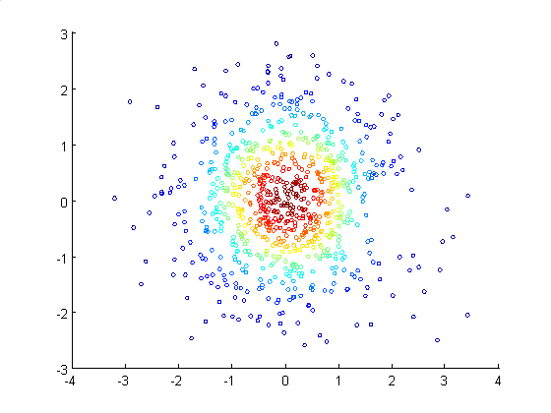
Curvature & Non-uniform Sampling
Gaussian: We can randomly sample a Gaussian distribution.
We increase the curvature by decreasing the standard deviation.
Coloring on the z-axis, we should map to concentric circles

Slide 38
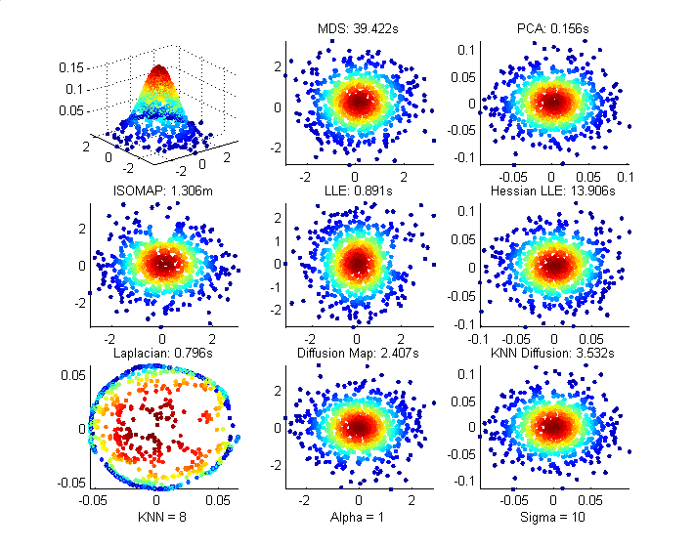
For std = 1 (low curvature), MDS and PCA can project accurately.
Laplacian Eigenmap cannot handle the change in sampling.

Slide 39
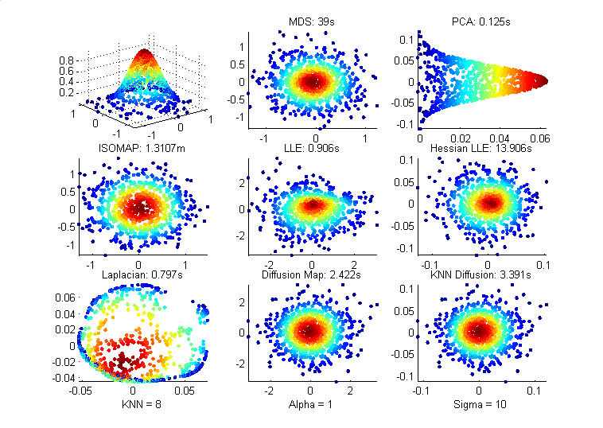
For std = 0.4 (higher curvature), PCA projects from the side rather than top-down.
Laplacian looks even worse.

Slide 40
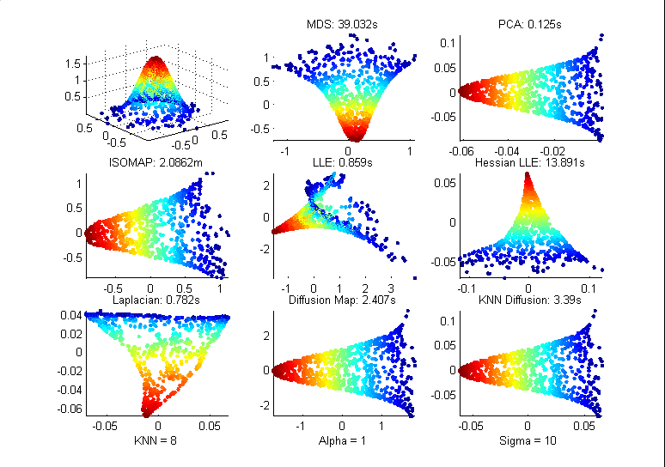
For std = 0.3 (high curvature), none of the methods can project correctly.

Slide 41
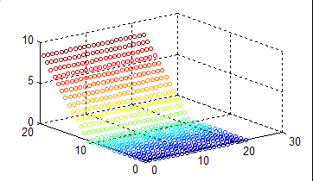
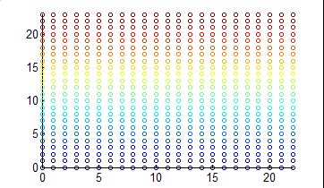
Corner
Corner Planes: We bend a plane with a lift angle A.
We want to bend it back down to a plane.
A

Slide 42
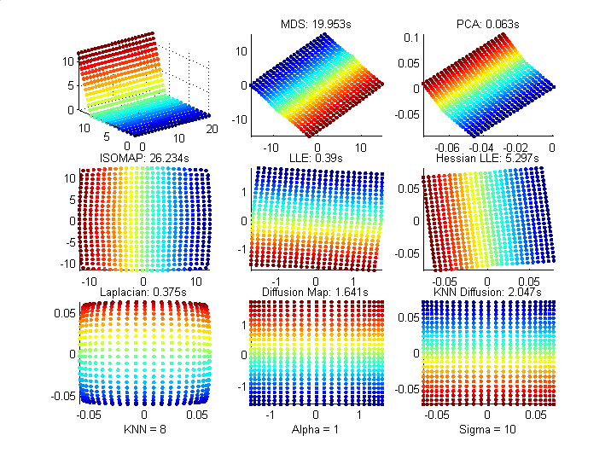
For angle A=75, we see some disortions in PCA and Laplacian.

Slide 43
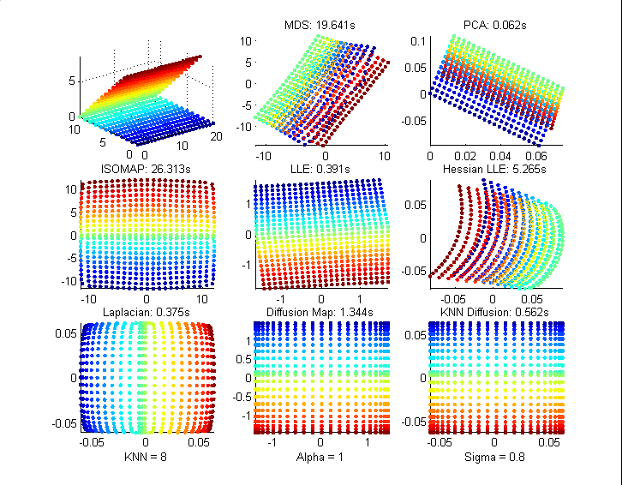
For A = 135, MDS, PCA, and Hessian LLE overwrite the data points.
Diffusion Maps work very well for Sigma < 1.
LLE handles corners surprisingly well.

Slide 44
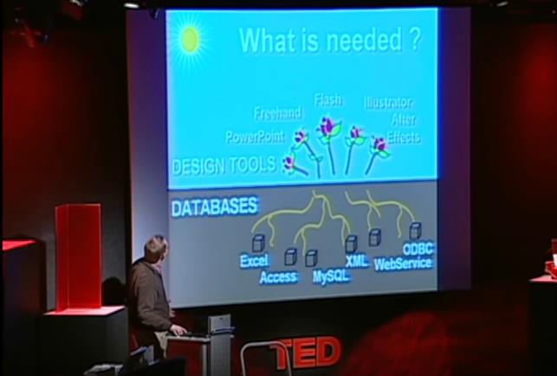
Story-telling through data visualization
https://www.youtube.com/watch?v=usdJgEwMinM

Slide 45
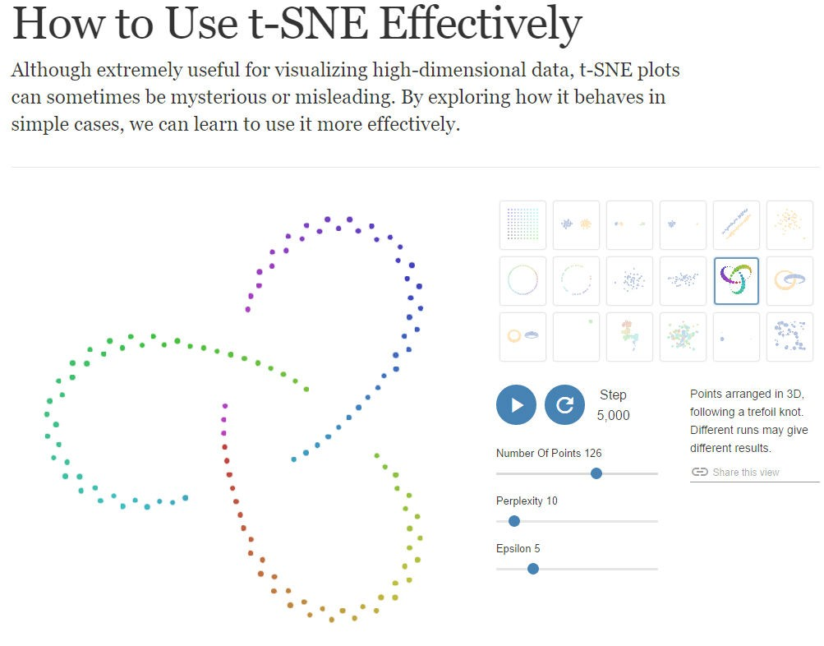
tSNE
tSNE (t-distributed Stochastic Neighbor Embedding)
more stable and faster solution
easier implementation
MDS SNE
Local+probability
2002
sym SNE UNI-SNE
crowding problem
2007
tSNE
Barnes-Hut-SNE
O(N²)->O(NlogN)
2008
2013
Explore tSNE simple cases:
http://distill.pub/2016/misread-tsne/

Slide 46
Stochastic Neighbor Embedding (SNE)
It is more important to get local distances right than non-local ones.
Stochastic neighbor embedding has a probabilistic way of deciding if a
pairwise distance is 䇾local䇿.
Convert each high-dimensional similarity into the probability that one data point will pick the other data point as its neighbor.
−||x_{i} −x _{j} ||² 2σ ²
−|| y − y ||²
probability of picking j given i in high D
e
i
e
i j
probability of picking j given i in low D
p =
q =
j|i
−||x_{i} −x_{k} ||² 2σ ²
j|i
_{∑ e}−|| y_{i} − y_{k} ||
k
2
∑ e
k
i

Slide 47


Picking the radius of the Gaussian that is used
to compute the p’s
We need to use different radii in different parts of the space so that we
keep the effective number of neighbors about constant.
A big radius leads to a high entropy for the distribution over neighbors of i. A small radius leads to a low entropy.
So decide what entropy you want and then find the radius that produces that entropy.
Its easier to specify perplexity:
−||x_{i} −x _{j} ||² 2σ ²
e
i
p =
j|i
−||x_{i} −x_{k} ||² 2σ ²
∑ e
k
i

Slide 48

The cost function for a low-dimensional
representation
^{p} j|i
Cost =
∑
i
KL(P || Q ) = ∑ ∑ p | log
i
i
j i
^{q} j|i
i j
Gradient descent:
∂C
= 2
∑
(y _{j} − y_{i} ) ( p _{j|i} − q _{j|i} + p_{i| j} − q_{i| j} )
∂y
i
j
Gradient update with a momentum term:
Learning rate
Momentum

Slide 49
Turning conditional probabilities into pairwise
probabilities
−||x_{i} −x _{j} ||² 2σ ²
−||x_{i} −x _{j} ||² 2σ ²
e
i
e
p =
p =
j|i
−||x_{i} −x_{k} ||² 2σ ²
ij
−||x −x ||² 2σ ²
∑ e
k
i
∑ e
k ≠l
k l
p
p log ^{ij}
Cost = KL(P || Q) =
∑
ij
^{q}ij
δ C ₌
4∑( p − q
_{ij} )( y − y _{j} )
δ y_{i}
ij
i
j

Slide 50
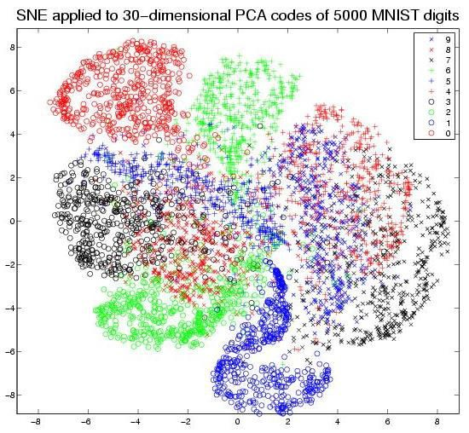
MNIST
Database
of handwritten
digits
28×28 images
Problem? Too crowded!

Slide 51

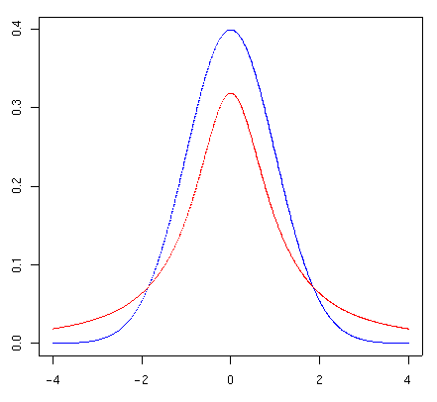
From SNE to t-SNE: solve crowding problem
High dimension: Convert distances into probabilities using a Gaussian distribution
Low dimension: Convert distances into probabilities using a
probability distribution that has much heavier tails than a Gaussian.
Student’s t-distribution
V : the number of degrees of freedom
Standard Normal Dis.
T-Dis. With
V = 1
(1+ || y − y ||² )⁻¹
^{q}ij
=
i j
∑
k ≠l
(1+ || y − y ||² )⁻¹
k l

Slide 52
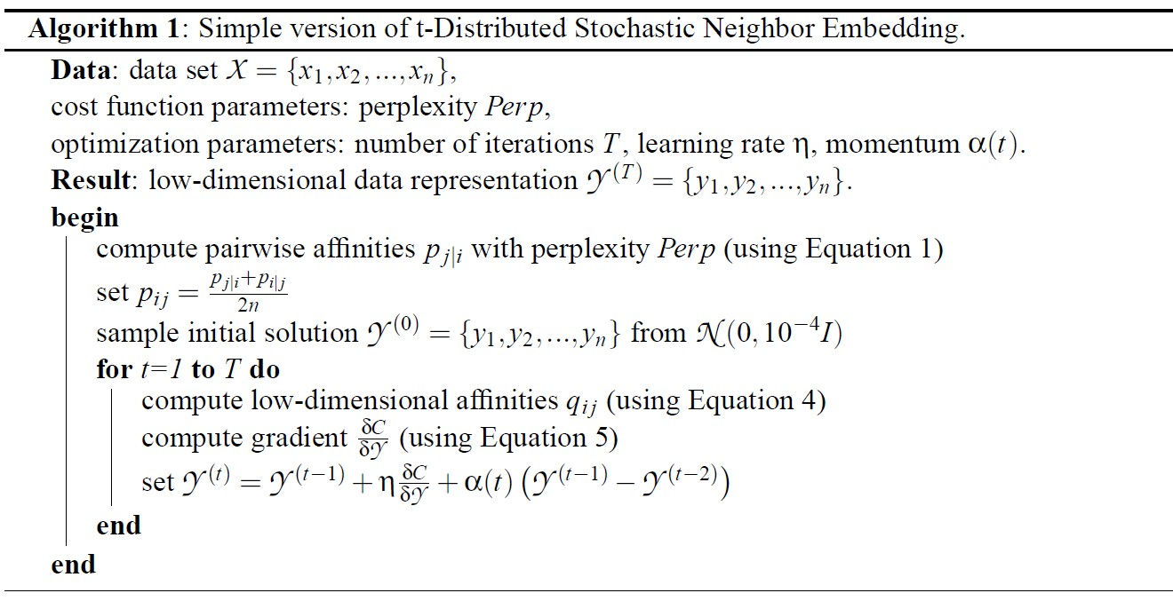
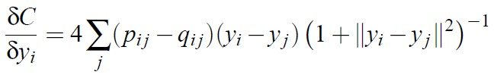
Optimization method for tSNE
−||x_{i} −x _{j} ||² 2σ ²
₌ e
(1+ || y − y ||² )⁻¹
p
^{q}ij
=
i j
ij
2
2
∑ e
k ≠l
−||x_{k} −x_{l} || 2σ
∑
k ≠l
(1+ || y − y ||² )⁻¹
k l

Slide 53
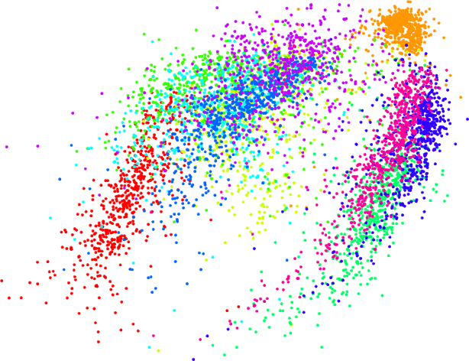
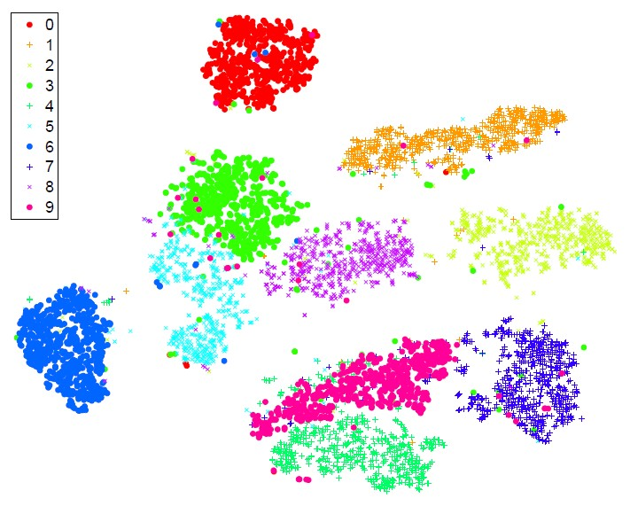
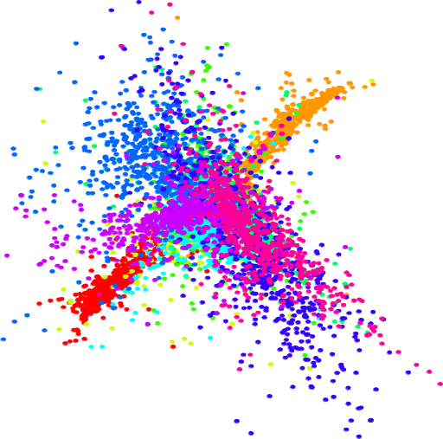
Isomap
6000 MNIST digits
t-SNE
LLE

Slide 54
Weakness
It’s unclear how t-SNE performs on general dimensionality reduction task (d >3);
The relative local nature of t-SNE makes it sensitive to the curse
of the intrinsic dimensionality of the data;
It’s not guaranteed to converge to a global optimum of its cost
function.
It tends to form sub-clusters even if the data points are totally random.
Explore tSNE simple cases: http://distill.pub/2016/misread-tsne/

Slide 55
References:
t-SNE homepage:
http://homepage.tudelft.nl/19j49/t-SNE.html
Advanced Machine Learning: Lecture11: Non-linear Dimensionality Reduction http://www.cs.toronto.edu/~hinton/csc2535/lectures.html

Slide 56
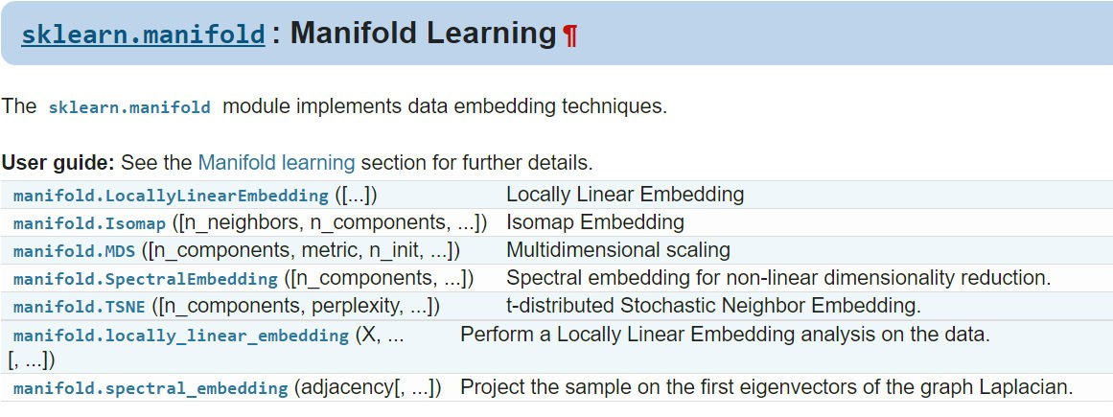
Implementation
Manifold method:
http://scikit-learn.org/stable/modules/classes.html#module-sklearn.manifold
Good examples:
http://scikit- learn.org/stable/auto_examples/manifold/plot_compare_methods.html#sphx- glr-auto-examples-manifold-plot-compare-methods-py

Slide 57
Roadmap: Method
Tour of machine learning algorithms (1 session)
Feature engineering (1 session)
Feature selection - Yan
Supervised learning (4 sessions)
Regression models -Yan
SVM and kernel SVM - Yan
Tree-based models - Dario
Bayesian method - Xiaoyang
Ensemble models - Yan
Unsupervised learning (3 sessions)
K-means clustering
DBSCAN - Cheng
Mean shift
Agglomerative clustering – Kunal
Spectral clustering – Yan
Dimension reduction for data visualization - Yan
Deep learning (4 sessions)
_ Neural network
Convolutional neural network – Hengyang Lu
Recurrent neural networks
Train deep nets with open-source tools

Slide 58


Thank you
Earlier slides at: Meetup page: More | File Later on Slides at: http://www.slideshare.net/xuyangela
Machine learning in Oil and Gas Conference @ Houston, April 19-20: https://energyconferencenetwork.com/machine-learning-oil-gas-2017/ 20% off, PROMO code: HML

