Slide 1
Интегрированные компьютерные системы проектирования и анализа Лекция 6: PhotoView 360

Slide 2
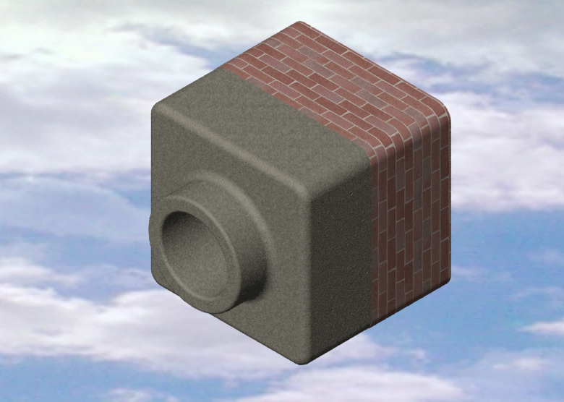
What is PhotoWorks?
A software application that creates realistic images from SolidWorks models.
PhotoWorks uses rendering effects such as:
Materials
Lights
Shadows
Backgrounds

Slide 3
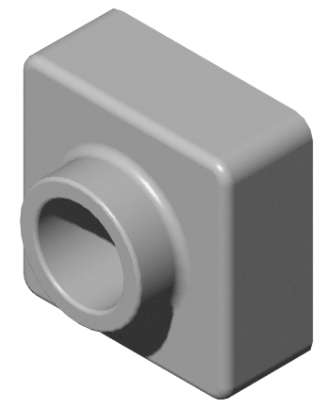
Shaded Rendering
The basis for images in PhotoWorks.
Shaded Rendering requires a material.
The default material is Plastic.
To display the Shaded Rendering:
Click Render on the PhotoWorks toolbar.

Slide 4
Materials
Materials specify the properties of a model’s surface.
Properties are:
Color
Texture
Surface Finish
Illumination

Slide 5
To Apply the Chromium Plate Material:
Click Material on the PhotoWorks toolbar.
Expand the metals folder.
Open the sub-folder chrome.
Select chromium plate.
Click Apply, Close.
Click Render .

Slide 6
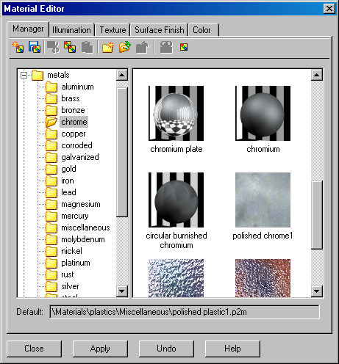
Materials Editor – Chromium Plate

Slide 7
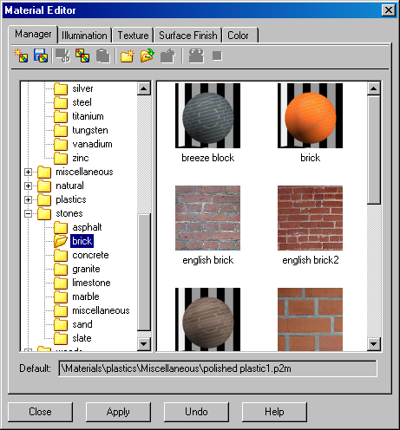
Materials Editor – English Brick 2

Slide 8
Image Background
The portion of the graphics area not covered by the model.
Background styles vary in complexity and rendering speed.
Background styles controlled by Scene Editor.
Incorporate advanced rendering effects into a PhotoWorks Scene.
Shadows
Reflections

Slide 9
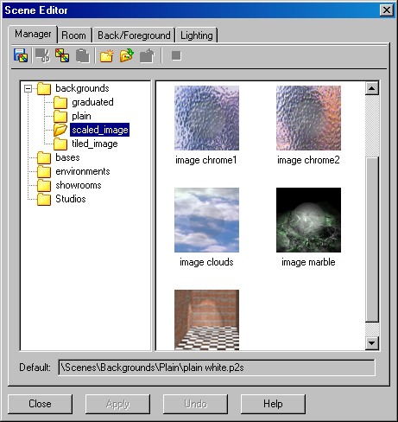
Scene Editor – Clouds

Slide 10
To Change the Background Style to Clouds:
Click Scene on the PhotoWorks toolbar.
Expand the Backgrounds folder.
Open the sub-folder scaled_image.
Select image clouds.
Click Apply.

Slide 11
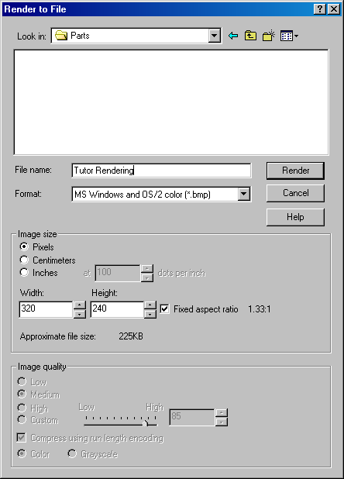
To Save the Image File
Click Render to File on the PhotoWorks toolbar.
Enter a file name.
Specify a file type.
Click Render.

Slide 12
SolidWorks Animator Application
What is SolidWorks Animator?
SolidWorks Animator animates and captures motion of SolidWorks parts and assemblies.
SolidWorks Animator generates Windows-based animations (*.avi files). The *.avi file uses a Windows-based Media Player.
SolidWorks Animator can be combined with PhotoWorks.

Slide 13
Renderer Options
The Renderer affects the quality of the saved image. There are two options:
SolidWorks screen
PhotoWorks buffer

Slide 14
Factors Affecting File Size
Number of frames per second
Renderer used
PhotoWorks buffer creates a larger file than SolidWorks screen
If using PhotoWorks buffer:
Materials
Background
Shadows
Multiple-light sources
Video compression
Key frames

Slide 15
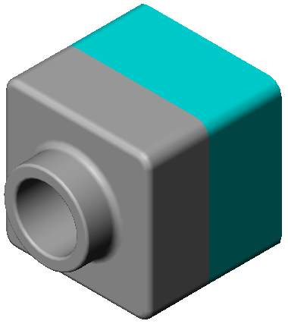
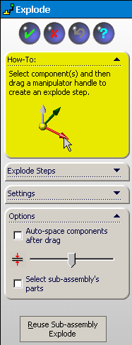
To Create an Exploded View:
Click Open on the Standard toolbar, and open the assembly, Tutor.
Click Exploded View on the Assembly toolbar. The Assembly Explode dialog appears.

Slide 16
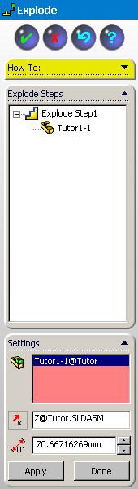
Creating an Exploded View:
Click on the component to explode to begin a new explode step. Drag the component to the explode location. The dialog box contains selection lists for:
Component(s) to explode
Direction to explode along
Distance

Slide 17
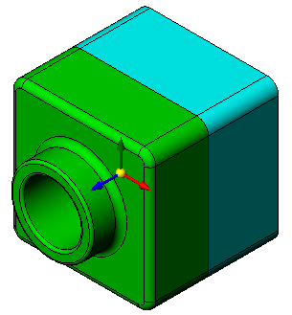
Creating an Exploded View:
Click the component to explode, in this case Tutor1. The component name appears in the dialog. Select the desired explode direction from the model triad. This selection is indicated in the Direction area of the dialog (Along Z, Z@Tutor.SLDASM by default).

Slide 18
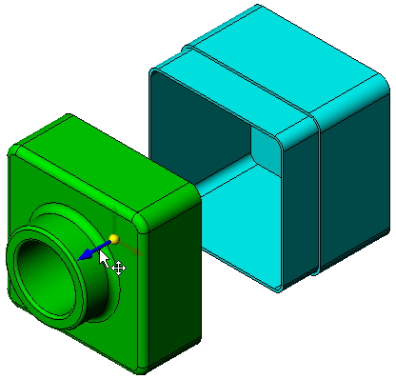

Creating an Exploded View:
Drag the component to the desired distance. Release the mouse button to create the Explode step.
Edit the step (right-click on the new Explode step, and select Edit Step) to adjust the Distance to exactly 70mm and click Apply in the dialog.
Since there is only one component to explode, this completes making the exploded view. Click OK to close the Assembly Explode dialog box.

Slide 19
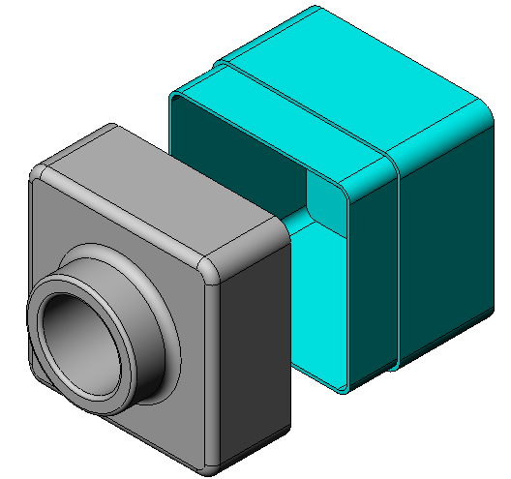
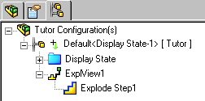
Creating an Exploded View:
Results. Note: Exploded views are related to and stored in configurations. You can only have one exploded view per configuration.

Slide 20
Collapsing an Exploded View:
Right-click the assembly icon in the FeatureManager design tree, and select Collapse from the shortcut menu.
To Explode an Existing Exploded View:
Right-click the assembly icon in the FeatureManager design tree, and select Explode from the shortcut menu.

