Slide 1
Кроссплатформенное программирование
Подготовлено по материалам
http://www.ccfit.nsu.ru/~rylov/java_lections/index.html
Лекция доступна по адресу
http://github.com/a-vodka/java/
Хороший учебник по Java
https://math.sgu.ru/sites/chairs/prinf/materials/java/index.htm

Slide 2
JSP Java server pages

Slide 3
Lesson goals
Why not servlets
What if not servlets
Expression Language
Tag Libraries

Slide 4
Servlet drawbacks
Not simple to maintain - business logic mixed with presentation logic
Slow development - servlet code needs to be updated and recompiled if we have to change the look of the application.
Too much non-reusable copy-paste
Servlet can be viewed as "HTML inside Java"

Slide 5
JSP (Java Server Page)
JSP is high-level abstraction of Java Servlets
JSP is a text document that contains two types of text:
static data (HTML, SVG, WML, and XML)
JSP elements, which construct dynamic content
JSPs servlet is cached and re-used until the original JSP is modified

Slide 6
JSP Example
<%@ page contentType="text/html; charset=UTF-8"%> <html> <head>
<title>First JSP</title>
</head> <body> JSP Page </body> </html>

Slide 7
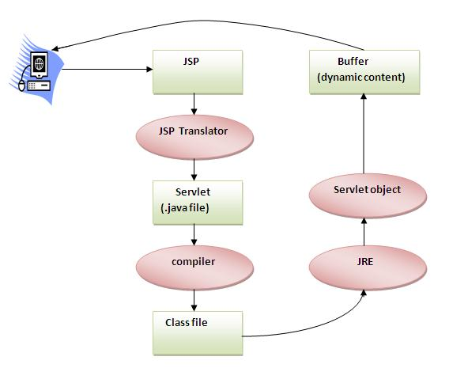
JSP life cycle
Notes:
Translation of JSP Page
Compilation of JSP Page
Classloading (class file is loaded by the classloader)
Instantiation (Object of the Generated Servlet is created)
Initialization ( jspInit() method is invoked by the container)
Reqeust processing ( _jspService() method is invoked by the container).
Destroy ( jspDestroy() method is invoked by the container)

Slide 8
JSP vs Raw Servlet
Extension to Servlet (supplement each other)
Easier to maintain
Faster Development: no necessity to recompile and redeploy
Less code than Servlet

Slide 9
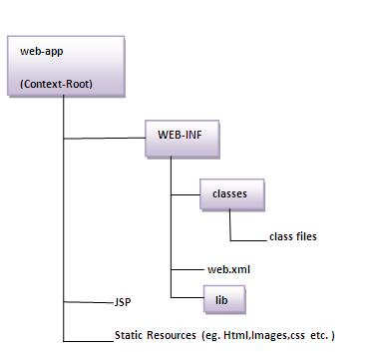
Folders structure with direct access to jsp
http://localhost:8080/page.jsp - available

Slide 10
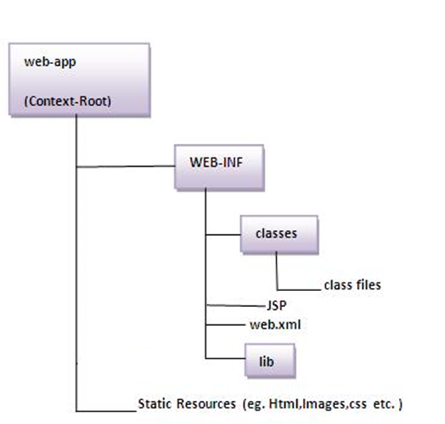
Folders structure without direct access to jsp
http://localhost:8080/page.jsp - non available. Requires servlet mapping

Slide 11
JSP Example with Java inside HTML
JSP Scriptlet is used to used to execute java source code in JSP
<% int i=0; %>
JSP Expression - evaluates a single Java expression and display its result.
Current Time: <%= java.util.Calendar.getInstance().getTime() %>

Slide 12
JSP Example with Java inside HTML
3. Declaration tag <%! field or method declaration %>
<%! int square(int a){ return a * a;} %> Square : <%= square(10) %>
4. Directives tag <%@ JSP directives %>
<%@ page contentType="text/html; charset=UTF-8"%> <%@ page import="java.util.*" %>
<%@ include file="some-another-part.jsp" %>

Slide 13
JSP Example with Java inside HTML (scriptlet)
<%@ page contentType="text/html; charset=UTF-8"%> <html> <head> <title>First JSP</title> </head> <body> <% double num = Math.random(); if (num > 0.5) { %> <h2>You'll be geek!</h2><p>(<%= num %>)</p> <% } else { %> <h2>Well, you won’t be geek ... </h2><p>(<%= num %>)</p> <% } %> </body> </html>

Slide 14
MVC
Architecture of building applications is called MVC
Model - classes of business logic and long-term storage
View - JSP pages
Controller - servlet.

Slide 15
Using JSP with Servlet
@WebServlet(name = "userPageServlet", urlPatterns = "/userpage") public class UserServlet extends HttpServlet { @Override protected void doGet( HttpServletRequest req, HttpServletResponse resp ) throws ServletException, IOException { req.setAttribute("username", "Johny"); req.getRequestDispatcher("/WEB-INF/pages/userIntro.jsp").forward(req, resp); } }
UserServlet.java
<%@ page contentType="text/html; charset=UTF-8" %> <html> <head> <title>Second JSP</title> </head> <body> Hello ${username} </body> </html>
userIntro.jsp

Slide 16
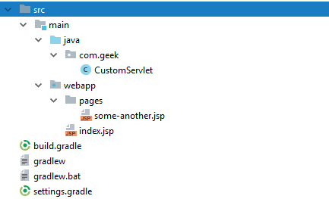
index.jsp vs custom.jsp
@WebServlet(name = "custom", urlPatterns = "/custom-page") public class CustomServlet extends HttpServlet { @Override protected void doGet(
HttpServletRequest req, HttpServletResponse resp
) throws ServletException, IOException { req.getRequestDispatcher("/pages/some-another.jsp").forward(req, resp); } }

Slide 17
JSP expression language (EL)
${username} , ${user.name} <p> Hello, ${author.name}</p>, <some:tag value=“${expr}”/>
Bean is searched by container in the next order:
page
request
session
application scopes
otherwise returns null

Slide 18
JSP Implicit Objects
Object | Type
out | JspWriter
request | HttpServletRequest
response | HttpServletResponse
config | ServletConfig
application | ServletContext
session | HttpSession
pageContext | PageContext
page | Object
exception | Throwable

Slide 19
Tag libraries
Advantages of using Tag Libs:
- get rid of "scriptlets"
- a simple HTML-like syntax
- JSP code can be modified by HTML developers
- code reuse

Slide 20
JSP Tags syntax
<someTagLib:tag attr=“…”…> body </someTagLib:tag>
or if no body
<someTagLib:tag attr=“…” …/>

Slide 21
JSP Tags types
1. Predefined (start with "jsp:") <jsp:include page="hello.jsp"/> 2. External (custom tag libraries). <c:set var="username" value="Johny" /> <c:out value="${username}" />

Slide 22
JSP Tag Example
<%@ page contentType="text/html; charset=UTF-8"%> <%@ taglib uri="http://java.sun.com/jsp/jstl/core" prefix="c"%> <h2>Hello, <c:choose> <c:when test="${not empty param.name}"> <c:out value="${param.name}"/> </c:when> <c:otherwise> <c:out value="anonymous"/> </c:otherwise> </c:choose> </h2>
<jsp:include page=“footer.jsp"/>

Slide 23
JSTL
The standard JSP tag library (JSL) is an extension of the JSP specification that adds a JSP tag library for general purposes, such as parsing XML data, conditional processing, creating loops, and supporting internationalization.

Slide 24
JSTL Examples
Core Tags - basic tags, provide iteration, exception handling, url, forward and redirect response, etc.
Formatting and Localization Tags - formatting tags, provide opportunities for formatting Numbers, Dates and support for i18n localization and resource bundles.
SQL Tags - tags for working with SQL, support for working with databases like MySQL, Oracle, etc.
XML Tags - tags for working with XML documents. For example, for parsing XML, converting XML data, and executing XPath expressions.
JSTL Functions Tags - function-tags for processing strings, provides a set of functions that allow you to perform various operations with strings, etc. For example, by concatenating or splitting strings.

Slide 25
JSTL core tags
<%@ taglib prefix="c" uri="http://java.sun.com/jsp/jstl/core" %> <c:out> <c:remove> <c:if> <c:when> <c:import> <c:set> <c:choose> <c:otherwise> <c:forEach> <c:param>

Slide 26
JSTL formatting tags
<%@ taglib prefix="fmt" uri="http://java.sun.com/jsp/jstl/fmt" %>
<fmt:formatNumber/> <fmt:formatDate> <fmt:setTimezone> <fmt:requestEncoding> <fmt:parseNumber> <fmt:parseDate> <fmt:setLocale> <fmt:timeZone> <fmt:message>

Slide 27
JSTL other tags
<%@ taglib prefix="fn" uri="http://java.sun.com/jsp/jstl/functions" %>
${fn:contains()} ${fn:endsWith()} ${fn:indexOf()} ${fn:split()} ${fn:substring()} ${fn:toUpperCase()} ${fn:escapeXml()} ${fn:join()} ${fn:replace()} ${fn:startsWith()} ${fn:toLowerCase()} ${fn:trim()}

Slide 28
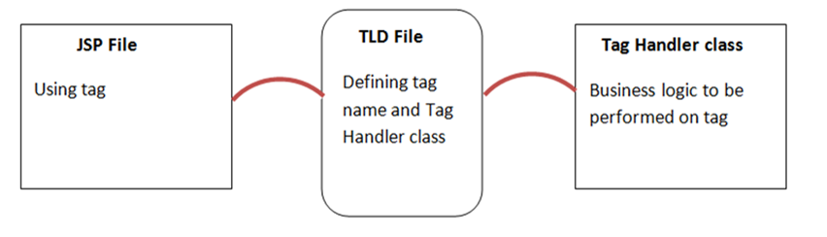
Creating custom tag library
Extend classes TagSupport or BodyTagSupport (JSP Custom Tag Handler) group: 'javax.servlet.jsp', name: 'jsp-api', version: '2.0'
Write Tag Lib Definition file (my-tag-lib.tld)
Connect your tag library into JSP file and use it

Slide 29
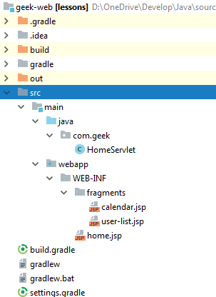
Example: structure + servlet
@WebServlet(name = "homeServlet", urlPatterns = "/home") public class HomeServlet extends HttpServlet { @Override protected void doGet( HttpServletRequest req, HttpServletResponse resp ) throws ServletException, IOException { req.setAttribute("users", Arrays.asList("Rikki", "Tommy", "Johny")); req.getRequestDispatcher("/WEB-INF/home.jsp").forward(req, resp); } }

Slide 30
Example: home.jsp
<%@ page contentType="text/html; charset=UTF-8" %> <html> <head><title>Home</title></head> <body> <jsp:include page="fragments/calendar.jsp"/> <br><br> <jsp:include page="fragments/user-list.jsp"/> </body> </html>

Slide 31
Example: calendar.jsp
<%@ page import="java.util.Date" %> <%@ taglib prefix="fmt" uri="http://java.sun.com/jsp/jstl/fmt" %> <%@ taglib prefix="c" uri="http://java.sun.com/jsp/jstl/core" %> <c:set var="date" value="<%=new Date()%>"/> Today is <fmt:formatDate value="${date}" pattern="YYYY-MM-dd HH:mm:ss"/>

Slide 32
Example: user-list.jsp
<%@ taglib prefix="c" uri="http://java.sun.com/jsp/jstl/core" %> <c:forEach var="user" items="${users}"> <br>Username: <c:out value="${user}"/> <c:choose> <c:when test="${user == 'Tommy'}"> need Jerry </c:when> <c:when test="${user == 'Rikki'}"> need Tikki </c:when> <c:otherwise> need a gun </c:otherwise> </c:choose> </c:forEach>

Slide 33
Literature
Java EE tutorial (3-9)
JSP Tutorial
Introduction to Java Server Pages

Slide 34
Homework Task 1
Implement a simple editing form on Servlet-JSP (JSTL) data stored in the session.
Implement output of data using Custom Taglib (keep "add" inside the JSP)
If any error happens – log and redirect user to custom error page
Add request blocking filter. Only user with Google Chrome 65 or later can access site – otherwise block requests and show error page.
Add request logging filter. Log endpoints path and total execution time. Should measure all actions (even when request blocked)
Add request blocking filter. Deny all operations if time between 1AM-7AM. Microsoft Edge users should never come here and be stopped by user-agent filter.
Attributes lists should not be shared between two browsers

Slide 35
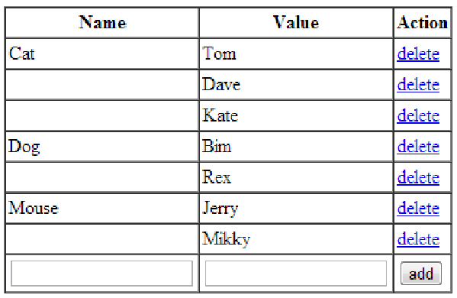
Homework 1

