Slide 1

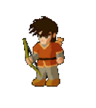
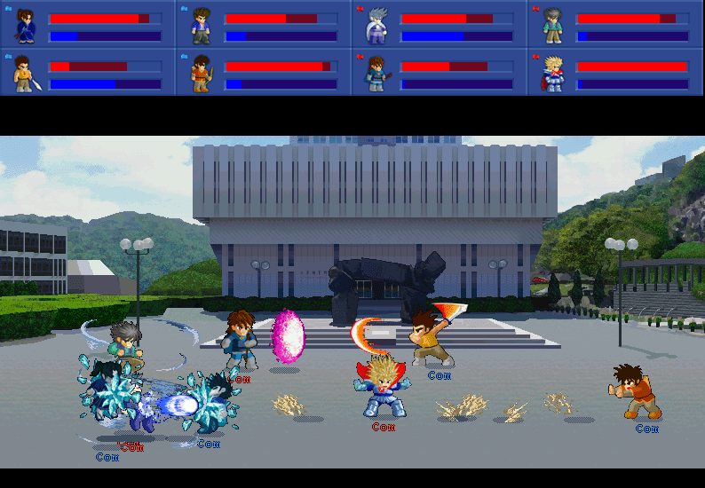
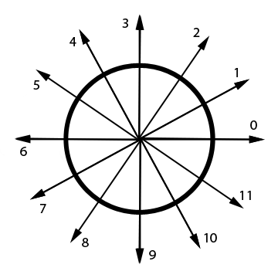
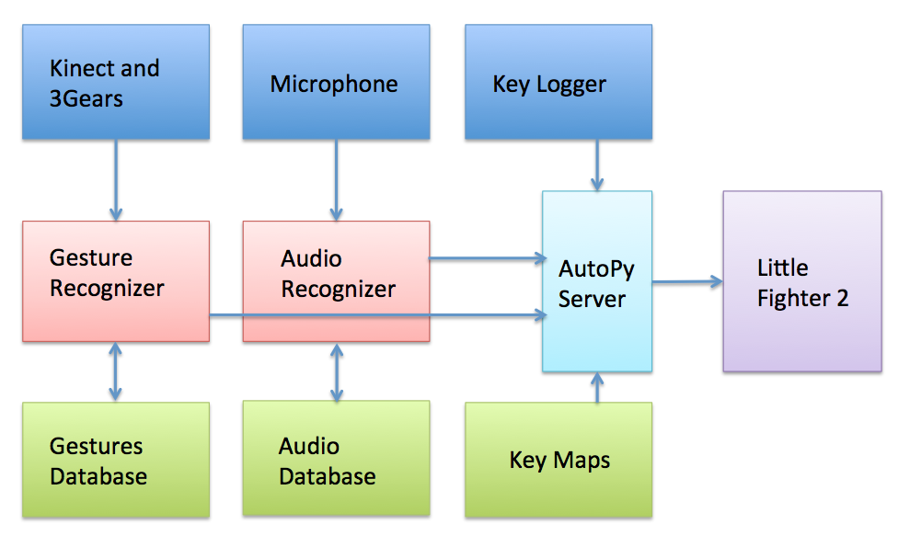
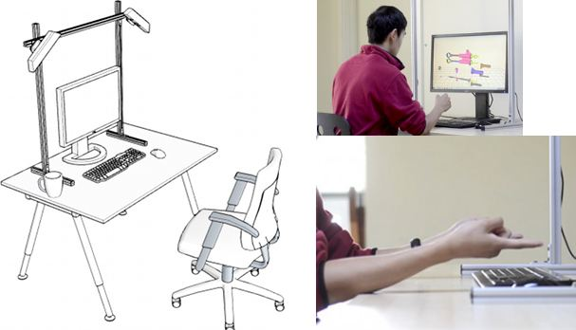
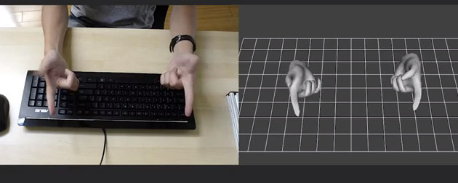
Henry vs. Rudolph
Experiments in Gestural Interaction
Anil Vaitla & Neel Patel
Introduction
There is a lot of interesting work being done in human computer interaction, both in hardware and software. As useful as the mouse and keyboard are, they can often feel unnatural when it comes to tasks such as drawing, doing 3D modeling, or playing video games. Our goal in this project was to write a gestural user interface for the game Little Fighter 2 (See Fig. 1). Little Fighter 2 is a multiplayer game where players can move their characters left, right, up, down, and perform a defend motion, jump motion, or attack motion. In addition, if a key combination is pressed in a specific order, such as defend, up, attack, then a more powerful action, such as throwing a large fireball, takes place. In many ways this is unintuitive. It would be more natural if a player could simply say the word “fireball” or form a fist gesture and quickly extend their fingers and have the fireball emerge on screen. Little Fighter 2 also has enough complexity to make designing a fluid user interface non trivial. For these reasons, we felt that Little Fighter 2 would be a great platform for demonstrating how successful gestural and audio interaction systems can really be.
Methods
Fig 1. Little Fighter 2 Screenshot from lf2.net
Hardware Inputs
We use a setup produced by the 3Gears team for hand reconstruction. The physical hardware is a stand with two vertically mounted Microsoft Kinects. The 3Gears SDK provides (x, y, z) coordinates as well as quaternions representing the angle and axis of rotation for all joints in both hands. The setup is shown in Figure 2. The audio recognition setup only requires an embedded or external microphone.
Audio Recognition Methodology:
The user begins by recording themselves saying a single audio command such as “pow” multiple times. The system takes this audio stream and segments it into the multiple samples. Segmentation occurs by detecting audio onset and silence. Silence is determined by comparing a background noise threshold to the root mean square of the current audio frame buffer. Each sound sample gets sliced into 30ms components, and 13 MFCC components are extracted from each of these subsamples. So, if the sound “pow” was 900ms long then our feature vector has 30 components, each of which has 13 MFCC features. For classification, we proceed by doing segmentation on the real-time microphone stream. Once audio followed by silence is detected we split the capture into 30ms chunks and extract MFCC features. We then examine which audio samples in our training set have same length within ±30ms of the recorded audio, and find the nearest neighbor. The metric used in nearest neighbor processing is L1 Norm of all components in the MFCC feature vector. If the distance from the closest point to our sound is below a trained threshold we assign this class label to our sample.
Static Gesture Recognition Methodology:
Static Gestures are found by looking at a subset of primitive features. The chosen features were the velocity vector of the hand and the pointer finger, whether the hand is a fist or outstretched (computed by checking finger tip distances), whether both hands participate in the action, and the orientation of the hand. These features were enough to separate our three primary static gestures “right punch”, “hadouken”, and “hand explode”. Although each of these involve motion and don’t seem static, we label them as such since velocity information allows us to perform classification using a single frame of data.
Architecture Overview
Figure 4 outlines the general design of the system. The audio recognition and gesture recognition systems receive inputs from the microphone and Kinect respectively. During real time classification they fetch the users trained models from the databases. Once they classify a gesture they send a message consisting of (Username, Gesture Name) to the AutoPy Server. All usernames and gesture names are resolved to the correct key combination through the keymaps file. AutoPy then injects the key up and key down events, with calibrated LF2 timing, into the systems keyboard buffer. These get picked up by the game and the actions occur onscreen. A key logger is required as well because certain combination moves require information about the direction of a player in order to resolve the correct combination attack. Therefore all changes in user position are also broadcast to AutoPy.
Fig 3. Code Points. For preprocessing we convert a
velocity direction in a frame into one of the discrete
directions shown above.
Continuous Gesture Recognition Methodology:
Continuous Gesture Recognition involves being able to detect some sort of movement that cannot be identified by looking at a single frame in isolation. Drawing shapes, letters, and sign language all fall into this category and cannot be identified with the static recognition system.
Gesture recognition begins with the user recording multiple samples of a single continuous gesture. Then from the entire set of motions, the user must choose which frames to persist and which ones to remove. For each gesture an HMM Model Is trained with Baum Welch seeded with a Left Right Transition matrix. In the HMM model, the hidden states correspond to a portion of a gesture. For example, the gesture for the number 7 seems to have two primary hidden states, one when you move your finger horizontally, and another when you move your finger diagonally. The left right transition matrix encodes the probability of transitioning from any hidden state to another, and has an upper bidiagonal structure. This is why this HMM System is commonly referred to as a Left Right HMM, because you move in a linear motion between states. Currently all HMM’s are fixed with 5 hidden states when we do the learning step. The emissions, or the observations, are discrete code points denoting direction of motion of the hand. In order to compute this code point we find the change in position of the hand, and map this direction onto the 2d plane and find the angle it is closest to from those seen in Figure 3.
Once we have built an HMM model for each set of continuous gestures, we proceed to do classification as follows. We record the code points of the hand, and use the Forwards Backwards algorithm, with backwards variable simply 1, in order to determine which state we believe the users hand to be in. If any gesture is signaled as being in State 5 (which means historically the user moved from states 1 to 2 to 3 to 4 to 5 because of the structure of the transition matrix), we indicate that the user has made the gesture corresponding to the triggered HMM. Currently Our System can detect Symbols 6 and 7, with 30 training samples provided for each.
Fig 4. Architecture Overview
Results and Conclusions
We set up automated tests for our audio recognition performance in which the training data was randomly split into a new test and train set. Given the words “play”, “cannon”, and “shoot”, the classifier had 100% accuracy on “play” and “cannon”, 90% accuracy on “shoot”, and only classified 3 / 20 false positives. Nevertheless, we noticed our system performance would degrade over time because a user would begin to say a word differently then the way they had recorded it.
For gestures, we didn’t have automated tests, but ran a trial run in which we counted the number of correct and incorrect classifications. All three static gestures were recognized 100% of the time, however there were some gestures which were not among the set which were also recognized. Our continuous gesture system had poor performance in the opposite regard. When it did make an classification it would be correct, but there were many instances of 6’s and 7’s which it failed to label. The overall success rate of the continuous system was about 60%, in that it assigned no class label to 4/10 entries. This might be improved by adding more training samples or changing the number of hidden states.
Sources / Acknowledgements
This project was completed as part of CS 234 Mobile Computing (Winter 2013), taught by Professor Chien, with TA support by Tanakorn L. and Falcon Dai. We’d like to thank 3Gears for providing us an Academic License to use their software. Also thanks to Marti and Starsky Wong for making Little Fighter 2. Code is available on Github under the project name HenryVsRudolph.
lmezain, Mahmoud, Ayoub Al-hamadi, and Bernd Michaelis. "A Hidden Markov Model-Based Isolated and
Meaningful Hand Gesture Recognition." International Journal of Electrical and Electronic Engineering 3.3 (2009):
156-63. Print.
Jang, Roger. "12-2." Audio Signal Processing. Web.
<http://neural.cs.nthu.edu.tw/jang/books/audiosignalprocessing/speechFeatureMfcc.asp?title=12-2%20MFCC>.
Kiran, Kranthi. Speech Recognition Using MFCC and Dynamic Time Warping. Indian Institute of Technology, Web.
<http://xa.yimg.com/kq/groups/24321415/1523383180/name/Speech_Recognition_seminar.pdf>.
Lee, Hyeon-Kyu, and Jin H. Kim. "An HMM-Based Threshold Model Approach for Gesture Recognition." IEEE
Transactions On Pattern Analysis And Machine Learning 21.10 (1999): 961-73. Print.
Shen, Dawei. Some Mathematics for HMM. MIT, Web.
<http://courses.media.mit.edu/2010fall/mas622j/ProblemSets/ps4/tutorial.pdf>.
Fig 2. 3 Gears Systems Hardware setup

