Slide 1
Introduction to Software Testing

Slide 2
Software Testing
Myers’ definition (1979)
Software testing is a process of finding errors in a software product
Testing never ends
IEEE Standard 829-2008 on Software and System Test Documentation
An activity in which a system or component is executed under specified conditions, the results are observed or recorded, and an evaluation is made of some aspect of the system or component.
Ensure that the software product meets its requirements

Slide 3
Three Important Questions to ask †
Why do we test?
Impacts the quality of the product
Customer satisfaction
What should we test?
Functionalities
GUI
Data flow
Code coverage
…
How do we test?
Discussed in detail throughout the course
† Paul Ammann and Jeff Offutt 2008

Slide 4
Some facts about cost of software testing
A study conducted by NIST (National Institute of Standards and Technology) in 2002 reports that software bugs cost the U.S. economy $59.5 billion annually. More than a third of this cost could be avoided if better software testing was performed.
Cost of testing: (© Steve McConnell, 2004)
 | Requirements | Architecture | Construction | System Testing | Post-Release
Requirements | 1X | 3X | 5-10X | 10X | 10-100X
Architecture |  | 1X | 10X | 15X | 25-100X
Construction |  |  | 1X | 10X | 10-25X
Defects injected

Slide 5
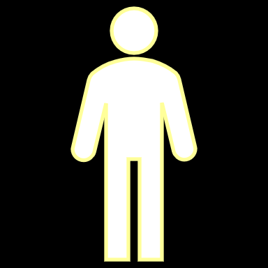
Activities involved in software testing
Generate test cases
Generate test cases
Plan for testing
Plan for Testing
Execute test cases
Tester
Result of execution
Source code
Test Report
Developer

Slide 6
Types of test activities
Test design
Design test cases, generate test data
Requires knowledge on programming, testing and some logic
Test automation
Write test scripts
Requires knowledge of script languages and systems
Test execution
Run test data on Software Under Test (SUT) and record the outcomes
Requires knowledge on how to use testing tools
Test evaluation
Compare test outcomes and report to developers and other stakeholders
Requires domain knowledge
© Ammann and Offutt, 2008

Slide 7
Static and Dynamic Testing
Static Testing
Testing without executing the program
Code review, symbolic execution
Dynamic Testing
Testing by running the program with test data
We will discuss, and possibly work on, both types of testing in this course

Slide 8
Specification, Program and Test cases
Universe
Specification
Program
2
5
7
1
3
4
Test cases
6
© Paul Jorgensen, 2008

Slide 9
Explanation of the three circles
The specification circle describes the behaviors or functionalities that must be implemented – taken from the requirements document.
The program circle describes the behaviors or functionalities that have been implemented. It is possible that additional behaviors or functionalities might have been implemented by the developers, for the sake of convenience.
The test cases circle describes the behaviors or functionalities that have been tested.

Slide 10
Regions on the diagram
1 | Behaviors specified, implemented and tested
2 | Behaviors specified and implemented but not tested
3 | Behaviors specified and test cases generated for them, but are not implemented
4 | Behaviors implemented and tested but were not originally specified
5 | Behaviors specified, but neither implemented, nor test cases generated for them
6 | Behaviors for which test cases are available but were neither specified nor implemented
7 | Behaviors implemented but were not specified; test cases not generated for them

Slide 11
Try to achieve
Universe
Specification
Program
Test cases
© Paul Jorgensen, 2008

Slide 12
Black-box testing - Definition
Testing process in which test cases are derived from the requirements specification or design specification
No knowledge of internal structure or code
Test results are collected by sole observation of the output from the code
GUI testing and acceptance testing also fall into the same category

Slide 13
Black-box testing
Universe
Specification
Program
Test cases
© Paul Jorgensen, 2008

Slide 14
White-box testing - Definition
Testing process in which test cases are derived from the source code
Purpose of this type of testing is check whether the code is written satisfactorily
It is possible that the code might not return the correct output but has the correct logic implemented
Knowledge of the programming language used is required to perform white box testing

Slide 15
White-box testing
Universe
Specification
Program
Test cases
© Paul Jorgensen, 2008

Slide 16
Gray-box testing
Can you guess what “gray-box testing” is?
Specification
Program
Test cases
© Paul Jorgensen, 2008

Slide 17
Levels of testing
Unit testing
Testing individual units (smallest piece of software)
Integration testing
Composing/assembling units into a module or a subsystem
System testing
Testing the entire system
GUI testing
Acceptance testing
Testing to ensure that customers accept the product
Testing to conform with standards

Slide 18
Requirements
Specification
System
Testing
Preliminary
Design
Integration
Testing
Detailed
Design
Unit Testing
Code
© Paul Jorgensen, 2008

Slide 19
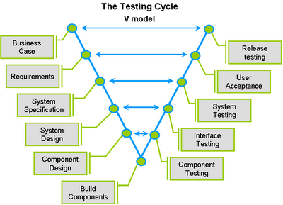
© Business Analyst, 2016

Slide 20
Some definitions
Test
A process of finding errors through the occurrences of faults
Another definition: the act of exercising test cases
Test case
Description of a set of inputs along with expected outputs
Test data
Values that instantiate a test case
Test Suite
A collection of test cases targeted to test a set of properties such as user interface functionalities, reliability, performance and so on.

Slide 21
Some definitions (continued)
SUT
System (or Software) Under Test
Test Harness
Software along with a set of executable test cases to test a SUT. This is part of an automated testing process.
Testing and debugging
Testing is a process of finding the presence of an error
May be performed by several people including the programmer
Debugging is a process of finding the source of an error, if it is present
Mostly performed by the programmer

