Slide 1
Why Software Engineering?
To work together, the software engineers must overcome three challenges, among others:
Conceptualization
Communication
Coordination
Solution:
Processes and methodologies for analysis and design
UML for communication and coordination
Tools that automate or support methodology steps.

Slide 2
Software Life Cycle Activities
Software processes and methodologies consist of life cycle activities:
Productivity
Quality
Cost
Time to Market
Software Development Process
Software Quality Assurance
Software Project Management

Slide 3
Life Cycle Activities
Software engineering consists of three tracks of interacting life cycle activities:
software development process
software quality assurance, and
software project management

Slide 4
Software Process
Coherent sets of activities for specifying, designing, implementing and testing software systems
A structured set of activities required to develop a software system
A software process model is an abstract representation of a process. It presents a description of a process from some particular perspective

Slide 5
Software Process Models
Software process models are general approaches for organizing a project into activities
Help the project manager and his or her team to decide:
What work should be done
In what sequence to perform the work
The models should be seen as aids to thinking, not rigid prescriptions of the way to do things
Each project ends up with its own unique plan

Slide 6
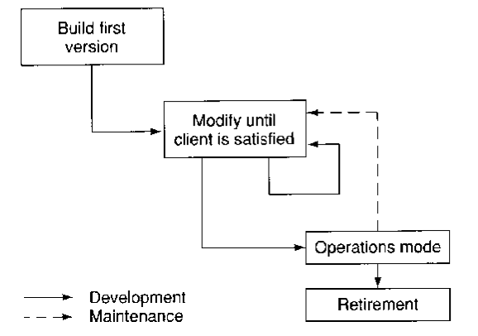
Build and Fix

Slide 7
Build and Fix
Totally unsatisfying approach for any project of reasonable size.
Cost is higher for larger projects.
Product will not be delivered on time most of the times.
No documentation is produced.
Maintenance can be extremely difficult without specification and design document.
Can be useful for small projects (reduced management overhead)
Notes:
----- Meeting Notes (2/1/18 12:10) -----

Slide 8
Life Cycle Models
Waterfall model
Prototyping models
Rapid prototyping
Incremental prototyping
Evolutionary prototyping
Spiral model

Slide 9
Waterfall model
Water flow through a set of trays
Each tray is filled before water flows to the next tray
Water does not flow upwards until it is pumped
Work flow through a series of stages (phases)
Each phase is completed before moving to next phase
Previous phase is not visited again unless there is an error found in the current phase

Slide 10
Waterfall model (continued)
There are several variations to this model

Slide 11
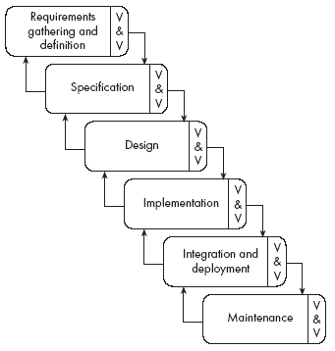
The waterfall model

Slide 12
Waterfall Model (continued)
Advantages
Linear model; simple and easy to follow
Feedback from each phase to earlier phases
Separate and distinct phases of specification and development
Enforced disciplined approach
The documents are essential tools for maintaining the product. Every change has to be reflected in the relevant documentation.
Every phase has to be approved by the SQA group.
Provides a good approach when the requirements are well understood.

Slide 13
Waterfall Model (continued)
Disadvantages
Not easy to use for wicked (not-well-understood) problems
“All requirements must be well understood and frozen before development starts” is unrealistic
Requirements evolve as development continues
Difficult to estimate all the resources accurately
Specific properties of the application domain are not considered
The specification only exists on paper and the client not necessarily fully understands what the final product will look like.
Only applicable, if a good specification document can be created.
Full specifications are not necessarily known or identifiable at the beginning → Unrealistic for most large scale projects

Slide 14
Prototyping Models
Prototyping is essential for parts of the system such as the user interface which cannot be effectively pre-specified. Users must be involved in prototype evaluation
Repeated processes
In each iteration
Add a subset (possibly small subset) of requirements
Correspond to most important functionalities that were not yet implemented
Analyze the requirements, design, implement, test (by developer), check with customer
requires customer’s approval before moving to the next iteration
Repeat until the product is done

Slide 15
Advantages of prototyping models
Most important functionalities are considered as and when they arrive
Consistency between requirements is checked in each iteration
Customers feel the progress of the development process
Developer can use the prototype in any iteration as a source for winning customer contracts
Used for bidding government contracts

Slide 16
Challenges posed by prototyping models
Identifying the most important subset of requirements at any stage is a tedious task
Establishing consistency in each iteration is a repetitive work, particularly when new subset of requirements bear no relationships with the existing ones
Moreover, it is a tedious and time consuming work
Project deadline cannot be estimated
No visible end to the set of iterations
Poses “maintenance” problems

Slide 17
Rapid Prototyping model
Initial:
A “quick and dirty” prototype is developed that implements the most important subset of requirements
“quick” because it is developed faster
“dirty” because development process does not follow any standard or disciplined approach
Get the approval of the customer
Follow-up:
After customer’s approval, discard the prototype
Start the project again from scratch; may use any model
Use the knowledge and expertise gained in developing the prototype
Also called “throw-away prototype”

Slide 18
Rapid prototyping model (continued)
Advantages – same as “prototyping models”
Disadvantages
Time and resources spent on prototype become a waste
Final product may not resemble the initial prototype
Developer might have overlooked some features while developing the “quick and dirty” prototype
May lead to customer dissatisfaction

Slide 19
Incremental Prototyping model
Initial: Same as “rapid prototyping model”
Follow-up:
Developer uses the initial model as the base, and keeps adding more functionalities
Implementation of the new subset of functionalities must be checked and approved by the customer before adding the next subset
Developer may use any model to implement the new subset of functionalities
Also called “staircase model”

Slide 20
Incremental prototyping model (continued)
Advantages
Same as “advantages of prototyping models” in general (see previous slides).
Disadvantages
Time consuming
Too much customer interaction; certain design decisions taken by the developer may not be approved by the customer
No visible end to the finished product
Can easily degenerate into the build and fix approach

Slide 21
Evolutionary prototyping model
“Initial” and “Follow-up” stages are similar to those of “incremental prototyping”.
Major difference
Customer interaction is reduced
Customer interact only when significant changes are made to the product
Who decides on the “significance” of changes?

Slide 22
Spiral Model
An evolutionary version of incremental prototyping, developed by Boehm in 1988.
Each iteration of the prototype is represented as a cycle in a spiral.
Each iteration of the spiral adds more functionalities, BUT..
in each iteration, a set of risks in carrying out that iteration is identified at the beginning of the iteration and the product is checked for risk-free at the end of the iteration

Slide 23
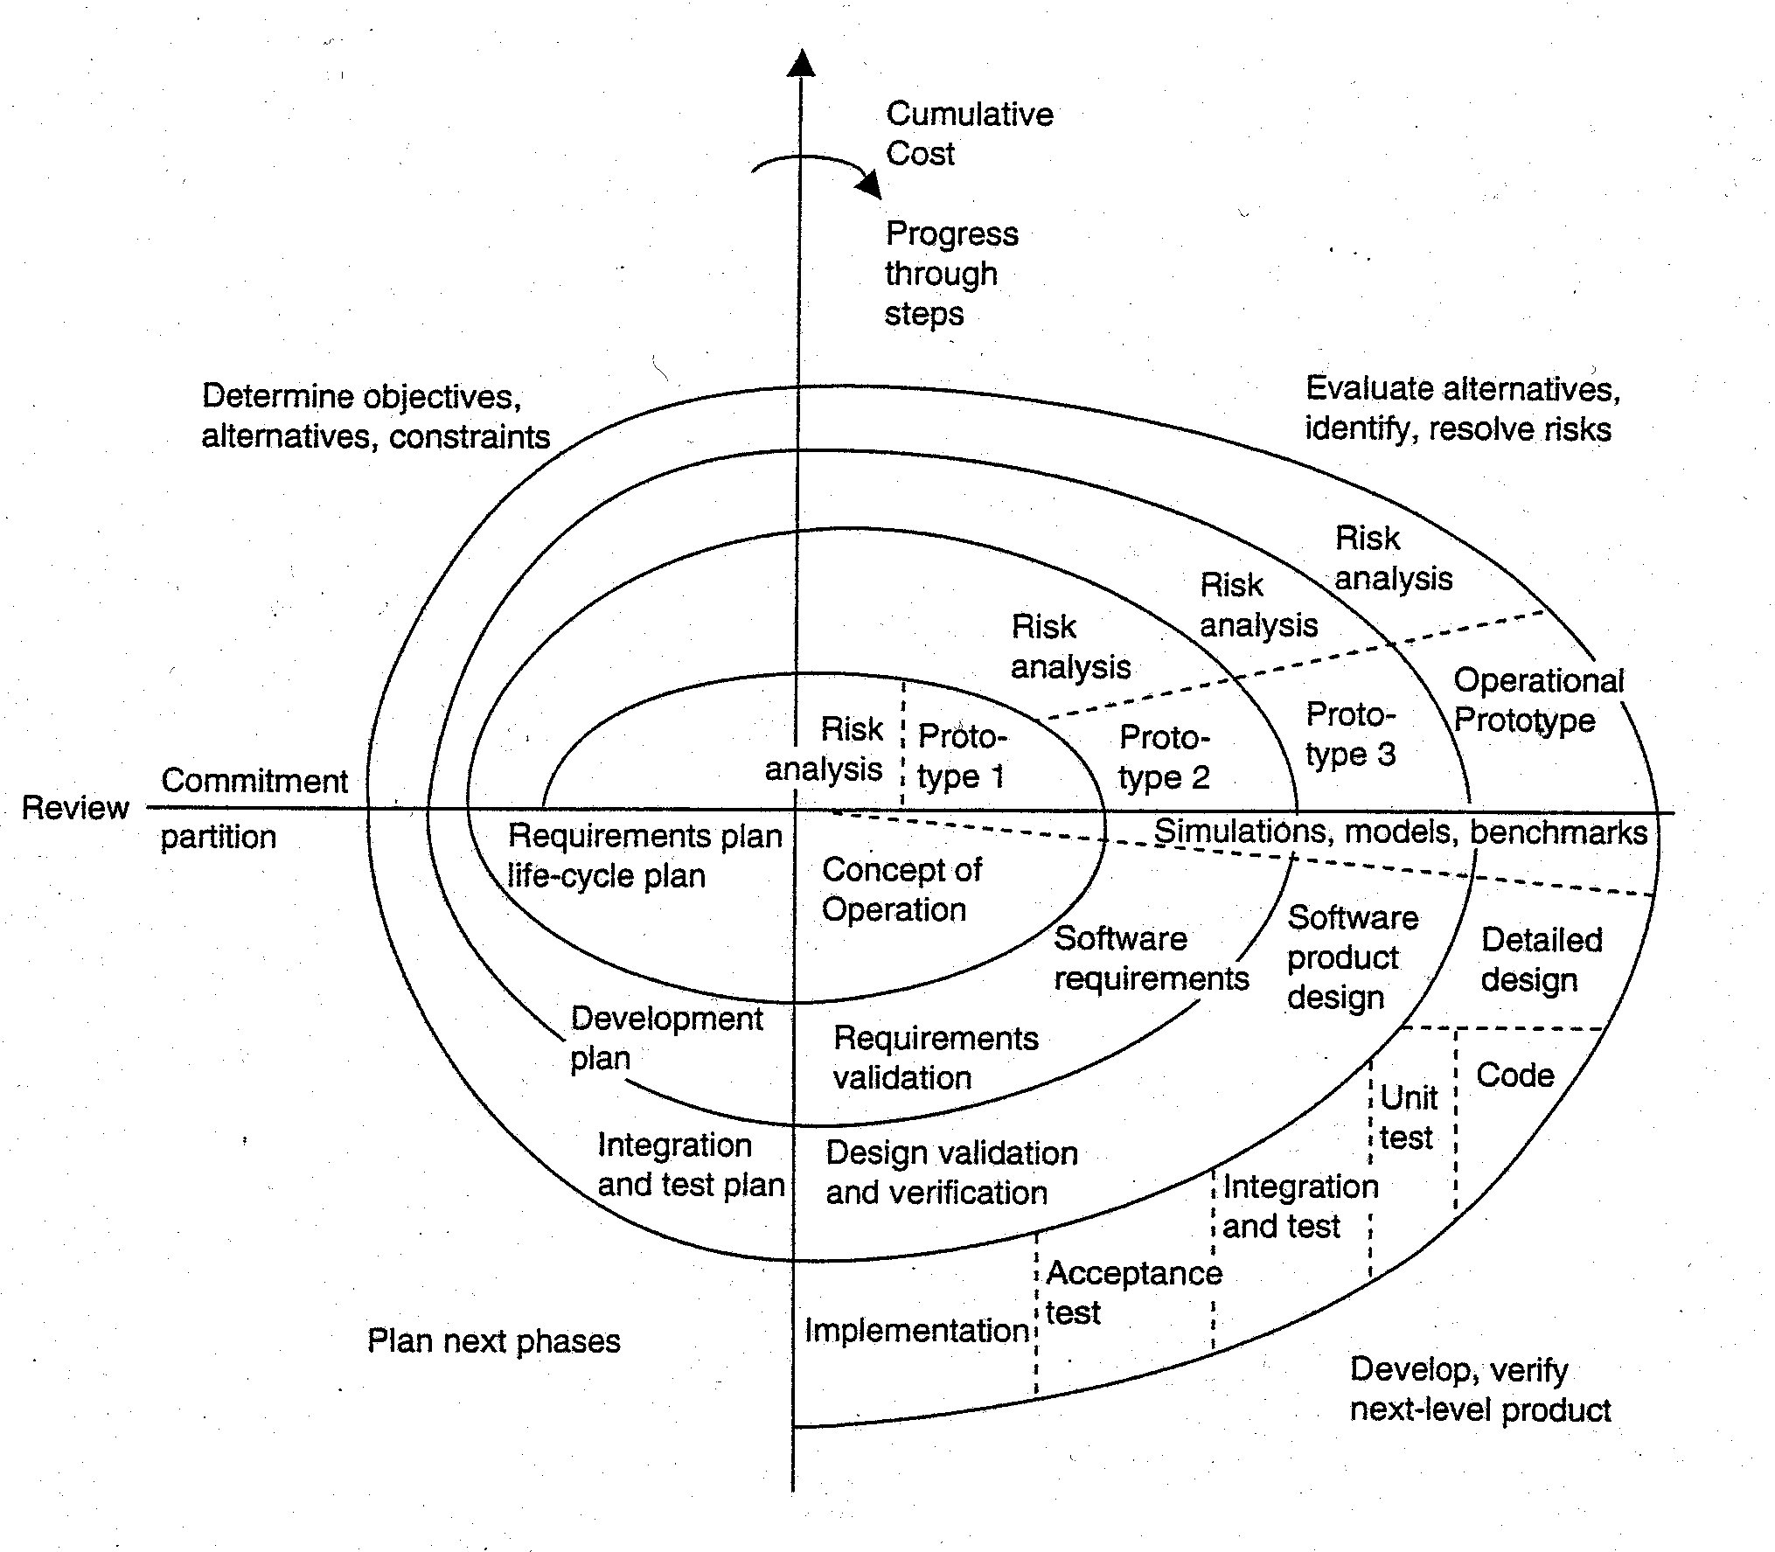
Spiral Model (continued)
© Boehm, 1988

Slide 24
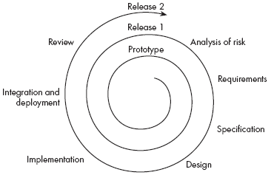
The spiral model

Slide 25
The spiral model
It explicitly embraces prototyping and an iterative approach to software development
Start by developing a small prototype
Followed by a mini-waterfall process, primarily to gather requirements
Then, the first prototype is reviewed
In subsequent loops, the project team performs further requirements, design, implementation and review
The first thing to do before embarking on each new loop is risk analysis
Maintenance is simply a type of on-going development

Slide 26
Spiral model (continued)
Accommodates all features of “incremental” and “evolutionary” prototyping models
Advantages
Focuses on “risks” early in development
More or less guarantees a better product (correct and consistent)
Accommodates changes in requirements during product development
Provides a mechanism for incorporating software quality objectives into product development
Spiral model targets testing by treating it as a risk, which has to be addressed.
Emphasis on alternatives and constraints => supports the reuse of existing solutions

Slide 27
Spiral Model
Disadvantages
Best used for internal projects (inside a company) – termination of a project causes just a reassignment of the staff.
In case of contract software development, all risk analysis must be performed by both client and developers before the contract is signed and not as in the spiral model.
Spiral model is risk driven. Therefore it requires knowledgeable staff.
Suitable for only large scale software development. Does not make sense if the cost of risk analysis is a major part of the overall project cost.

Slide 28
Spiral model (continued)
Risk Management
Risk identification
Consider all sorts of “what if …”
Prioritize/rank risks
Risk analysis
Identify methods, techniques and schedules to evaluate risks during product development in that iteration
Risk control
Evaluate risks during product development and document the results
Plan the next iteration such that the same set of risks do not arise again

Slide 29
Spiral model (continued)
Some risk items listed in literature
Change in requirements
Change in external resources (e.g., databases)
Change in staff/personnel
Budget overrun
Resource reallocation
Equipment failure
Change in business policies
Deviation from expected performance

Slide 30
Key Points
Lifecycle models are almost never used as-is.
The lifecycle model used should be adapted to the current situation.
Different projects require different models.
The waterfall model is generic but almost never used as is.
A prototype can be used to give end-users a concrete impression of the system’s capabilities
Prototyping is becoming increasingly used for system development where rapid development is essential
Throw-away prototyping is used to understand the system requirements
In evolutionary prototyping, the system is developed by evolving an initial version to the final version
Incremental models are heavily used, but dangerous to use.

Slide 31
Synchronize and Stabilize Model
Used by Microsoft (introduced in 1997).
The work is divided in 2 or 3 builds. The first build consists of the most critical features, the second build with next critical ones, etc.
Each build is carried out by a number of small teams working in parallel.
At the end of. each day, all the teams synchronize; i.e. they put the partially completed components together and test and debug the resulting product
Stabilization is performed at the end of each of the builds.

Slide 32
Synchronize and Stabilize Model
Advantages
Repeated synchronization ensures that the various components always work together.
Regular execution of the partial product allows developers to get a insight in the operations of the product and modify the requirements as necessary during the course of a build.

Slide 33
The Rational Unified process
This is the most widely known methodology that embraces UML
Designed to be adaptable
Suggests a process framework
Adapts to the project needs
Use-case-driven development
Architecture-centric process

Slide 34
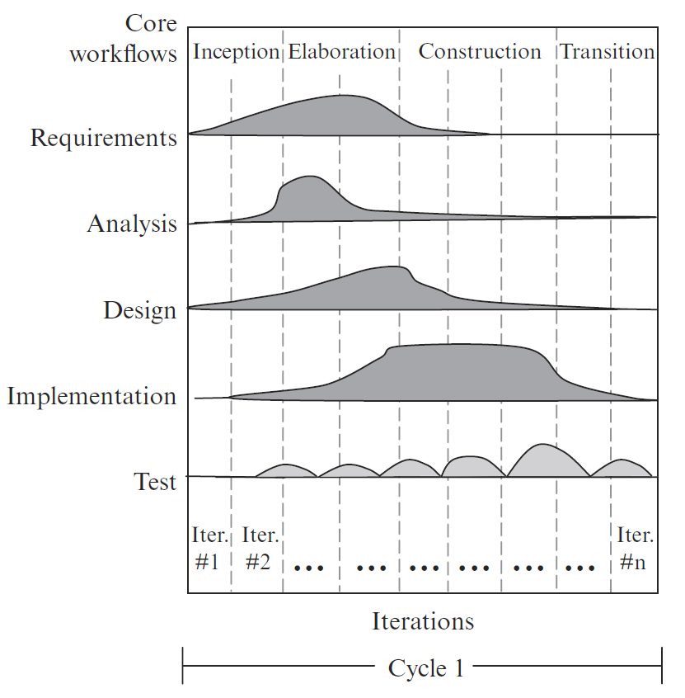
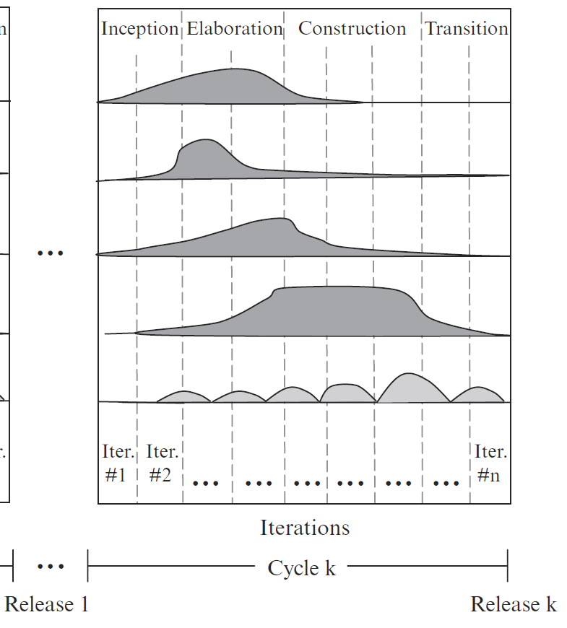
Rational Unified Process (RUP)

Slide 35
Rational Unified Process (RUP)
Inception consists of the first 1-2 iterations. It produces a simplified use case model, a tentative architecture, and a project plan.
Elaboration consists of the next N iterations. It produces the architectural design and implements the most critical use cases.
Construction, during which remaining use cases are iteratively implemented and integrated into the system.
Transition, during which the system is deployed, users are trained, and defects are corrected.

Slide 36
Agile Process
Emphasize teamwork, joint application development with the users, design for change, and rapid development and frequent delivery of small increments in short iterations.
A light-weight methodology
Minimize initial planning

Slide 37
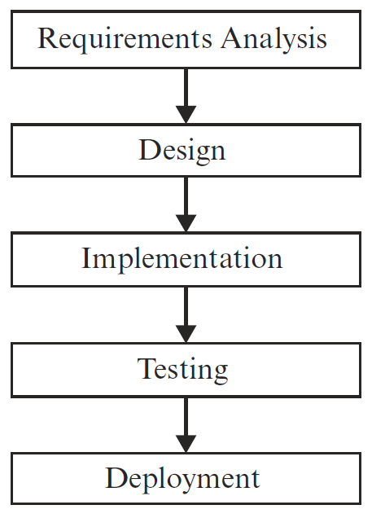
Agile Process Models
phases in an iteration
Iterations

Slide 38
Some Well-Known Agile Methods
Scrum
Extreme Programming (XP)

Slide 39
Scrum
Unique key features:
include Scrum Master, Product Owner, and Team roles
15 minute daily status meeting to improve communication
team retrospect to improve process
Notes:
Scrum Master, who maintains the processes and is the supervisor of a scrum team
Product Owner who represents the stakeholders and the business
Team Member A team member is a basic member who works for the completion of a
product
a product backlog, which is a prioritized list of the functionality to be developed in a product or service

Slide 40
Scrum Lifecycle Activities
Release planning meeting
identify and prioritize requirements, called product backlog
identify top priority requirements to be delivered within an increment, called a sprint
identify sprint development activities
Sprint iteration
sprint planning meeting to determine what and how to build next
daily Scrum meeting to exchange status
Sprint review meeting
increment demo
team retrospection
Deployment

Slide 41
Scrum Process
Daily Scrum Meeting
Release Planning
Sprint Planning
2-4 Weeks
Sprint Retrospection
Potentially Shippable Product Increment
Product Backlog
Sprint Backlog
Notes:
a product backlog, which is a prioritized list of the functionality to be developed in a product or service

Slide 42
Extreme Programming (XP)
Unique Key Features:
All stakeholders work closely together
User stories are written instead of requirement document
There must be a series of small and frequent releases (1 to 3 weeks)
The project variable are: scope, resources and time (and quality)
Test cases are written before the software is developed
A large amount of refactoring is encouraged
Pair programming is recommended

Slide 43
User Story
A good user story is
Independent
Negotiable
Valuable to users or customers
Small
Estimable
Testable

Slide 44
User Story
As a _____, I want __________, so that ______
As an administrator, I want to be able to create user accounts, so that I can grant users access to the system

Slide 45
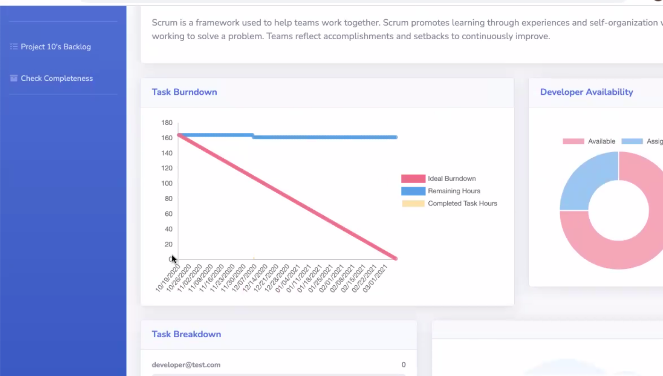
Sample Project 1

Slide 46
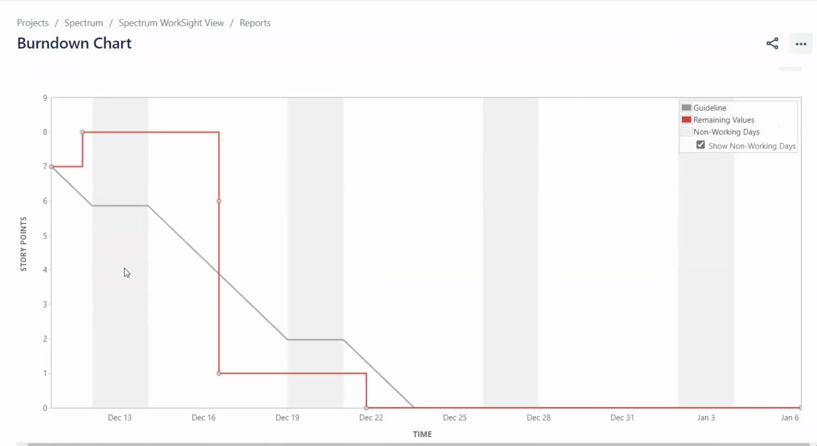
Sample Project 2

Slide 47
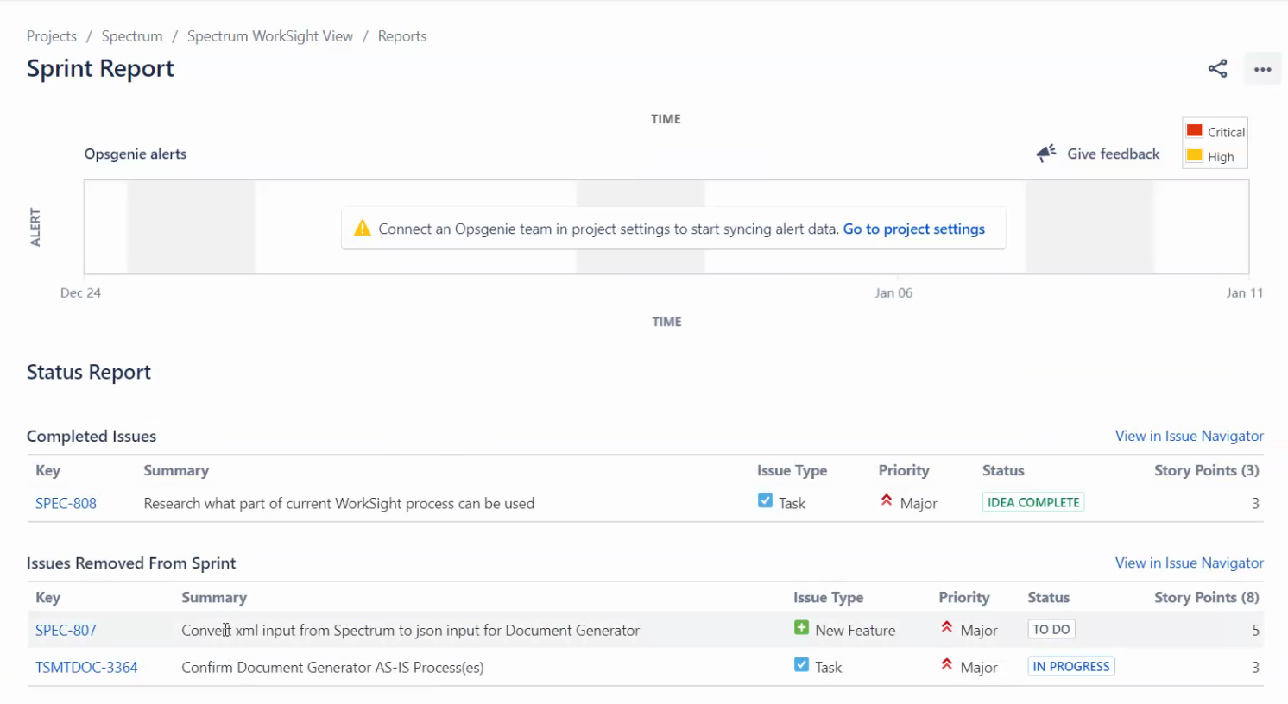
Sample Project 2

Slide 48
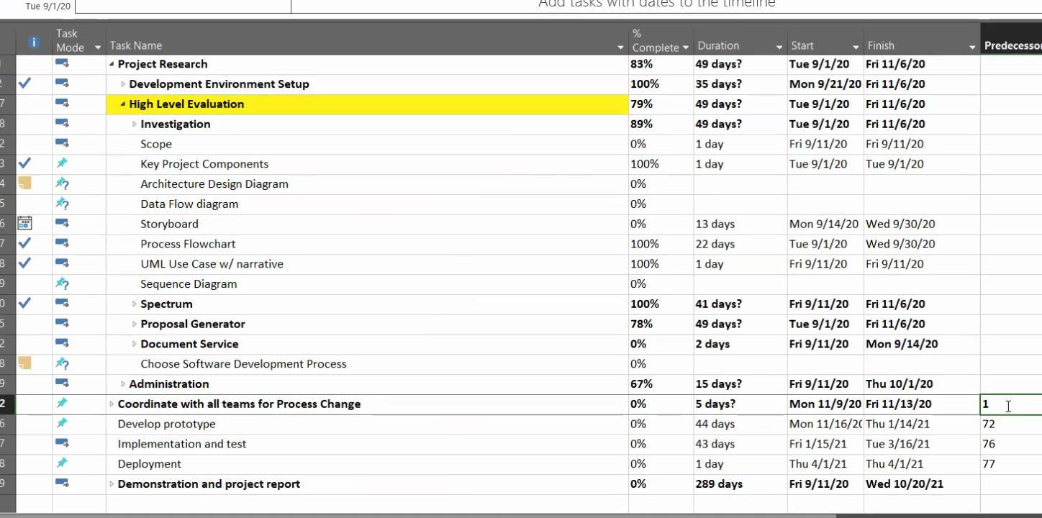
Sample Project 2

Slide 49
Agile vs. Plan-driven
Agile development values individuals and interactions over processes and tools
Agile methods work well for small to medium-size projects
Plan-driven approach: large, complex systems
Both approaches are needed

Slide 50
The Methodology Presented in the textbook
It is designed for beginners as well as seasoned developers.
It is aimed at educating software architects and systems analysts.
It can be applied to agile as well as plan-driven projects. It has been applied to sponsored as well as industrial projects.

Slide 51
Methodology Overview – Planning Phase
Business goals & needs
Current situation
Acquiring Requirements & Domain Modeling
Requirements
Deriving Use Cases
from Requirements
Abstract & high level use cases, use case diagrams
Allocating Use Cases &
to Iterations
Use case-iteration allocation matrix
Producing an
Architecture Design
Software architecture

Slide 52
Methodology Overview – Iterative Phase
Software architecture
Use case-iteration allocation matrix
Accommodating
Requirements Change
Iteration use cases
Domain Modeling
Domain model
Actor-System Interaction Modeling & UI Design
Domain model
Expanded use cases & UI design
Behavioral Design
Behavior diagrams
Deriving Design Class Diagram
Design class diagram
TDD, Integration, & Deployment

Slide 53
Class Exercise
ATM system
State two functional requirements for an ATM system
Derive use cases from these requirements
Write user stories from these requirements

Slide 54
Class Exercise
Your course project
State two functional requirements for your course project
Derive use cases from these requirements
Write user stories from these requirements

