Slide 1
Analysis and Design Models
These models can be used both by the analysis and design processes
They are somewhat abstract and hence not biased towards implementation
They are somewhat concrete because they add a little more details than requirements

Slide 2
Analysis and Design Models
Models help the analyst to understand the functionality of the system and models are used to communicate with customers
Different models present the system from different perspectives
External perspective showing the system’s context or environment
Behavioural perspective showing the behaviour of the system
Structural perspective showing the system or data architecture

Slide 3
Weaknesses
They do not model non-functional requirements
They do not usually include information about whether a method is appropriate for a given problem
They may produce too much documentation
The models are sometimes too detailed and difficult for users to understand

Slide 4
Analysis and Design Models
Data
Object
Descriptions
Process
Specifications
Entity
Relationship
Diagrams
Data
Flow
Diagrams
Data
Dictionary
State
Transition
Diagrams
Control
Specifications

Slide 5
Data Dictionaries
Data dictionaries are lists of all of the names used in the system models. Descriptions of the entities, relationships and attributes are also included
Advantages
Support name management and avoid duplication
Store of organisational knowledge linking analysis, design and implementation

Slide 6
Models
All the three models use a data dictionary
a collection of data objects in the application domain
Entity-Relationship Diagrams (ERD)
a diagrammatic description of data objects
Data Flow Diagrams (DFD)
indicate the processes involved and data flowing between the processes
State-Transition Diagrams (STD)
a behavioral model of the system; indicates the states of the system/data objects

Slide 7
Data Objects
Object: something that is described by a set of attributes (data items) and that will be manipulated within the software (system)
Each instance of an object (e.g. a book) can be identified uniquely (e.g. ISBN#)
Each plays a necessary role in the system i.e., the system could not function without access to instances of the object
Each is described by attributes that are themselves data items

Slide 8
Types of Objects
External entities (printer, user, sensor)
Things ( reports, displays, signals)
Occurrences or events (interrupt, alarm)
Roles (manager, engineer, salesperson)
Organizational units (division, team)
Places ( manufacturing floor)
Structures (employee record)

Slide 9
Data Object
A composite entity holding data
different from primitive entities that hold only one value
an identification card is a data object
an identification number is not a data object
different from objects in object-oriented approach
data objects do not have encapsulated functions

Slide 10
Data Object Description
A data object consists of
a unique identifier
a set of attributes
a set of relationships with other data objects
Example - Chair
identifier: part # is AZ12876
attributes: color is blue, type is “no-arm”, …
relationships: “is placed” in a “computer room”

Slide 11
Relationship
Relationship – indicates “connectedness”; a fact that must be “remembered” by the system and cannot or is not computed or derived mechanically
Several instances of a relationship can exist
Objects can be related in many different ways

Slide 12
Cardinality of relationships between data objects
One-to-one
a car has a steering wheel
One-to-many
a person has several cars
Many-to-many
a library user may read several books and a library book might be read by several users

Slide 13
Modality of relationships between data objects
True or false (1 or 0)
Each data object in the relationship has a modality
Two data objects participating in the same relation may have different modalities
True (or 1) indicates that the relationship is MANDATORY in that application
A relationship between “repair work” and “vehicle”. True from “repair work”.
False (or 0) indicates that the relationship is OPTIONAL in that application
The relationship between “repair work” and “vehicle” is optional as far as “vehicle” is concerned because a vehicle may or may not have any repairs

Slide 14
Notations and semantics of entity-relationship diagrams
Entity Name
Entity
Relationship Name
Relationship

Slide 15
ERD – Example 1 (Data Dictionary)
Restaurant
Id: <restaurant name and address>
Attributes: food items prepared, special for the day, preferred customers list, …
Relationships: <<fill in later>>
Food
Id: <item name>
Attributes: color, type, taste, price, …
Relationships: <<fill in later>>
Customer
Id: <customer name>
Attributes: preferred food items, …
Relationships: <<fill in later>>

Slide 16
ERD – Example 1 (ERD diagram)
Food
Prepares
n
n
Eats
1
m
Restaurant
Pays
Customer
n
m
Modality: thick (small) bar indicates mandatory;
circle indicates optional
Cardinality indicated by the number closer to the entity

Slide 17
ERD – Example 1 Explanation
Relationship – Prepares
Entities – Restaurant and Food
Cardinality for Restaurant is 1 One restaurant prepares many
Cardinality for Food is n food items
Modality for Restaurant is 1 Restaurant must prepare
Modality for Food is 1 food items
Relationship – Eats
Entities – Customer and Food
Cardinality for Customer is n Many customers eat several
Cardinality for Food is m food items
Modality for Customer is 0
Modality for Food is 0

Slide 18
ERD – Example 1 Explanation (continued)
Relationship – Pays
Entities: Customer and Restaurant
Cardinality for Customer is m There are customers
Cardinality for Restaurant is n for a restaurant
and there are several restaurants that
a customer visits
Modality for Customer is 0 Customer not interested in
Modality for Restaurant is 0 visiting any restaurant and
Restaurant does not have
any customer

Slide 19
Default notations in ERD diagrams
If a cardinality is not specified, it is assumed to be 1 (ONE).
If a modality is not specified, it is assumed to 0 (ZERO).

Slide 20
ERD – Example 2 (Data Dictionary)
Dealer
Id: <Dealer name and address>
Attributes: list of automobiles, list of customers, …
Relationships: <<fill in later>>
Customer
Id: <customer name and address>
Attributes: list of automobiles interested, …
Relationships: <<fill in later>>
Automobile
Id: <vehicle ID number>
Attributes: color, model, year, …
Relationships: <<fill in later>>

Slide 21
ERD – Example 2 (ERD Diagram)
pays
n
1
buys
Customer
1
n
sells
Dealer
Automobile
1
n
classified
Car
Minivan

Slide 22
ERD – Example 2 Explanation
Relationship – Pays
Entities – Dealer and Customer
Cardinality for Dealer is 1 One dealer and many customers
Cardinality for Customer is n
Modality for Dealer is 0 No dealer for a particular
Modality for Customer is 0 customer and no customer for a
particular dealer
Relationship – Buys
Entities – Customer and Automobile
Cardinality for Customer is 1 One customer buys many
Cardinality for Automobile is n automobiles
Modality for Customer is 0 No customer is buying
Modality for Automobile is 0 an automobile, and there may
not be any automobile for a customer

Slide 23
ERD – Example 2 Explanation (continued)
Relationship – Sells
Entities – Dealer and Automobile
Cardinality for Dealer is 1 One dealer sells many
Cardinality for Automobile is n automobiles
Modality for Dealer is 1 At least one dealer must be
Modality for Automobile is 0 there to sell, but there may
not be any automobile to
sell
Relationship – classified
Entity Automobile is specialized into Car and Minivan
Every relation with Automobile is also applicable to Car and to Minivan

Slide 24
ERD – Example 3 Phone Book
Data Dictionary
Entity: User
Attributes: ??
Relationships: uses a phone book
Entity: Phone Book
Attributes: Phone Diary and Appointment Calendar
Relationships: used by a user
Entity: Phone Diary
Attributes: Name, address, phone numbers, …
Relationships: none
Entity: Appointment Calendar
Attributes: Date, time, appointment, name
Relationships: none

Slide 25
ERD –Phone Book
User
uses
PhoneBook
PhoneDiary
contains
AppointmentCalendar
has
has
Date
Time
Name
Address
n
PhoneNumber
Appointment
Name
0

Slide 26
ERD - Phone book Explanation
Exercise
Write down the explanation of the relationships in the ERD for phone book.

Slide 27
Building ERD
Level 1: model all data objects (entities) and their “connections” to one another
Level 2: model all entities and relationships
Level 3: model all entities, relationships and the attributes that provide further depth

Slide 28
Example 4: ERD
name
member
{0..1}
{0..10}
item
identification
address
borrow
identification
Notes:
A book can be borrowed by at most one member, and a member may borrow up to 10 books

Slide 29
Limitations of ERDs
Do not convey any information about the processes
Do not describe complex relationships
Attributes are part of data dictionary, but not shown in the diagram
Useful for data abstractions
mainly used in database modeling
Might be difficult for non-technical readers to understand

Slide 30
Data flow diagrams
Modelling the system from a functional perspective
Tracking and documenting how the data associated with a process is helpful to develop an overall understanding of the system
Data flow diagrams may also be used in showing the data exchange between a system and other systems in its environment

Slide 31
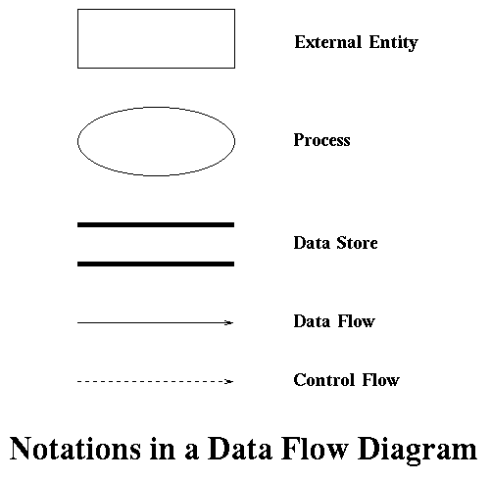
Data Flow Diagram (DFD)

Slide 32
Semantics of DFD
External entity
External to the software; not created by the developers
Interacts with the software, but developer does not know (and cannot assume) its behavior
Following are the rules concerning external entities:
Each external entity has a unique name in the diagram; where there is more than one external entity with the same name, they are merged together to form a single logical external entity.
An external entity can send or receive data.
An external entity can only send control, but cannot receive control from the rest of the diagram; i.e., only the external entity can invoke some functionalities in the diagram, but not in the other way.
An external entity may not be connected to another external entity directly. This is because an external entity is (of course) external to the software under development and hence the communication between the two external entities is not under the control of the software.

Slide 33
Semantics of DFD
Process
Represents an activity or a group of activities to be developed
Similar to procedure or module in a program
The rules given below govern the use of a process:
Each process in a data flow diagram must have a unique name. If more than one process has the same name, then all these processes are merged together to form one single logical process.
Self-looping arrows are not permitted in data flow diagrams (even though they are meaningful in the final implementation).

Slide 34
Semantics of DFD
Data Store
Passive entity
Used to store and retrieve data
No need to specify its format in DFD
A data store is governed by the following rules:
A data store is uniquely labeled. If more than one data store exists with the same name, then they are all merged together to form one single logical data store.
A data store can be connected to a process or to an external entity through a data flow arrow only; hence, there should be no control flow arrows connected to a data store.
A data store may not be connected to another data store directly.

Slide 35
Semantics of DFD (continued)
Data Flow
Carries data between
pair of processes
an external entity and a process
an external entity and a data store
a process and a data store
Control flow
Used by a master to invoke a slave
Used between
From an external entity to a process
From one process to another

Slide 36
Data Flow Arrow
Data flow arrows are governed by the following rules:
A data flow arrow must be labeled; the label indicates one or more names corresponding to the data passed.
It is a good practice to choose labels that are meaningful in the application domain. Sometimes, the diagram may become messy if you choose the same names as in the application domain (example - supervisor, project manager, technical leader, and so on), particularly when there are so many elements in the diagram and the names are long. In such situations, you may use simple or short labels and give the actual meaning of the labels separately, under the title "Legend". Neither the labels nor their meanings have any fixed format or representation or type information. They simply stand for the data being exchanged.

Slide 37
Control Flow Arrow
The following rules are applied to control flow arrows:
A control flow must connect either two processes or connect an external entity and a process.
If it connects two processes, the process at the head of the arrow is invoked/used by the process at the tail end of the arrow.
If it connects an external entity and a process, then the external entity must be at the tail end of the arrow, meaning that the external entity invokes the process.
A control flow is not labeled.
There cannot be more than one control flow between the same two processes or between the same pair of an external entity and a process.

Slide 38
DFD – Example 1
Home alarm system
A computerized home alarm system includes a front panel. This front panel has a keypad and a display unit. Users can configure the system with passwords. All interactions with the alarm system are done through the front panel.When an intruder enters the home, the sensors (part of the alarm system hardware) identify the intrusion and the alarm system raises an alarm. At the same time, the alarm system automatically dials one or more predefined numbers stored in the configuration.

Slide 39
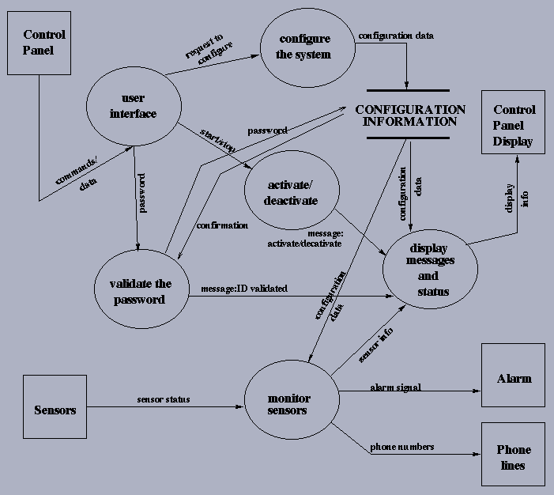

Slide 40
DFD Example 2: A Library
A library maintains a collection of items. The information about all items is kept in a database. The information about users is kept in another database. A user of the library can borrow an item, return an item and reserve an item. Assume that there is no limit to the number of items a user can borrow. Develop a DFD for this problem.

Slide 41
DFD – Example 2: A Library
Data Dictionary
Entity: User
Id: user name or user id
Attributes: name, …
Entity: Item
Id: call number
Attributes: call number, title, year of publication, …
Entity: User Database
Id: Name of the database
Attributes: user entries

Slide 42
DFD – Example 2: A Library (continued)
Data Dictionary (continued)
Entity: Item Database
Id: Name of the database
Attributes: Item entries
Entity: Librarian
Id: name or employee id
Attributes: name, …

Slide 43
DFD – Library -- “Borrow”
User database
User id
User details
Updated user details
User id
User id
Update user details
Verify user
User
Return date
Librarian
Call number
Call number
Issue item
Verify item
Return date
Issued item
Call num
Item details
Item Database
Updated item details

Slide 44
DFD – Library - Exercise
Expand the DFD for the library shown in the previous slide by adding the processes and dataflow corresponding to the two activities “reserve an item” and “return an item”.

Slide 45
Data flow hierarchy
a
P
b
x
y
level 0
a
c
p2
f
p1
p4
g
b
d
p5
p3
e
level 1

Slide 46
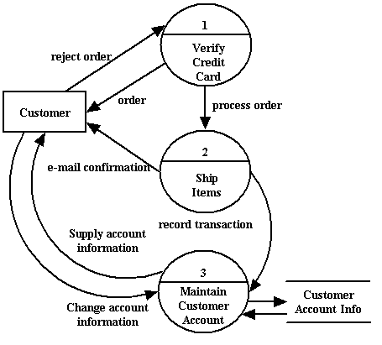
Data Flow Diagram – Example 1
Notes:
- No Title
No labels for the arrows between process 3 Maintain Customer Account to Customer Account info data store
Wong directions: The arrows between Entity Customer and Process Verify Credit Card

Slide 47
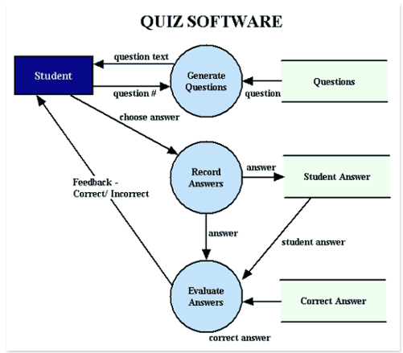
Data Flow Diagram – Example 2
Notes:
Problems:
The data flow arrow from Student Answer Data store to The process Evaluate Answers was not necessary

Slide 48
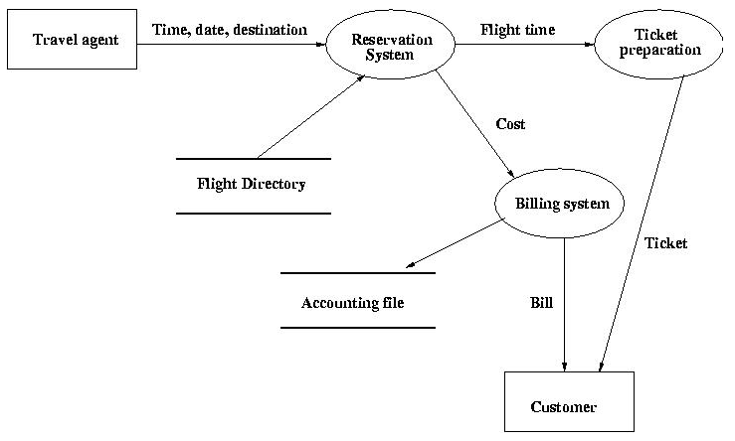
Data Flow Diagram – Example 3
Notes:
No title for the diagram
Some data flow arrows do not have labels
No need for Travel agent this external entity, since there is no connection between Travel Agent and Customer.

Slide 49
State machine models
Model the behaviour of the system in response to external and internal events
Show the responses to a stimuli so are often used for modelling real-time systems
M=(S,I,T, F, s0), where
S is a finite nonempty set of states
I is a finite nonempty set of inputs
T is a function from S X I to S
called the transition function
s0 S is the initial state
F is a finite set of terminal states

Slide 50
State Transition Diagrams
Graphic representation of a state machine
Nodes represent states
Arrows(directed edges) represent transitions
The annotations on the edges represent events and actions

Slide 51
State Transition Diagram - notations
State name
State
Initial state
Name of transition
Transition
Final state
[condition]

Slide 52
State Transition Diagram - Semantics
Initial state
Does not have any incoming arrow
There can be more than one initial state
Final state
Does not have any outgoing arrow
There can be more than one final state

Slide 53
State Transition Diagrams
Describe control specifications
Indicate the “change of state” for each object separately
Many objects may not have any interesting state transition diagrams
Example: phone entry in the phone book
Consequence: draw the state transition diagrams for only those objects which are significant

Slide 54
State Diagrams
A state diagram describes the behaviour of a system, some part of a system, or an individual object
At any given point in time, the system or object is in a certain state
Being in a state means that it is will behave in a specific way in response to any events that occur
Some events will cause the system to change state
In the new state, the system will behave in a different way to events

Slide 55
States
At any given point in time, the system is in one state
It will remain in this state until an event occurs that causes it to change state
Defined by a collection of values for the objects (must be unique for a given state)
Not all possible states are represented; only interesting and important states are represented

Slide 56
Transitions
A transition represents a change of state in response to an event
It is considered to occur instantaneously
The label on each transition is the event that causes the change of state
Optionally, it may have a condition; in this case, a transition is fired/invoked only if the condition is satisfied

Slide 57
Some guidelines for drawing a STD
Select only those objects which change the state
Example: an ID # will not change and hence does not contribute to state changes
The name of a state must not represent an action
Example: “calculate tax” is not a state; it is an action carried out inside a state or to change a state.
There must be an initial state
Specify all possible transitions that might occur between states

Slide 58
STD – Example 1 Item in a library
return
In-shelf,
unreserved
borrow
Borrowed,
unreserved
reserve
return
reserve
Borrowed,
reserved
return
In-shelf,
reserved
borrow
reserve
Notes:
Return to In-shelf unreserved
-- how about one book has several copies

Slide 59
STD for Library - Explanation
The states are defined based on the status of a library loan item
The diagram specifies the state changes for only one item in the library

Slide 60
STD – Example 2 User in a library
return
Not borrowed,
Not reserved
borrow
Borrowed,
Not reserved
borrow
return
Borrowed
maximum
reserve
reserve
return
Reserved,
Not borrowed
borrow
Borrowed,
Reserved
borrow
return
reserve
reserve

Slide 61
STD for Library - Explanation
The states are now defined based on the status of a user
The diagram shows the state changes for only one user in the library
It may look very similar to the STD for an item, but there are subtle differences

Slide 62
STD – Example 3
Develop the STD for the objects in the phone book.
Are there any interesting state transition diagrams?

Slide 63
Example 4
State Transition Diagram for a garage door
Closed
pressButton
Opening
pressButton
closingCompleted
openingCompleted
Closing
pressButton
Open

Slide 64
Guarded Transition
A guard is a predicate expression associated with an event
A guarded transition can not fire unless
The system is in the accepting state for this transition
The guarded event occurs
The guarded predicate evaluates to true
A transition without an explicit guard is equivalent to a transition with a guard of true

Slide 65
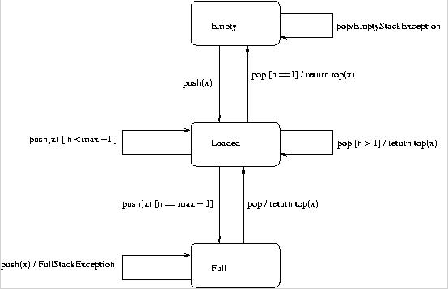
Example – Stack Model

Slide 66
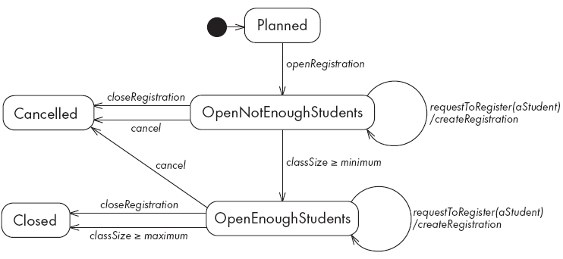
State Diagram of a CourseSection class

Slide 67
Statecharts
Statecharts are an integral part of the UML
Model the control requirements of complex reactive systems
Overcome the basic finite state machine’s scalability and concurrency limitations
State hierarchy: an aggregate of other states(a superstate)
Concurrent
Synchronization: a single event causes simultaneous transitions in several machines.

Slide 68
StateChart
A
D
E
B
C
F
State Hierarchy and Concurrent

Slide 69
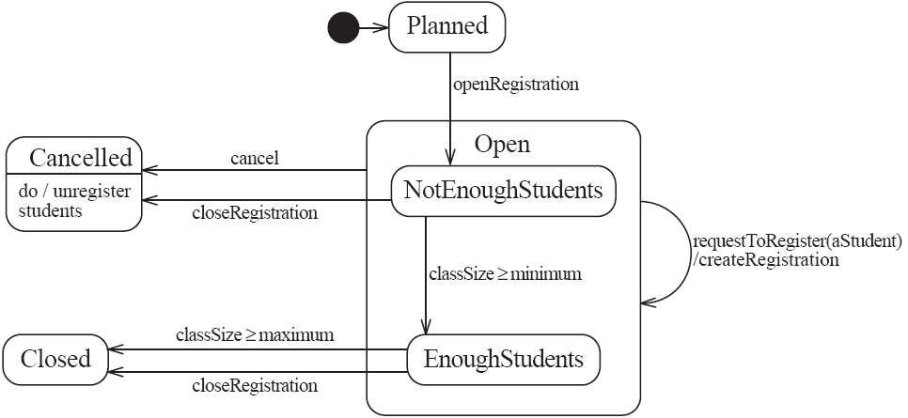
State diagram – an example with substates

Slide 70
Implementing
Planned
closedOrCancelled ==false && open ==false
Open (accepting registrations)
open == true
NotEnoughStudents (substate of Open)
open ==true && registrationList.size() < course.getMinimum()
EnoughStudents (substate of Open)
open ==true && registrationList.size() >= course.getMinimum()
Cancelled
closedOrCalcelled == true && registrationList.size()==0
Closed (course section is too full or being taught)
closedOrCancelled == true && registrationList.size() > 0

Slide 71
public class CourseSection {
private Course course;
private List registrationList;
//the following are presnt only to determine the state
// The initial state is Planned
private boolean open = false;
private boolean closedOrCancelled = false;
public CourseSection(Course course) {
this.course = course;
registrationList = new LinkedList();
}
public void openRegistration() {
if(!closedOrCancelled) { //must be in Planned state
open = true;
}
}
public void closeRegistration() {
//to Cancelled or Closed state
open = false;
closedOrCancelled = true;
if(registrationList.size() < course.getMinimum()) {
unregisterStudents(); // to Cancelled state
}
}

Slide 72
public void cancel() {
// to Cancelled state
open = false;
closedOrCancelled = true;
unregisterStudents();
}
public void requestToRegister(Student student) {
if(open) { // must be in one of the two Open states
Course prereq = course.getPrerequisite();
if(student.hasPassedCourse(prereq)) {
// indirectly calls to addToRegistrationList
new Registration(this,student);
}
// check for automatic transition to Closed state
if(registrationList.size() >= course.getMaximum()) {
// to Closed state
open = false;
closedOrCancelled = true;
}
}
}

Slide 73
// private method to remove all registrations
// activity associated with Cancelled state
private void unregisterStudents() {
Iterator it = registrationList.iterator();
while(it.hasNext()) {
Registartion r = (Registration)it.next();
r = unregisterStudent();
it.remove();
}
}
//Called within this package only, by the constructor of
// Registration to ensure the link is bidirectional
void addToRegistrationList(Registration newRegistration) {
registrationList.add(newRegistration);
}
}

Slide 74
Synchronous Communication
A1
B2
e
e
f
g
h
B1
A2
B3
k
State Machine A
State Machine B
Synchronous communication, shared event e

Slide 75
Synchronous Product Machine
Construction using Breadth-first search Algorithm
A2B1 is non-reachable state
A1B1
k
e
A1B3
A2B2
f
f
h
g
g
h
A1B2
f
A2B3
Notes:
When no more new state is generated, stop construction algorithm

Slide 76
Object-Oriented Analysis/Design
OO method
Identify the classes
Analysis/design the relationship among classes
Use case diagram
Class diagram
Sequence diagram
Collaboration diagram
Activity diagram
Component diagram
Deployment diagram
Implement each class and their relationship

