Slide 1
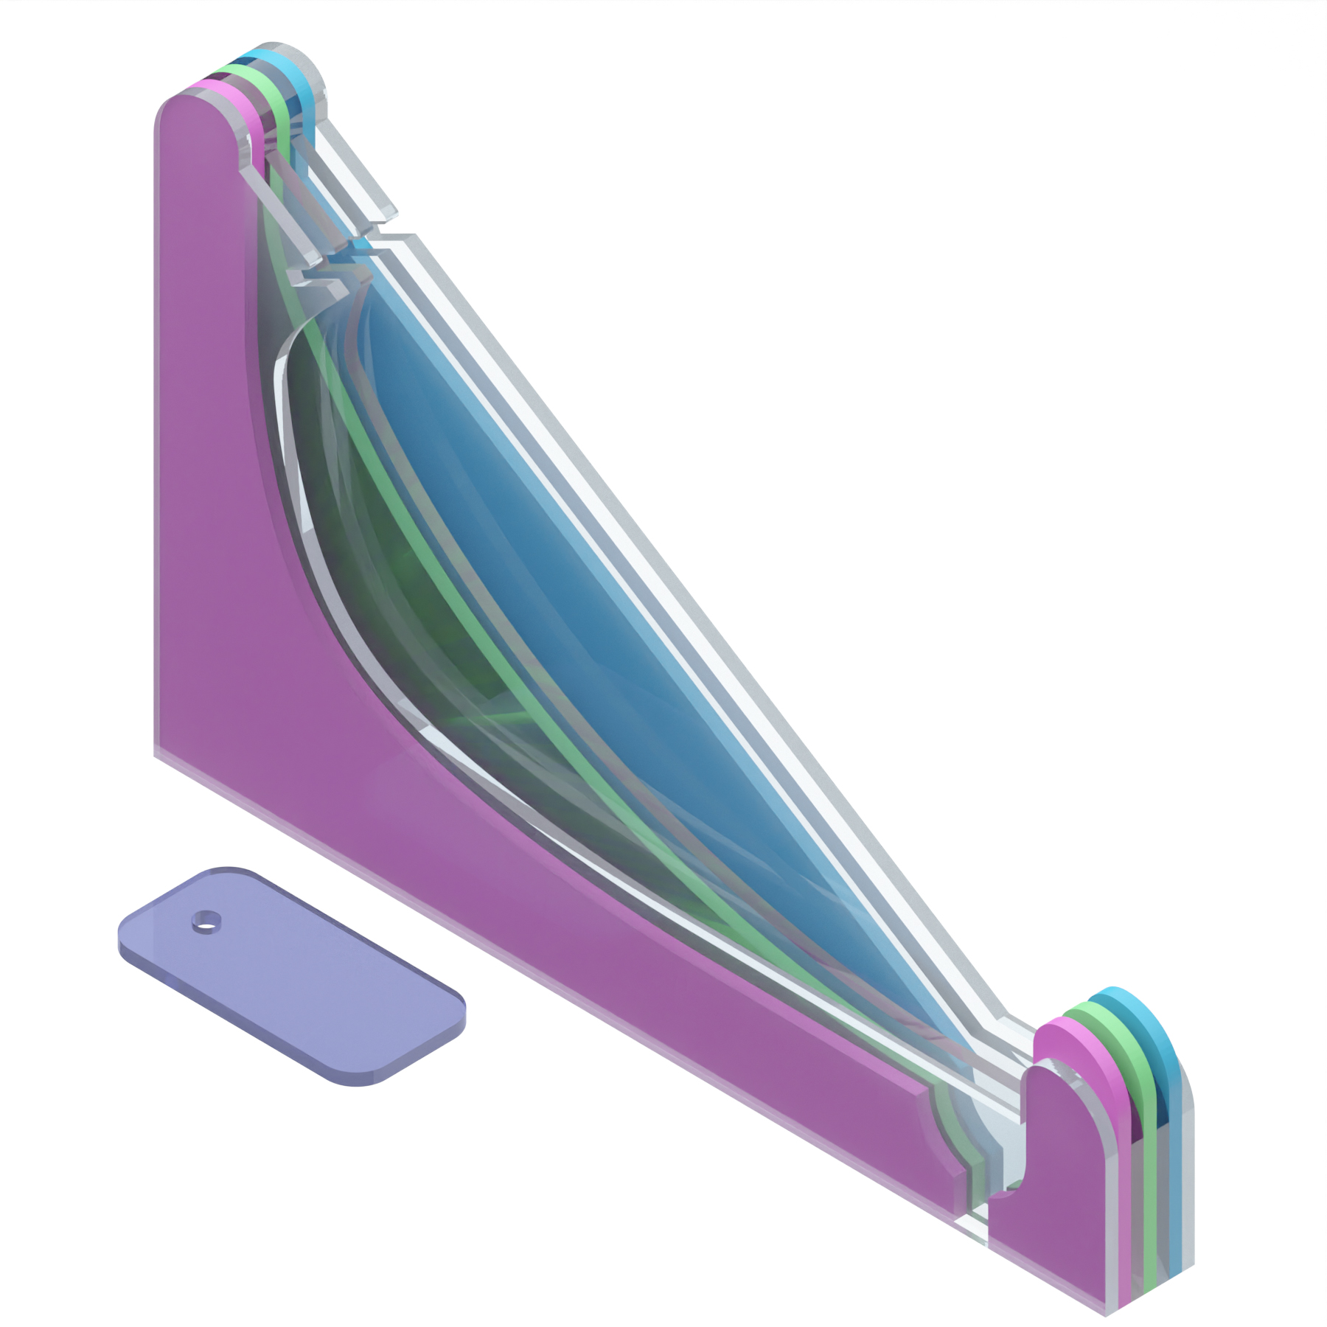
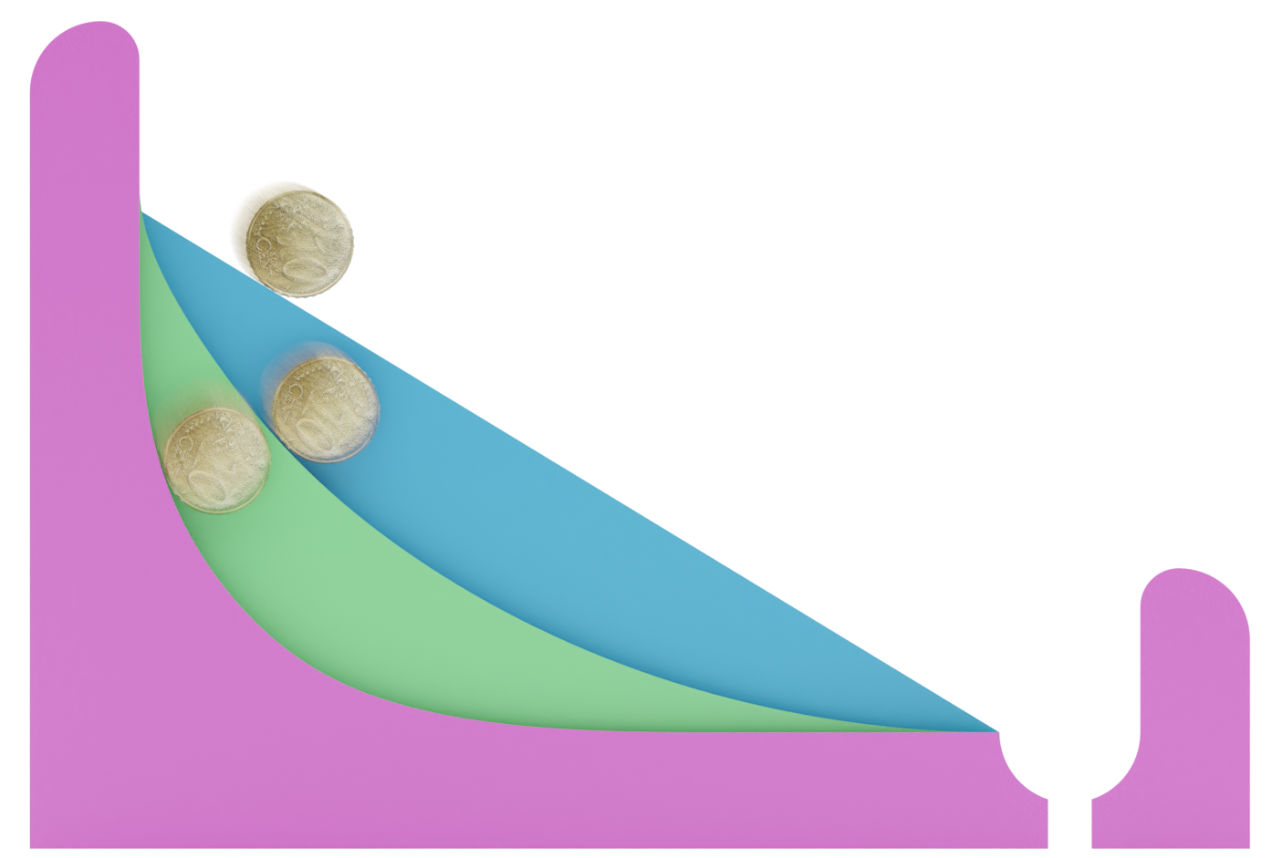
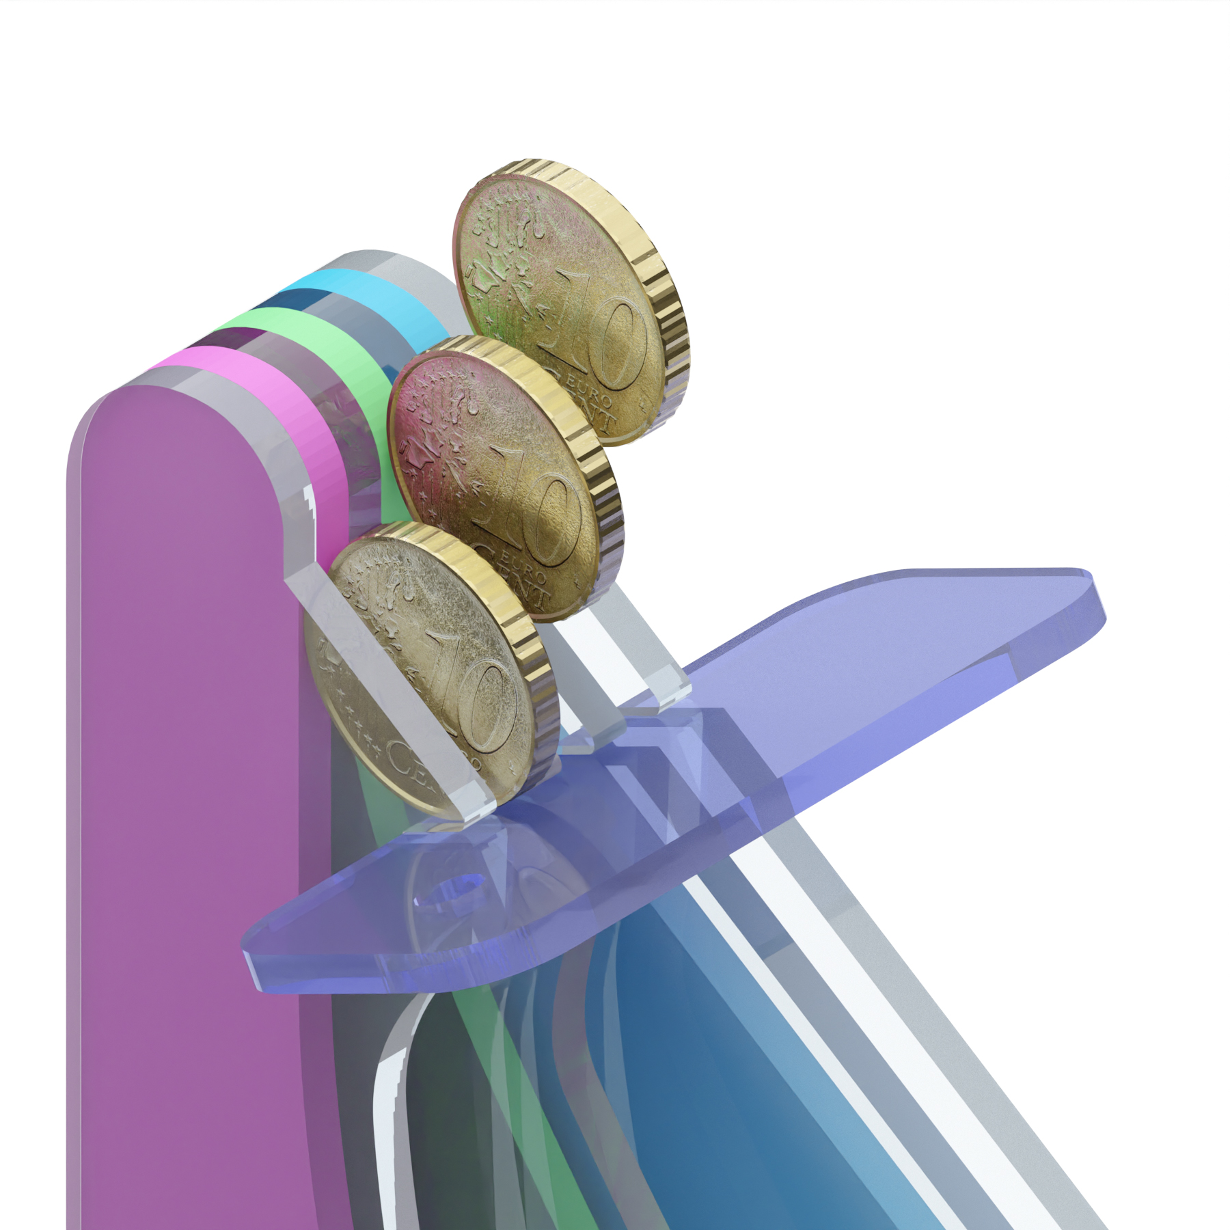
2
1
minimum distance
?
maximum speed
Place the rectangle “starting line” in the slot.
Put 3 coins at the top of the slopes. (10c coins are recommended)
Remove the starting line and watch the coins roll down the slopes.
Which coin reaches the finish line first?
113% is ~1:1 scale

