Slide 1
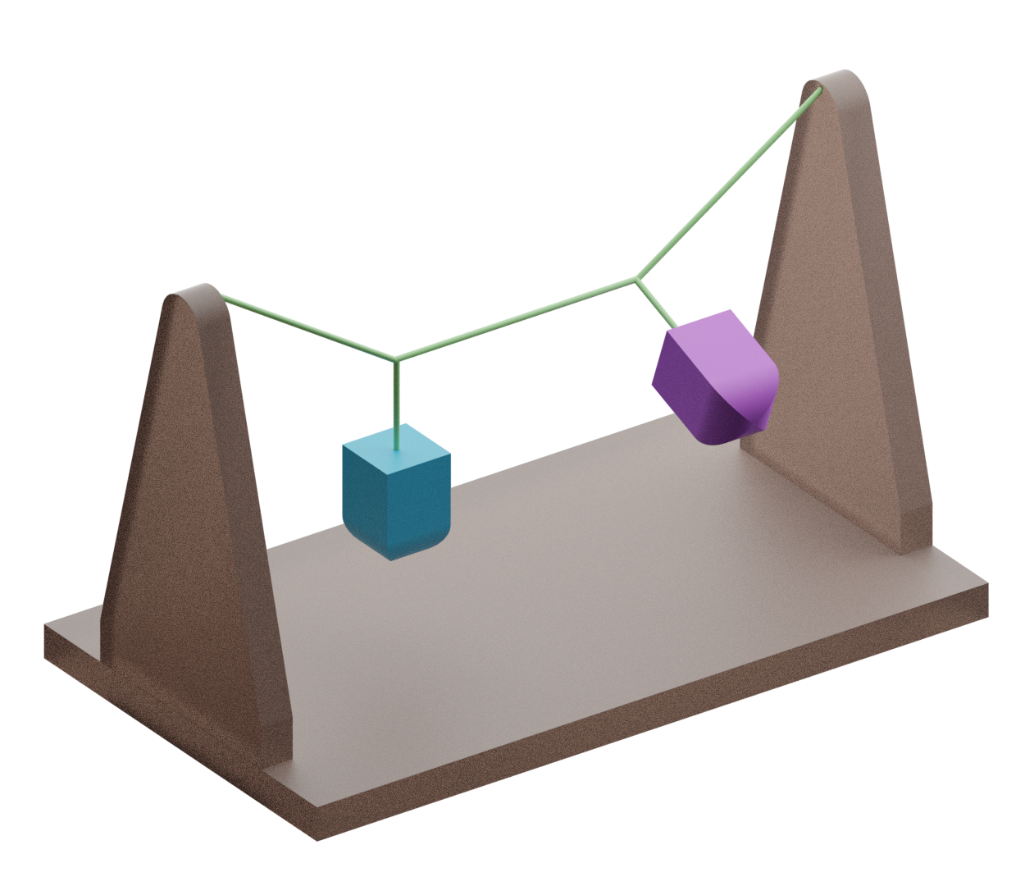


Coupled Oscillators
Why does this happen?
As one pendulum swings, it pulls on the string that connects it to the other pendulum.
This pulling of the string builds up the swinging of the other pendulum. When this happens, it also pulls on the string and slows down the first pendulum.
This repeats over and over until the pendulums have lost all their energy to friction.
Start one pendulum by letting it swing.
Watch as the pendulums take turns swinging.
Stop 1
of 8
Centre of Mechanics
Mechanics Fun Walk
Next stop: UCD Quinn School of Business

