Slide 1
This document requires the following fonts: Nunito Roboto Slab These can be downloaded from https://fonts.google.com/

Slide 2



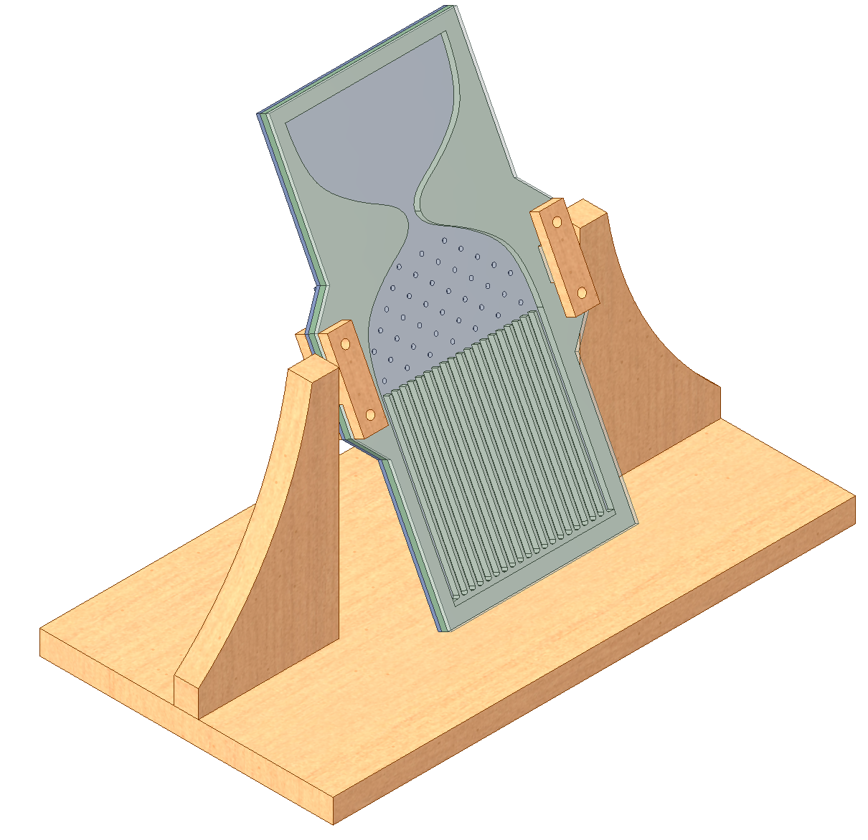
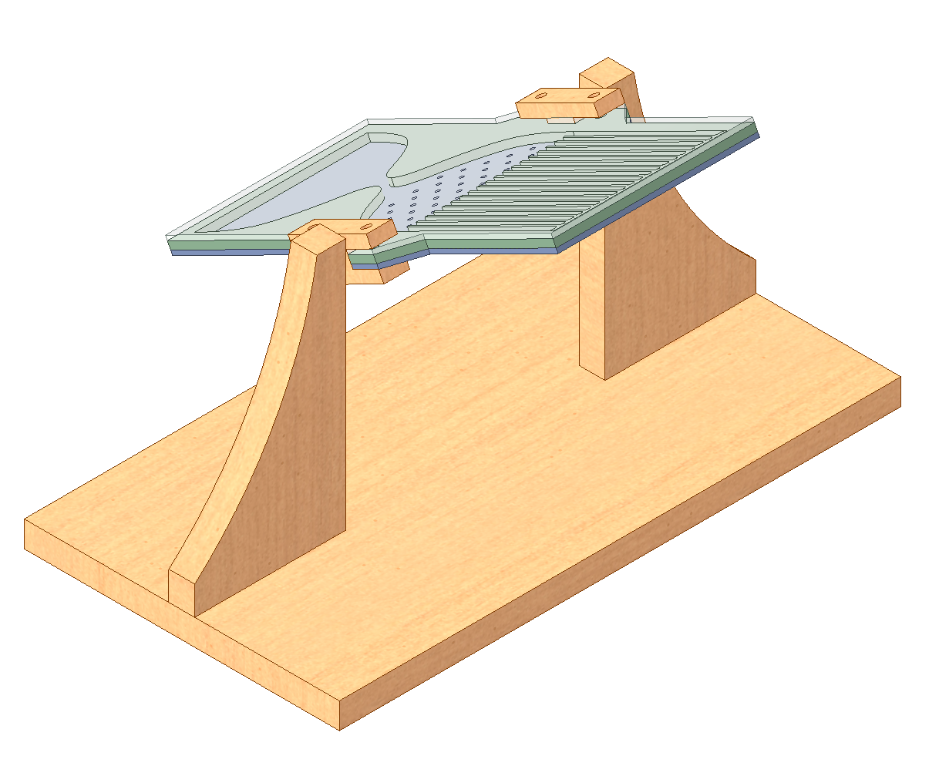


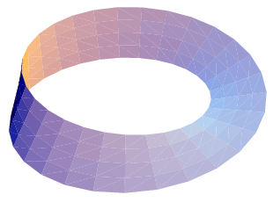
Galton Board
Scan for mechanical explanation!
➔
Which way?
1
½
½
Photo of normal distribution formed in our Galton Board
½
½
½
½
½
½
⅛
½
⅛
Stop 1
of 8
Centre of Mechanics
Mechanics Fun Walk
Where an individual ball goes is random and unpredictable. But, but balls form the same pattern every time*! How?
*Try it!
Rotate the board to let the balls fall into the funnel, then again for the balls to fall into the bins
The pegs scatter the balls randomly as they fall through
Next stop: UCD Quinn School of Business

