Slide 1
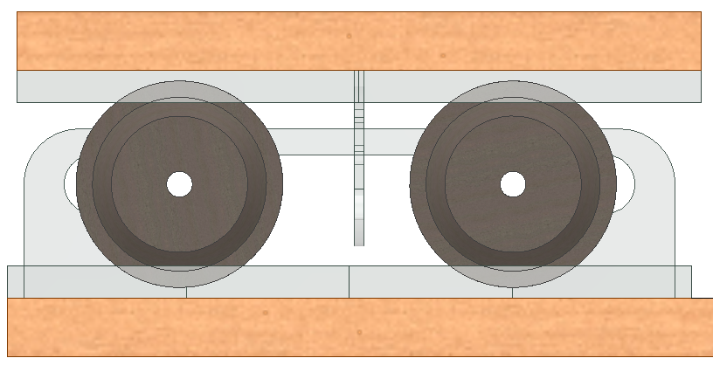


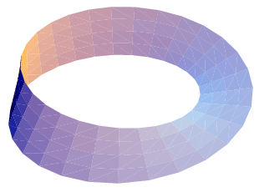
Spontaneous Synchronization
1
2
Photography or render required
Photography required
Centre the rollers and platform as shown.
Set the metronomes to the same frequency by sliding the part shown.
(176 BPM is recommended)
3
4
The metronomes will start out of synchrony and will synchronise by themselves after some time.
Please treat the metronomes gently. Thank you ☺
Photography required
Photography required
Start the metronomes individually by lightly pushing the arm.
Wind up the metronomes
Scan for mechanical explanation!
Stop 1
of 8
Centre of Mechanics
Mechanics Fun Walk
➔
Next stop: UCD Quinn School of Business
113% is ~1:1 scale at 163 ppi

