Slide 1
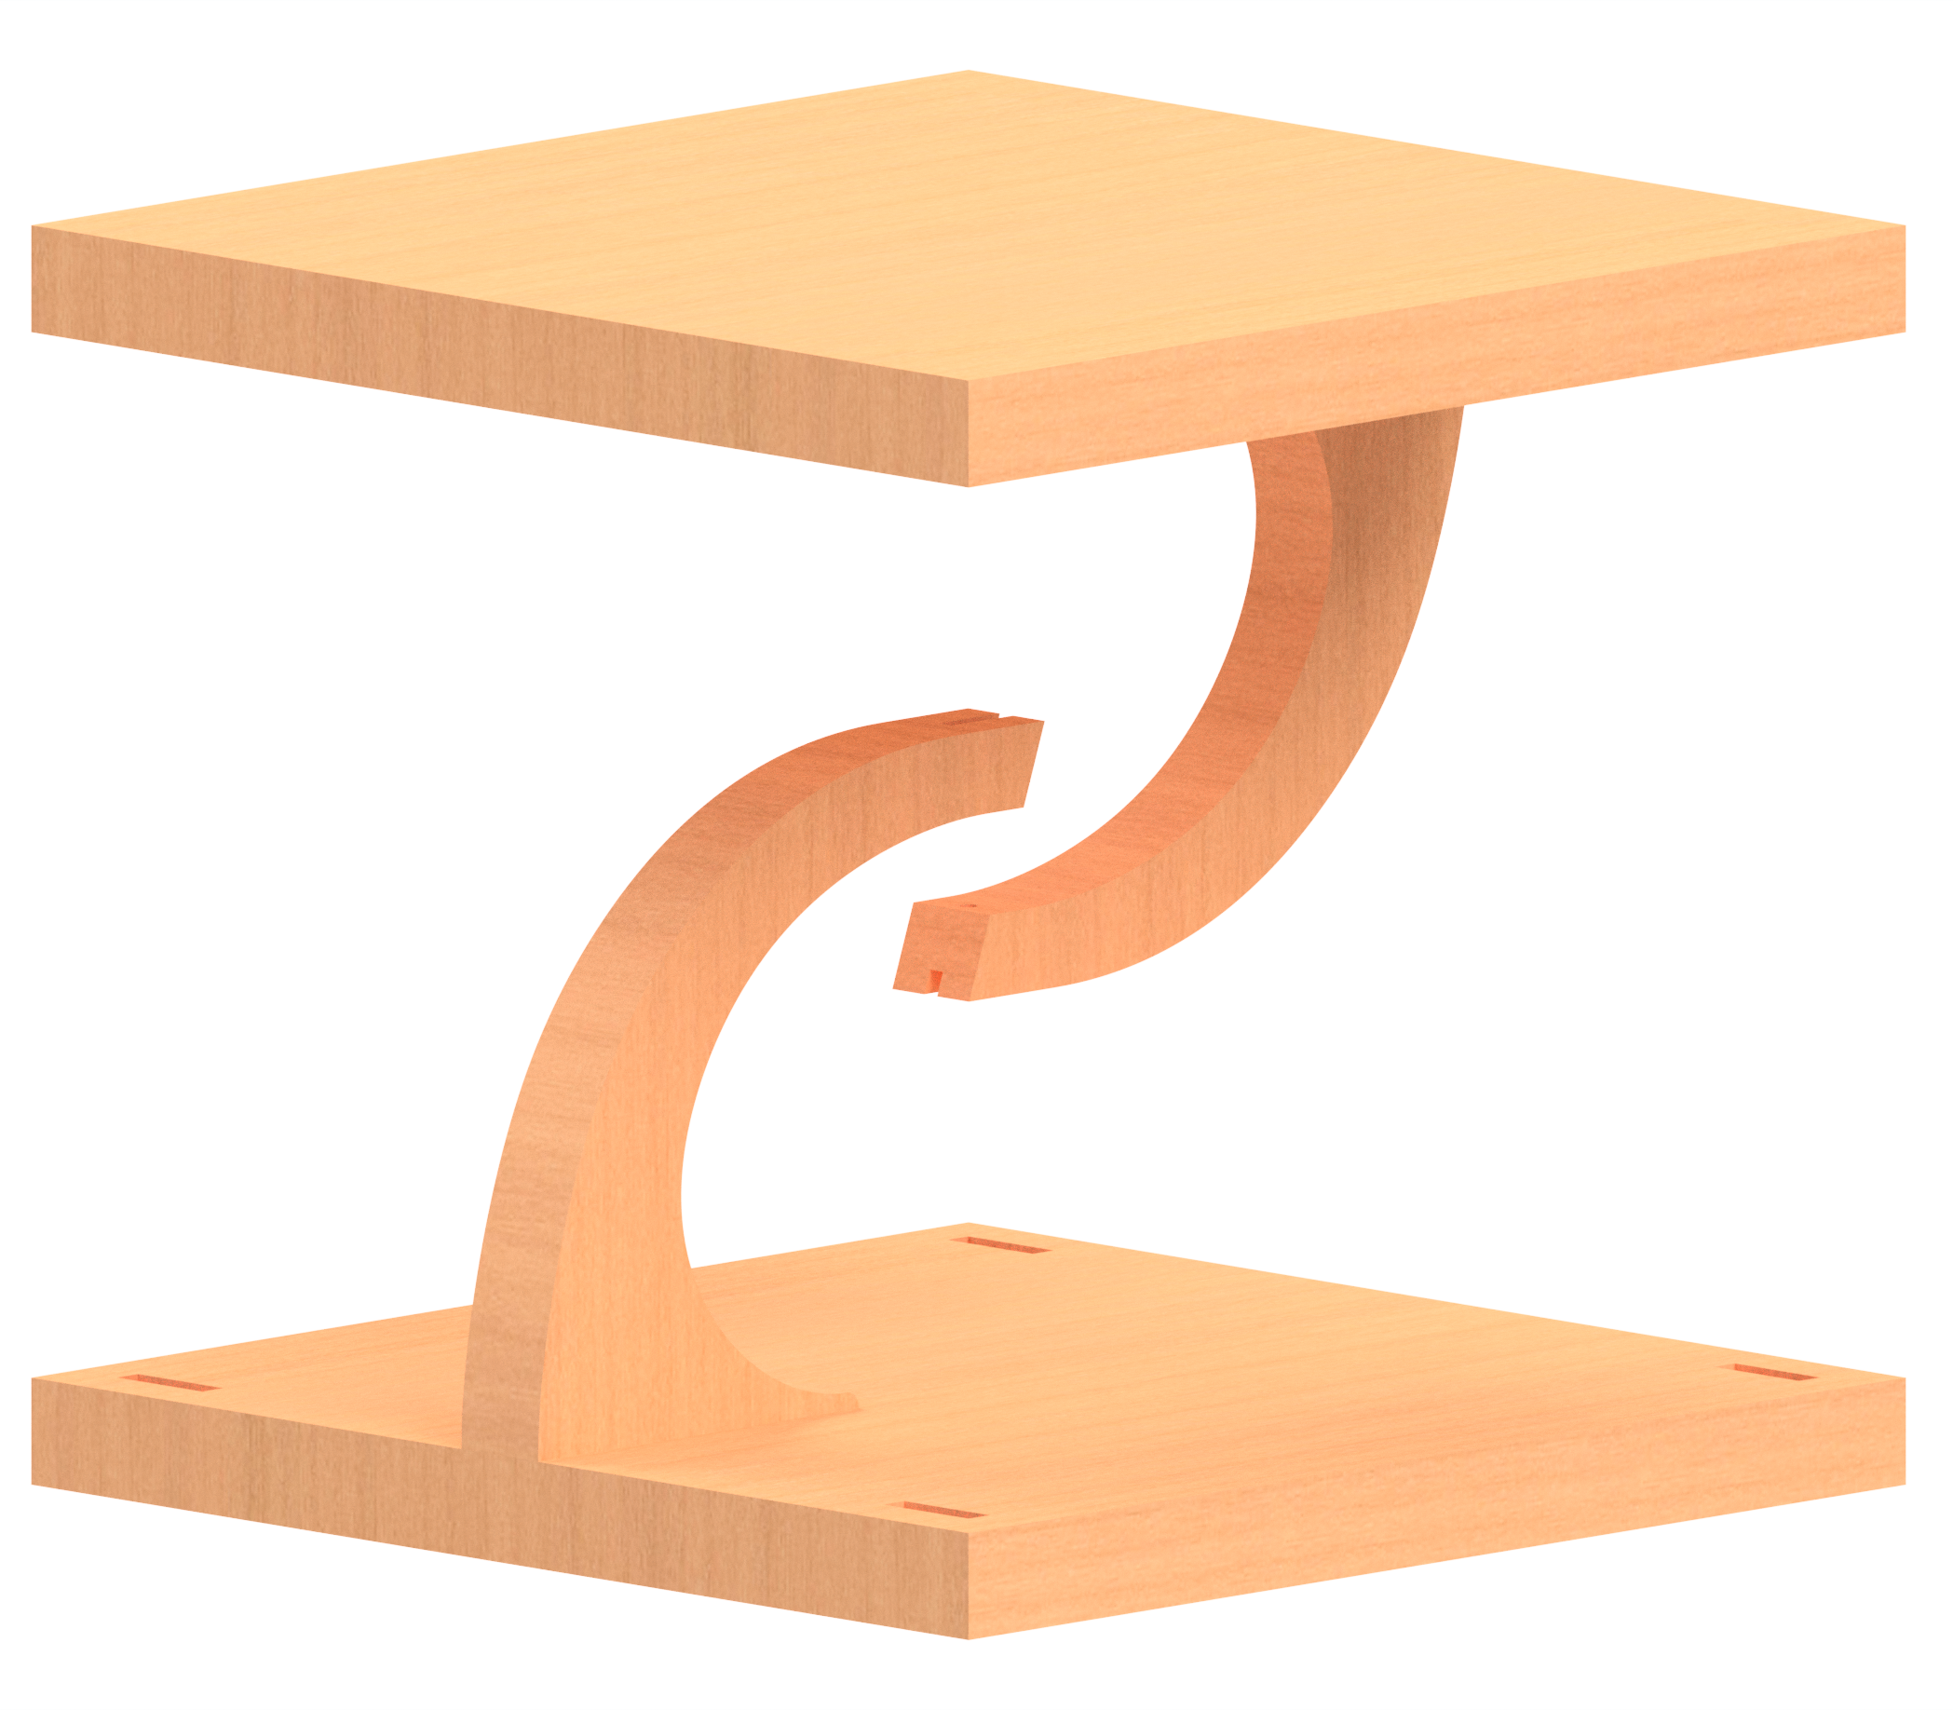
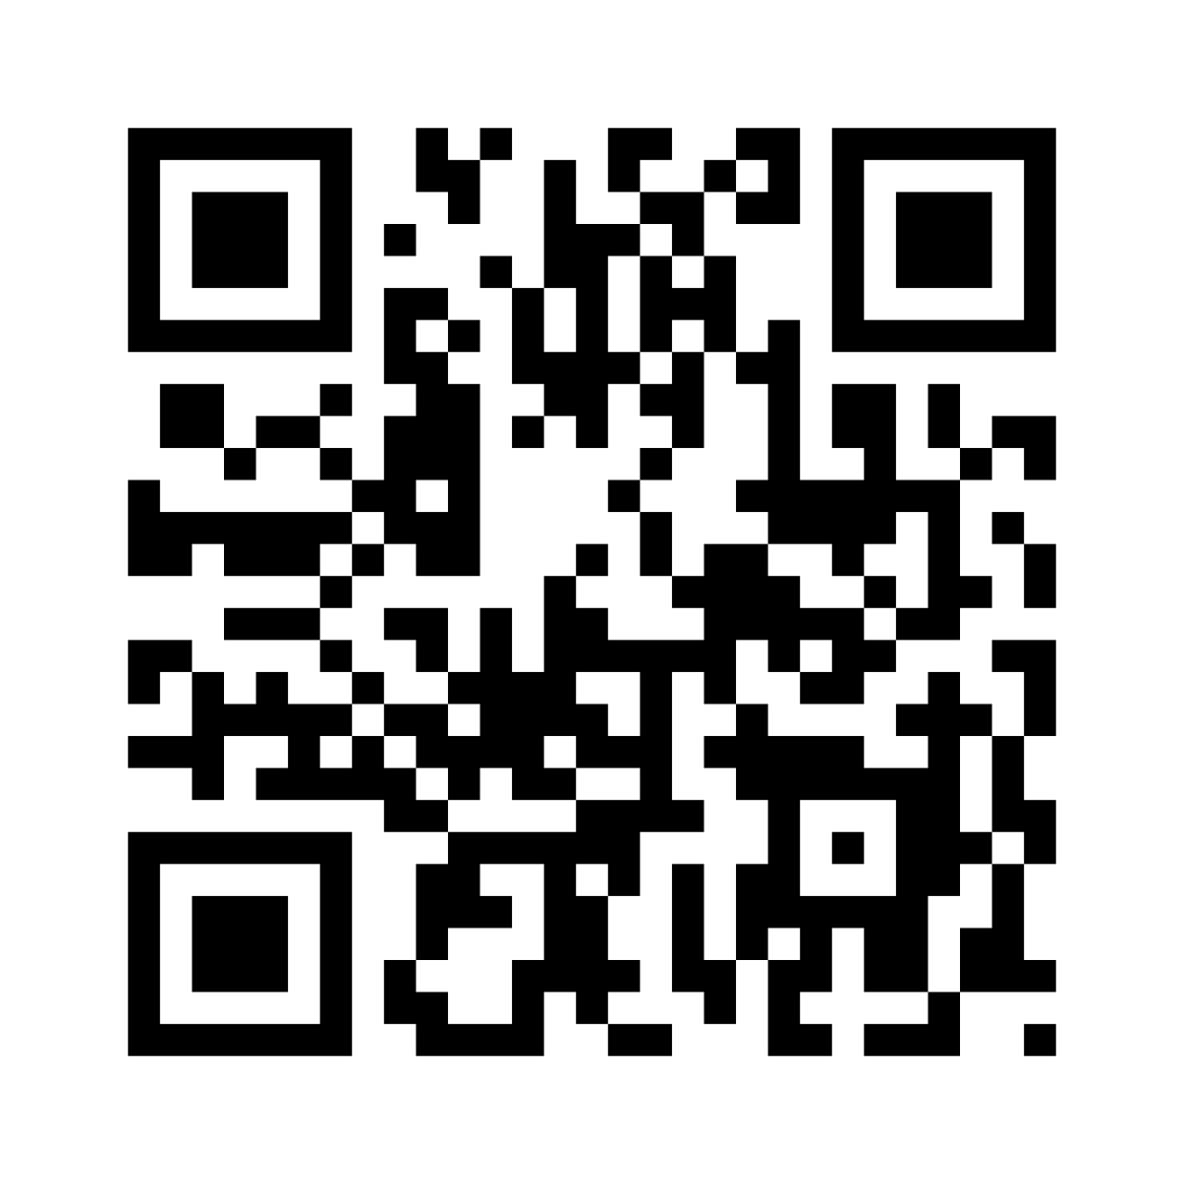

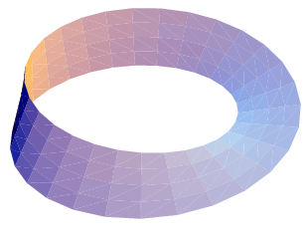
Tensegrity
The top platform looks like it’s floating, but it isn’t.
It is being held up entirely by string.
How is this possible?
Hint: It’s all about tension. The top is hanging off the bottom.
Scan for mechanical explanation!
Stop 1
of 8
Centre of Mechanics
Mechanics Fun Walk
➔
Next stop: UCD Quinn School of Business

