Slide 1
KAFKA STREAMS
arturo.tarin.villaescusa@ikano.se
Notes:
30

Slide 2
Kafka Streams features
It is a library (jar) that greatly facilitates the processing and transformation of data stored in Kafka.
It is not an external component, it is a standard Java application, perfectly synchronized with Kafka's engine
To use it you don't need a separate cluster, unlike if you decide to use Nifi, Flink, Lightbend Fast Data platform or Spark: just include in your Java code the Kafka Streams package and that's it.
It is horizontally scalable, fault-tolerant and elastic. Why? Because it inherits each and every feature of the Kafka engine
It allows the delivery of "Exactly-Once" messages. There is no one in the world that does it, except Kafka 0.11, and by extension, Kafka Streams
Processes record by record, does not execute record batches: this is real time streaming
It works well for any size: you will use the same code, regardless if you are doing a large project, or if you are just testing a main() console application, like the one we will see later in our examples.
1

Slide 3
What does it make different Kafka Streams to other streaming frameworks like Nifi, Spark Streaming o Flink
Kafka Streams does record to record streaming (real time) Spark Streaming does micro batches
Kafka Streams does not require an additional machine cluster
The Kafka Streams developer should only be concerned with solving his code, without worrying about how it will affect the performance of the physical cluster that will run it
Kafka Streams scales easily, simply by adding one more java process to the group
Kafka Streams is the only framework that implements "Exactly-once" semantics
1

Slide 4
KSTREAMS FEATURES
The only operation that allows Kstreams is to insert records
It is like a log, an ordered sequence of messages, like a Topic
It is infinite
It is powered by Data Streams
Time line
Topic (key, value)
KStream
t0
(Pilar, 1)
(Pilar, 1)
t1
(Antonio, 4)
(Pilar, 1)
(Antonio, 4)
t2
(Pilar, 2)
(Pilar, 1)
(Antonio, 4)
(Pilar, 2)
4

Slide 5
KTABLES FEATURES
It makes upserts in non-null value records
It makes deletions in null value records
It is similar to a database table
There is a strong correlation with log compacted topics
Time line
Topic (key, value)
KTable
t0
insert
(Pilar, 1)
(Pilar, 1)
t1
(Antonio, 4)
insert
(Pilar, 1)
(Antonio, 4)
t2
update
(Pilar, 2)
(Pilar, 2)
(Antonio, 4)
t3
(Antonio, null)
delete
(Pilar, 2)
5
(Antonio, 4)

Slide 6
WHEN TO USE KSTREAMS AND WHEN TO USE KTABLES?
KStream
When we read from an uncompacted Topic
When new data arrives is partial information or transactional information
Ktable
When we read from a compacted Topic (in which aggregations have been made)
When your application needs to use a structure that has a behavior similar to a database table, in which we want to make updates, inserts and deletes
6

Slide 7
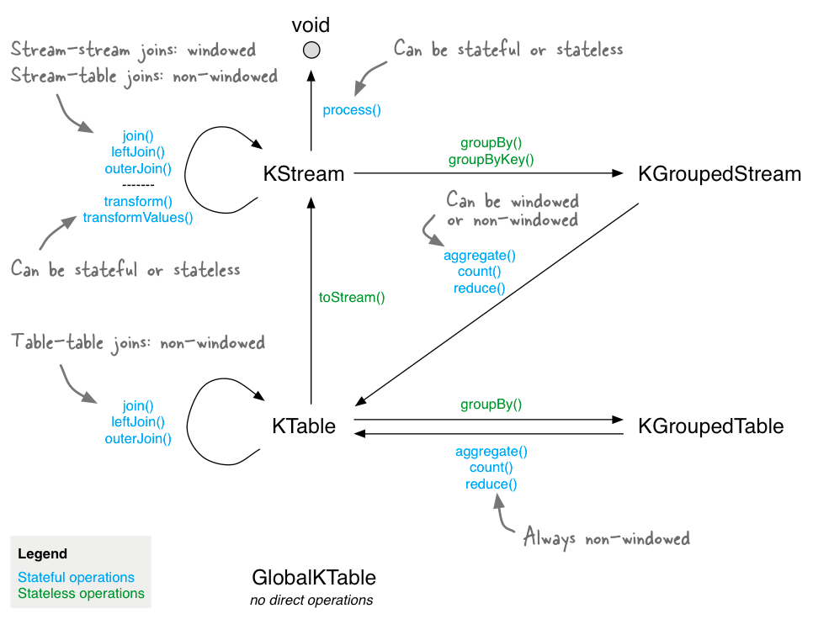
KSTREAMS & KTABLES: STATELESS & STATEFUL OPERATIONS
6

Slide 8
KSTREAMS & KTABLES: STATELESS & STATEFUL OPERATIONS
Stateless
the result of a transformation depends only on the data you are currently processing
  For example: "multiply the value of the record by two" is a stateless operation, because it is not necessary to know historical data to perform it:
    (null, 1) => 2
    (null, 7) => 14
    (null, 100) => 200
Stateful
The result of the transformation depends on external information, the "state”
  For example: "count" is a stateful operation, because the application needs to know what has happened since its execution started in order to obtain the result
    (null, “hola”) => (“hola”, 1)
    (null, “hola”) => (“hola”, 2)
    (null, “adios”) => ((“hola”, 2), (“adios”, 1))
8

Slide 9

KAFKA STREAMS PROCESSOR API
9
Notes:
30

Slide 10
The Processor API allows developers to define and connect custom processors and to interact with state stores. With the Processor API, you can define arbitrary stream processors that process one received record at a time, and connect these processors with their associated state stores to compose the processor topology that represents a customized processing logic.
The Processor API can be used to implement both stateless as well as stateful operations, where the latter is achieved through the use of state stores.
There are a number of scenarios where using the Processor API may be helpful:
Customization: we need to implement special customized logic that is not or not yet available in DSL.
Combination of easy-of-use with full flexibility where it is needed: even though we generally prefer to use the expressiveness of DSL, there are certain steps in our processing that may require more flexibility and tinkering than the DSL provides. For example, only the Processor API provides access to record's metadata such as topic, partition and offset information. However, we don't want to switch completely to the Processor API just because of that.
Migrating from other tools: we are migrating from other stream processing technologies that provide an imperative API, and migrating some of our legacy code to the Processor API was faster and/or easier than to migrate completely to the DSL right away.
9

Slide 11
KAFKA STREAMS DSL
11
Notes:
30

Slide 12
The Kafka Streams DSL (Domain Specific Language) is built on top of the Streams Processor API. It is recommended for most users, especially beginners. Most data processing operations can be expressed in just a few lines of DSL code.
11

Slide 13
STREAMS DSL: KSTREAMS & KTABLES
SIMPLE (STATELESS) OPERATIONS
13
Notes:
30

Slide 14
KAFKA STREAMS STATELESS OPERATIONS
We will see
KStream and KTable duality
Log compaction
Stateless transformations are these. Click on each link to see an example:
Map / MapValues Filter / FilterNot FlatMap / FlatMapValues toStream() Read/write from/to Kafka Foreach() group() / groupBy() / groupByKey() / coGroup() | branch() Merge() Peek() Print() Repartition() SelectKey() Stream to table / Table to stream
Let’s see a few of them in detail. For exhaustive explanations and full examples click on
each link in this slide
13

Slide 15
STATELESS OPERATIONS: MapValues / Map
Read a record and produce a record
mapValues: Kstream → Kstream / Ktable → Ktable (click to see full example):
only modifies values, not keys, so it does not produce distribution
It is for Kstreams and Ktables
map: KStream -> Kstream (click to see full example):
Modifies keys and values. Any change in the keys produces distribution
It is only for Kstreams
Kstream<byte[], String> uppercase = streams.mapValues(value -> value.toUpperCase());
(key1, Value1)
(key1, VALUE1)
15

Slide 16
STATELESS OPERATIONS: Filter / FilterNot
Read a record and produce one or no record
filter: KStream -> KStream / KTable -> KTable
It does not modify either keys or values, so it does not produce distribution
It is for Kstreams and Ktables
filterNot: KStream -> KStream / KTable -> Ktable
It is the inverse of Filter
Kstream<byte[], String> positives = streams.filter((key, value) -> value > 0);
(key1, 5)
(key1, 5)
(key2, -105)
removed
16

Slide 17
STATELESS OPERATIONS: FlatMapValues / FlatMap
Read a record and produce one or more records
flatMapValues: KStream -> KStream
It does not modify the keys, so it does not produce distribution
It is for Kstreams only
flatMap: KStream -> KStream
Modifies the keys, so it produces distribution
It is for Kstreams only
Kstream<byte[], String> palabras = streams.flatMapValues(value -> Arrays.asList(value.Split(“\\s+”)));
(key1, Kafka)
(key1, Kafka Streams rules)
(key1, Streams)
(key1, rules)
17

Slide 18
STATELESS OPERATIONS: Branch
branch: KStream -> Kstream[]
Divide a Kstream into multiple child Kstreams based on one or more predicates.
Predicates are evaluated in order, and records are deleted if none of the predicates match
Kstream<String, Long>[] branches = stream.branch(
(key, value) -> value > 100,
(key, value) -> value > 10,
(key, value) -> value > 0);
(key1, 300)
(key3, 150)
(key1, 300)
(key2, 11)
(key3, 150)
(key4, 3)
(key2, 11)
(key4, 3)
18

Slide 19
STATELESS OPERATIONS: Branch
stream
branches[0] > 100
branches[1] (> 10)
branches[2] (> 0)
Deleted
Time Line
t0
(key1, 1)
(key1, 1)
t1
(key2, 20)
(key2, 20)
(key1, 1)
t2
(key2, 200)
(key2, 200)
(key2, 20)
(key1, 1)
t3
(key3, 12)
(key2, 200)
(key2, 20)
(key1, 1)
(key3, 12)
t4
(key4, -400)
(key2, 200)
(key2, 20)
(key1, 1)
(key4, -400)
(key3, 12)
t5
(key5, 345)
(key2, 200)
(key2, 20)
(key1, 1)
(key4, -400)
(key5, 345)
(key3, 12)
19

Slide 20
STATELESS OPERATIONS: selectKey
selectKey: KStream -> KStream
Assigns a new key to the registry, so the registry is marked for distribution.
It is best to do this operation at the end of the list of transformations, so that it applies in isolation to the smallest group of records possible. That way it will consume less network resources, because the set of records to move will be smaller.
keyChangedStream = stream.selectKey((key, value) -> key.substring(0, 1));
(key01, Kafka)
(k, Kafka)
20

Slide 21
STATELESS OPERATIONS: read data from Kafka
You can read data like Kstream, Ktable and GlobalKtable.
Their syntax is similar, but they do not have the same behavior, as we have seen before.
KStream<String, String> wordCountInput = builder.stream("streams-topic");
KTable<String, String> wordCountInput = builder.table("streams-topic");
GlobalKTable<String, String> wordCountInput = builder.globalKtable("streams-topic”);
21

Slide 22
STATELESS OPERATIONS: write data back to Kafka
You can write in Kafka any Kstream and Ktable.
If you are going to write a Ktable, the target Topic must have "log compaction" enabled, because it will help optimize the recovery time from failures and the use of space.
To (terminal operation): write records in a Topic. Any change in the stream or table will be written to Kafka's "destination-topic":
stream.to(“destination-topic");
table.to(“destination-topic");
through: writes records in a Topic and returns a kstream or a ktable, to allow us to continue transforming the records of the original stream or table. Any changes to the stream or table will be written to Kafka's destination-topic:
KStream<String, Long> newStream = stream.through(“destination-topic");
KTable<String, Long> newTable = table.to(“destination-topic");
22

Slide 23
WHEN KSTREAMS are marked for repartition
As soon as an operation changes any registration key, the stream is marked for distribution:
Map
flatMap
SelectKey
Use these operations only when you have to change the password. If you don't need to change it, use these other operations:
MapValues
FlatMapValues
The distribution is made by Kafka when the key changes. Repartition forces the reorganization of records among Kafka Streams' workers, sending the records to the corresponding worker, so that all records with the same key are in the same worker.
This reorganization has an associated cost in network and disk consumption, since the repartition makes use of intermediate Topics with name ending in "repartition".
23

Slide 24
KTABLES log compaction
It optimizes the performance of operations with Ktables, since it discards records that are grouped from time to time.
This results in having to do less readings to disk to obtain the final state, and also to recover the state after possible failures
Log compaction must be activated manually in the Topics where this feature is required
Log compaction guarantees that the log (topic) contains at least the last known value for a particular key in a partition of the Topic.
It is very useful when we need a state snapshot (Ktable) instead of a change history (Kstream)
The essential idea is that log compaction keeps the last update that has been made to a key in the log (topic)
24

Slide 25
KTABLES: log compaction example
Time line
employee-salary topic
employee-salary topic (after log compaction)
(key1, {“juan”:8000})
(key1, {“juan”:8000})
segment 0
(key2, {“marcos”:9000})
segment 0
(key2, {“marcos”:9000})
(key3, {“elisa”:10000})
(key3, {“elisa”:10000})
Log compaction
(key1, {“juan”:8500})
(key1, {“juan”:8500})
segment 1
(key3, {“elisa”:11000})
segment 1
(key3, {“elisa”:11000})
25

Slide 26
KSTREAMS Y KTABLES DUALITY
A Stream seen from the point of view of a Table:
It can be seen as a table change log, in which each record of the stream captures a change in the state of the table
A table seen from the point of view of a Stream:
It can be seen as a snapshot in a moment of the Topic's life, with the most modern value that the stream has for each key. Remember that the stream is a set of records with key-value pairs.
26

Slide 27
STREAMS DSL: COMPLEX TRANSFORMATION OPERATIONS (STATEFUL)
27
Notes:
30

Slide 28
KAFKA STREAMS STATEFUL OPERATIONS
We will see
Record caches in DSL
Controlling Ktable emit rate
Writing back streams to Kafka with the to() function
Agggregations | Joins | Windowing | Custom processor and transformers
aggregagte() windowedBy() count() reduce() | Kstream-Kstream innerJoin() leftJoin() outerJoin() Kstream-Ktable innerJoin() leftJoin() Kstream-GlobalKTable innerJoin() leftJoin() | Tumbling time windows Hoping time windows Sliding time windows Session time windows | process() transform() transformValues()
Let’s see a few of them in detail. For exhaustive explanations and full examples click on
each link in this slide
27

Slide 29
STATEFUL AGGREGATION OPERATIONS: aggregate
aggregate: KGroupedStream -> KTable / CogroupedKStream -> KTable / KGroupedTable -> Ktable
aggregates the values of non-windowed records by the grouped key.
Aggregating is a generalization of reduce, and allows for example the aggregate value to have a different type than the input values.
When aggregating a grouped stream you must provide an initializer, e.g. aggValue = 0, and an "adder" aggregator, e.g. aggValue + currValue.
When aggregating a cogrouped stream you must only provide an initializer, because the corresponding aggregators are provided in the prior cogroup() calls already.
When aggregating a grouped table you must provide an initializer, an adder and a subtractor, e.g. aggValue - oldValue
keyChangedStream = stream.aggregate((key, value) -> key.substring(0, 1));
29

Slide 30
STATEFUL AGGREGATION OPERATIONS: aggregate
// Build a KStream from the inputTopic
KStream<String, Integer> stream = streamsBuilder.stream(inputTopic,
Consumed.with(Serdes.String(), Serdes.Integer()));
// Group the stream
KGroupedStream<String, Integer> groupedStream =
stream.groupByKey(Grouped.with(Serdes.String(), Serdes.Integer()));
// Aggregate the groupedStream
KTable<String, Long> aggregatedStream = groupedStream.aggregate(
() -> 0L, // Initializer
// Adder
(key, newVal, aggVal) -> aggVal + newVal,
// State Store name
Materialized.<String, Long, KeyValueStore<Bytes, byte[]>>as("aggregated-stream-store")
.withKeySerde(Serdes.String())
.withValueSerde(Serdes.Long())
);
KStream<key, value>
Time line
Ktable<key, value>
t0
(key01, 1)
(key01, 1)
t1
(key02, 4)
(key01, 1)
(key02, 4)
t2
(key01, 2)
(key01, 3)
(key02, 4)
30

Slide 31
STATEFUL AGGREGATION OPERATIONS: windowedBy()
windowedBy (aggregate windowed): KGroupedStream → TimeWindowedStream; TimeWindowedStream → KTable
aggregates the values of records, per window, by the grouped key.
The aggregation for the existing keys in a window of time will be renewed in the next window in case records of the existing keys arrive then.
Aggregating is a generalization of reduce and allows, for example, the aggregate value to have a different type than the input values.
KStream<key, value>
Time line
Ktable<key, value>
t0
(key01, 1)
(key01, 1)
(key01, 3)
(key01, 4)
t1
(key02, 4)
(key02, 4)
(key01, 1)
(key01, 1)
t2
(key01, 2)
(key01, 2)
30

Slide 32
STATEFUL AGGREGATION OPERATIONS: count()
count: KGroupedStream → KTable / KGroupedTable → KTable
is a rolling aggregation.
It counts the number of records by grouped key. Input records with null keys are ignored. Input records with null values are not ignored but interpreted as tombstones for the corresponding key, indicating the deletion of the key from the table.
Time line
KStream<key, value>
Ktable<key, value>
t0
(key01, 21)
(key01, 1)
(key01, 3)
(key01, 2)
t1
(key02, 4)
(key02, 1)
(key01, 11)
(key01, 3)
t2
(key02, 1)
(key01, 2)
(key01, 4)
30

Slide 33
STATEFUL AGGREGATION OPERATIONS: reduce()
reduce: KGroupedStream → KTable / KGroupedTable → KTable
Combines the values of non-windowed records by the grouped key.
The current record value is combined with the last reduced value, and the new reduced value is returned.
The result value type cannot be changed, unlike aggregate()
When reducing a grouped stream you must provide an "adder" reducer, e.g. aggValue + curValue.
When reducing a grouped table you must additionally provide a "subtractor" reducer, e.g. aggValue – oldValue.
30

Slide 34
STATEFUL TUMBLING TIME WINDOWS
Tumbling windows are a special case of hoping time windows and are windows based on time intervals MEAURED IN MILLISECONDS.
They model fixed-size, non overlapping, gap-less windows.
A tumbling window is defined by a single property: the window's size.
A tumbling window is a hoping window whose window size is equal to it's advance interval.
Since tumbling window never overlap, a data record will belong to one and only one window.
Tumbling time windows are aligned to the epoch, with the lower interval bound being inclusive and the upper bound being exclusive.
"Aligned to the epoch" means that the first window starts at timestamp Zero.
For example, tumbling window with a size of 5000ms have predictable window boundaries:
(0;5000),(5000;10000),(10000;15000), ...
30
30
30

Slide 35
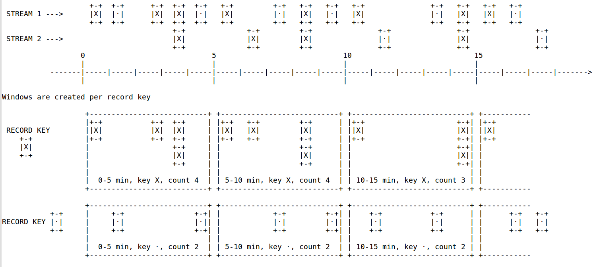
STATEFUL TUMBLING TIME WINDOWS
A 5 MINUTE TUMBLING WINDOW
30
30
30

Slide 36
STATEFUL HOPING TIME WINDOWS
Those are windows based on time intervals. They model fixed-size possibly overlapped windows.
A hopping window is defined by two properties: the window size and it's advance interval, aka "hop". The advance interval specifies by how much a window moves forward relative to the previous one.
For example, you can configure a hopping window with a size 5 minutes and an advance time of 1 minute. Since hopping window can overlap, and in general they do, a data record may belong to more than one such record.
NOTE: hopping windows vs sliding windows: hopping windows are sometimes called sliding windows in other stream processing tools. Kafka Streams follows the terminology in academic literature, where the semantics of sliding windows are different to hoping windows.
Hopping time windows are aligned to the epoch, with the lower interval bound being inclusive and the upper bound being exclusive. "Aligned to the epoch" means that the first window starts at timestamp zero.
For example, hopping windows with a size of 5000ms and an advance interval, i.e. "hop", of 3000ms have predictable boundaries
[0;5000),[3000;8000),[6000;11000),[9000;14000), ...
30
30
30

Slide 37
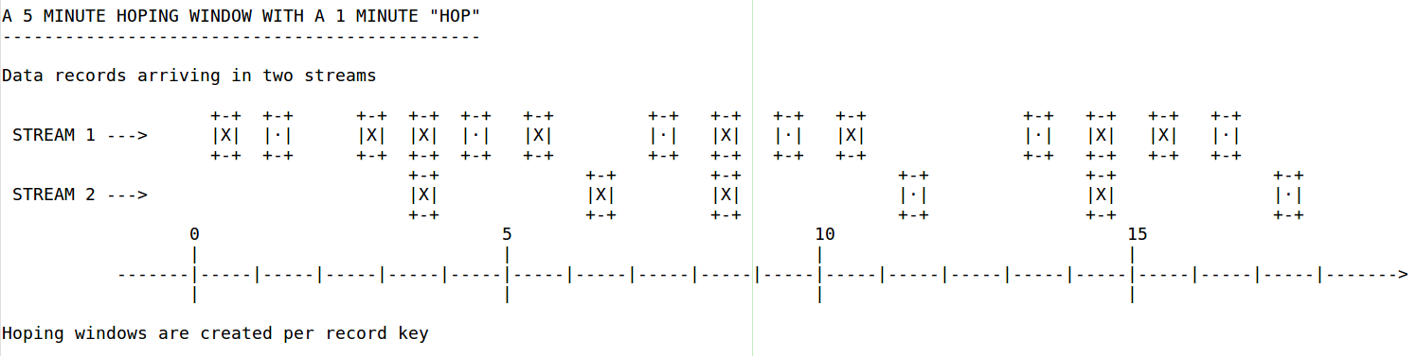
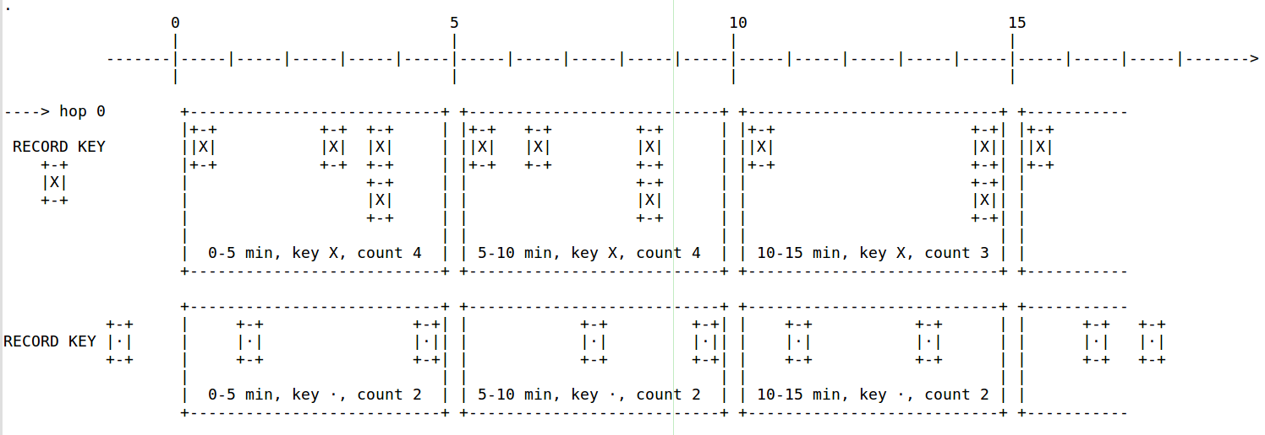
STATEFUL HOPING TIME WINDOWS
A 5 MINUTE HOPING WINDOW WITH A 1 MINUTE "HOP"
30
30
30

Slide 38
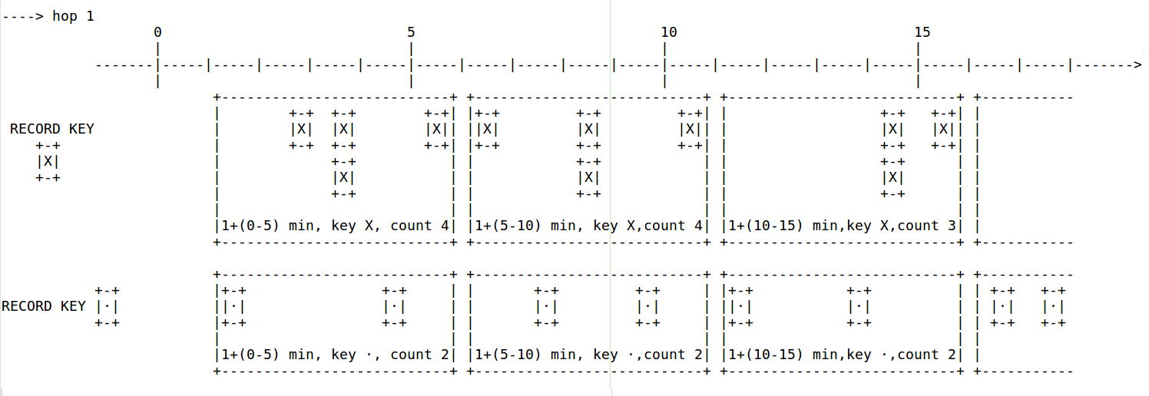
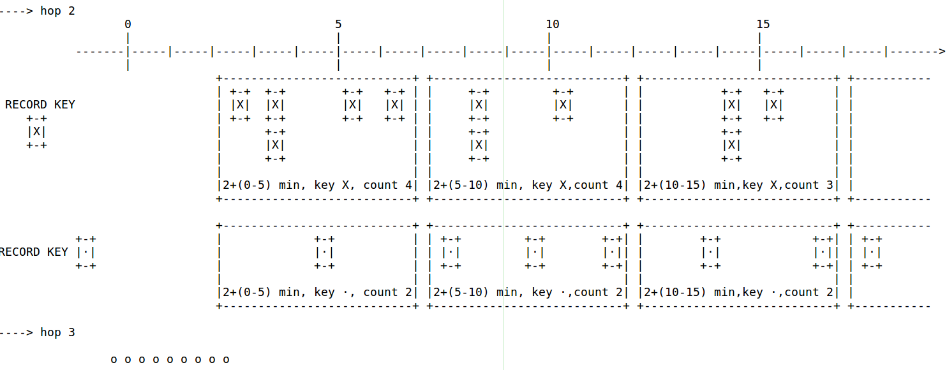
STATEFUL HOPING TIME WINDOW
30
30
30

Slide 39
STATEFUL SLIDING TIME WINDOWS
Those are actually quite different from hoping and tumbling windows.
In Kafka Streams, sliding windows are used only for join operations and can be specified through the JoinWindows class
A sliding window models a fixed-size window that slides continuously over the time axis; here, two data records are said to be included in the same window if, in the case of simmetric windows, the difference of their timestamps is within the window size.
Thus, sliding windows are not aligned to the epoch, but to the data record timestamps.
In contrast to hoping windows, the lower and upper window time interval bounds of sliding windows are both inclusive.
30
30
30

Slide 40
STATEFUL SESSION WINDOWS
Those are used to aggregate key-based events into so-called sessions; the process of which is referred to as “sessionization”.
Sessions represent a period of activity separated by a defined gap of inactivity, or "idleness".
Any events processed that fall within the inactivity gap of any existing sessions are merged into the existing sessions. If an event falls outside of the session gap, then a new session will be created. Session windows are different from the other window types in that:
All windows are tracked independently across keys, e.g. windows of different keys typically have different start and
end times. Their window sizes vary, even window for the same key typically have different sizes.
The prime area of application or use case is USER BEHAVIOR ANALYSIS.
Session based analysis can range for simple metrics, e.g. count of user visits on a news web site or social platform,
to more complex metrics, e.g. customer conversion funnel and event flows.
30
30
30

Slide 41
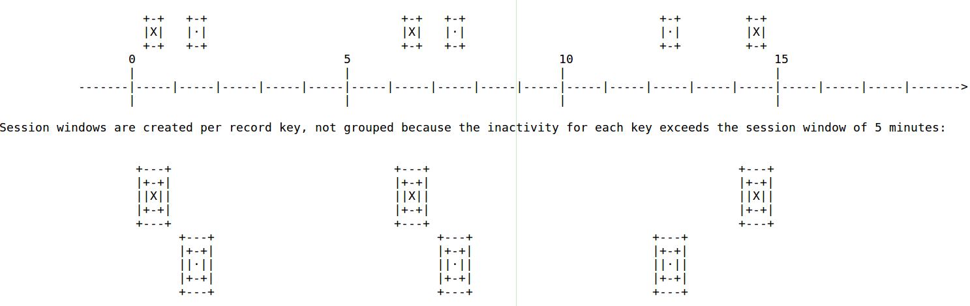
STATEFUL SESSION WINDOWS
Given a session window of 5 minutes, here's what would happen if we had records for a key arriving late to a session window (more than 5 minutes latency): new arriving records for the key in the expired session window are included in a new session window:
30
30
30

Slide 42
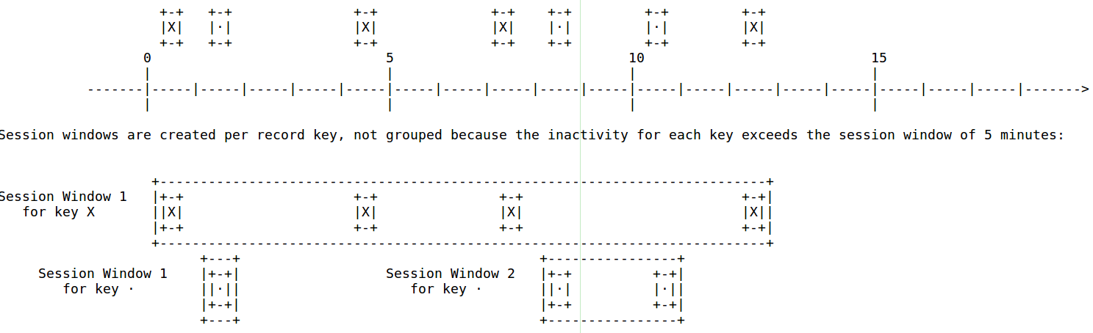
STATEFUL SESSION WINDOWS
Again, given a session window of 5 minutes, here's what would happen if we had records for a key arriving on time to a session window (less than 5 minutes latency): new arriving records for the key in the active session window are included on it:
30
30
30

