Slide 1
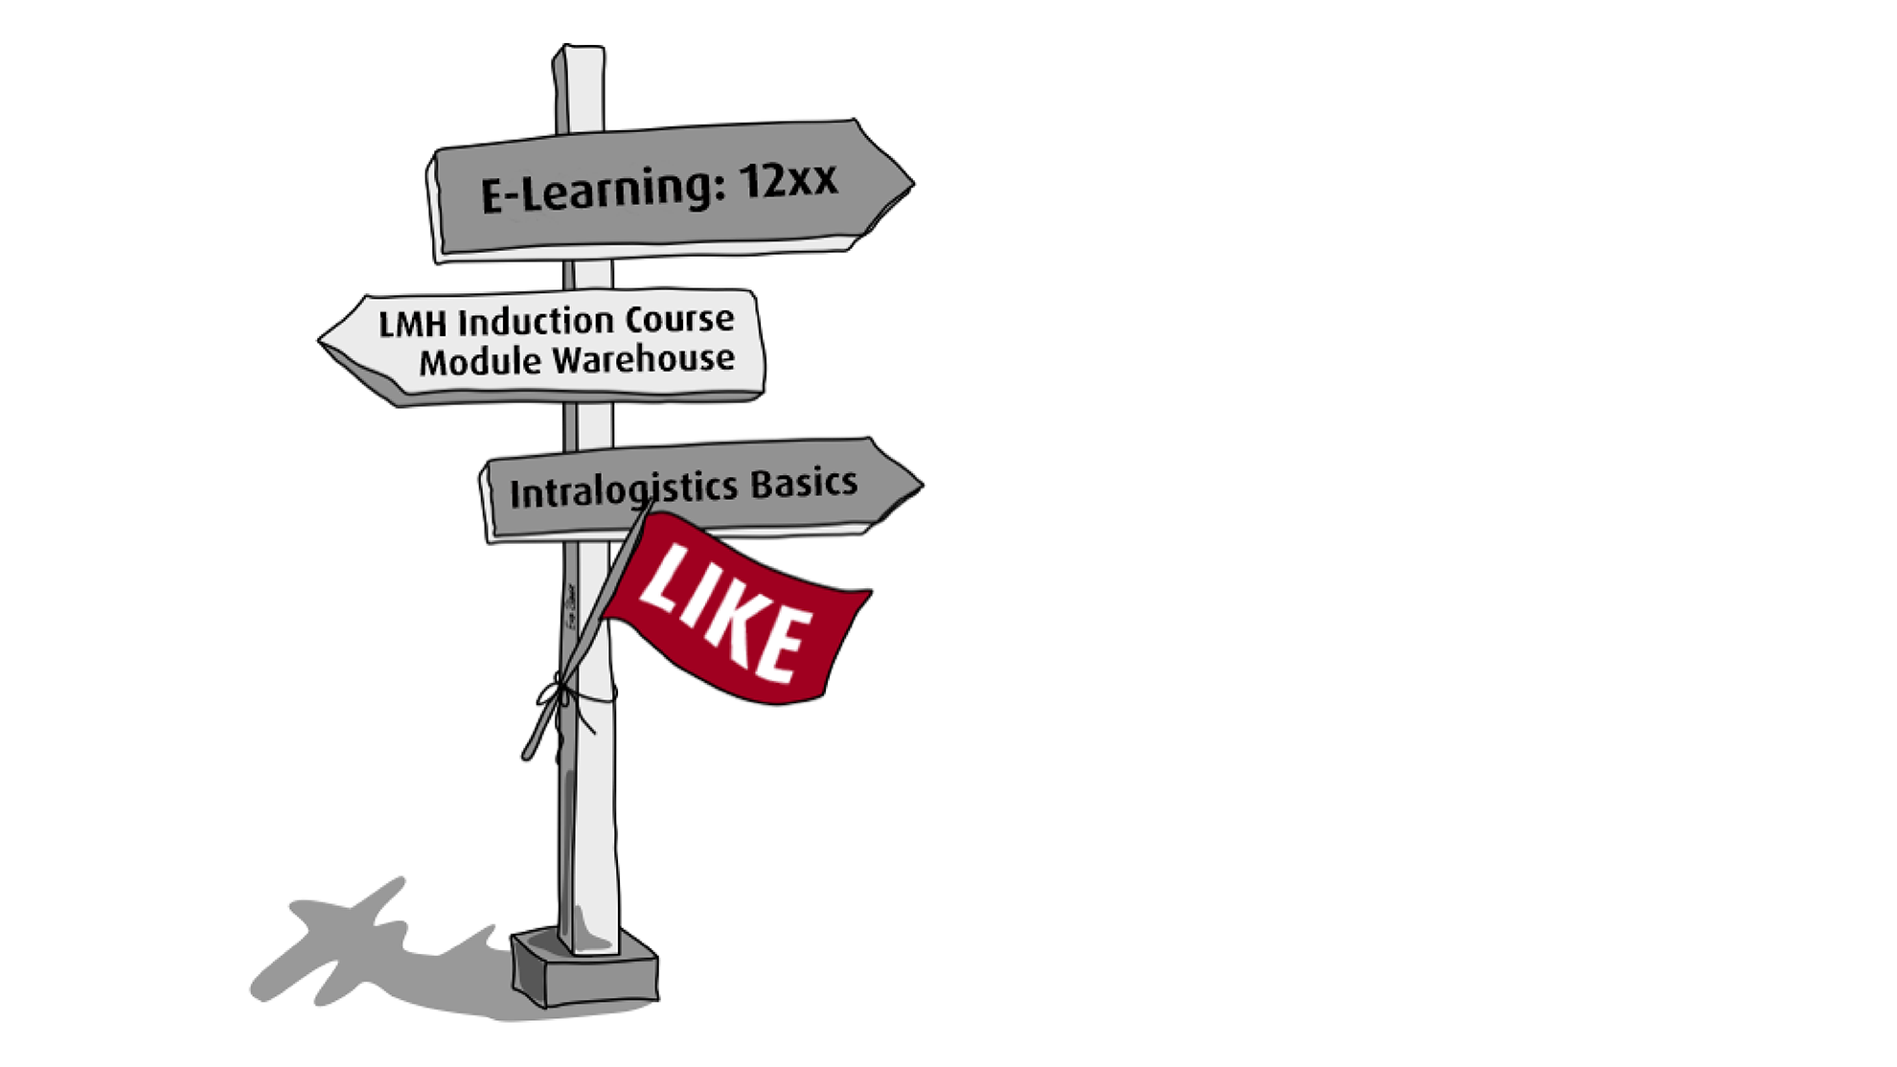
LIKE Learn Development – Module
Region– Results 202X
Average Accuracy (all modules)
total_nr_participants
Knowledge increase (Metacognition progress)
participants
avg_acc
knowledge
Average time needed to complete
Total amount of time spent*:
Consciousness
UI / CI / UC / CC
time
total_time
consciousness
Reduction Unconscious incompetence
iui
Notes:
Average Accuracy: How often a person answers a question or completes a task correctly in relation to the total number of tries. A high Average Accuracy indicates strong performance and a good understanding of the material/ content.
Unconscious Incompetence – You don’t know what you don’t know. You are unaware of your lack of knowledge or skill.
Conscious Incompetence – You become aware of your lack of knowledge or skill. You understand that you need to learn.
Conscious Competence – You can perform the skill, but you need to consciously think about it and focus.
Unconscious Competence – You perform the skill effortlessly and automatically, without having to think about it.
The Knowledge Increase (Metacognition Progress) in Area9 Rhapsode is calculated based on a comparison of two factors:
Self-Assessment vs. Actual Performance:
Learners rate their confidence level on a given question (Metacognition).
They then answer the question.
Discrepancy Between Confidence and Knowledge:
If a learner answers incorrectly but was confident they were right → Overestimation (Low Metacognition).
If a learner answers correctly but was unsure → Underestimation.
The goal is to help learners develop a more accurate self-assessment of their knowledge.
Calculation of Progress:
Area9 compares the initial and final phases of the training.
Metacognition Progress measures the improvement in a learner’s ability to assess their own knowledge accurately (fewer misjudgments).
It is expressed as a percentage.
In Summary:
Knowledge Increase (Metacognition Progress) measures how well learners improve their ability to accurately assess their own knowledge throughout the training. A higher percentage indicates better self-assessment skills.
Reduction of Unconscious Incompetence in Area9
Unconscious Incompetence refers to situations where learners believe they know something but are actually incorrect. The reduction of unconscious incompetence measures how well learners improve in recognizing their lack of knowledge and reducing incorrect confidence over time.
How It Is Calculated:
Initial Unconscious Incompetence Assessment:
At the start of training, learners answer questions and rate their confidence.
If they answer incorrectly but were highly confident, this is classified as unconscious incompetence.
The system tracks the percentage of these cases.
Progress During Training:
As learners go through the adaptive training, they receive feedback, explanations, and retry questions.
Over time, they either correct their knowledge or become more aware of their knowledge gaps.
If they still answer incorrectly but now indicate low confidence, they have moved from unconscious incompetence to conscious incompetence—which is progress.
Final Measurement & Calculation:
At the end of the training, the system re-evaluates how often learners still overestimate their knowledge.
The percentage decrease in unconscious incompetence (from the initial assessment to the final results) is measured.
This reduction is expressed as a percentage improvement.
In Summary:
The Reduction of Unconscious Incompetence measures how much a learner has improved in recognizing when they do not know something. A higher reduction percentage means that learners have become better at identifying their knowledge gaps and are less likely to be overconfident in incorrect answers.

Slide 2
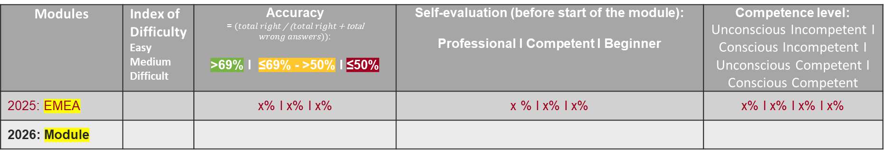
LIKE Learn Development – Module
Region – Comparison of LIKE Module Results (EMEA vs. Module)
Modules | Index of Difficulty Easy Medium Difficult | Accuracy = $(total right$ / ($total right$ + total $wrong answers))$: >69% I ≤69% - >50% I ≤50% | Self-evaluation (before start of the module): Professional I Competent I Beginner | Competence level: Unconscious Incompetent I Conscious Incompetent I Unconscious Competent I Conscious Competent
2025: EMEA |  | x% I x% I x% | x % I x% I x% | x% I x% I x% I x%
2026: Module |  |  |  | ​
text1
text2
text3
Notes:
The Index of Difficulty is based on the ski slope system, which shows how hard the slopes are. There are blue slopes for beginners, red slopes for more experienced skiers, and black slopes for expert skiers. The modules can be grouped in a similar way.
Average Accuracy: How often a person answers a question or completes a task correctly in relation to the total number of attempts. A high Average Accuracy indicates strong performance and a good understanding of the material/ content.
Unconscious Incompetence – You don’t know what you don’t know. You are unaware of your lack of knowledge or skill.
Conscious Incompetence – You become aware of your lack of knowledge or skill. You understand that you need to learn.
Conscious Competence – You can perform the skill, but you need to consciously think about it and focus.
Unconscious Competence – You perform the skill effortlessly and automatically, without having to think about it.

Slide 3
LIKE Learn Development – Module
Region – Most difficult learning objectives
Module | Learning Objective | Unconsciously Incompetent | Wrong Answers

