Slide 1
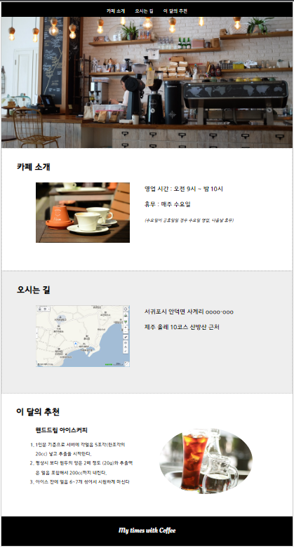
nav
h1
image
detail
p

