Slide 1





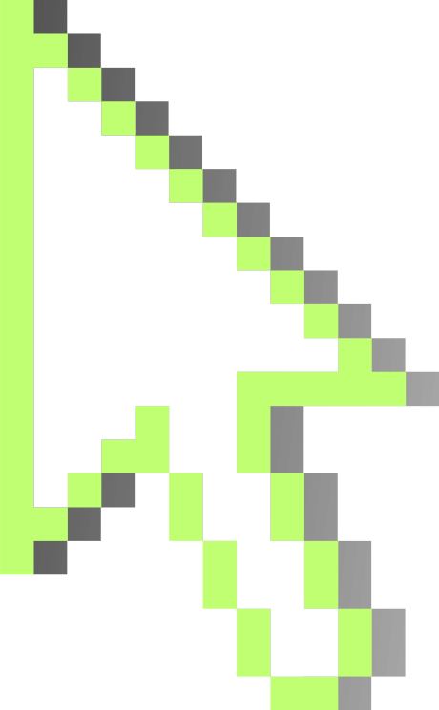

ANURA
Renata Uruchurtu Ransom - A01786687
Carlos Enrique Rosete Pascual - A01787451
Emilio Torres Castillo - A01787141

Slide 2
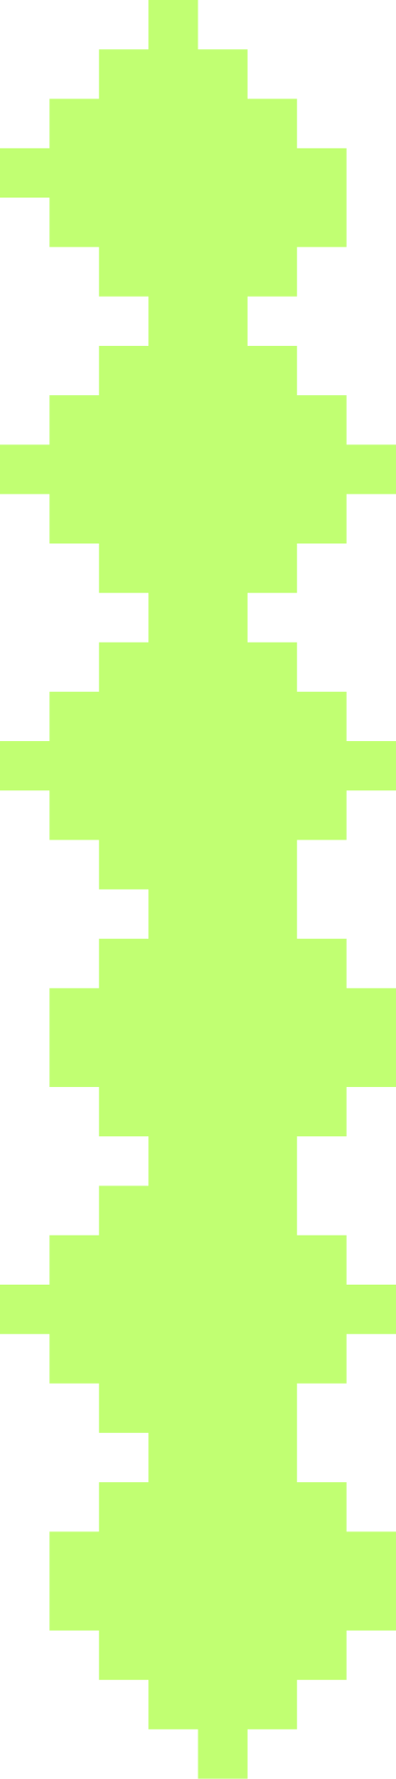

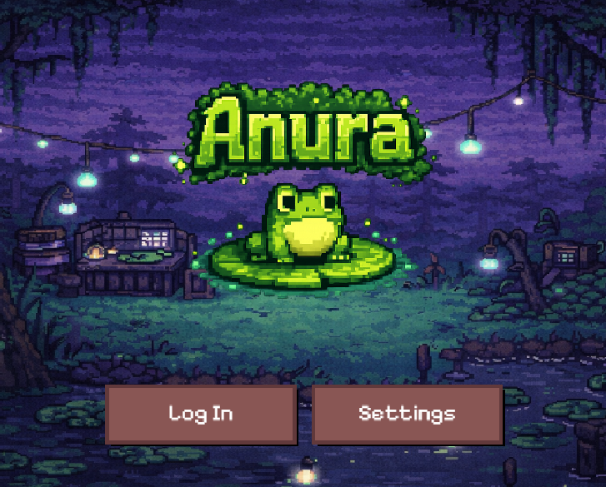
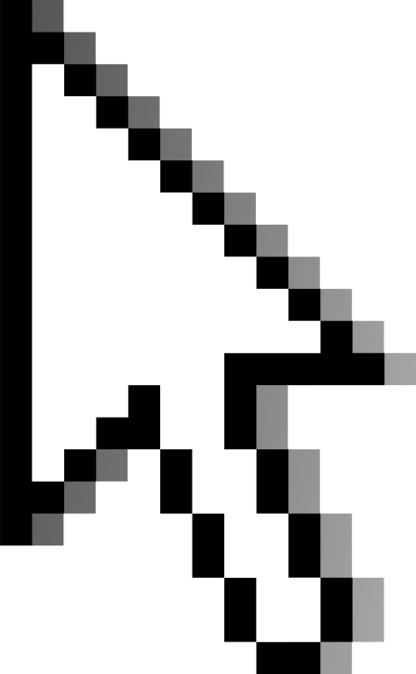

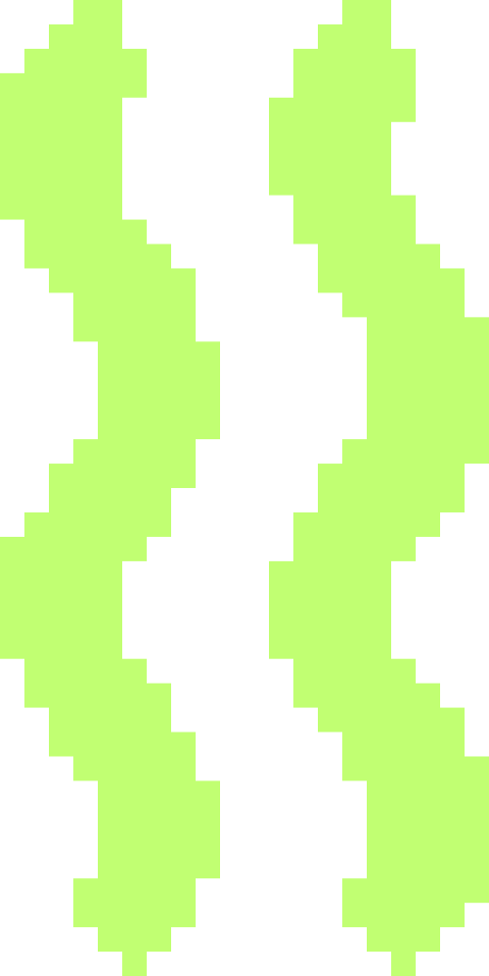

ELEVATOR PITCH
A small frog fights its way up the food chain in a 2D roguelite platformer set in a dangerous swamp. Players collect mosquitoes as persistent currency, build strategic card decks across runs, and defeat increasingly challenging predator bosses. Every card burns on use, choose wisely.
SMALL CREATURE, BIG WORLD, SMART SURVIVAL.

Slide 3
GAME OBJECTIVE
El contraste entre exploración tranquila y combate intenso crea ritmo emocional.
La progresión esta basada en aprendizaje y mejora estratégica, no solo reflejos o movimientos aleatorios.
WHAT IS ANURA?
MAIN GOAL
A 2D roguelite where you control a small frog surviving in a dangerous swamp.
• Navigate platforming sections
• Collect mosquitoes (currency)
• Face bosses with unique patterns
• Build strategic decks
Survive and climb the food chain by defeating all bosses in a single run.
Each run:
1. Platforms → Boss 1
2. Platforms → Boss 2 (Final)
Death = progress
Buy cards → Try again stronger

Slide 4
CORE MECHANICS
MOVEMENT
A/D → Horizontal
W → Aim up
Space → Jump
Dash → (ONLY WITH CARD)
Glide → (ONLY WITH CARD)
Attack → I
TONGUE
Primary weapon
Collects mosquitoes
Melee attack
Hitbox system
CARDS
3 active slots
Burn-and-replace
Permanent effects (until burned)
Strategy over Reflexes
Mosquitoes
Never lost on death
Persist across runs
Spent on new cards
Fair and permanent progression
BOSS SYSTEM (FSM)
Finite State Machine:
Idle → Attack → Recovery → Phase 2
Learnable patterns, not random
Clear vulnerability windows
Skill over Luck

Slide 5
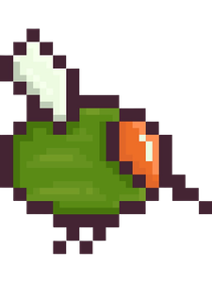
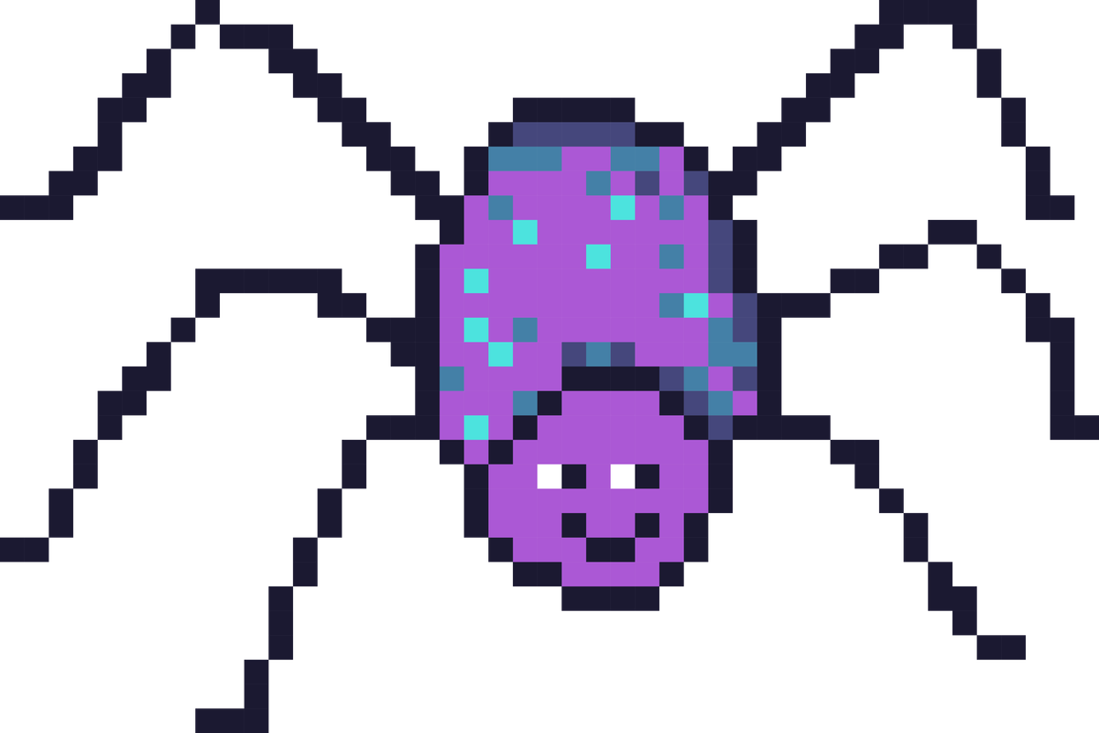
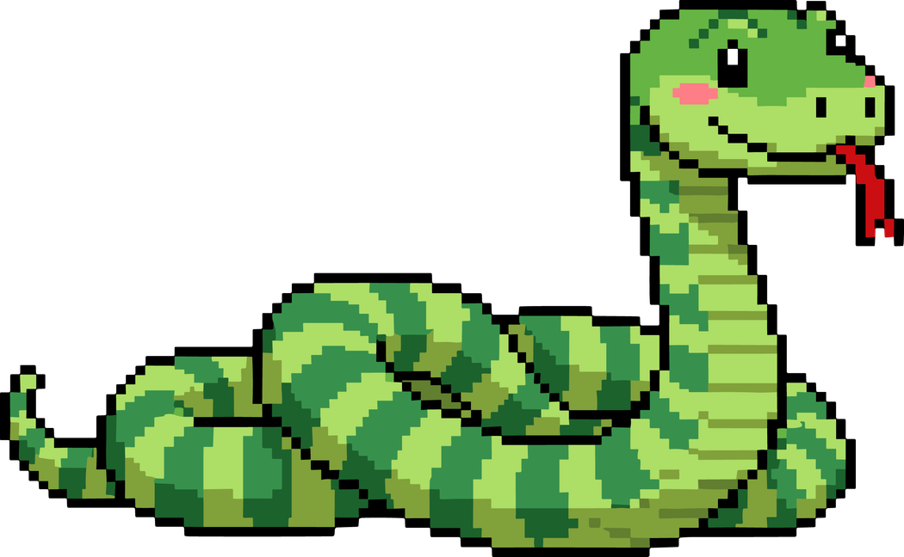
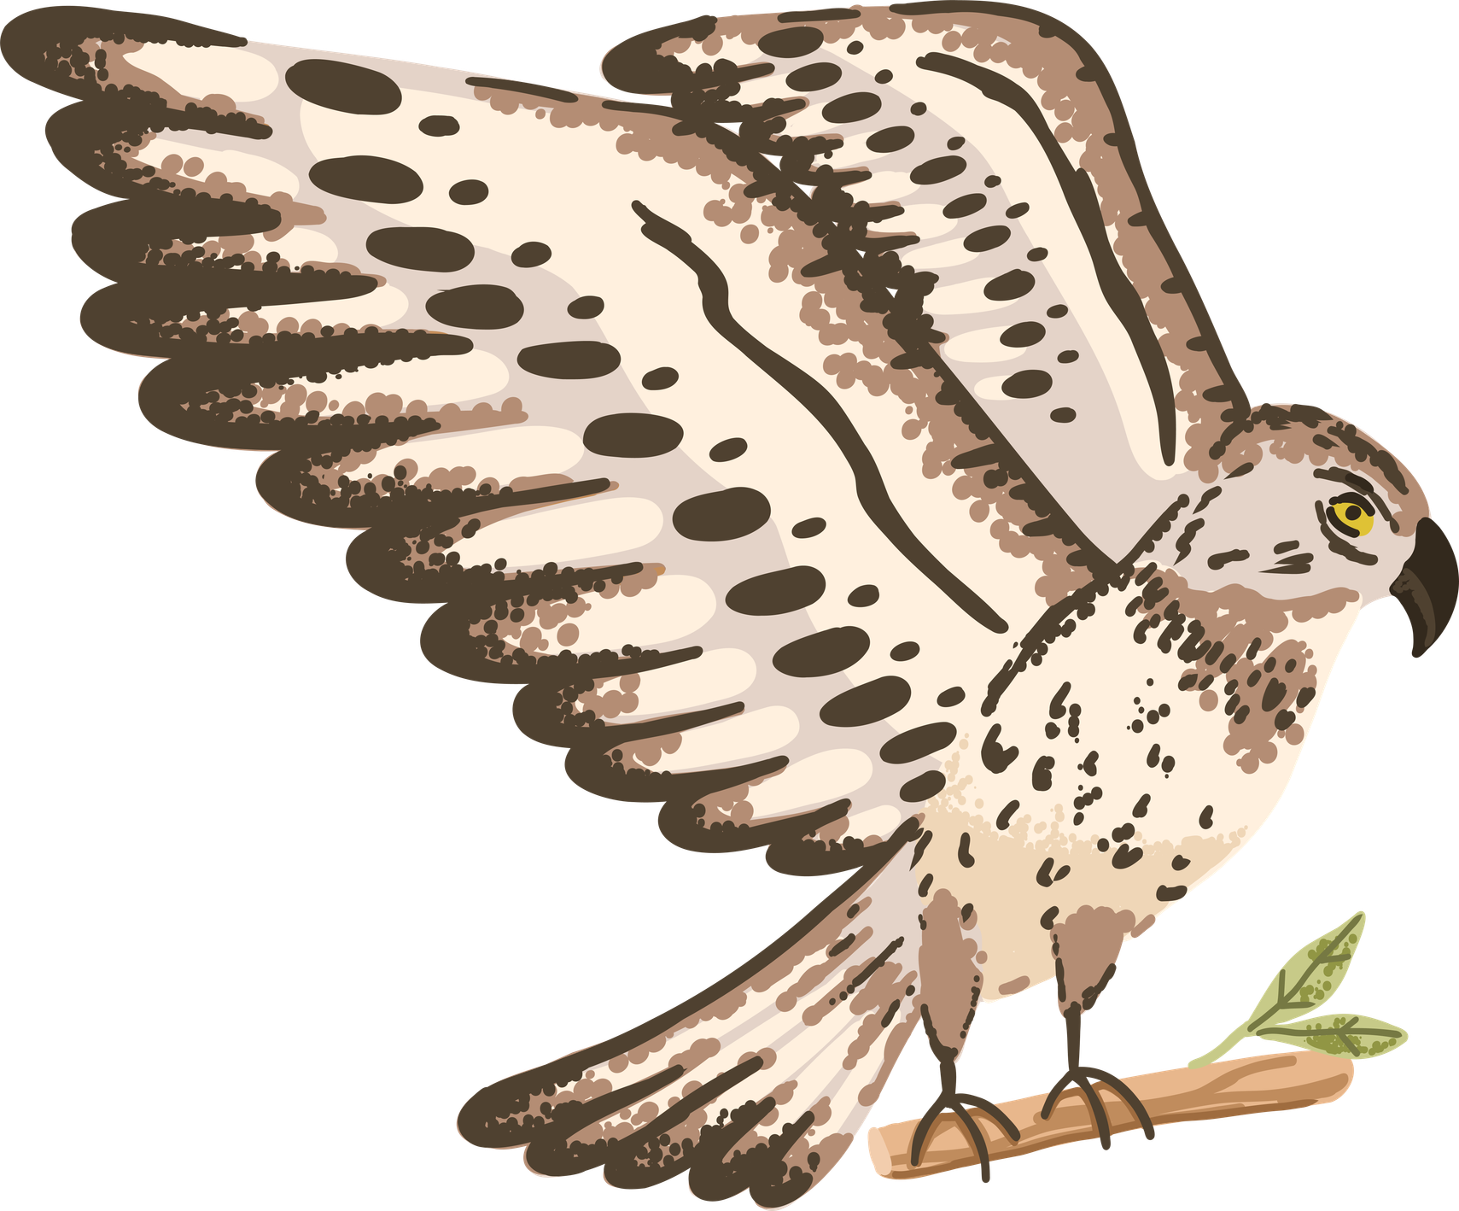
ENEMY TYPES
Agressive (least aggressive)
Collectible with tongue
In game currency
mosquitoes
Agressive
Patrol platforms
Active obstacles
spiders
Simple, predictable pattern
Long recovery windows
Teaches combat fundamentals
HP: medium, Damage: medium
snake
(boss 1)
Fast, aggressive attacks
Short vulnerability windows
Phase 2 at 25% HP
Final boss
hawk
(boss 2)

Slide 6

ROGUELITE ELEMENTS
“FAILURE IS PROGRESS”
Run
Dfeat/Death
Reward (Mosquitoes)
Permanent Upgrade (Cards)
New Run Stronger

Slide 7
TCG ELEMENTS
Strategic Card System
MOVEMENT
Mobility and traversal abilities
Iron Hindlegs
Dragonfly Hop
Glide Membrane
Bubble Dash
Rocket Frog
COMBAT
Offensive and defensive abilities
Chameleon Veil
Fire Kiss
Thunder Tongue
Toad Shockwave
Venom Lash
UTILITY
Support and resource abilities
Lucky Pond
Metamorphosis
Spiked Whip
Tadpole Heart
Thorn Skin
Implemented TCG Mechanics:
Pre-run deck building, 3 limited slots, card combinations benefit from each other, strategic decisions, cooldowns and effects

Slide 8
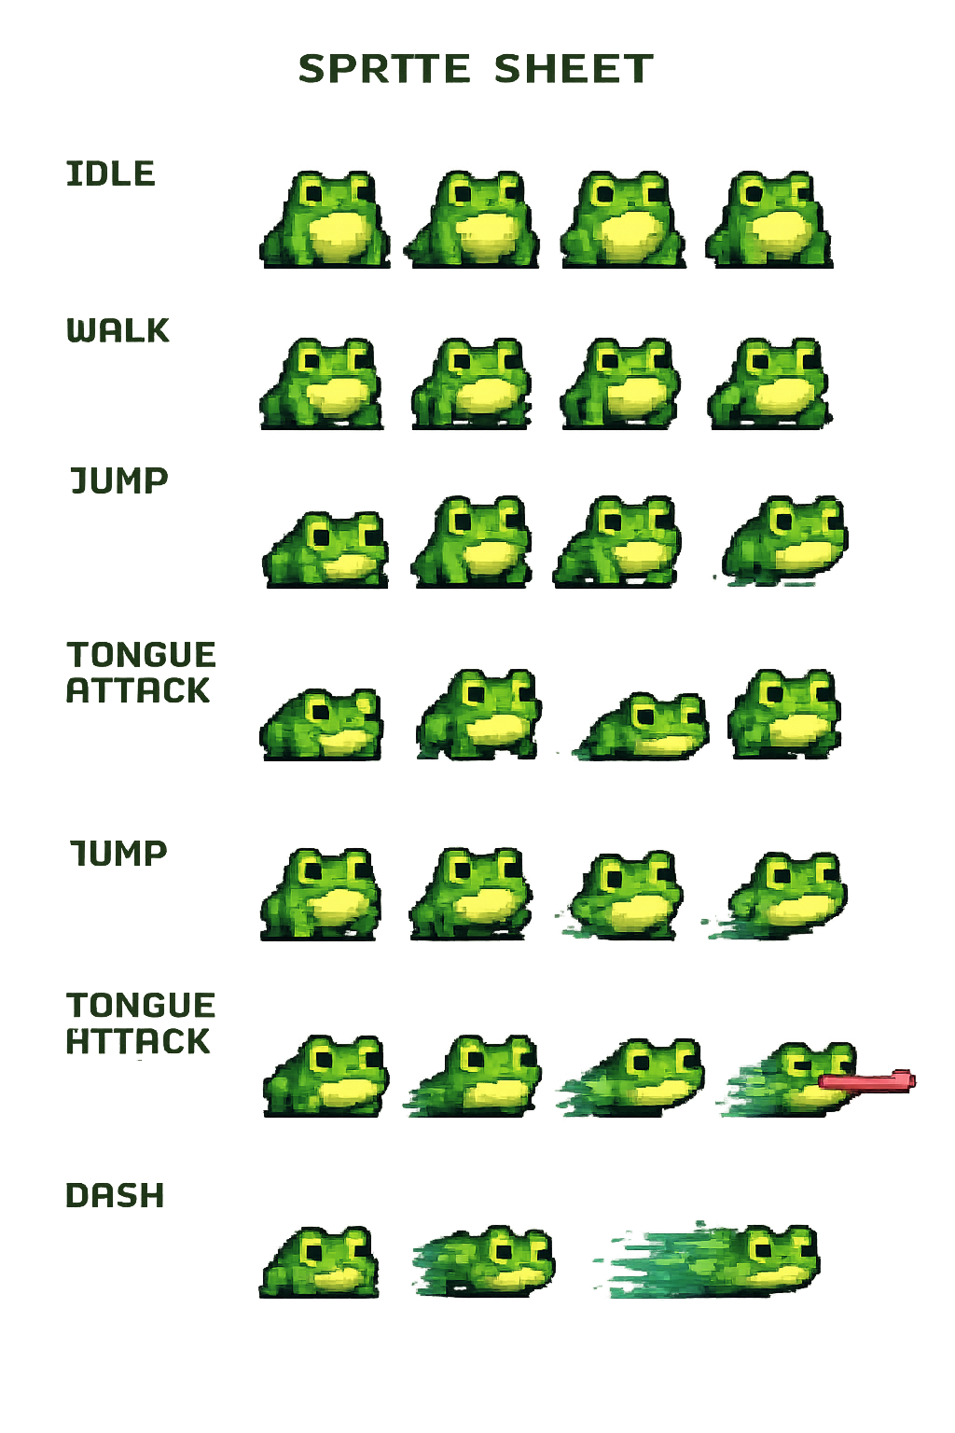
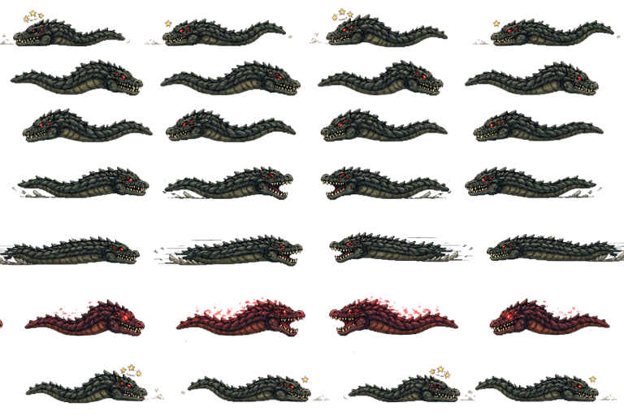
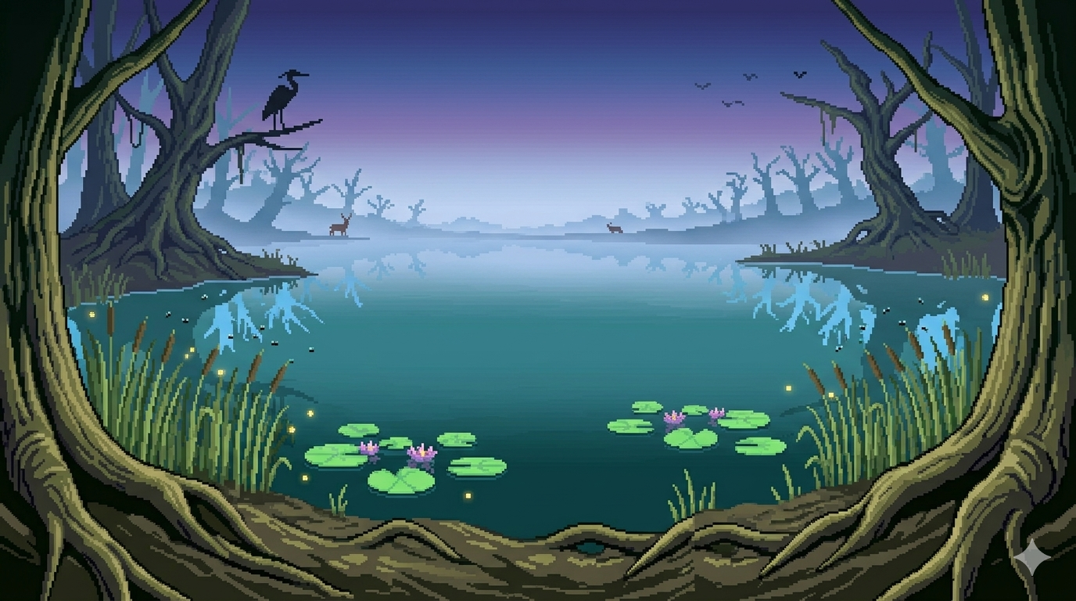
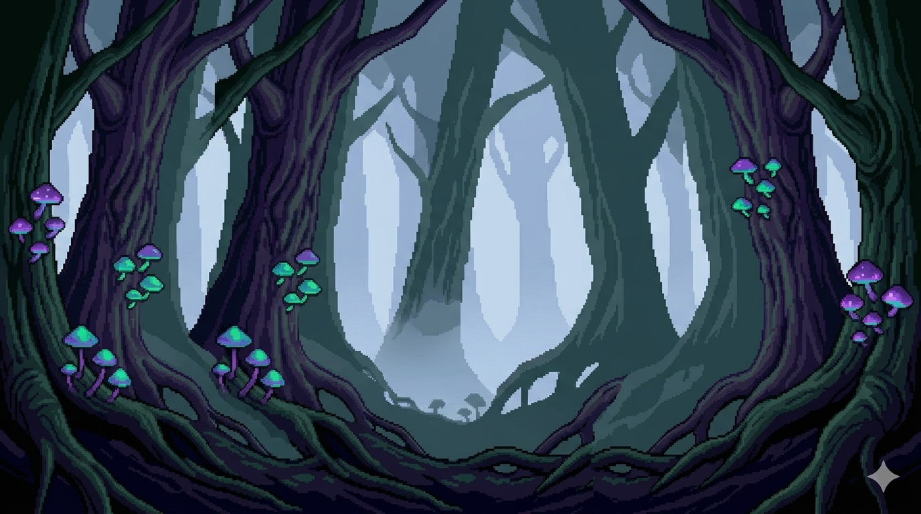
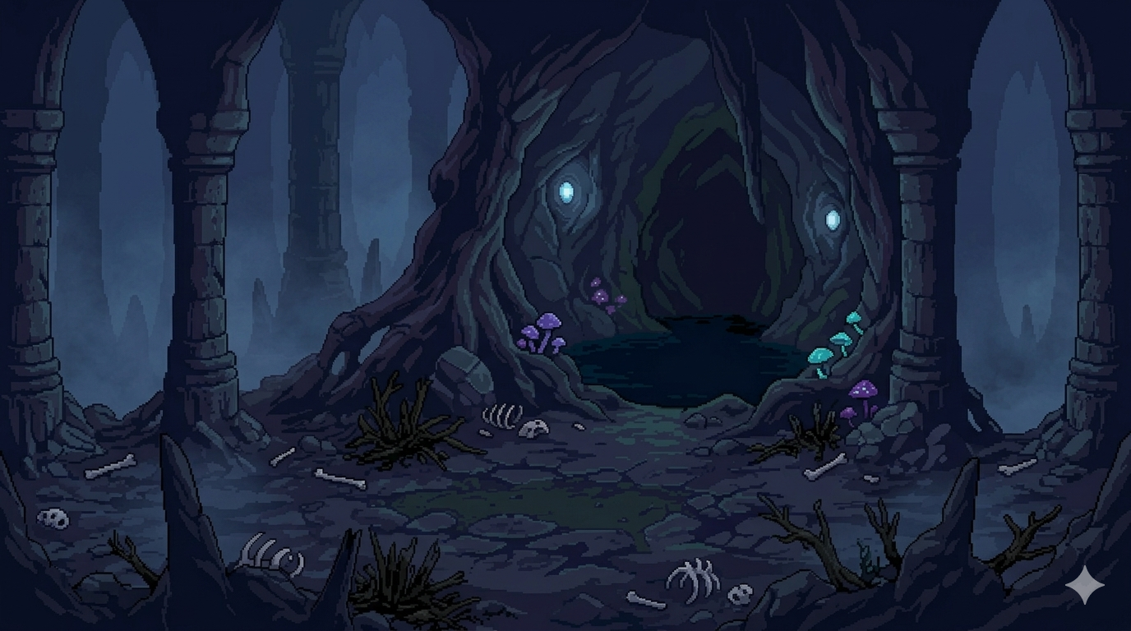
VISUAL STYLE
Anura uses a pixel-art aesthetic with a "Cute but Deadly" design philosophy.
Swamp Surface
Calm, humid, cozy, slightly tense, natural and alive
Dense Swamp
Darker, more enclosed, slightly oppressive, more dangerous, less visually open
Predator Arena
Tense, focused, quiet before combat, isolated

Slide 9
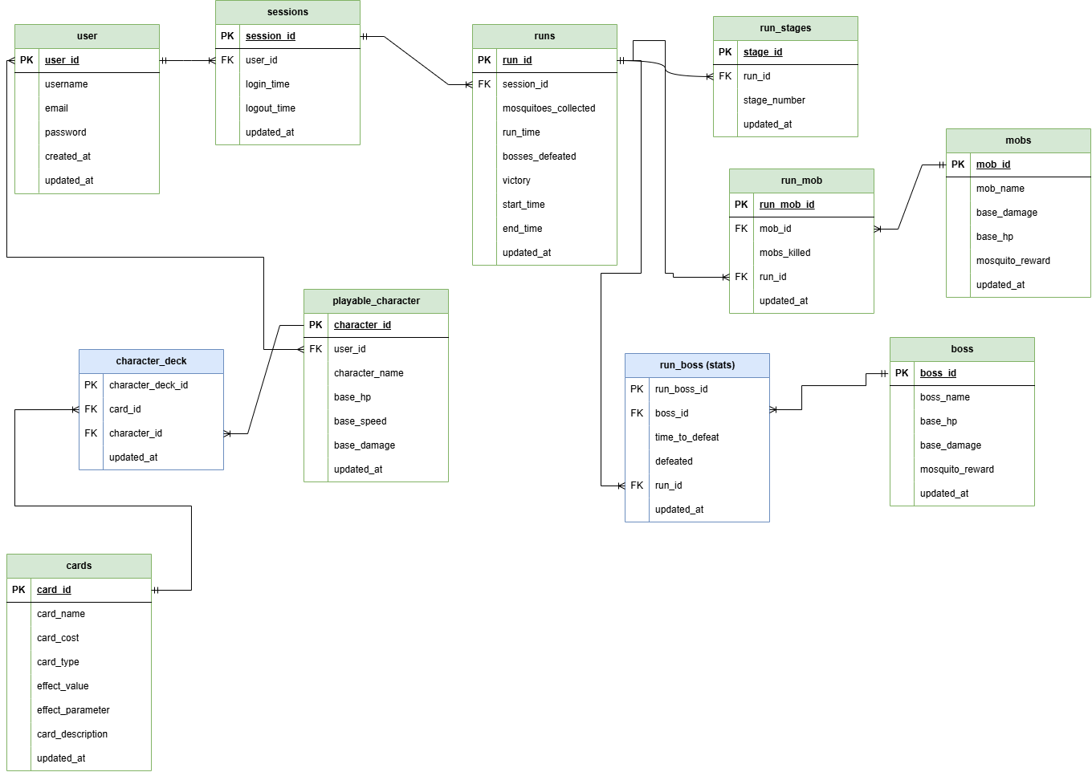
DATABASE

Slide 10
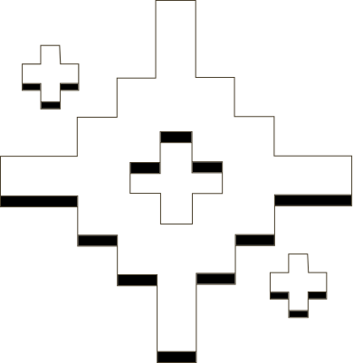
PART 2
GROUP REFLECTION

Slide 11
WHY WE CHOSE THIS STRATEGY
WHAT WAS REQUIRED
WHAT WE DECIDED
Build a roguelite
Include TCG card mechanics
Use a database
Burn and replace card mechanic
Persistent mosquito currency
Platformer
We created a roguelite TCG platformer to combine action and strategy in one game. Each run feels different, and players build their playstyle through cards. The card selection screen we implemented lets players choose their deck, and the burn-and-replace system adds strategy by allowing them to replace unwanted cards.

Slide 12
CHALLENGES WE FACED
DATA PERSISTENCE + API
Problem: cards and mosquitoes had to persist across runs, cards burn on activation but survive death if unused, implementation was a struggle at first.
Solution: use of views for mysql
MySQL CONFIGURATION
Problem: 2 of the teammates kept having issues with the MySQL configuration, leading to errors, delays with the backend, etc.
Solution: use of mysql workbench community
El contraste entre exploración tranquila y combate intenso crea ritmo emocional.
La progresión esta basada en aprendizaje y mejora estratégica, no solo reflejos o movimientos aleatorios.
DIFFERENT SCHEDULES & AVAILABILITY
Problem: the 3 of us had different schedules throughout the day, specially in the afternoon, which made organization difficult at first but we managed to adapt and find time for team work.
Solution: Microsoft Teams calls on weekends, weekdays, etc.
BACKEND
Problem: starting to work on the backend got us behind at first, we struggled a lot on understanding it, but after some classes and other resources we got the hang of it.
Solution: we kept asking our teacher’s for help and even watched videos to learn more.

Slide 13


WHAT WE LEARNED
This project was our introduction to full-stack development. We started with the basics like HTML and CSS, then worked our way up to building a complete system. We created a custom game engine in JavaScript for the frontend, built APIs using Express for the backend, used MySQL for the database, and connected everything together. Each part helped us learn something new.
DATABASE:
Data integrity
CRUD Operations
Views, Triggers, etc.
Connection to backend
WEB DESIGN:
How to create websites
Use of css in HTML
Bootstrap & Jquery
GAME DEVELOPMENT:
Role of Physics in games
FSM
Videogame concepts
SOFTWARE DEVELOPMENT:
Github
SCRUM
Github Projects
TEAM WORK !!
FULL STACK DEVELOPMENT

Slide 14
TEAM REFLECTIONS
RENATA
Over these 10 weeks, I learned a lot and improved on my skills. At the beginning, I felt confused and didn’t know many things, but now I feel happy with what I can do and that I helped build Anura. I also learned more about teamwork and realized how important it is for everything we do.
CARLOS
I learned how important organization and planning are in a project like this. Keeping everything structured was challenging at first, but over time we improved in managing tasks. I also learned how to work on different areas of the project and do a bit of everything.
EMILIO
During the making of this project I learned a lot about teamwork and problem solving. I also improved my skills in databases, which wasn’t my strength at first, but I managed to understand it better and apply it throughout the project.

Slide 15


THANK YOU!

