Slide 1
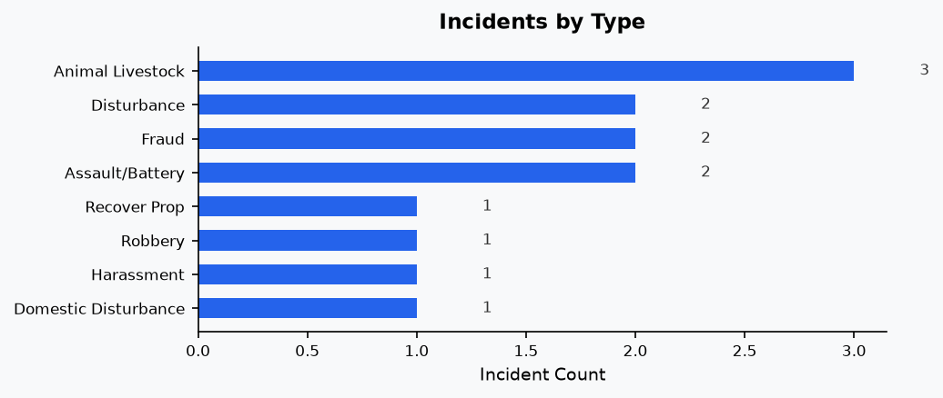
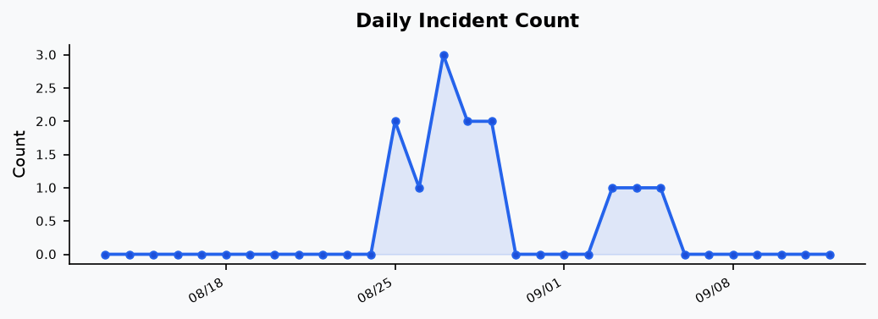
Registered User Reports — PDF Generation Design
Server-side rendering pipeline: ReportLab + Matplotlib + staticmap
ReportLab (Platypus) over WeasyPrint
  Assembles Paragraphs, Tables, and Images programmatically from in-memory BytesIO buffers — no HTML/CSS templating step and no Pango system dependency to embed dynamic charts.
staticmap over leaflet-image / html2canvas / dom-to-image
  Browser-side DOM/canvas capture hits the tainted-canvas limitation: OSM tiles don't send Access-Control-Allow-Origin, so cross-origin tile pixels can't be read client-side.
staticmap over Puppeteer
  A headless-Chromium screenshot server sidesteps CORS too, but adds heavy memory/startup cost and a system dependency that doesn't fit a lightweight Flask deployment.
Matplotlib with the Agg backend
  Renders bar/line charts headlessly straight into BytesIO PNG buffers — no display server, no temp files.
Fully in-memory request pipeline
  Map snapshot, charts, and final PDF are generated and streamed back within a single Flask request/response — no external processes.
Example charts from a generated report
Rendered with the project's own _bar_chart() / _line_chart() functions on sample data
Notes:
This slide covers how the registered-user PDF report actually gets built, server-side. The whole thing runs in Flask, in memory, inside a single request — no separate service, no temp files, no external process.
I picked ReportLab's Platypus layer over WeasyPrint because the report content is mixed — a map image, two chart images, a couple of tables — and Platypus lets me assemble that programmatically from BytesIO buffers, without an HTML template step or a system dependency like Pango.
For the map snapshot, I first looked at browser-side capture — leaflet-image, html2canvas, dom-to-image. They all hit the same wall: OpenStreetMap's tile server doesn't send CORS headers, so the browser can't read the tile pixels to composite an image — the 'tainted canvas' problem. Puppeteer would sidestep that by screenshotting from a headless Chromium on the server, but that's a lot of operational weight for a lightweight Flask app. staticmap solves it cleanly: it downloads OSM tiles server-side over plain Python requests, which isn't subject to browser CORS at all.
Charts are Matplotlib running its non-interactive Agg backend, so there's no display environment needed — figures render straight into memory. The two charts on the right aren't mockups — they're real output from the project's own _bar_chart() and _line_chart() functions, run against sample data.

