Slide 1
Python Introduction
2020/07/14
臺北科技大學電子系

Slide 2
Python Basic Introduction
Python is the Object-oriented programming Language.The code of Python is easy to read,understand,study and use.Also,Python can shorten program development time.It can complete all kinds of difficult program application to run in most of system.

Slide 3
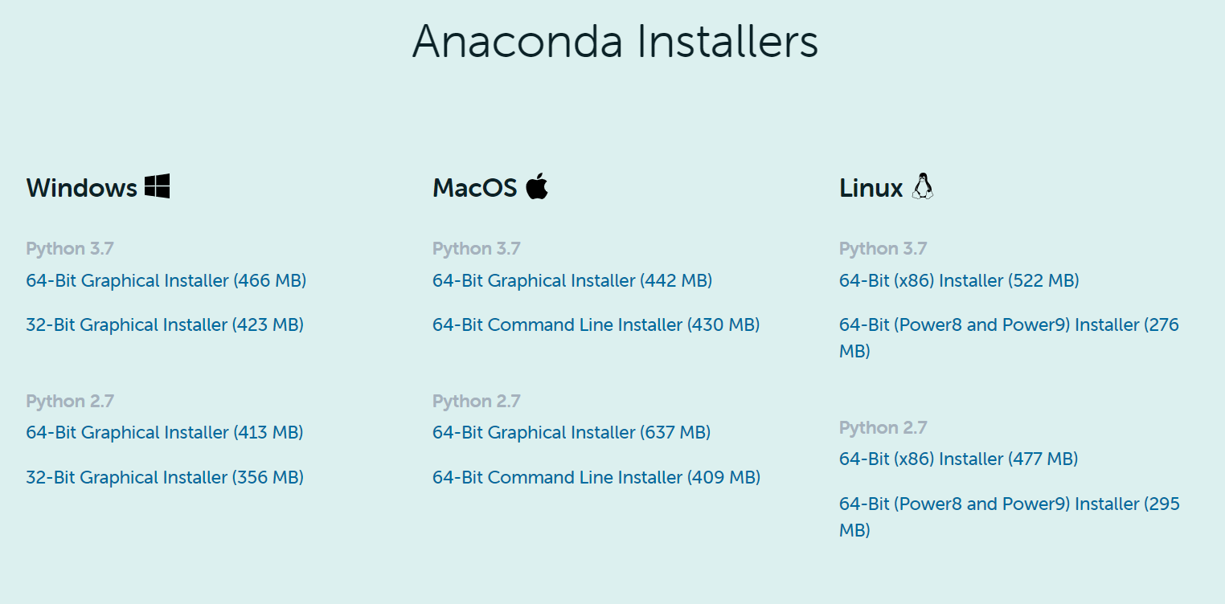
Anaconda Install
Install Anaconda packages：https://www.anaconda.com/products/individual
Include a lot of science,math,engineering,data analysis Python package

Slide 4
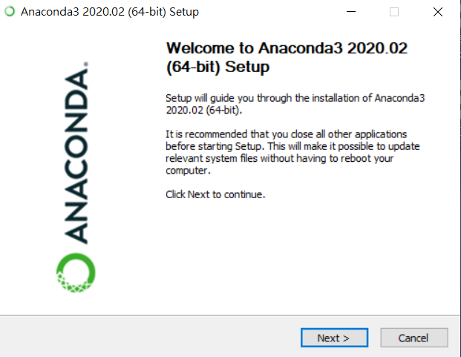
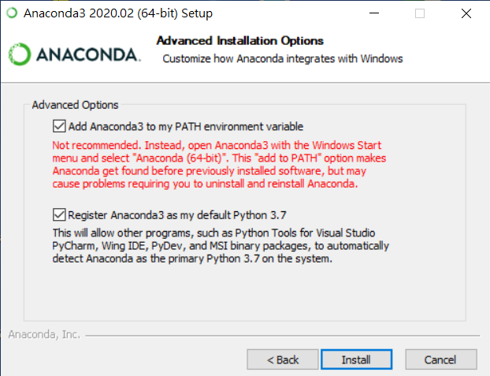
Anaconda Install
Setup Anaconda

Slide 5
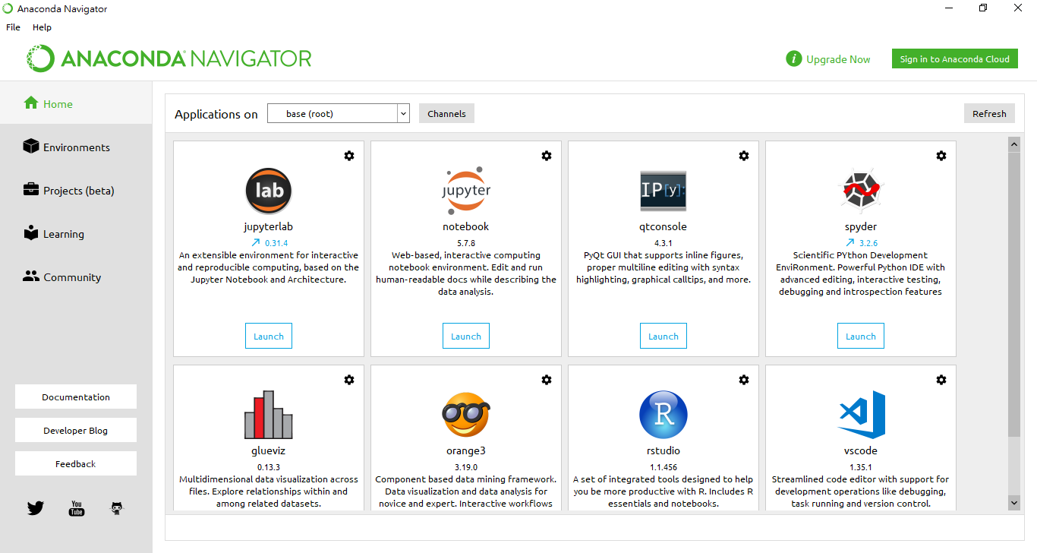
Anaconda Install
Install complete

Slide 6
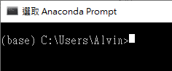
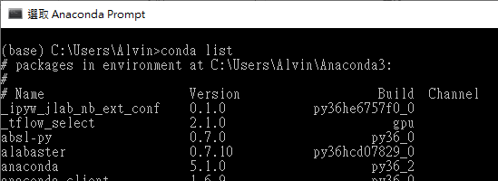
Build Anaconda virtual environment
Open Anaconda Command：
Anaconda package list
conda list

Slide 7

Build Anaconda virtual environment
Build file
md \pythonwork
cd \pythonwork

Slide 8
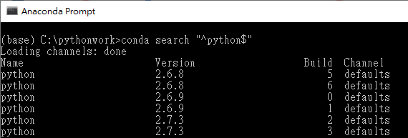
Build Anaconda virtual environment
Python version
conda search "^python$"

Slide 9
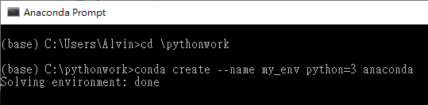
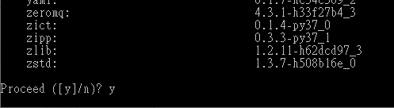
Build Anaconda virtual environment
Build environment:
conda create --name my_env python=3 anaconda

Slide 10
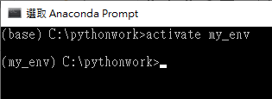

Build Anaconda virtual environment
Run virtual environment
activate my_env
Close virtual environment
deactivate

Slide 11
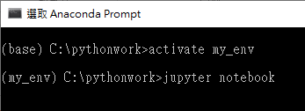

Build Anaconda virtual environment
Jupyter Notebook
jupyter notebook
Spyder
start spyder

Slide 12
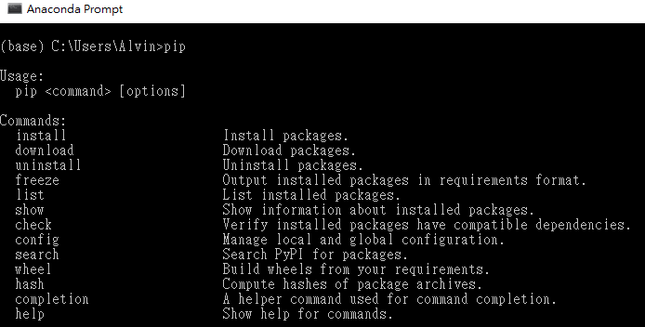
Build Anaconda virtual environment
“pip”is used by the tools of installing and controlling python package.
Example：pip install numpy

Slide 13
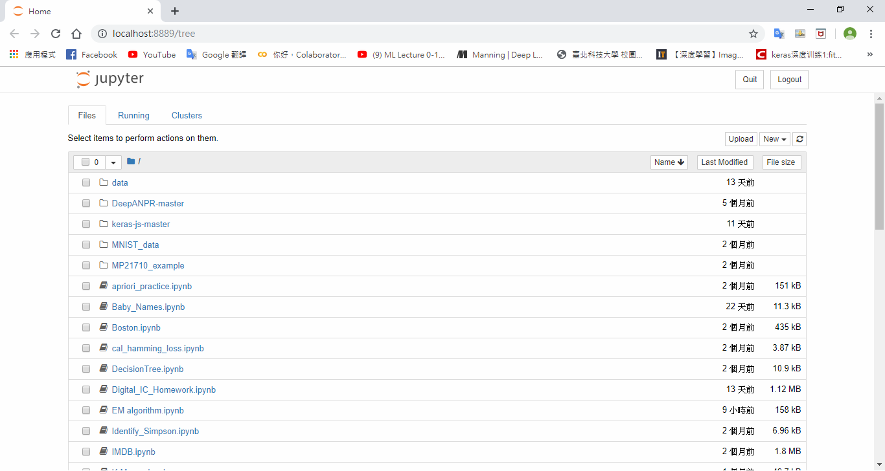
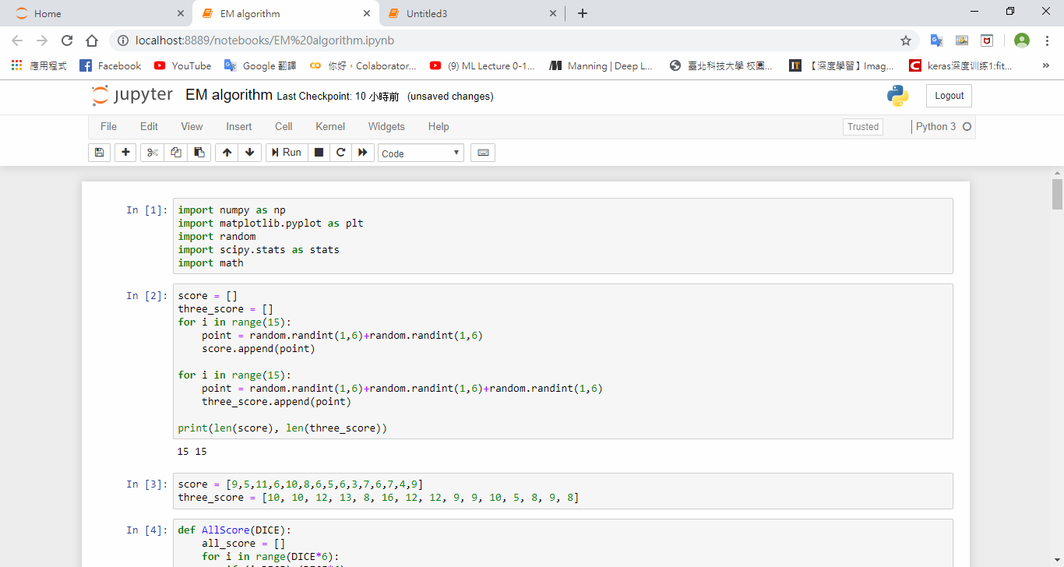
Jupyter Notebook

Slide 14
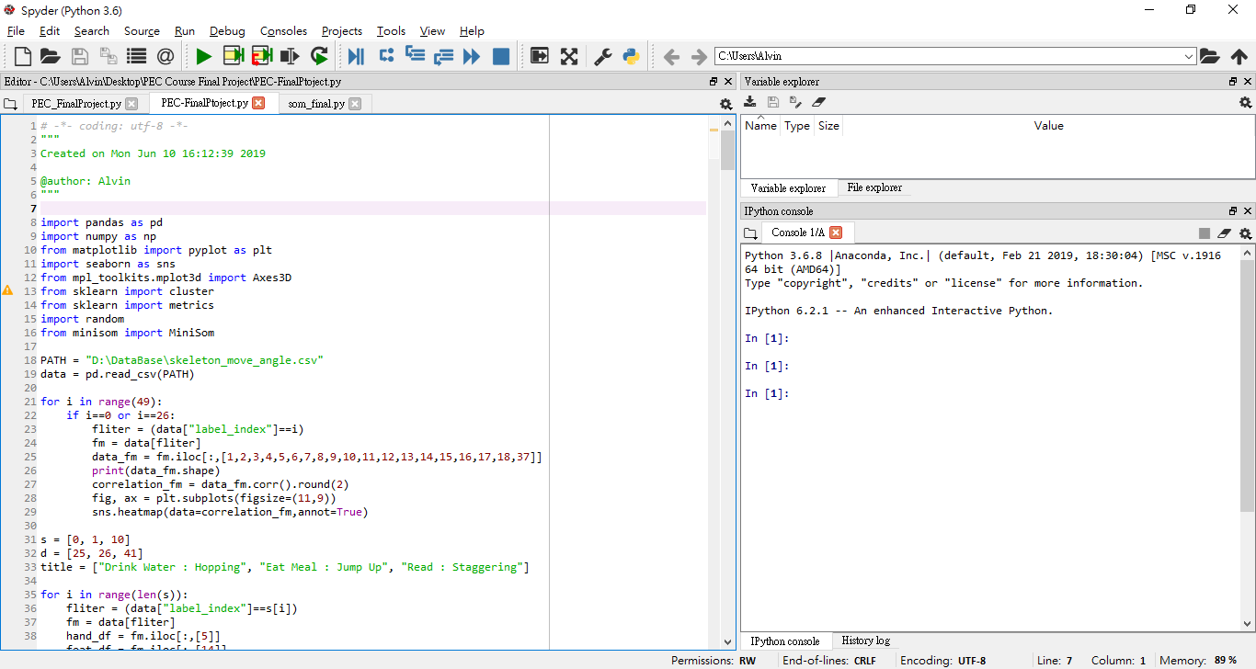
Spyder

Slide 15

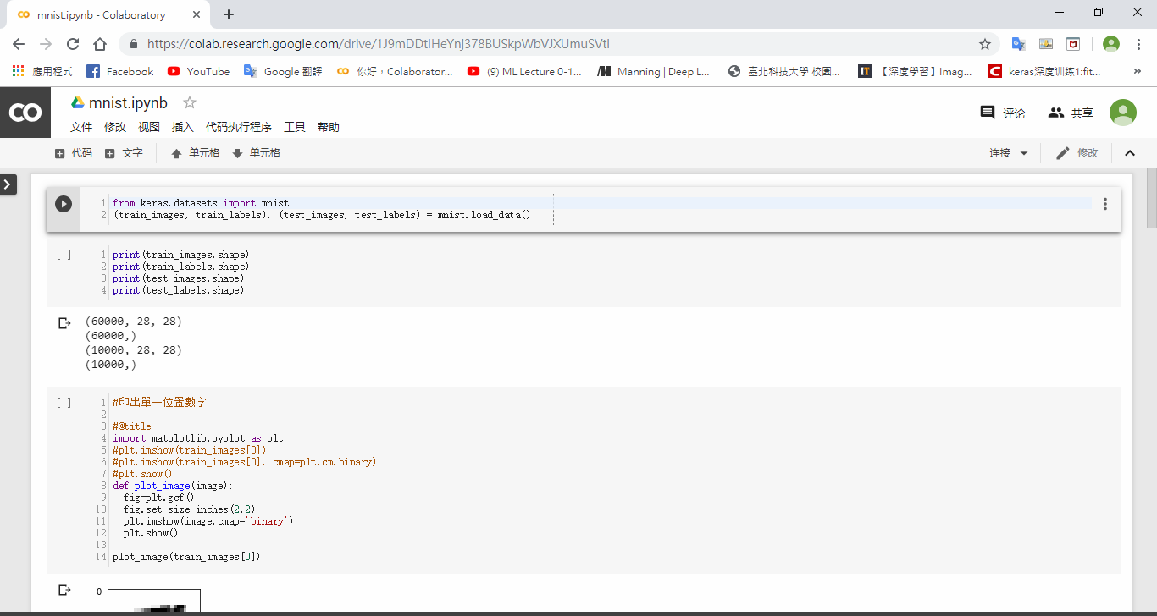
Google Colaboratory

Slide 16
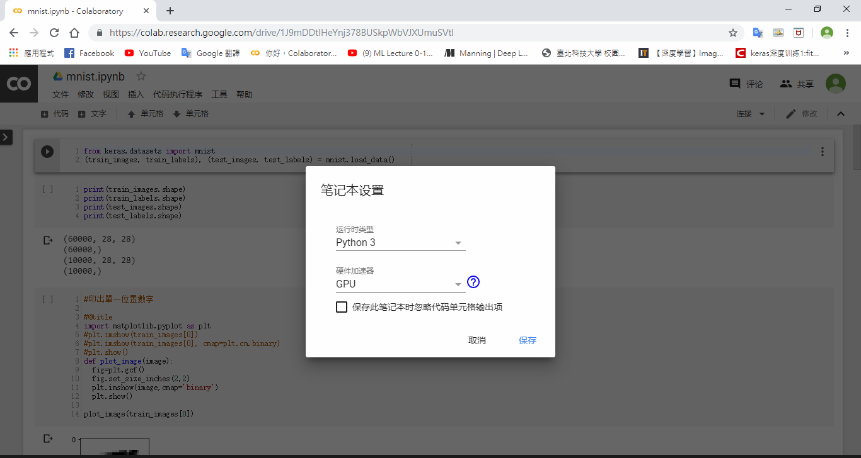
Google Colaboratory

Slide 17
Data Types Introduction
In Python,anything is a object.The object can be the smallest unit in Python,so now we will introduct Data Types which can be a object.
There are three main types of Python built-in：
Numerical form：int, float, bool
String form：str, chr
Container type：list, dict, tuple

Slide 18
Numeric Data Types
Integer( int )：
Integers(int) will not render the number after the decimal point. When using division removes integers,the answer the answer will show integers without decimal points
Floating-point (float)：
Floating-point(float) can display the number after the decimal point.Floating-point’s range of using is bigger than integer.
Boolean(bool)：
Boolean has only true and false.

Slide 19
String Data Types
String (str)：
String is text data wrapped by (') or ("), which is composed of a series of characters.
Character (chr)：
Characters are the elements that make up a string.

Slide 20
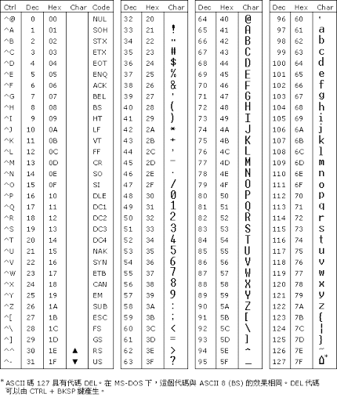
String Data Types

Slide 21
End

