Slide 1
Data Structure
Professor : Kuan-Ting Lai
TA :王鼎鈞
Lab : 綜科208
E-mail:dan08080301@gmail.com
1

Slide 2
Data Types Introduction
In Python,anything is a object.The object can be the smallest unit in Python,so now we will introduct Data Types which can be a object.
There are three main types of Python built-in：
Numerical form：int, float, bool, complex
String form：str, chr
Container type：list, dict, tuple, set

Slide 3
Numeric Data Types
Integer( int )：
Integers(int) will not render the number after the decimal point. When using division removes integers,the answer the answer will show integers without decimal points
Floating-point (float)：
Floating-point(float) can display the number after the decimal point.Floating-point’s range of using is bigger than integer.
Boolean(bool)：
Boolean has only true and false.

Slide 4
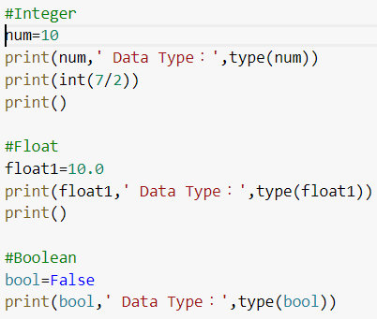
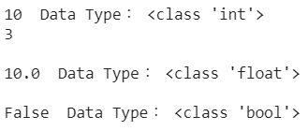
Numeric Data Types

Slide 5
String Data Types
String (str)：
String is text data wrapped by (') or ("), which is composed of a series of characters.
("") is as same as (‘’)
(\n) can switch to the next line. (\t) = tab on keyboard. (I\'m) = I'm
Character (chr)：
Characters are the elements that make up a string.

Slide 6
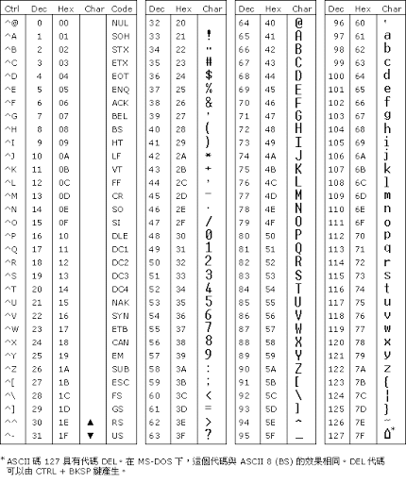
String Data Types
ASCII code

Slide 7
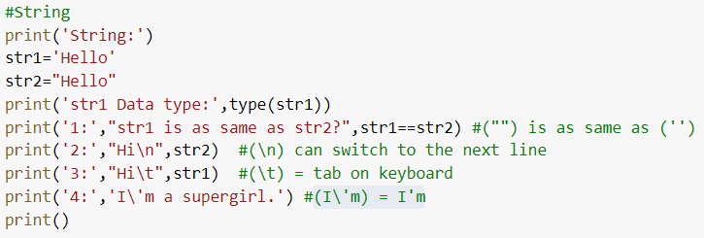
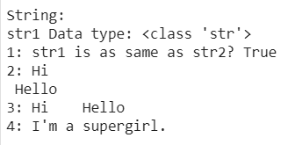
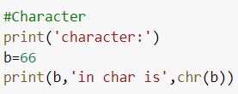

String Data Types

Slide 8
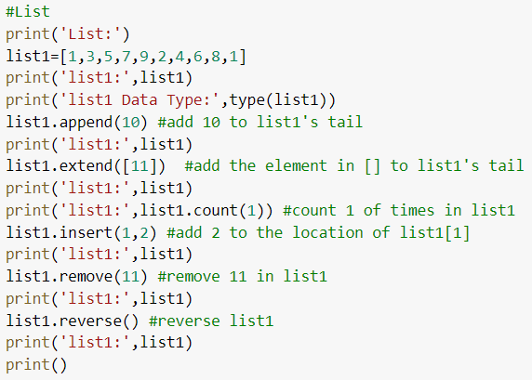
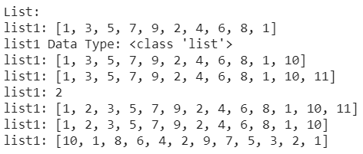
Container Type
List：
List is represented by [].It can save elements.List’s content can edit too.

Slide 9
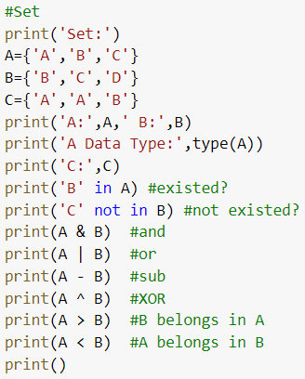
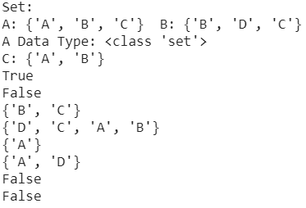
Container Type
Set：
Set is represented by {}.It can save and edit elements.The elements can’t repeat in Set.

Slide 10
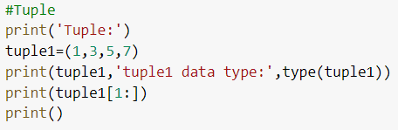

Container Type
Tuple：
Tuple is represented by ().It can’t save and edit elements.
Dictionary：
Dictionary is represented by {}.Dictionary’s key and value are a group.

Slide 11
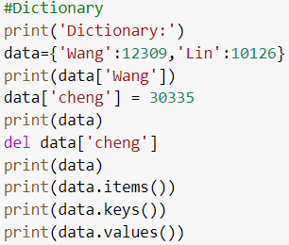
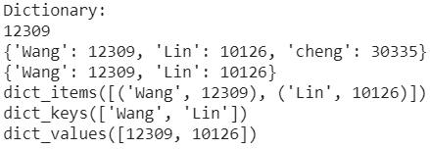
Container Type

Slide 12
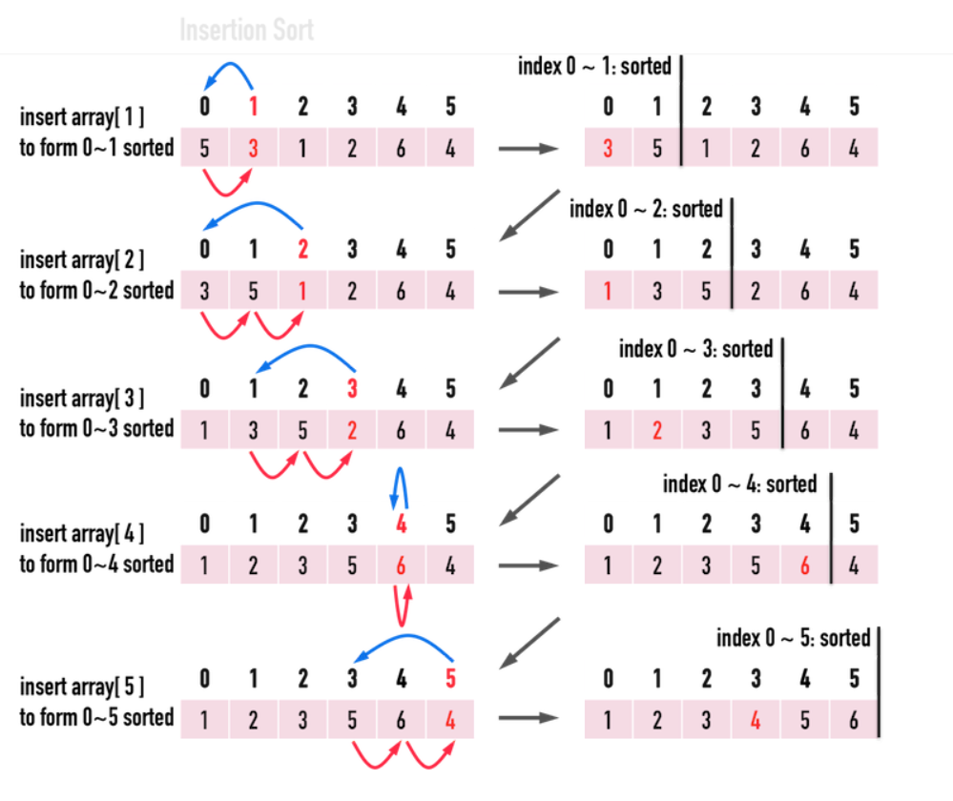
Insertion Sort

Slide 13
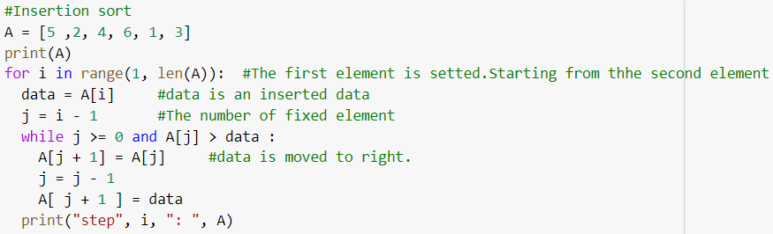
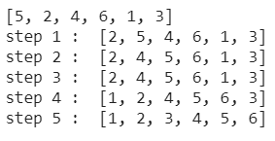
Insertion Sort

Slide 14
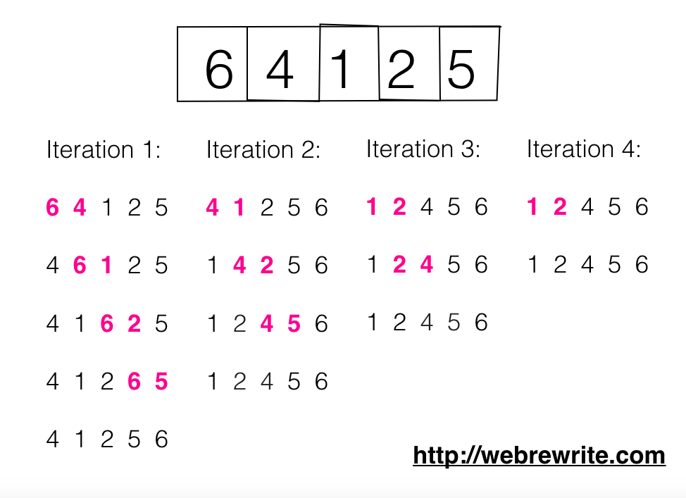
Bubble Sort

Slide 15
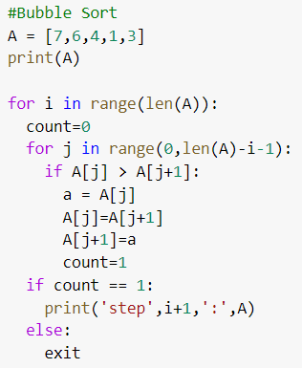
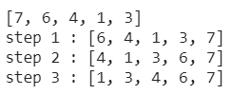
Bubble Sort

Slide 16
Practice
A = [3,7,1,2,5,9],please remove 5 and add 6 and use insertion sort to print it.
A = {1,2,4,5,6} B = {3,6},try to print (A or B), (A and B), (A - B) and (B belongs to A ?)

Slide 17
End

