Slide 1
Question
Music source separation
 | Ours (Band-split RNN) | Preprocessing+Open-Unmix
Dataset | Training (4 hours 23min 35sec) / Validation(1 hour 1min 12 sec) Training data is public dataset | Training(5 hours) / Validation(1 hour) Training data is not provided due to copyright issues (private dataset)
Evaluation | 16 songs in MedleyDB | 16 songs in MedleyDB
問題
因為他們沒有公開training data，但有source code可以使用
是否要把自己收集的data拿去用他們的模型跑結果會比較公平 ?
還是只要test data是同一筆就可以了 ?

Slide 2
Question
Music Tracking System
 | Ours | Institute of Information Science
Instrument of human player | Violin | Piano
Instrument of accompanist (computer) | Piano | Violin
Performance setting | Ours | Institute of Information Science
Live data | Player’s performance | Player’s performance
Reference data | Aligned audio (not MIDI) | Aligned audio (MIDI) + Player’s recording
Assessment setting | Ours | Institute of Information Science
Live data | Random speed MIDI audio in 4 type | Player’s performance in 4 type
Reference data | Aligned audio (MIDI) | Aligned audio (MIDI) + performer’s recording
問題
輸入不同(樂器不同的話追蹤的特徵一定不同，且論文沒有提供輸入資料)
系統不同(因為沒有source code可以跑)
這樣還可以直接使用論文中的結果與自己的結果比較嗎?
可能不能把他們跑出來的結果拿來比較 但可以使用他們的評估方法說明我的評估結果?
問題
輸入不同(樂器不同的話追蹤的特徵一定不同，且論文沒有提供輸入資料)
系統不同(因為沒有source code可以跑)
這樣還可以直接使用論文中的結果與自己的結果比較嗎?
可能不能把他們跑出來的結果拿來比較 但可以使用他們的評估方法說明我的評估結果?

Slide 3
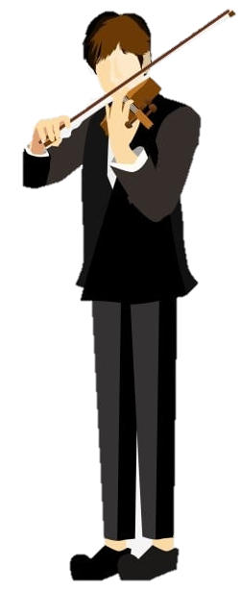
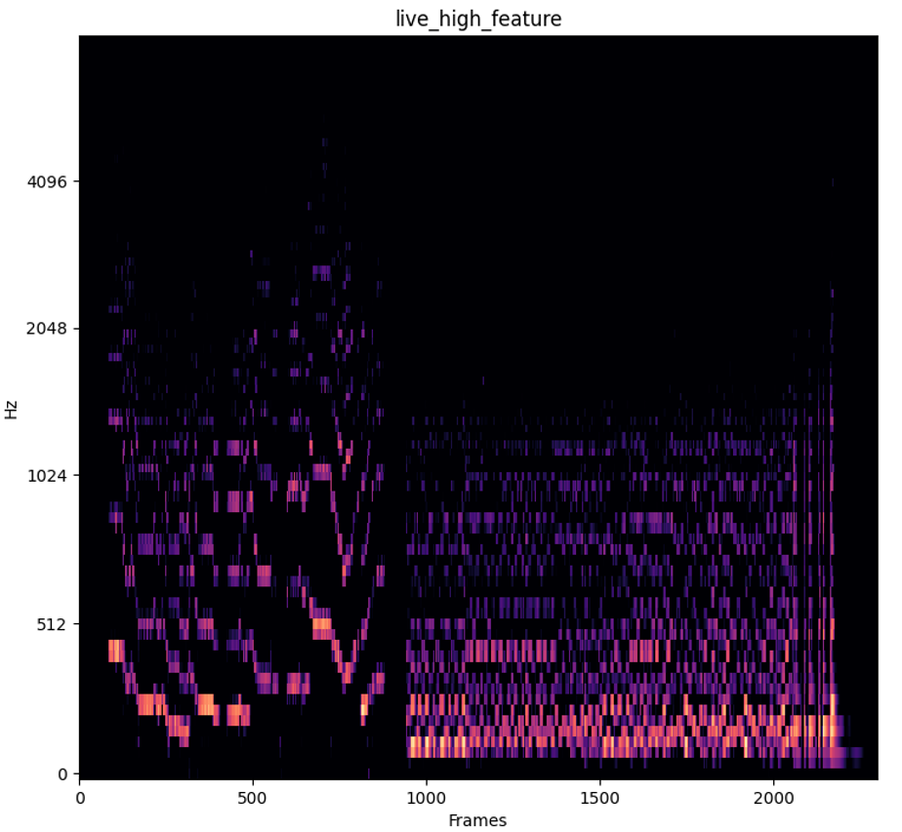
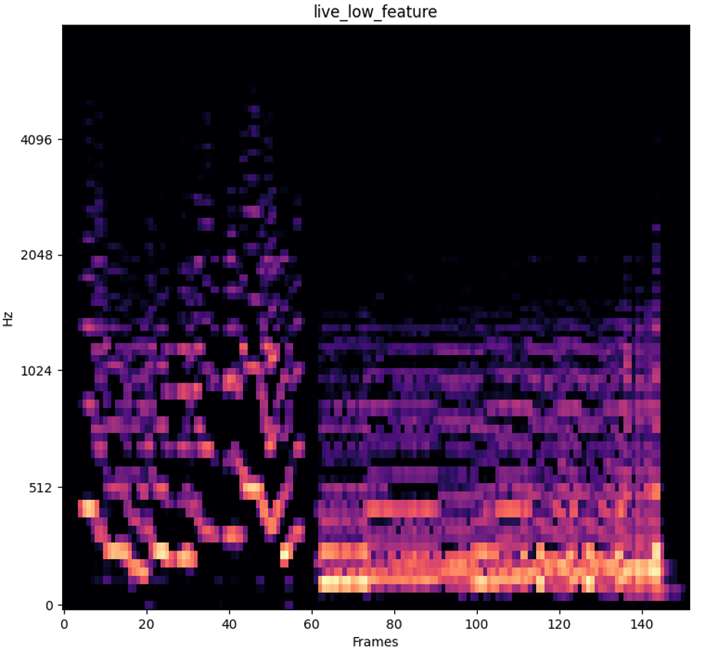
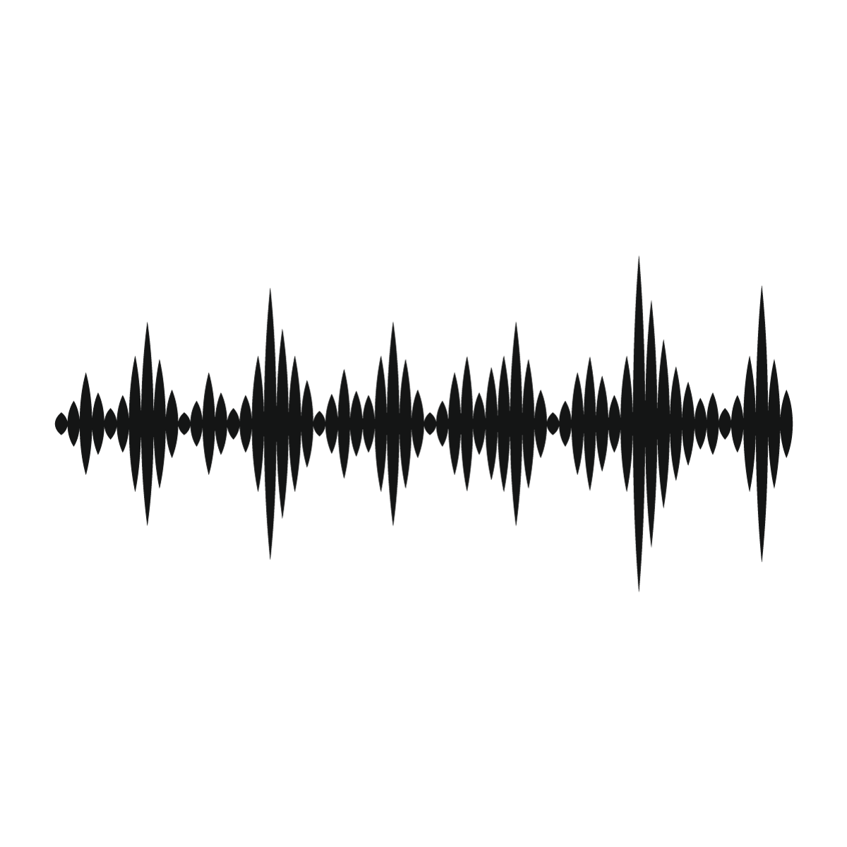
Music tracking system overview
Live
Data Manager
Feature Extraction
Music Detector
High resolution Reference feature
Low resolution Reference feature
Decision Maker
ODTW main thread
Accompany
Note that the reference feature is calculated when initializing the system
Rough Estimator
ODTW backtracking threads

Slide 4
Live
Reference violin audio
Data Manager
Mixed audio
Music Separation
Offline Feature Extraction
Online Feature Extraction
Reference Piano audio
Music Detector
Decision Maker
ODTW main thread
Accompany
Rough Estimator
ODTW backtracking threads

Slide 5
(A) Overall Structure
(B) Music Separation Module
Mixed
Band-Split RNN
Target: Violin
If have MIDI
False
True
Band-Split RNN
Target: Piano
Music Separation
Post-Processing
Reference
Accompaniment
(C) Music Tracker Module
Rough Position Estimator
Offline
Greedy backward alignment
Online
Live
Music Detector
Data Manager
Decision Maker
Music Tracker
Live
ODTW main thread
Reference
Greedy backward alignment threads
Specific Accompaniment Frame
Accompaniment

Slide 6


(A) Overall Structure
(B) Music Separation Module
Band-Split RNN
Target: Violin
Reference Source
Mixed
Mixed
Band-Split RNN
Target: Piano
Accompaniment Source
Music Separation
Accompaniment
Reference
(C) Music Tracker Module
Rough Position Estimator
Offline
Music Detector
Greedy backward alignment
Online
Live
Data Manager
Decision Maker
Music Tracker
Live
ODTW main thread
Reference
Greedy backward alignment threads
Specific Accompaniment Frame
Accompaniment

Slide 7
Music Tracking System - Feature extraction
Audio
Shape = (secs * sample rate frames,)
Sample rate: 44100Hz
10 sec audio
Shape = (441000 frames,)
High resolution
feature
STFT setting
Window length: 46ms (2028 frames)
Hop length: 20ms (882 frames)
Number of FFT = Window length
Window: Hann
Mel spectrogram setting
Number of mel bins: 84 bins
Shape = (mel bins, time frames)
10 sec audio
Shape = (84 bins, 500 frames)
Low resolution feature
Downsample setting
Window length: 600ms (30 high resolution feature frames)
Hop length: 300ms (15 high resolution feature frames)
Window: Hann
Shape = (mel bins, time frames)
10 sec audio
Shape = (84 bins, 34 frames)

Slide 8
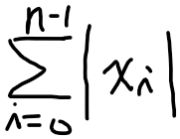

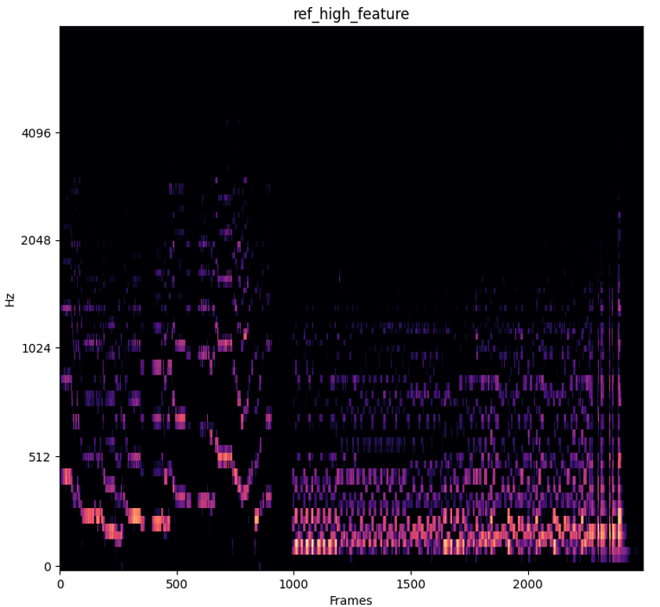
Music Tracking System - Music Detector
Get streaming audio
Stream Audio
mean amplitude =
Calculate mean amplitude
False
Mean amplitude threshold = 0.01
Is mean amplitude > threshold
Offline DTW
True
High resolution
Live feature
10 | 10 | 11 | 18 | 17
9 | 11 | 13 | 12 | 11
9 | 11 | 13 | 6 | 8
2 | 4 | 5 | 8 | 12
1 | 2 | 3 | 10 | 16
DTW cost = Ʃ_{i,j} cost[path_{i}, path_{j}]
Calculate alignment cost
DTW cost threshold = 2000
Is DTW cost < threshold
False
High resolution
Reference feature
True
Trigger music tracker event

Slide 9
t₁
t₂
1 | 1 | 1 | 7 | 6
0 | 2 | 2 | 6 | 5
7 | 9 | 9 | 1 | 2
1 | 3 | 3 | 5 | 4
1 | 1 | 1 | 7 | 6
10 | 10 | 11 | 18 | 17
9 | 11 | 13 | 12 | 11
9 | 11 | 13 | 6 | 8
2 | 4 | 5 | 8 | 12
1 | 2 | 3 | 10 | 16
1 | 1 | 1 | 7 | 6
0 | 2 | 2 | 6 | 5
7 | 9 | 9 | 1 | 2
1 | 3 | 3 | 5 | 4
1 | 1 | 1 | 7 | 6
10 | 10 | 11 | 18 | 17
9 | 11 | 13 | 12 | 11
9 | 11 | 13 | 6 | 8
2 | 4 | 5 | 8 | 12
1 | 2 | 3 | 10 | 16
10 | 10 | 11 | 18 | 17
9 | 11 | 13 | 12 | 11
9 | 11 | 13 | 6 | 8
2 | 4 | 5 | 8 | 12
1 | 2 | 3 | 10 | 16
10 | 10 | 11 | 18 | 17
9 | 11 | 13 | 12 | 11
9 | 11 | 13 | 6 | 8
2 | 4 | 5 | 8 | 12
1 | 2 | 3 | 10 | 16
10 | 10 | 11 | 18 | 17
9 | 11 | 13 | 12 | 11
9 | 11 | 13 | 6 | 8
2 | 4 | 5 | 8 | 12
1 | 2 | 3 | 10 | 16
10 | 10 | 11 | 18 | 17
9 | 11 | 13 | 12 | 11
9 | 11 | 13 | 6 | 8
2 | 4 | 5 | 8 | 12
1 | 2 | 3 | 10 | 16
 |  |  | 19 | 17
 |  | 13 | 12 | 11
 | 11 | 13 | 6
2 | 4 | 5
1 | 2
 |  |  | 19 | 17
 |  | 13 | 12 | 11
 | 11 | 13 | 6
2 | 4 | 5
1 | 2
10 | 10 | 11 | 18 | 17
9 | 11 | 13 | 12 | 11
9 | 11 | 13 | 6 | 8
2 | 4 | 5 | 8 | 12
1 | 2 | 3 | 10 | 16

Slide 10
Ours
Conventional ODTW
42 25 22 26 32
8 7 6 5 4
5.25 3.57 3.66 5.2 8
j
i
Assume search range c = 2
D_{total}
D_{cell}
D_{total}
9 | … | 13
2 | … | …
1 | 2 | 3
 |  | …
7 | … | 9
1 | … | …
1 | 1 | 1
 |  | …
9 | … | 13
2 | … | …
1 | 2 | 3
+
j
j
i
i

Slide 11
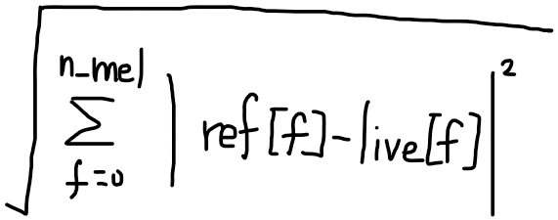
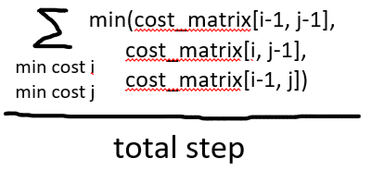
Music Tracking System - Rough Estimator
For each time frame in live and reference:
Get new low live feature
Cost =
Calculate RPE cost matrix
False
Calculate min cost path for each reference frame (max direction count = 3)
Normalize each cost value and sort by ascending order
cost matrix
 |  |  |  | i, j
…
For each frame (i, j):
min cost path =
Is live accumulate to a certain length (9 sec)
True
where i in lastest 9 sec range
Rough backward alignment
newest live frame
 |  |  |  | c_{n}
 |  |  |  | …
… |  |  |  | c₁
For each reference frame min cost path:
C_{norm} = array([1 - (C_{i} - C_{min} / C_{max} - C_{min})])
Calculate top 8 highest similarity ref frame
Similarity = sort(C_{norm})

Slide 12
Music Tracking System
Music Detector | Ours | Institute of Information Science
Mean amplitude | V | X
DTW alignment | V | V
Rough Estimator | Ours | Institute of Information Science
Calculate cost matrix | V | V
Rough backward alignment | V | V
normalization | V | V

Slide 13
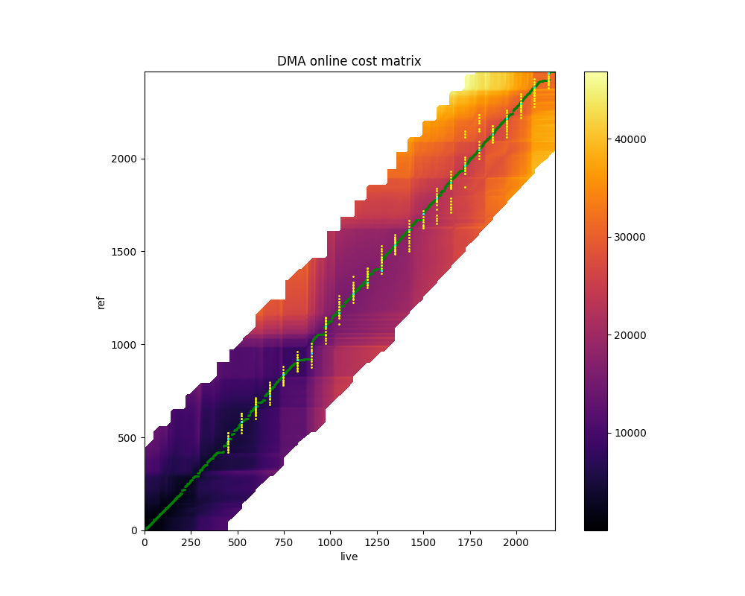
Music Tracking System - Decision Maker
Calculate ODTW cost matrix
High resolution
Reference feature
Is there have possible frame coming
True
False
backtracking
High resolution
Live feature
Get ref output frame from ODTW backward alignment threads
Get ref output frame from ODTW main thread

Slide 14
Music Tracking System - Decision Maker
Calculate ODTW cost matrix:
For each time frame in search range live and reference
 |  |  |  | …
 |  |  | i,j
…
Get output frame from ODTW main thread:
Find min cost in range(j-1, j+30 frames)
cost = totalCostMatrix[i,j] + cellCostMatrix[i,j]
Cost =
Jumping mechanism:
If output frame stuck in the same possition for 10 frames
Force to jump output frame to output frame+1
Search range = 9 sec (450 frames)
Ours
Conventional ODTW
 |  |  | c₁ | …
 |  |  | i,j
…
Get output frame from ODTW backward alignment threads :
For each possible current frame
We add current output frame and +-(0.3, 0.6, 0.9) sec in backward alignment list
Backward alignment point is output frame 9 seconds ago
Assume search range = 2
Widen calculation range of reference frame
Backtracking point

Slide 15
Music Tracking System - Music Detector
Compute mean amplitude
Compute DTW cost
High resolution
Live feature
High resolution
Reference feature
Stream Audio
mean amplitude =
Offline DTW
Cost
If mean amplitude > threshold
If DTW cost < threshold
mean amplitude threshold = 0.01
Cost threshold = 2000
Calculate alignment cost
Trigger music tracker event

Slide 16
Music Tracking System
Performance setting
 | Ours | Institute of Information Science
Live data | Player’s performance | Player’s performance
Reference data | Aligned audio (not MIDI) | Aligned audio (MIDI) + Player’s recording
Assessment setting
 | Ours | Institute of Information Science
Live data | Random speed MIDI audio | Player’s performance
Reference data | Aligned audio (MIDI) | Aligned audio (MIDI) + performer’s recording
問題
輸入不同(樂器不同的話追蹤的特徵一定不同，且論文沒有提供輸入資料)
系統不同(因為沒有source code可以跑)
這樣還可以直接使用論文中的結果與自己的結果比較嗎?
可能不能把他們跑出來的結果拿來比較 但可以使用他們的評估方法說明我的評估結果?

Slide 17
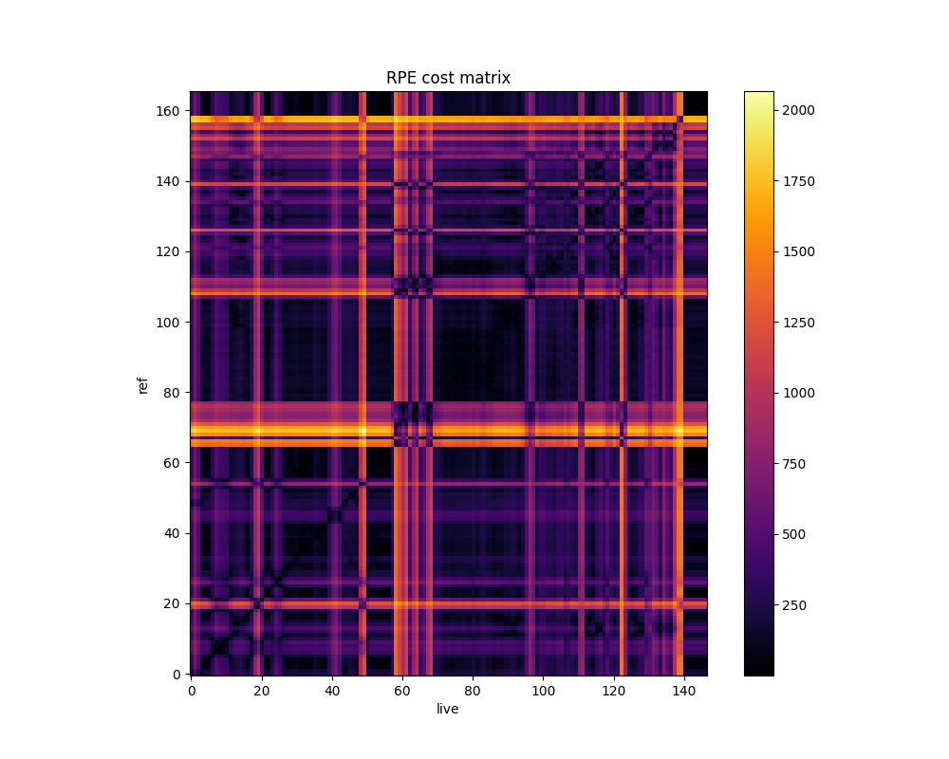
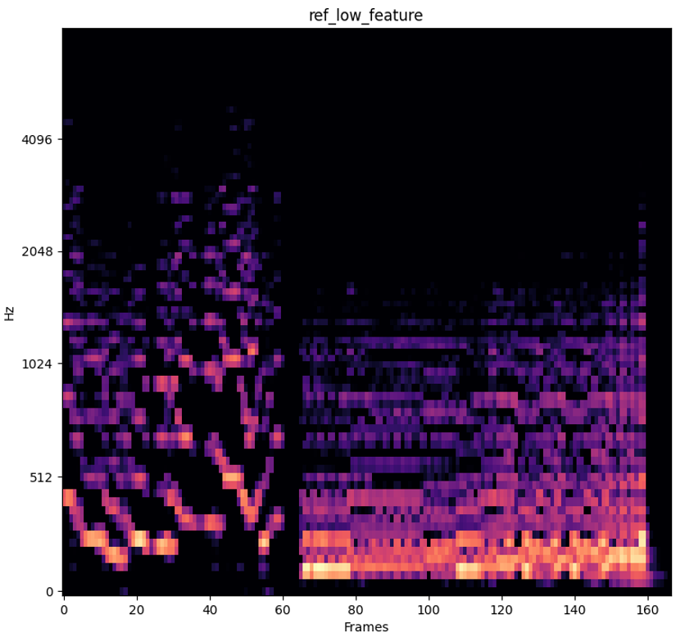
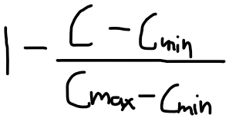
Music Tracking System - Rough Estimator
For each time frame in live and reference:
When live accumulate to a certain length (9 sec)
For all reference frame, backtracking start from newest live frame
Cost =
Backtracking
Calculate min cost path for each reference frame (max direction count = 3)
Normalize each cost value and sort by ascending order
cost matrix
Low resolution Reference feature
 |  |  |  | i, j
…
For each frame (i, j):
min cost path =
where i in lastest 9 sec range
newest live frame
For each reference frame min cost path:
C_{norm} =
 |  |  |  | c_{n}
 |  |  |  | …
… |  |  |  | c₁
Low resolution Live feature
Similarity = sort(C_{norm})
Get the top 8 reference frame with the highest similarity for ODTW

Slide 18
Music Tracking System - Decision Maker
 |  |  | …
 |  |  | i,j
…
Get output frame from cost matrix:
Find min cost in range(j-1, j+30 frames)
cost = totalCostMatrix[i,j] + cellCostMatrix[i,j]
Jumping mechanism:
If output frame stuck in the same possition for 10 frames
Force to jump output frame to output frame+1
 | … |  | c₁
 | …
 |  |  | i,j
Get output frame from ODTW backtracking :
For each possible current frame
We add current output frame+-3 in backtracking list
Backtracking point is output frame 9 seconds ago
Backtracking point

